Slide 1
Chapter 16 Welcome to Chemistry
Slides to accompany Enhanced Introductory College Chemistry by Gregory Anderson, Caryn Fahey, J.R. van Haarlem, Jackie MacDonald, Adrienne Richards, Samantha Sullivan Sauer, and David Wegman
Slide design and template by Revathi Mahadevan
Except where otherwise noted, images, tables & diagrams are reused from Enhanced Introductory College Chemistry, a derivative of Chemistry (Open Stax) by Paul Flowers, Klaus Theopold, Richard Langley & William R. Robinson and is licensed under CC BY 4.0. ​Access for free at Chemistry (OpenStax)​
Slides are licensed under CC-BY 4.0, Except while otherwise noted

Slide 2
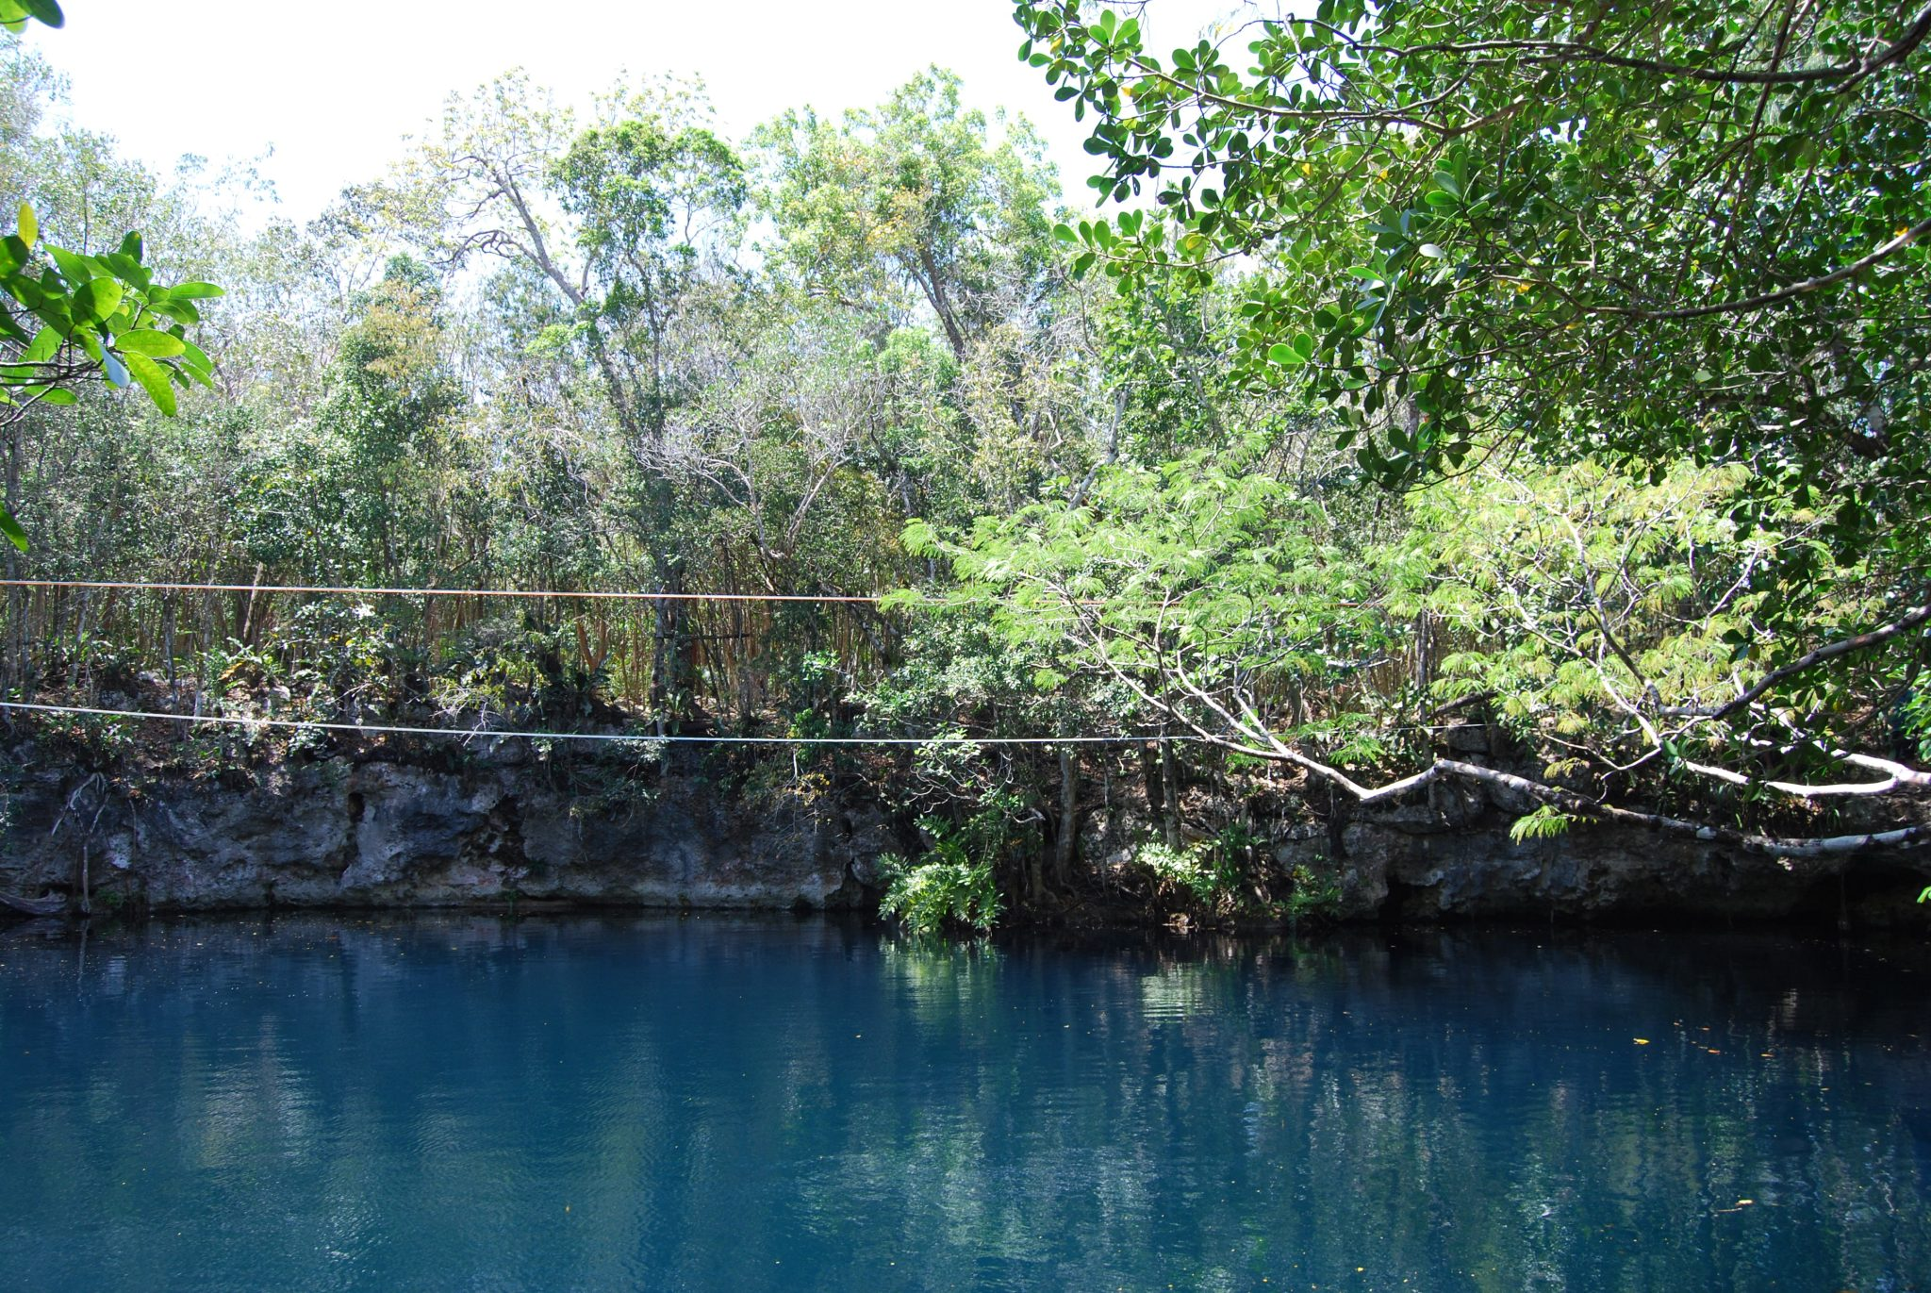
Figure 16a
Figure 16a Sinkhole Shown in Nature: Cenote Angelita is located in the state of Quintana Roo, in the Yucatan Peninsula of Mexico. Sinkholes in nature, such as this one, are the result of reactions between acidic groundwaters and basic rock formations, like limestone. (credit: work by Offthebeatonpath, CC BY-SA 3.0)

Slide 3
Table 16.1a
Table 16.1a Common Acids and Their Uses
Compound Name and Chemical Formula | Common Name (if applicable) | Uses
hydrochloric acid, HCl | muriatic acid (used in pools) and stomach acid is HCl | Used in cleaning (refining) metals, in maintenance of swimming pools, and for household cleaning.
sulfuric acid, H₂SO₄ | none | Used in car batteries, and in the manufacture of fertilizers.
nitric acid, HNO₃ | none | Used in the manufacture of fertilizers, explosives and in extraction of gold.
acetic acid, HC₂H₃O₂ | vinegar | Main ingredient in vinegar.
carbonic acid, H₂CO₃ | responsible for the “fizz” in carbonated drinks | As an ingredient in carbonated drinks.
citric acid, C₆H₈O₇ | none | Used in food and dietary supplements. Also added as an acidulant in creams, gels, liquids, and lotions.
acetylsalicylic acid, C₆H₄(OCOCH₃)CO₂H | aspirin | The active ingredient in aspirin.
(credit: Map: Introductory Chemistry (Tro), CK-12 license.)

Slide 4
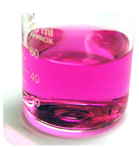
Figure 16.1a
Figure 16.1a An Image of a solution containing Phenolphthalein Indicator: Phenolphthalein is often used as an indicator in acid–base titrations. It is colourless in acidic solutions and typically pink in basic solutions between a pH of 8.5-10. (credit: work by Ben Mills, PD)

Slide 5
Table 16.1b
Table 16.1b Common Bases and Corresponding Uses
Compound Name and Chemical Formula | Common Name (if applicable) | Uses
sodium hydroxide, NaOH | (lye or caustic soda) | Used in the manufacture of soaps and detergents, and as the main ingredient in oven and drain cleaners.
potassium hydroxide, KOH | (lye or caustic potash) | Used in the production of liquid soaps and soft soaps. Used in alkaline batteries.
magnesium hydroxide, Mg(OH)₂ | (milk of magnesia) | Used as an ingredient in laxatives, antacids, and deodorants. Also used in the neutralization of acidic wastewater.
calcium hydroxide, Ca(OH)₂ | (slaked lime) | Used in the manufacture of cement and lime water. Also, added to neutralize acidic soil.
aluminum hydroxide, Al(OH)₃ |  | Used in water purification and as an ingredient in antacids.
ammonia, NH₃ |  | Used as a building block for the synthesis of many pharmaceutical products and in many commercial cleaning products. Used in the manufacture of fertilizers.
(credit: Map: Introductory Chemistry (Tro), CK-12 license.)

Slide 6
Table 16.1c
Table 16.1c Strong Acids and Bases
Acids | Bases
HCl | LiOH
HBr | NaOH
HI | KOH
HNO₃ | RbOH
H₂SO₄ | CsOH
HClO₃ | Mg(OH)₂
HClO₄ | Ca(OH)₂
[Blank] | Sr(OH)₂
[Blank] | Ba(OH)₂
(credit: Map: Introductory Chemistry (Tro), CK-12 license.)

Slide 7
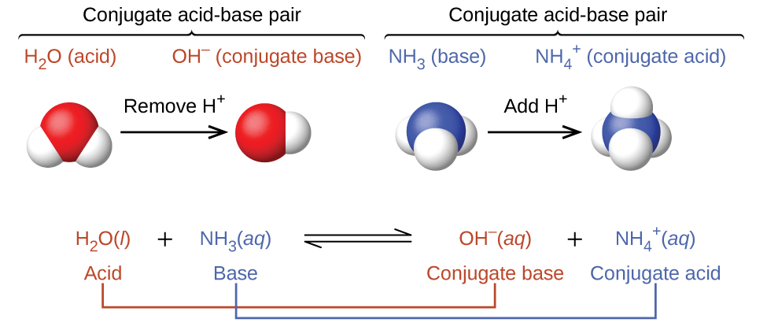
Figure 16.1b
Figure 16.1b Acid-Base Reaction between Water and Ammonia showing Conjugate Acid-Base Pairs: A Brønsted-Lowry acid reacts with a base to form the conjugate base and acid, as shown with H2O (acid) reacting with NH3 (base) to form their respective conjugates (credit: Chemistry 2e (OpenStax), CC-BY-4.0).

Slide 8
Figure 16.1c
Figure 16.1c The Acid Ionization Reaction of an Acid (HF) with Water: The acid ionization reaction of an acid (HF) with water, resulting in formation of hydronium ions and the conjugate base of the acid. In this reaction, the water molecule functions as an base since it accepts a proton from the hydrofluoric acid (HF) molecule (functioning as a Brønsted-Lowry acid), yielding the conjugate acid of water, a hydronium ion (H₃O⁺) and the conjugate base of hydrofluoric acid, F–. (credit: Chemistry 2e (OpenStax), CC-BY-4.0).

Slide 9
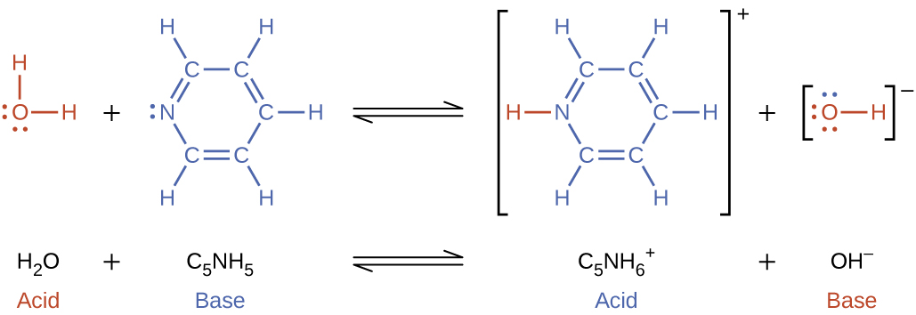
Figure 16.1d
Figure 16.1d Pyridine Reacts with Water to Form the Pyridinium Ion and Hydronium Ion: In this reaction, the water molecule functions as an acid since it donates a proton to pyridine (functioning as a Brønsted-Lowry base), yielding the conjugate base of water, hydroxide ions (OH-) and the conjugate acid of pyridine, pyridinium ions (C5NH6+) (credit: Chemistry 2e (OpenStax), CC-BY-4.0).

Slide 10
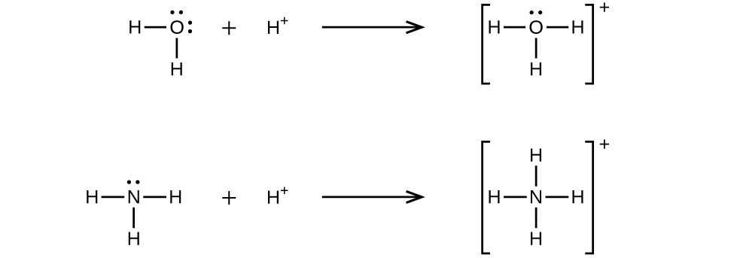
Figure 16.1e
Figure 16.1e Illustrating Coordinate Covalent Bonds: Two chemical equations are shown to illustrate Lewis acids and base reactions: the formation of a hydronium ion and an ammonium ion. (credit: Chemistry (OpenStax), CC BY 4.0.)

Slide 11
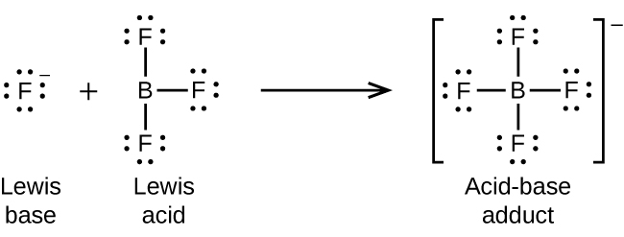
Figure 16.1f
Figure 16.1f Lewis Acid-Base Reaction Involving Boron Trifluoride: The Lewis base, a fluorine ion, reacts with a Lewis acid, boron trifluoride, to produce boron tetrafluoride, which is an acid-base adduct. (credit: Chemistry (OpenStax), CC BY 4.0.)

Slide 12
Figure 16.1g
Figure 16.1g Lewis Acid-Base Reaction Involving Nonmetal Oxides: The Lewis base, an oxygen ion, reacts with a Lewis acid, sulfur trioxide, to produce a sulphate ion, which is an acid-base adduct. (credit: Chemistry (OpenStax), CC BY 4.0.)

Slide 13
Figure 16.1h
Figure 16.1h Lewis Acid-Base Displacement Reaction: In this reaction, HCl is an acid-base adduct that reactants with water, which is behaving as a base, to form a new adduct (hydronium ion) and a new base (chloride ion). (credit: Chemistry (OpenStax), CC BY 4.0.)

Slide 14
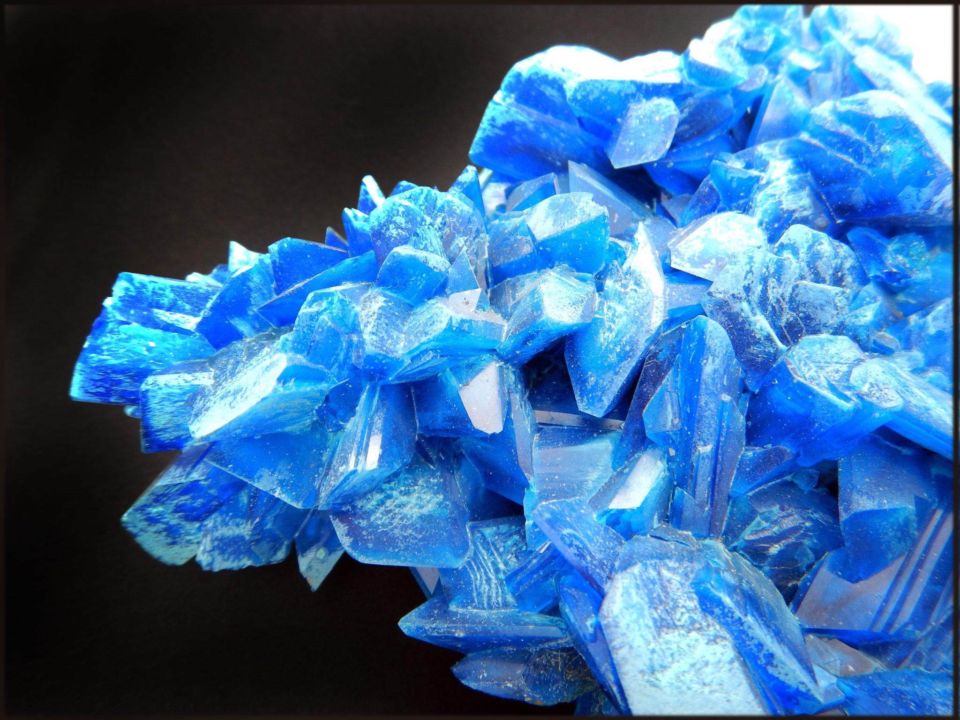
Figure 16.2a
Figure 16.2a Crystal of Copper(II) Sulfate: Sample of the collection of artificial minerals from the Natural History Museum Lille. This blue crystal of copper(II) sulphate is of industrial origin, created by slow crystallization from a saturated solution. (credit: work by Lamiot, CC BY-SA 4.0).

Slide 15
Table 16.2a
Table 16.2a Various Acids Found in Food and Beverages
Acid Name | Acid Formula | Use and Appearance
acetic acid | HC₂H₃O₂ | flavouring; found in vinegar
adipic acid | H₂C₆H₈O₄ | flavouring; found in processed foods and some antacids
alginic acid | various | thickener; found in drinks, ice cream, and weight loss products
ascorbic acid | HC₆H₇O₆ | antioxidant, also known as vitamin C; found in fruits and vegetables
benzoic acid | HC₆H₅CO₂ | preservative; found in processed foods
citric acid | H₃C₆H₅O₇ | flavouring; found in citrus fruits
dehydroacetic acid | HC₈H₇O₄ | preservative, especially for strawberries and squash
erythrobic acid | HC₆H₇O₆ | antioxidant; found in processed foods
fatty acids | various | thickener and emulsifier; found in processed foods
fumaric acid | H₂C₄H₂O₄ | flavouring; acid reactant in some baking powders
(credit: Introduction to Chemistry, CC BY-NC-SA.)

Slide 16
Table 16.2a (Continued)
Table 16.2a (continued) Various Acids Found in Food and Beverages
Acid Name | Acid Formula | Use and Appearance
glutamic acid | H₂C₅H₇NO₄ | flavouring; found in processed foods and in tomatoes, some cheeses, and soy products
lactic acid | HC₃H₅O₃ | flavouring; found in wine, yogurt, cottage cheese, and other sour milk products
malic acid | H₂C₄H₄O₅ | flavouring; found in apples and unripe fruit
phosphoric acid | H₃PO₄ | flavouring; found in some colas
propionic acid | HC₃H₅O₂ | preservative; found in baked goods
sorbic acid | HC₆H₇O₂ | preservative; found in processed foods
stearic acid | HC₁₈H₃₅O₂ | anticaking agent; found in hard candies
succinic acid | H₂C₄H₄O₄ | flavouring; found in wine and beer
tartaric acid | H₂C₄H₄O₆ | flavouring; found in grapes, bananas, and tamarinds
(credit: Introduction to Chemistry, CC BY-NC-SA.)

Slide 17
Figure 16.3a
Figure 16.3a Autoionization of Water: Water acts both as an acid and a base. A very small fraction of water molecules donate protons to other water molecules to form hydronium ions and hydroxide ions. (credit: Chemistry (OpenStax), CC BY 4.0.)

Slide 18
Table 16.4a
Table 16.4a Summarizing pH Properties for Acidic, Basic and Neutral Solutions
Classification | Relative Ion Concentrations | pH at 25 °C
acidic | [H₃O⁺] > [OH⁻] | pH < 7
neutral | [H₃O⁺] = [OH⁻] | pH = 7
basic | [H₃O⁺] < [OH⁻] | pH > 7
(credit: Chemistry (OpenStax), CC BY 4.0.)

Slide 19
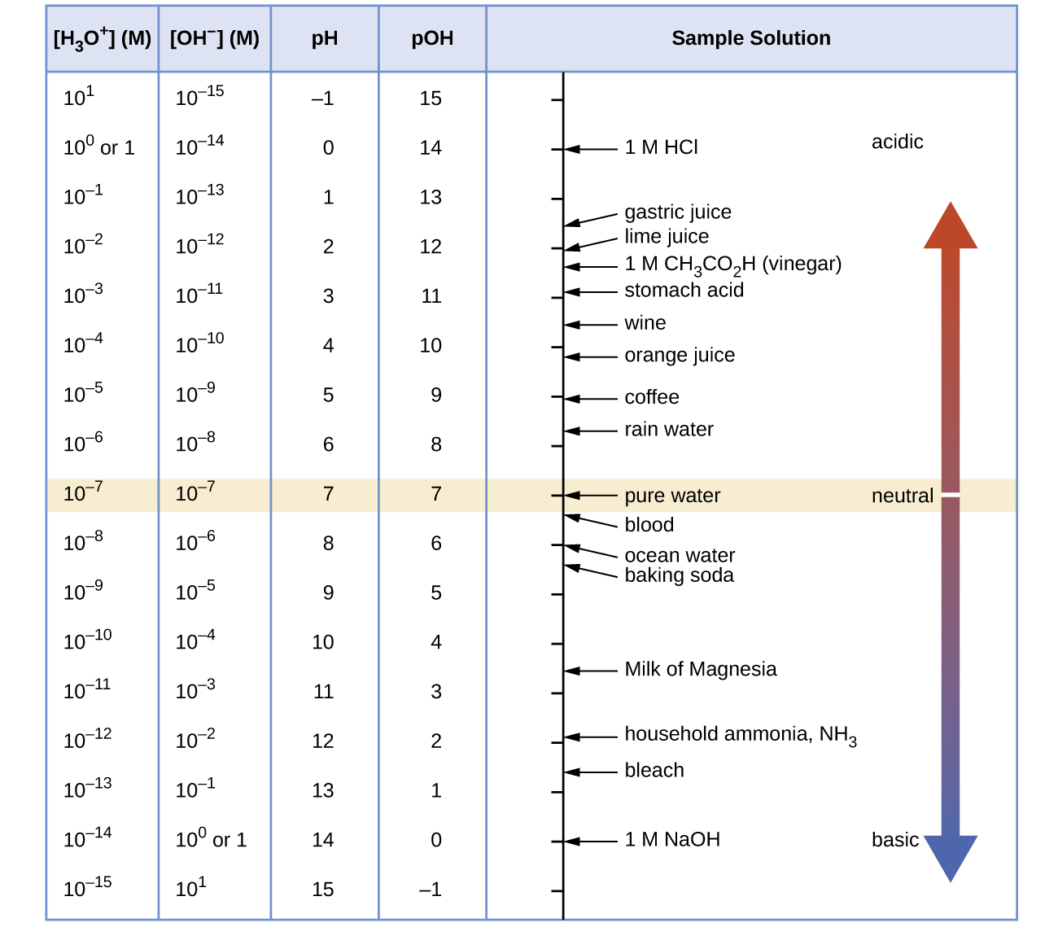
Figure 16.4a
Figure 16.4a Relationships between [H₃O⁺], [OH⁻], pH, and pOH: The pH and pOH scales represent concentrations of [H₃O⁺] and OH⁻, respectively. The pH and pOH values of some common substances at standard temperature (25 °C) are shown in this chart. (credit: Chemistry (OpenStax), CC BY 4.0.)

Slide 20
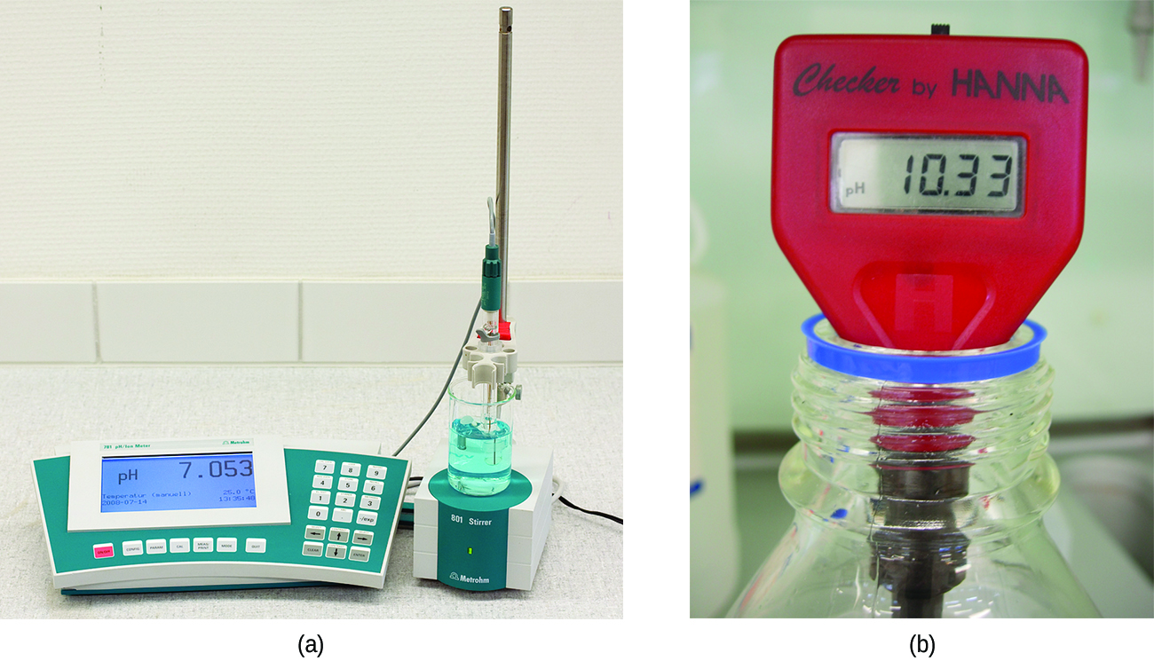
Figure 16.4b
Figure 16.4b (a) A research-grade pH meter used in a laboratory can have a resolution of 0.001 pH units, an accuracy of ± 0.002 pH units, and may cost in excess of 1000 dollars. (b) A portable pH meter has lower resolution (0.01 pH units), lower accuracy (± 0.2 pH units), and a far lower price tag. (credit a: work by Datamax, PD; credit b: modification of work by Laurence Livermore, CC BY 2.0)

Slide 21
Figure 16.4c
Figure 16.4c (a) A universal indicator assumes a different colour in solutions of different pH values. Thus, it can be added to a solution to determine the pH of the solution. The eight vials each contain a universal indicator and 0.1-M solutions of progressively weaker acids: HCl (pH = l), CH3CO2H (pH = 3), and NH4Cl (pH = 5), deionized water, a neutral substance (pH = 7); and 0.1-M solutions of the progressively stronger bases: KCl (pH = 7), aniline, C6H5NH2 (pH = 9), NH3 (pH = 11), and NaOH (pH = 13). (b) pH paper contains a mixture of indicators that give different colours in solutions of differing pH values. (credit: modification of work by Sahar Atwa in Chemistry (OpenStax), CC BY 4.0.)

Slide 22
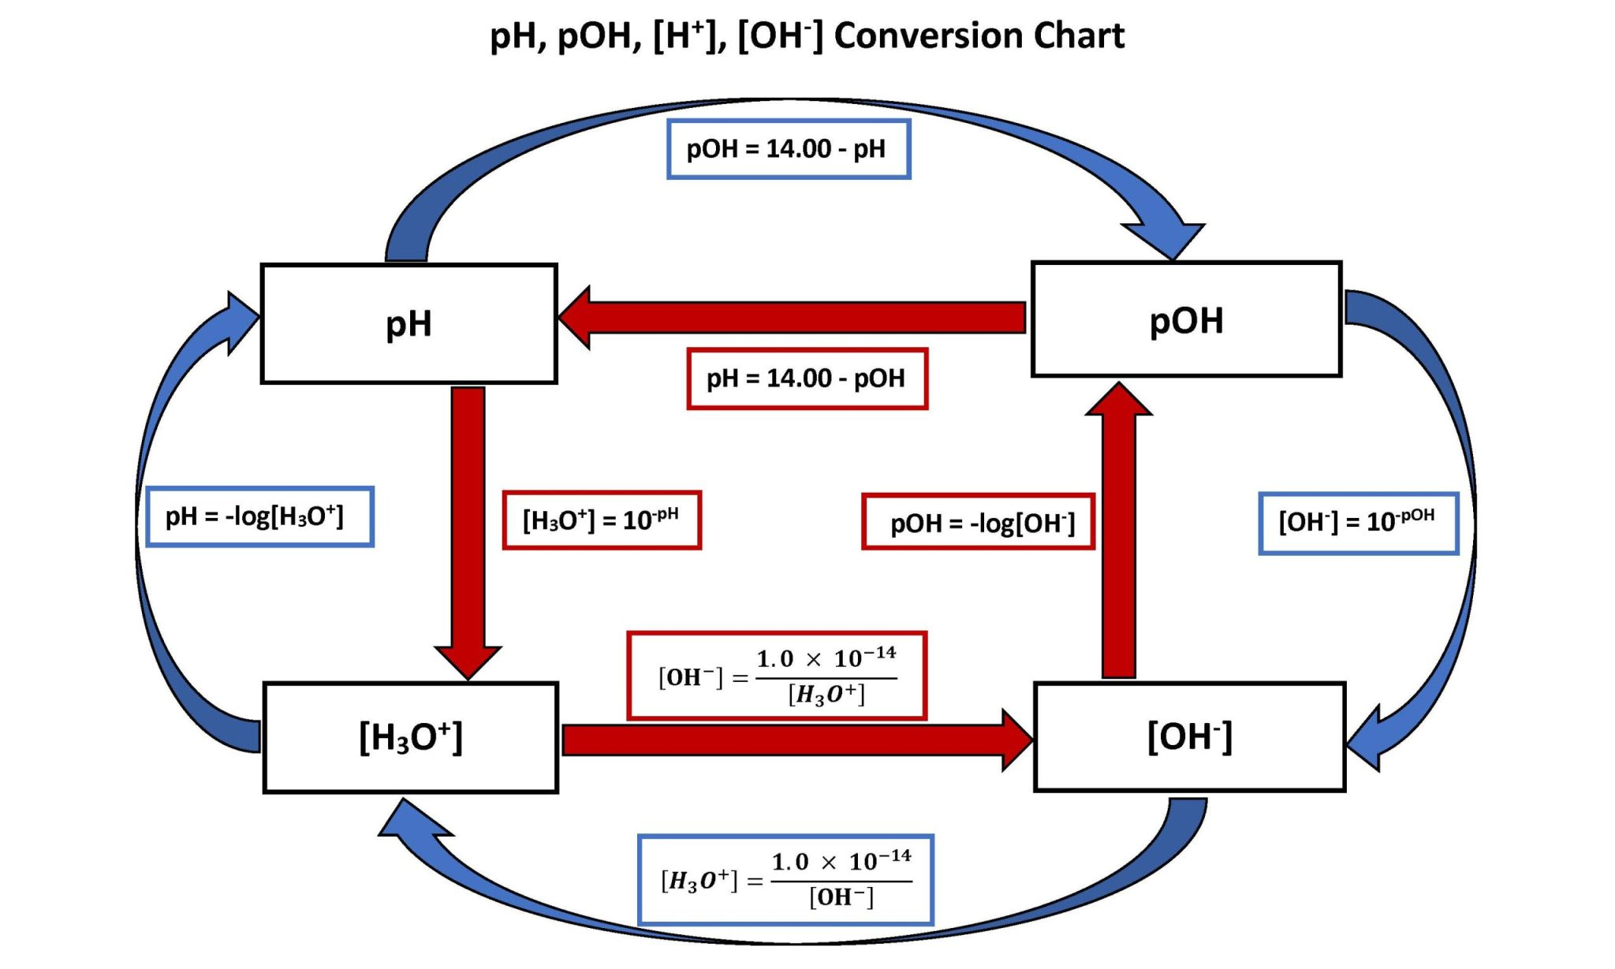
Figure 16.4d
Figure 16.4d Calculation Relationships between Hydrogen Ion Concentration, Hydroxide Concentration, pH and pOH: Use the flow chart to determine which formula(s) to use to answer an acid/base calculation. To begin, locate the unit of the given information on the diagram that was provided in the question. Next, locate the unit of the answer you are asked to calculate. Use the formula(s) to solve the question that is associated with the arrow(s) pointing in the direction of the unit you are trying to calculate. It may be a one step or two step problem. (credit: Figure 16.4b by Jackie MacDonald, CC-BY-NC 4.0).

Slide 23
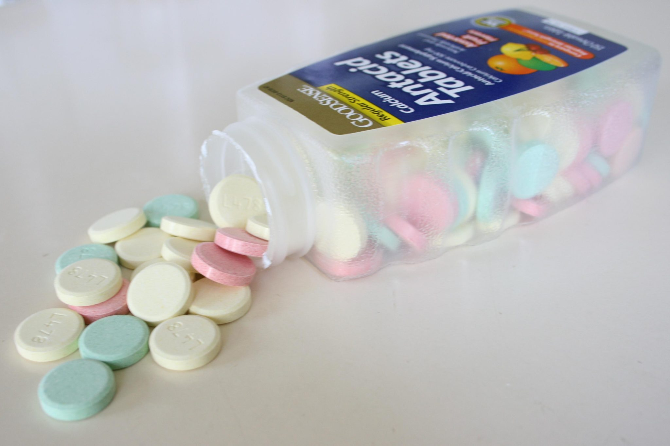
Figure 16.5a
Figure 16.5a Magic of Antacids: A jar of Antacids is shown. Antacids are bases, and are used to neutralize stomach acids by individuals experiencing acid reflux (credit: work by Midnightcomm, CC BY-SA 2.5).

Slide 24
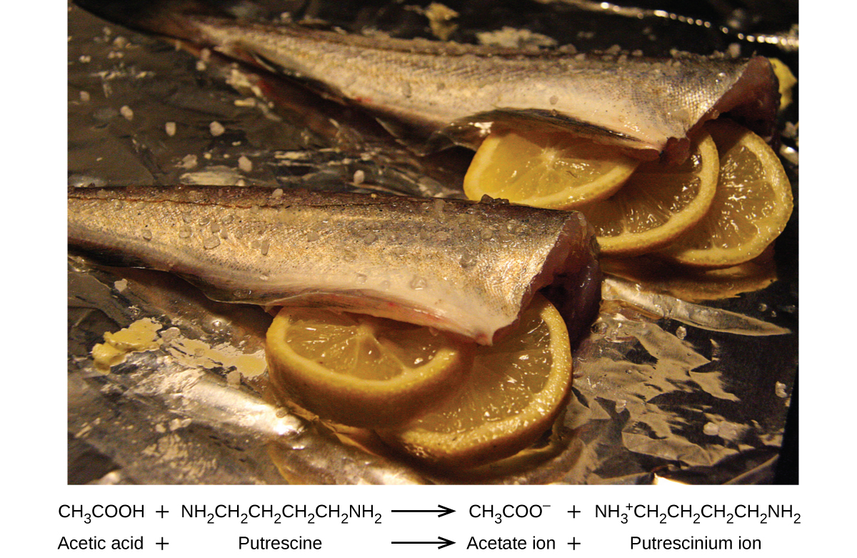
Figure 16.5b
Figure 16.5b A neutralization reaction takes place between citric acid in lemons or acetic acid in vinegar, and the bases in the flesh of fish. (credit: Chemistry (OpenStax), CC BY 4.0.)

Slide 25
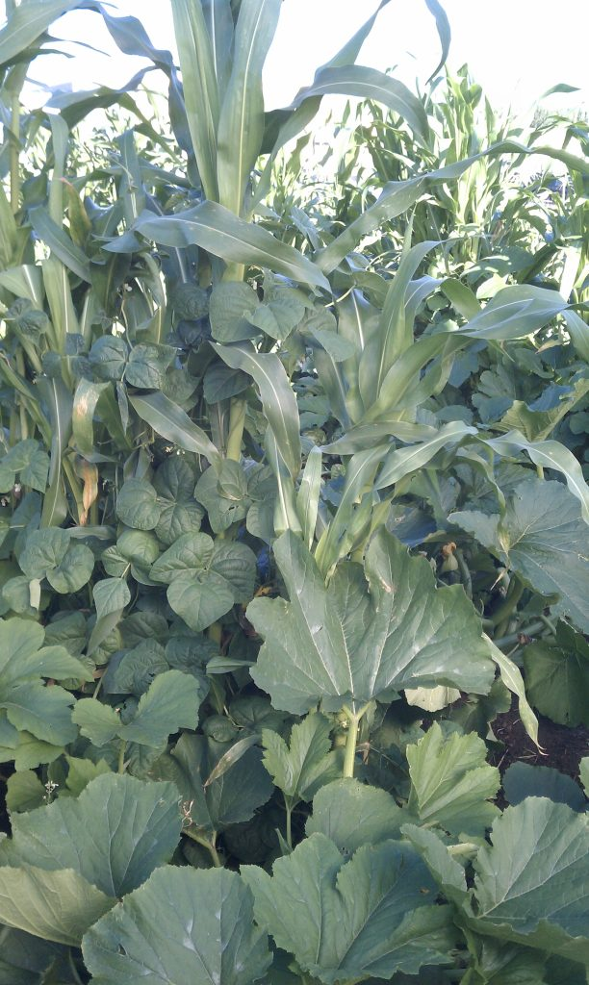
Figure 16.5c
Figure 16.5c Three sisters Garden: Three sisters planting (corn, beans, and squash) at a community garden is pictured. (credit: work by esagor , CC BY-NC 2.0.)

Slide 26
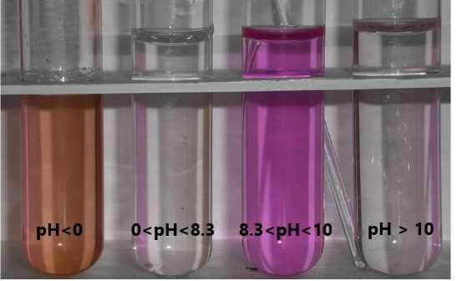
Figure 16.6a
Figure 16.6a Phenolphthalein at different pH: Four test tubes are shown containing solutions at various pH, all containing the pH indicator, phenolphthalein. From left to right: At a pH less than zero, phenolphthalein will turn orange, as shown in the first test tube on the left. At a pH between 0 and 8.3, the solution will remain clear. A solution between a pH of zero to 8.3 through 10, the solution will be pink. Finally a solution with this indicator will be clear for any solutions with a pH greater than 10. Exact pH ranges of this indicator are provided by the supplier when purchased used in lab. (credit: modification of work by Siegert, PD / pH ranges corrected by Jackie MacDonald).

Slide 27
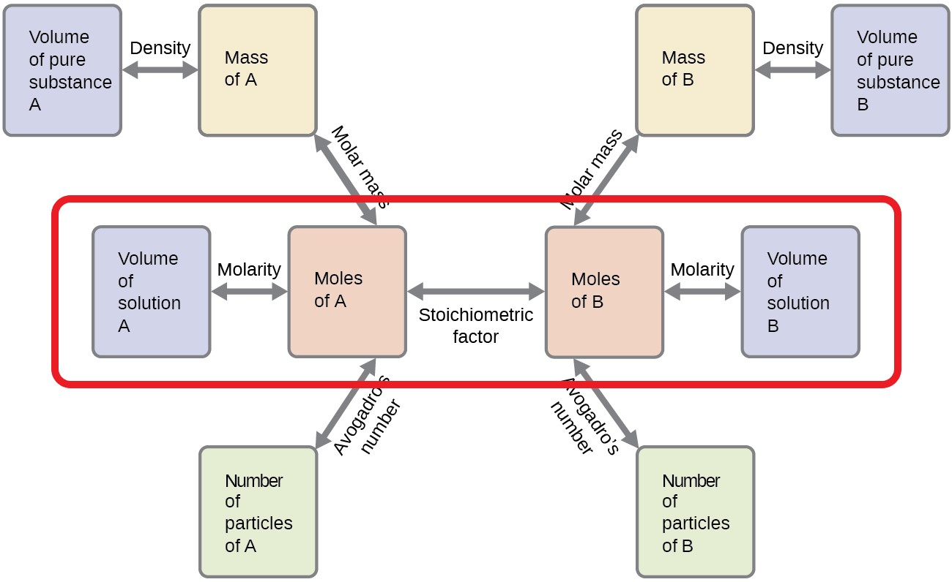
Figure 16.6b
Figure 16.6b Stoichiometry Flowchart for Neutralization Calculations. (Image Source: General Chemistry 1 & 2, CC BY 4.0).

Slide 28
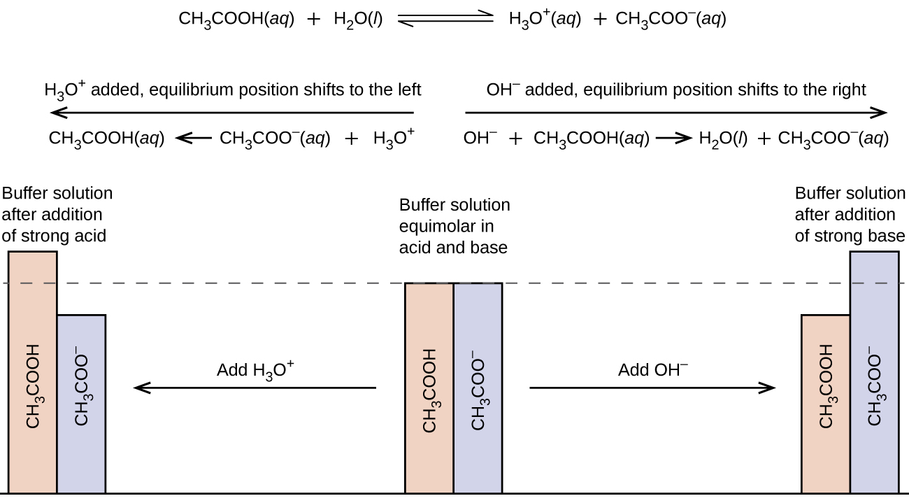
Figure 16.7a
Figure 16.7a Buffering Action of Acetic Acid and Sodium Acetate: Whether a small amounts of strong acid or base are added to this buffer system, the pH does not drastically change due to its ability to form more weak acid or more conjugate base depending on whether acid or base is added to the system. (credit: General Chemistry 1 & 2, CC BY 4.0),

Slide 29
Figure 16.7b
Figure 16.7b Generalizing the Actions of Buffers: “HAn” represents the weak Acid. “An–” represents the conjugate base of the weak acid. If strong acid is added to buffer, the system shifts to the right to produce more weak acid, which holds pH steady. If a strong base is added to the buffer, the system shifts to the right forming water and more weak acid, which also holds the pH constant. (credit: Map: Introductory Chemistry (Tro), CK-12 license.)

Slide 30
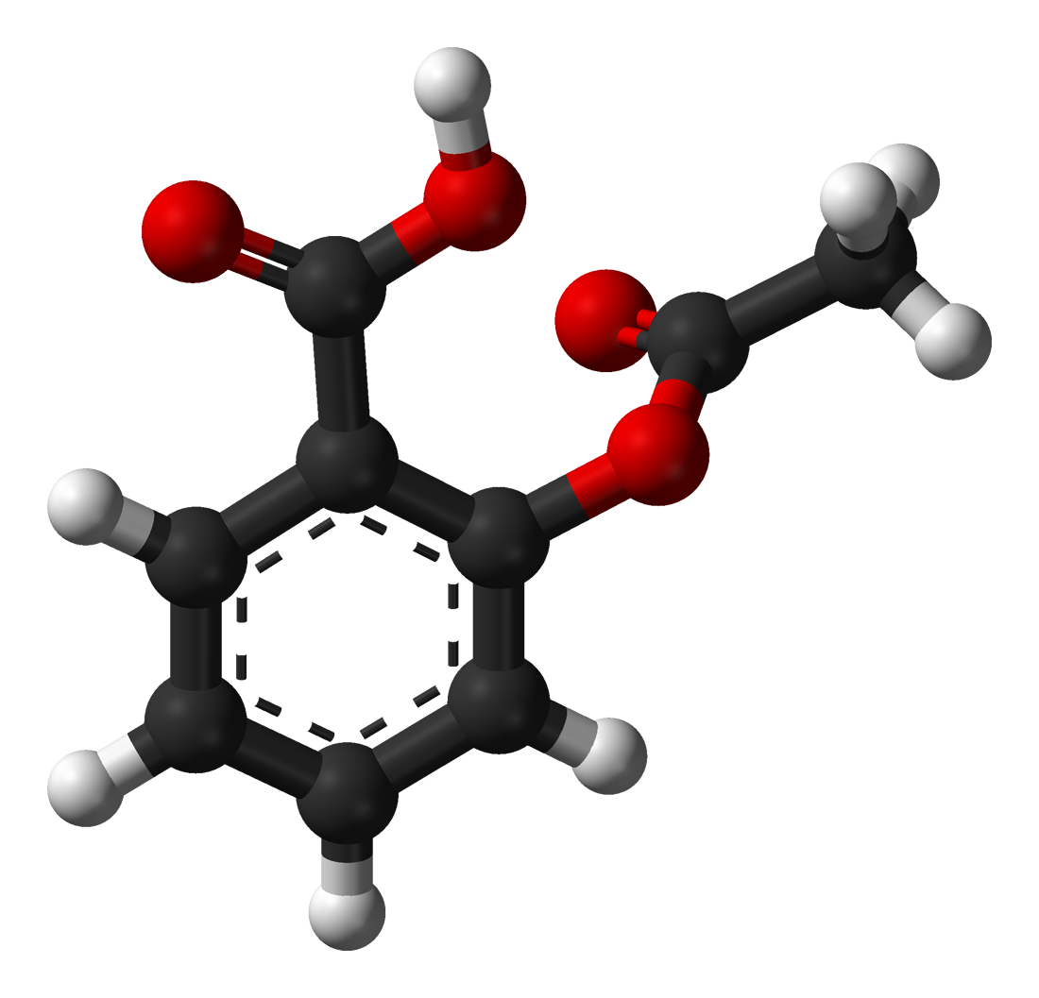
Figure 16.7c
Figure 16.7c 3D Ball and Stick Molecular Structure of Aspirin: Aspirin (acetylsalicylic acid) is an aromatic compound containing both a carboxylic acid functional group and an ester functional group rendering it is a weak acid that is only slightly soluble in water. (credit: work by Ben Mills, PD).

Slide 31
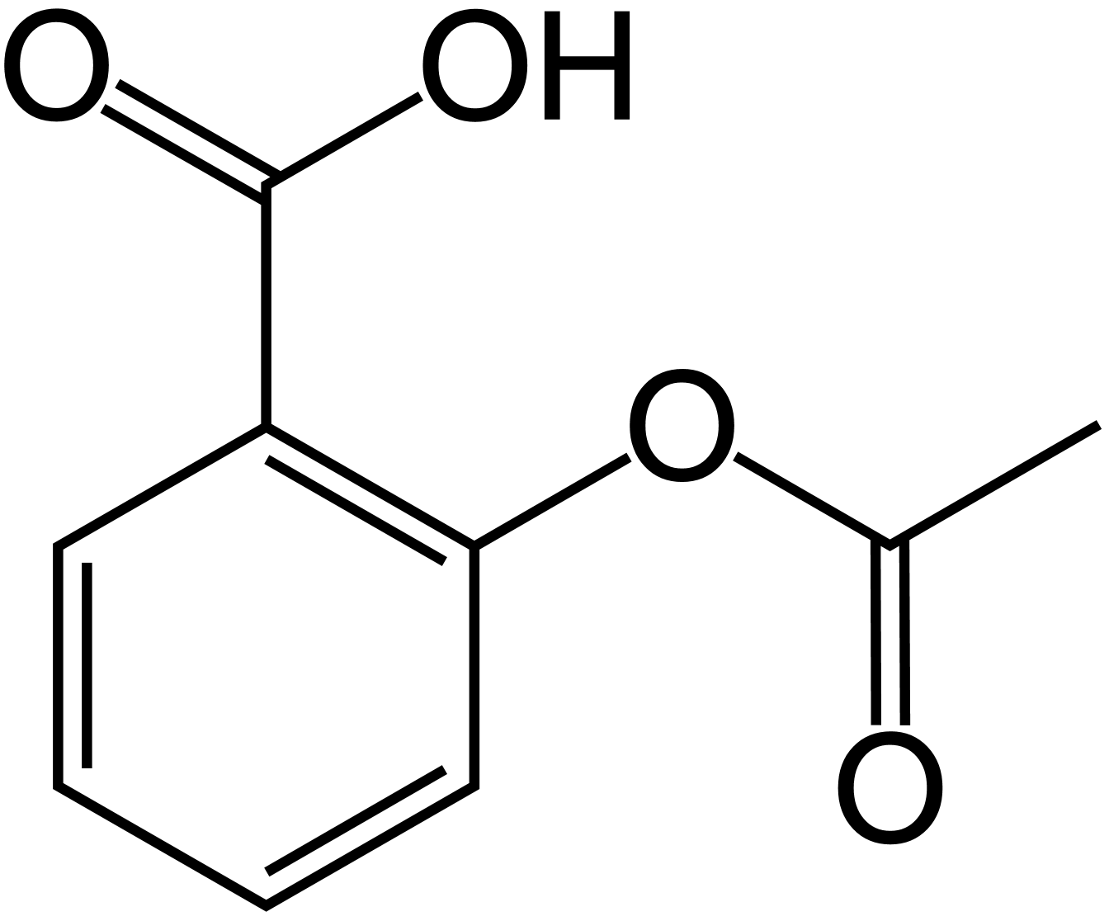
Figure 16.7d
Figure 16.7d Skeletal 2D Image of Aspirin: Aspirin (acetylsalicylic acid) is an aromatic compound containing both a carboxylic acid functional group and an ester functional group rendering it is a weak acid. (credit: work by Ben Mills, PD).

