Slide 1
Chapter 15 Welcome to Chemistry
Slides to accompany Enhanced Introductory College Chemistry by Gregory Anderson, Caryn Fahey, J.R. van Haarlem, Jackie MacDonald, Adrienne Richards, Samantha Sullivan Sauer, and David Wegman
Slide design and template by Revathi Mahadevan
Except where otherwise noted, images, tables & diagrams are reused from Enhanced Introductory College Chemistry, a derivative of Chemistry (Open Stax) by Paul Flowers, Klaus Theopold, Richard Langley & William R. Robinson and is licensed under CC BY 4.0. ​Access for free at Chemistry (OpenStax)​
Slides are licensed under CC-BY 4.0, Except while otherwise noted

Slide 2
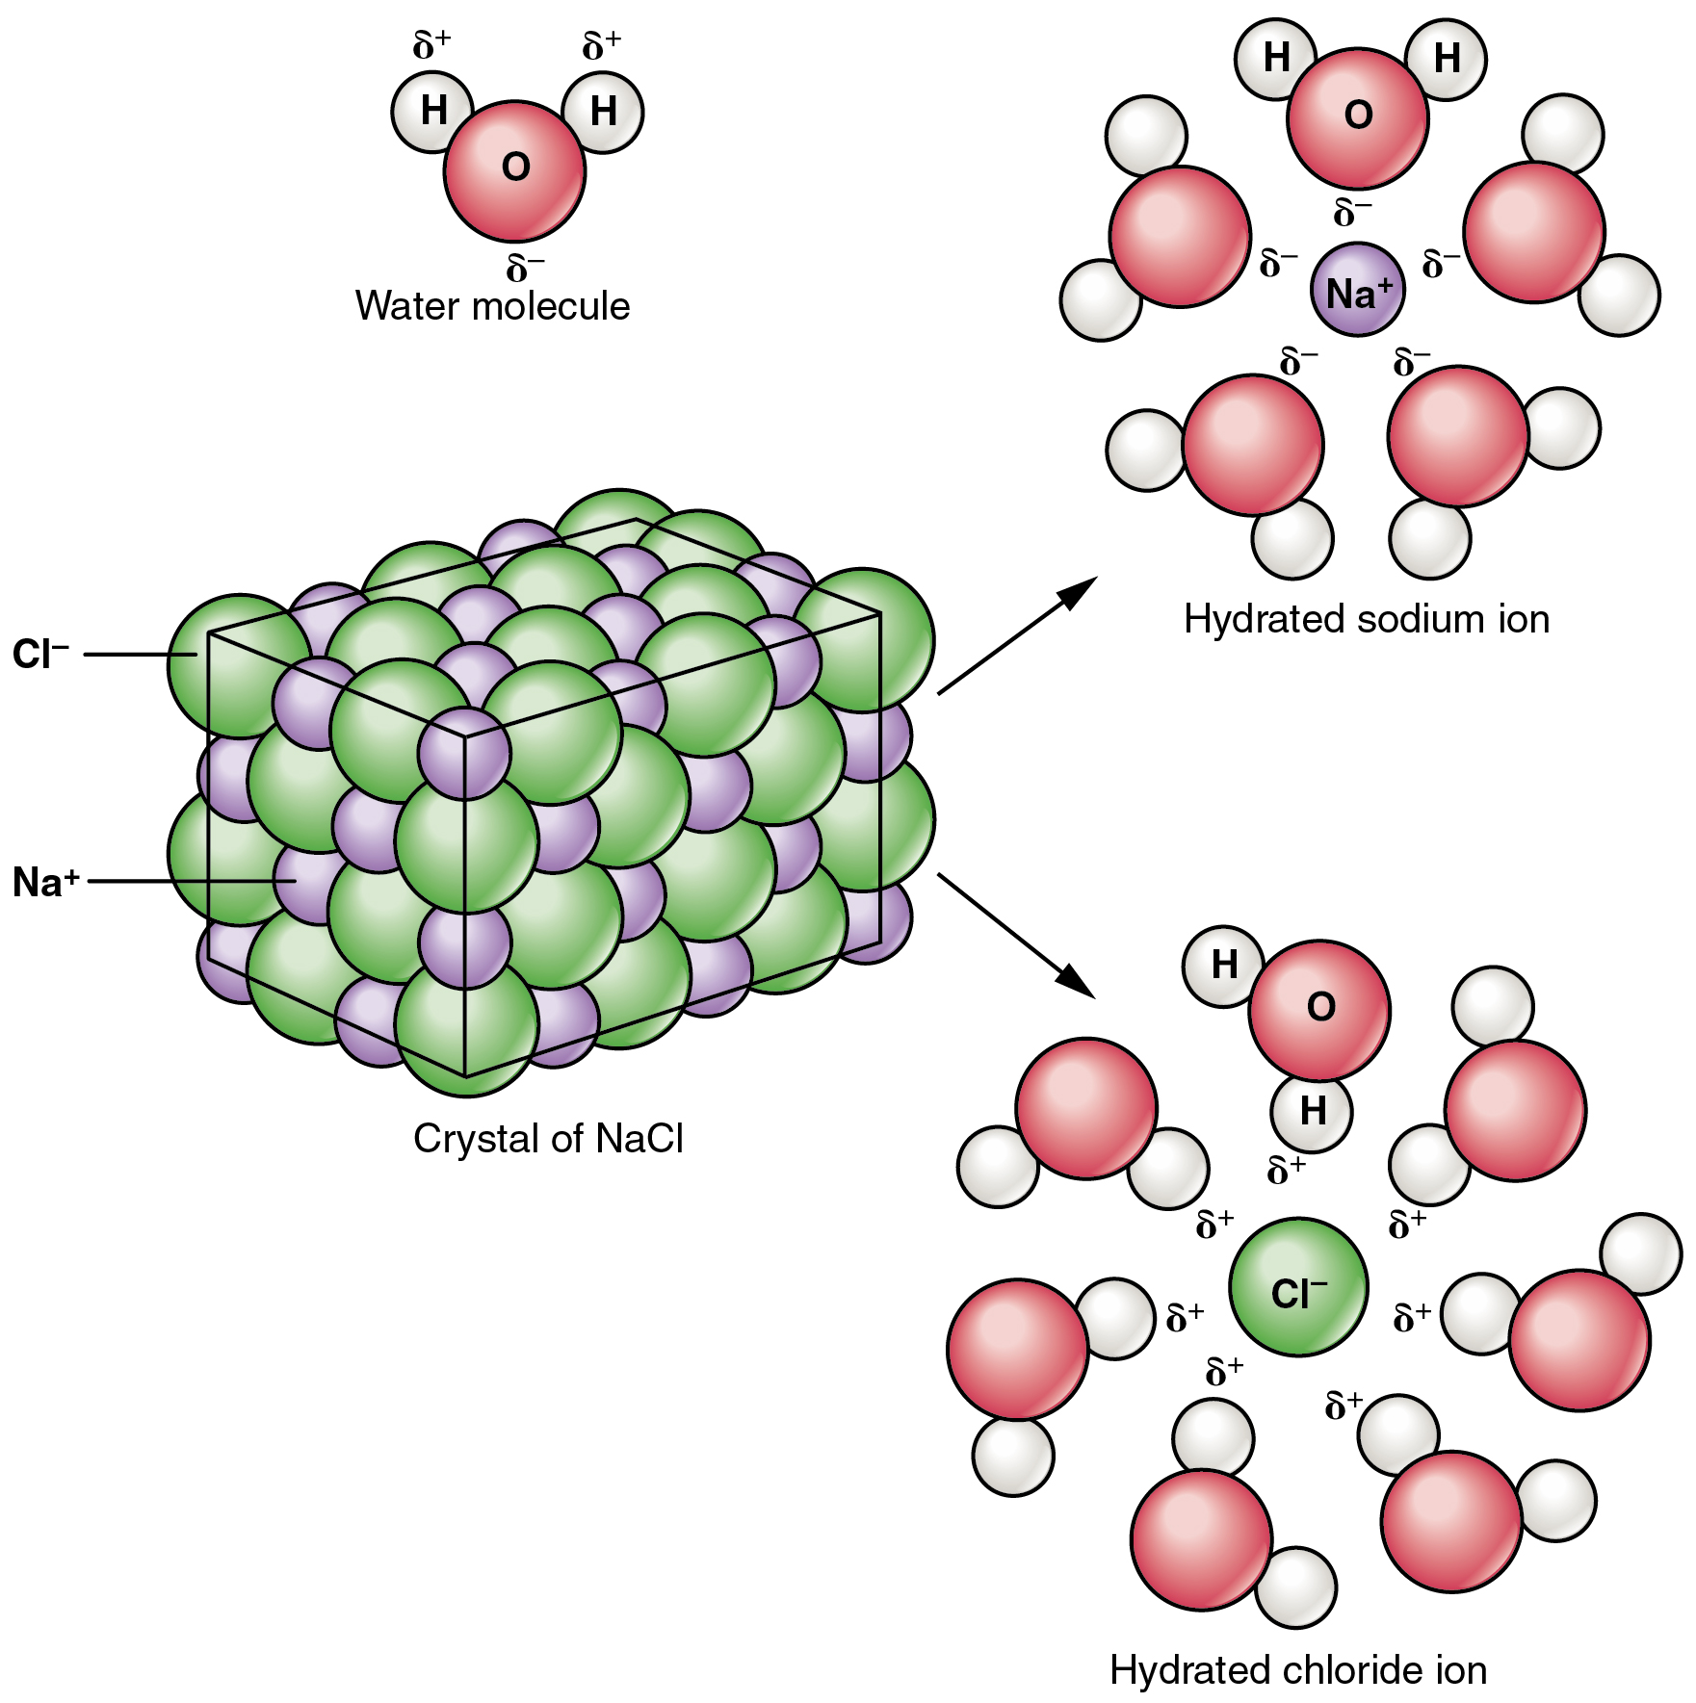
Figure 15.1a
Figure 15.1a Dissociation of Sodium Chloride in Water: Notice that the solid crystals of sodium chloride dissociate not into molecules of NaCl, but into Na⁺ cations and Cl– anions, each completely surrounded by water molecules. (credit: Anatomy and Physiology 2e (OpenStax), CC BY 4.0.)

Slide 3
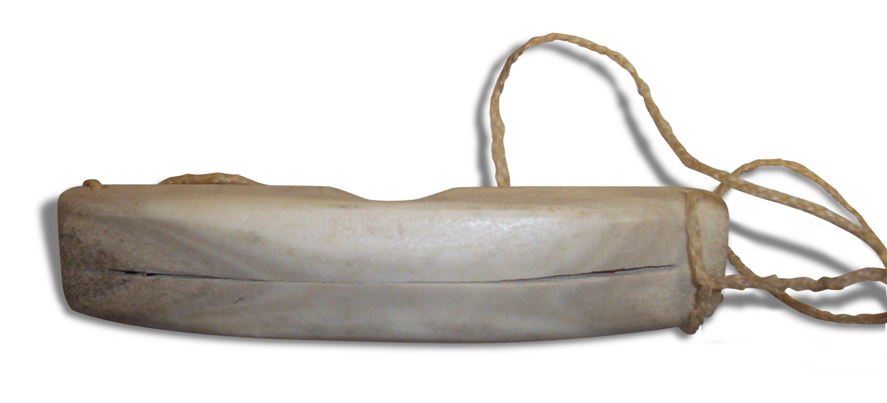
Figure 15.1b
Figure 15.1b Ilgaak/Iggaak – Inuit snow goggles: Snow goggles such as the ones illustrated are commonly made from caribou antler with caribou sinew for a strap (credit: work by CambridgeBayWeather, PD)

Slide 4
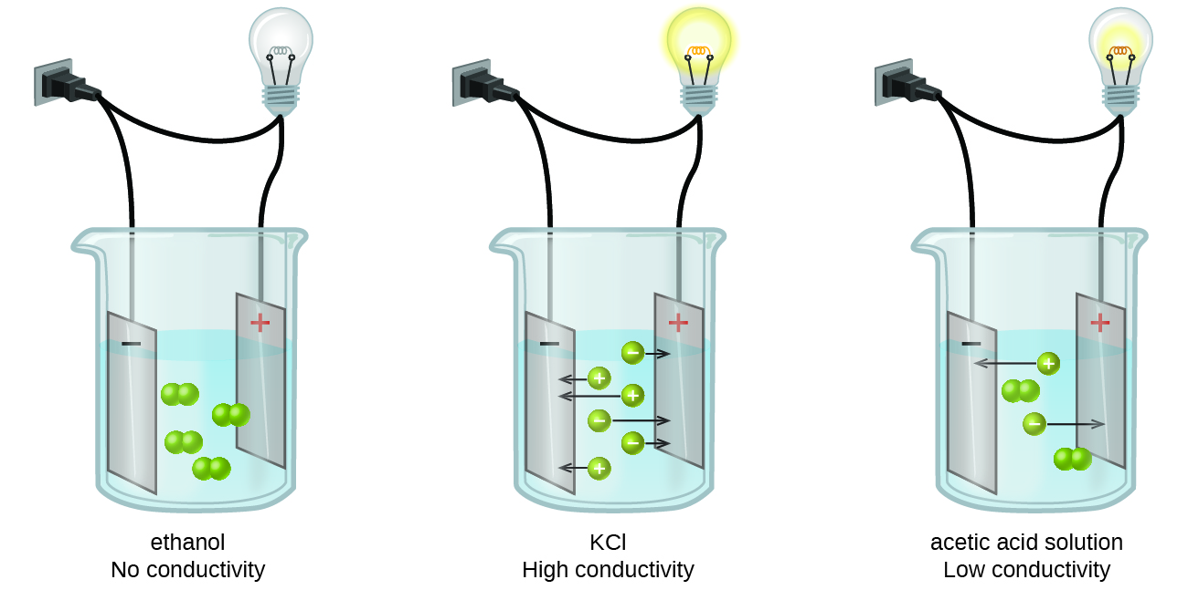
Figure 15.2a
Figure 15.2a Solutions Containing Nonelectrolytes, Strong Electrolytes, or Weak Electrolytes: Solutions of nonelectrolytes such as ethanol do not contain dissolved ions and cannot conduct electricity. Solutions of electrolytes contain ions that permit the passage of electricity. The conductivity of an electrolyte solution is related to the strength of the electrolyte. (credit: Chemistry (OpenStax), CC BY 4.0.)

Slide 5
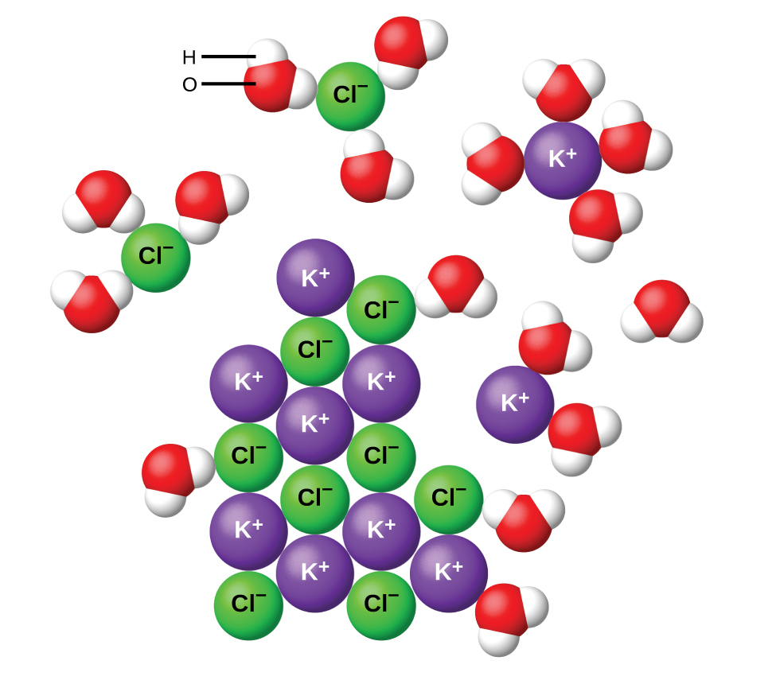
Figure 15.2b
Figure 15.2b Representation of what Happens when Potassium Chloride is Dissolved in Water: As potassium chloride (KCl) dissolves in water, the ions are hydrated. The polar water molecules are attracted by the charges on the K⁺ and Cl⁻ ions. Water molecules in front of and behind the ions are not shown. (credit: Chemistry (OpenStax), CC BY 4.0.)

Slide 6
Figure 15.2c
Figure 15.2c Reaction between Water and Hydrogen Chloride Gas to form Hydrochloric Acid: Hydrogen chloride gas dissolves in water and the ions react with water, transferring H⁺ ions to form hydronium ions (H₃O⁺) and chloride ions (Cl⁻), which illustrates the ionization of this strong acid. (credit: Chemistry (OpenStax), CC BY 4.0.)

Slide 7
Table 15.3a
Table 15.3a Solubility Guidelines for Inorganic Compounds in Water at 25°C
Negative Ion (Anion) | Positive Ion (Cation) | Solubility | Phase, Phase Symbol
All | Li⁺, Na⁺, K⁺, Rb⁺, Cs⁺ NH₄⁺ | Soluble | aqueous, (aq)
Chloride (Cl–), Bromide (Br–), Iodide (I–) | Ag⁺, Pb²⁺, Hg₂²⁺, Cu⁺ | Low solubility | solid, (s)
Chloride (Cl–), Bromide (Br–), Iodide (I–) | All others | Soluble | aqueous, (aq)
F– | compounds with group 2 metal cations, Li⁺, Al³⁺, Pb²⁺, Fe²⁺and Fe³⁺ | Low solubility | solid, (s)
F– | All others | Soluble | aqueous, (aq)
Hydroxide (OH–) | Li⁺, Na⁺, K⁺, Rb⁺, NH₄⁺, Sr²⁺, Ba²⁺ | Soluble | aqueous, (aq)
(credit: table data summarized by Jackie MacDonald, CC BY-NC-SA 4.0)

Slide 8
Table 15.3a (Continued)
Table 15.3a (continued) Solubility Guidelines for Inorganic Compounds in Water at 25°C
Negative Ion (Anion) | Positive Ion (Cation) | Solubility | Phase, Phase Symbol
Hydroxide (OH–) | All others | Low solubility | solid, (s)
NO₃–, NO₂– | All (exception: AgNO₂ is insoluble) | Soluble | aqueous, (aq)
Phosphate (PO₄³⁻), Carbonate (CO₃²⁻) | Na⁺, K⁺, Rb⁺, NH₄⁺ | Soluble | aqueous, (aq)
Phosphate (PO₄³⁻), Carbonate (CO₃²⁻) | All others | Low solubility | solid, (s)
Sulphate (SO₄²⁻) | Ca²⁺, Sr²⁺, Ba²⁺, Ag⁺, Pb²⁺ | Low solubility | solid, (s)
Sulphate (SO₄²⁻) | All others | Soluble | aqueous, (aq)
(credit: table data summarized by Jackie MacDonald, CC BY-NC-SA 4.0)

Slide 9
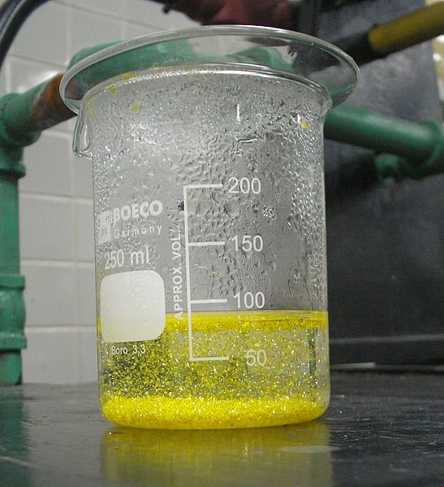
Figure 15.3a
Figure 15.3a Formation of Precipitate Lead(II) Iodide during a Precipitation Reaction: The precipitation reaction producing Lead(II) iodide is shown. It is known as “golden rain” because of the yellow hexagonal crystals forming throughout in the aqueous solution and the solid crystals settle at the bottom of the beaker. This picture was taken after cooling a heated lead(II) nitrate and potassium iodide solution on a Bunsen burner. (credit: work by Der Kreole, CC BY-SA 3.0)

Slide 10
Figure 15.4a
Figure 15.4a Chemical Equation Illustrating Sodium Chloride Salt Ionizing in Water: NaCl will dissolve in water; each atom separates into their individual ions in the water solution. Na⁺ and Cl– ions disperse throughout the water and the salt has dissolved or ionized in the aqueous solution. (credit: work by Shirley Wacowich-Sgarbi, CC BY-NC-SA 4.0; / Adapted by Jackie MacDonald).

Slide 11
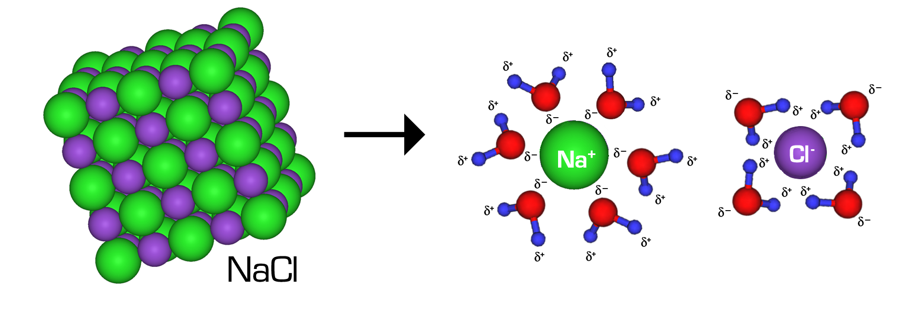
Figure 15.4b
Figure 15.4b Water Hydration of a Crystal of Salt (NaCl): When immersed in water, the attractive forces of the water molecules to the NaCl separates the NaCl molecule to disperse into its separate ions. The negatively-charged oxygens of the water molecules are attracted to the positively-charged sodium ions. The positively-charged side of the water molecules (the hydrogen atoms) are attracted to the negatively-charged chloride ions. Water molecules pull the sodium and chloride ions apart, breaking the ionic bond that held them together. After the salt compounds are pulled apart, the sodium and chloride atoms are surrounded by water molecules. Once this happens, the salt is dissolved, resulting in a homogeneous solution. (credit: work by Andrea Hazard, CC-BY-SA 4.0)

