Slide 1
Chapter 14 Welcome to Chemistry
Slides to accompany Enhanced Introductory College Chemistry by Gregory Anderson, Caryn Fahey, J.R. van Haarlem, Jackie MacDonald, Adrienne Richards, Samantha Sullivan Sauer, and David Wegman
Slide design and template by Revathi Mahadevan
Except where otherwise noted, images, tables & diagrams are reused from Enhanced Introductory College Chemistry, a derivative of Chemistry (Open Stax) by Paul Flowers, Klaus Theopold, Richard Langley & William R. Robinson and is licensed under CC BY 4.0. ​Access for free at Chemistry (OpenStax)​
Slides are licensed under CC-BY 4.0, Except while otherwise noted

Slide 2
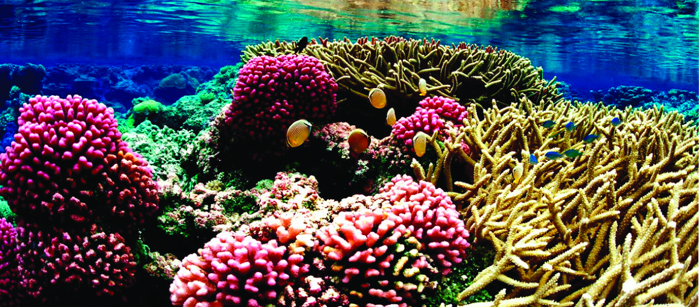
Figure 14a
Figure 14a Coral reefs, such as this one at the Palmyra Atoll National Wildlife Refuge, are vital to the ecosystem of earth’s oceans but are threatened by climate change and dissolved pollution. Marine life depends on the specific chemical composition of the complex mixture we know as seawater. (credit: modification of work by Jim Maragos/USFWS – Pacific Region, CC BY-NC 2.0. / Cropped.)

Slide 3
Figure 14.1a
Figure 14.1a : When potassium dichromate (K₂Cr₂O₇) is mixed with water, it forms a homogeneous orange solution. (credit: modification of work by Mark Ott in Chemistry (OpenStax), CC BY 4.0.)

Slide 4
Table 14.1a
Table 14.1a Different Types of Solutions
Solution | Solute | Solvent
air | O₂(g) | N₂(g)
soft drinks^{[1]} | CO₂(g) | H₂O(l)
hydrogen in palladium | H₂(g) | Pd(s)
rubbing alcohol | H₂O(l) | C₃H₈O(l) (2-propanol)
saltwater | NaCl(s) | H₂O(l)
brass | Zn(s) | Cu(s)
(credit: Chemistry (OpenStax), CC BY 4.0.)
[1] - If bubbles of gas are observed within the liquid, the mixture is not homogeneous and, thus, not a solution.

Slide 5
Figure 14.1b
Figure 14.1b Samples of helium and argon spontaneously mix to give a solution in which the disorder of the atoms of the two gases is increased. (credit: Chemistry (OpenStax), CC BY 4.0.)

Slide 6
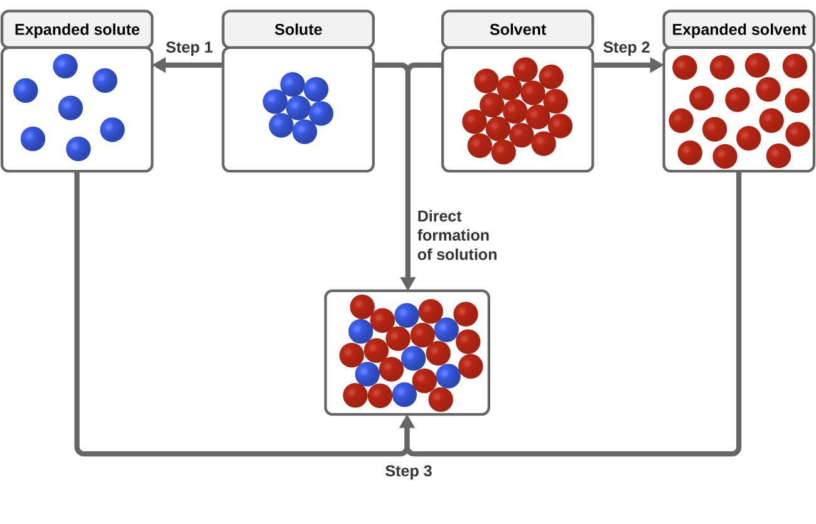
Figure 14.1c
Figure 14.1c This schematic representation of dissolution shows a stepwise process involving the endothermic separation of solute and solvent species (Steps 1 and 2) and exothermic solvation (Step 3). (credit: Chemistry (OpenStax), CC BY 4.0.)

Slide 7
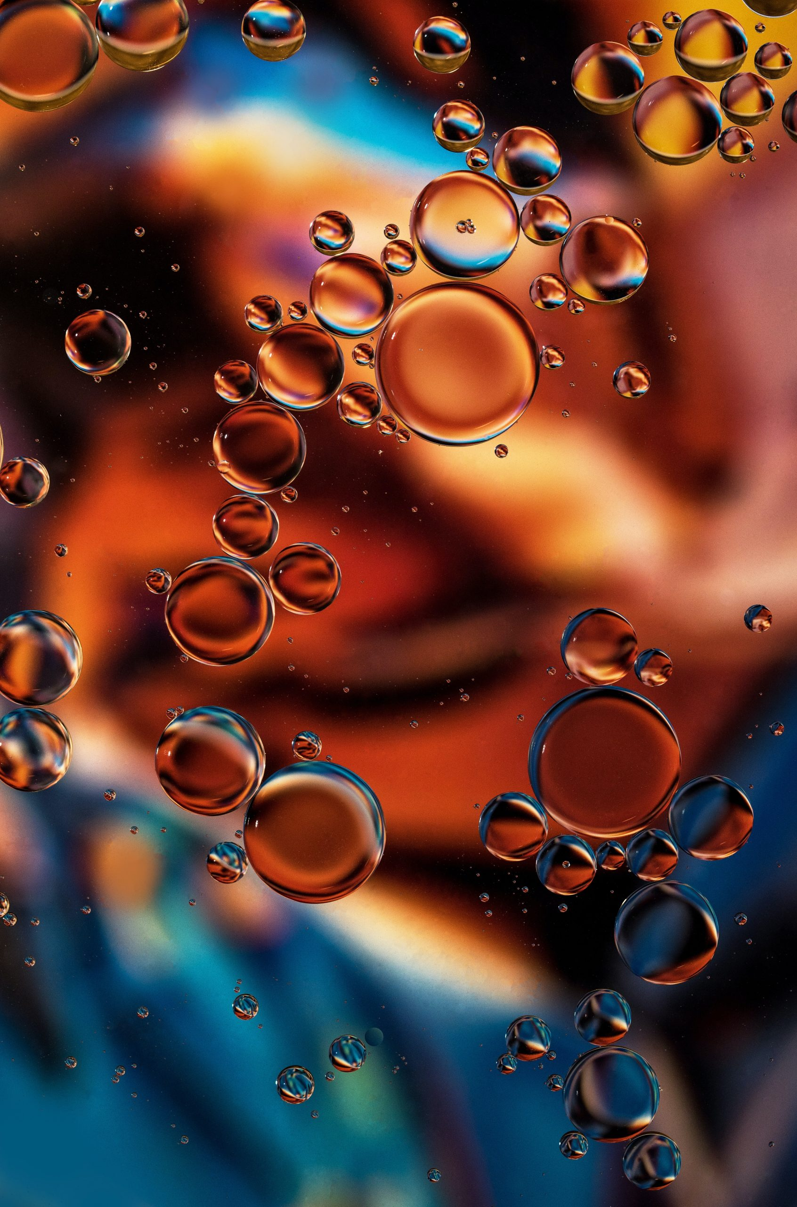
Figure 14.1d
Figure 14.1d A mixture of nonpolar cooking oil and polar water does not yield a solution. (credit: work by David Clode, Unsplash license).

Slide 8
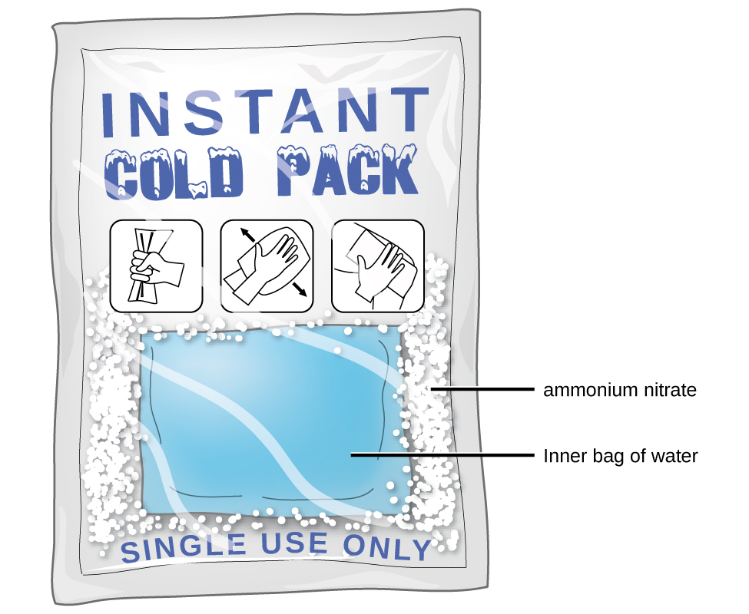
Figure 14.1e
Figure 14.1e An instant cold pack gets cold when certain salts, such as ammonium nitrate, dissolve in water—an endothermic process. (credit: Chemistry (OpenStax), CC BY 4.0.)

Slide 9
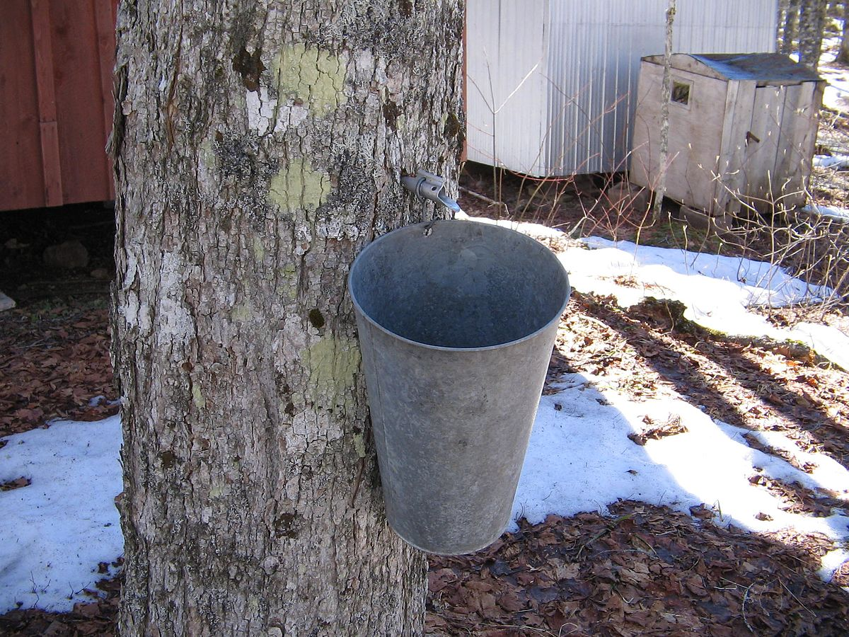
Figure 14.1f
Figure 14.1f Sap collection (credit: work by Oven Fresh, PD)

Slide 10
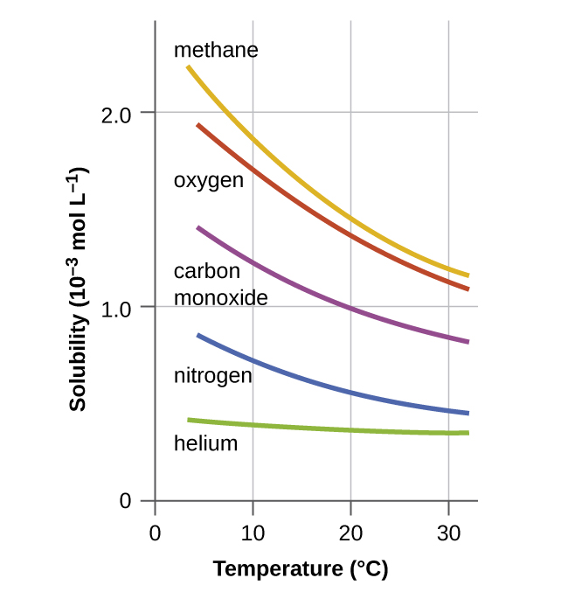
Figure 14.2a
Figure 14.2a The solubilities of these gases in water decrease as the temperature increases. All solubilities were measured with a constant pressure of 101.3 kPa (1 atm) of gas above the solutions. (credit: Chemistry (OpenStax), CC BY 4.0.)

Slide 11
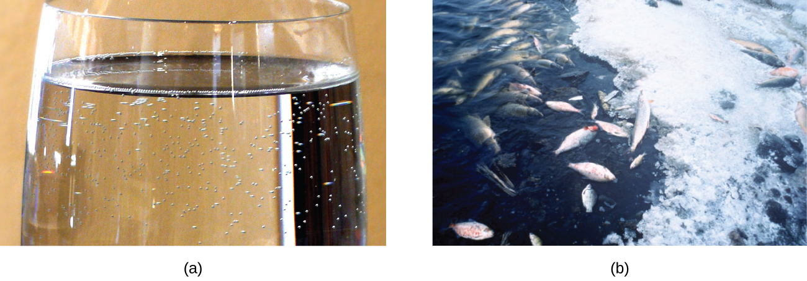
Figure 14.2b
Figure 14.2b (a) The small bubbles of air in this glass of chilled water formed when the water warmed to room temperature and the solubility of its dissolved air decreased. (b) The decreased solubility of oxygen in natural waters subjected to thermal pollution can result in large-scale fish kills. (credit a: modification of work by Liz West, CC BY 2.0; credit b: modification of work by U.S. Fish and Wildlife Service, PD)

Slide 12
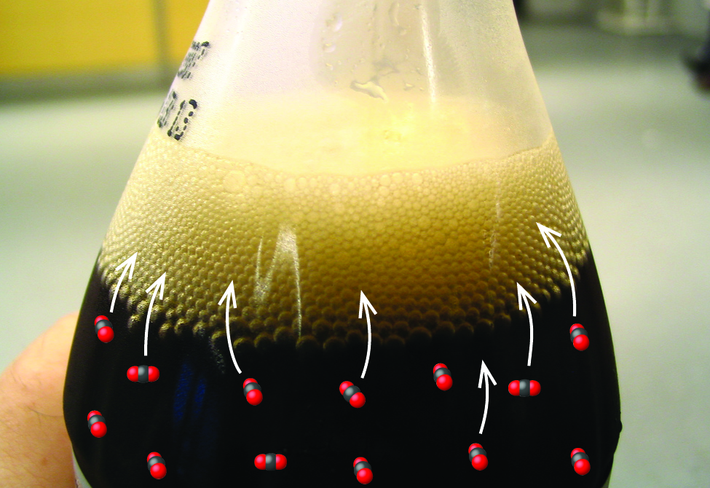
Figure 14.2c
Figure 14.2c Opening the bottle of carbonated beverage reduces the pressure of the gaseous carbon dioxide above the beverage. The solubility of CO2 is thus lowered, and some dissolved carbon dioxide may be seen leaving the solution as small gas bubbles. (credit: modification of work by Chiara Coetzee, CC0 in Chemistry (OpenStax), CC BY 4.0).

Slide 13
Figure 14.2d
Figure 14.2d Reaction of ammonia with water to form ammonium ion and hydroxide ion. (credit: Chemistry (OpenStax), CC BY 4.0.)

Slide 14
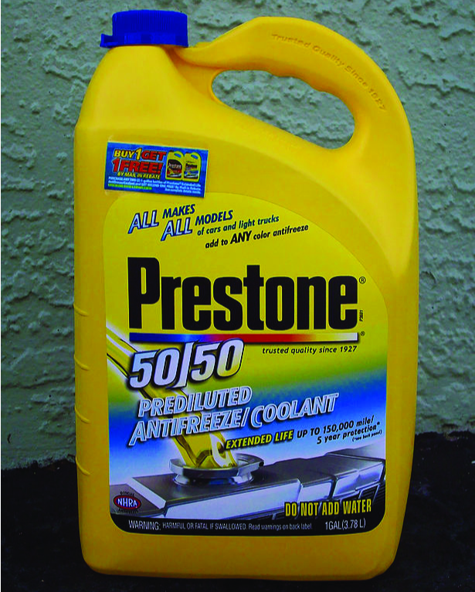
Figure 14.2e
Figure 14.2e Water and antifreeze are miscible; mixtures of the two are homogeneous in all proportions. (credit: work by dno1967, CC BY 2.0)

Slide 15
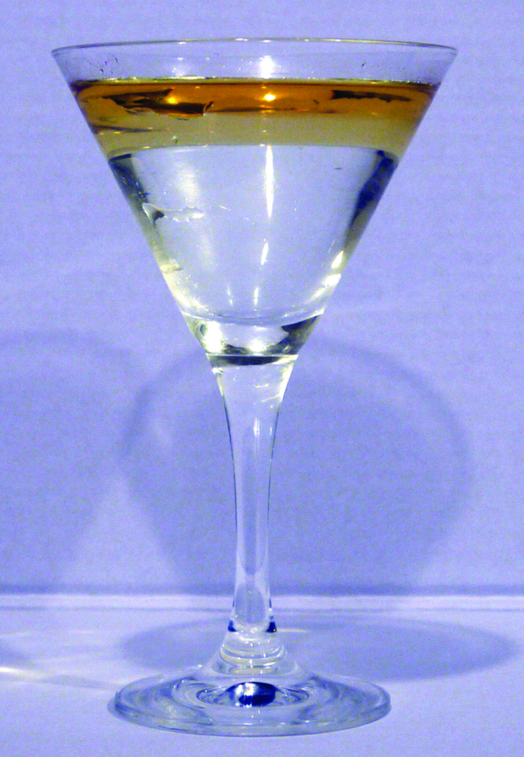
Figure 14.2f
Figure 14.2f Water and oil are immiscible. Mixtures of these two substances will form two separate layers with the less dense oil floating on top of the water. (credit: work by Yortw, CC BY 2.0)

Slide 16
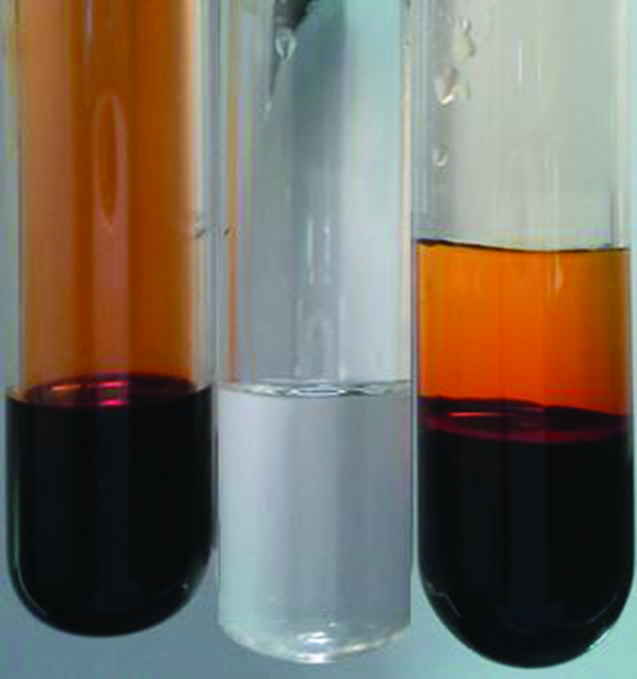
Figure 14.2g
Figure 14.2g Bromine (the deep orange liquid on the left) and water (the clear liquid in the middle) are partially miscible. The top layer in the mixture on the right is a saturated solution of bromine in water; the bottom layer is a saturated solution of water in bromine. (credit: Paul Flowers in Chemistry (OpenStax), CC BY 4.0.)

Slide 17
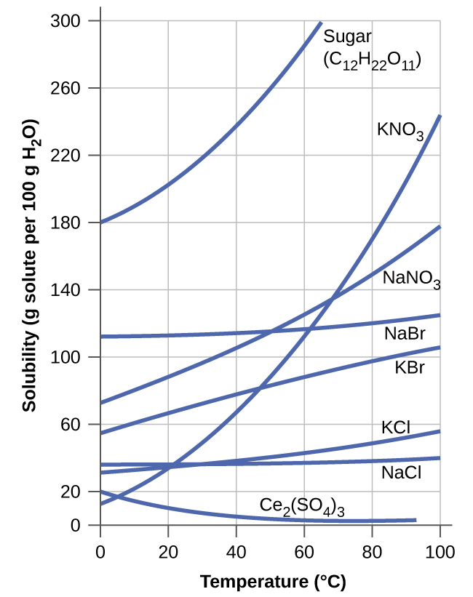
Figure 14.2h
Figure 14.2h This graph shows how the solubility of several solids changes with temperature. (credit: Chemistry (OpenStax), CC BY 4.0.)

Slide 18
Table 14.2a
Table 14.1a Soluble Ionic Compounds
Compounds containing these ions | Exceptions
NH₄⁺ | none
Li⁺ | none
Na⁺ | none
K⁺ | none
Rb⁺ | none
Cs⁺ | none
Cl– | Compounds with Ag+, Hg₂²⁺, Pb²⁺
NH₄⁺ | none
Li⁺ | none
Na⁺ | none
K⁺ | none
(credit: table data summarized by Greg Anderson, CC BY 4.0)

Slide 19
Table 14.2a (Continued)
Table 14.2a (continued) Soluble Ionic Compounds
Compounds containing these ions | Exceptions
Br– | Compounds with Ag+, Hg₂²⁺, Pb²⁺
I– | Compounds with Ag+, Hg₂²⁺, Pb²⁺
F– | Compounds with group 2 metal cations Pb²⁺, Fe²⁺
C₂H₃O₂– | None
HCO₃– | None
CIO₃– | None
SO₄²⁻ | Compounds with Ag⁺, Ba²⁺, Ca²⁺, Hg₂²⁺, Pb²⁺, Sr²⁺
(credit: table data summarized by Greg Anderson, CC BY 4.0)

Slide 20
Table 14.2b
Table 14.2b Insoluble Ionic Compounds
Compounds containing these ions | Exceptions
CO₃²⁻ | Compounds with group 1 cations and NH₄⁺
CrO₄²⁻ | Compounds with group 1 cations and NH₄⁺
PO₄³⁻ | Compounds with group 1 cations and NH₄⁺
S²⁻ | Compounds with group 1 cations and NH₄⁺
OH– | Compounds with group 1 cations and Ba²⁺
(credit: table data summarized by Greg Anderson, CC BY 4.0)

Slide 21
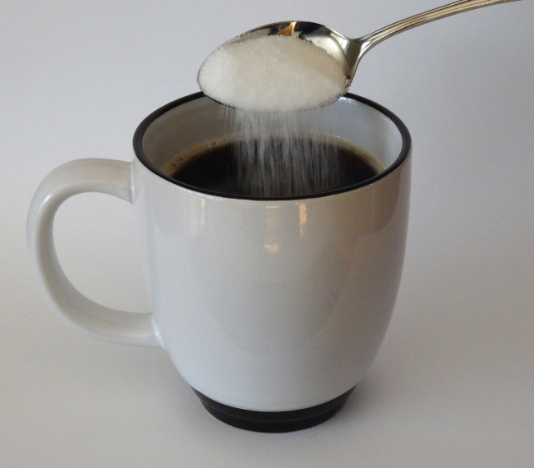
Figure 14.3a
Figure 14.3a Sugar is one of many components in the complex mixture known as coffee. The amount of sugar in a given amount of coffee is an important determinant of the beverage’s sweetness. (credit: Photo by Jane Whitney in Chemistry (OpenStax), CC BY 4.0.)

Slide 22
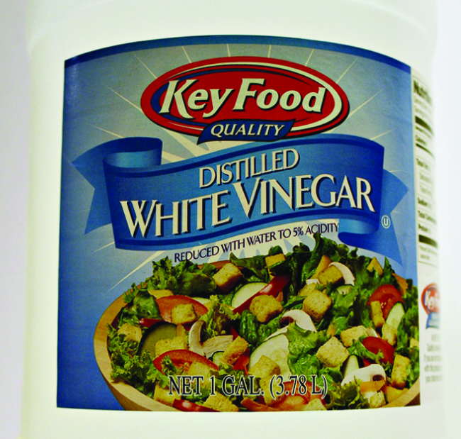
Figure 14.3b
Figure 14.3b Distilled white vinegar is a solution of acetic acid in water. (credit: modification of work by HomeSpot HQ, CC BY 2.0)

Slide 23
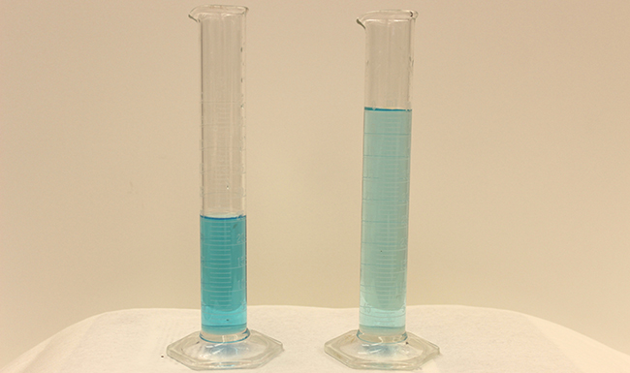
Figure 14.3c
Figure 14.3c: Both solutions contain the same mass of copper nitrate. The solution on the right is more dilute because the copper nitrate is dissolved in more solvent. (credit: Mark Ott in Chemistry (OpenStax), CC BY 4.0.)

Slide 24
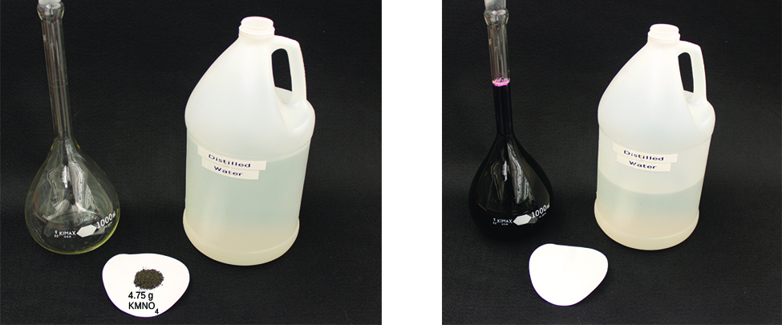
Figure 14.3d
Figure 14.3d: A solution of KMnO4 is prepared by mixing water with 4.74 g of KMnO4 in a flask. (credit: modification of work by Mark Ott in Chemistry (OpenStax), CC BY 4.0.)

Slide 25
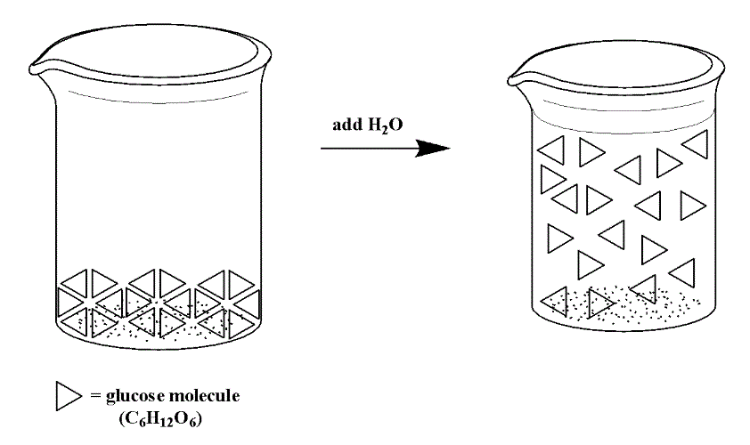
Figure 14.3e
Figure 14.3e: Glucose, when placed into a solvent such as water, does not dissociate. The molecules maintain their covalent bonds, and thus float around in solution as complete glucose molecules (triangles above). (credit: General Chemistry 1 & 2, CC BY 4.0.)

Slide 26
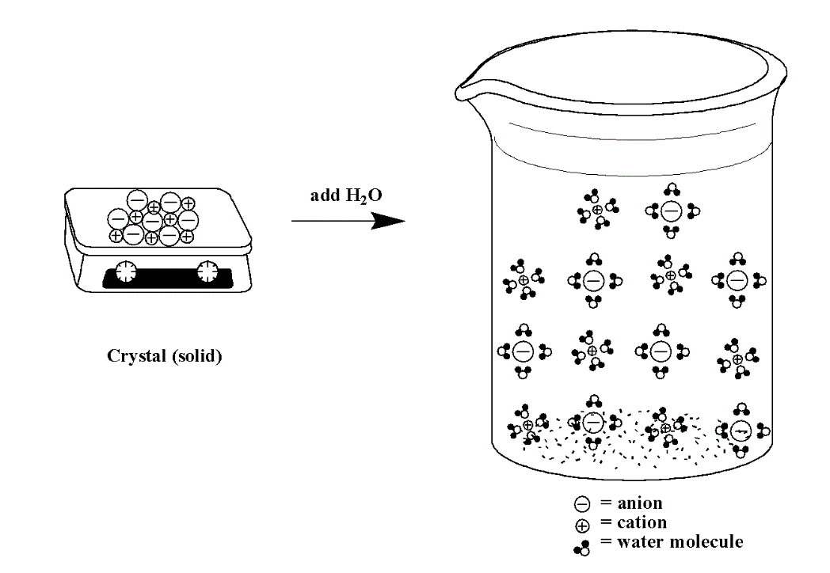
Figure 14.3f
Figure 14.3f: Ionic solids, when placed into a polar solvent such as water, will undergo dissociation. Each ion is surrounded by water molecules due to dipole-dipole interactions, thus pulling the ionic compound apart into individual ions. (credit: General Chemistry 1 & 2 , CC BY 4.0.)

Slide 27
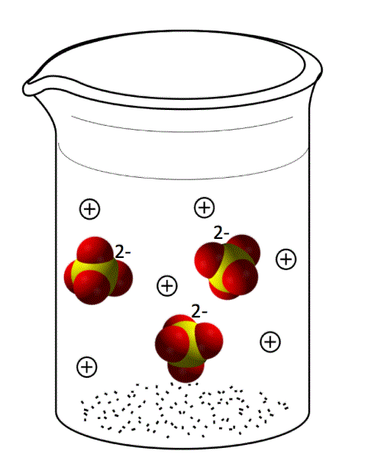
Figure 14.3g
Figure 14.3g: Sodium sulfate (Na₂SO₄), when placed into a polar solvent such as water, will dissociate into individual Na⁺ ions and SO₄²⁻ ions. (credit: General Chemistry 1 & 2 , CC BY 4.0.)

Slide 28
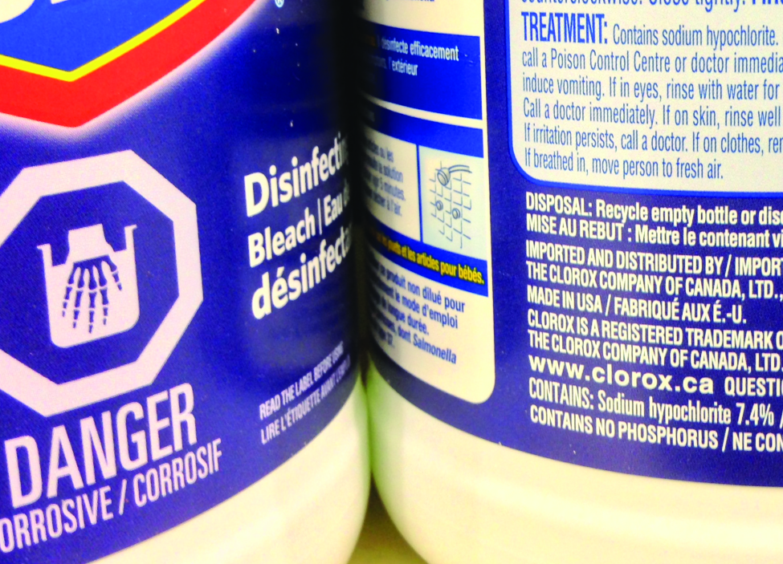
Figure 14.4a
Figure 14.4a: Liquid bleach is an aqueous solution of sodium hypochlorite (NaOCl). This brand has a concentration of 7.4% NaOCl by mass. (credit: Chemistry (OpenStax), CC BY 4.0.)

Slide 29
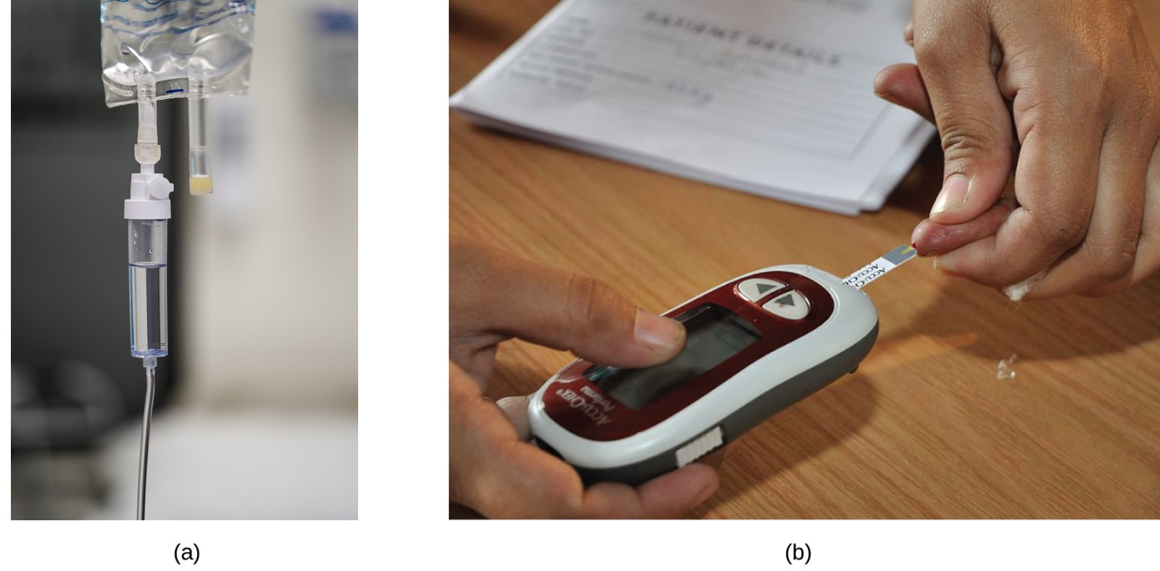
Figure 14.4b
Figure 14.4b: “Mixed” mass-volume units are commonly encountered in medical settings. (a) The NaCl concentration of physiological saline is 0.9% (m/v). (b) This device measures glucose levels in a sample of blood. The normal range for glucose concentration in blood (fasting) is around 70–100 mg/dL. (credit a: work by Samuel Ramos, Unsplash license; credit b: modification of work by Biswarup Ganguly, CC BY 3.0)

Slide 30
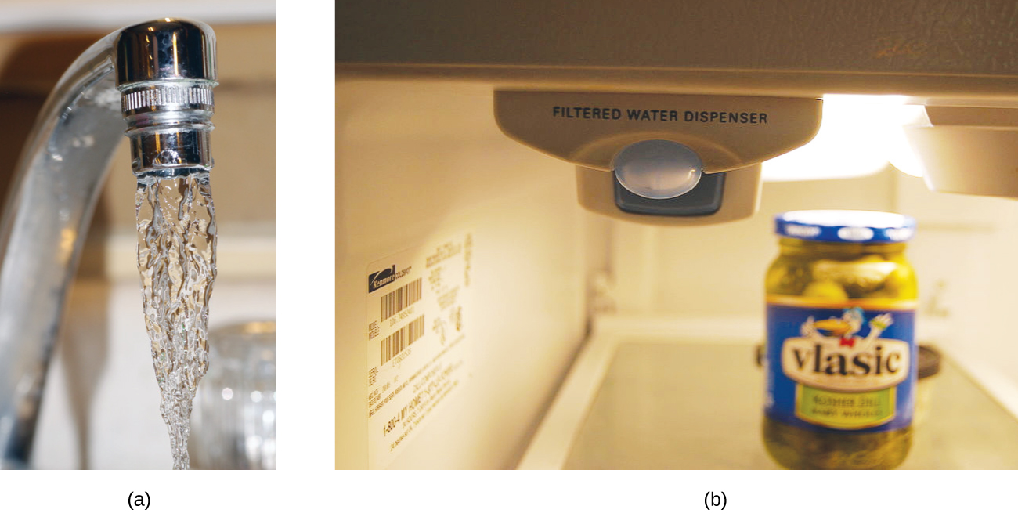
Figure 14.4c
Figure 14.4c: (a) In some areas, trace-level concentrations of contaminants can render unfiltered tap water unsafe for drinking and cooking. (b) Inline water filters reduce the concentration of solutes in tap water. (credit a: modification of work by Jenn Durfey, CC BY 2.0; credit b: modification of work by vastateparkstaff, CC BY 2.0)

Slide 31
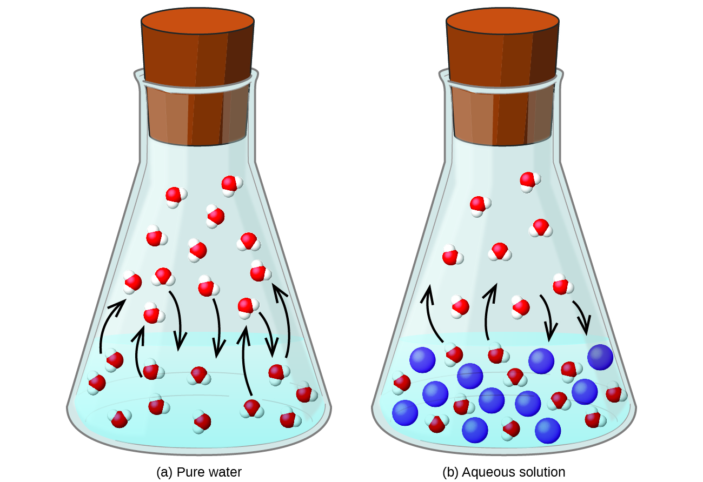
Figure 14.5a
Figure 14.5a: The presence of nonvolatile solutes lowers the vapour pressure of a solution by impeding the evaporation of solvent molecules. (credit: Chemistry (OpenStax), CC BY 4.0.)

Slide 32
Table 14.5a
Table 14.5a Boiling Point Elevation and Freezing Point Depression Constants for Several Solvents
Solvent | Boiling Point (°C at 1 atm) | K_{b} (Cm⁻¹) | Freezing Point (°C at 1 atm) | K_{f} (Cm⁻¹)
water | 100.0 | 0.512 | 0.0 | 1.86
hydrogen acetate | 118.1 | 3.07 | 16.6 | 3.9
benzene | 80.1 | 2.53 | 5.5 | 5.12
chloroform | 61.26 | 3.63 | −63.5 | 4.68
nitrobenzene | 210.9 | 5.24 | 5.67 | 8.1
(credit: Chemistry (OpenStax), CC BY 4.0.)

Slide 33
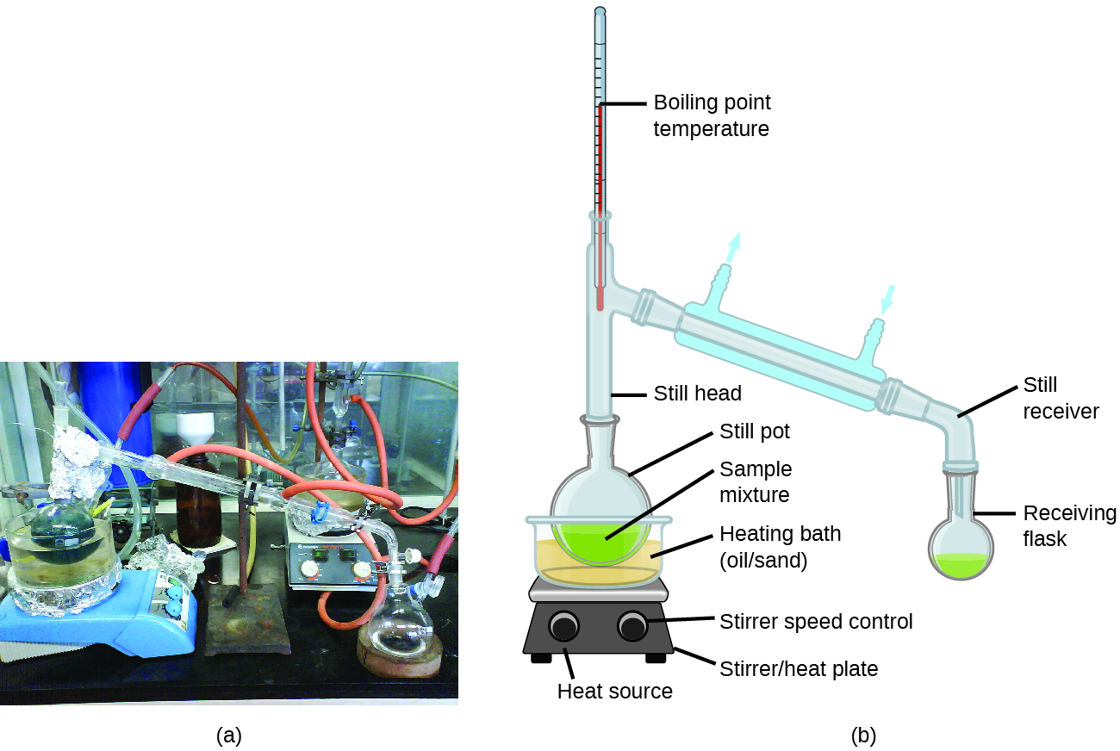
Figure 14.5b
Figure 14.5b: A typical laboratory distillation unit is shown in (a) a photograph and (b) a schematic diagram of the components. (credit a: modification of work by Rifleman82, PD; credit b: modification of work adapted by Slashme, PD in Chemistry (OpenStax), CC BY 4.0).

Slide 34
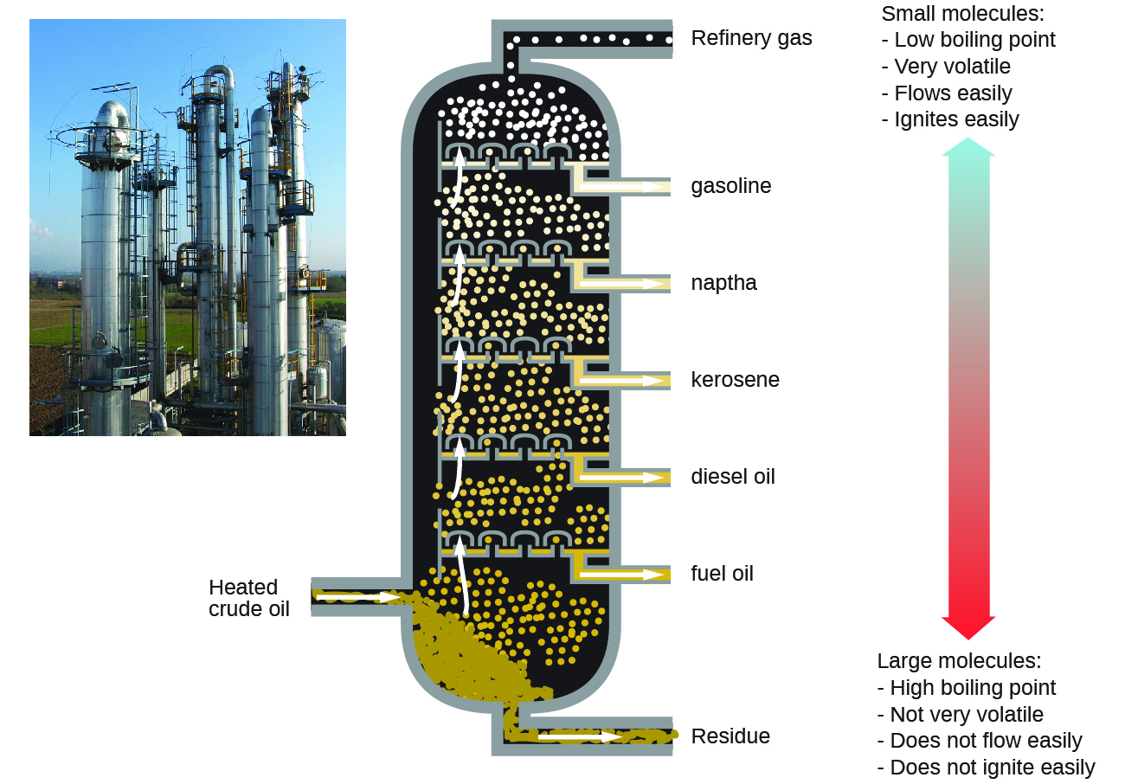
Figure 14.5c
Figure 14.5c: Crude oil is a complex mixture that is separated by large-scale fractional distillation to isolate various simpler mixtures. (credit: modification of work by Luigi Chiesa, CC BY 3.0 in Chemistry (OpenStax), CC BY 4.0).

Slide 35
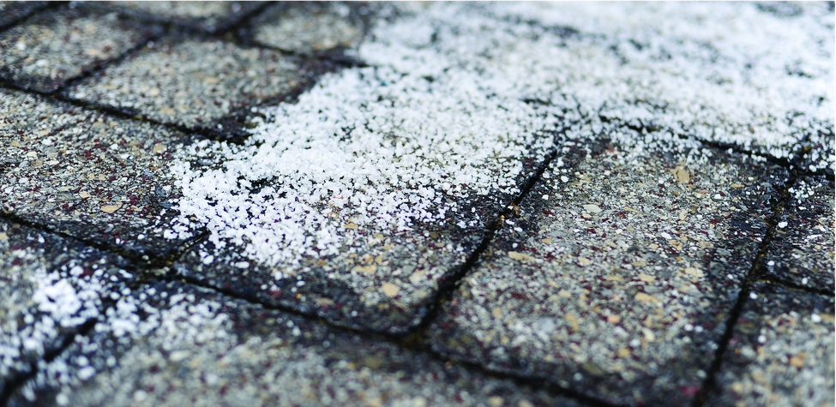
Figure 14.5d
Figure 14.5d: Rock salt (NaCl), calcium chloride (CaCl₂), or a mixture of the two are used to melt ice. (credit: modification of work by Eddie Welker, CC BY 2.0)

Slide 36
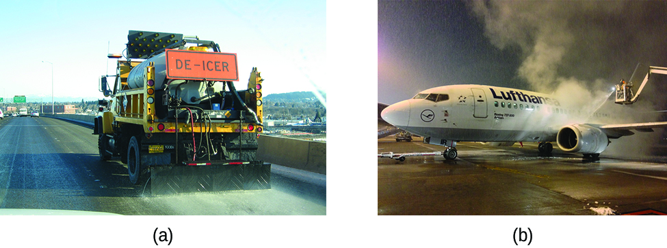
Figure 14.5e
Figure 14.5e: Freezing point depression is exploited to remove ice from (a) roadways and (b) the control surfaces of aircraft. (credit a: work by Oregon Department of Transportation, CC BY 2.0; credit b: work by Paolo Cerutti, CC BY 2.0)

Slide 37
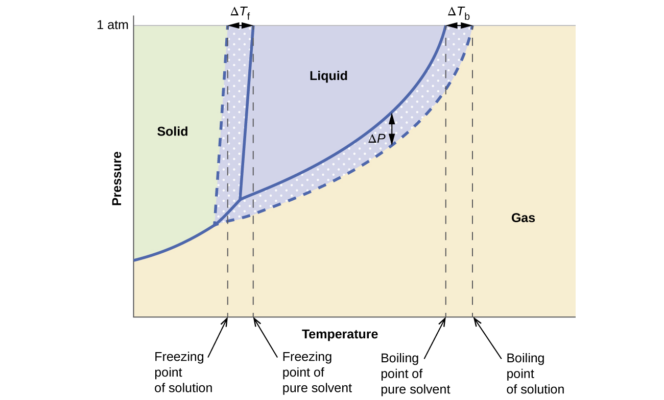
Figure 14.5f
Figure 14.5f: These phase diagrams show water (solid curves) and an aqueous solution of nonelectrolyte (dashed curves). (credit: Chemistry (OpenStax), CC BY 4.0.)

Slide 38
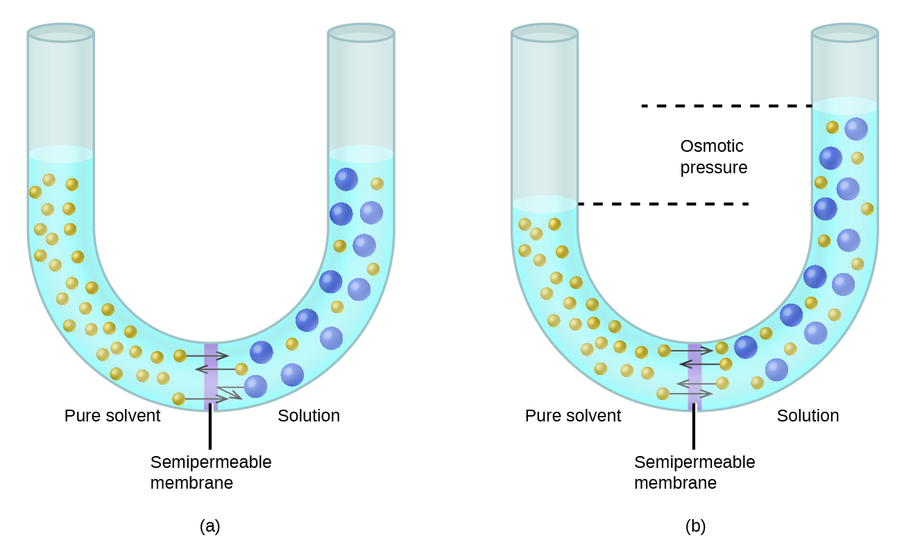
Figure 14.5g
Figure 14.5g: Osmosis results in the transfer of solvent molecules from a sample of low (or zero) solute concentration to a sample of higher solute concentration. (credit: Chemistry (OpenStax), CC BY 4.0.)

Slide 39
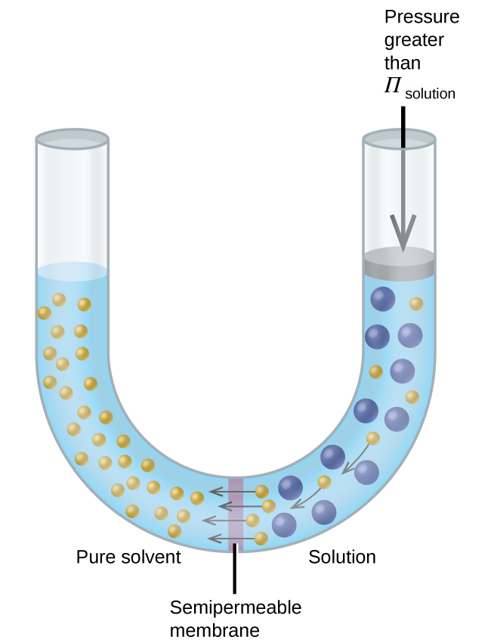
Figure 14.5h
Figure 14.5h: Applying a pressure greater than the osmotic pressure of a solution will reverse osmosis. Solvent molecules from the solution are pushed into the pure solvent. (credit: Chemistry (OpenStax), CC BY 4.0.)

Slide 40
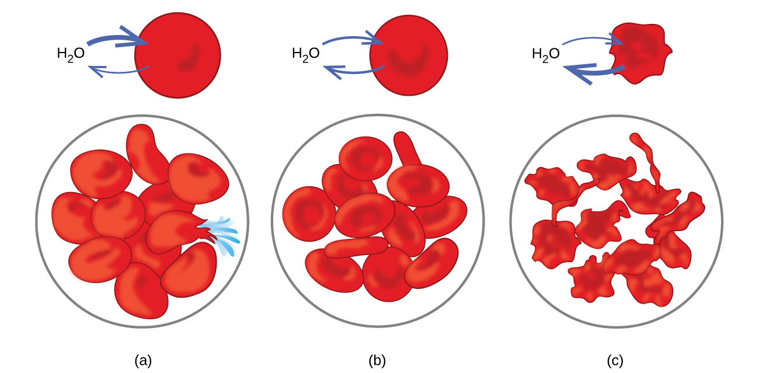
Figure 14.5i
Figure 14.5i: Red blood cell membranes are water permeable and will (a) swell and possibly rupture in a hypotonic solution; (b) maintain normal volume and shape in an isotonic solution; and (c) shrivel and possibly die in a hypertonic solution. (credit a/b/c: modifications of work by LadyofHats, PD in Chemistry (OpenStax), CC BY 4.0).

Slide 41
Table 14.5b
Table 14.5b Expected and Observed van’t Hoff Factors for Several 0.050 m Aqueous Electrolyte Solutions
Electrolyte | Particles in Solution | i (Predicted) | i (Measured)
HCl | H⁺, Cl⁻ | 2 | 1.9
NaCl | Na⁺, Cl⁻ | 2 | 1.9
MgSO₄ | Mg²⁺, SO₄²⁻ | 2 | 1.3
MgCl₂ | Mg²⁺, 2Cl⁻ | 3 | 2.7
FeCl₃ | Fe³⁺, 3Cl⁻ | 4 | 3.4
Glucose (A nonelectrolyte shown for comparison) | C₁₂H₂₂O₁₁ | 1 | 1.0
(credit: Chemistry (OpenStax), CC BY 4.0.)

Slide 42
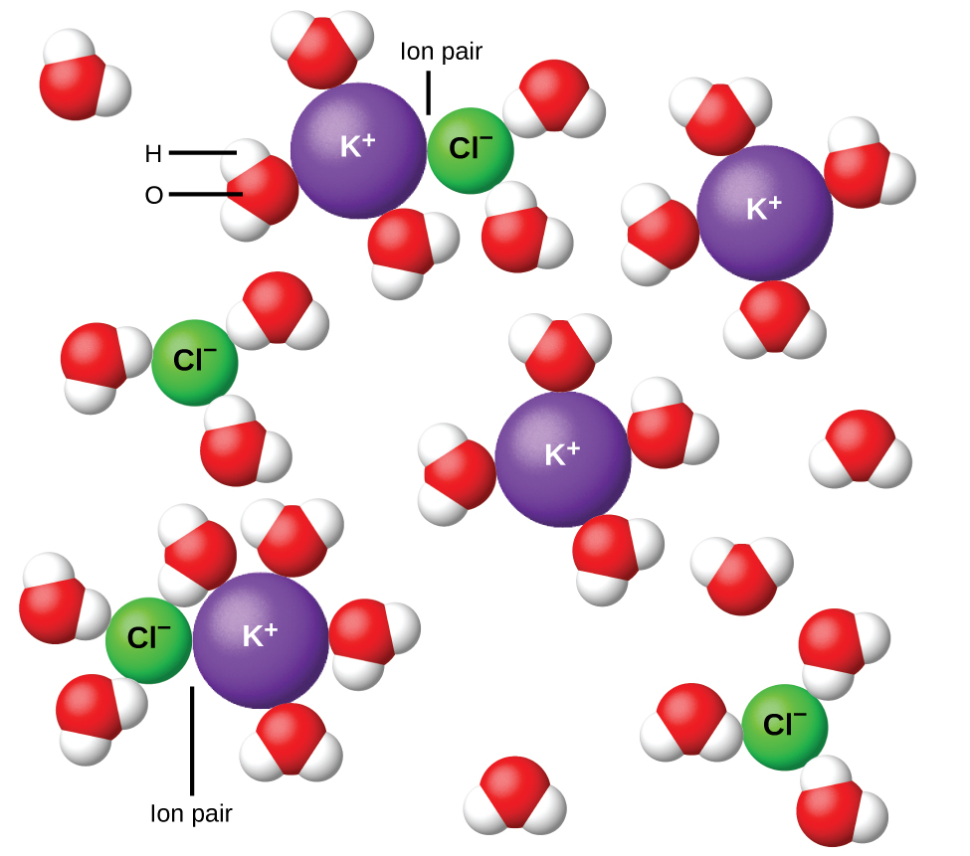
Figure 14.5j
Figure 14.5j: Ions become more and more widely separated the more dilute the solution, and the residual interionic attractions become less. (credit: Chemistry (OpenStax), CC BY 4.0.)

Slide 43
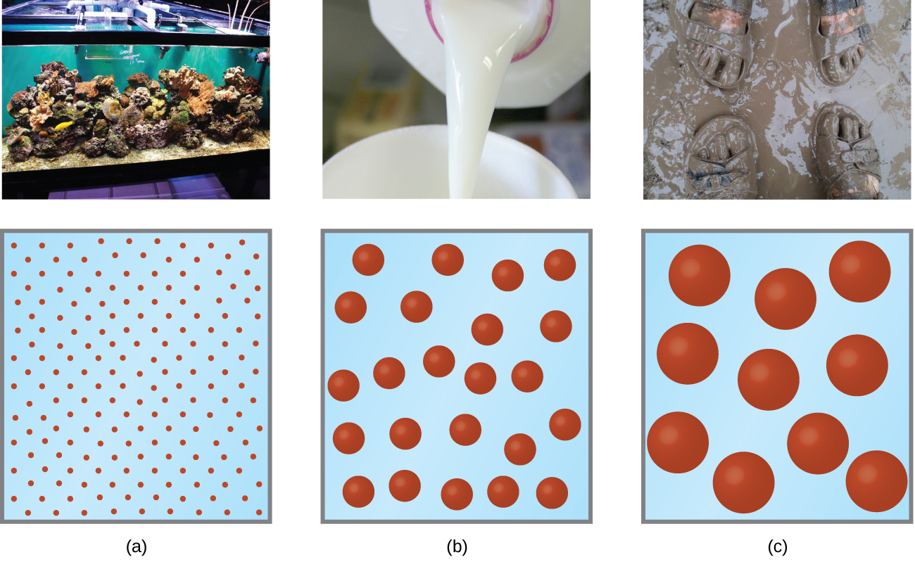
Figure 14.6a
Figure 14.6a: (a) A solution is a homogeneous mixture that appears clear, such as the saltwater in this aquarium. (b) In a colloid, such as milk, the particles are much larger but remain dispersed and do not settle. (c) A suspension, such as mud, is a heterogeneous mixture of suspended particles that appears cloudy and in which the particles can settle. (credit a photo: modification of work by Adam Wimsatt, CC BY 2.0; credit b photo: modification of work by Melissa Wiese, CC BY 2.0; credit c photo: modification of work by Peter Burgess, CC BY 2.0; in Chemistry (OpenStax), CC BY 4.0).

Slide 44
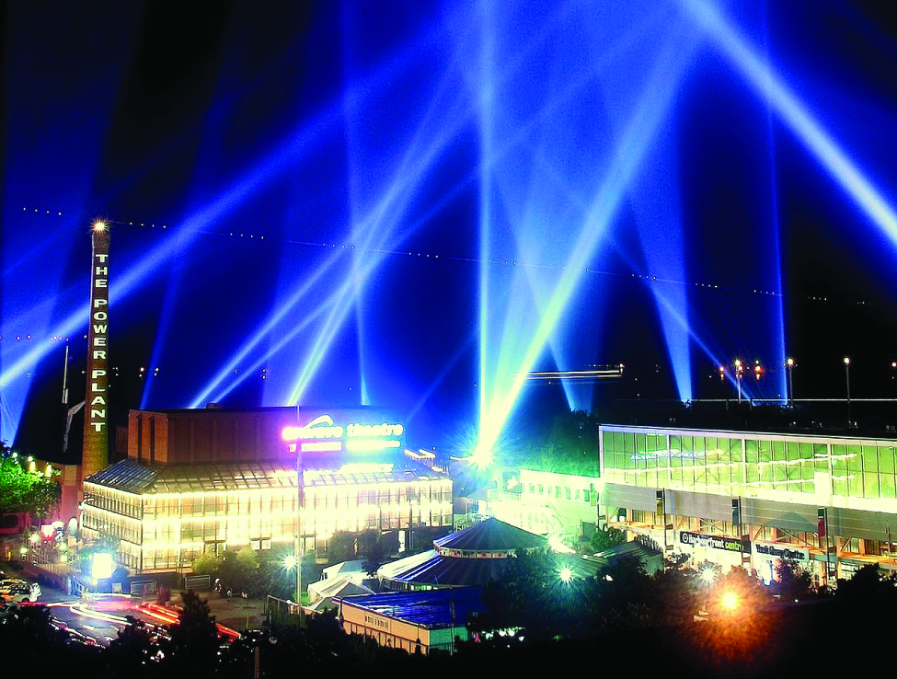
Figure 14.6b
Figure 14.6b: The paths of searchlight beams are made visible when light is scattered by colloidal-size particles in the air (fog, smoke, etc.). (credit: work by Bahman, CC BY 2.0)

Slide 45
Table 14.6a
Table 14.6a Examples of Colloidal Systems
Dispersed Phase | Dispersion Medium | Common Examples | Name
solid | gas | smoke, dust | —
solid | liquid | starch in water, some inks, paints, milk of magnesia | sol
solid | solid | some coloured gems, some alloys | —
liquid | gas | clouds, fogs, mists, sprays | aerosol
liquid | liquid | milk, mayonnaise, butter | emulsion
liquid | solid | jellies, gels, pearl, opal (H₂O in SiO₂) | gel
gas | liquid | foams, whipped cream, beaten egg whites | foam
gas | solid | pumice, floating soaps | —
(credit: Chemistry (OpenStax), CC BY 4.0.)
Notes:
https://ecampusontario.pressbooks.pub/enhancedchemistry/chapter/electrode-cell-potentials/

Slide 46
Figure 14.6c
Figure 14.6c: Soaps contain a nonpolar hydrocarbon end (blue) and an ionic end (red). An ionic end is a carboxylate group. The length of the hydrocarbon end can vary from soap to soap. (credit: Chemistry (OpenStax), CC BY 4.0.)

Slide 47
Figure 14.6d
Figure 14.6d: Detergents contain a nonpolar hydrocarbon end (blue) and an ionic end (red). The ionic end can be either a sulfate or a sulfonate. The length of the hydrocarbon end can vary from detergent to detergent. (credit: Chemistry (OpenStax), CC BY 4.0.)

Slide 48
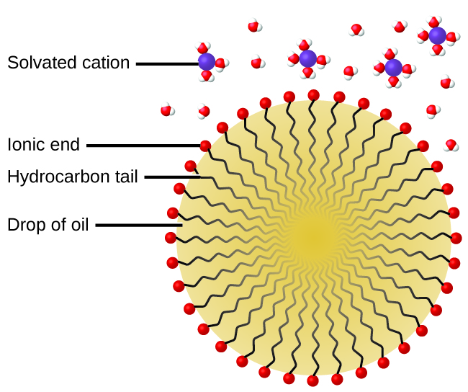
Figure 14.6e
Figure 14.6e: This diagrammatic cross-section of an emulsified drop of oil in water shows how soap or detergent acts as an emulsifier. (credit: Chemistry (OpenStax), CC BY 4.0.)

Slide 49
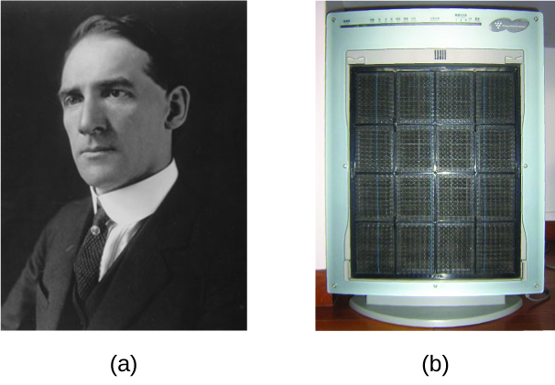
Figure 14.6f
Figure 14.6f: (a) Frederick Cottrell developed (b) the electrostatic precipitator, a device designed to curb air pollution by removing colloidal particles from air. (credit a: work by unknown, PD; credit b: modification of work by SpLot, CC BY-SA 3.0)

Slide 50
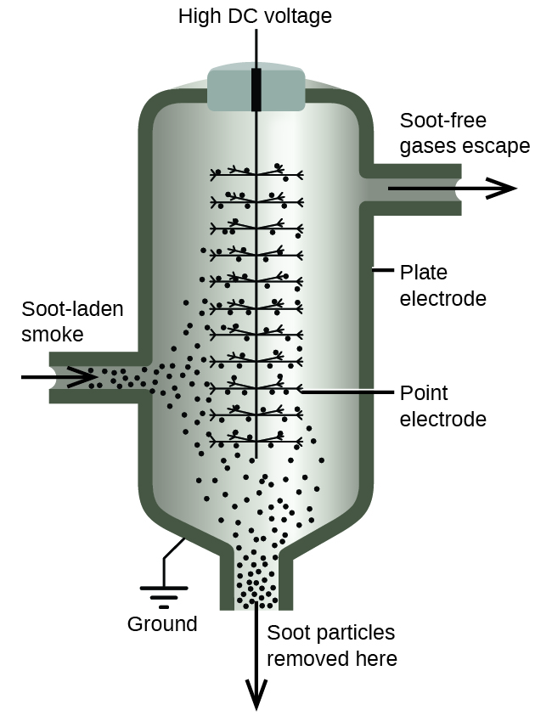
Figure 14.6g
Figure 14.6g: In a Cottrell precipitator, positively and negatively charged particles are attracted to highly charged electrodes, where they are neutralized and deposited as dust. (credit: Chemistry (OpenStax), CC BY 4.0.)

Slide 51
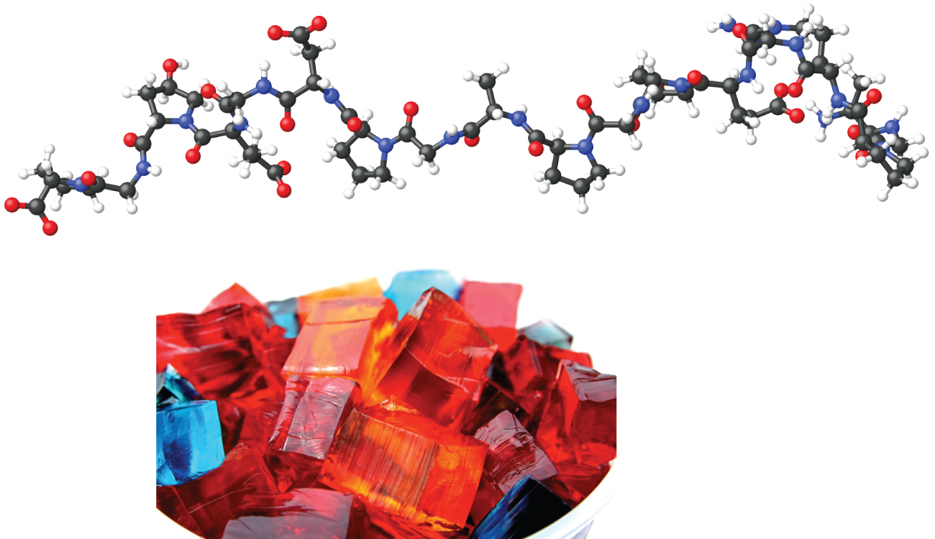
Figure 14.6h
Figure 14.6h: Gelatin desserts are colloids in which an aqueous solution of sweeteners and flavours is dispersed throughout a medium of solid proteins. (credit photo: modification of work by Steven Depolo, CC BY 2.0; in Chemistry (OpenStax), CC BY 4.0).

