Slide 1
Chapter 13 Welcome to Chemistry
Slides to accompany Enhanced Introductory College Chemistry by Gregory Anderson, Caryn Fahey, J.R. van Haarlem, Jackie MacDonald, Adrienne Richards, Samantha Sullivan Sauer, and David Wegman
Slide design and template by Revathi Mahadevan
Except where otherwise noted, images, tables & diagrams are reused from Enhanced Introductory College Chemistry, a derivative of Chemistry (Open Stax) by Paul Flowers, Klaus Theopold, Richard Langley & William R. Robinson and is licensed under CC BY 4.0. ​Access for free at Chemistry (OpenStax)​
Slides are licensed under CC-BY 4.0, Except while otherwise noted

Slide 2
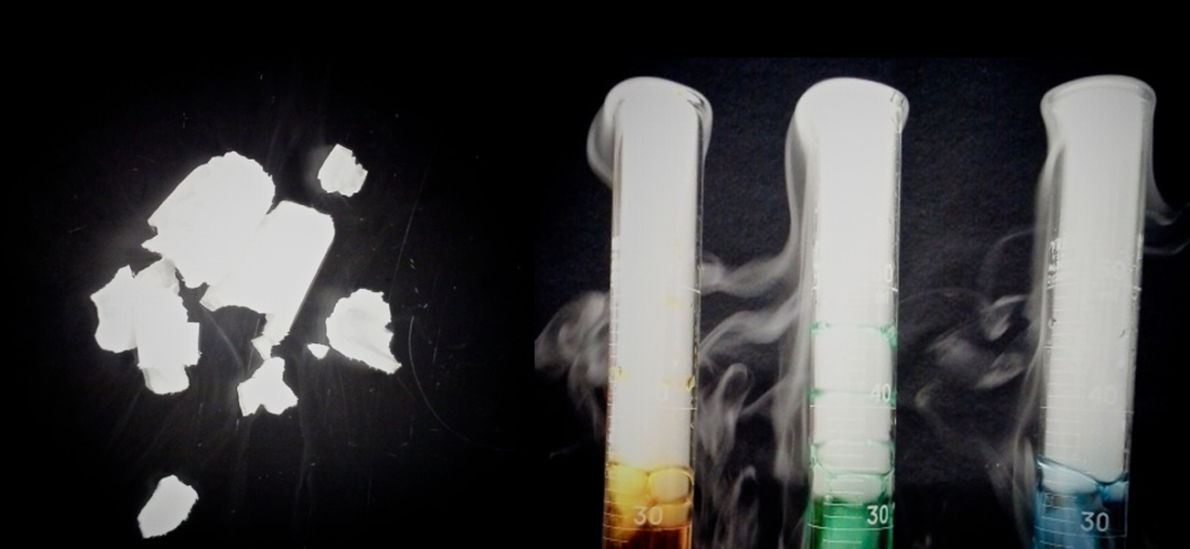
Figure 13a
Figure 13a Solid carbon dioxide (“dry ice”, left) sublimes vigorously when placed in a liquid (right), cooling the liquid and generating a fog of condensed water vapour above the cylinder. (credit: modification of work by Paul Flowers in Chemistry (OpenStax), CC BY 4.0.)

Slide 3
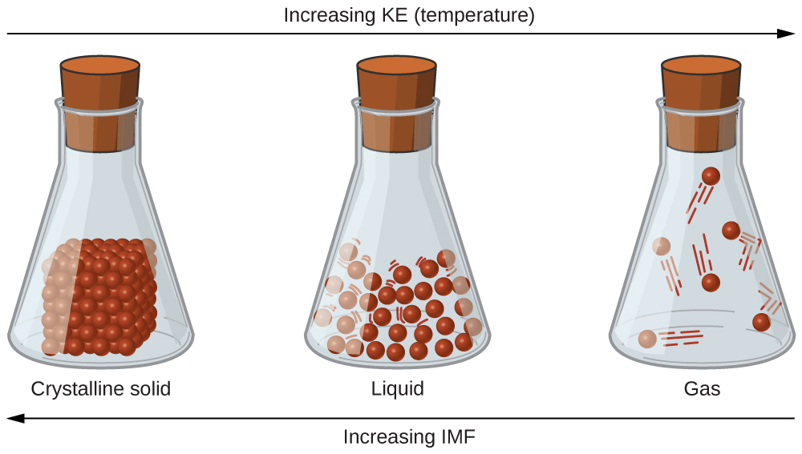
Figure 13.1a
Figure 13.1a : Transitions between solid, liquid, and gaseous states of a substance occur when conditions of temperature or pressure favour the associated changes in intermolecular forces. (Note: The space between particles in the gas phase is much greater than shown.) (credit: Chemistry (OpenStax), CC BY 4.0.)

Slide 4
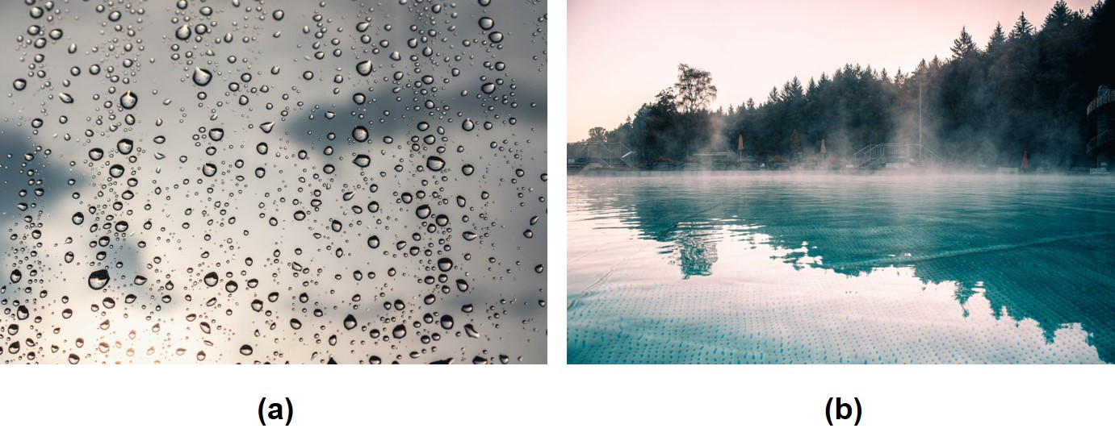
Figure 13.1b
Figure 13.1b Condensation forms when water vapour in the air is cooled enough to form liquid water, such as (a) on the outside of a window or (b) in the form of fog. (credit a: work by Christian Wiediger, Unsplash license; credit b: work by Mary Noe, Unsplash license)

Slide 5
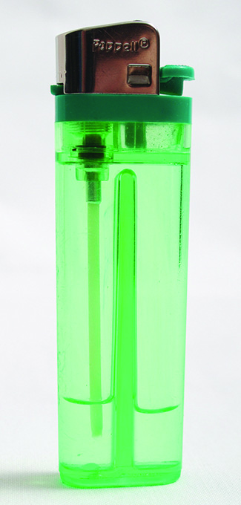
Figure 13.1c
Figure 13.1c Gaseous butane is compressed within the storage compartment of a disposable lighter, resulting in its condensation to the liquid state. (credit: modification of work by Sam-Cat, CC BY 2.0)

Slide 6
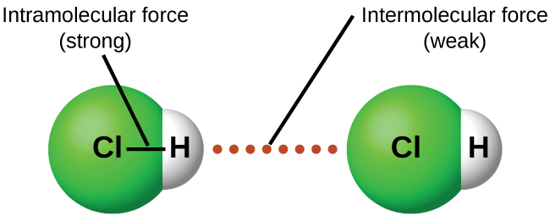
Figure 13.1d
Figure 13.1d Intramolecular forces keep a molecule intact. Intermolecular forces hold multiple molecules together and determine many of a substance’s properties. (credit: Chemistry (OpenStax), CC BY 4.0.)

Slide 7
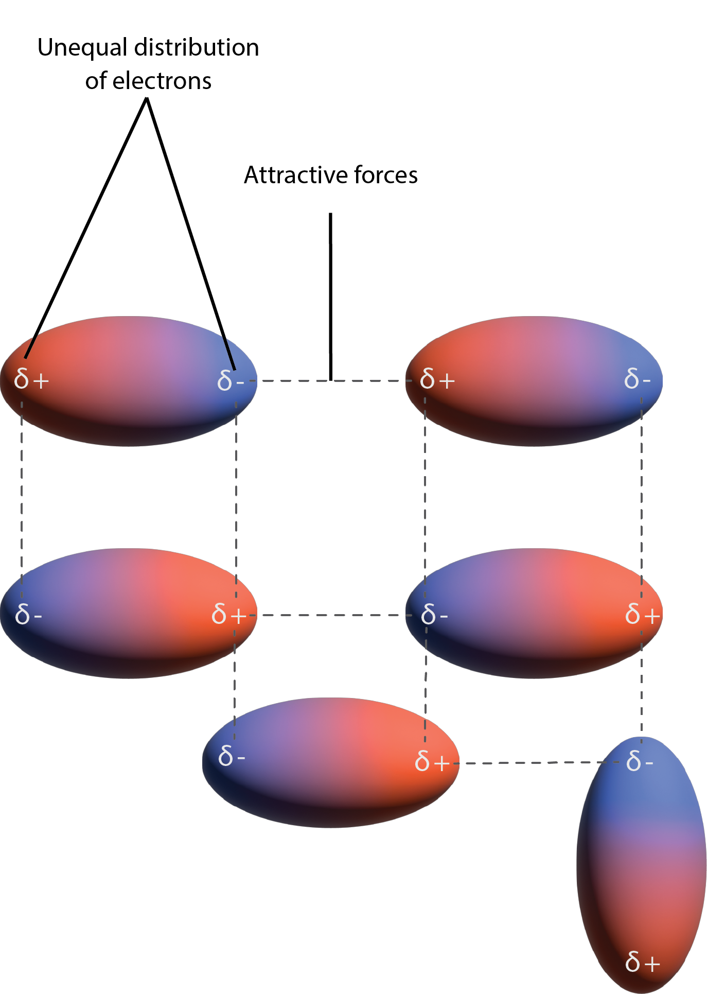
Figure 13.1e
Figure 13.1e Dispersion forces result from the formation of temporary dipoles, as illustrated here for several nonpolar diatomic molecules (credit: graphic by Revathi Mahadevan, CC BY 4.0)

Slide 8
Table 13.1a
Table 13.1a Melting and Boiling Points of the Halogens
Halogen | Molar Mass | Atomic Radius | Melting Point | Boiling Point
fluorine, F₂ | 38 g/mol | 72 pm | 53 K | 85 K
chlorine, Cl₂ | 71 g/mol | 99 pm | 172 K | 238 K
bromine, Br₂ | 160 g/mol | 114 pm | 266 K | 332 K
iodine, I₂ | 254 g/mol | 133 pm | 387 K | 457 K
astatine, At₂ | 420 g/mol | 150 pm | 575 K | 610 K
(credit: Chemistry (OpenStax), CC BY 4.0.)

Slide 9
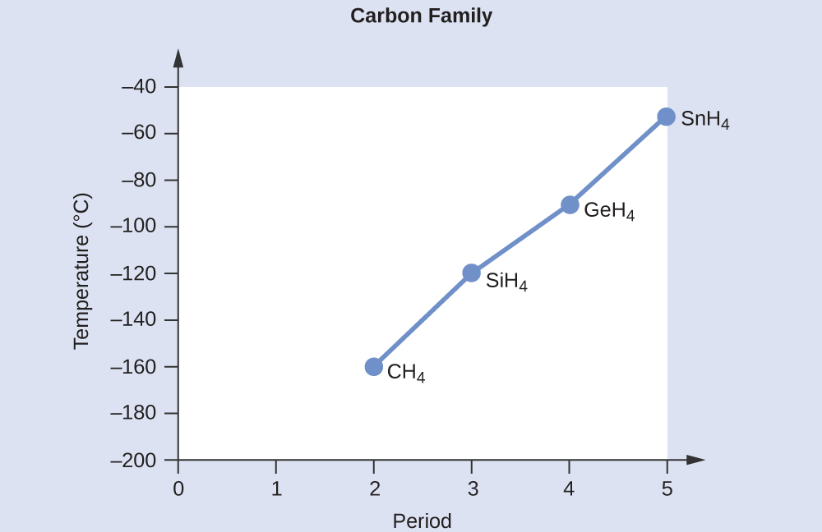
Figure 13.1f
Figure 13.1f Boiling points of hydrogen compounds containing Group 14 elements. (credit: Chemistry (OpenStax), CC BY 4.0.)

Slide 10
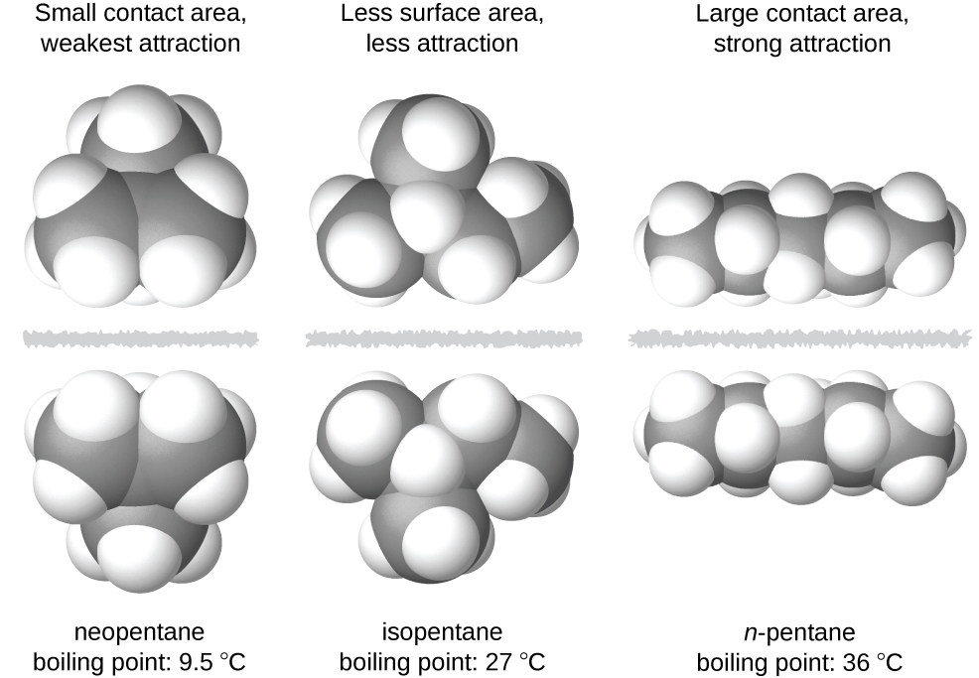
Figure 13.1g
Figure 13.1g The strength of the dispersion forces increases with the contact area between molecules, as demonstrated by the boiling points of these pentane isomers. (credit: Chemistry (OpenStax), CC BY 4.0.)

Slide 11
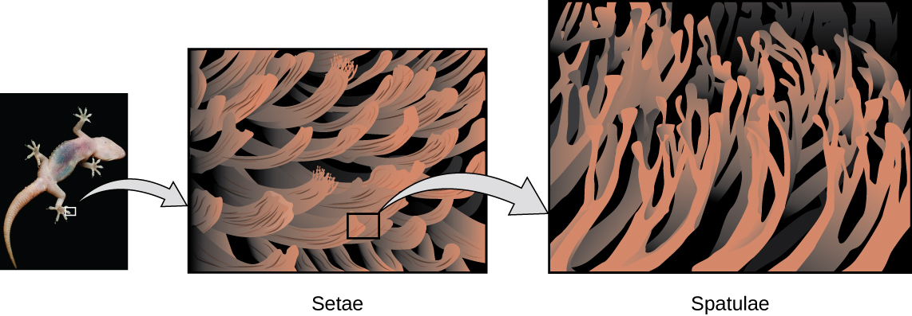
Figure 13.1h
Figure 13.1h Geckos’ toes contain large numbers of tiny hairs (setae), which branch into many triangular tips (spatulae). Geckos adhere to surfaces because of van der Waals attractions between the surface and a gecko’s millions of spatulae. By changing how the spatulae contact the surface, geckos can turn their stickiness “on” and “off.” (credit photo: modification of work by JC+A, CC BY 2.0; in Chemistry (OpenStax), CC BY 4.0).

Slide 12
Figure 13.1i
Figure 13.1i This image shows two arrangements of polar molecules, such as HCl, that allow an attraction between the partial negative end of one molecule and the partial positive end of another. (credit: Chemistry (OpenStax), CC BY 4.0.)

Slide 13
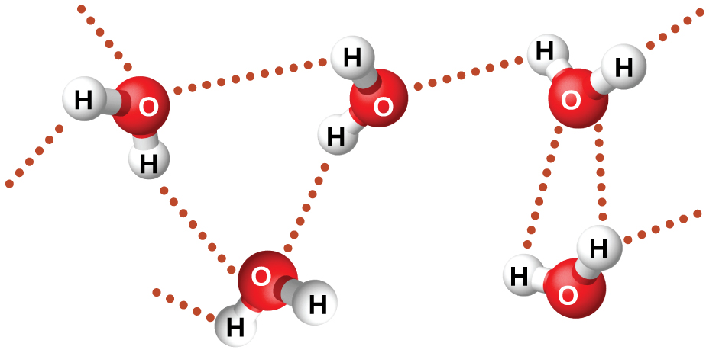
Figure 13.1j
Figure 13.1j Water molecules participate in multiple hydrogen-bonding interactions with nearby water molecules. (credit: Chemistry (OpenStax), CC BY 4.0.)

Slide 14
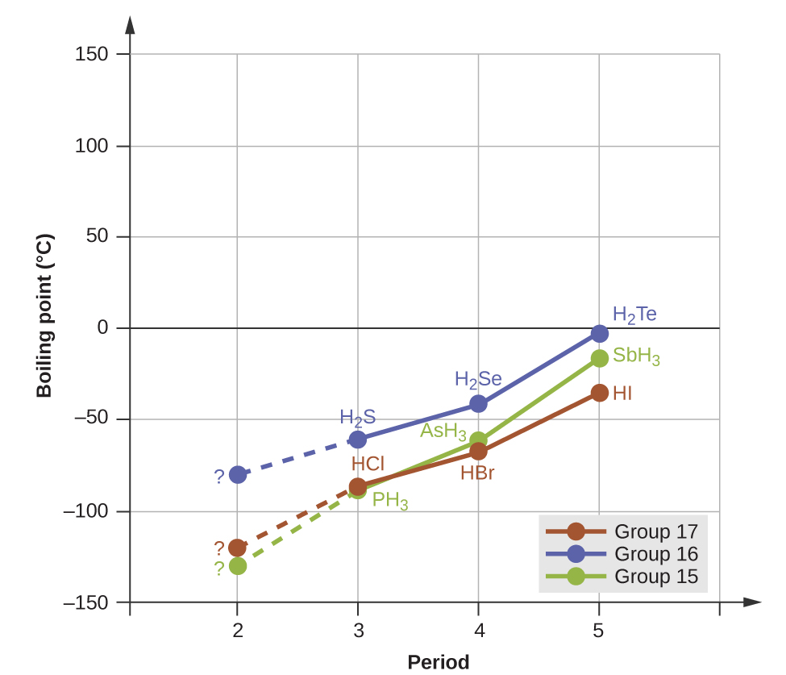
Figure 13.1k
Figure 13.1k For the group 15, 16, and 17 hydrides, the boiling points for each class of compounds increase with increasing molecular mass for elements in periods 3, 4, and 5. (credit: Chemistry (OpenStax), CC BY 4.0.)

Slide 15
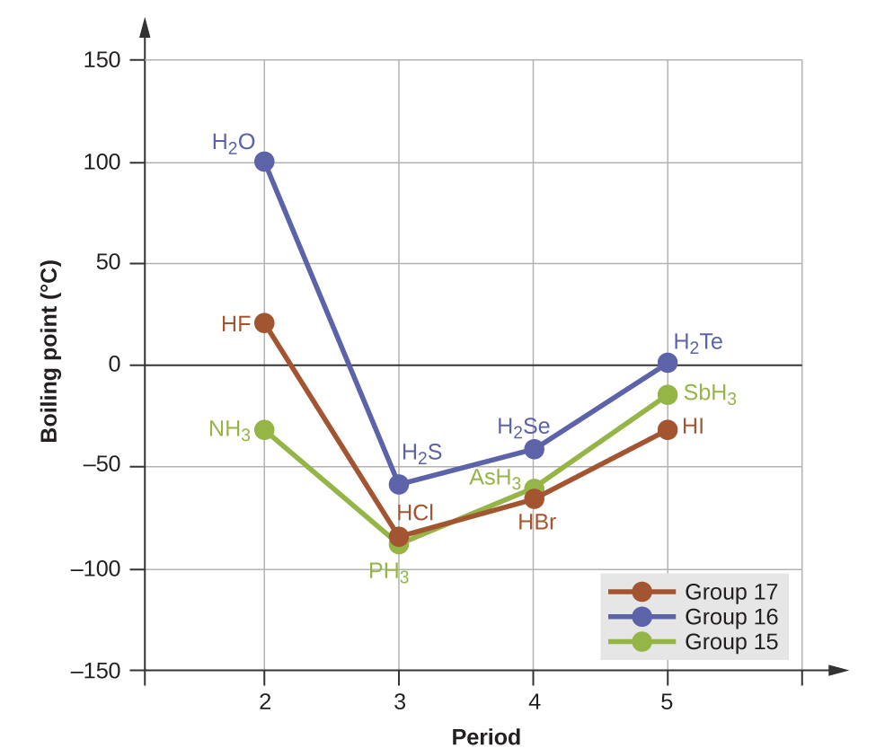
Figure 13.1l
Figure 13.1l In comparison to periods 3−5, the binary hydrides of period 2 elements in groups 17, 16 and 15 (F, O and N, respectively) exhibit anomalously high boiling points due to hydrogen bonding. (credit: Chemistry (OpenStax), CC BY 4.0.)

Slide 16
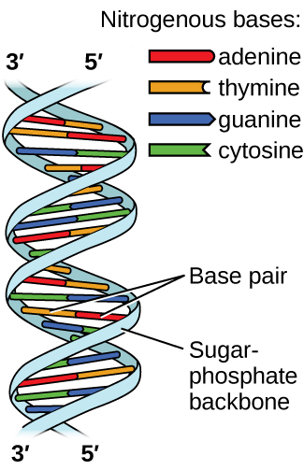
Figure 13.1m
Figure 13.1m Two separate DNA molecules form a double-stranded helix in which the molecules are held together via hydrogen bonding. (credit: modification of work by Jerome Walker, Dennis Myts, CC BY 4.0)

Slide 17
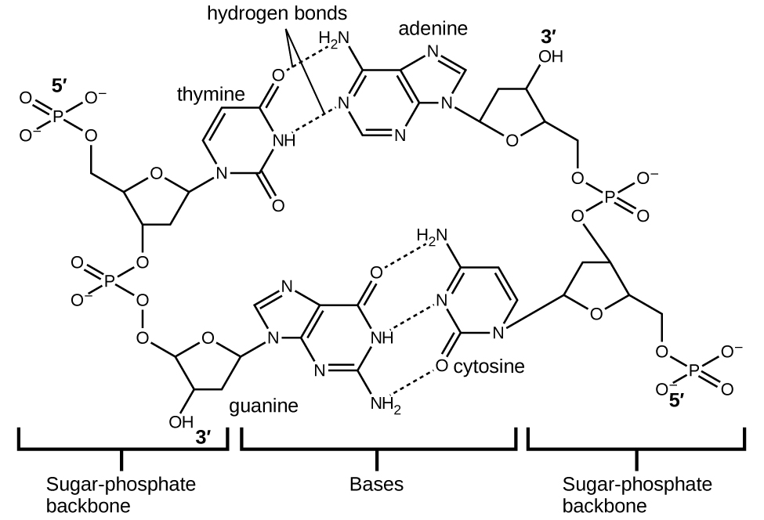
Figure 13.1n
Figure 13.1n The geometries of the base molecules result in maximum hydrogen bonding between adenine and thymine (AT) and between guanine and cytosine (GC), so-called “complementary base pairs.” (credit: Chemistry (OpenStax), CC BY 4.0.)

Slide 18
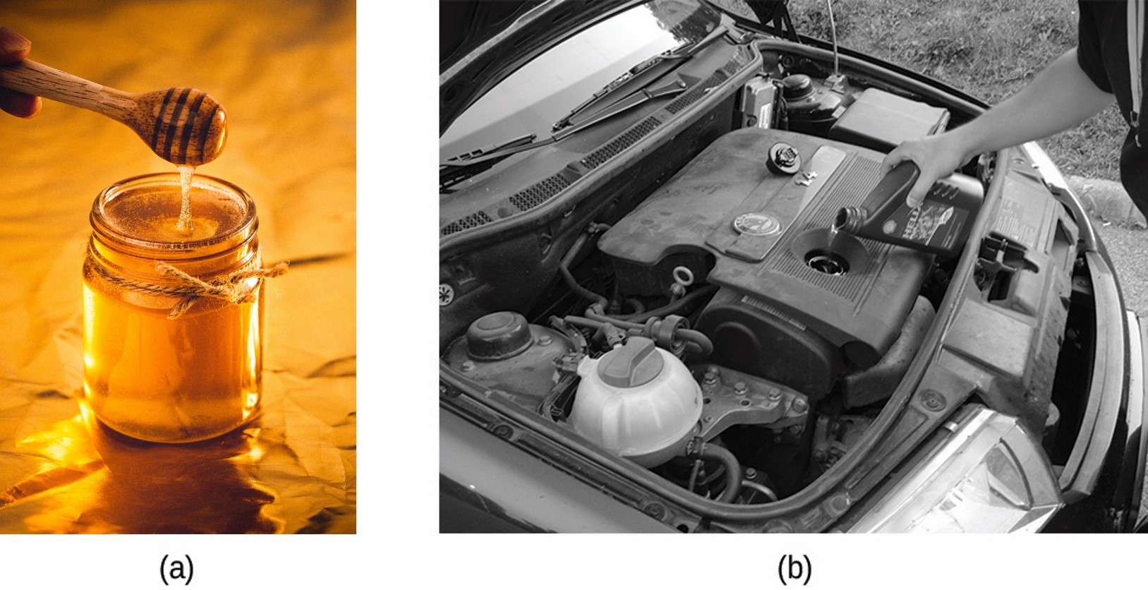
Figure 13.2a
Figure 13.2a (a) Honey and (b) motor oil are examples of liquids with high viscosities; they flow slowly. (credit a: work by Art Rachen, Unsplash license; credit b: modification of work by David Nagy, CC BY 2.0)

Slide 19
Table 13.2a
Table 13.2a Viscosities of Common Substances at 25 °C
Substance | Formula | Viscosity (mPa·s)
water | H₂O | 0.890
mercury | Hg | 1.526
ethanol | C₂H₅OH | 1.074
octane | C₈H₁₈ | 0.508
ethylene glycol | CH₂(OH)CH₂(OH) | 16.1
honey | variable | ~2,000–10,000
motor oil | variable | ~50–500
(credit: Chemistry (OpenStax), CC BY 4.0.)

Slide 20
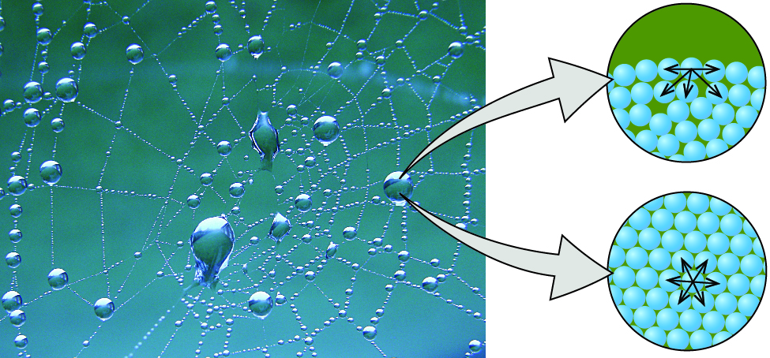
Figure 13.2b
Figure 13.2b Attractive forces result in a spherical water drop that minimizes surface area; cohesive forces hold the sphere together; adhesive forces keep the drop attached to the web. (credit photo: modification of work by OliBac, CC BY 2.0; in Chemistry (OpenStax), CC BY 4.0).

Slide 21
Table 13.2b
Table 13.2b Surface Tensions of Common Substances at 25 °C
Substance | Formula | Surface Tension(mN/m)
water | H₂O | 71.99
mercury | Hg | 458.48
ethanol | C₂H₅OH | 21.97
octane | C₈H₁₈ | 21.14
ethylene glycol | CH₂(OH)CH₂(OH) | 47.99
(credit: Chemistry (OpenStax), CC BY 4.0.)

Slide 22
Figure 13.2c
Figure 13.2c Surface tension (right) prevents this insect, a “water strider,” from sinking into the water. (credit: modification of work by TimVickers, PD; in Chemistry (OpenStax), CC BY 4.0).

Slide 23
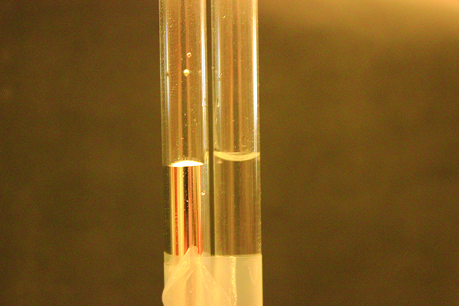
Figure 13.2d
Figure 13.2d Differences in the relative strengths of cohesive and adhesive forces result in different meniscus shapes for mercury (left) and water (right) in glass tubes. (credit: Mark Ott in Chemistry (OpenStax), CC BY 4.0.)

Slide 24
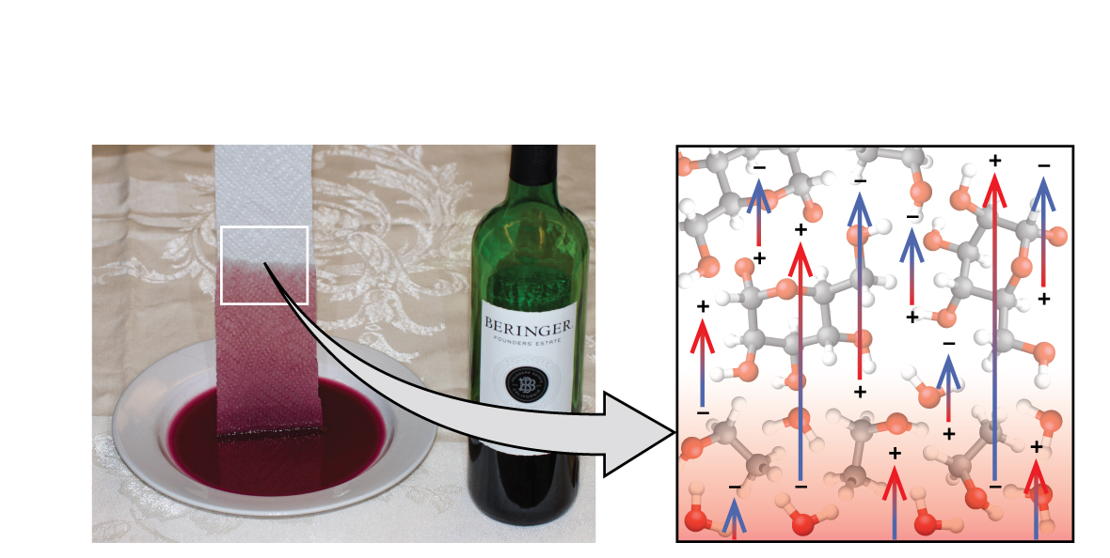
Figure 13.2e
Figure 13.2e Wine wicks up a paper towel (left) because of the strong attractions of water (and ethanol) molecules to the −OH groups on the towel’s cellulose fibres and the strong attractions of water molecules to other water (and ethanol) molecules (right). (credit photo: modification of work by Mark Blaser in Chemistry (OpenStax), CC BY 4.0.)

Slide 25
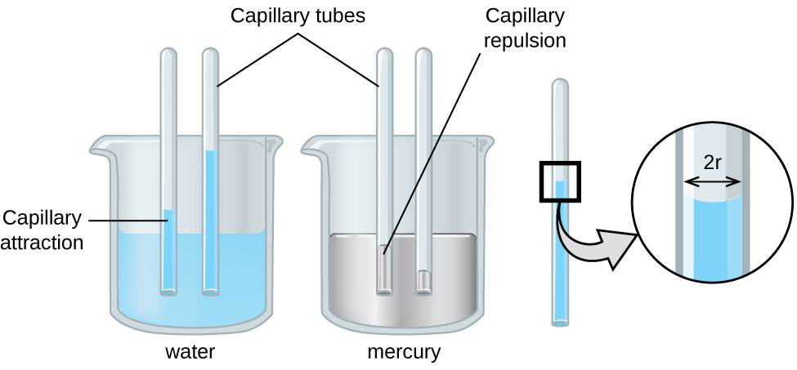
Figure 13.2f
Figure 13.2f Depending upon the relative strengths of adhesive and cohesive forces, a liquid may rise (such as water) or fall (such as mercury) in a glass capillary tube. The extent of the rise (or fall) is directly proportional to the surface tension of the liquid and inversely proportional to the density of the liquid and the radius of the tube. (credit: Chemistry (OpenStax), CC BY 4.0.)

Slide 26
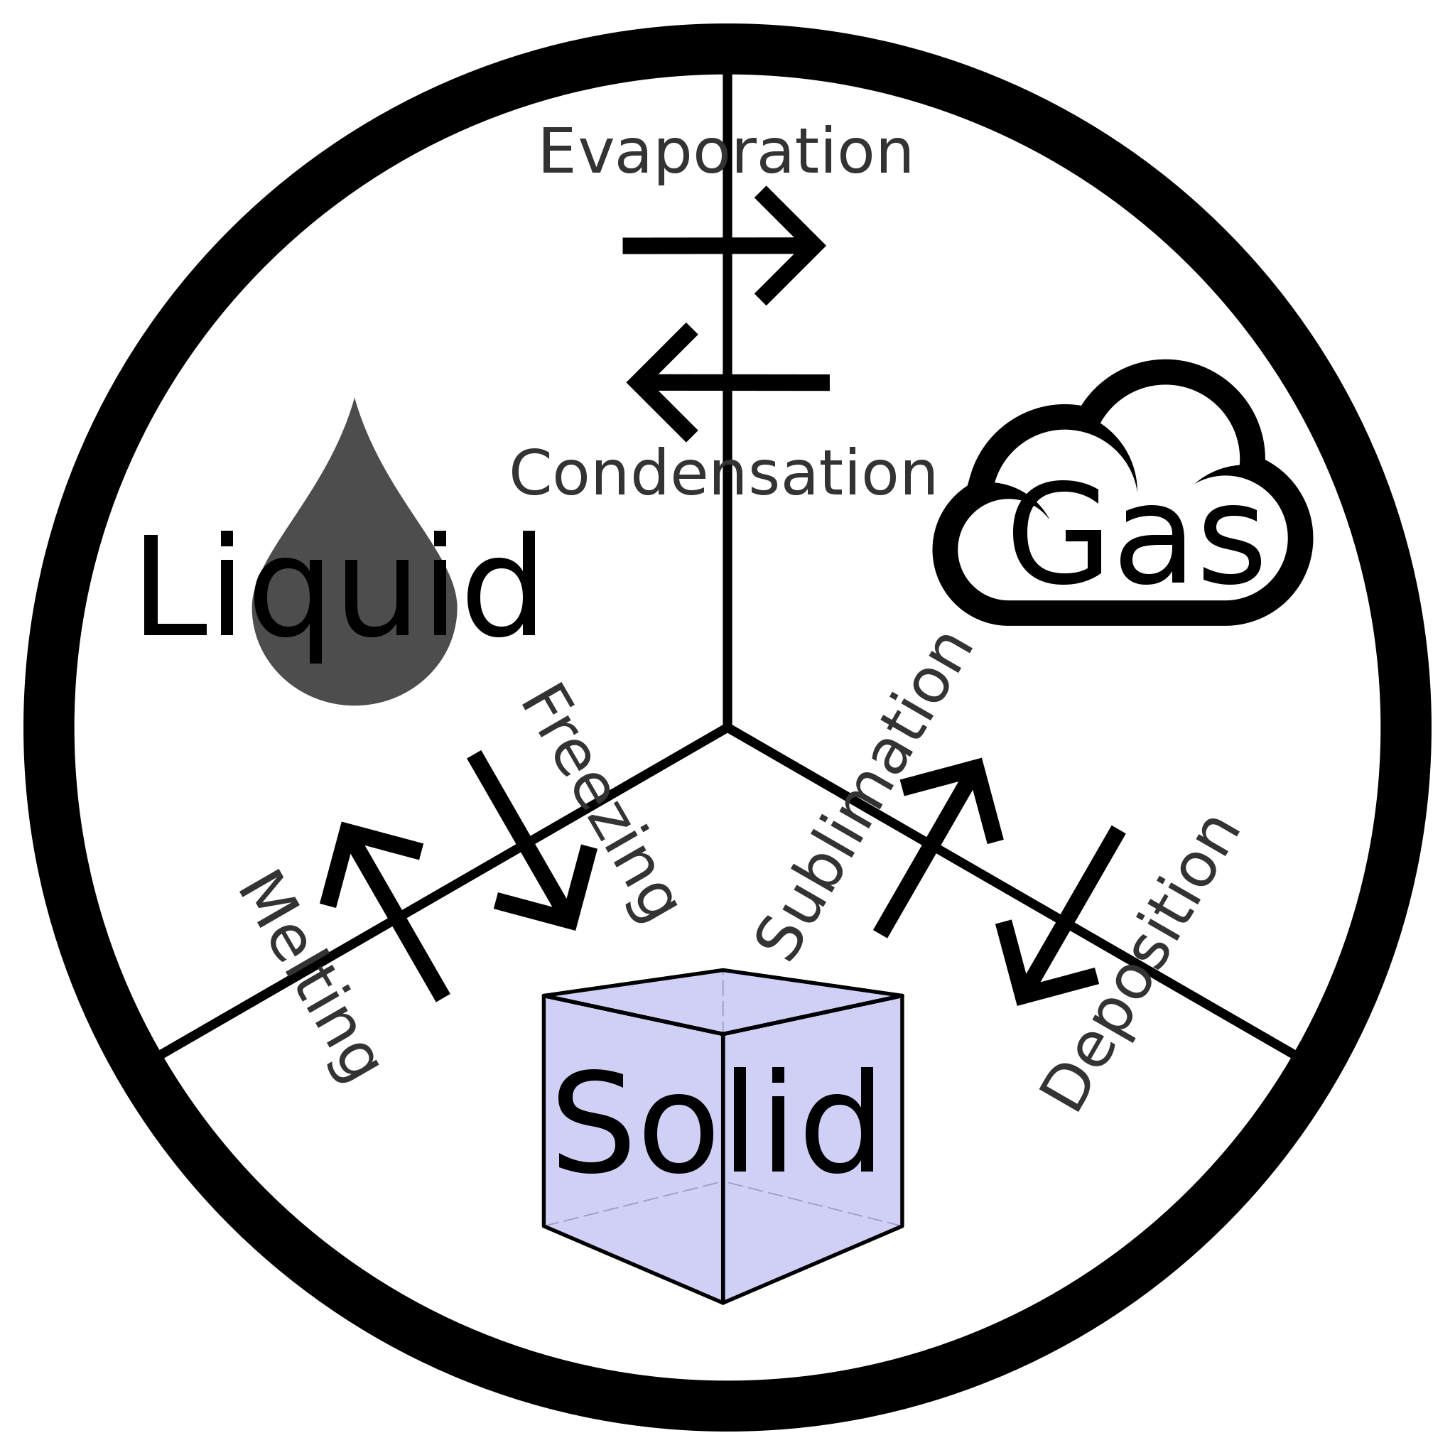
Figure 13.3a
Figure 13.3a Phase Change Diagram: Condensation changes a gas to a liquid. Evaporation changes a liquid to a gas. Freezing changes a liquid to a solid. Melting changes a solid to a liquid. Sublimation changes a solid to a gas; whereas, deposition changes a gas to a solid. (credit: work by SiliconProphet, CC BY-SA 4.0).

Slide 27
Figure 13.3b
Figure 13.3b In a closed container, dynamic equilibrium is reached when (a) the rate of molecules escaping from the liquid to become the gas (b) increases and eventually (c) equals the rate of gas molecules entering the liquid. When this equilibrium is reached, the vapour pressure of the gas is constant, although the vaporization and condensation processes continue. (credit: Chemistry (OpenStax), CC BY 4.0.)

Slide 28
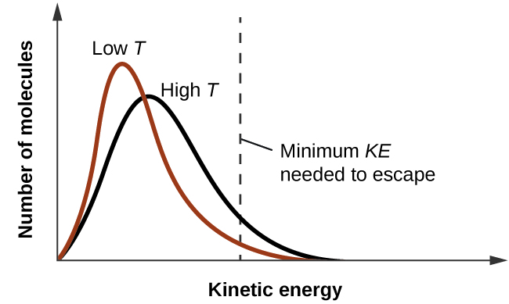
Figure 13.3c
Figure 13.3c Temperature affects the distribution of kinetic energies for the molecules in a liquid. At the higher temperature, more molecules have the necessary kinetic energy, KE, to escape from the liquid into the gas phase. (credit: Chemistry (OpenStax), CC BY 4.0.)

Slide 29
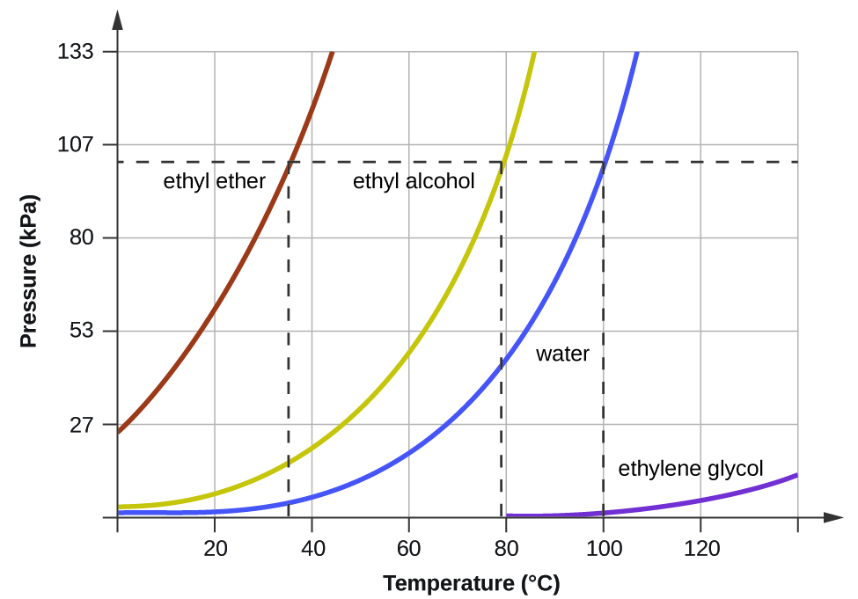
Figure 13.3d
Figure 13.3d The boiling points of liquids are the temperatures at which their equilibrium vapour pressures equal the pressure of the surrounding atmosphere. Normal boiling points are those corresponding to a pressure of 1 atm (101.3 kPa.) (credit: Chemistry (OpenStax), CC BY 4.0.)

Slide 30
Figure 13.3e
Figure 13.3e Evaporation of sweat helps cool the body. (credit: work by Kullez, CC BY 2.0)

Slide 31
Figure 13.3f
Figure 13.3f (a) This beaker of ice has a temperature of −12.0 °C. (b) After 10 minutes the ice has absorbed enough heat from the air to warm to 0 °C. A small amount has melted. (c) Thirty minutes later, the ice has absorbed more heat, but its temperature is still 0 °C. The ice melts without changing its temperature. (d) Only after all the ice has melted does the heat absorbed cause the temperature to increase to 22.2 °C. (credit: modification of work by Mark Ott in Chemistry (OpenStax), CC BY 4.0.)

Slide 32
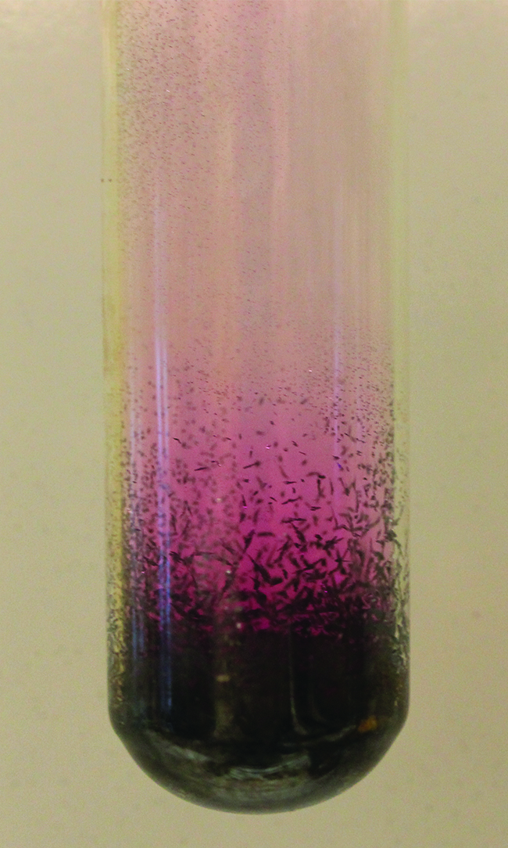
Figure 13.3g
Figure 13.3g Sublimation of solid iodine in the bottom of the tube produces a purple gas that subsequently deposits as solid iodine on the colder part of the tube above. (credit: modification of work by Mark Ott in Chemistry (OpenStax), CC BY 4.0.)

Slide 33
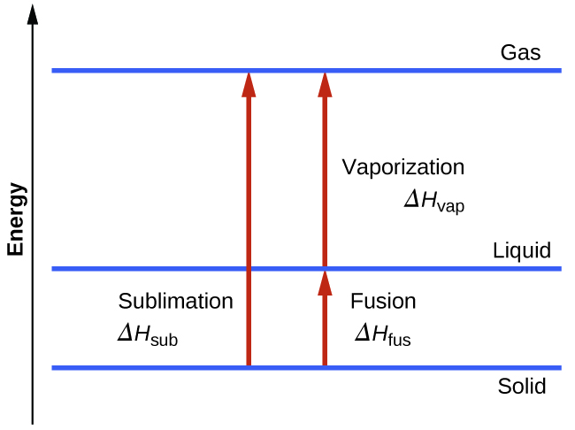
Figure 13.3h
Figure 13.3h For a given substance, the sum of its enthalpy of fusion and enthalpy of vaporization is approximately equal to its enthalpy of sublimation. (credit: Chemistry (OpenStax), CC BY 4.0.)

Slide 34
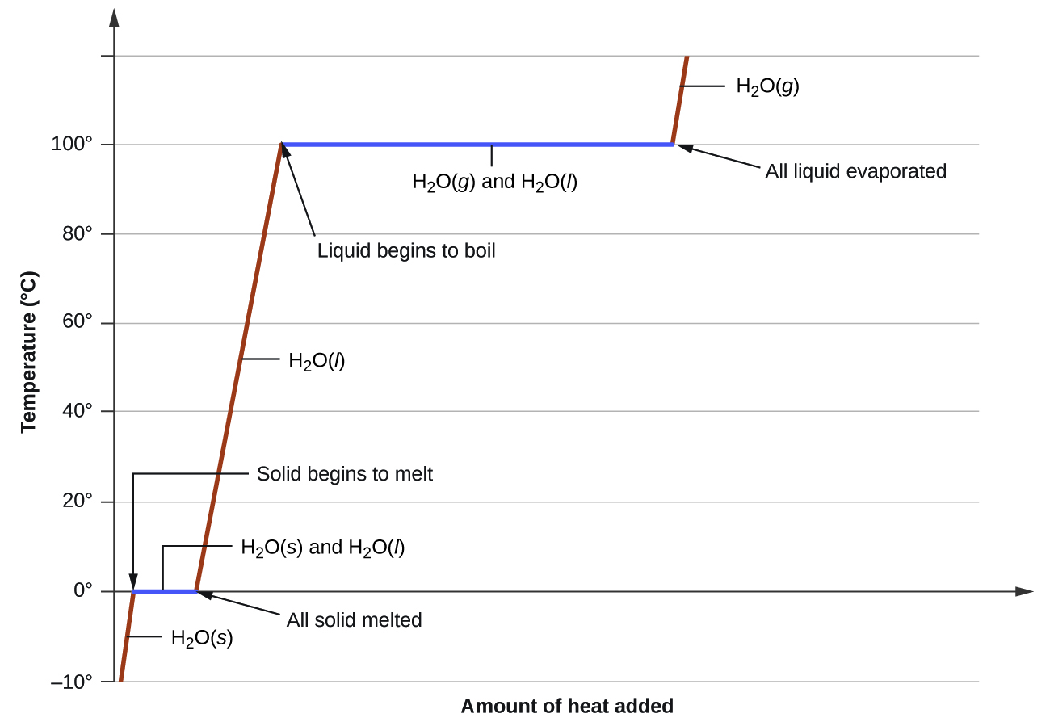
Figure 13.3i
Figure 13.3i A typical heating curve for a substance depicts changes in temperature that result as the substance absorbs increasing amounts of heat. Plateaus in the curve (regions of constant temperature) are exhibited when the substance undergoes phase transitions. (credit: Chemistry (OpenStax), CC BY 4.0.)

Slide 35
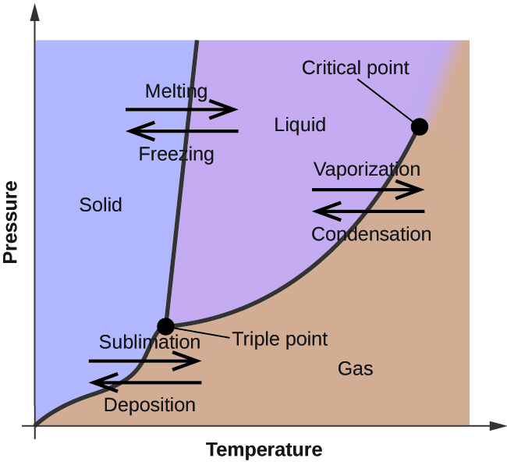
Figure 13.4a
Figure 13.4a The physical state of a substance and its phase-transition temperatures are represented graphically in a phase diagram. (credit: Chemistry (OpenStax), CC BY 4.0.)

Slide 36
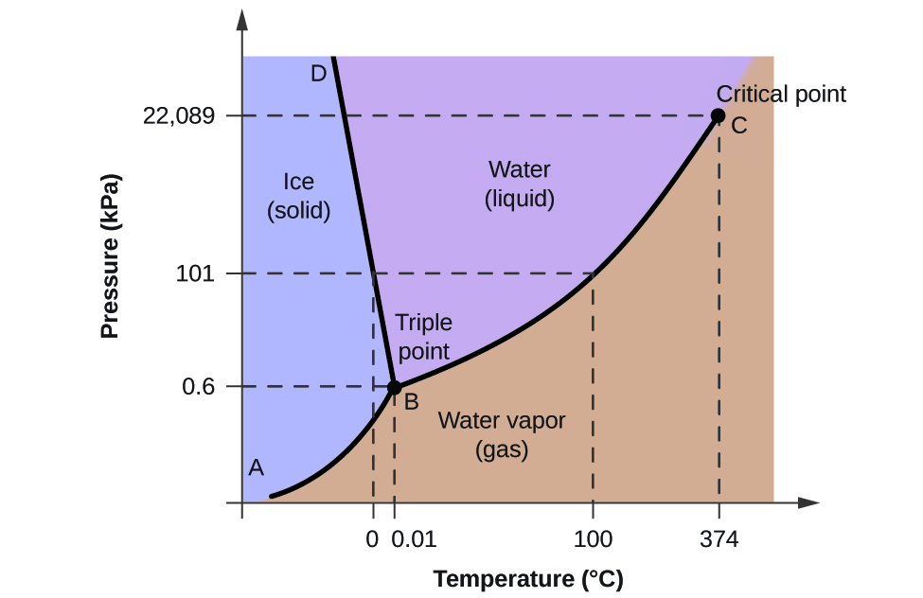
Figure 13.4b
Figure 13.4b The pressure and temperature axes on this phase diagram of water are not drawn to constant scale in order to illustrate several important properties. (credit: Chemistry (OpenStax), CC BY 4.0.)

Slide 37
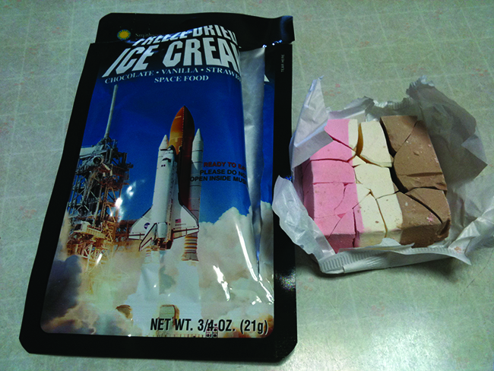
Figure 13.4c
Figure 13.4c Freeze-dried foods, like this ice cream, are dehydrated by sublimation at pressures below the triple point for water. (credit: work by lwao, CC BY 2.0)

Slide 38
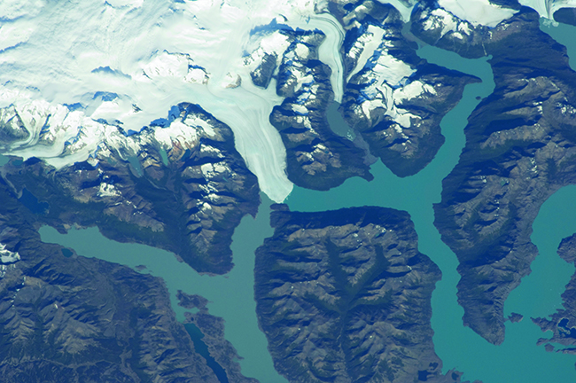
Figure 13.4d
Figure 13.4d The immense pressures beneath glaciers result in partial melting to produce a layer of water that provides lubrication to assist glacial movement. This satellite photograph shows the advancing edge of the Perito Moreno glacier in Argentina. (credit: work by NASA, Image use policy)

Slide 39
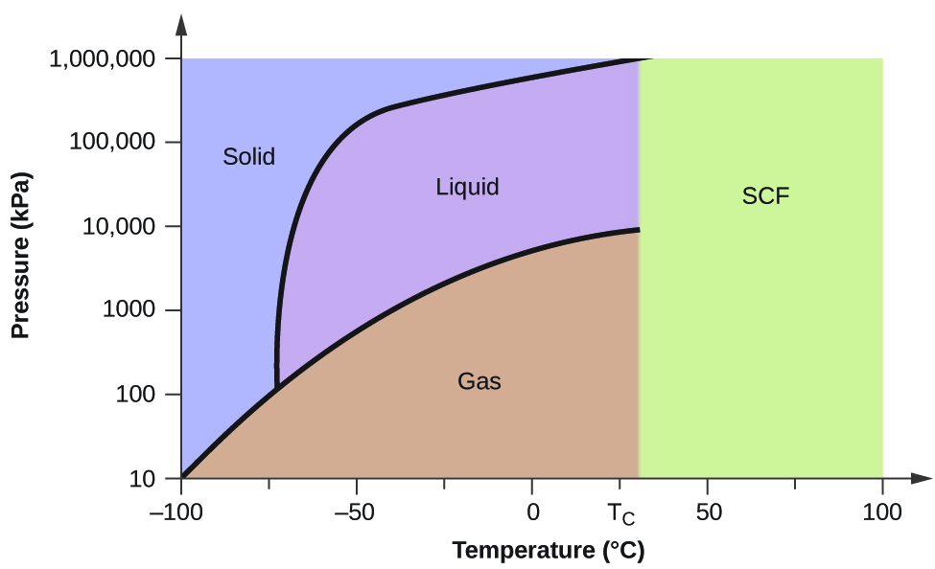
Figure 13.4e
Figure 13.4e The pressure and temperature axes on this phase diagram of carbon dioxide are not drawn to constant scale in order to illustrate several important properties. (credit: Chemistry (OpenStax), CC BY 4.0.)

Slide 40
Table 13.4a
Table 13.4a Critical temperatures and pressures of common substances.
Substance | Critical Temperature (K) | Critical Pressure (atm)
hydrogen | 33.2 | 12.8
nitrogen | 126.0 | 33.5
oxygen | 154.3 | 49.7
carbon dioxide | 304.2 | 73.0
ammonia | 405.5 | 111.5
sulfur dioxide | 430.3 | 77.7
water | 647.1 | 217.7
(credit: Chemistry (OpenStax), CC BY 4.0.)
Notes:
https://ecampusontario.pressbooks.pub/enhancedchemistry/chapter/electrode-cell-potentials/

Slide 41
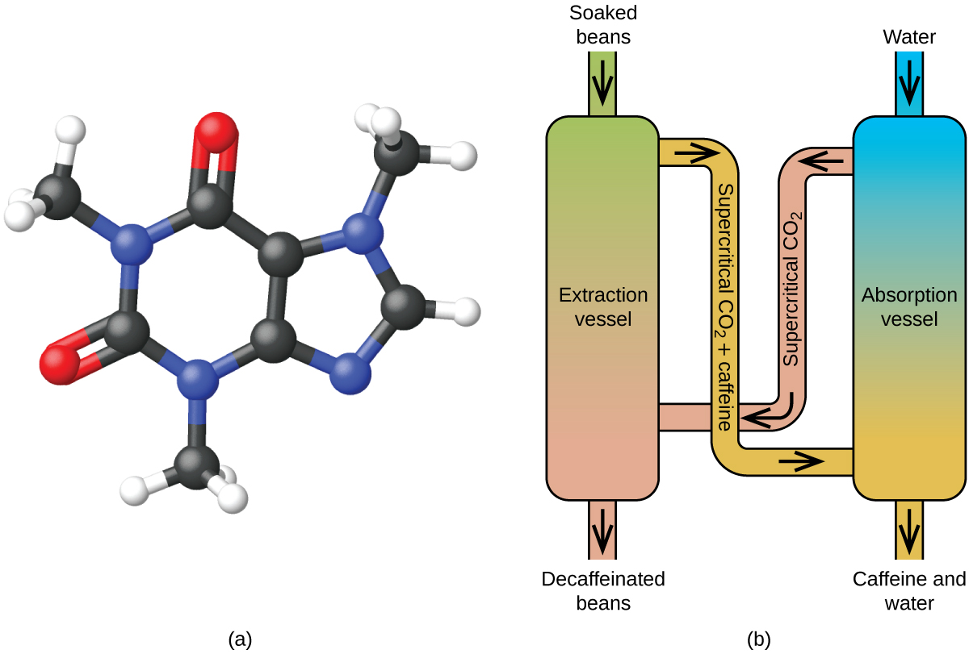
Figure 13.4f
Figure 13.4f (a) Caffeine molecules have both polar and nonpolar regions, making it soluble in solvents of varying polarities. (b) The schematic shows a typical decaffeination process involving supercritical car. (credit: Chemistry (OpenStax), CC BY 4.0.)

Slide 42
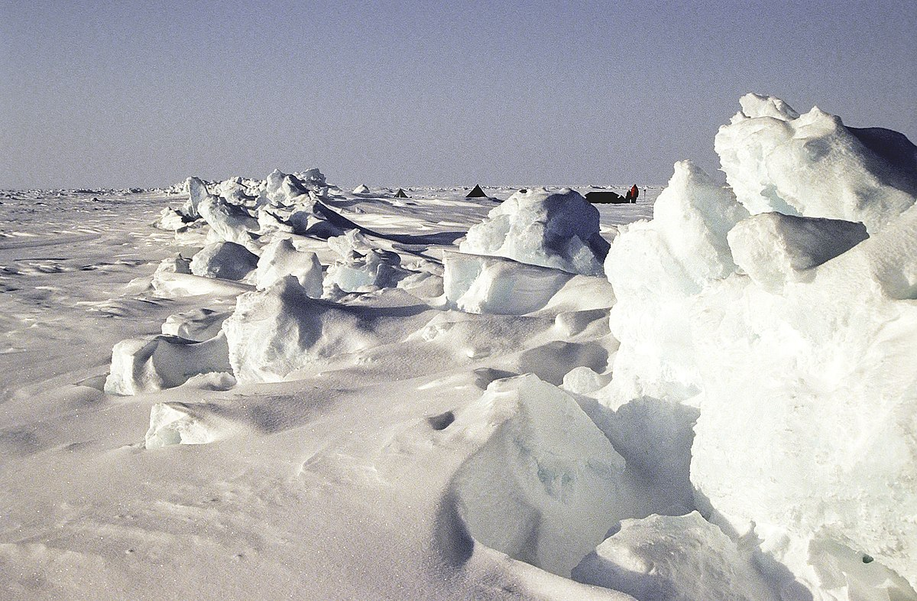
Figure 13.5a
Figure 13.5a Sea ice in the Arctic (credit: work by Matti&Keti, CC BY-SA 4.0)

Slide 43
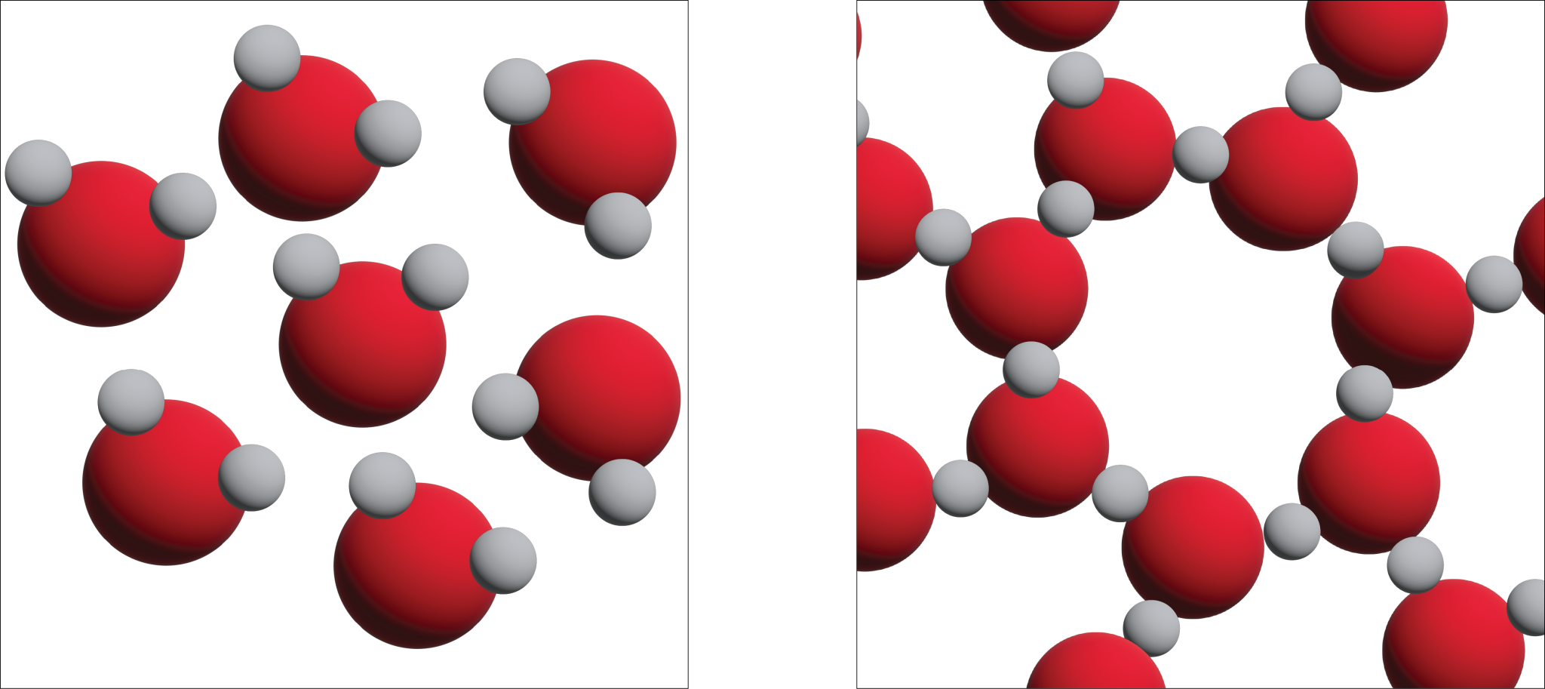
Figure 13.5b
Figure 13.5b Three-dimensional views of a typical local structure of liquid water (left) and ice (right). (credit: graphics by Revathi Mahadevan, CC BY 4.0)

Slide 44
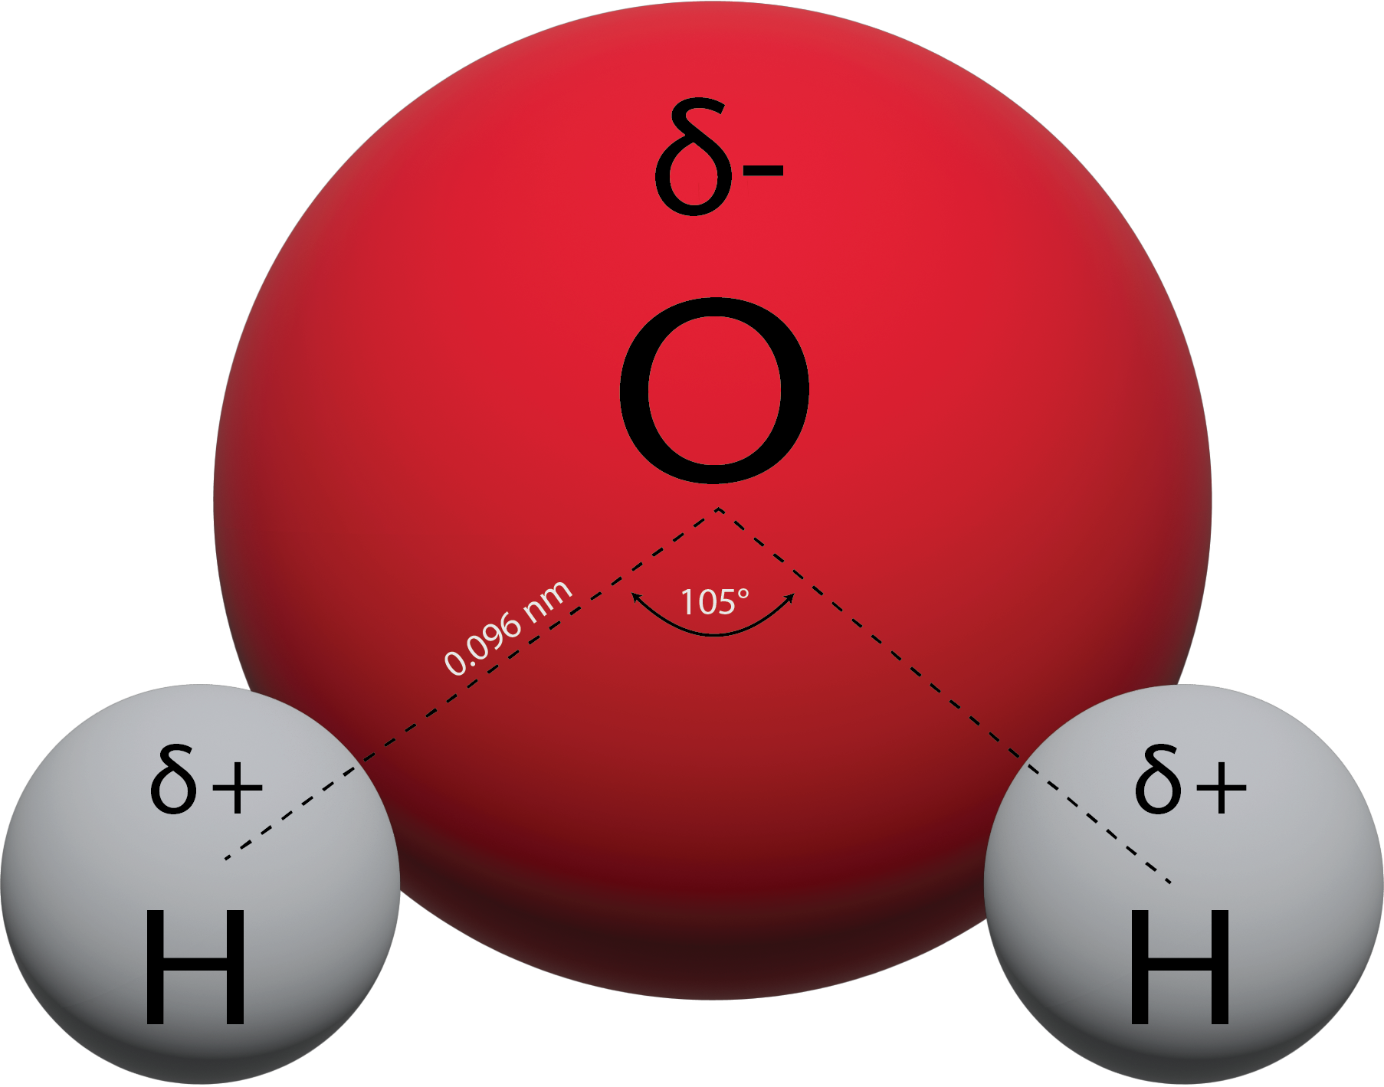
Figure 13.5c
Figure 13.5c The figure illustrates the water molecular structure, O-H bond length, and bond angle. (credit: graphics by Revathi Mahadevan, CC BY 4.0)

Slide 45
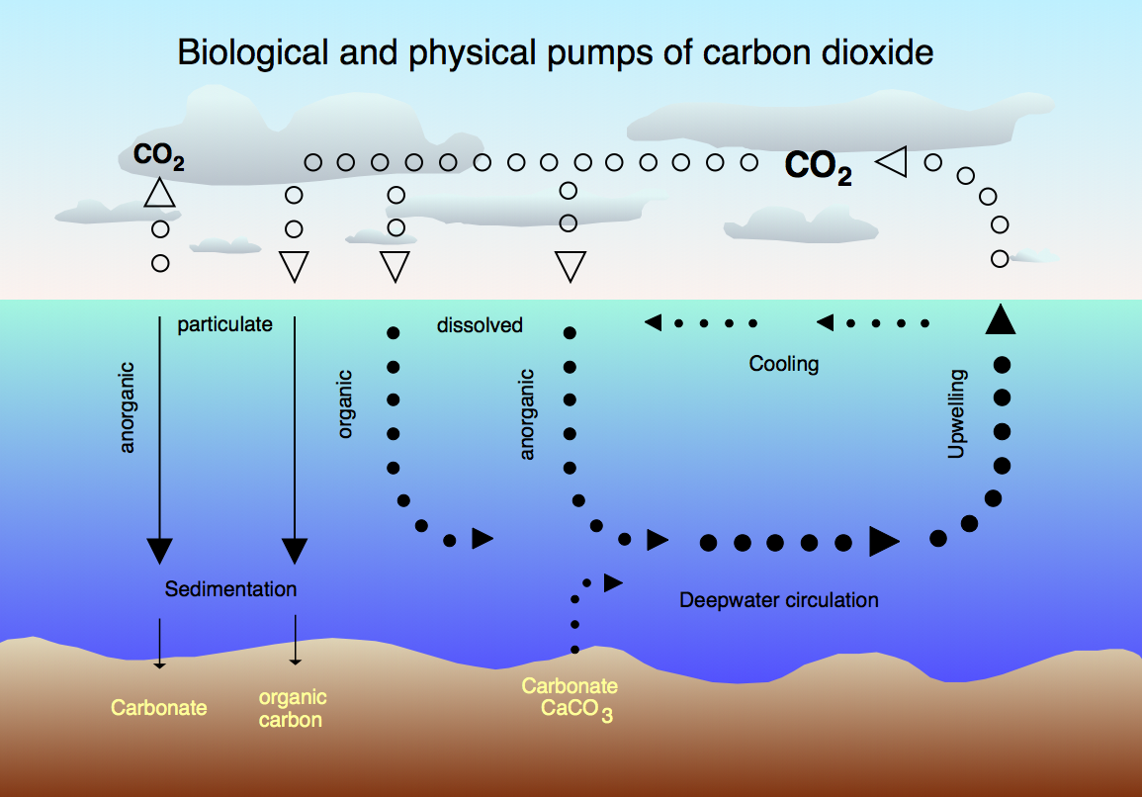
Figure 13.5d
Figure 13.5d Working of the biological and physical pumps of carbon dioxide. (credit: work by Hannes Grobe, CC BY-SA 2.5)

