Slide 1
Chapter 11 Chemical Bonding
Slides to accompany Enhanced Introductory College Chemistry by Gregory Anderson, Caryn Fahey, J.R. van Haarlem, Jackie MacDonald, Adrienne Richards, Samantha Sullivan Sauer, and David Wegman
Slide design and template by Revathi Mahadevan
Except where otherwise noted, images, tables & diagrams are reused from Enhanced Introductory College Chemistry, a derivative of Chemistry (Open Stax) by Paul Flowers, Klaus Theopold, Richard Langley & William R. Robinson and is licensed under CC BY 4.0. ​Access for free at Chemistry (OpenStax)​
Slides are licensed under CC-BY 4.0, Except while otherwise noted

Slide 2
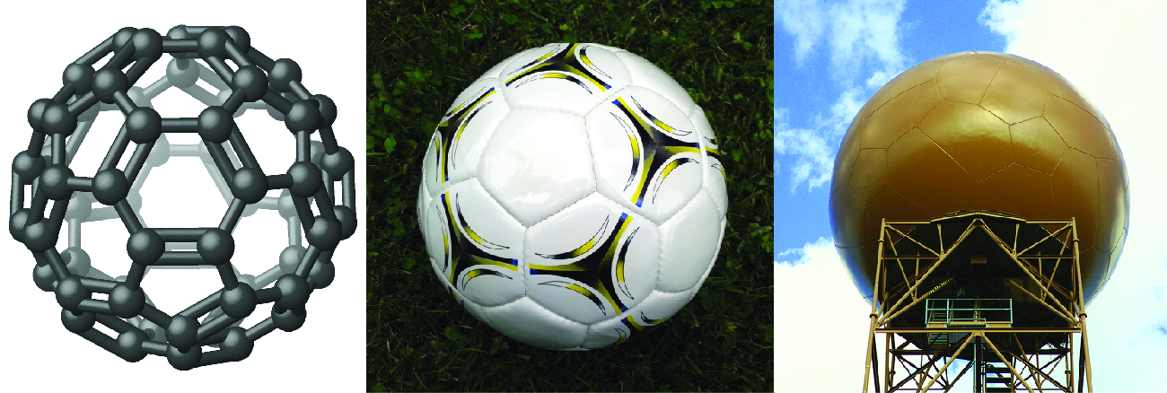
Figure 11a
Figure 11a Nicknamed “buckyballs,” buckminsterfullerene molecules (C₆₀) contain only carbon atoms. Here they are shown in a ball-and-stick model (left). These molecules have single and double carbon-carbon bonds arranged to form a geometric framework of hexagons and pentagons, similar to the pattern on a soccer ball (centre). This unconventional molecular structure is named after architect R. Buckminster Fuller, whose innovative designs combined simple geometric shapes to create large, strong structures such as this weather radar dome near Tucson, Arizona (right). (credit left: Chemistry (OpenStax), CC BY 4.0; credit middle: modification of work by “Petey21”, CC0; credit right: modification of work by Bill Morrow, CC BY 2.0)

Slide 3
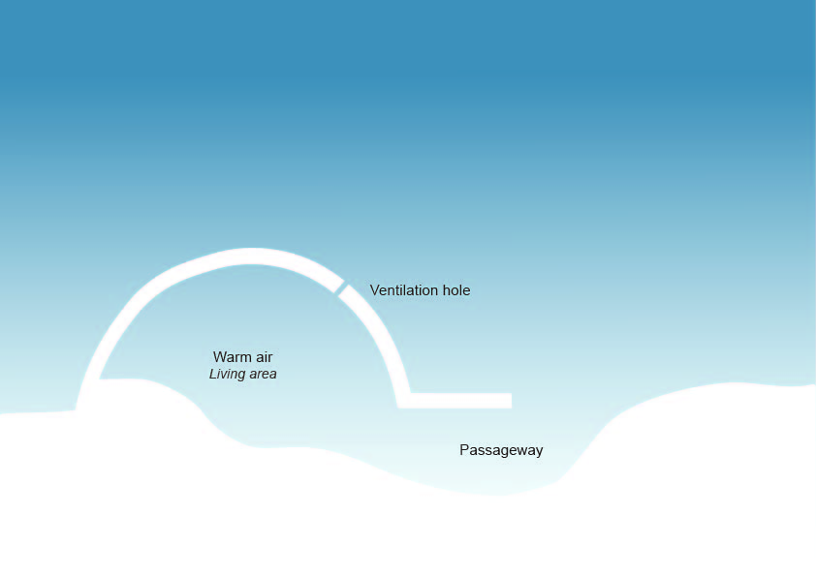
Figure 11b
Figure 11.b Cross section of an iglu (credit: graphic by Revathi Mahadevan, CC BY 4.0)

Slide 4
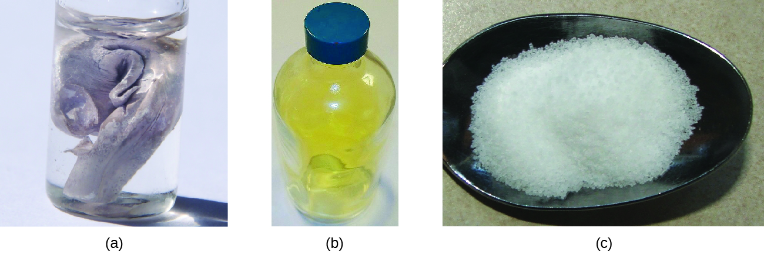
Figure 11.1a
Figure 11.1a (a) Sodium is a soft metal that must be stored in mineral oil to prevent reaction with air or water. (b) Chlorine is a pale yellow-green gas. (c) When combined, they form white crystals of sodium chloride (table salt). (credit a: modification of work by Jurii, CC BY 3.0; b: work by Greenhorn1, PD; c: work by Chemicalinterest, PD)

Slide 5
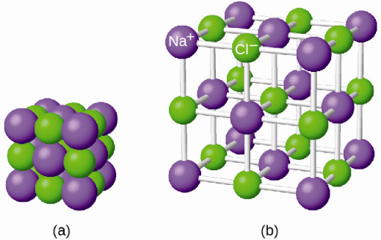
Figure 11.1b
Figure 11.1b The atoms in sodium chloride (common table salt) are arranged to (a) maximize opposite charges interacting. The smaller spheres represent sodium ions, the larger ones represent chloride ions. In the expanded view (b), the geometry can be seen more clearly. Note that each ion is “bonded” to all of the surrounding ions—six in this case. (credit: Chemistry (OpenStax), CC BY 4.0.)

Slide 6
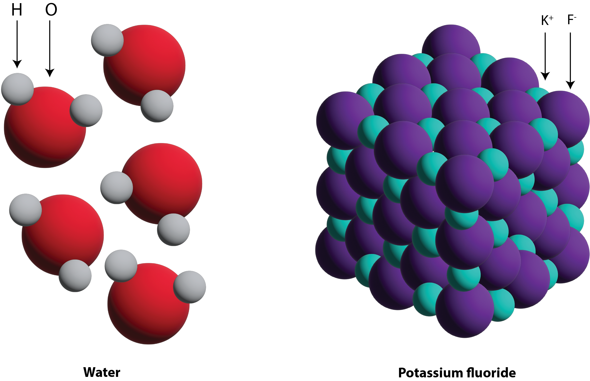
Figure 11.2a
Figure 11.2a The figure shows the structure of a water molecule and potassium fluoride. (credit: graphic by Revathi Mahadevan, CC BY 4.0.)

Slide 7
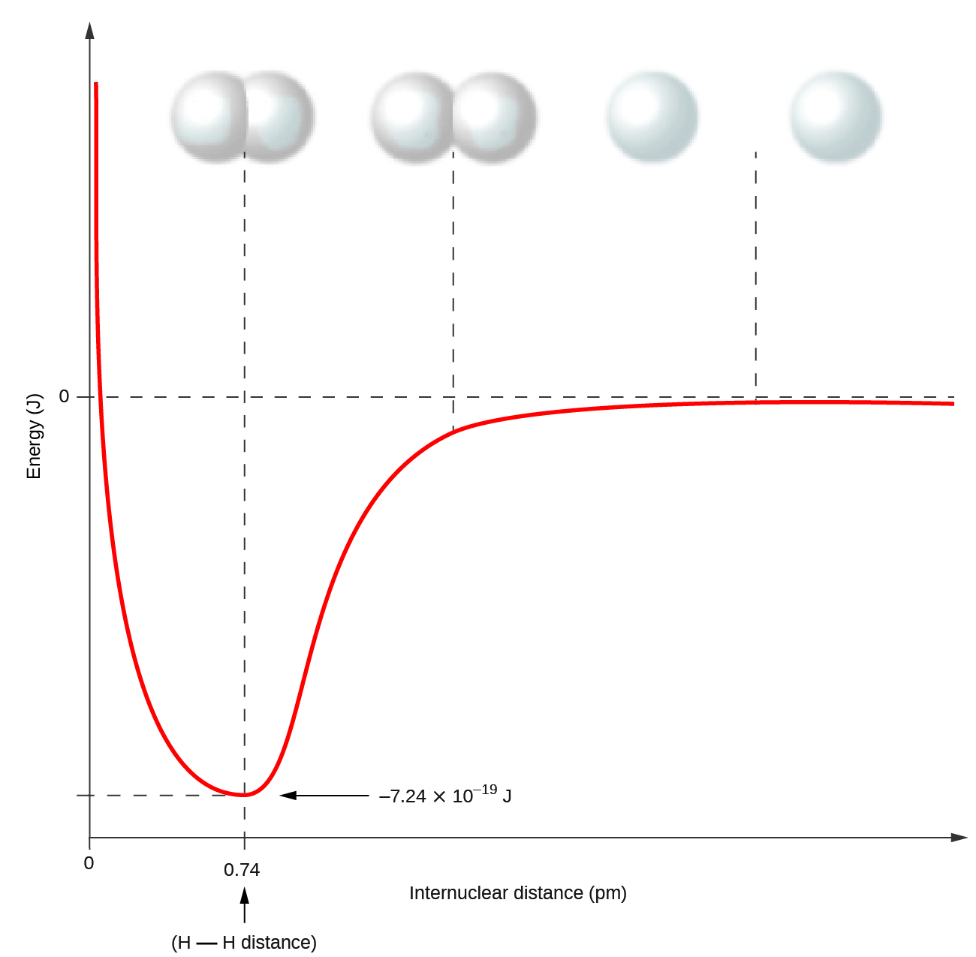
Figure 11.2b
Figure 11.2b The potential energy of two separate hydrogen atoms (right) decreases as they approach each other, and the single electrons on each atom are shared to form a covalent bond. The bond length is the internuclear distance at which the lowest potential energy is achieved. (credit: Chemistry (OpenStax), CC BY 4.0.)

Slide 8
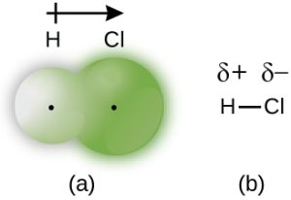
Figure 11.2c
Figure 11.2c (a) The distribution of electron density in the HCl molecule is uneven. The electron density is greater around the chlorine nucleus. The small, black dots indicate the location of the hydrogen and chlorine nuclei in the molecule. (b) Symbols δ+ and δ– indicate the polarity of the H–Cl bond. (credit: Chemistry (OpenStax), CC BY 4.0.)

Slide 9
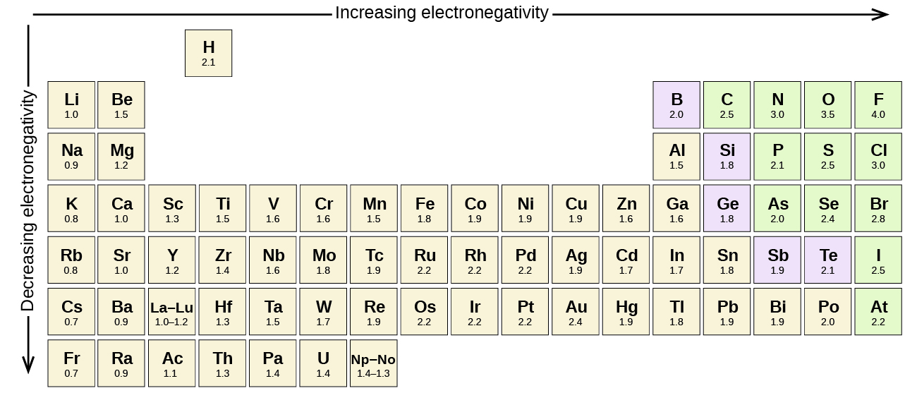
Figure 11.2d
Figure 11.2d The electronegativity values derived by Pauling follow predictable periodic trends with higher electronegativities toward the upper right of the periodic table. Review the Periodic Table of the Elements in other formats in Appendix A. (credit: Chemistry (OpenStax), CC BY 4.0.)

Slide 10
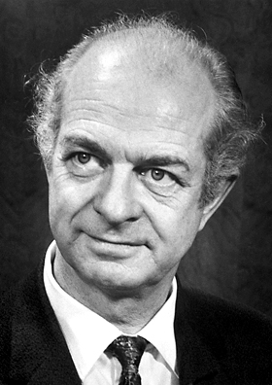
Figure 11.2e
Figure 11.2e Linus Pauling (1901–1994). (credit: work by unknown, courtesy of Nobel Foundation, PD)

Slide 11
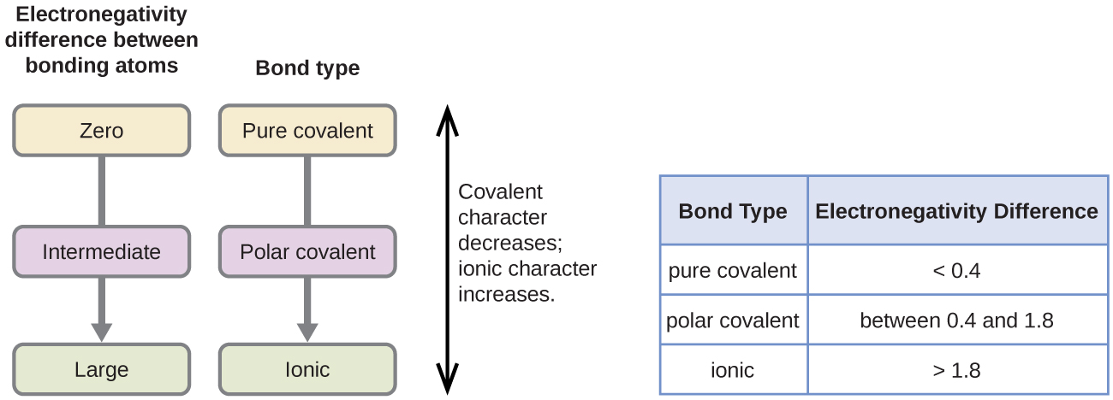
Figure 11.2f
Figure 11.2f As the electronegativity difference increases between two atoms, the bond becomes more ionic. (credit: Chemistry (OpenStax), CC BY 4.0.)

Slide 12
Table 11.2a
Table 11.2a Bond Polarity and Electronegativity Difference
Bond | ΔEN | Polarity
C–H | 0.4 | ^{δ−}C − ^{δ+}H
S–H | 0.4 | ^{δ−}S − ^{δ+}H
C–N | 0.5 | ^{δ+}C − ^{δ−}N
N–H | 0.9 | ^{δ−}N − ^{δ+}H
C–O | 1.0 | ^{δ+}C − ^{δ−}O
O–H | 1.4 | ^{δ−}O − ^{δ+}H
(credit: Chemistry (OpenStax), CC BY 4.0.)

Slide 13
Figure 11.3a
Figure 11.3a Lewis structure of calcium atom. (credit: Chemistry (OpenStax), CC BY 4.0.)

Slide 14
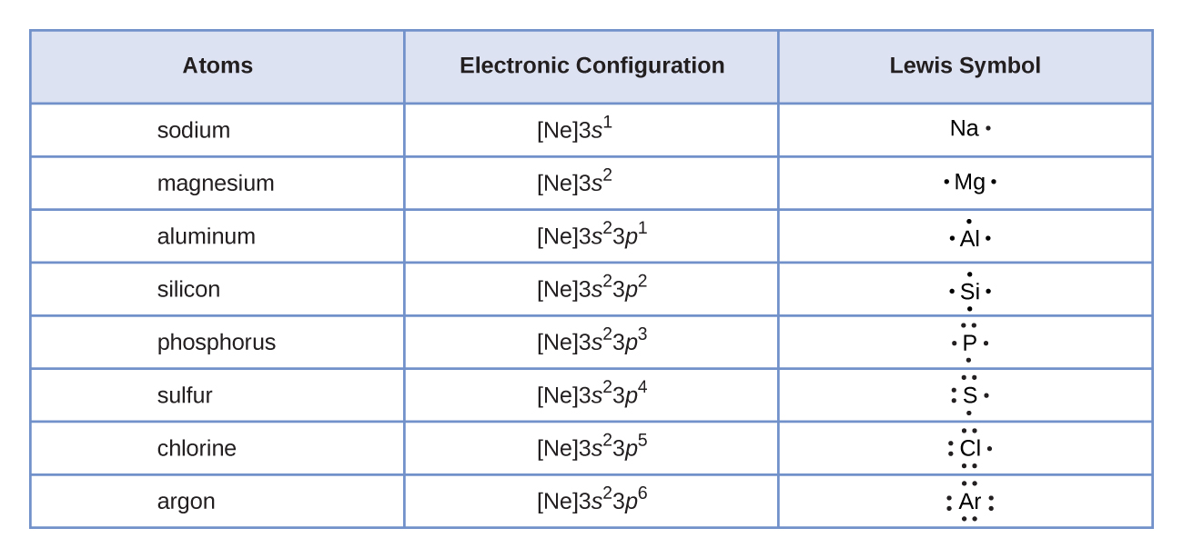
Figure 11.3b
Figure 11.3b Lewis symbols illustrate the number of valence electrons for each element in the third period of the periodic table. (credit: Chemistry (OpenStax), CC BY 4.0.)

Slide 15
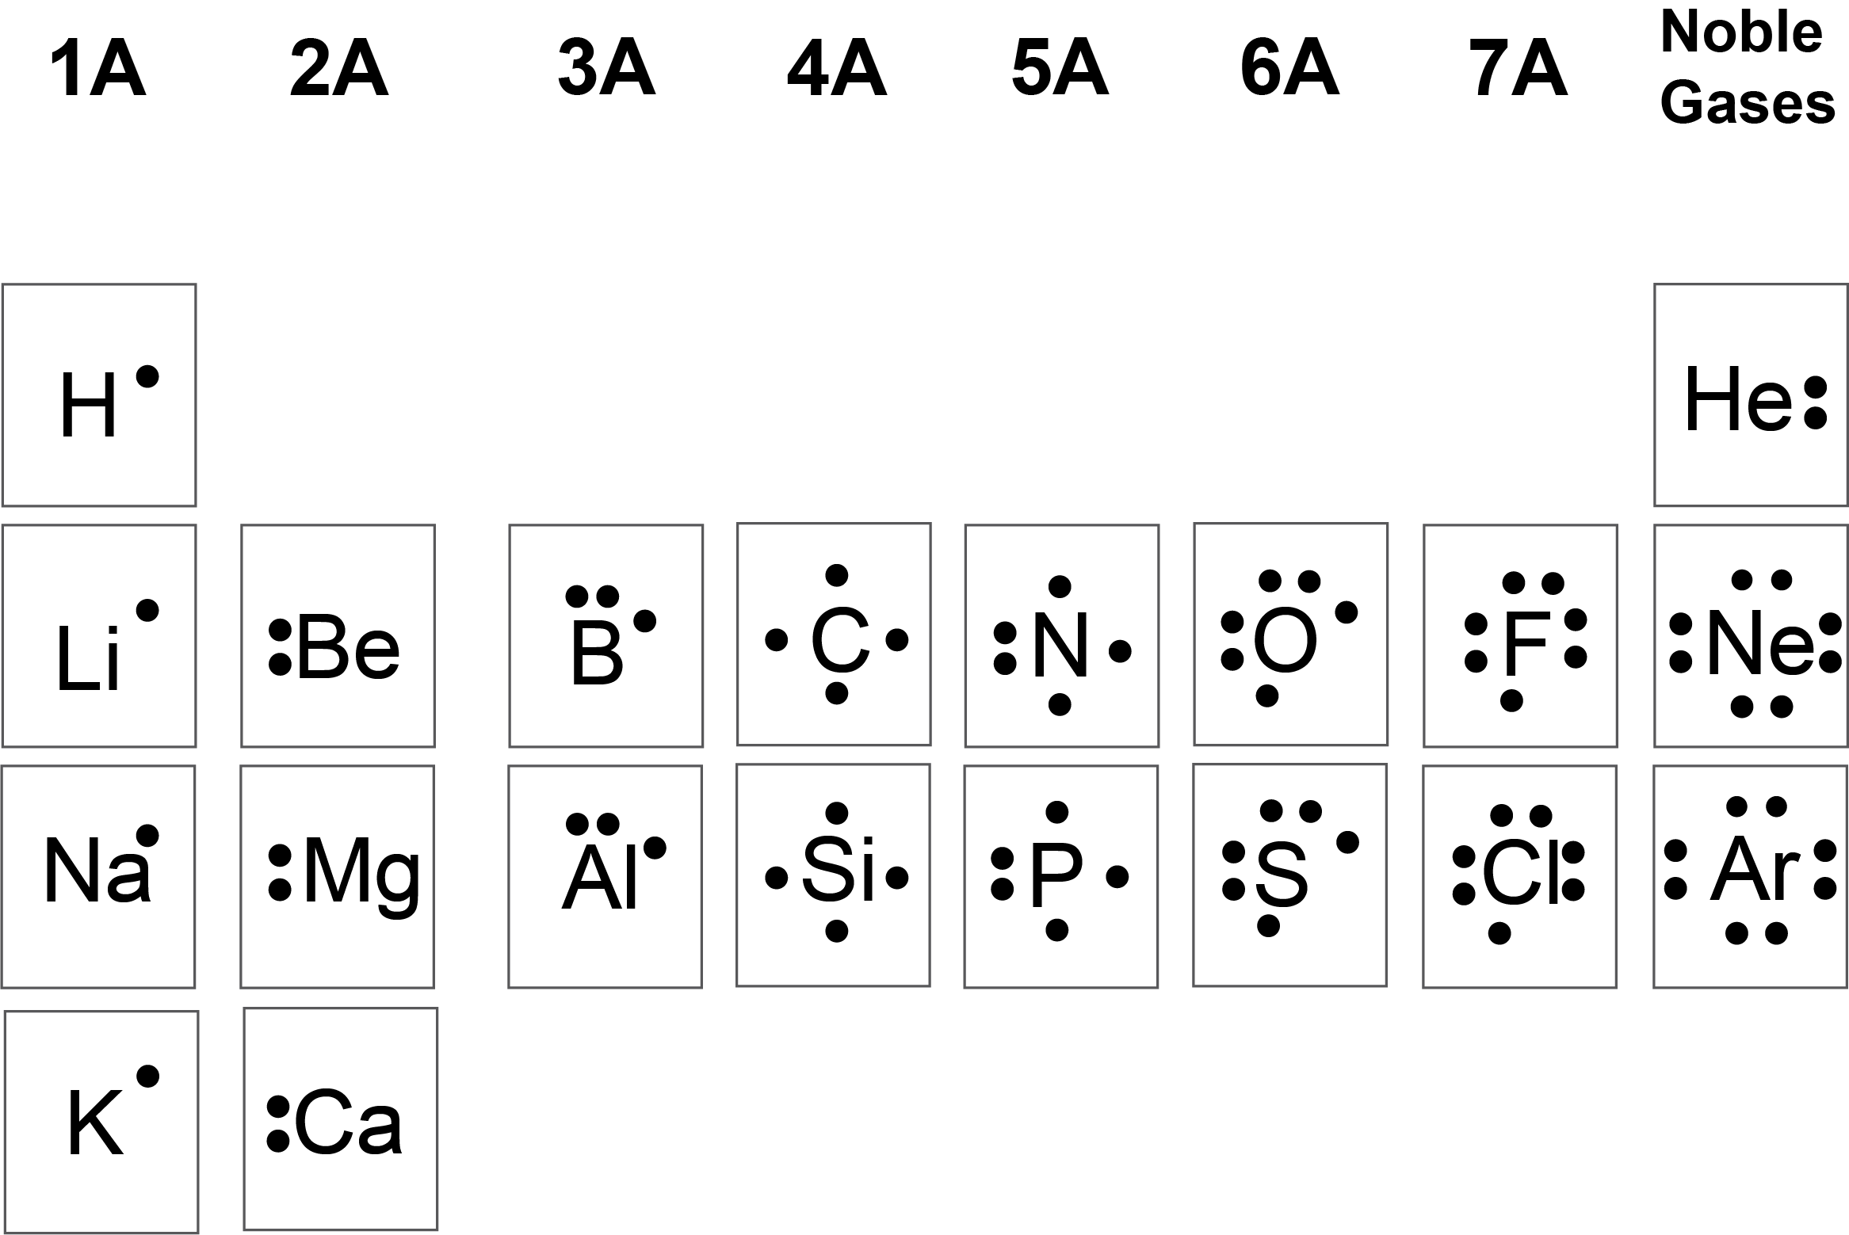
Figure 11.3c
Figure 11.3c Lewis symbols for elements of the periodic table. Review the Periodic Table of the Elements in other formats in Appendix A (credit: graphic by Revathi Mahadevan, CC BY 4.0).

Slide 16
Figure 11.3d
Figure 11.3d Formation of sodium and calcium cations shown as Lewis structures. (credit: Chemistry (OpenStax), CC BY 4.0.)

Slide 17
Figure 11.3e
Figure 11.3e Formation of chloride and sulfide anions shown as Lewis structures. (credit: Chemistry (OpenStax), CC BY 4.0.)

Slide 18
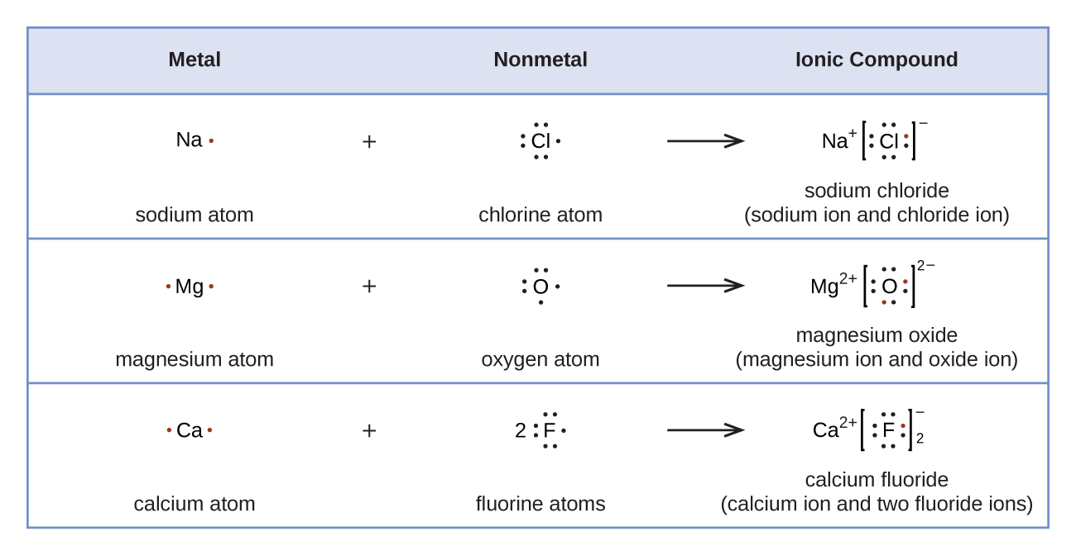
Figure 11.3f
Figure 11.3f Cations are formed when atoms lose electrons, represented by fewer Lewis dots, whereas anions are formed by atoms gaining electrons. The total number of electrons does not change. (credit: Chemistry (OpenStax), CC BY 4.0.)

Slide 19
Figure 11.3g
Figure 11.3g Two chlorine atoms bonding for form chlorine diatomic molecule, Cl₂, shown as Lewis structures. (credit: Chemistry (OpenStax), CC BY 4.0.)

Slide 20
Figure 11.3h
Figure 11.3h Lewis structure of hydrogen diatomic molecule, H₂, and chlorine diatomic molecule, Cl₂, (with lone pairs). (credit: Chemistry (OpenStax), CC BY 4.0.)

Slide 21
Figure 11.3i
Figure 11.3i Lewis structures of carbon tetrachloride, CCl₄, and silane, SiH₄. Bonding pairs of electrons can be as a bash or bond between atoms. (credit: Chemistry (OpenStax), CC BY 4.0.)

Slide 22
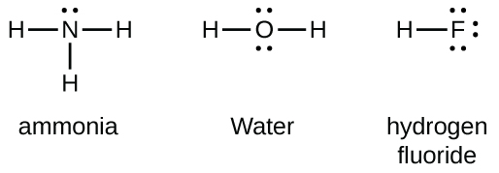
Figure 11.3j
Figure 11.3j Lewis structures of ammonia, NH₃, water, H₂O, and hydrogen fluoride, HF. (credit: Chemistry (OpenStax), CC BY 4.0.)

Slide 23
Figure 11.3k
Figure 11.3k Lewis structures of formaldehyde, CH₂O, and ethylene, C₂H₂, showing double bonds (two shared pairs of electrons). (credit: Chemistry (OpenStax), CC BY 4.0.)

Slide 24
Figure 11.3l
Figure 11.3l Lewis structures of carbon monoxide, CO, and cyanide ion, CN⁻, showing triple bonds (three shared pairs of electrons). (credit: Chemistry (OpenStax), CC BY 4.0.)

Slide 25
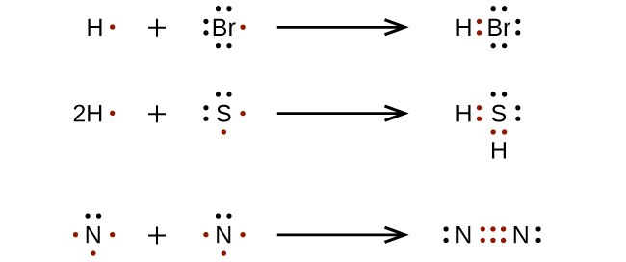
Figure 11.3m
Figure 11.3m Lewis structures of the formation of hydrogen bromide, HBr, hydrogen sulfide, H₂S, and nitrogen, N₂. (credit: Chemistry (OpenStax), CC BY 4.0.)

Slide 26
Figure 11.3n
Figure 11.3n Skeletal structures (incomplete Lewis structures) of SiH₄, CHO₂⁻, NO⁺, and OF₂. Step 2 of process to draw Lewis structure. (credit: Chemistry (OpenStax), CC BY 4.0.)

Slide 27
Figure 11.3o
Figure 11.3o Lewis structure of SiH₄. Skeletal structures (incomplete Lewis structures) of CHO₂⁻, NO⁺, and OF₂. Step 3 of process to draw Lewis structure. (credit: Chemistry (OpenStax), CC BY 4.0.)

Slide 28
Figure 11.3p
Figure 11.3p Lewis structure of OF₂. Step 4 of process to draw Lewis structure. (credit: Chemistry (OpenStax), CC BY 4.0.)

Slide 29
Figure 11.3q
Figure 11.3q Lewis structure of CHO₂⁻. Step 5 of process to draw Lewis structure. (credit: Chemistry (OpenStax), CC BY 4.0.)

Slide 30
Figure 11.3r
Figure 11.3r Lewis structure of CHO₂⁻. Step 5 of process to draw Lewis structure. (credit: Chemistry (OpenStax), CC BY 4.0.)

Slide 31
Figure 11.3s
Figure 11.3s Lewis structure of NO⁺. Step 5 of process to draw Lewis structure. (credit: Chemistry (OpenStax), CC BY 4.0.)

Slide 32
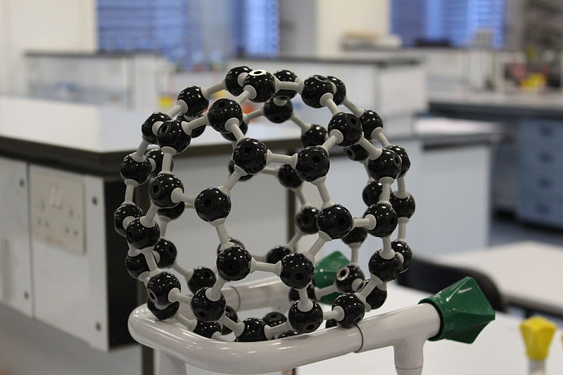
Figure 11.3t
Figure 11.3t This model shows the arrangement of carbon atoms in a fullerene (or 'buckyball') a large molecule made up of 60 carbon atoms. (credit: work by UCL Mathematical and Physical Science, CC BY 2.0)

Slide 33
Figure 11.3u
Figure 11.3u Dr. Mario J. Molina (credit: work by http://science.in2pic.com, CC BY-SA 3.0)

Slide 34
Figure 11.3v
Figure 11.3v Lewis structure of NO where oxygen has been assigned the eight electrons as it is more electronegative compared to nitrogen. (credit: Chemistry (OpenStax), CC BY 4.0.)

Slide 35
Figure 11.3w
Figure 11.3w The Lewis structure of NO double bond where the electrons are rearranged to obtain octets where a double bond is formed so that nitrogen can move closer to an octet. (credit: Chemistry (OpenStax), CC BY 4.0.)

Slide 36
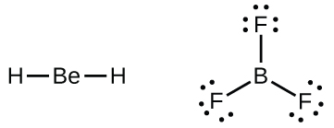
Figure 11.3x
Figure 11.3x The Lewis structures for beryllium dihydride, BeH₂ (left), and boron trifluoride, BF₃ (right). (credit: Chemistry (OpenStax), CC BY 4.0.)

Slide 37
Figure 11.3y
Figure 11.3y The reaction between BF₃ and NH₃ come together to form a single bond between boron and nitrogen because boron requires the lone pair of electrons from nitrogen to fulfill its octet. (credit: Chemistry (OpenStax), CC BY 4.0.)

Slide 38
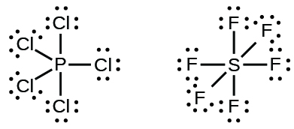
Figure 11.3z
Figure 11.3z The Lewis structures for two hypervalent molecules, PCl₅ and SF₆. (credit: Chemistry (OpenStax), CC BY 4.0.)

Slide 39
Figure 11.3aa
Figure 11.3aa The Lewis structures for hypervalent molecules, IF₅ and XeF₄. (credit: Chemistry (OpenStax), CC BY 4.0.)

Slide 40
Figure 11.4a
Figure 11.4a Three possible structures for carbon dioxide, CO₂. (credit: Chemistry (OpenStax), CC BY 4.0.)

Slide 41
Figure 11.4b
Figure 11.4b Three possible structures for the thiocyanate ion. (credit: Chemistry (OpenStax), CC BY 4.0.)

Slide 42
Figure 11.4c
Figure 11.4c The molecular structures for the nitrite anion, NO₂⁻. (credit: Chemistry (OpenStax), CC BY 4.0.)

Slide 43
Figure 11.4d
Figure 11.4d The resonance structures of the nitrite anion, NO₂⁻. (credit: Chemistry (OpenStax), CC BY 4.0.)

Slide 44
Figure 11.4e
Figure 11.4e The resonance structures for the carbonate anion, CO₃²⁻. (credit: Chemistry (OpenStax), CC BY 4.0.)

Slide 45
Table 11.5a
Table 11.5a Bond Energies (kJ/mol)
Bond | Type of Bond | Bond Energy
H–H | single | 436
H–C | single | 415
H–N | single | 390
H–O | single | 464
H–F | single | 569
H–Si | single | 395
H–P | single | 320
H–S | single | 340
H–Cl | single | 432
H–Br | single | 370
H–I | single | 295
C–C | single | 345
C=C | double | 611
C≡C | triple | 837
(credit: Chemistry (OpenStax), CC BY 4.0.)

Slide 46
Table 11.5a (Continued 1)
Table 11.5a (continued) Bond Energies (kJ/mol)
Bond | Type of Bond | Bond Energy
C–N | single | 290
C=N | double | 615
C≡N | triple | 891
C–O | single | 350
C=O | double | 741
C≡O | triple | 1080
C–F | single | 439
C–Si | single | 360
C–P | single | 265
C–S | single | 260
C–Cl | single | 330
C–Br | single | 275
C–I | single | 240
N–N | single | 160
(credit: Chemistry (OpenStax), CC BY 4.0.)

Slide 47
Table 11.5a (Continued 2)
Table 11.5a (continued 2) Bond Energies (kJ/mol)
Bond | Type of Bond | Bond Energy
N=N | double | 418
N≡N | triple | 946
N–O | single | 200
N–F | single | 270
N–P | single | 210
N–Cl | single | 200
N–Br | single | 245
O–O | single | 140
O=O | double | 498
O–F | single | 160
O–Si | single | 370
O–P | single | 350
O–Cl | single | 205
O–I | single | 200
(credit: Chemistry (OpenStax), CC BY 4.0.)

Slide 48
Table 11.5a (Continued 3)
Table 11.5a (continued 3) Bond Energies (kJ/mol)
Bond | Type of Bond | Bond Energy
F–F | single | 160
F–Si | single | 540
F–P | single | 489
F–S | single | 285
F–Cl | single | 255
F–Br | single | 235
Si–Si | single | 230
Si–P | single | 215
Si–S | single | 225
Si–Cl | single | 359
Si–Br | single | 290
Si–I | single | 215
P–P | single | 215
P–S | single | 230
(credit: Chemistry (OpenStax), CC BY 4.0.)

Slide 49
Table 11.5a (Continued 4)
Table 11.5a (continued 4) Bond Energies (kJ/mol)
Bond | Type of Bond | Bond Energy
P–Cl | single | 330
P–Br | single | 270
P–I | single | 215
S–S | single | 215
S–Cl | single | 250
S–Br | single | 215
Cl–Cl | single | 243
Cl–Br | single | 220
Cl–I | single | 210
Br–Br | single | 190
Br–I | single | 180
I–I | single | 150
(credit: Chemistry (OpenStax), CC BY 4.0.)

Slide 50
Table 11.5b
Table 11.5b Average Bond Lengths and Bond Energies for Some Common Bonds
Bond | Bond type | Bond Length (Å) | Bond Energy (kJ/mol)
C–C | single | 1.54 | 345
C=C | double | 1.34 | 611
C≡C | triple | 1.20 | 837
C–N | single | 1.43 | 290
C=N | double | 1.38 | 615
C≡N | triple | 1.16 | 891
C–O | single | 1.43 | 350
C=O | double | 1.23 | 741
C≡O | triple | 1.13 | 1080
(credit: Chemistry (OpenStax), CC BY 4.0.)

Slide 51
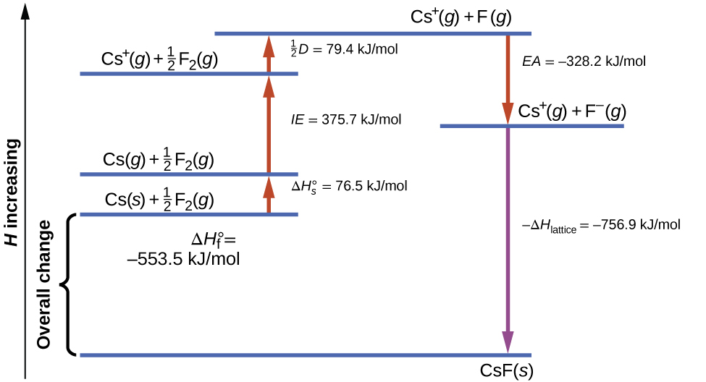
Figure 11.5e
Figure 11.5a The Born-Haber cycle shows the relative energies of each step involved in the formation of an ionic solid from the necessary elements in their reference states. (credit: Chemistry (OpenStax), CC BY 4.0.)

Slide 52
Table 11.5c
Table 11.5c Enthalpies and enthalpy formation for Cesium chloride, CsCl2
Steps in Formation Process | Enthalpy Equations
Enthalpy of sublimation of Cs(s) | Cs(s)⟶Cs(g) ΔH = ΔH∘_{s} = 76.5kJ
One-half of the bond energy of Cl₂ | ½ Cl₂(g)⟶Cl(g) ΔH = ½ D = 122kJ
Ionization energy of Na(g) | Na(g)⟶Na⁺(g) + e⁻ ΔH = IE = 496kJ
Negative of the electron affinity of Cl | Cl(g) + e⁻⟶Cl⁻(g) ΔH = −EA = −368kJ
Negative of the lattice energy of NaCl(s) | Na⁺(g) + Cl⁻(g)⟶NaCl(s) ΔH = −ΔH_{lattice} = ?
Enthalpy of formation of NaCl(s), add steps 1–5 | ΔH = ΔH∘_{f} = ΔH∘_{s} + ½ D + IE + (−EA) + (−ΔH_{lattice}) Na(s) + ½ Cl₂(g)⟶NaCl(s) = −411kJ
(credit: Chemistry (OpenStax), CC BY 4.0.)

Slide 53
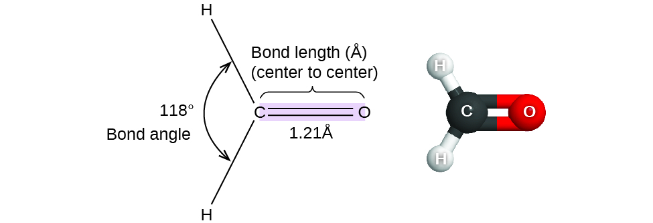
Figure 11.6a
Figure 11.6a Bond distances (lengths) and angles are shown for the formaldehyde molecule, H₂CO. (credit: Chemistry (OpenStax), CC BY 4.0.)

Slide 54
Figure 11.6b
Figure 11.6b The BeF₂ molecule adopts a linear structure in which the two bonds are as far apart as possible, on opposite sides of the Be atom. (credit: Chemistry (OpenStax), CC BY 4.0.)

Slide 55
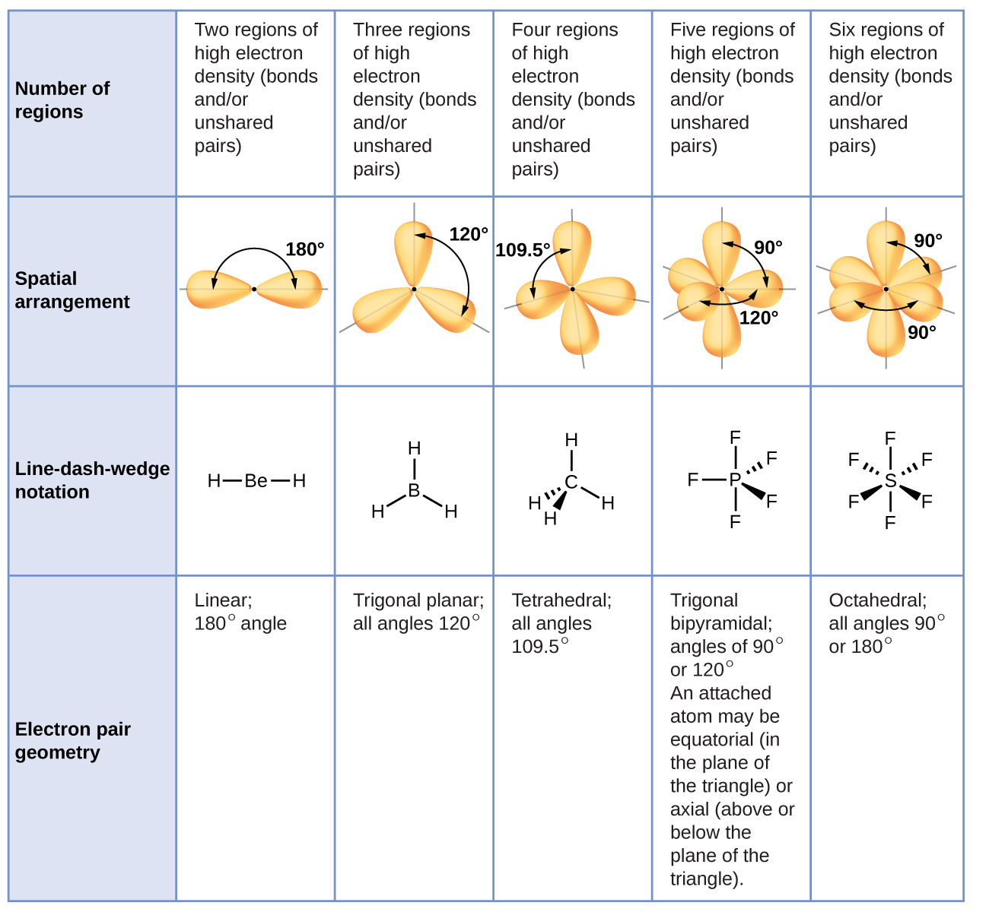
Figure 11.6c
Figure 11.6c The basic electron-pair geometries predicted by VSEPR theory maximize the space around any region of electron density (bonds or lone pairs). (credit: Chemistry (OpenStax), CC BY 4.0.)

Slide 56
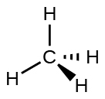
Figure 11.6d
Figure 11.6d Tetrahedral structure of methane, CH₄. (credit: Chemistry (OpenStax), CC BY 4.0.)

Slide 57
Figure 11.6e
Figure 11.6e (a) The electron-pair geometry for the ammonia molecule is tetrahedral with one lone pair and three single bonds. (b) The trigonal pyramidal molecular structure is determined from the electron-pair geometry. (c) The actual bond angles deviate slightly from the idealized angles because the lone pair takes up a larger region of space than do the single bonds, causing the HNH angle to be slightly smaller than 109.5°. (credit: Chemistry (OpenStax), CC BY 4.0.)

Slide 58
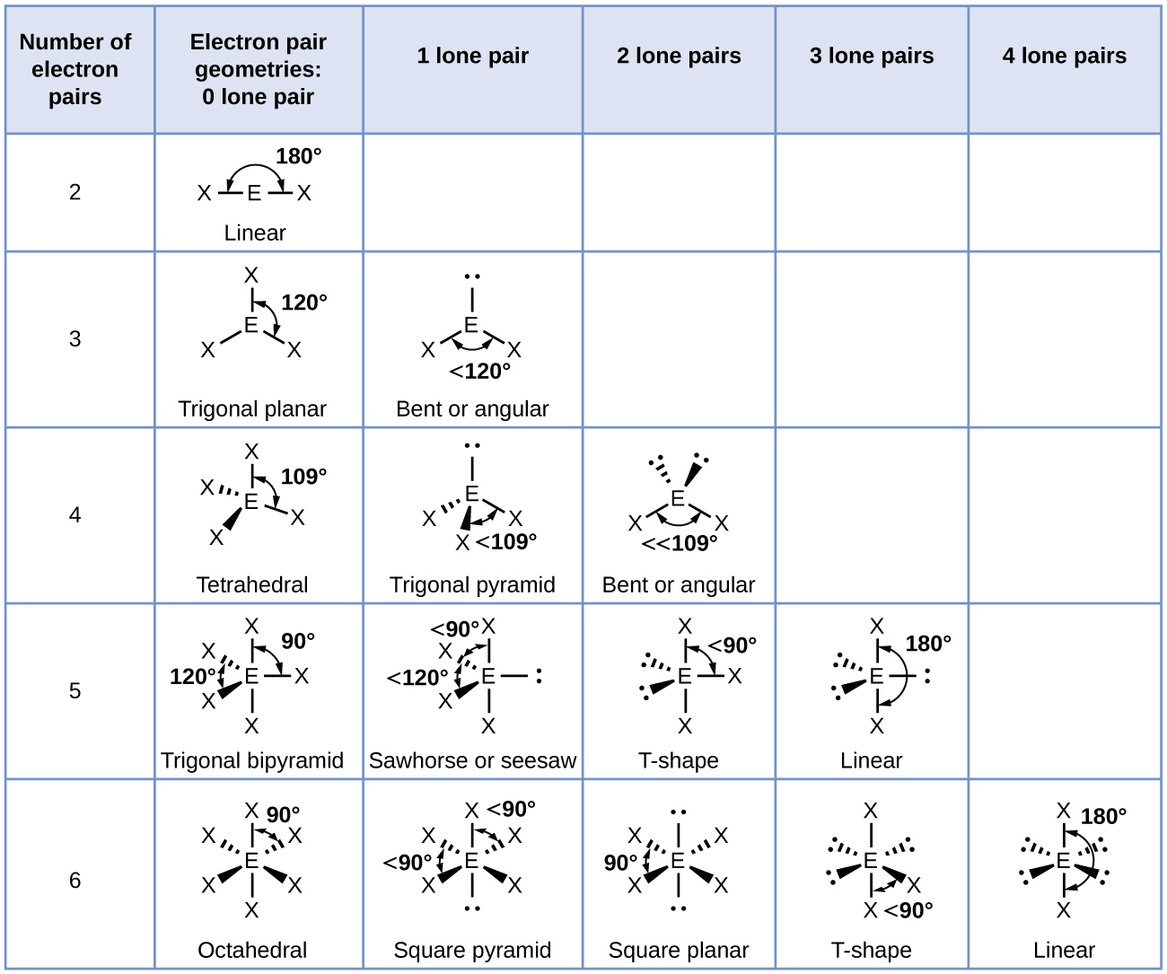
Figure 11.6f
Figure 11.6f The molecular structures are identical to the electron-pair geometries when there is no lone pairs present (first column). For a particular number of electron pairs (row), the molecular structures for one or more lone pairs are determined based on modifications of the corresponding electron-pair geometry. (credit: Chemistry (OpenStax), CC BY 4.0.)

Slide 59
Figure 11.6g
Figure 11.6g (a) In a trigonal bipyramid, the two axial positions are located directly across from one another, whereas the three equatorial positions are located in a triangular arrangement. (b–d) The two lone pairs (red lines) in ClF₃ have several possible arrangements, but the T-shaped molecular structure (b) is the one actually observed, consistent with the larger lone pairs both occupying equatorial positions. (credit: Chemistry (OpenStax), CC BY 4.0.)

Slide 60
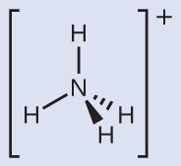
Figure 11.6i
Figure 11.6i The ammonium ion displays a tetrahedral electron-pair geometry as well as a tetrahedral molecular structure. (credit: Chemistry (OpenStax), CC BY 4.0.)

Slide 61
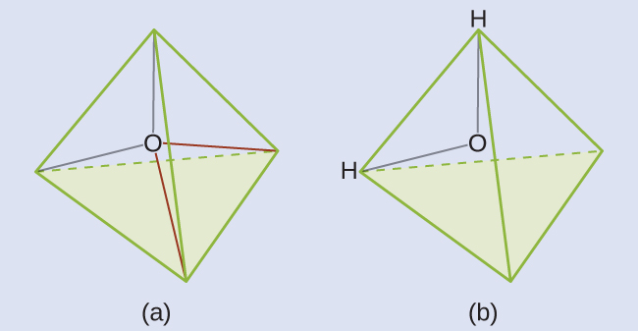
Figure 11.6j
Figure 11.6j (a) H₂O has four regions of electron density around the central atom, so it has a tetrahedral electron-pair geometry. (b) Two of the electron regions are lone pairs, so the molecular structure is bent. (credit: Chemistry (OpenStax), CC BY 4.0.)

Slide 62
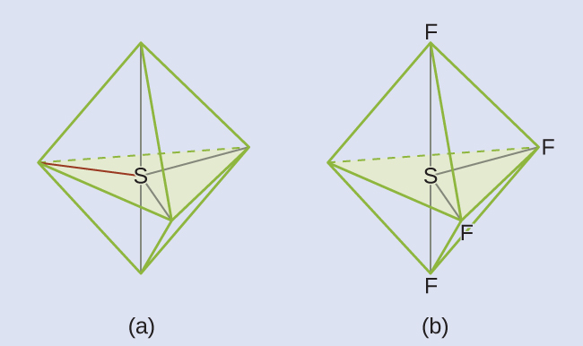
Figure 11.6k
Figure 11.6k (a) SF₄ has a trigonal bipyramidal arrangement of the five regions of electron density. (b) One of the regions is a lone pair, which results in a seesaw-shaped molecular structure. (credit: Chemistry (OpenStax), CC BY 4.0.)

Slide 63
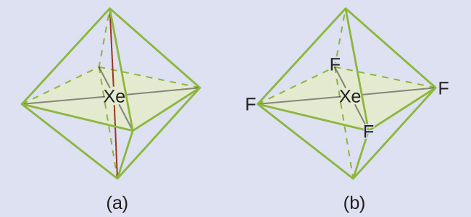
Figure 11.6l
Figure 11.6l (a) XeF₄ adopts an octahedral arrangement with two lone pairs (red lines) and four bonds in the electron-pair geometry. (b) The molecular structure is square planar with the lone pairs directly across from one another. (credit: Chemistry (OpenStax), CC BY 4.0.)

Slide 64
Figure 11.6m
Figure 11.6m (a) There is a small difference in electronegativity between C and H, represented as a short vector. (b) The electronegativity difference between B and F is much larger, so the vector representing the bond moment is much longer. (credit: Chemistry (OpenStax), CC BY 4.0.)

Slide 65
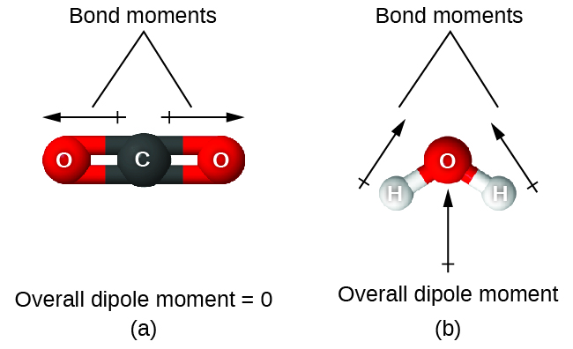
Figure 11.6n
Figure 11.6n The overall dipole moment of a molecule depends on the individual bond dipole moments and how they are arranged. (a) Each CO bond has a bond dipole moment, but they point in opposite directions so that the net CO₂ molecule is nonpolar. (b) In contrast, water is polar because the OH bond moments do not cancel out. (credit: Chemistry (OpenStax), CC BY 4.0.)

Slide 66
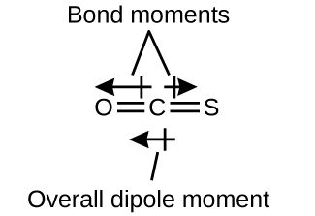
Figure 11.6o
Figure 11.6o The OCS molecule is shown to have a linear structure. (credit: Chemistry (OpenStax), CC BY 4.0.)

Slide 67
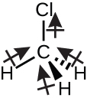
Figure 11.6p
Figure 11.6p The CH₃Cl structure has a tetrahedral shape and represents a polar molecule. (credit: Chemistry (OpenStax), CC BY 4.0.)

Slide 68
Figure 11.6q
Figure 11.6q H₂S and NH₃ represent structures where the dipoles do not cancel due to the lone pair of electrons. (credit: Chemistry (OpenStax), CC BY 4.0.)

Slide 69
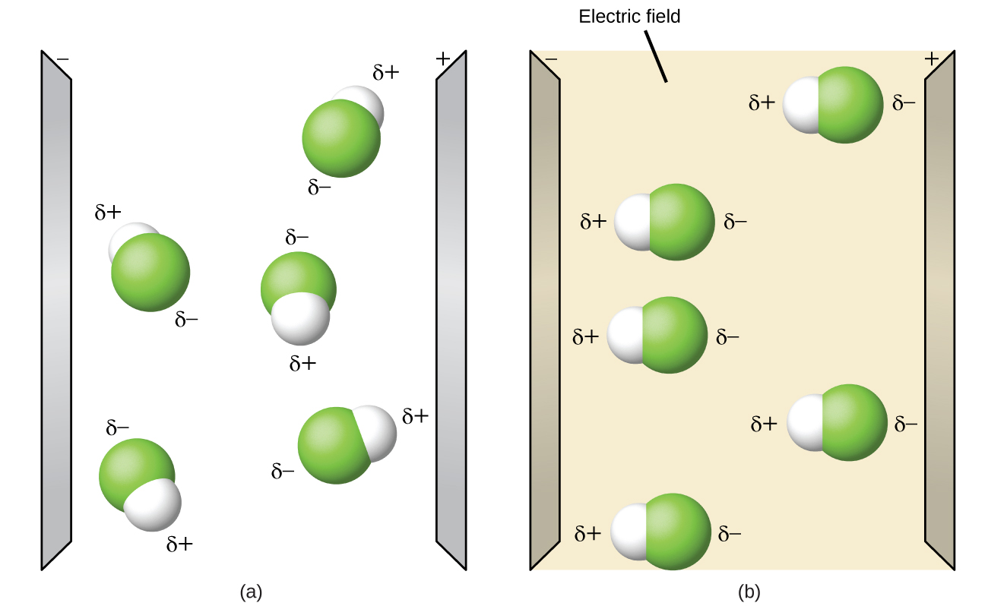
Figure 11.6r
Figure 11.6r (a) Molecules are always randomly distributed in the liquid state in the absence of an electric field. (b) When an electric field is applied, polar molecules like HF will align to the dipoles with the field direction. (credit: Chemistry (OpenStax), CC BY 4.0.)

