Slide 1
Chapter 10 Modern Atomic Theory
Slides to accompany Enhanced Introductory College Chemistry by Gregory Anderson, Caryn Fahey, J.R. van Haarlem, Jackie MacDonald, Adrienne Richards, Samantha Sullivan Sauer, and David Wegman
Slide design and template by Revathi Mahadevan
Except where otherwise noted, images, tables & diagrams are reused from Enhanced Introductory College Chemistry, a derivative of Chemistry (Open Stax) by Paul Flowers, Klaus Theopold, Richard Langley & William R. Robinson and is licensed under CC BY 4.0. ​Access for free at Chemistry (OpenStax)​
Slides are licensed under CC-BY 4.0, Except while otherwise noted

Slide 2
Figure 10a
Figure 10a The Crab Nebula consists of remnants of a supernova (the explosion of a star). NASA’s Hubble Space Telescope produced this composite image. Measurements of the emitted light wavelengths enabled astronomers to identify the elements in the nebula, determining that it contains specific ions including S⁺ (green filaments) and O²⁺ (red filaments). (credit: Crab Nebula by NASA, ESA, J. Hester and A. Loll (Arizona State University), PD).

Slide 3
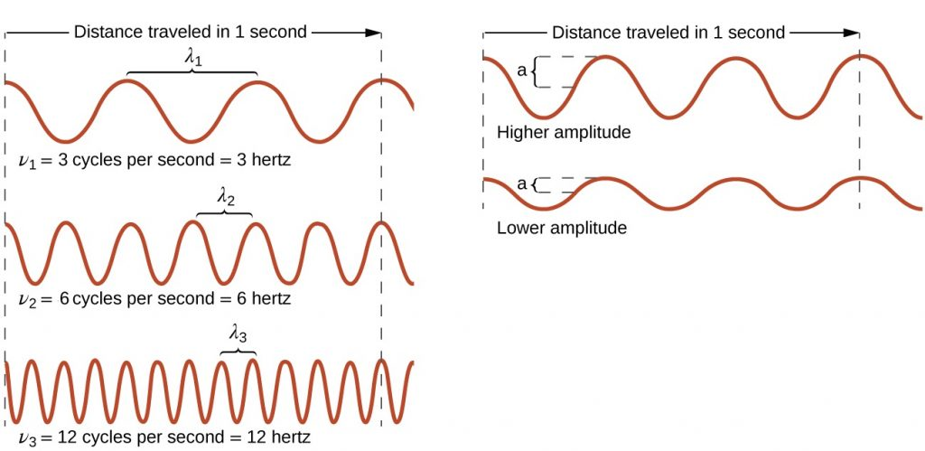
Figure 10.1a
Figure 10.1a Comparing Wavelength, Frequency, and Speed using Sinusoidal Waves: One-dimensional sinusoidal waves show the relationship among wavelength, frequency, and speed. The wave with the shortest wavelength has the highest frequency. Amplitude is one-half the height of the wave from peak to trough. (credit: General Chemistry I & II, a derivative of Chemistry (Open Stax), CC BY 4.0).

Slide 4
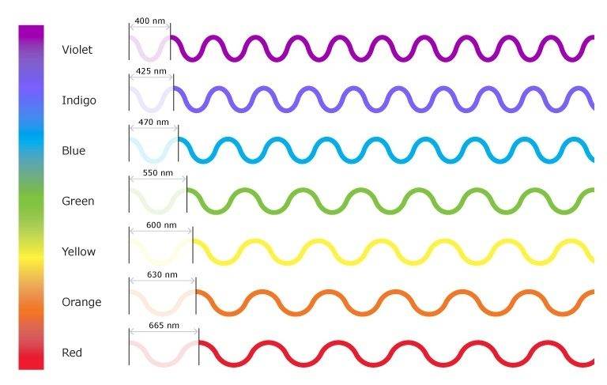
Figure 10.1b
Figure 10.1b The Visible Light Spectrum of Electromagnetic Radiation: The Visual Spectrum of Electromagnetic Radiation: The visible spectrum is illustrated showing the wavelengths of each of the component colours. The spectrum ranges from dark red at 700 nm to violet at 400 nm. Longer wavelengths have lower frequency and carry less energy; Shorter wavelengths have higher frequency and carry more energy. (credit: Colours of Light by Science Learning Hub – Pokapū Akoranga Pūtaiao, University of Waikato, Educational Use.)

Slide 5
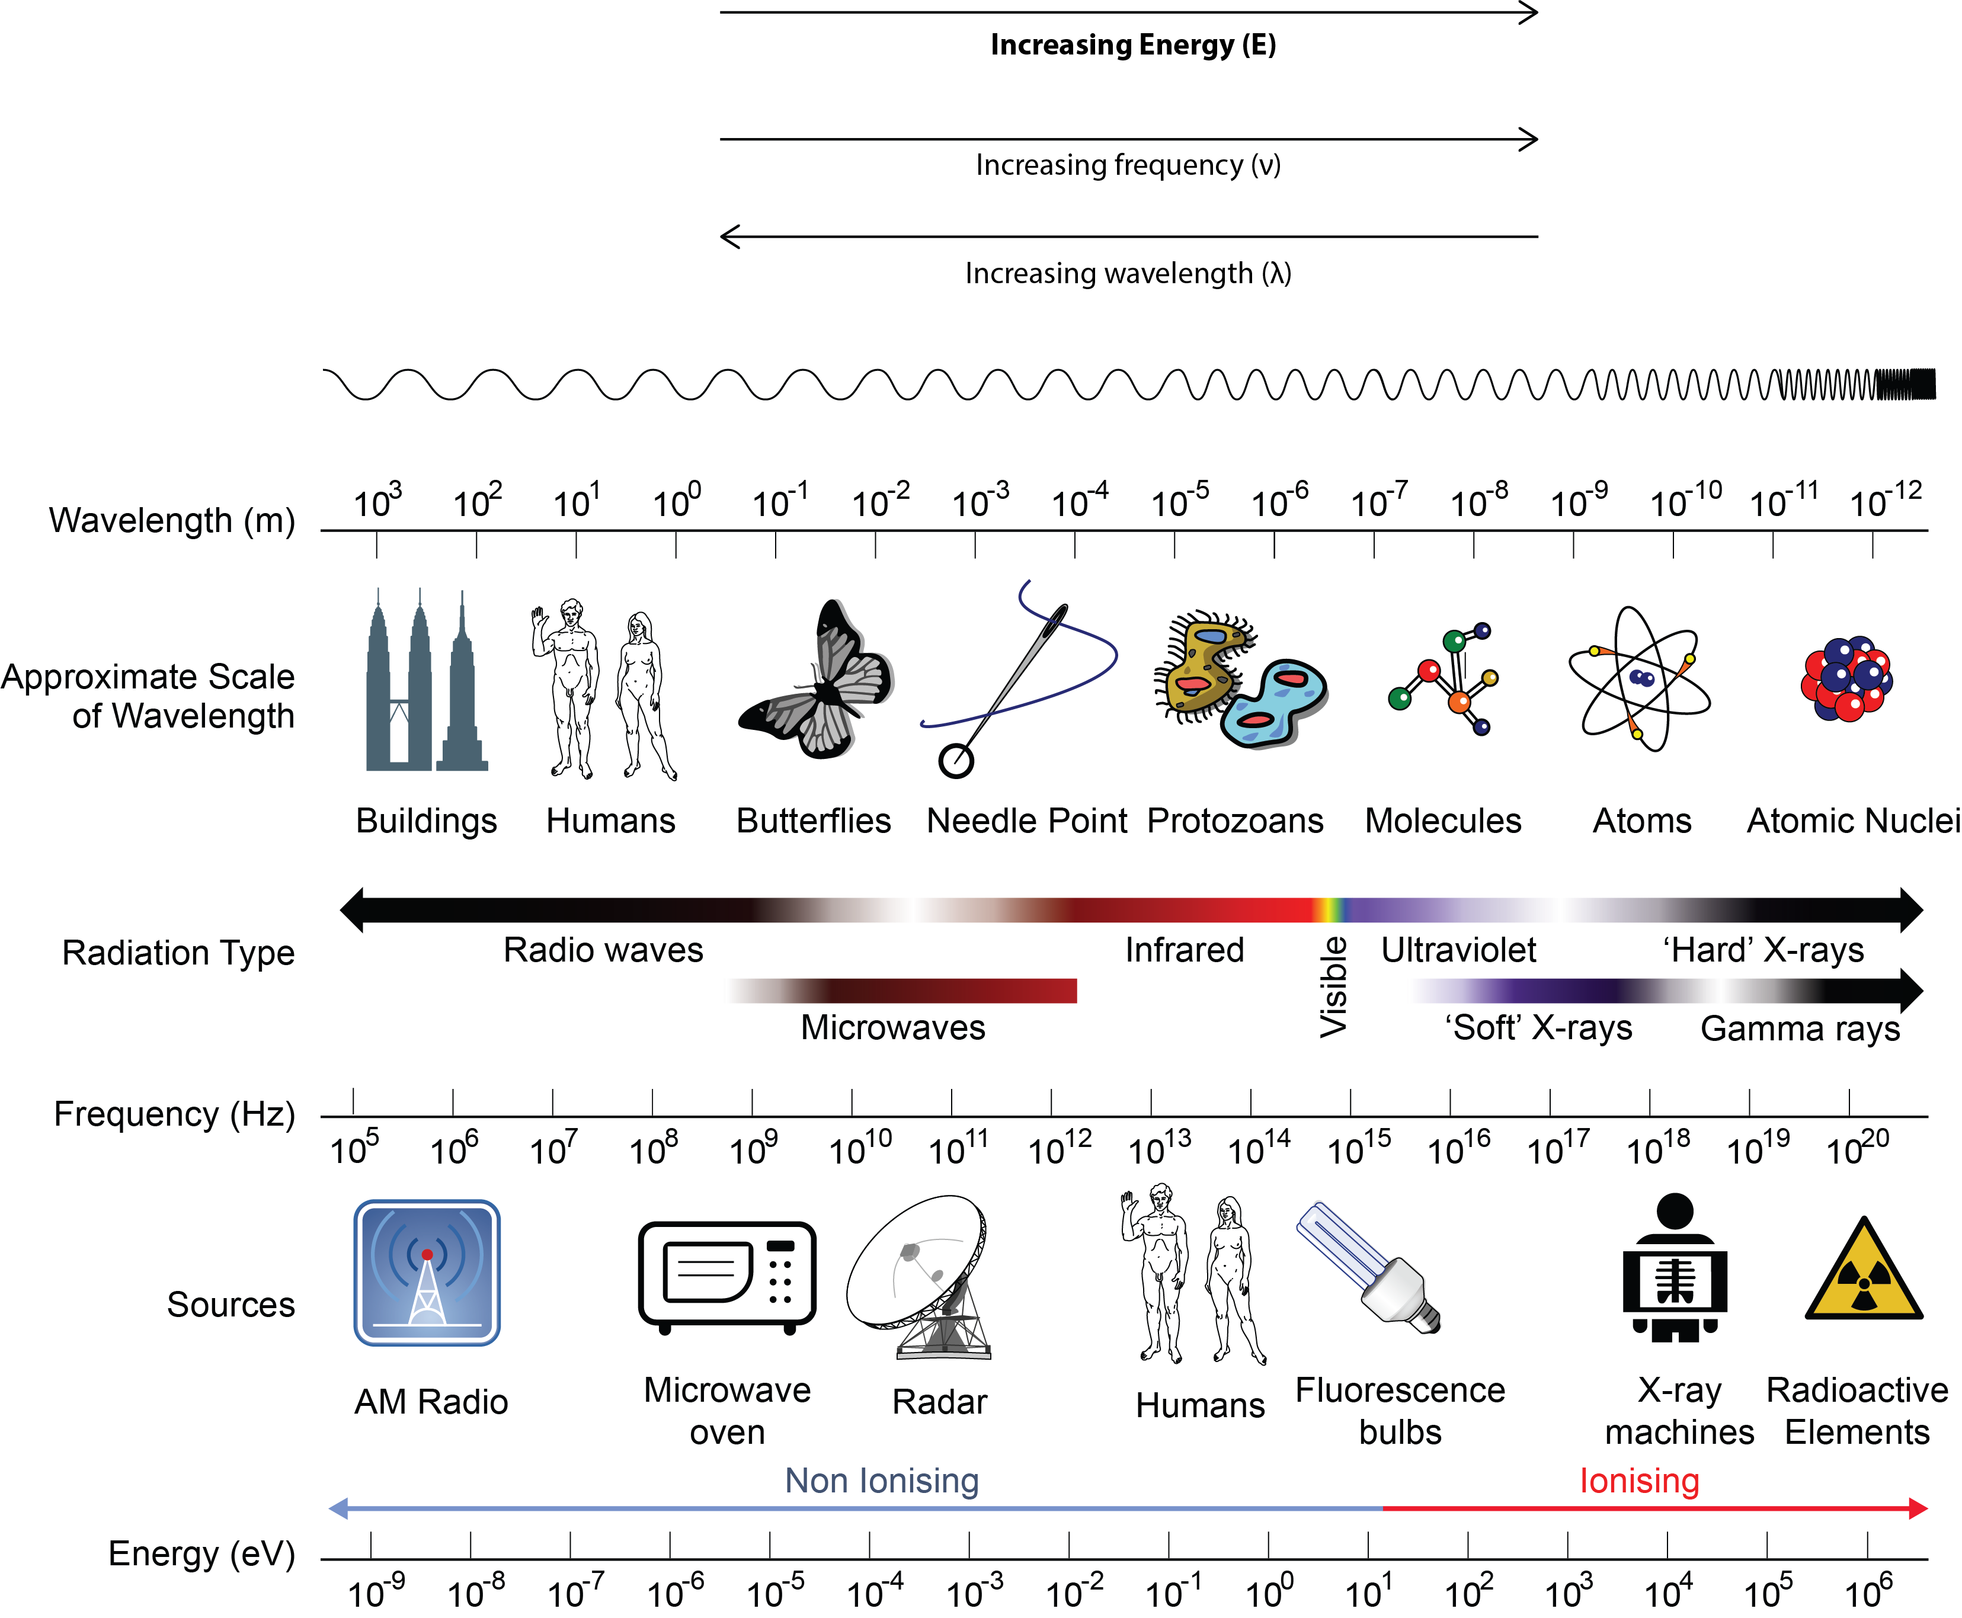
Figure 10.1c
Figure 10.1c The Electromagnetic Spectrum: Portions of the electromagnetic spectrum are shown in order of decreasing frequency and increasing wavelength. Examples of some applications for various wavelengths include positron emission tomography (PET) scans, X-ray imaging, remote controls, wireless Internet, cellular telephones, and radios. (credit: modification of work by Dinksbumf, Inductiveload, NASA, CC BY-SA 3.0. / Adapted by Revathi Mahadevan to include energy, frequency & wavelength trends).

Slide 6
Figure 10.1d
Figure 10.1d Wireless Communication: Radio and cell towers are typically used to transmit long-wavelength electromagnetic radiation. Increasingly, cell towers are designed to blend in with the landscape, as with the Tucson, Arizona, cell tower (right) disguised as a palm tree. (credit left: modification of work by Sir Mildred Pierce, CC BY 2.0; credit middle: modification of work by M.O. Stevens, CC BY 3.0; credit right: work by Gary Minnaert, PD)

Slide 7
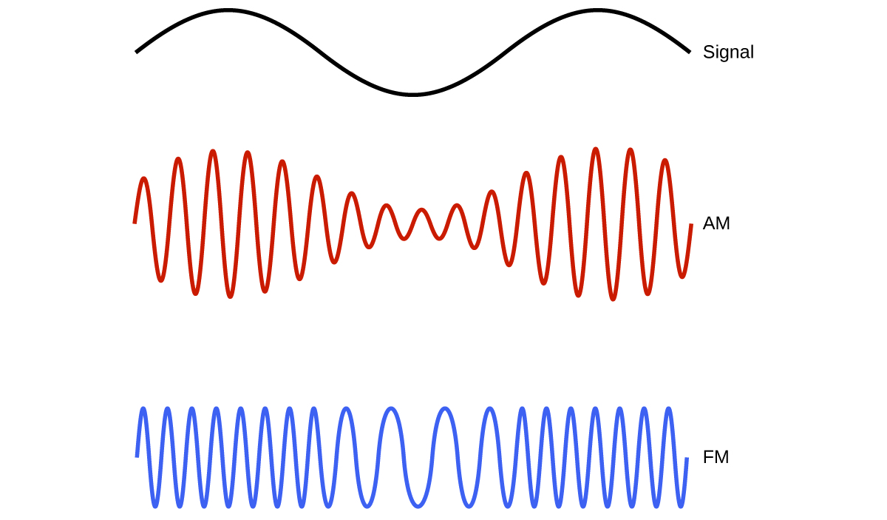
Figure 10.1e
Figure 10.1e Schematic of AM and FM radio wave transmission: This schematic depicts how amplitude modulation (AM) and frequency modulation (FM) can be used to transmit a radio wave. (credit: Chemistry (Open Stax), CC BY 4.0).

Slide 8
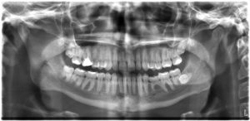
Figure 10.1f
Figure 10.1f X-Ray of Human Mouth: An x-ray image reveals fillings in a person’s teeth and can be use to detect cavities or other oral hygiene concerns. (credit: work by Dmitry G, PD)

Slide 9
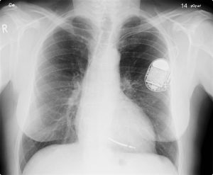
Figure 10.1g
Figure 10.1g Medical Diagnostic Use of X-Ray: This x-ray image of a person’s chest shows many details, including an artificial pacemaker. (credit: work by Sunzi99, CC BY 3.0)

Slide 10
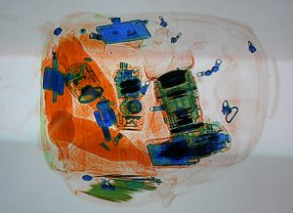
Figure 10.1h
Figure 10.1h X-Ray Imaging for Security: This x-ray image shows the contents of a piece of luggage. The denser the material, the darker the shadow. (credit: work by IDuke, CC BY 2.5)

Slide 11
Figure 10.1i
Figure 10.1i Noble Prize Winner, Dorothy-Hodgkin: Dorothy Hodgkin was born on May 12, 1910; died July 29, 1994. She’s most famous for being one of only four women to have won a Nobel Prize in Chemistry, and the only British woman to have done so. This graphic takes a look at the work that earned her the prize. She successfully determined the structure of penicillin in 1945, and in 1956 the structure of vitamin B12. Then in 1969 after over 30 years of capturing an x-ray photo of an insulin crystal , she determined insulin’s three-dimensional structure. She used of X-ray crystallography to visualize the structures of molecules including penicillin, vitamin B12 and insulin. (credit: "This Day in Chemistry May 12 - Dorothy Hodgkin" by Andy Brunning/Compound Interest, CC BY-NC-ND 4.0)

Slide 12
Figure 10.2a
Figure 10.2a Absorption Spectra: In the solar emission spectrum in the visible range from 380 nm to 710 nm, Fraunhofer lines are observed as vertical black lines at specific spectral positions in the continuous spectrum. Highly sensitive modern instruments observe thousands of such lines. (credit: University Physics Volume 3 (Open Stax), CC BY 4.0.)

Slide 13
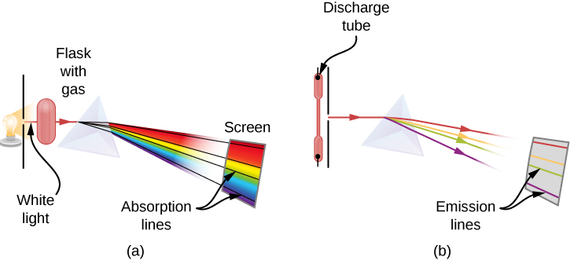
Figure 10.2b
Figure 10.2b Observation of line spectra: (a) setup to observe absorption lines; (b) setup to observe emission lines. (a) White light passes through a cold gas that is contained in a glass flask. A prism is used to separate wavelengths of the passed light. In the spectrum of the passed light, some wavelengths are missing, which are seen as black absorption lines in the continuous spectrum on the viewing screen. (b) A gas is contained in a glass discharge tube that has electrodes at its ends. At a high potential difference between the electrodes, the gas glows and the light emitted from the gas passes through the prism that separates its wavelengths. In the spectrum of the emitted light, only specific wavelengths are present, which are seen as colourful emission lines on the screen. (credit: University Physics Volume 3 (Open Stax), CC BY 4.0.)

Slide 14
Figure 10.2c
Figure 10.2c The emission spectrum of atomic hydrogen: The spectral positions of emission lines are characteristic for hydrogen atoms. (credit: work by JKasd, CC BY 3.0)

Slide 15
Figure 10.2d
Figure 10.2d The emission spectrum of atomic iron: The spectral positions of emission lines are characteristic for iron atoms. (credit: University Physics Volume 3 (Open Stax), CC BY 4.0.)

Slide 16
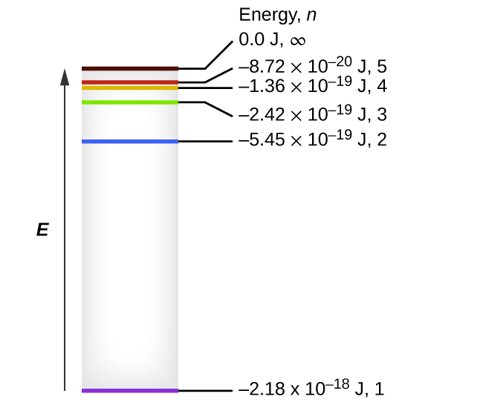
Figure 10.2e
Figure 10.2e Quantum numbers and energy levels in a hydrogen atom: The more negative the calculated value, the lower the energy. (credit: Chemistry (Open Stax), CC BY 4.0)

Slide 17
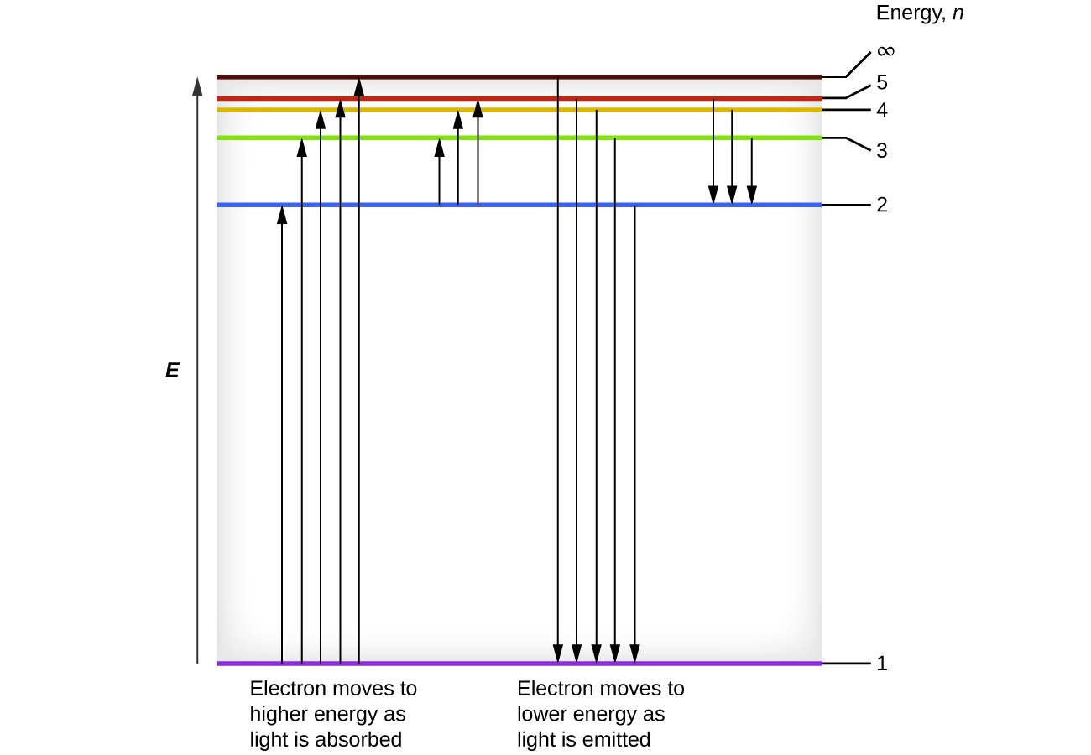
Figure 10.2f
Figure 10.2f Relative energy of orbits in the Bohr model of the hydrogen atom: The horizontal lines show the relative energy of orbits in the Bohr model of the hydrogen atom, and the vertical arrows depict the energy of photons absorbed (left) or emitted (right) as electrons move between these orbits. (credit: Chemistry (Open Stax), CC BY 4.0)

Slide 18
Figure 10.3a
Figure 10.3a Interference Patterns on Water Surface: An interference pattern on the water surface is formed by interacting waves. The waves are caused by the reflection of water from the rocks. (credit: work by Daniela_deGol, CC BY 4.0)

Slide 19
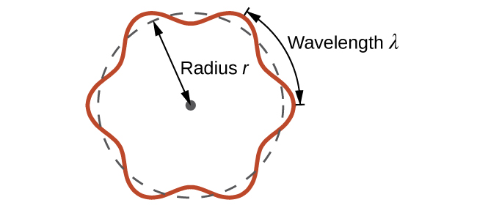
Figure 10.3b
Figure 10.3b de Broglie's Electron Circulating Standing Wave Theory: If an electron is viewed as a wave circling around the nucleus, an integer number of wavelengths must fit into the orbit for this standing wave behaviour to be possible. (credit: Chemistry (OpenStax), CC BY 4.0.)

Slide 20
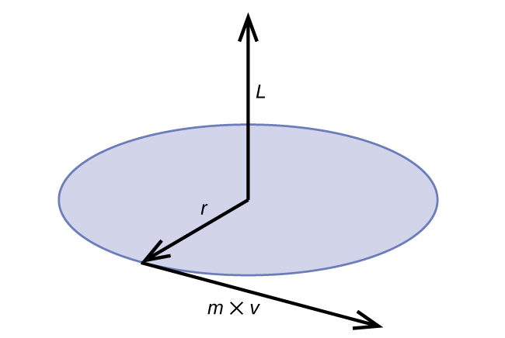
Figure 10.3c
Figure 10.3c Angular Momentum for Circular Motion: The diagram shows angular momentum for a circular motion. L = rp = rmv (credit: Chemistry (OpenStax), CC BY 4.0.)

Slide 21
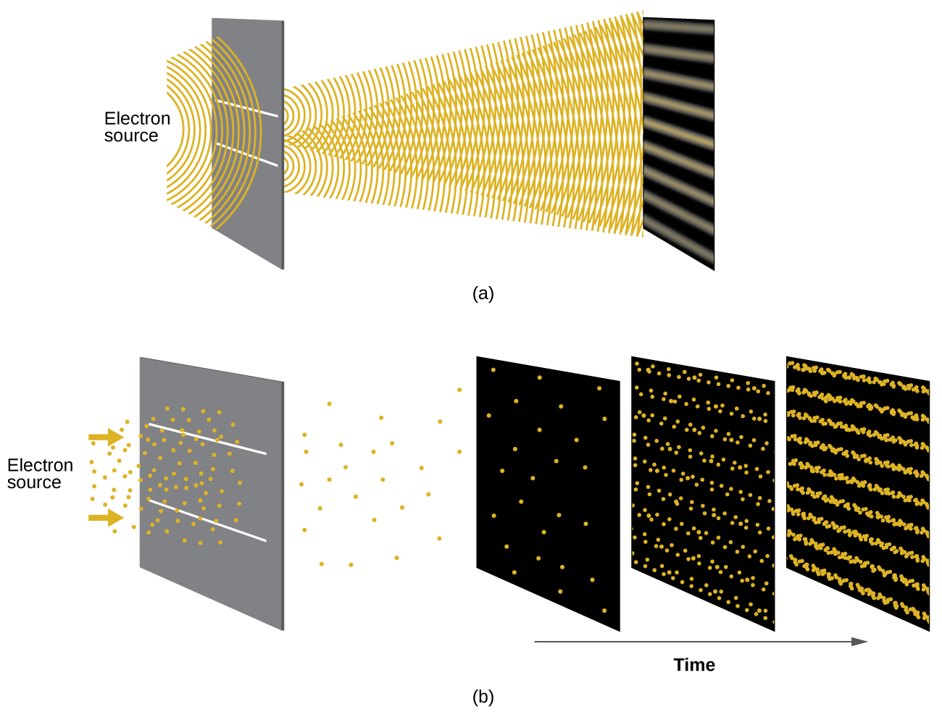
Figure 10.3d
Figure 10.3d Experiments Showing Interference Pattern for Electrons (a) The interference pattern for electrons passing through very closely spaced slits demonstrates that quantum particles such as electrons can exhibit wavelike behaviour. (b) The experimental results illustrated here demonstrate the wave–particle duality in electrons. The electrons pass through very closely spaced slits, forming an interference pattern, with increasing numbers of electrons being recorded from the left image to the right. With only a few electrons recorded, it is clear that the electrons arrive as individual localized “particles,” but in a seemingly random pattern. As more electrons arrive, a wavelike interference pattern begins to emerge. Note that the probability of the final electron location is still governed by the wave-type distribution, even for a single electron, but it can be observed more easily if many electron collisions have been recorded. (credit: Chemistry (OpenStax), CC BY 4.0.)

Slide 22
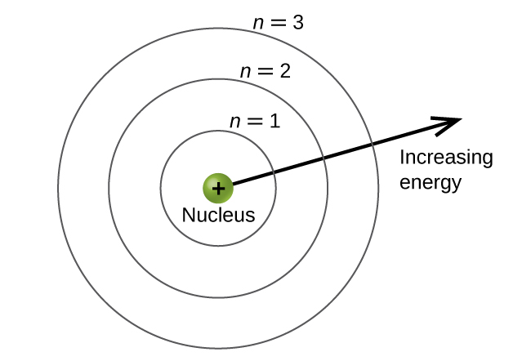
Figure 10.4a
Figure 10.4a Principal Energy Level Schematic: Different shells are numbered by principal quantum numbers. (credit: Chemistry (OpenStax), CC BY 4.0.)

Slide 23
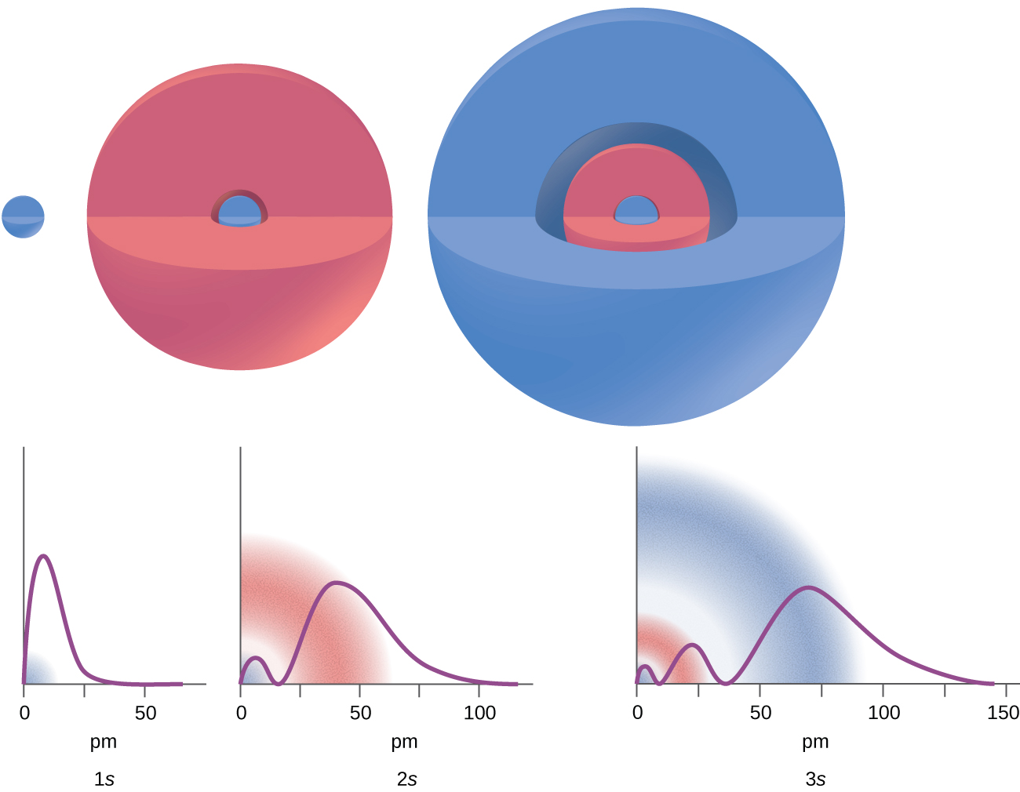
Figure 10.4b
Figure 10.4b Probability of Finding an Electron vs Distance from Nucleus: The graphs show the probability (y axis) of finding an electron for the 1s, 2s, 3s orbitals as a function of distance from the nucleus. (credit: Chemistry (OpenStax), CC BY 4.0.)

Slide 24
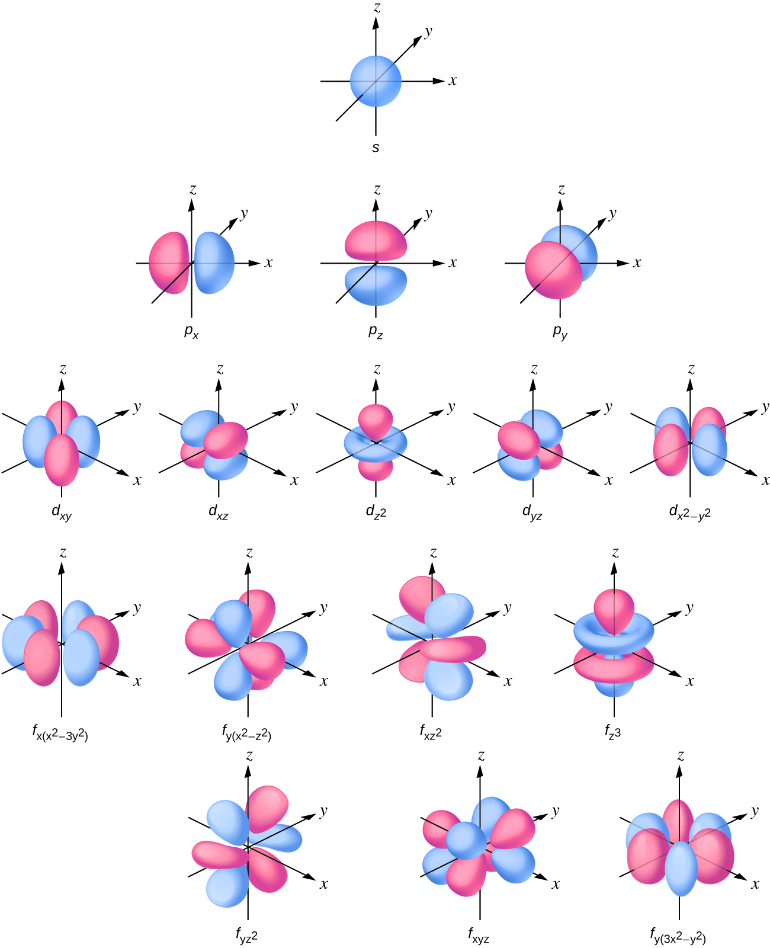
Figure 10.4c
Figure 10.4c The Shapes of Orbitals: Shapes of s, p, d, and f orbitals. (credit: Chemistry (OpenStax), CC BY 4.0.)

Slide 25
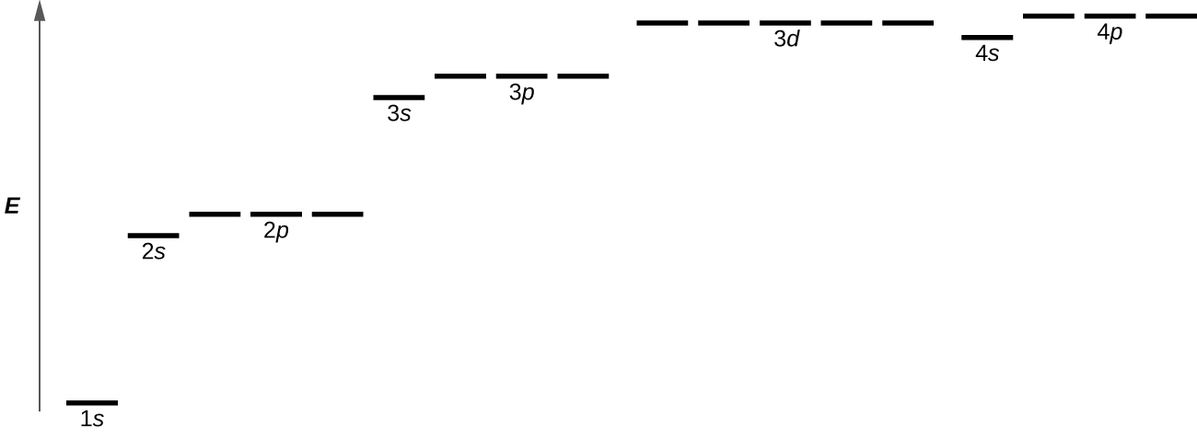
Figure 10.4d
Figure 10.4d Energy Levels of Electron Orbitals: The chart shows the energies of electron orbitals in a multi-electron atom. (credit: Chemistry (OpenStax), CC BY 4.0.)

Slide 26
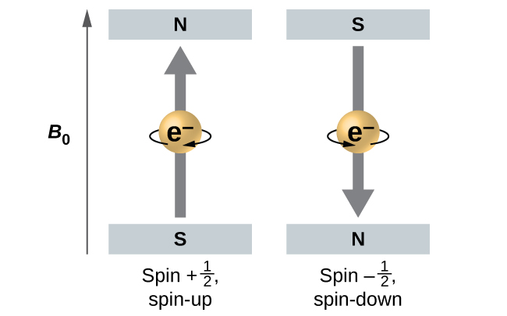
Figure 10.4e
Figure 10.4e The Spin Quantum Number (m_{s}): Electrons with two possible spin values ±1/2 in an external magnetic field. (credit: Chemistry (OpenStax), CC BY 4.0.)

Slide 27
Table 10.4a
Table 10.4a Quantum Numbers, Their Properties, and Significance
Name | Symbol | Allowed values | Physical meaning
principal quantum number | n | 1, 2, 3, 4, …. | shell, the general region for the value of energy for an electron on the orbital; principal energy level
angular momentum or azimuthal quantum number | l | 0 ≤ l ≤ n – 1 | subshell, the shape of the orbital (s, p, d, f ….)
magnetic quantum number | m_{l} | – l ≤ m_{l} ≤ l | orientation of the orbital
spin quantum number | m_{s} | 1/2, −1/2 | direction of the intrinsic quantum “spinning” of the electron
(credit: Chemistry (OpenStax), CC BY 4.0.)

Slide 28
Table 10.4b
Table 10.4b Types of Orbitals and Electron Capacities of the First Four Principal Energy Levels
Principal Energy Level (n) | Type of Subshell (l) | Number of Orbitals per Type of Subshell (m_{l}) | Orbital Name | Maximum Number of Electrons in each Subshell | Maximum Number of Electrons in each Principal Energy Level (2n²)
1 | s (0) | 1 (0) | 1s | 2 | 2
2 | s (0) | 1 (0) | 2s | 2
2 | p (1) | 3 (-1, 0, +1) | 2p | 6 | 8
3 | s (0) | 1 (0) | 3s | 2
3 | p (1) | 3 (-1, 0, +1) | 3p | 6
3 | d (2) | 5 (-2, -1, 0, +1, +2) | 3d | 10 | 18
4 | s (0) | 1 (0) | 4s | 2
4 | p (1) | 3 (-1, 0, +1) | 4p | 6
4 | d (2) | 5 (-2, -1, 0, +1, +2) | 4d | 10
4 | f (3) | 7 (-3, -2, -1, 0, +1, +2, +3) | 4f | 14 | 32
(credit: table data summarized by Jackie MacDonald, CC BY-NC 4.0)

Slide 29
Table 10.4c
Table 10.4c Working with Quantum Numbers Exercise 10.4c. Fill the spaces marked with [blank] in each column.
Orbital | n | l | m_{l} degeneracy | Radial nodes (no.)
4f | [blank] | [blank] | [blank] | [blank]
[blank] | 4 | 1 | [blank] | [blank]
[blank] | 7 | [blank] | 7 | 3
5d | [blank] | [blank] | [blank] | [blank]
(credit: Chemistry (OpenStax), CC BY 4.0.)

Slide 30
Table 10.4c (Continued)
Table 10.4d Answers to Exercise 10.4c Working with Quantum Numbers
Orbital | n | l | m_{l} degeneracy | Radial nodes (no.)
4f | 4 | 3 | 7 | 0
4p | 4 | 1 | 3 | 2
7f | 7 | 3 | 7 | 3
5d | 5 | 2 | 5 | 2
(credit: Chemistry (OpenStax), CC BY 4.0.)

Slide 31
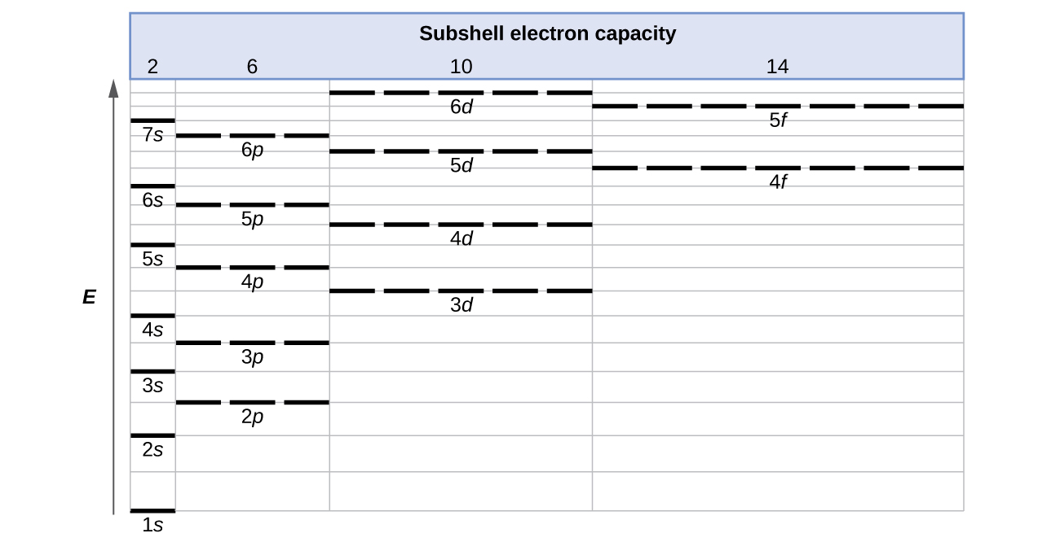
Figure 10.5a
Figure 10.5a Generalized Energy-Level Diagram: Generalized energy-level diagram for atomic orbitals in an atom with two or more electrons (not to scale). (credit: Chemistry (OpenStax), CC BY 4.0.)

Slide 32
Figure 10.5b
Figure 10.5b The diagram of an Electron Configuration for Hydrogen: The diagram of an electron configuration specifies the subshell (n and l value, with letter symbol) and superscript number of electrons. (credit: Chemistry (OpenStax), CC BY 4.0.)

Slide 33
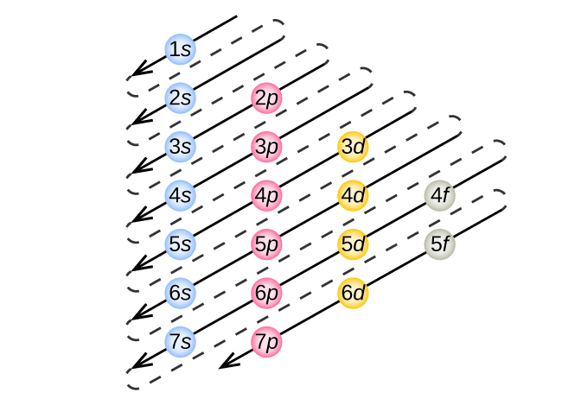
Figure 10.5c
Figure 10.5c Using the Aufbau Principle to Determine Appropriate Filling Order for Electron Configurations: The arrow leads through each subshell in the appropriate filling order for electron configurations. This chart is straightforward to construct. Simply make a column for all the s orbitals with each n shell on a separate row. Repeat for p, d, and f. Be sure to only include orbitals allowed by the quantum numbers (no 1p or 2d, and so forth). Finally, draw diagonal lines from top to bottom as shown. (credit: Chemistry (OpenStax), CC BY 4.0.)

Slide 34
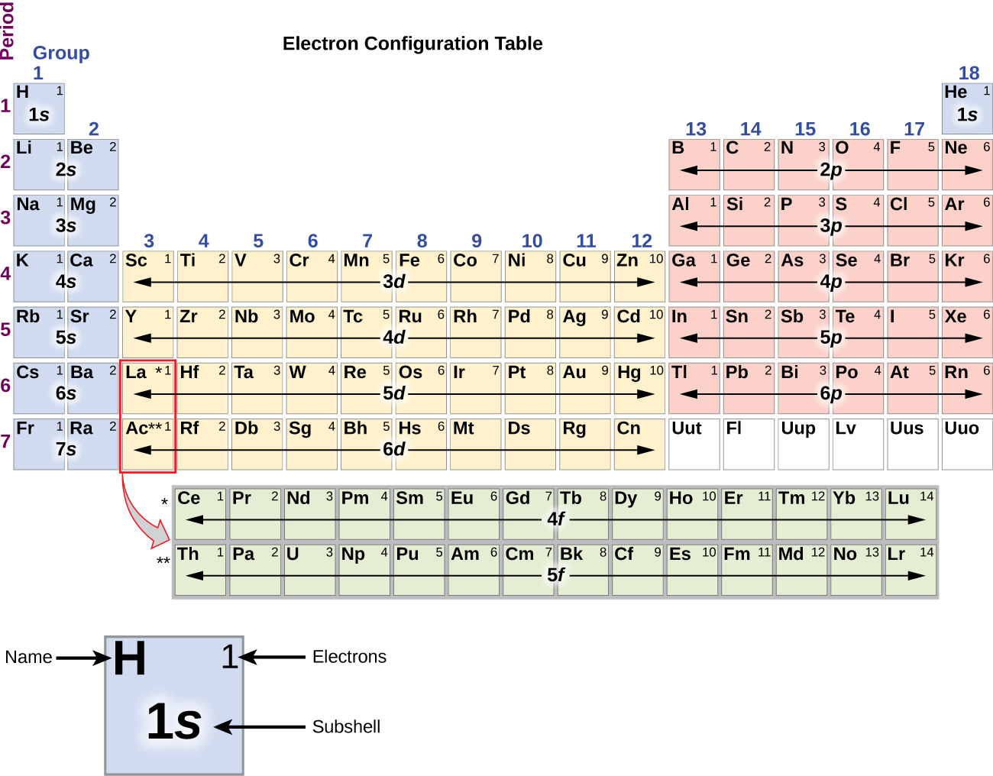
Figure 10.5d
Figure 10.5d Using the Periodic Table to Predict Electron Configuration for each Subshell: This periodic table shows the electron configuration for each subshell. By “building up” from hydrogen, this table can be used to determine the electron configuration for any atom on the periodic table. Review the Periodic Table of the Elements in other formats in Appendix A. (credit: Chemistry (OpenStax), CC BY 4.0.)

Slide 35
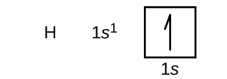
Figure 10.5e
Figure 10.5e Electron configuration and orbital diagram for hydrogen. (credit: Chemistry (OpenStax), CC BY 4.0.)

Slide 36
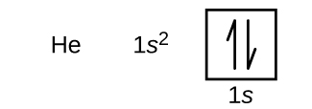
Figure 10.5f
Figure 10.5f Electron configuration and orbital diagram for helium. (credit: Chemistry (OpenStax), CC BY 4.0.)

Slide 37
Figure 10.5g
Figure 10.5g Electron configuration and orbital diagram for lithium. (credit: Chemistry (OpenStax), CC BY 4.0.)

Slide 38
Figure 10.5h
Figure 10.5h Electron configuration and orbital diagram for beryllium. (credit: Chemistry (OpenStax), CC BY 4.0.)

Slide 39
Figure 10.5i
Figure 10.5i Electron configuration and orbital diagram for boron. (credit: Chemistry (OpenStax), CC BY 4.0.)

Slide 40
Figure 10.5j
Figure 10.5j Electron configuration and orbital diagram for carbon. (credit: Chemistry (OpenStax), CC BY 4.0.)

Slide 41
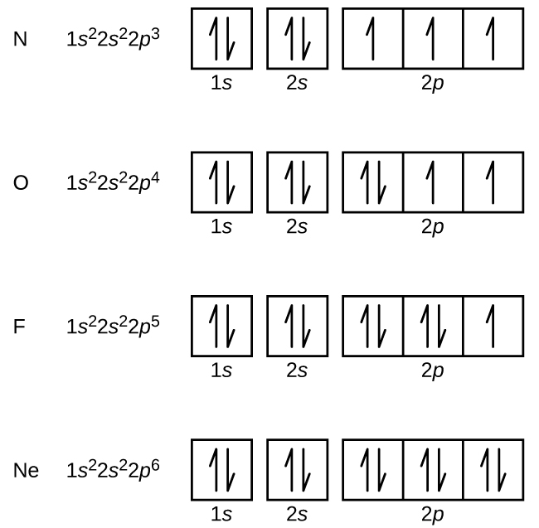
Figure 10.5k
Figure 10.5k Electron configuration and orbital diagram for nitrogen, oxygen, fluorine, and neon. (credit: Chemistry (OpenStax), CC BY 4.0.)

Slide 42
Figure 10.5l
Figure 10.5l Identifying Core Electrons and Valence Electrons in Electron Configurations: A core-abbreviated electron configuration (right) replaces the core electrons with the noble gas symbol whose configuration matches the core electron configuration of the other element. The abbreviated notation represents the elements noble gas electron configuration. (credit: Chemistry (OpenStax), CC BY 4.0.)

Slide 43
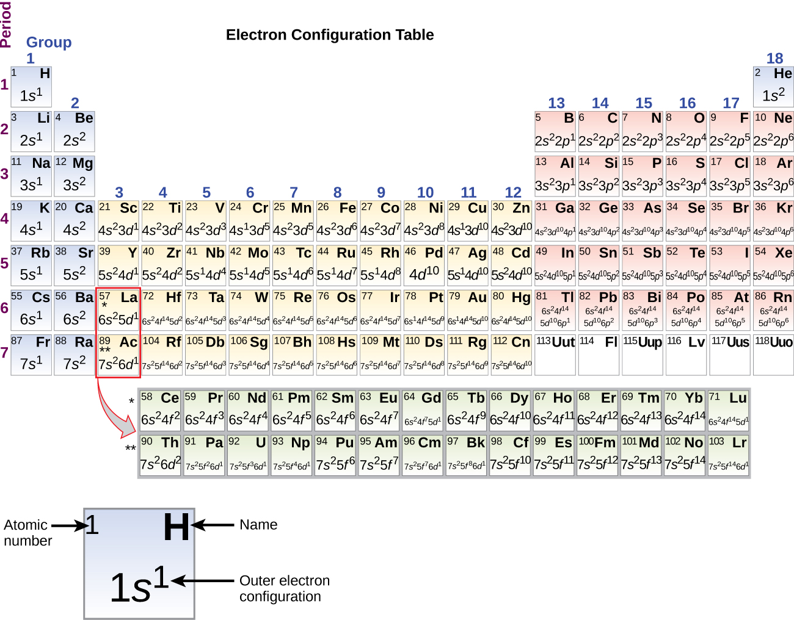
Figure 10.5m
Figure 10.5m The Periodic Table showing the Outer-Shell Electron Configuration of each Element: This version of the periodic table shows the outer-shell electron configuration of each element. Note that down each group, the configuration is often similar. Review the Periodic Table of the Elements in other formats in Appendix A. (credit: Chemistry (OpenStax), CC BY 4.0.)

Slide 44
Table 10.6a
Table 10.6a Covalent Radii of the Halogen Group Elements
Atom | Covalent radius (pm) | Nuclear charge
F | 64 | +9
Cl | 99 | +17
Br | 114 | +35
I | 133 | +53
At | 148 | +85
(credit: Chemistry (OpenStax), CC BY 4.0.)

Slide 45
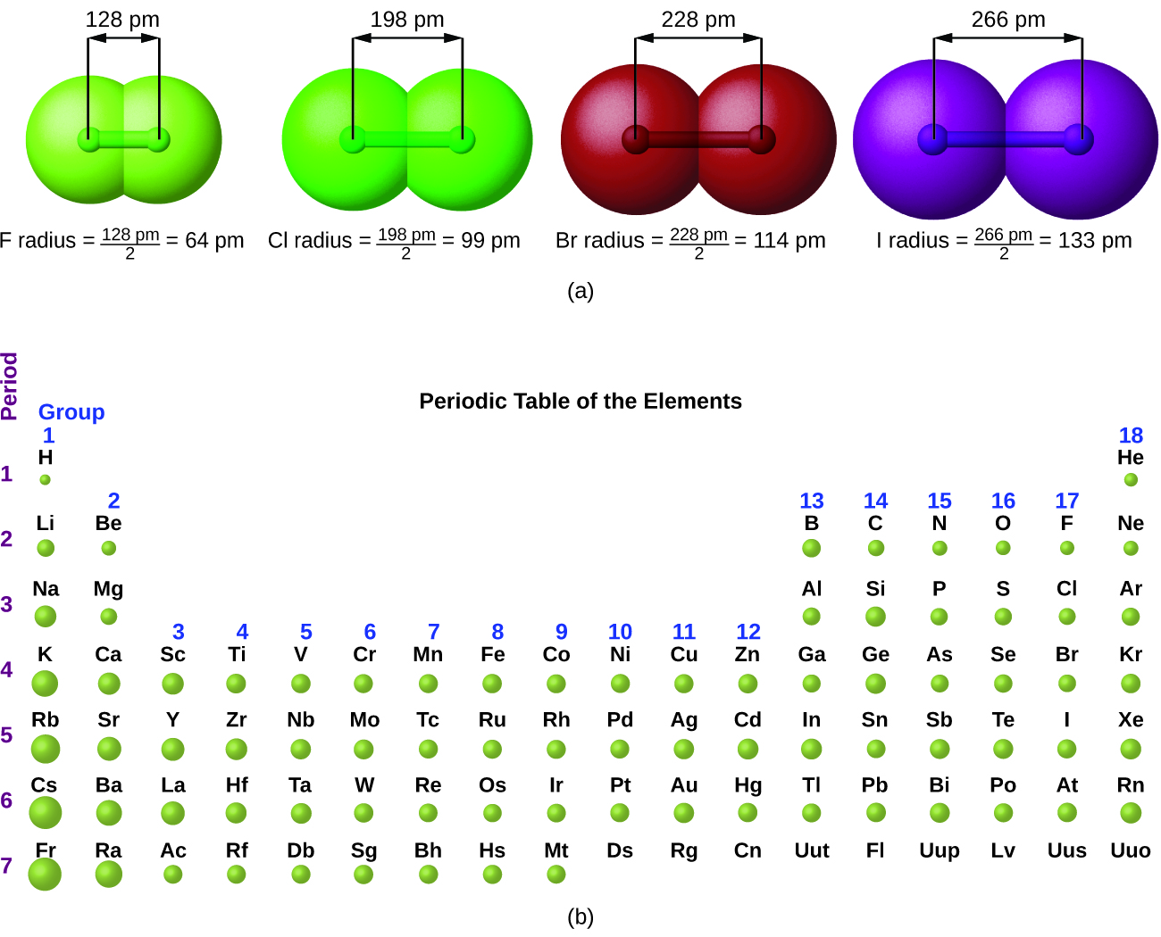
Figure 10.6a
Figure 10.6a Trends in Atomic Radii using the Periodic Table: (a) The radius of an atom is defined as one-half the distance between the nuclei in a molecule consisting of two identical atoms joined by a covalent bond. In (a) The atomic radius for the halogens increases down the group as n increases. (b) Covalent radii of the elements are shown to scale. The general trend is that radii increase down a group and decrease across a period. Review the Periodic Table of the Elements in other formats in Appendix A. (credit: Chemistry (OpenStax), CC BY 4.0.)

Slide 46
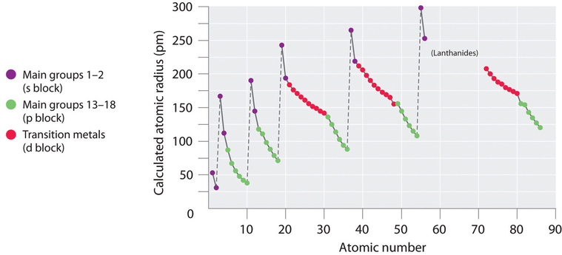
Figure 10.6b
Figure 10.6b A Plot of Periodic Variation of Atomic Radius for the First Six Rows of the Periodic Table: The intrinsic sizes of all the elements and clearly show that atomic size varies in a periodic fashion. Atomic number is listed in ascending order on the x-axis. The calculated atomic radius (pm) is plotted on the y-axis. The main groups 1 and 2 (s Blocks) are shown in purple dots; the main groups 13-18 (p block) is shown in green dots; the transition metals (d block) are shown in red. The general trend shows that atomic radii decrease from left to right across a row and increase from top to bottom down a column. Because of these two trends, the largest atoms are found in the lower left corner of the periodic table, and the smallest are found in the upper right corner. (credit: "7.3 Sizes of Atoms and Ions" by Joshua Halpern/LibreTexts, CC BY-NC-SA 4.0)

Slide 47
Figure 10.6c
Figure 10.6c Comparing Atomic Radius of a Cation to its Parent Atom: The radius for a cation is smaller than the parent atom (Al), due to the lost electrons; the radius for an anion is larger than the parent (S), due to the gained electrons. (credit: Chemistry (OpenStax), CC BY 4.0.)

Slide 48
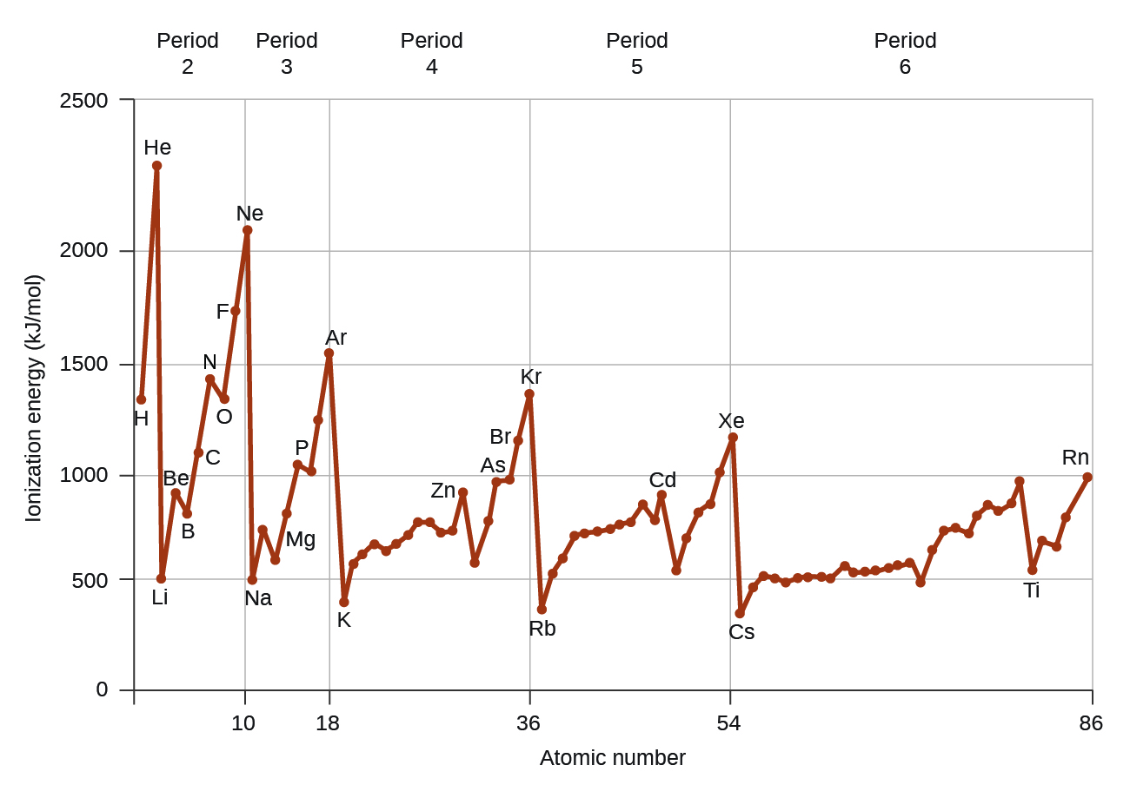
Figure 10.6d
Figure 10.6d First Ionization Energies of Some Elements: The first ionization energy of the elements in the first five periods are plotted against their atomic number. (credit: Chemistry (OpenStax), CC BY 4.0.)

Slide 49
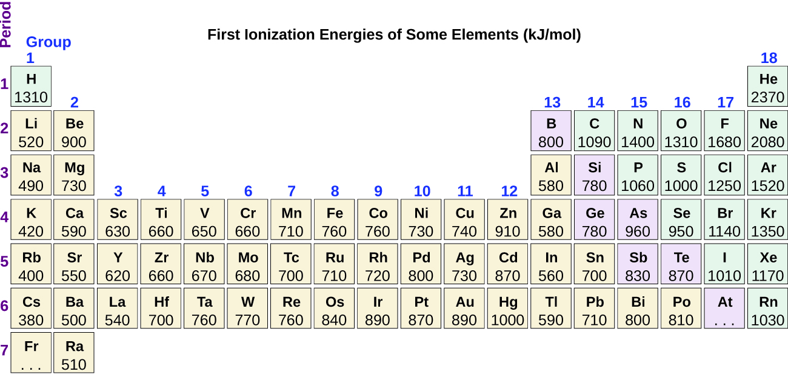
Figure 10.6e
Figure 10.6e Ionization Energies of Elements Shown in the Periodic Table: This version of the periodic table shows the first ionization energy of (IE₁), in kJ/mol, of selected elements. Review the Periodic Table of the Elements in other formats in Appendix A. (credit: Chemistry (OpenStax), CC BY 4.0.)

Slide 50
Table 10.6b
Table 10.6b Successive Ionization Energies for Selected Elements (kJ/mol)
Element | IE₁ | IE₂ | IE₃ | IE₄ | IE₅ | IE₆ | IE₇
K | 418.8 | 3051.8 | 4419.6 | 5876.9 | 7975.5 | 9590.6 | 11343
Ca | 589.8 | 1145.4 | 4912.4 | 6490.6 | 8153.0 | 10495.7 | 12272.9
Sc | 633.1 | 1235.0 | 2388.7 | 7090.6 | 8842.9 | 10679.0 | 13315.0
Ga | 578.8 | 1979.4 | 2964.6 | 6180 | 8298.7 | 10873.9 | 13594.8
Ge | 762.2 | 1537.5 | 3302.1 | 4410.6 | 9021.4 | Not available | Not available
As | 944.5 | 1793.6 | 2735.5 | 4836.8 | 6042.9 | 12311.5 | Not available
(credit: Chemistry (OpenStax), CC BY 4.0.)

Slide 51
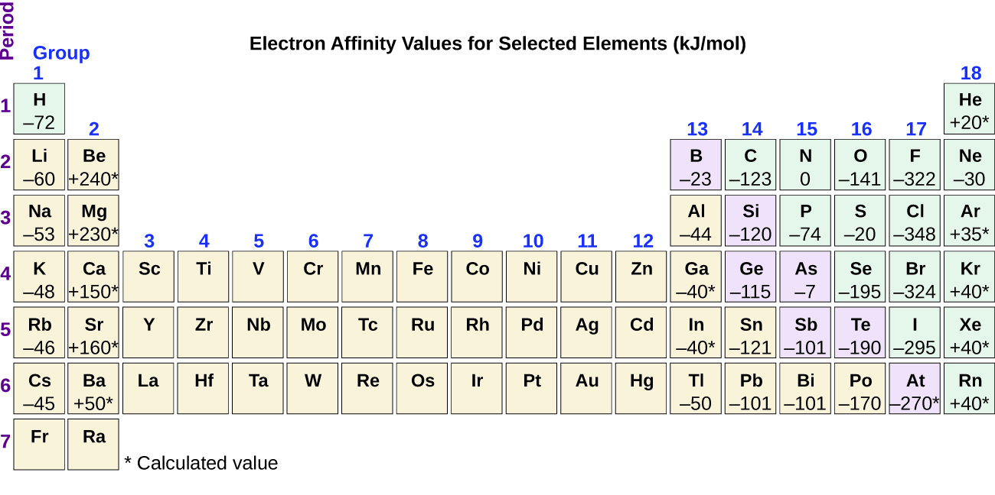
Figure 10.6f
Figure 10.6f Electron Affinities Shown in a Periodic Table: This version of the periodic table displays the electron affinity values (in kJ/mol) for selected elements. Review the Periodic Table of the Elements in other formats in Appendix A. (credit: Chemistry (OpenStax), CC BY 4.0.)

