Slide 1
Chapter 1 Welcome to Chemistry
Slides to accompany Enhanced Introductory College Chemistry by Gregory Anderson, Caryn Fahey, J.R. van Haarlem, Jackie MacDonald, Adrienne Richards, Samantha Sullivan Sauer, and David Wegman
Slide design and template by Revathi Mahadevan
Except where otherwise noted, images, tables & diagrams are reused from Enhanced Introductory College Chemistry, a derivative of Chemistry (Open Stax) by Paul Flowers, Klaus Theopold, Richard Langley & William R. Robinson and is licensed under CC BY 4.0. ​Access for free at Chemistry (OpenStax)​
Slides are licensed under CC-BY 4.0, Except while otherwise noted

Slide 2
Figure 1a
Figure 1a shows a Tipi at the Toronto Zoo. (credit: Photo by Samantha Sullivan Sauer, CC BY 4.0)

Slide 3
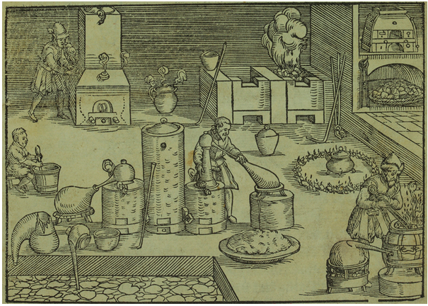
Figure 1.1a
Figure 1.1a This portrayal shows an alchemist’s workshop circa 1580. Although alchemy made some useful contributions to how to manipulate matter, it was not scientific by modern standards. (credit: “Alchemist’s workshop” by Lazarus Ercker provided by the Science History Institute, PD)

Slide 4
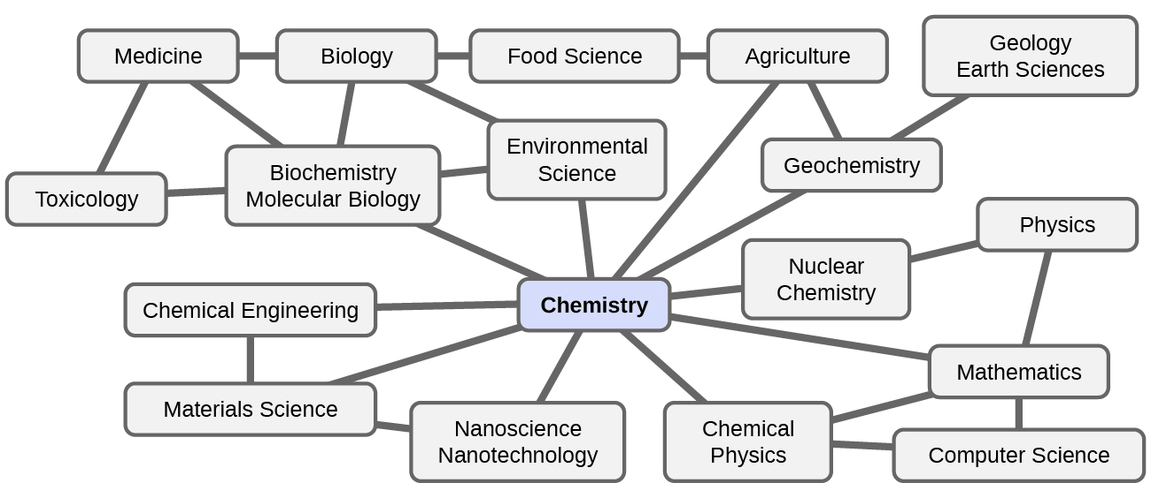
Figure 1.1b
Figure 1.1b Knowledge of chemistry is central to understanding a wide range of scientific disciplines. This diagram shows just some of the interrelationships between chemistry and other fields. (credit: Chemistry (OpenStax), CC BY 4.0.)

Slide 5
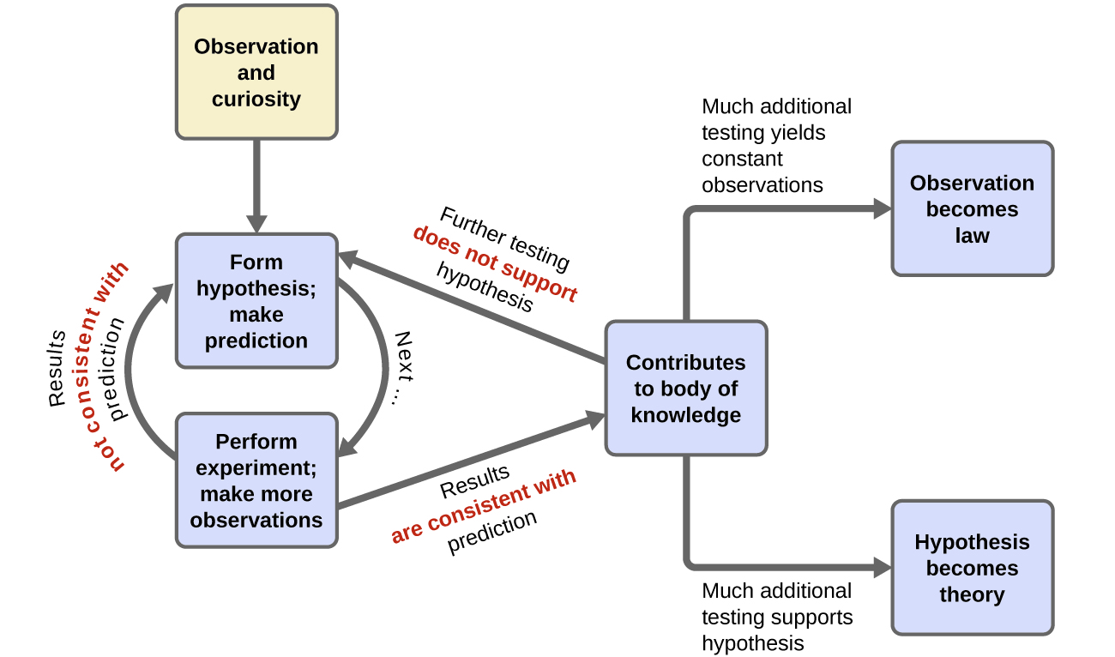
Figure 1.1c
Figure 1.1c The scientific method follows a process similar to the one shown in this diagram. All the key components are shown, in roughly the right order. Scientific progress is seldom neat and clean: It requires open inquiry and the reworking of questions and ideas in response to findings. (credit: Chemistry (OpenStax), CC BY 4.0.)

Slide 6
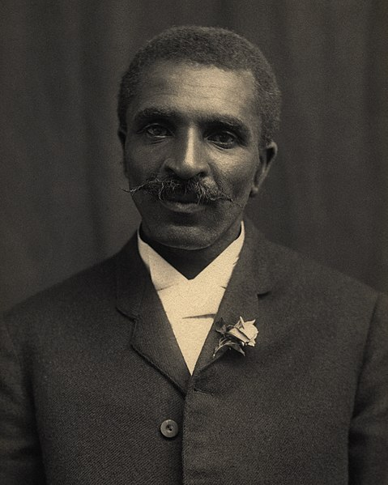
Figure 1.1e
Figure 1.1d George Washington Carver (credit: Photo by Unknown, restored by Adam Cuerden, PD)

Slide 7
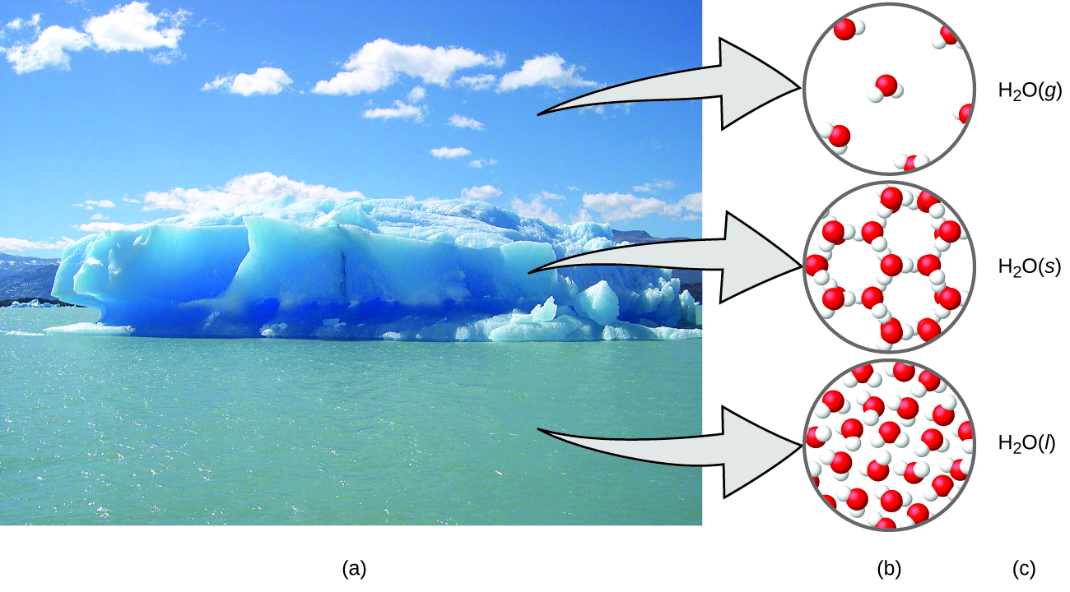
Figure 1.1d
Figure 1.1e (a) Moisture in the air, icebergs and the ocean represent water in the macroscopic domain. (b) At the molecular level (microscopic domain), gas molecules are far apart and disorganized, solid water molecules are close together and organized, and liquid molecules are close together and disorganized. (c) The formula H2O symbolizes water, and (g), (s), and (l) symbolize its phases. Note that clouds are actually comprised of either very small liquid water droplets or solid water crystals; gaseous water in our atmosphere is not visible to the naked eye, although it may be sensed as humidity. (credit: modification of work by Gorkaazk, CC BY 3.0; in Chemistry (OpenStax), CC BY 4.0).)

Slide 8
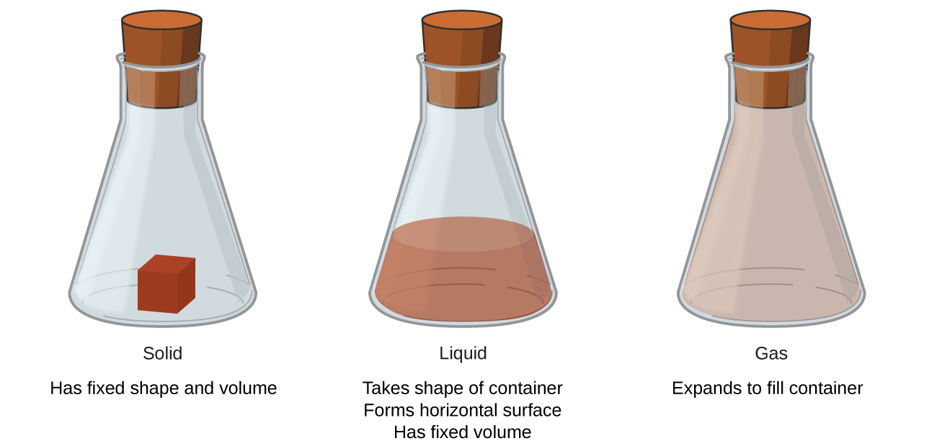
Figure 1.2a
Figure 1.2a The three most common states or phases of matter are solid, liquid, and gas. (credit: Chemistry (OpenStax), CC BY 4.0.)

Slide 9
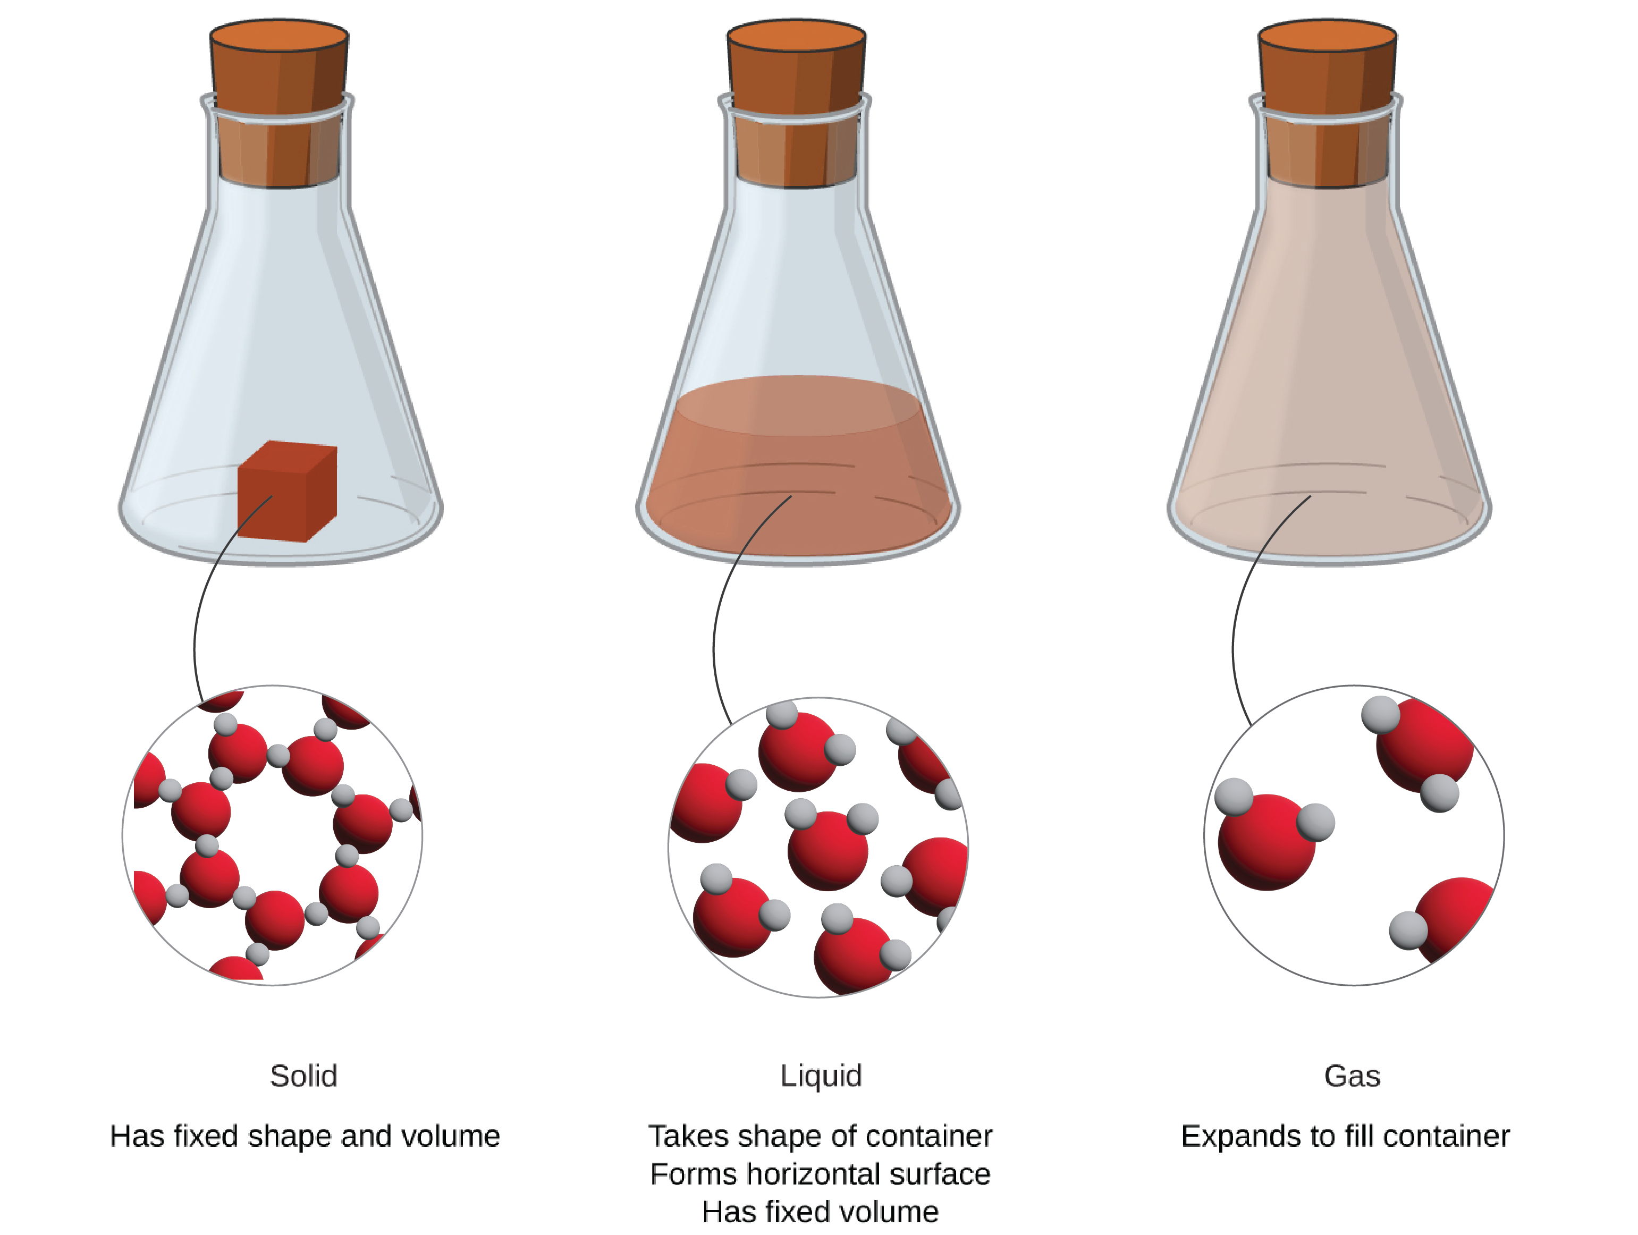
Figure 1.2b
Figure 1.2b States of matter illustrated with the molecular structure of each. (credit: Chemistry (Open Stax), adapted by Revathi Mahadevan, CC BY 4.0)

Slide 10
Table 1.2a
Table 1.2a Summary characteristics of the states of matter
Characteristic | Solid | Liquid | Gas
Shape | definite shape | Takes the shape of the container | Takes the shape of the container
Volume | Has a definite volume | Has a definite volume | Fills the volume of the container
Particle Arrangement | Very close, fixed positions | Close, random motion | Far apart, random motion
Particle Interaction | Very strong | Strong | Essentially none
Particle Movement | Very slow | Moderate | Very fast
Examples | Ice, sugar, copper | Water, mercury, ethanol | Water vapour, hydrogen, air
(credit: table data summarized by JR van Haarlem, CC BY 4.0)

Slide 11
Figure 1.2c
Figure 1.2c A plasma torch can be used to cut metal. (credit: work by Hypertherm, undeclared license)

Slide 12
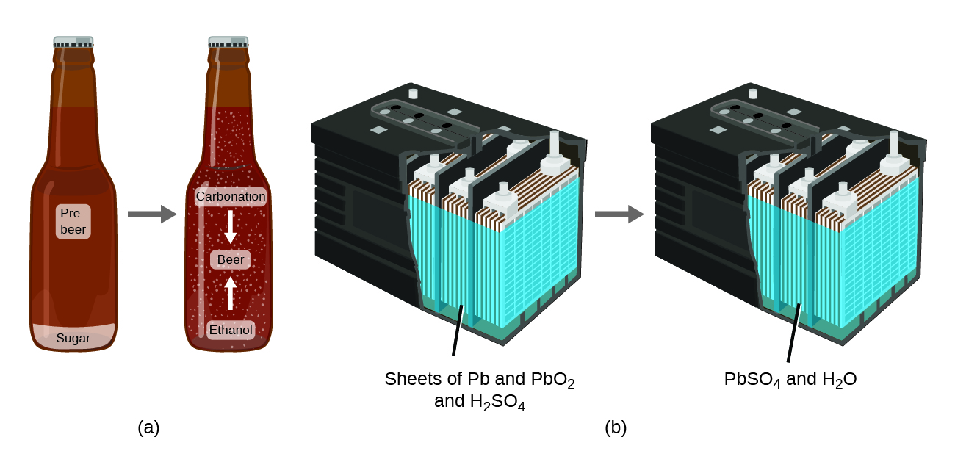
Figure 1.2d
Figure 1.2d (a) The mass of beer precursor materials is the same as the mass of beer produced: Sugar has become alcohol and carbonation. (b) The mass of the lead, lead oxide plates, and sulfuric acid that goes into the production of electricity is exactly equal to the mass of lead sulfate and water that is formed. (credit: Chemistry (OpenStax), CC BY 4.0.)

Slide 13
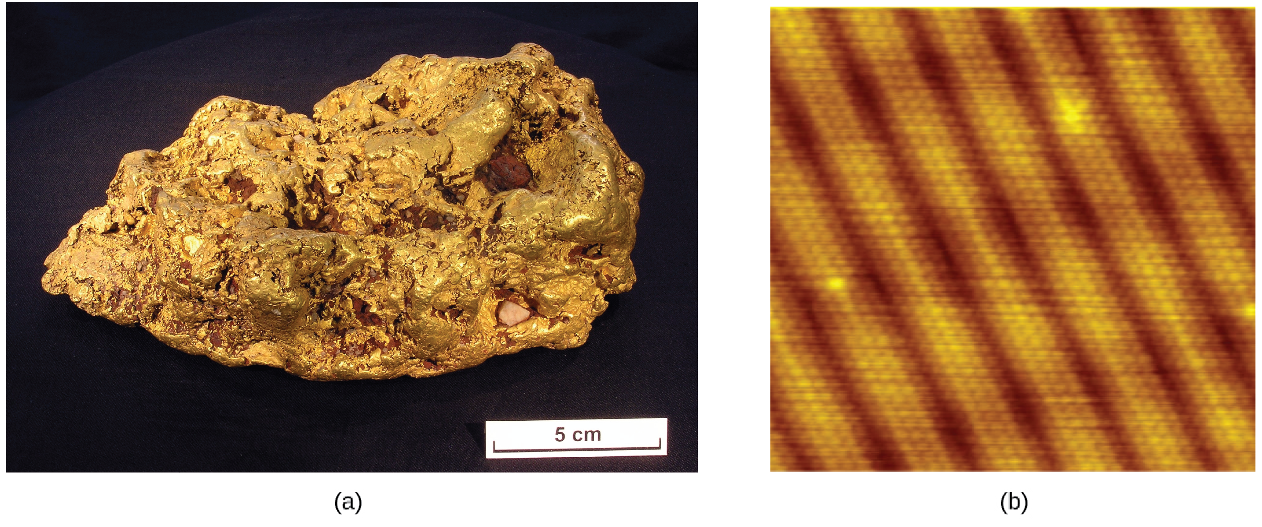
Figure 1.2e
Figure 1.2e (a) This photograph shows a gold nugget. (b) A scanning-tunneling microscope (STM) can generate views of the surfaces of solids, such as this image of a gold crystal. Each sphere represents one gold atom. (credit a: modification of work by CSIRO,, CC BY 3.0; credit b: modification of work by Erwinrossen, PD.)

Slide 14
Figure 1.2f
Figure 1.2f These images provide an increasingly closer view: (a) a cotton boll, (b) a single cotton fibre viewed under an optical microscope (magnified 40 times), (c) an image of a cotton fibre obtained with an electron microscope (much higher magnification than with the optical microscope); and (d and e) atomic-level models of the fibre (spheres of different colours represent atoms of different elements). (credit a: work by KoS, PD; credit c: modification of work by Featheredtar, CC BY 3.0) (credit b, d, e: Chemistry (OpenStax), CC BY 4.0.)

Slide 15
Figure 1.2g
Figure 1.2g The elements hydrogen, oxygen, phosphorus, and sulfur form molecules consisting of two or more atoms of the same element. The compounds water, carbon dioxide, and glucose consist of combinations of atoms of different elements. (credit: Chemistry (OpenStax), CC BY 4.0.)

Slide 16
Figure 1.2h
Figure 1.2h (a) The compound mercury(II) oxide, (b) when heated, (c) decomposes into silvery droplets of liquid mercury and invisible oxygen gas. (credit: modification of work by Paul Flowers in Chemistry (OpenStax), CC BY 4.0.)

Slide 17
Figure 1.2i
Figure 1.2i (a) Oil and vinegar salad dressing is a heterogeneous mixture because its composition is not uniform throughout. (b) A commercial sports drink is a homogeneous mixture because its composition is uniform throughout. (credit a “left”: modification of work by John Mayer, CC BY 2.0; credit a “right”: modification of work by Umberto Salvagnin, CC BY 2.0; credit b “left: modification of work by Jeff Bedford; credit a and b “right”: Chemistry (OpenStax), CC BY 4.0.)

Slide 18
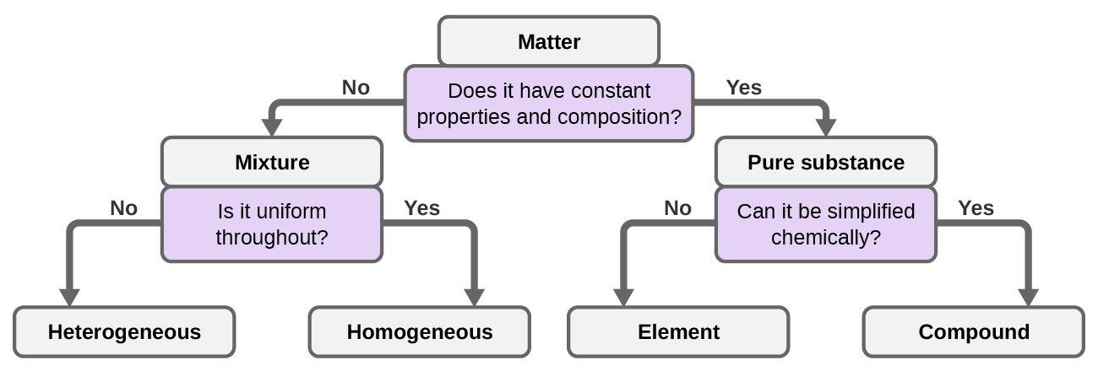
Figure 1.2j
Figure 1.2j Depending on its properties, a given substance can be classified as a homogeneous mixture, a heterogeneous mixture, a compound, or an element. (credit: Chemistry (OpenStax), CC BY 4.0.)

Slide 19
Table 1.2b
Table 1.2b Elemental Composition of Earth
Element | Symbol | Percent Mass
oxygen | O | 49.20
silicon | Si | 25.67
aluminum | Al | 7.50
iron | Fe | 4.71
calcium | Ca | 3.39
sodium | Na | 2.63
potassium | K | 2.40
magnesium | Mg | 1.93
hydrogen | H | 0.87
titanium | Ti | 0.58
chlorine | Cl | 0.19
phosphorus | P | 0.11
manganese | Mn | 0.09
carbon | C | 0.08
sulfur | S | 0.06
barium | Ba | 0.04
nitrogen | N | 0.03
fluorine | F | 0.03
strontium | Sr | 0.02
all others | - | 0.47
(credit: Chemistry (OpenStax), CC BY 4.0.)

Slide 20
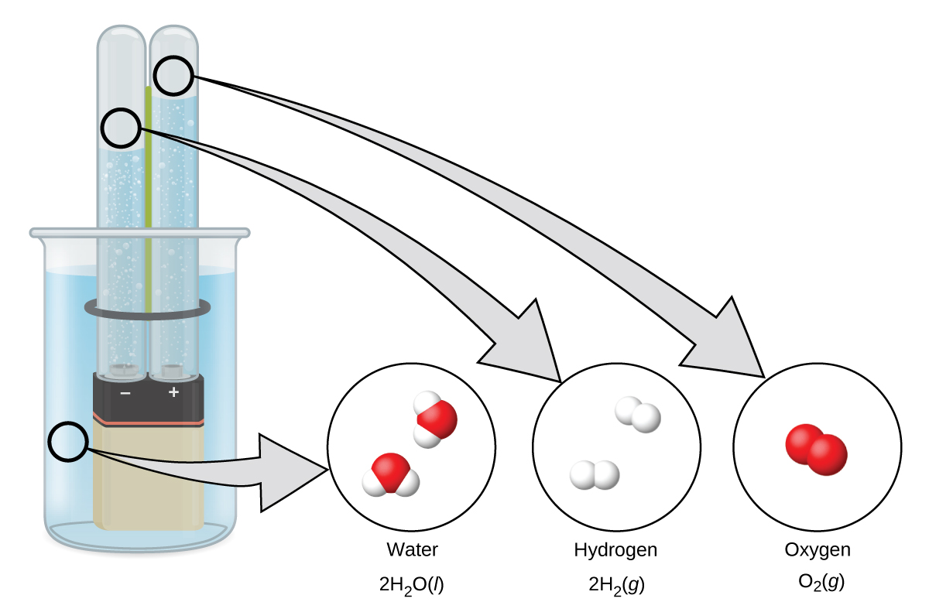
Figure 1.2k
Figure 1.2k The decomposition of water is shown at the macroscopic, microscopic, and symbolic levels. The battery provides an electric current (microscopic) that decomposes water. At the macroscopic level, the liquid separates into the gases hydrogen (on the left) and oxygen (on the right). Symbolically, this change is presented by showing how liquid H₂O separates into H₂ and O₂ gases (credit: Chemistry (OpenStax), CC BY 4.0).

Slide 21
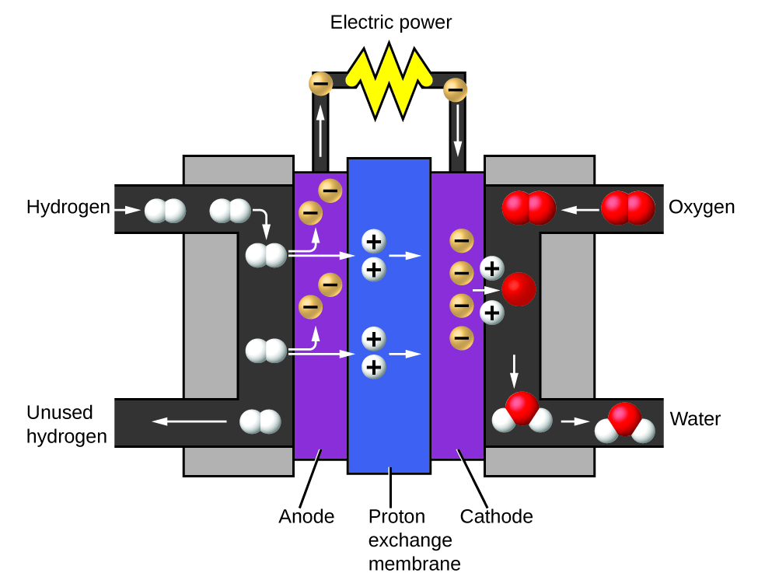
Figure 1.2l
Figure 1.2l A fuel cell generates electrical energy from hydrogen and oxygen via an electrochemical process and produces only water as the waste product. (credit: Chemistry (OpenStax), CC BY 4.0.)

Slide 22
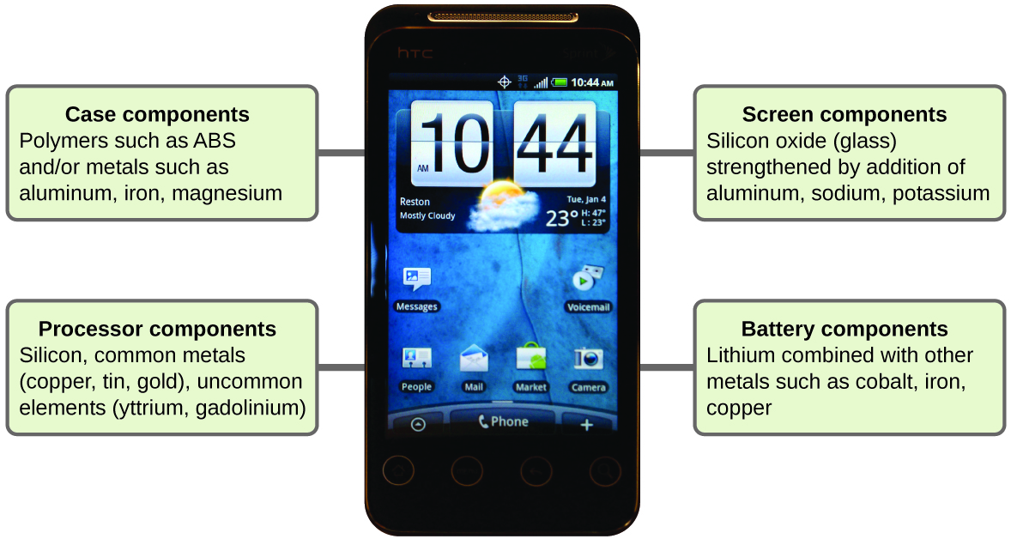
Figure 1.2m
Figure 1.2m Almost one-third of naturally occurring elements are used to make a cell phone. (credit: modification of work by John Taylor, CC BY 2.0 ; in Chemistry (OpenStax), CC BY 4.0).

