Slide 1
Talking Business
Chapter 3: Intercultural and International Communication
Unless otherwise noted, this work is licensed under a Creative Commons Attribution-NonCommercial-ShareAlike 4.0 International (CC BY-NC-SA 4.0) license. Feel free to use, modify, reuse or redistribute any portion of this presentation.

Slide 2
Learning Outcomes
At the end of this chapter, learners will be able to:
Define Culture
Define intercultural communication
Discuss the effects of ethnocentrism.
List several examples of common cultural characteristics.
Describe international communication and the global marketplace
Give examples of various styles of management, including Theory X, Y, and Z.

Slide 3
3.1 Intercultural Communication
Culture is the ongoing negotiation of learned and patterned:
Beliefs
Attitudes
Values
Behaviours
Photo by geralt, Pixabay License

Slide 4
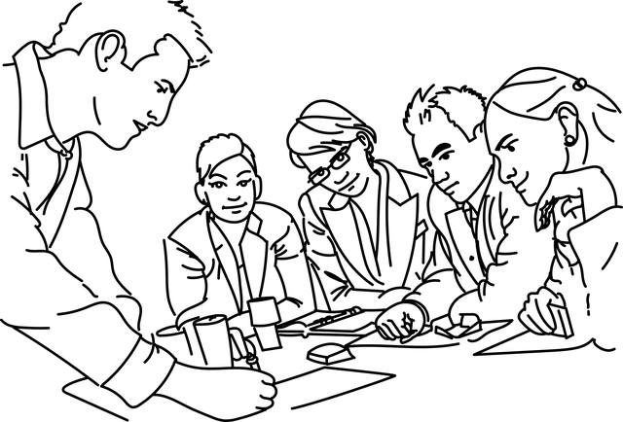
3.1 Intercultural Communication
Ethnocentrism prevents you from bridging the gap with others and increases intolerance of difference.
In business and industry, you need:
Tolerance
Understanding
Patience
Openness to difference
Image by Augusto Ordóñez, Pixabay License

Slide 5
3.1 Intercultural Communication
Intercultural communication is communication between people with differing cultural identities.
Understand Intercultural communication:
Compare cultures
Shift to local perspective
You don’t have to know everything to know something
There are rules we can learn
Experience counts
Perspectives can differ
Intercultural communication can be applied to international business
Intercultural communication integrates disciplines

Slide 6
3.2 Common Cultural Characteristics
Five common cultural characteristics:
Rites of initiation
Common history and traditions
Common values and principles
Common purpose and sense of mission
Common symbols, boundaries, status, language, and rituals

Slide 7
3.3 Divergent Cultural Characteristics
Cultures are distinct when it comes to:
Rules
Uncertainty
Time and time horizons
Directness
Materialism
Power distance
Photo by Gerd Altmann, Pixabay License

Slide 8
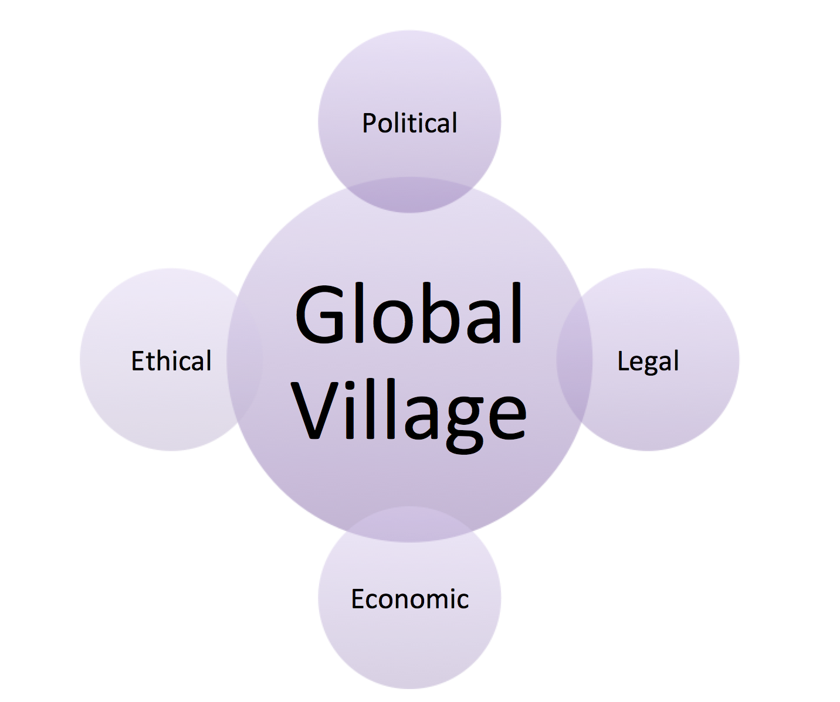
3.4 International Communication and the Global Marketplace
International Communication and the Global Marketplace
Fig 3.1 Components of the Global Village

Slide 9
3.4 International Communication and the Global Marketplace
What is the Global Village?
Information and transportation technologies reduce the time and space required to interact.
Photo by Gerd Altmann, Pixabay License

Slide 10
3.5 Styles of Management
Theory X
Workers:
Are motivated by basic needs.
Have a general disposition against labour.
Need constant, direct supervision
Managers:
Are authoritarian, autocratic.
Do no seek input/feedback from employees.
Use control and incentive programs to provide punishment and reward.
Photo by JL G, Pixabay License

Slide 11
3.5 Styles of Management
Theory Y
Workers:
Are ambitious, self-directed, capable of self
motivation.
Managers:
Think that a job well done is a reward.
View employees as a valuable source of feedback.
Value collaboration.
Believe workers need little supervision.
Photo by JL G, Pixabay License

Slide 12
3.5 Styles of Management
Theory Z
Workers:
Have a high need for reinforcement.
Emphasize belonging.
Are trusted to do their jobs with excellence.
Managers:
Are trusted to support their workers.
Photo by JL G, Pixabay License

Slide 13
Reflection Activity
After learning more about cultural differences in business contexts, what advice do you have for Abe, where her country of origin culture and customs are different from the new Canadian customs she encounters? Should she assimilate and just shake hands with male colleagues? If it’s important for her to maintain some of her customs, how might she communicate about that with her new colleagues?

