Slide 1
Talking Business
Chapter 15: Feedback
Unless otherwise noted, this work is licensed under a Creative Commons Attribution-NonCommercial-ShareAlike 4.0 International (CC BY-NC-SA 4.0) license. Feel free to use, modify, reuse or redistribute any portion of this presentation.

Slide 2
Learning Outcomes
Explain why effective feedback is important.
Outline how to give useful, skillful feedback that supports and encourages your colleagues.
Discuss how to accept and implement feedback to advance yourself and your career.

Slide 3
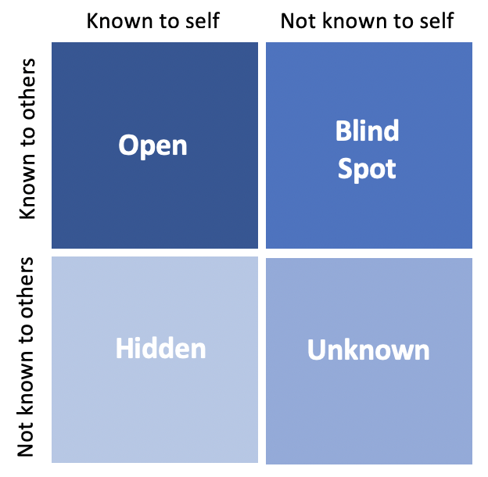
15.1 Giving & Receiving Feedback
Why is Effective Feedback Important?
Effective feedback helps us improve and grow.
Johari Window
The Johari Window explains self-awareness as a quadrant:
Open: What we know about ourselves, and is also known by others
Blindspot: What we don’t know about ourselves, but is known by others
Hidden: What we know about ourselves, but is not known by others.
Unknown: What we don’t know about ourselves, and is not known by others (Luft & Ingham, 1961)
Figure 15.1. The Johari Window

Slide 4
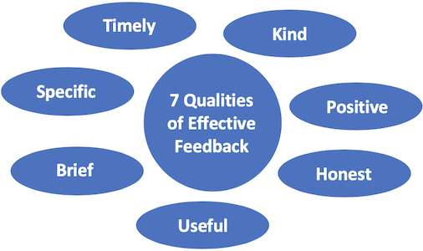
15.1 Giving & Receiving Feedback
How to Give Feedback
Timely: Give feedback as soon as possible
Kind: Help the recipient grow and build skills
Positive: Tell the recipient what to do
Honest: Always tell the truth (kindly!)
Useful: Make suggestions that are practical and actionable
Brief: Focus on only 1 improvement
Specific: Be precise and give examples
Figure 15.2. The 7 Qualities of Effective Feedback

Slide 5
15.1 Giving & Receiving Feedback
The Easy 3-Step Method
Keep: Start by describing the best part
Improve: Describe the most important improvement, and why it’s important
Ask: the recipient if they have questions, if what you said makes sense.
Keep
Improve
Ask

Slide 6
15.1 Giving & Receiving Feedback
How to Receive Feedback
When someone offers feedback, try to silence your inner critic so that you can benefit from the ideas and support. These strategies will help:

Slide 7
15.2 Giving Feedback to Others
Non-Verbal Feedback
Uninterested non-verbal cues:
Eyes closed
Verbal Feedback
You can use questions to confirm your understanding of the speaker’s message
If you’re not entirely sure of a significant point, you might ask a clarifying question
Interested non-verbal cues:
Sitting up straight and facing you with an intent look
Asking questions when the opportunity presents itself can help you as a listener
Arms and legs crossed
Bodies bent in slouches
Eye contact
Nodding your head affirmatively
Making backchannel responses such as “Yes,” “Umhum,” or “OK”

Slide 8
15.2 Giving Feedback to Others
The key to good written feedback is to offer constructive criticism, which consists of comments that are specific and descriptive enough for the receiver to apply them for the purpose of self-improvement
Written Feedback
When giving written feedback to others
Be specific and descriptive
Be positive
Be constructive
Be realistic
Be relevant

Slide 9
15.3 Receiving Feedback
Being open to receiving feedback is the only way to have a better picture of your performance as a presenter or speaker
The Art of Receiving Feedback
Some guidelines for learning to love receiving feedback:
Be Open and Accept Someone Else’s Perspective
Embrace the Discomfort
Ask for More Information, Examples, and Clarifying Questions
Remember – Feedback Doesn’t Mean You Suck

Slide 10
15.3 Receiving Feedback
Giving formal feedback to yourself
The key to effective self-evaluation is to identify strengths and weaknesses, to evaluate yourself within the context of the task, and to set concrete goals for future performance
Guidelines relevant for students’ self-evaluation of their speeches:
Identify strengths and weaknesses
Evaluate yourself within a context
Set goals for next time
Revisit goals and assess progress at regular intervals

Slide 11
Reflection Activity
Returning to Dhavit, who is preparing to give feedback to Samantha:
What are some ways he can provide feedback?
Which method is preferred? What are some things he should
Consider while giving the feedback to ensure Samantha is successful in presenting?

