Slide 1
CONFLICT MANAGEMENT
CHAPTER 9: PERSONALITY AND CONFLICT STYLES
Unless otherwise noted, this work is licensed under a Creative Commons Attribution-NonCommercial-ShareAlike 4.0 International (CC BY-NC-SA 4.0) license. Feel free to use, modify, reuse or redistribute any portion of this presentation.

Slide 2
Learning Outcomes
Upon successful completion of this chapter, you will be able to:
Define personality.
Identify components of the Big 5 Personality Trait theory.
Recognize the relationship between personality traits and approaches to conflict.
Review cognitive and personal-social dimensions that impact our perceptions and relationships.
Summarize Janie Harden Fritz’s types of problematic bosses, coworkers, and subordinates.
Compare the ABC styles of conflict management.

Slide 3
9.1 PERSONALITY I
Personality encompasses a person’s relatively stable feelings, thoughts, and behavioral patterns.
Notes:
Each of us has a unique personality that differentiates us from other people, and understanding someone’s personality gives us clues about how that person is likely to act and feel in a variety of situations. To manage conflict effectively, it is helpful to understand the personalities of different employees. Having this knowledge is also useful for placing people into jobs and organizations.

Slide 4
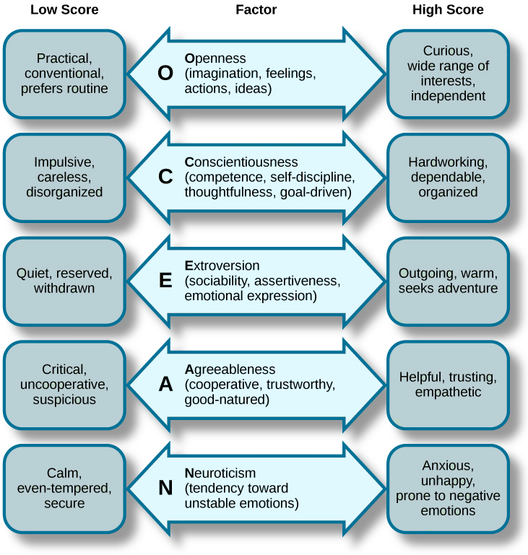
9.1 PERSONALITY II
Five Factor Model
Image in Psychology, 2nd edition by Rice University, CC BY-NC-SA 4.0.
Notes:
How many personality traits are there? How do we even know? In every language, there are many words describing a person’s personality. In fact, in the English language, more than 15,000 words describing personality have been identified.
The Big Five dimensions are openness, conscientiousness, extraversion, agreeableness, and neuroticism—if you put the initials together, you get the acronym OCEAN. Everyone has some degree of each of these traits; it is the unique configuration of how high a person rates on some traits and how low on others that produces the individual quality we call personality. Let’s talk about each of these traits in more detail.
Openness is the degree to which a person is curious, original, intellectual, creative, and open to new ideas. People high in openness seem to thrive in situations that require flexibility and learning new things.
Conscientiousness refers to the degree to which a person is organized, systematic, punctual, achievement-oriented, and dependable. Conscientiousness is the one personality trait that uniformly predicts how high a person’s performance will be across a variety of occupations and jobs (Barrick & Mount, 1991).
Extraversion is the degree to which a person is outgoing, talkative, sociable, and enjoys socializing. One of the established findings is that they tend to be effective in jobs involving sales (Barrick & Mount, 1991; Vinchur, et al., 1998).
Agreeableness is the degree to which a person is affable, tolerant, sensitive, trusting, kind, and warm. In other words, people who are high in agreeableness are likeable people who get along with others.
Neuroticism refers to the degree to which a person is anxious, irritable, temperamental, and moody. It is perhaps the only Big Five dimension where scoring high is undesirable. Neurotic people have a tendency to have emotional adjustment problems and habitually experience stress and depression.

Slide 5
9.1 PERSONALITY III
Personality and Conflict
Studying personality gives us the chance to understand ourselves and others needs and preferences, which may be very different from one another. In previous chapters, we talked about Type A personality and conflict. We can also think about the Big 5 personality traits and conflict.
Notes:
For example, introverts gain and gather energy through alone time. At work, they may prefer to work alone and need some time to themselves after team activities. Extroverts on the other hand gain and gather energy through interactions with other people and might prefer group work and an open office floor plan (Cain, 2012).
These difference in how we gain and gather energy could very well be the cause of the above conflict. Instead of taking each other behaviors, one wanting some alone time and one wanting to talk, personally (being hurt or annoyed with each other), we can use this understand to set up clear expectations and personal boundaries with others.

Slide 6
9.2 COGNITIVE AND PERSONAL-SOCIAL DISPOSITIONS I
Cognitive Dispositions
Cognitive dispositions refer to general patterns of mental processes that impact how people respond and react to the world around them. These dispositions (or one’s natural mental or emotional outlook) take on several different forms. For our purposes, we’ll briefly examine the four identified by John Daly (2011): locus of control, cognitive complexity, authoritarianism/dogmatism, and emotional intelligence.

Slide 7
9.2 COGNITIVE AND PERSONAL-SOCIAL DISPOSITIONS II
Locus of Control
As we have previous learned, individuals differ with respect to how much control they perceive they have over their behaviour and life circumstances. People with an internal locus of control believe that they can control their behavior and life circumstances. For example, people with an internal locus of control would believe that their careers and choice of job are ultimately a product of their behaviors and decisions.
Notes:
The opposite is an external locus of control, or the belief that an individual’s behavior and circumstances exist because of forces outside the individual’s control. An individual with an external locus of control might believe that their career is a matter of luck or divine intervention. This individual would also be more likely to blame outside forces if their work life isn’t going as desired.

Slide 8
9.2 COGNITIVE AND PERSONAL-SOCIAL DISPOSITIONS III
Cognitive Complexity
According to John Daly (2002), “cognitive complexity has been defined in terms of the number of different constructs an individual has to describe others (differentiation), the degree to which those constructs cohere (integration), and the level of abstraction of the constructs (abstractiveness)”
Notes:
By differentiation, we are talking about the number of distinctions or separate elements an individual can utilize to recognize and interpret an event. For example, in the world of communication, someone who can attend to another individual’s body language to a great degree can differentiate large amounts of nonverbal data in a way to understand how another person is thinking or feeling. Someone low in differentiation may only be able to understand a small number of pronounced nonverbal behaviors.

Slide 9
9.2 COGNITIVE AND PERSONAL-SOCIAL DISPOSITIONS IV
Authoritarianism/Dogmatism
Authoritarianism is a form of social organization where individuals favor absolute obedience to authority (or authorities) as opposed to individual freedom. The highly authoritarian individual believes that individuals should just knowingly submit to their power.
Dogmatism, although closely related, is not the same thing as authoritarianism. Dogmatism is defined as the inclination to believe one’s point-of-view as undeniably true based on faulty premises and without consideration of evidence and the opinions of others
Notes:
According to Jason Wrench, James C. McCroskey, and Virginia Richmond (2008), two personality characteristics that commonly impact interpersonal communication are authoritarianism and dogmatism.

Slide 10
9.2 COGNITIVE AND PERSONAL-SOCIAL DISPOSITIONS V
Emotional Intelligence
Emotional intelligence (EQ) is important for interpersonal communication because individuals who are higher in EQ tend to be more sociable and less socially anxious. As a result of both sociability and lowered anxiety, high EQ individuals tend to be more socially skilled and have higher quality interpersonal relationships.

Slide 11
9.2 COGNITIVE AND PERSONAL-SOCIAL DISPOSITIONS VI
Personal-Social Dispositions
Social-personal dispositions refer to general patterns of mental processes that impact how people socially relate to others or view themselves. All of the following dispositions impact how people interact with others, but they do so from very different places. Without going into too much detail, we are going to examine the seven personal-social dispositions identified by John Daly (2011).

Slide 12
9.2 COGNITIVE AND PERSONAL-SOCIAL DISPOSITIONS VII
Self-Esteem
Self-esteem consists of your sense of
self-worth and the level of satisfaction you have with yourself; it is how you feel about yourself. A good self-image raises your self-esteem; a poor self-image often results in poor self-esteem, lack of confidence, and insecurity.
Photo by Pawel Czerwinski licensed by Unsplash
Notes:
Not surprisingly, individuals with low self-esteem tend to have more problematic interpersonal relationships and may have difficulty asserting their needs and boundaries.
Our self-esteem is determined by many factors, including how well we view our own performance and appearance, and how satisfied we are with our relationships with other people (Tafarodi & Swann, 1995). Self-esteem is in part a trait that is stable over time, with some people having relatively high self-esteem and others having lower self-esteem.

Slide 13
9.2 COGNITIVE AND PERSONAL-SOCIAL DISPOSITIONS VIII
Narcissism
In modern times, narcissism is defined a personality trait characterized by overly high self-esteem, self-admiration, and self-centeredness. Highly narcissistic individuals are completely self-focused and tend to ignore the communicative needs and emotions of others.
Notes:
In social situations, highly narcissistic individuals strive to be the center of attention. Narcissists tend to agree with statements such as the following:
“I know that I am good because everybody keeps telling me so.” “I can usually talk my way out of anything.” “I like to be the center of attention.” “I have a natural talent for influencing people.”

Slide 14
9.3 TYPES OF DEVIANT WORKPLACE BEHAVIOUR I
Deviant workplace behaviour is defined as voluntary behavior of organizational members that violates significant organizational norms and practices or threatens the wellbeing of the organization and its members.
Notes:
Eventually, everyone is going to run into someone within the workplace that is going to annoy them. There are many out there designed to help you deal with difficult people, toxic people, workplace vampires, energy drainers, etc.… Some of these people are just irritants while other problem people can be more egregious (e.g., aggressive, bullying, deviating from work norms, overly cynical about everything, etc.).
We view these people as problem people because they ultimately take more of our resources to deal with them.

Slide 15
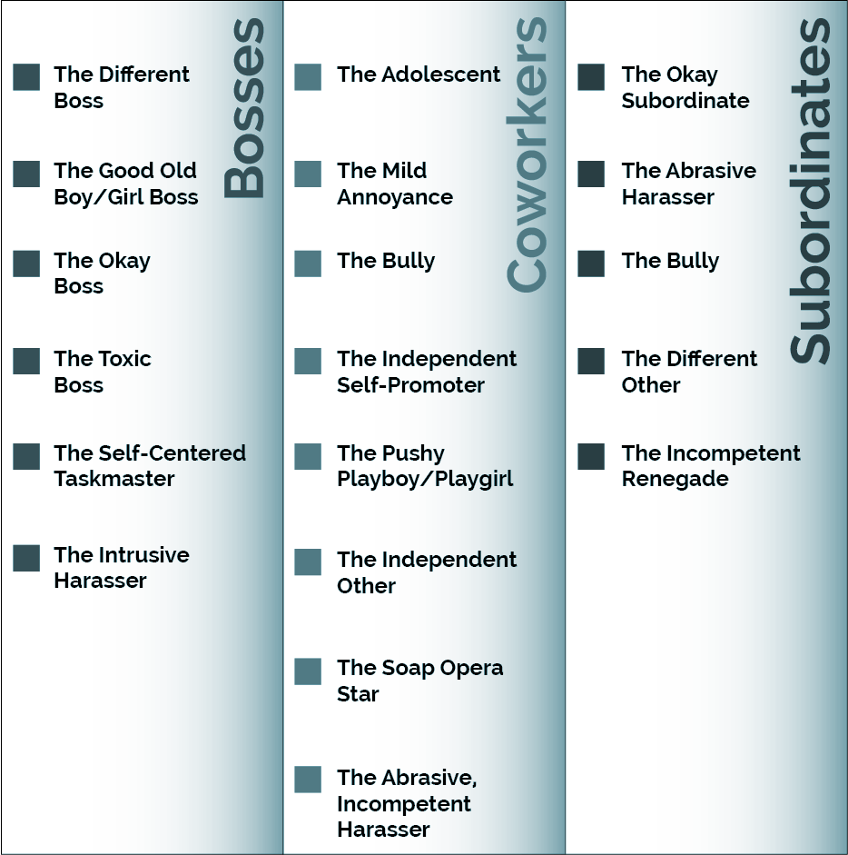
9.3 TYPES OF DEVIANT WORKPLACE BEHAVIOUR II
Problematic People in the Workplace
Image by Jason S. Wrench, Narissra M. Punyanunt-Carter, and Katherine S. Thweatt, Interpersonal Communication, CC BY-NC-SA 4.0. Color altered from the original.
Notes:
Problem Bosses- Through Harden Fritz’s research into bosses, she found that there are six common types of problematic bosses: different, okay good old boy/girl, toxic, self-centered taskmaster, and intrusive harasser.
The Different Boss- First, The Different Boss is someone a subordinate sees as distractingly different from them as a person. Different subordinates are going to view what is “distractingly different” in a wide range of different ways.
Good Old Boy or Good Old Girl Boss- Second, is the Good Old Boy or Good Old Girl Boss. This type of boss is someone who probably hasn’t progressed along with the modern world of corporate thinking. This person may be gregarious and outgoing, but this person tends to see the “old ways of doing things” as best – even when they’re problematic.
Okay Boss- The third type of boss is the Okay Boss. This person is exactly like the name says, okay and average in just about every way possible. These individuals are, in many ways, coasting towards retirement.
The Toxic Boss- Fourth, we have the Toxic Boss. These bosses are just all-around problematic in the workplace. These people are often seen as unethical, obnoxious, and unprofessional by their subordinates.
Self-Centered Taskmaster- The fifth type of problematic boss is the Self-Centered Taskmaster. The self-centered taskmaster is ultimately “focused on getting the job done to advance his/her own goals, without concern for others” (Harden Fritz, 2009, p. 31). This type of boss is purely focused on getting work done.
The Intrusive Harasser Boss- Sixth, we have the Intrusive Harasser Boss. This individual tends to be highly interfering and often wants to get caught up in their subordinates’ personal and professional lives.

Slide 16
9.3 TYPES OF DEVIANT WORKPLACE BEHAVIOUR III
Problem Coworkers
Through Harden Fritz’s research into coworkers, she found that there are eight common types of problematic coworkers: adolescent, bully, mild annoyance, independent self-promoter, pushy playboy/playgirl, independent other, soap opera star, and the abrasive, incompetent harasser.
Notes:
Adolescent- The first common problematic coworker you can have is the Adolescent. The adolescent is the Peter Pan of the business world, they don’t want to grow up. These people tend to want to be the center of attention and will be the first to let everyone know when they’ve accomplished something.
Bully- Second, we have the Bully. As we have previously discussed, bully is still common in many Canadian workplaces. This individual has a knack of being overly demanding on their peers, but then dares to take credit for their peers’ work when the time comes.
Mild Annoyance- The third type of problematic coworker is the Mild Annoyance. When it comes down to it, this person isn’t going to ruin your day, but they are mildly annoying and tend to be so on a routine basis. Maybe it’s a coworker who wants to come in every morning and talk to you about what they watched on television the night before while you’re trying to catch up on email.
Independent Self-Promoter- Fourth, we have the Independent Self-Promoter. The independent self-promoter is someone who likes to toot their own horn at work. This individual tends to be slight to extremely narcissistic and thinks the world revolves around them.
Pushy Playboy/Playgirl- The fifth problematic coworker is the Pushy Playboy/Playgirl. The pushy playboy/playgirl is an individual marked by their tendency to push other coworkers into doing things for them. Often these tasks have nothing to do with work at all. For example, the pushy playboy/playgirl would be the type of person to demand that a younger or more submissive coworker run down the street for a Starbucks run.
Independent Other- The sixth common problematic coworker is the Independent Other. In many ways, the independent other is similar to the different bosses discussed earlier. These people tend to be perceived as uniquely different from their coworkers.
Soap Opera Star- The seventh common problematic coworker identified by Harden Fritz (2009) is the Soap Opera Star. The soap opera star lives for drama in the workplace. New rumors of office romances? This person tends to be a busybody and will be all up in everyone’s business both at work and in their personal lives.
Abrasive, Incompetent Harasser- The final type of problematic coworker is the Abrasive, Incompetent Harasser, which is an individual who tends to be highly uncivil in the workplace with a particular emphasis on sexually harassing behavior. This coworker is very similar to the intrusive harasser boss discussed earlier.

Slide 17
9.3 TYPES OF DEVIANT WORKPLACE BEHAVIOUR IV
Problem Subordinates
In the two previous sections, we’ve looked at problematic bosses and coworkers, but subordinates can also be a bit of a problem in the workplace. For this reason, Harden Fritz (2009) identified five clear troublesome subordinates: the okay subordinate, the abrasive harasser, the bully, the different other, and the incompetent renegade.
Notes:
First, we have the Okay Subordinate. Just like the name sounds, this person is not stellar, nor is this person awful; this person is just OK. This person does tend towards being a mildly annoying busybody at work.
Second, we have the Abrasive Harasser. The abrasive harasser is an individual who tends to be someone who needs counseling regularly about what constitutes sexual harassment. They may not even always realize what types of behavior are appropriate in the workplace.
The next common problem subordinate is the Bully. According to Harden Fritz, this subordinate is one “who bosses others, usurps authority, is competitive and is at the same time insecure” (Harden Fritz, 2009, p. 40).
The fourth common problem subordinate is the Different Other. Just like the two previous versions of “difference” discussed for bosses and coworkers, the different other is a subordinate who is perceived as distinctly different from their supervisor
Finally, we have the Incompetent Renegade. This individual tends to be ethically incompetent and views themself as above the law within the organization. This individual may view themself as better than the organization to begin with, which causes a lot of problems around the office.

Slide 18
9.3 TYPES OF DEVIANT WORKPLACE BEHAVIOUR V
Dealing with Deviant Behaviour in the Workplace
While we can’t control other people and what they do and say, we can control our own perspectives and actions. We can also be aware of our own triggers and why another person poses a challenge to us. Sometimes it has nothing to do with them at all! When we encounter deviant behaviour, we can also assert and reinforce our boundaries using assertive language

Slide 19
9.4 ABCS OF CONFLICT
Over the years, a number of different patterns for handling conflict have arisen in the literature, but most of them agree with the first two proposed by Walton and McKersie, but they generally add a third dimension of conflict: avoidance. In this framework, there are three conflict management styles that form the acronym ABC. They are:
Avoiders,
Battlers, and
Collaborators.
Notes:
Avoiders--Alan Sillars, Stephen, Coletti, Doug Parry, and Mark Rogers (1982) created a taxonomy of different types of strategies that people can use when avoiding conflict. EG-
Battlers- For our purposes, we have opted to describe those who engage in distributive conflict as battlers because they often see going into a conflict as heading off to war, which is most appropriately aligned with the distributive conflict management strategies. Battlers believe that conflict should take on an approach where the battler must win the conflict at all costs without regard to the damage they might cause along the way.
Collaborators- The last type of conflicting partners are collaborators. There are a range of collaborating choices, from being completely collaborative in an attempt to find a mutually agreed upon solution, to being compromising when you realize that both sides will need to win and lose a little to come to a satisfactory solution.

Slide 20
9.5 KEY TAKEAWAYS
Personality encompasses a person’s relatively stable feelings, thoughts, and behavioral patterns.
The Big 5 personality traits are summarized by the acronym OCEAN. They are Openness, Contentiousness, Extraversion, Agreeableness, and Neuroticism. Neuroticism is associated with poor emotion regulation while individuals who score high in contentiousness, openness and agreeableness may be more likely to engage in positive conflict.
Cognitive dispositions (general patterns of mental processes that impact how people respond and react to the world around them) discussed in this chapter were locus of control, cognitive complexity, authoritarianism, dogmatism, emotional intelligence, and AO.
Social-personal dispositions (general patterns of mental processes that impact how people socially relate to others or view themselves) discussed in this chapter were loneliness, depression, self-esteem, narcissism, Machiavellianism, empathy, and self-monitoring. These ways of being impact our relationships and ability to engage in conflict management.
Workplace deviance involves the voluntary behavior of organizational members that violates significant organizational norms and practices or threatens the wellbeing of the organization and its members.
Harden Fritz categorized six types of problematic bosses: different, okay good old boy/girl, toxic, self-centered taskmaster, and intrusive harasser.
Harden Fritz categorized eight types of problematic coworkers:
Harden Fritz categorized five types of problematic subordinates: the okay subordinate, the abrasive harasser, the bully, the different other, and the incompetent renegade.
Using the ABC model, we discussed three basic forms of conflict management:

