Slide 1
CONFLICT MANAGEMENT
CHAPTER 6: VALUES, PERCEPTIONS AND ATTRIBUTIONS
Unless otherwise noted, this work is licensed under a Creative Commons Attribution-NonCommercial-ShareAlike 4.0 International (CC BY-NC-SA 4.0) license. Feel free to use, modify, reuse or redistribute any portion of this presentation.

Slide 2
Learning Outcomes
Upon successful completion of this chapter, you will be able to:
Define values.
Describe how values influence our behaviours.
Define perception.
Identify how salience influences the selection of perceptual information.
Recognize ways in which we organize perceptual information.
Describe the role of schemata in the interpretation of perceptual information.
Define attribution.
Compare between internal and external attributions.
Explain the fundamental attribution error and the self-serving bias.
Identify the influence that our values have on our behaviours.
Review strategies for perceiving the self and others more accurately.
Use perception checking to improve perception of self and others.

Slide 3
6.1 Values I
A value may be defined as “an enduring belief that a specific mode of conduct or end-state of existence is personally or socially preferable to an opposite or converse mode of conduct or end-state of existence.” (Rokeach, 1973, p. 5).
Notes:
In other words, a value represents a judgment by an individual that certain things are “good” or “bad,” “important” or “unimportant,” and so forth. As such, values serve a useful function in providing guidelines or standards for choosing one’s own behavior and for evaluating the behavior of others.

Slide 4
6.1 Values II
The values people have tend to be relatively stable over time. The reason for this lies in the manner in which values are acquired in the first place. That is, when we first learn a value (usually at a young age), we are taught that such-and-such behavior is always good or always bad.
Image by Pete Linforth from Pixabay
Notes:
For instance, we may be taught that lying or stealing is always unacceptable. Few people are taught that such behavior is acceptable in some circumstances but not in others. Hence, this definitive quality of learned values tends to secure them firmly in our belief systems.

Slide 5
6.1 Values III
Values and Workplace Behaviour
The values a person holds will affect their employment.
In terms of work behaviors, a person is more likely to accept a job offer when the company possesses the values he or she cares about. A firm’s values are often described in the company’s mission and vision statements, an element of the Planning function (Judge & Bretz, 1992; Ravlin & Meglino, 1987).
Notes:
Value attainment is one reason people stay in a company. When a job does not help them attain their values, they are likely to decide to leave if they are also dissatisfied with the job (George & Jones, 1996).

Slide 6
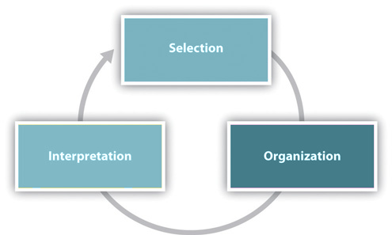
6.2 Perceptions
Perception is the process of selecting, organizing, and interpreting information.
Notes:
Our behavior is not only a function of our personality, values, and preferences, but also of the situation. We interpret our environment, formulate responses, and act accordingly.
What makes human perception so interesting is that we do not solely respond to the stimuli in our environment.
We go beyond the information that is present in our environment, pay selective attention to some aspects of the environment, and ignore other elements that may be immediately apparent to other people.
Our perception of the environment is not entirely rational.
Selection is the first part of the perception process, in which we focus our attention on certain incoming sensory information.
Organizing is the second part of the perception process, in which we sort and categorize information that we perceive based on innate and learned cognitive patterns. Three ways we sort things into patterns are by using proximity, similarity, and differences (Coren, 1980).
Interpretation the third part of the perception process, in which we assign meaning to our experiences using mental structures known as schemata. Schemata are like databases of stored, related information that we use to interpret new experiences.

Slide 7
6.3 Attributions I
“Attribution theory concerns the process by which an individual interprets events as being caused by a particular part of a relatively stable environment” (Kelly, 1980, p. 193).
Notes:
The cognitive process by which people interpret the reasons or causes for their behavior is described by attribution theory (Kelley, 1980; Fosterling, 1985; Weiner, 1980).
Attribution theory is based largely on the work of Fritz Heider. Heider argues that behavior is determined by a combination of internal forces (e.g., abilities or effort) and external forces (e.g., task difficulty or luck).

Slide 8
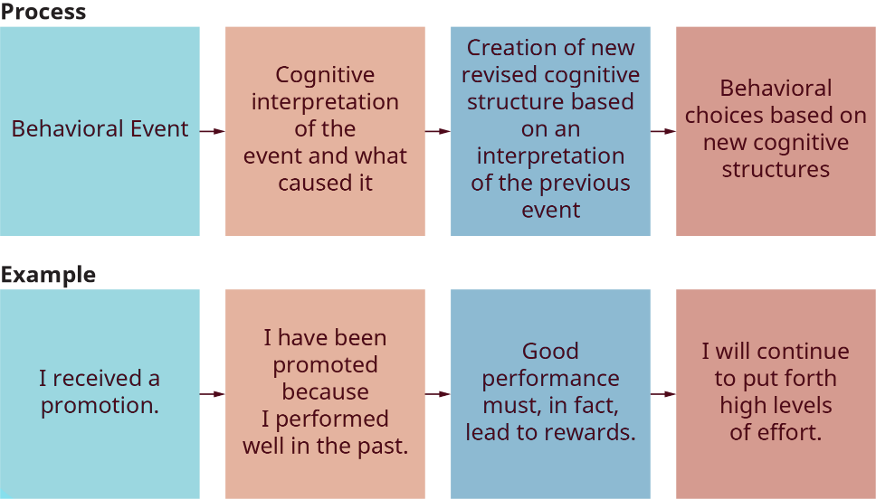
6.3 Attributions II
The Attribution Process
Notes:
The underlying assumption of attribution theory is that people are motivated to understand their environment and the causes of particular events. If individuals can understand these causes, they will then be in a better position to influence or control the sequence of future events.
Specifically, attribution theory suggests that particular behavioral events (e.g., the receipt of a promotion) are analyzed by individuals to determine their causes. This process may lead to the conclusion that the promotion resulted from the individual’s own effort or, alternatively, from some other cause, such as luck.

Slide 9
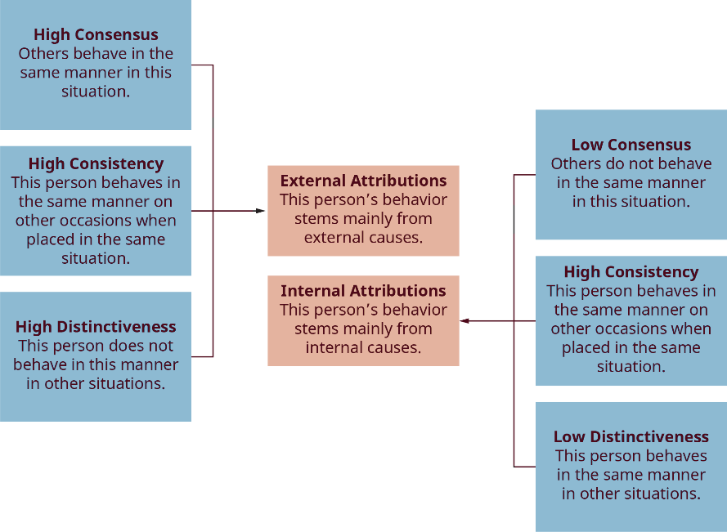
6.3 Attributions III
Internal and External Causes of Behavior
Notes:
Building upon the work of Heider, Harold Kelley attempted to identify the major antecedents of internal and external attributions. He examined how people determine—or, rather, how they actually perceive—whether the behavior of another person results from internal or external causes. Internal causes include ability and effort, whereas external causes include luck and task ease or difficulty.
Kelley’s conclusion, illustrated in this figure, is that people actually focus on three factors when making causal attributions:

Slide 10
6.4 Examining our Perceptions in Conflict I
In the perceptual process, several barriers can be identified that inhibit the accuracy of our perception. These barriers are biases, selective perception, and perceptual defense. These barriers to accurate perceptions can be present in many situations, including conflict. Being aware of our own biases can help us to critically examine our own perceptions .

Slide 11
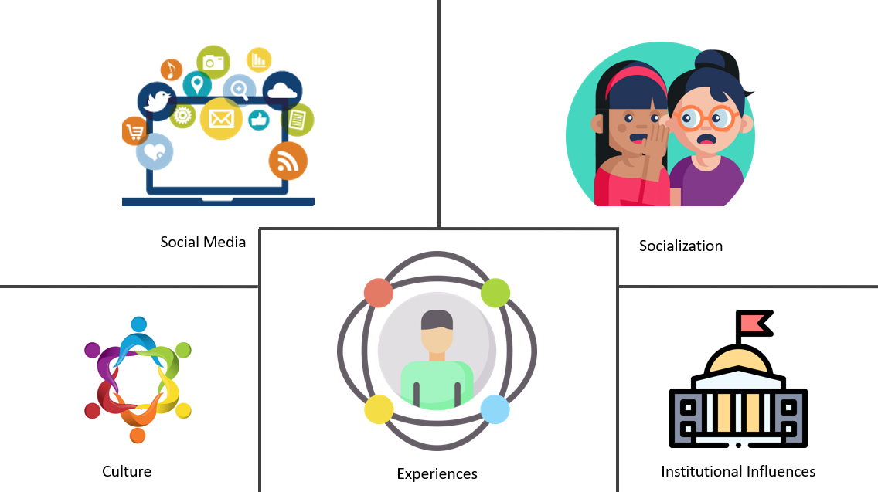
6.4 Examining our Perceptions in Conflict II
Biases
Biases are shortcuts our brain forms based on culture, our own experiences, things other people tell us, and institutional influences. Often, unconscious bias can be difficult to spot because it is not the same as explicit bias or blatant bigotry.
Image: Trecia McLennon. Intercultural Awareness and Competence, 2021. CC BY 4.0.
Notes:
For instance, perhaps you consider yourself to be a very open-minded, liberal person who would never use pejorative language about any group of people, but you would still quickly cross the street when you see this group. Or, maybe when providing anecdotes to friends and family regarding people who have annoyed or irritated you in some way, you make sure to mention the race or ethnicity of those who are different from that of your own.

Slide 12
6.4 Examining our Perceptions in Conflict III
Selective Perception
Selective perception is the process by which we systematically screen out information we don’t wish to hear, focusing instead on more salient information. Saliency here is obviously a function of our own experiences, needs, and orientations.

Slide 13
6.4 Examining our Perceptions in Conflict IV
Perceptual Defense
Perceptual defense is founded on three related principles:
Emotionally disturbing or threatening stimuli have a higher recognition threshold than neutral stimuli.
Such stimuli are likely to elicit substitute perceptions that are radically altered so as to prevent recognition of the presented stimuli.
These critical stimuli arouse emotional reactions even though the stimuli are not recognized.
Notes:
Through perceptual defense we tend to distort or ignore information that is either personally threatening or culturally unacceptable. Because emotionally disturbing stimuli have a higher recognition threshold, people are less likely to fully confront or acknowledge the threat.

Slide 14
6.4 Examining our Perceptions in Conflict V
Perception Checking
Through perception checking, we describe what we perceive the other person to be thinking or feeling and then request clearly and in a non-threatening manner that the other person confirms or corrects our perception.
Notes:
According to Brookfield and Preskill (2005), perception checks send the valuable message that you truly want to listen, observe, and then understand their communication, verbal or nonverbal. This process is valuable in everyday interactions and during both formal and informal conflicts.

Slide 15
6.4 Examining our Perceptions in Conflict VI
Steps in Perception Checking
Step 1: Describe the behavior or situation without evaluating or judging it. Perception checks include “I” language and a clearly stated observation or fact: “I heard you mention ____.
Step 2: Think of some possible interpretations of the behavior, being aware of attributions and other influences on the perception process. This is followed by 2 possible interpretations: “I am wondering if ___ or ___ is the case for you?”
Step 3: Verify what happened and ask for clarification from the other person’s perspective. Be aware of punctuation, since the other person likely experienced the event differently than you.
The perception check is completed with a clarification request: “Can you clarify?”
Notes:
Perception-checking is vital to making sure that all involved are interpreting the meaning and message fully and accurately. Importantly, this process gives those whose voice is habitually misunderstood and are victims of miscommunication, for a number of reasons. Such a process, then, allows individuals who may feel persecuted or misunderstood to express their narrative or story in a dignified, humane fashion, thus giving them an opportunity to express their felt human experience.

Slide 16
6.5 Key Takeaways
Values are relatively stable over time and guide our behaviour.
Perception is the process of selecting, organizing, and interpreting information.
Given the massive amounts of stimuli taken in by our senses, we only select a portion of the incoming information to organize and interpret.
We organize information that we select into patterns based on proximity, similarity, and difference.
We interpret information using schemata, which allow us to assign meaning to information based on accumulated knowledge and previous experience.
We use attributions to interpret perceptual information, specifically, people’s behavior.
Two common perceptual errors that occur in the process of attribution are the fundamental attribution error and the self-serving bias.
Barriers to accurate perception include stereotyping, selective perception and perceptual defense.
Perception checking is a strategy that allows us to monitor our perceptions of and reactions to others and communication.
We can improve our perceptions using a number of suggestions

