Slide 1
CONFLICT MANAGEMENT
CHAPTER 5: INTERPERSONAL RELATIONSHIPS AND GROUP DYNAMICS
Unless otherwise noted, this work is licensed under a Creative Commons Attribution-NonCommercial-ShareAlike 4.0 International (CC BY-NC-SA 4.0) license. Feel free to use, modify, reuse or redistribute any portion of this presentation.

Slide 2
Learning Outcomes
Upon successful completion of this chapter, you will be able to:
Identify the communication patterns in the supervisor-subordinate relationship.
Describe the function and types of peer co-worker relationships.
Explain the process of friendship development and strategies for disengagement.
Define and provide examples of sexual harassment in the workplace, as well as strategies for how to eliminate it.
Recognize the potential challenges and benefits of work in teams compared to as individuals.
Describe different positive and negative team roles.
Explain the relationship between status and power in groups.
Review qualities of toxic leadership and strategies to handle working with a toxic leader.
Explore strategies for cultivating a positive group climate.
Compare cooperative and collaborative group work.
List the process of problem solving in teams.
Summarize strategies for improving group decisions.

Slide 3
5.1 Interpersonal Relationships at Work I
Although some careers require less interaction than others, all jobs require interpersonal communication skills.
Notes:
Televisions shows like The Office offer glimpses into the world of workplace relationships. These humorous examples often highlight the dysfunction that can occur within a workplace. Since many people spend as much time at work as they do with their family and friends, the workplace becomes a key site for relation development.

Slide 4
5.1 Interpersonal Relationships at Work II
Supervisor-Subordinate Relationships
The supervisor-subordinate relationships can be primarily based in mentoring, friendship, or romance and includes two people, one of whom has formal authority over the other.
Image by StartupStockPhotos from Pixabay
Notes:
Given that most workplaces are based on hierarchy, it is not surprising that relationships between supervisors and their subordinates develop (Sias, 2009)
In any case, these relationships involve some communication challenges and rewards that are distinct from other workplace relationships.
Information exchange is an important part of any relationship, whether it is self-disclosure about personal issues or disclosing information about a workplace to a new employee. Supervisors are key providers of information, especially for newly hired employees who have to negotiate through much uncertainty as they are getting oriented.

Slide 5
5.1 Interpersonal Relationships at Work III
Co-worker Relationships
According to organizational workplace relationship expert Patricia Sias (2009), peer co-worker relationships exist between individuals who exist at the same level within an organizational hierarchy and have no formal authority over each other.
Photo by Brooke Cagle on Unsplash
Notes:
According to Sias, we engage in these coworker relationships because they provide us with mentoring, information, power, and support. Let’s look at all four of these reasons for workplace relationships further.

Slide 6
5.1 Interpersonal Relationships at Work IV
Types of Co-worker Relationships
Notes:
Relationships with coworkers in a workplace can range from someone you say hello to almost daily without knowing their name, to an acquaintance in another department, to your best friend that you go on vacations with.
A peer coworker relationship refers to a workplace relationship between two people who have no formal authority over the other and are interdependent in some way. This is the most common type of interpersonal workplace relationship, given that most of us have many people we would consider peer coworkers and only one supervisor (Sias, 2005).
Friendships between peer coworkers have many benefits, including making a workplace more intrinsically rewarding, helping manage job-related stress, and reducing employee turnover. Peer friendships may also supplement or take the place of more formal mentoring relationships (Sias & Cahill, 1998).
Information peers are so-called because we rely on these individuals for information about job tasks and the organization itself.
The second class of relationships we’ll have in the workplace are collegial peers or relationships that have moderate levels of trust and self-disclosure and is different from information peers because of the more openness that is shared between two individuals. Collegial peers may not be your best friends, but they are people that you enjoy working with.
The final group of peers we work with are called special peers. Kram and Isabella (1985)note that special peer relationships “involves revealing central ambivalences and personal dilemmas in work and family realms.

Slide 7
5.1 Interpersonal Relationships at Work V
Sexual Harassment
According to Provision 241.1 of the Code, sexual harassment means any conduct, comment, gesture or contact of a sexual nature that is likely to cause offence or humiliation to any employee, or that might, on reasonable grounds, be perceived by that employee as placing a condition of a sexual nature on employment or on any opportunity for training or promotion.
Notes:
(Government of Canada, 1985, p. 214)The Code clarifies that all employees have a right to conduct their work without being harassed (241.2), but what does that look like in practice?
It is also important to acknowledge the fact that many romantic advances that occur in the workplace are unsolicited and unwanted. It is important for everyone to be aware of what sexual harassment is, what types of behaviours that it entails, and what to do you if you are the subject of unwanted advances at work or if you witness an incidence of sexual harassment against another individual in your place of work.
Though the Canada Labour Code places the responsibility of ensuring a harassment-free workplace squarely on the employer (Provision 247.3), all employees must do their part to uphold one another’s right to work free of harassment.
Employees everywhere should be held to a higher standard, however, which the HRPA advocates in the following recommendations:
All companies must have a stand-alone sexual harassment and assault policy, as required by the Labour Code.
All employees must familiarize themselves with their company’s sexual harassment policy, which should include guidance on how to report instances of harassment.
All companies must conduct training sessions on their sexual harassment policy,including instruction on what to do when harassed or witnessing harassment, and all employees must participate.

Slide 8
5.2 Small Group Dynamics I
A high-functioning, cohesive, and efficient team is essential to workplace productivity anywhere you have three or more people working together. Effective teamwork means working together toward a common goal guided by a common vision, and it’s a mighty force.
Photo by Jason Goodman on Unsplash
Notes:
Compared with several people working independently, teams maximize productivity through collaborative problem solving. When each member brings a unique combination of skills, talents, experience, and education, their combined efforts make the team synergistic
Collaboration can motivate and result in creative solutions not possible in single-contractor projects. The range of views and diversity can energize the process, helping address creative blocks and stalemates.
NB- Teamwork is NOT without its challenges. The work itself may prove to be difficult as members juggle competing assignments and personal commitments. The work may also be compromised if team members are expected to conform and pressured to follow a plan, perform a procedure, or use a product that they themselves have not developed or don’t support.

Slide 9
5.2 Small Group Dynamics II
Positive and Negative Team Roles
When a manager selects a team for a particular project, its success depends on its members filling various positive roles. There are a few standard roles that must be represented to achieve the team’s goals, but diversity is also key.
Notes:
Whether a team member has a positive or negative effect often depends on context. Just as the class clown can provide some much-needed comic relief when the timing’s right, they can also impede productivity when they merely distract members during work periods
A good manager must therefore be a good psychologist in building a team with diverse personality types and talents.

Slide 10
5.2 Small Group Dynamics III
Positive Group Roles
Initiator
Elaborator
Coordinator
Evaluator-critic
Reorder
Comic Relief
Notes:
1. Suggests new ideas or new ways of looking at the problem
2. Builds on ideas and provides examples
3. Brings ideas, information, and suggestions together
4. Evaluates ideas and provides constructive criticism
5. Records ideas, examples, suggestions, and critiques
6. Uses humour to keep the team happy

Slide 11
5.2 Small Group Dynamics IV
Negative Group Roles
Dominator
Recognition Seeker
Special interest-pleader
Blocker
Slacker
Joker or clown
Notes:
1. Dominates discussion so others can’t take their turn
2. Seeks attention by relating discussion to their actions
3. Relates discussion to special interests or personal agenda
4. Blocks attempts at consensus consistently
5. Does little-to-no work, forcing others to pick up the slack
6. Seeks attention through humour and distracting members

Slide 12
5.2 Small Group Dynamics V
Toxic Leadership in Groups
Nothing good comes of toxic leadership. Employees just aren’t productive when fearing abuse from their managers or worrying about the their leadership running the operation into the ground.
Notes:
If the mismanagement is severe—especially if it is physically or emotionally abusive—the best way of dealing with the situation is to leave it. A person at work who makes you feel unsafe may suffer from a personality disorder that makes them dangerous, and there’s no fixing that. If you’re in immediate danger, of course you must leave immediately. From there, figure out your options.
If the toxicity is relatively minor, perhaps the result of some nasty things said here and bad moves there, using internal procedures required of employers by law to address managerial misconduct is the most ethical course of action.
NB--It is ultimately the employer’s responsibility to ensure a non-toxic work environment, and if that means disciplinary action going up the chain of command, then it’s worth it to have people doing their best work without hating the people they’re working for.

Slide 13
5.2 Small Group Dynamics VI
Cultivating a Supportive Group Climate
Qualities that contribute to a positive group climate.
Participation.
Messages.
Feedback.
Equity.
Clear and accepted roles.
Motivation.
Notes:
Appropriate levels of group cohesion usually create a positive group climate, since group climate is affected by members’ satisfaction with the group. Climate has also been described as group morale.
1. Group members feel better when they feel included in the discussion and a part of the functioning of the group.
2. Confirming messages help build relational dimensions within a group, and clear, organized, and relevant messages help build task dimensions within a group.
3. Positive, constructive, and relevant feedback contribute to the group climate.
4. Aside from individual participation, group members also like to feel as if participation is managed equally within the group and that appropriate turn-taking is used.
5. Group members like to know how status and hierarchy operate within a group. Knowing the roles isn’t enough to lead to satisfaction, though—members must also be comfortable with and accept those roles.
6. Member motivation is activated by perceived connection to and relevance of the group’s goals or purpose.

Slide 14
5.3 Collaboration, Decision-Making and Problem Solving in Groups I
Cooperation and Collaboration
In The Construction of Shared Knowledge in Collaborative Problem Solving, Roschelle and Teasley define cooperative group work as “the division of labour among participants, as an activity where each person is responsible for a portion of the problem solving” and collaborative work is “a coordinated, synchronous activity that is the result of a continued attempt to construct and maintain a shared conception of a problem” (1995, p. 70).
Notes:
When it comes to how groups work, they can be cooperative, collaborative, or a combination of both. What is the difference between cooperation and collaboration? The two terms are often used interchangeably but the distinction between them can be important.
If a group works collaboratively, everyone shares ideas and contributes to all aspects of the project. The advantage of this is that everyone can have input, have a chance to point out weaknesses, and make the end result better. The disadvantages of this are that it can take more time because the group has to make decisions together which can be chaotic and lead to interpersonal conflicts
Collaboration is inherently messy. Great ideas need some tension; otherwise, they would be easy to make. And ultimately, members need to be respectful of other people’s roles, thoughts and what they bring to the table. And there also needs to be trusted.--Lynn Power (2016)

Slide 15
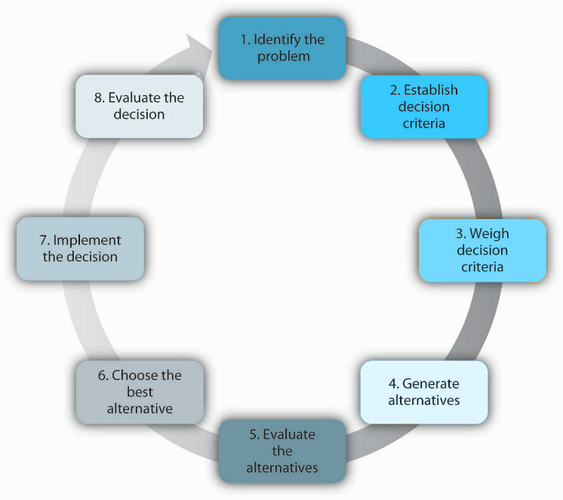
5.3 Collaboration, Decision-Making and Problem Solving in Groups II
Steps in the decision-making process
Notes:
Once a group encounters a problem, questions that come up range from “Where do we start?” to “How do we solve it?” While there are many approaches to a problem, the steps in the rational decision-making model are a good start.
While decision makers can get off track during any of these steps, research shows that searching for alternatives in the fourth step can be the most challenging and often leads to failure.

Slide 16
5.4 Working in Diverse Teams I
Decision-making and problem-solving can be much more dynamic and successful when performed in a diverse team environment. The multiple diverse perspectives can enhance both the understanding of the problem and the quality of the solution.
Notes:
NB- working in diverse teams can be challenging given different identities, cultures, beliefs, and experiences.

Slide 17
5.4 Working in Diverse Teams II
The Benefits of Team Diversity
Teams made up of diverse members tend to perform better than teams of similar backgrounds.
Image: wocintech, Women of Color in Tech, Flickr, CC BY 2.0.
Notes:
In the Harvard Business Review article “Why Diverse Teams are Smarter,” David Rock and Heidi Grant (2016) support the idea that increasing workplace diversity is a good business decision.
A 2015 McKinsey report on 366 public companies found that those in the top quartile for ethnic and racial diversity in management were 35% more likely to have financial returns above their industry mean, and those in the top quartile for gender diversity were 15% more likely to have returns above the industry mean.

Slide 18
5.5 Conflict Management Strategies for Groups and Teams I
Conflict in Groups and Teams
Remember that a complete lack of conflict in a group is a bad sign, as it indicates either a lack of activity or a lack of commitment on the part of the members (Ellis & Fisher, 1994).
Photo by Afif Kusuma on Unsplash
Notes:
Conflict, when properly handled, can lead a group to have a better understanding of the issues they face
Conflict that goes on for too long or is poorly handled can lead to decreased cohesiveness. Group members who try to avoid a conflict can still feel anger or frustration when the conflict drags on.
Members who consistently take task-oriented conflict personally and escalate procedural or substantive conflict to interpersonal conflict are especially unpopular with other group members.

Slide 19
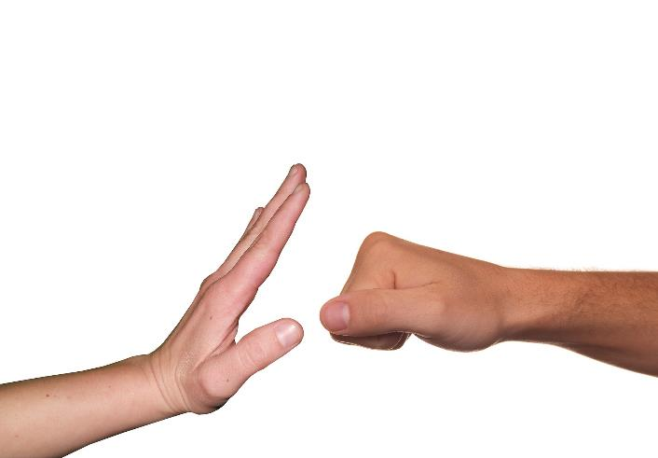
5.5 Conflict Management Strategies for Groups and Teams II
Preventing Conflict in Groups
As well as being able to handle conflict when it arises, teams need to develop ways of preventing conflict from becoming damaging. Team members can learn skills and behavior to help this.
Image by Tumisu from Pixabay
Notes:
Dealing with conflict immediately – avoid the temptation to ignore it.
Being open – if people have issues, they need to be expressed immediately and not allowed to fester.
Practicing clear communication – articulate thoughts and ideas clearly.
Practicing active listening – paraphrasing, clarifying, questioning.
Practicing identifying assumptions – asking yourself “why” on a regular basis.
Not letting conflict get personal – stick to facts and issues, not personalities.
Focusing on actionable solutions – don’t belabor what can’t be changed.

Slide 20
5.5 Conflict Management Strategies for Groups and Teams III
Managing Conflict in Groups
When conflict does arise, here are some techniques for managing conflict in group interactions:
“Test the waters” for new ideas without making it seem that you’re so attached to them that you’ll fight to impose them on others.
If an ego clash erupts, see if you can identify something that the disagreeing individuals can agree on. Perhaps this will be a superordinate goal. It could also be a common opposing force, since the idea that “my enemy’s enemy is my friend” can serve to bind people together.
Employ active listening. Strive to fully understand other people’s viewpoints before stating your own.
If people’s comments meander to topics that aren’t germane, steer the discussion back to the key issues under discussion.

Slide 21
5.6 Key Takeaways
The supervisor-subordinate relationship includes much information exchange that usually benefits the subordinate.
People engage in workplace relationships for several reasons:
There are three different types of workplace relationships
Workplace relationships can transform into friendships.
Group members can occupy a number of roles
Toxic leadership can impair team effectiveness.
Status can be defined as a person’s perceived level of importance or significance within a particular context.
Group climate refers to the relatively enduring tone and quality of group interaction that is experienced similarly by group members.
Cooperation occurs when each group member completes their assigned tasks.
There are many ways for groups to approach problem solving and decision-making
Groups can make better decisions than individuals because group members can contribute more knowledge and a diversity of perspectives.
Developing cultural intelligence skills can help individuals manage cultural differences when working in diverse teams.

