Slide 1
CONFLICT MANAGEMENT
CHAPTER 4: POWER AND POLITICS
Unless otherwise noted, this work is licensed under a Creative Commons Attribution-NonCommercial-ShareAlike 4.0 International (CC BY-NC-SA 4.0) license. Feel free to use, modify, reuse or redistribute any portion of this presentation.

Slide 2
Learning Outcomes
Upon successful completion of this chapter, you will be able to:
Define power.
Contrast power, leadership, and authority.
Recognize symbols of managerial power.
Explain the relationship between power and dependency.
Review the bases of power.
Compare the different use of power bases and the likelihood that they will result in resistance, compliance, or commitment.
Summarize common power tactics used in the workplace.
Define politics.
Identify individual and organizational antecedents of political behaviour,
Recognize common influence tactics and their outcomes.
Describe potential directions of influence.
Explore suggestions for how-to use power and politics ethically in the workplace.
Define bullying, harassment, and violence.
Recognize that bullying and harassment disproportionally impact some groups more than others.
Review types of bullying.
Compare response to bullying and harassment.
Identify the role or organizations in reducing and addressing bullying and harassment

Slide 3
4.1 Power I
Power can be defined as an interpersonal relationship in which one individual (or group) has the ability to cause another individual (or group) to take an action that would not be taken otherwise.
Notes:
In other words, power involves one person changing the behavior of another.
NB---It is important to note that in most organizational situations, we are talking about implied force to comply, not necessarily actual force. That is, person A has power over person B if person B believes that person A can, in fact, force person B to comply.

Slide 4
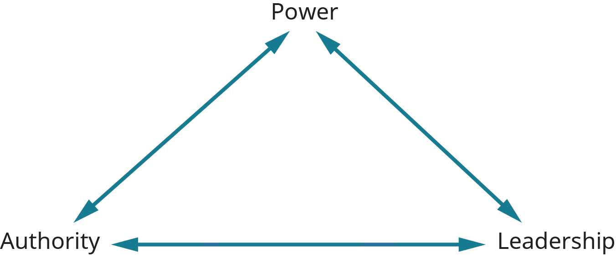
4.1 Power II
The concept of power is closely related to the concepts of authority and leadership
Notes:
Power has been referred to by some as “informal authority,” whereas authority has been called “legitimate power.” However, these three concepts are not the same, and important differences among the three should be noted (Mintzberg, 1983; House, 1988).
As stated previously, power represents the capacity of one person or group to secure compliance from another person or group. Nothing is said here about the right to secure compliance—only the ability.
In contrast, authority represents the right to seek compliance by others; the exercise of authority is backed by legitimacy.
Leadership is the ability of one individual to elicit responses from another person that go beyond required or mechanical compliance. It is this voluntary aspect of leadership that sets it apart from power and authority.

Slide 5
4.1 Power III
Symbols of Managerial Power
How do we know when a manager has power in an organizational setting?
Harvard professor Rosabeth Moss Kanter (2004) has identified several of the more common symbols of managerial power.
Image by Tumisu from Pixabay
Notes:
Managers have power to the extent that they can intercede favorably on behalf of someone in trouble with the organization.
Managers have power when they can get a desirable placement for a talented subordinate or get approval for expenditures beyond their budget. Other manifestations of power include the ability to secure above-average salary increases for subordinates and the ability to get items on the agenda at policy meetings.
And we can see the extent of managerial power when someone can gain quick access to top decision makers or can get early information about decisions and policy shifts. In other words, who can get through to the boss, and who cannot? Who is “connected,” and who is not?
Finally, power is evident when top decision makers seek out the opinions of a particular manager on important questions. Who gets invited to important meetings, and who does not? Who does the boss say “hello” to when they enter the room? Through such actions, the organization sends clear signals concerning who has power and who does not. In this way, the organization reinforces or at least condones the power structure in existence.

Slide 6
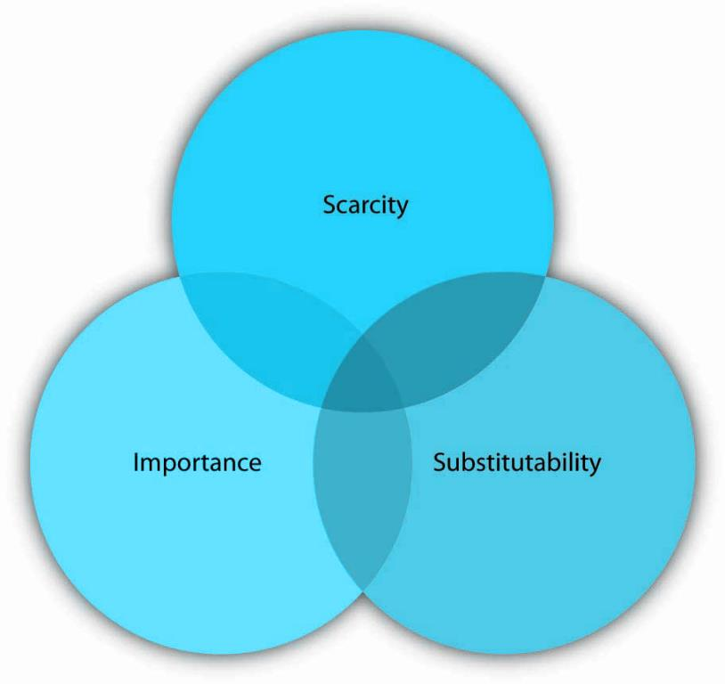
4.1 Power IV
Relationship Between Dependency & Power
Notes:
Dependency is directly related to power. The more that a person or unit is dependent on you, the more power you have.
The strategic contingencies model provides a good description of how dependency works. According to the model, dependency is power that a person or unit gains from their ability to handle actual or potential problems facing the organization (Saunders, 1990). You know how dependent you are on someone when you answer three key questions surrounding scarcity, importance, and substitutability.
1. Scarcity- Scarcity (actual or perceived) is often involved in conflict. In the context of dependency, scarcity refers to the uniqueness of a resource. The more difficult something is to obtain, the more valuable it tends to be.
2. Importance refers to the value of the resource. The key question here is “How important is this?” If the resources or skills you control are vital to the organization, you will gain some power.
3. Substitutability refers to one’s ability to find another option that works as well as the one offered. The question around whether something is substitutable is “How difficult would it be for me to find another way to this?” The harder it is to find a substitute, the more dependent the person becomes and the more power someone else has over them.

Slide 7
4.1 Power V
Bases of Power
Having power and using power are two different things. What are the sources of one’s power over others? Researchers identified six sources of power, which include legitimate, reward, coercive, expert, information, and referent. (French & Raven, 1960).
Notes:
Legitimate power is power that comes from one’s organizational role or position. It is synonymous with authority.
Reward power is the ability to grant a reward, such as an increase in pay, a perk, or an attractive job assignment. Reward power tends to accompany legitimate power and is highest when the reward is scarce.
Coercive power is the ability to take something away or punish someone for noncompliance. Coercive power often works through fear, and it forces people to do something that ordinarily they would not choose to do.
Expert power comes from knowledge and skill. In an organization include long-time employees, such as a steelworker who knows the temperature combinations and length of time to get the best yields have expert power.
Information power is similar to expert power but differs in its source. Experts tend to have a vast amount of knowledge or skill, whereas information power is distinguished by access to specific information.
Referent power stems from the personal characteristics of the person such as the degree to which we like, respect, and want to be like them. Referent power is often called charisma—the ability to attract others, win their admiration, and hold them spellbound.

Slide 8
4.2 Politics and Influence I
For our purposes here, we will adopt Pfeffer’s (2011) definition of politics as involving “those activities taken within organizations to acquire, develop, and use power and other resources to obtain one’s preferred outcomes in a situation in which there is uncertainty or dissensus about choices” (p. 8).
Organizational politics are informal, unofficial, and sometimes
behind-the-scenes efforts to sell ideas, influence an organization, increase power, or achieve other targeted objectives (Brandon & Seldman, 2004: Hochwarter et al., 2000).
Notes:
Politics has been around for millennia. Aristotle wrote that politics stems from a diversity of interests, and those competing interests must be resolved in some way. “Rational” decision making alone may not work when interests are fundamentally incongruent, so political behaviors and influence tactics arise.
Another definition of politics was offered by Lasswell (1936), who described it as who gets what, when, and how. Even from this simple definition, one can see that politics involves the resolution of differing preferences in conflicts over the allocation of scarce and valued resources. Politics represents one mechanism to solve allocation problems when other mechanisms, such as the introduction of new information or the use of a simple majority rule, fail to apply.

Slide 9
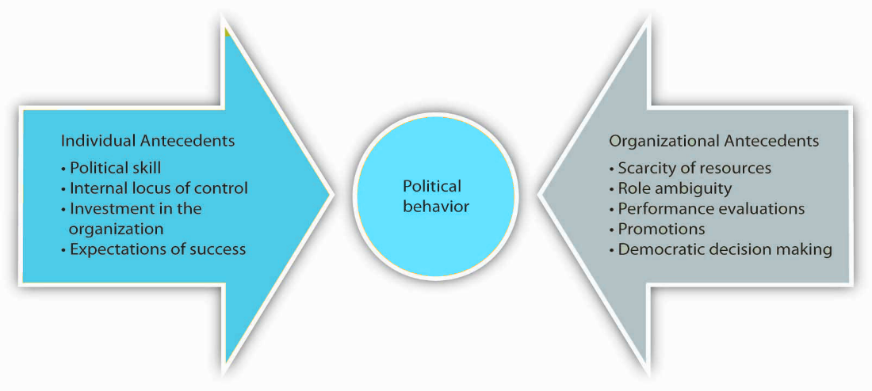
4.2 Politics and Influence II
Reasons for Political Behaviour
Notes:
We can trace the source of political behaviour back to a number of ancedents. We will broadly define these as individual factors and organizational factors.
Individual antecedents of political behaviour include political skills, locus of control, investment in the organization and expectation of success.
1. Political skill refers to peoples’ interpersonal style, including their ability to relate well to others, self-monitor, alter their reactions depending upon the situation they are in, and inspire confidence and trust (Ferris et al., 2000).
2. Individuals who are high in internal locus of control believe that they can make a difference in organizational outcomes. They do not leave things to fate.
3. Investment in the organization is also related to political behavior. If a person is highly invested in an organization either financially or emotionally, they will be more likely to engage in political behavior because they care deeply about the fate of the organization.
4. Expectations of success also matter. When a person expects that they will be successful in changing an outcome, they are more likely to engage in political behavior.
Organizational Antecedents- Relevant factors include scarcity of resources, role ambiguity, performance evaluations, promotions, and democratic decision making.
1. Scarcity of resources breeds politics. When resources such as monetary incentives or promotions are limited, people see the organization as more political.
2. Any type of ambiguity can relate to greater organizational politics. When the goals of a department or organization are ambiguous, more room is available for politics.
3. Ambiguity also exists around performance evaluations and promotions. These human resource practices can lead to greater political behavior, such as impression management, throughout the organization.
4. Democratic decision-making leads to more political behavior. Since many people have a say in the process of making decisions, there are more people available to be influenced.

Slide 10
4.2 Politics and Influence III
Commonly Used Influence Tactics
Researchers have identified distinct influence tactics and discovered that there are few differences between the way managers, subordinates, and peers use them.
Rational Persuasion
Inspirational Appeals
Consultation
Ingratiation
Personal Appeals
Exchange
Coalition Tactics
Pressure
Legitimating
Notes:
Rational persuasion includes using facts, data, and logical arguments to try to convince others that your point of view is the best alternative. This is the most commonly applied influence tactic.
Inspirational appealsseek to tap into our values, emotions, and beliefs to gain support for a request or course of action.
Consultation refers to the influence agent’s asking others for help in directly influencing or planning to influence another person or group.
Ingratiation refers to different forms of making others feel good about themselves. Ingratiation includes any form of flattery done either before or during the influence attempt.
Personal appeals refers to helping another person because you like them and they asked for your help.
Exchange refers to give-and-take in which someone does something for you, and you do something for them in return.
Coalition tacticsrefer to a group of individuals working together toward a common goal to influence others.
Pressure refers to exerting undue influence on someone to do what you want or else something undesirable will occur.
Legitimating tactics occur when the appeal is based on legitimate or position power. This tactic relies upon compliance with rules, laws, and regulations. It is not intended to motivate people but to align them behind a direction.

Slide 11
4.2 Politics and Influence IV
Direction of Influence
The type of influence tactic used tends to vary based on the target. For example, you would probably use different influence tactics with your boss, with employees working under you, or with a peer.

Slide 12
4.2 Politics and Influence V
Upward Influence
Upward influence, as its name implies, is the ability to influence your manager and others in positions higher than yours. Upward influence may include appealing to a higher authority or citing the firm’s goals as an overarching reason for others to follow your cause.
Image by Wilson Joseph from Pixabay
Notes:
Upward influence can also take the form of an alliance with a higher status person (or with the perception that there is such an alliance) (Farmer & Maslyn, 1999; Farmer et al., 1997).
As complexity grows, the need for this upward influence grows as well—the ability of one person at the top to know enough to make all the decisions becomes less likely.

Slide 13
4.2 Politics and Influence VI
Downward Influence
Downward influence is the ability to influence employees lower than you in the institutional hierarchy. This is best achieved through an inspiring vision. By articulating a clear vision, you help people see the end goal and move toward it.
Image by Wilson Joseph from Pixabay
Notes:
You often don’t need to specify exactly what needs to be done to get there—people will be able to figure it out on their own.
An inspiring vision builds buy-in and gets people moving in the same direction.
Research conducted within large savings banks shows that managers can learn to be more effective at influence attempts.

Slide 14
4.3 Ethical Use of Power and Politics I
The Ethical Use of Power
People are often uncomfortable discussing the topic of power, which implies that somehow they see the exercise of power as unseemly. On the contrary, the question is not whether power tactics are or are not ethical; rather, the question is which tactics are appropriate and which are not.

Slide 15
4.3 Ethical Use of Power and Politics II
Several guidelines for the ethical use of power can be identified.
Referent power
Expert power
Legitimate power
Reward power
Coercive power
Notes:
Referent Power- Treat subordinates fairly, Defend subordinates interests, Be sensitive to subordinates needs, feelings
Expert Power- Promote image of expertise, Maintain credibility, Act confident and decisive, Keep informed
Legitimate Power- Be cordial and polite, Be confident, Be clear and follow up to verify understanding
Reward Power- Verify compliance, Make feasible, reasonable requests, Make only ethical, proper requests
Coercive Power- Inform subordinates of rules and penalties, Warn before punishing, Administer punishment consistently and uniformly

Slide 16
4.3 Ethical Use of Power and Politics III
The Ethical Use of Politics
Similar to power, there is not inherent good or bad in politics. Politics in organizations cannot be eliminated. Yet to some extent, the negative aspects of it can be neutralized if managers carefully monitor the work environment and take remedial action where necessary.

Slide 17
4.3 Ethical Use of Power and Politics IV
Several strategies can be identified that can help manage organizational politics. Four basic strategies that can be used are:
Reduce System Uncertainty
Reduce Competition
Break Existing Political Empires/Coalitions
Prevent Future Political Empires/Coalitions
Notes:
Reduce System Uncertainty- Make clear what are the bases and processes for evaluation. Differentiate rewards among high and low performers.
Reduce Competition- Try to minimize resource competition among managers. Replace resource competition with externally oriented goals and objectives.
Break Existing Political Empires/Coalitions- Where highly cohesive political empires exist, break them apart by removing or splitting the most dysfunctional subgroups.
Prevent Future Political Empires/Coalitions- Make one of the most important criteria for promotion an apolitical attitude that puts organizational ends ahead of personal power ends.

Slide 18
4.4 Bullying, Violence, and Harassment I
Harassment, bullying, and violence are examples of psychosocial hazards that negatively affect worker health and safety. These behaviours are unacceptable and illegal, but nonetheless, still occur. These abuses are often grounded in misuse of power and are often visible during dysfunctional and escalating conflicts.
Notes:
Harassment and bullying can involve physical contact but are distinguished from violence in that the purpose is not physical harm but emotional and psychological harm.
Harassment and bullying can also include acts that indirectly affect the targeted worker(s), such as undesirable shift scheduling, unreasonable workloads, spreading rumours, or denying leave requests.
Harassment, bullying, and violence can occur concurrently.

Slide 19
4.4 Bullying, Violence, and Harassment II
Workplace harassment is behaviour aimed at an individual (or group) that is belittling or threatening in nature.
Image by mohamed Hassan from Pixabay
Notes:
This can include actions (e.g., unwanted touching) or words (e.g., insults, jokes) that have the effect of causing psychological harm to victim(s). Harassment can take a variety of forms, including racial/ethnic harassment, sexual harassment, and general workplace harassment.

Slide 20
4.4 Bullying, Violence, and Harassment III
Bullying is similar to harassment and comprises repeated actions or verbal comments that lead to mental harm, isolation, or humiliation of a worker (or group), often with the intent to wield power over them.
Image by Gerd Altmann from Pixabay
Notes:
Often harassment and bullying are used interchangeably and, indeed, the definitions are highly similar.

Slide 21
4.4 Bullying, Violence, and Harassment IV
Types of Bullying Behaviours
Isolation and exclusion
Intimidation and threats
Verbal threats
Damaging professional identity
Limiting career opportunities
Obstructing work or making work-life difficult
Denial of due process and natural justice
Notes:
There is no clear profile of who might be a harasser. The range of tactics, behaviours, and approaches used by bullies and harassers is extensive and reflective of specific contexts.
Some researchers suggest that employers may overtly or covertly encourage bullying by managers as a way to maximize the work the employer can extract from its workers (Beale, 2011).
Isolation& exclusion: Tactic- Being ignored/Being excluded from conversation
Intimidation and threats: Tactic- Raised voices or raised hands/Being stared at, watched and followed
Verbal Threats- Tactic- Being singled out, scrutinized and monitored/Being yelled at or verbally abused
Damaging professional Identity: Tactic- Public denigration of ability or achievements/Questioning skills and ability
Limiting Career Opportunities: Tactics- Denial of opportunities that lead to promotion/Being overlooked for promotion
Obstructing work or making work-life difficult: Tactics- Relocation to make job difficult/Removal of administrative support
Denial of due process and natural justice: Tactics- Denial of due process in meetings/Denial of meal breaks

Slide 22
4.4 Bullying, Violence, and Harassment V
Responses to Bullying and Harassment
Workers respond to threats such as bullying with a range of behaviours that include:
Exit
Voice
Patience
Neglect.
Notes:
Exit- The worker decides to get away from the undesired situation, either by quitting the employer or transferring to another location or job within the same employer.
Voice- The worker decides to speak up in an attempt to change the situation. Voice can take a number of forms, including attempting to repair the situation directly, lodging a complaint, filing a grievance or, less constructively, retaliating with their own inappropriate behaviour.
Patience- The worker decides to do nothing in the hopes that the situation will eventually improve.
Neglect- The worker does nothing, based on the belief that the situation will not change or might grow worse.

Slide 23
4.5 Key Takeaways
Power is the ability to influence the behavior of others to get what you want.
Power is distinct from both leadership and authority.
Symbols of managerial power include access to key people and resources within an organization.
Power is closely tied to dependency.
There are many bases of power
Depending upon which kind of power is employed, the recipient of a power effort can respond with commitment, compliance, or resistance.
Common power tactics include controlling access to information, controlling access to persons, the selective use of objective criteria, controlling the agenda and using outside experts.
Organizational politics is a natural part of organizational life.
Individual antecedents of political behavior include political skill, internal locus of control, high investment in the organization, and expectations of success.
Organizational antecedents include scarcity of resources, role ambiguity, frequent performance evaluations and promotions, and democratic decision making.
Political behavior is more likely to occur when there are scarce resources, ambiguity, performance evaluations/promotions, and democratic and/or nonprogrammed decisions.
Influence tactics are the way that individuals attempt to influence one another in organizations. Influence attempts may be upward, downward, or lateral in nature.
Workplace harassment is behaviour aimed at an individual (or group) that is belittling or threatening in nature.
Bullying is similar to harassment and comprises repeated actions or verbal comments that lead to mental harm, isolation, or humiliation of a worker (or group), often with the intent to wield power over them.

