Slide 1
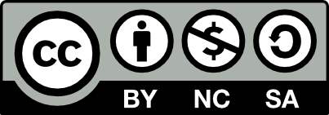
Conflict Management
CHAPTER 3: ORGANIZATIONAL CULTURE AND POLICIES
Unless otherwise noted, this work is licensed under a Creative Commons Attribution-NonCommercial-ShareAlike 4.0 International (CC BY-NC-SA 4.0) license. Feel free to use, modify, reuse or redistribute any portion of this presentation.

Slide 2
Learning Outcomes
Upon successful completion of this chapter, you will be able to:
Define organizational culture.
Compare the three levels of organizational culture.
Recognize the importance of organizational culture on behaviours and outcomes.
Describe the process of creating and maintaining organizational culture.
Explain the influence of external factors on organizational culture.
Review the process for changing culture.
Explore common reactions to change.
List common reasons that employees are resistant to change in the workplace.
Describe strategies for effectively executing change.
Summarize popular frameworks for assessing organizational culture.
Analyze the role of codes in enacting workplace culture and behaviours.
Identify steps in the processive discipline and termination processes.

Slide 3
3.1 Organizational Culture I
Organizational culture refers to a system of shared assumptions, values, and beliefs that show employees what is appropriate and inappropriate behavior (Chatman & Eunyoung, 2003; Kerr & Slocum Jr., 2005).
Notes:
These values have a strong influence on employee behavior as well as organizational performance. In fact, the term organizational culture was made popular in the 1980s when Peters and Waterman’s best-selling book In Search of Excellence made the argument that company success could be attributed to an organizational culture that was decisive, customer oriented, empowering, and people oriented.
Culture is by and large invisible to individuals. Even though it affects all employee behaviors, thinking, and behavioral patterns, individuals tend to become more aware of their organization’s culture when they have the opportunity to compare it to other organizations.

Slide 4
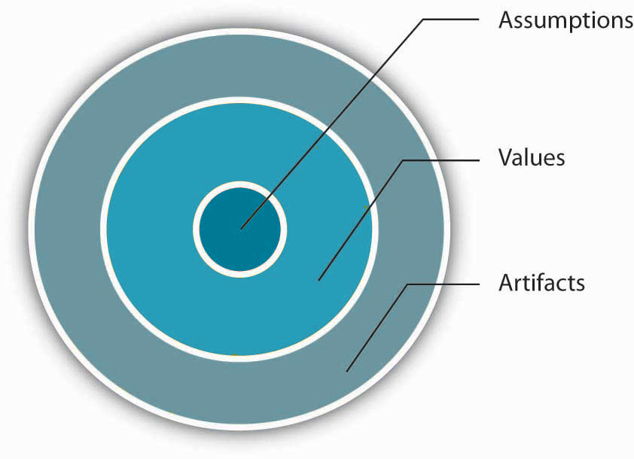
3.1 Organizational Culture II
Levels of Organizational Culture
Notes:
Organizational culture consists of some aspects that are relatively more visible, as well as aspects that may lie below one’s conscious awareness. Organizational culture can be thought of as consisting of three interrelated levels (Schein, 1992).
At the deepest level, below our awareness lie basic assumptions. Assumptions are taken for granted, and they reflect beliefs about human nature and reality.
At the second level, values exist. Values are shared principles, standards, and goals.
Finally, at the surface we have artifacts, or visible, tangible aspects of organizational culture. If assumptions and values are not shared by everyone or there are basic differences in assumptions between departments or subcultures, this may be a source of conflict within the organization.

Slide 5
3.1 Organizational Culture III
The Importance of Organizational Culture
An organization’s culture may be one of its strongest assets, as well as its biggest liability. In fact, it has been argued that organizations that have a rare and hard-to-imitate organizational culture benefit from it as a competitive advantage (Barney, 1986).
Notes:
Kihlstrom goes as far to assert that culture is an important as strategy when it comes to organizational performance.
Company performance may benefit from the benefits of shared values provided by culture when they have a match to the company and the industry at large (Arogyaswamy & Byles, 1987)

Slide 6
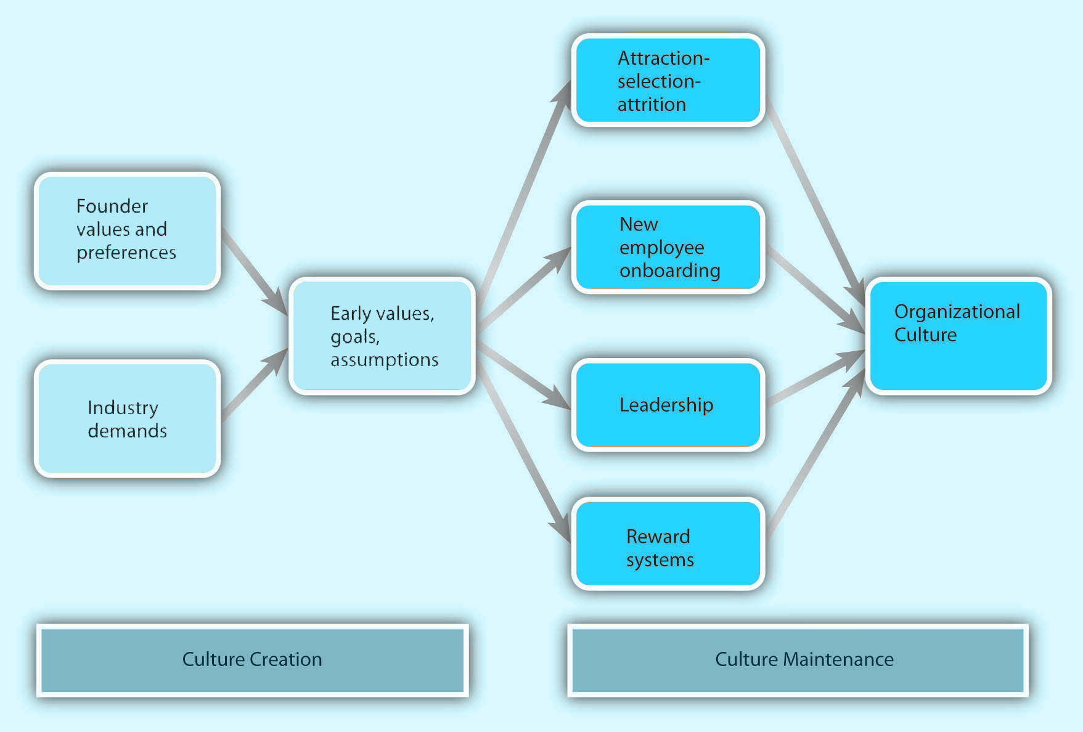
3.2 Creating, Maintaining, and Changing Culture I
Creating and Maintaining Organizational Culture
Notes:
Where do cultures come from?
Understanding this question is important so that you know how they can be maintained or changed.
An organization’s culture is shaped as the organization faces external and internal challenges and learns how to deal with them. When the organization’s way of doing business provides a successful adaptation to environmental challenges and ensures success, those values are retained. These values and ways of doing business are taught to new members as the way to do business (Schein, 1992).

Slide 7
3.2 Creating, Maintaining, and Changing Culture II
Creating Organizational Culture
The factors that are most important in the creation of an organization’s culture include:
Founders’ values & preferences
Industry demands.
Notes:
Founders Values- A company’s culture, particularly during its early years, is inevitably tied to the personality, background, and values of its founder or founders, as well as their vision for the future of the organization. This explains one reason why culture is so hard to change: It is shaped in the early days of a company’s history.
While founders undoubtedly exert a powerful influence over corporate cultures, the industry characteristics also play a role. Industry characteristics and demands act as a force to create similarities among organizational cultures. For example, despite some differences, many companies in the insurance and banking industries are stable and rule oriented, many companies in the high-tech industry have innovative cultures, and companies in the nonprofit industry tend to be people oriented.

Slide 8
3.2 Creating, Maintaining, and Changing Culture III
External Influences on Organizational Culture
To succeed and thrive, organizations must adapt, exploit, and fit with the forces in their external environments. Organizations are groups of people deliberately formed together to serve a purpose through structured and coordinated goals and plans. As such, organizations operate in different external environments and are organized and structured internally to meet both external and internal demands and opportunities.

Slide 9
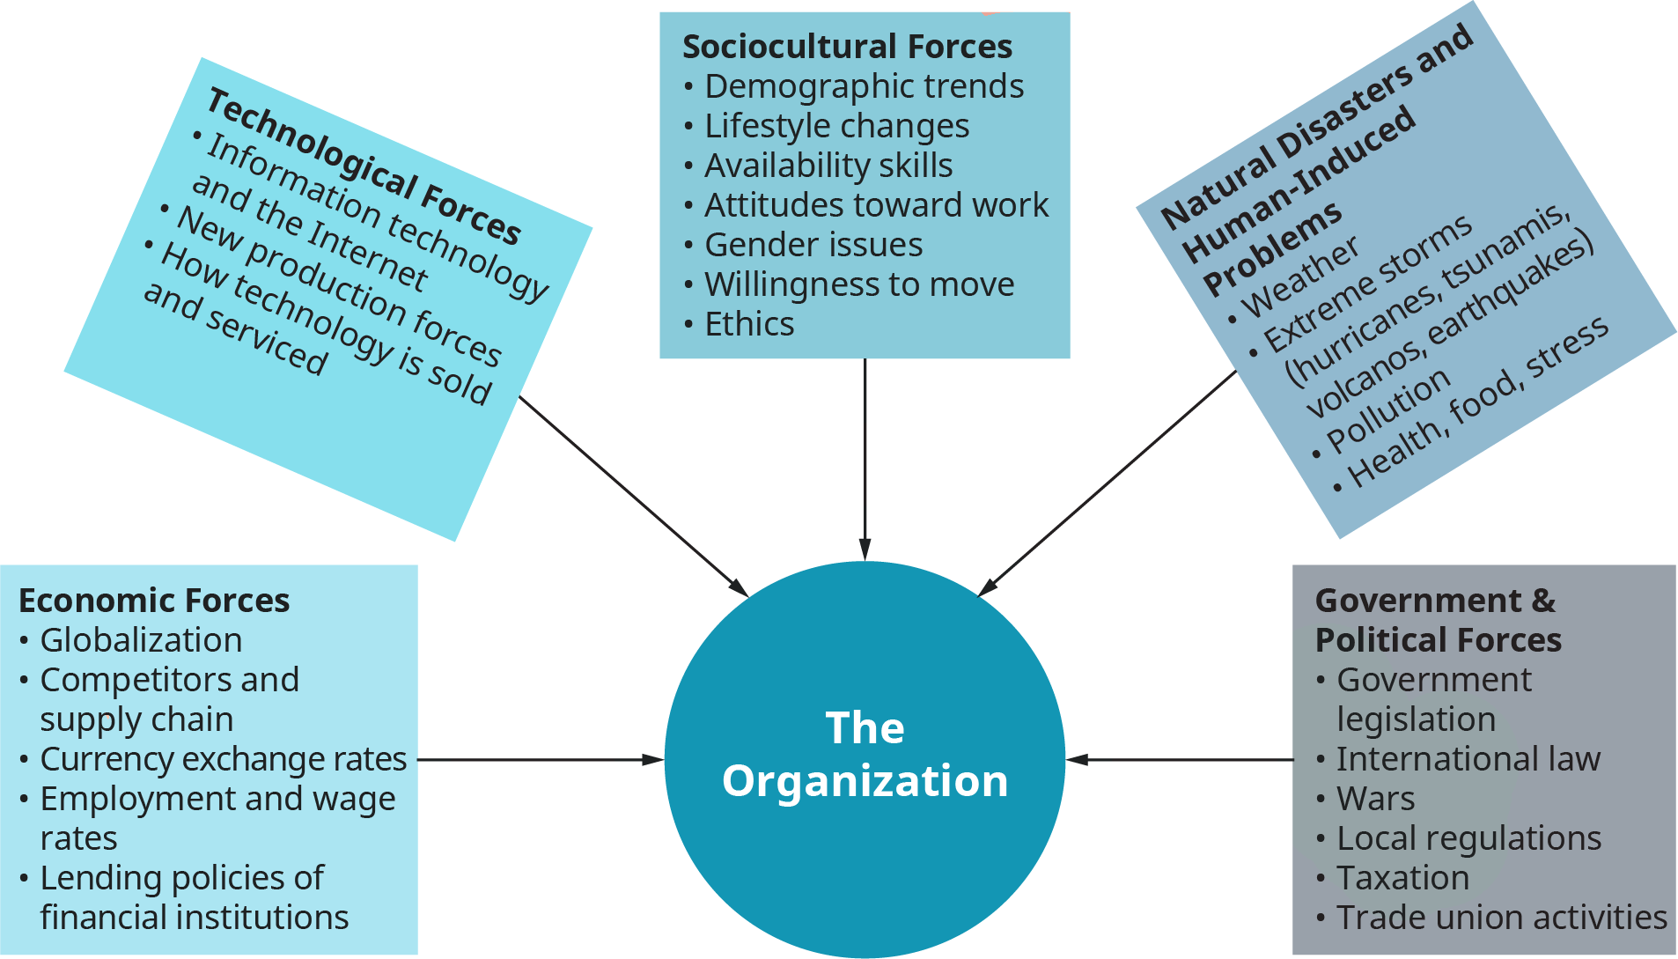
3.2 Creating, Maintaining, and Changing Culture IV
External Influences on Organizational Culture
Notes:
This figure here illustrates types of general macro environments and forces that are interrelated and affect organizations: sociocultural, technological, economic, government and political, natural disasters, and human-induced problems that affect industries and organizations.

Slide 10
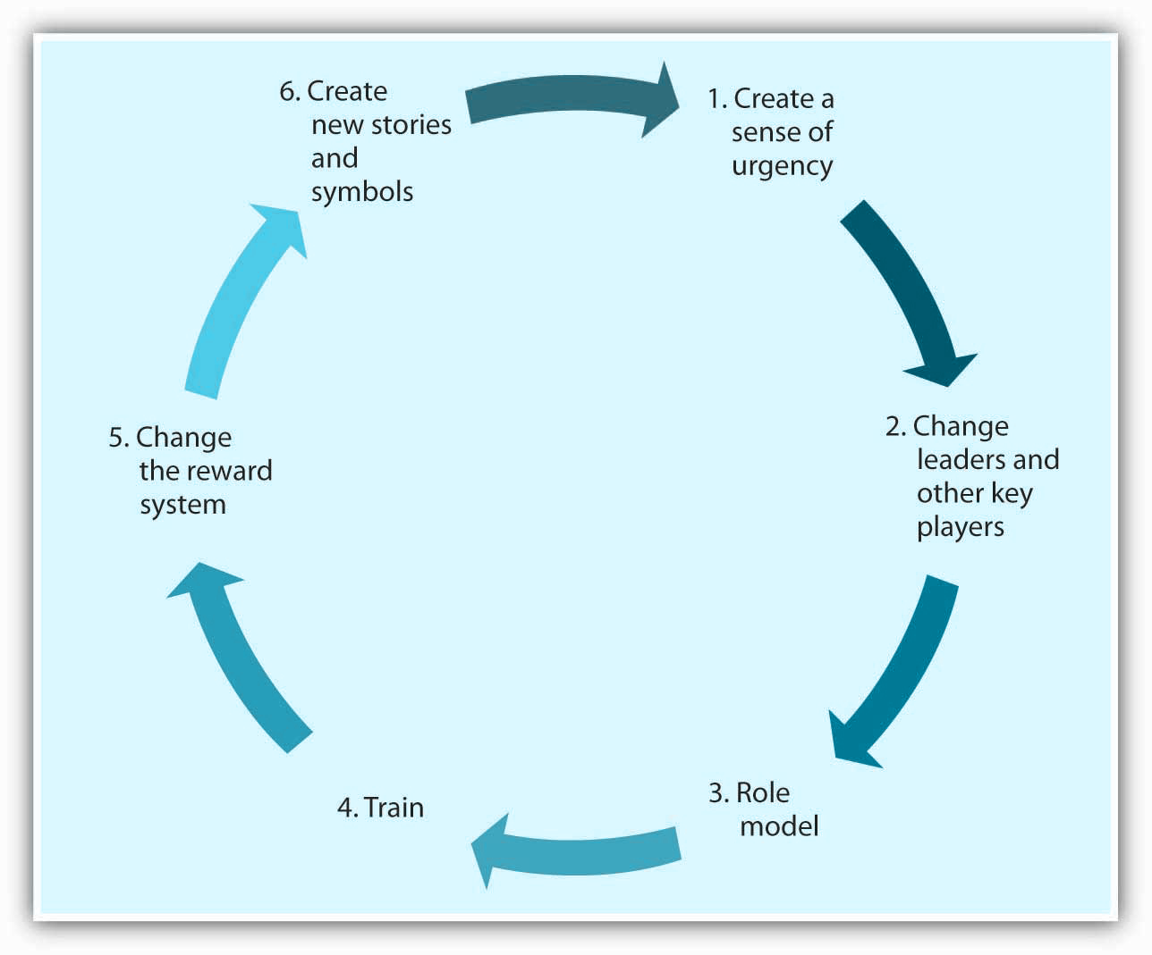
3.2 Creating, Maintaining, and Changing Culture V
Changing Organizational Culture
Notes:
Culture is often deeply ingrained and resistant to change efforts. Unfortunately, many organizations may not even realize that their current culture constitutes a barrier against organizational productivity and performance.
Changing company culture may be the key to the company turnaround when there is a mismatch between an organization’s values and the demands of its environment.
1. Create a sense of urgency- In order for the change effort to be successful, it is important to communicate the need for change to employees. One way of doing this is to create a sense of urgency on the part of employees and explain to them why changing the fundamental way in which business is done is so important.
2. Change leaders and other key players- A leader’s vision is an important factor that influences how things are done in an organization. Thus, culture change often follows changes at the highest levels of the organization.
3. Role Model- Role modeling is the process by which employees modify their own beliefs and behaviors to reflect those of the leader (Kark & Dijk, 2007).
4. Train- Well-crafted training programs may be instrumental in bringing about culture change by teaching employees the new norms and behavioral styles.
5. Changing the reward system- The criteria with which employees are rewarded and punished have a powerful role in determining the cultural values in existence. Switching from a commission-based incentive structure to a straight salary system may be instrumental in bringing about customer focus among sales employees.
6. Create new stories and symbols- the success of the culture change effort may be increased by developing new rituals, symbols, and stories.

Slide 11
3.2 Creating, Maintaining, and Changing Culture VI
Reactions to Change
Notes:
Active resistance is the most negative reaction to a proposed change attempt. Those who engage in active resistance may sabotage the change effort and be outspoken objectors to the new procedures.
In contrast, passive resistance involves being disturbed by changes without necessarily voicing these opinions.
Compliance, on the other hand, involves going along with proposed changes with little enthusiasm.
Those who show enthusiastic support are defenders of the new way and actually encourage others around them to give support to the change effort as well.

Slide 12
3.2 Creating, Maintaining, and Changing Culture VII
Common Reasons for Resisting Change
Resisting change can be a source of conflict in the workplace. Some of the common reasons that people are resistant to change are:
Disrupted Habits
Personality
Feelings of Uncertainty
Fear of Failure
Personal Impact of Change
Prevalence of Change
Perceived Loss of Power
Notes:
Disrupted Habits- People often resist change for the simple reason that change disrupts our habits.
Personality- Some people are more resistant to change than others. Research shows that people who have a positive self-concept are better at coping with change, probably because those who have high self-esteem may feel that whatever the changes are, they are likely to adjust to it well and be successful in the new system
Feelings of Uncertainty- Change inevitably brings feelings of uncertainty. You have just heard that your company is merging with another. What would be your reaction?
Fear of Failure- People also resist change when they feel that their performance may be affected under the new system. People who are experts in their jobs may be less than welcoming of the changes, because they may be unsure whether their success would last under the new system.
Personal Impact of Change- It would be too simplistic to argue that people resist all change, regardless of its form. In fact, people tend to be more welcoming of change that is favorable to them on a personal level (such as giving them more power over others, or change that improves quality of life such as bigger and nicer offices).
Prevalence of Change- Any change effort should be considered within the context of all the other changes that are introduced in a company.
Perceived Loss of Power- One other reason why people may resist change is that change may affect their power and influence in the organization.

Slide 13
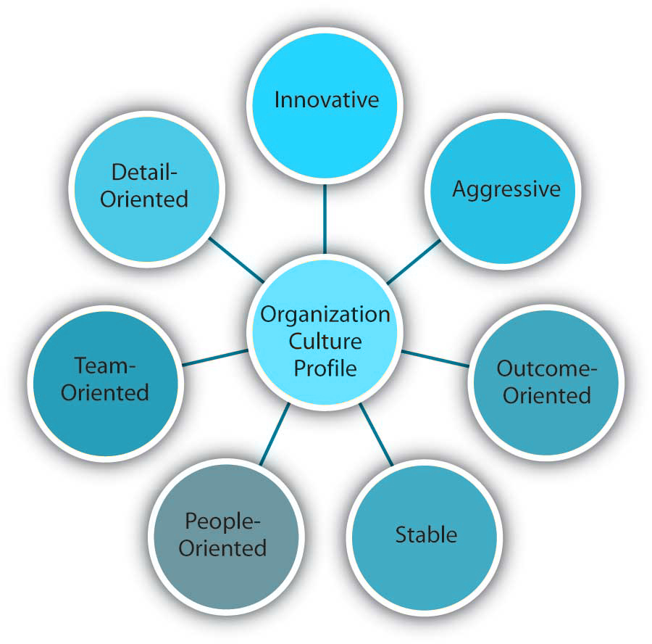
3.3 Frameworks for Assessing Organizational Culture I
Organizational Culture Profile (OCP)
Notes:
One typology that has received a lot of research attention is the Organizational Culture Profile (OCP), in which culture is represented by seven distinct values (Chatman & Jehn, 1991; O’Reilly, Chatman, & Caldwell, 1991).
Dimensions of Organizational Culture Profile:
Detail-oriented- Organizations with detail-oriented cultures are characterized in the OCP framework as emphasizing precision and paying attention to details.
Innovative- According to the OCP framework, companies that have innovative cultures are flexible and adaptable, and experiment with new ideas.
Aggressive- Companies with aggressive cultures value competitiveness and outperforming competitors: By emphasizing this, they may fall short in the area of corporate social responsibility.
Outcome-oriented- The OCP framework describes outcome-oriented cultures as those that emphasize achievement, results, and action as important values.
Stable- Stable cultures are predictable, rule-oriented, and bureaucratic. These organizations aim to coordinate and align individual effort for greatest levels of efficiency.
People-oriented- People-oriented cultures value fairness, supportiveness, and respect for individual rights. These organizations truly live the mantra that “people are their greatest asset.”
Team-oriented- Companies with team-oriented cultures are collaborative and emphasize cooperation among employees.

Slide 14
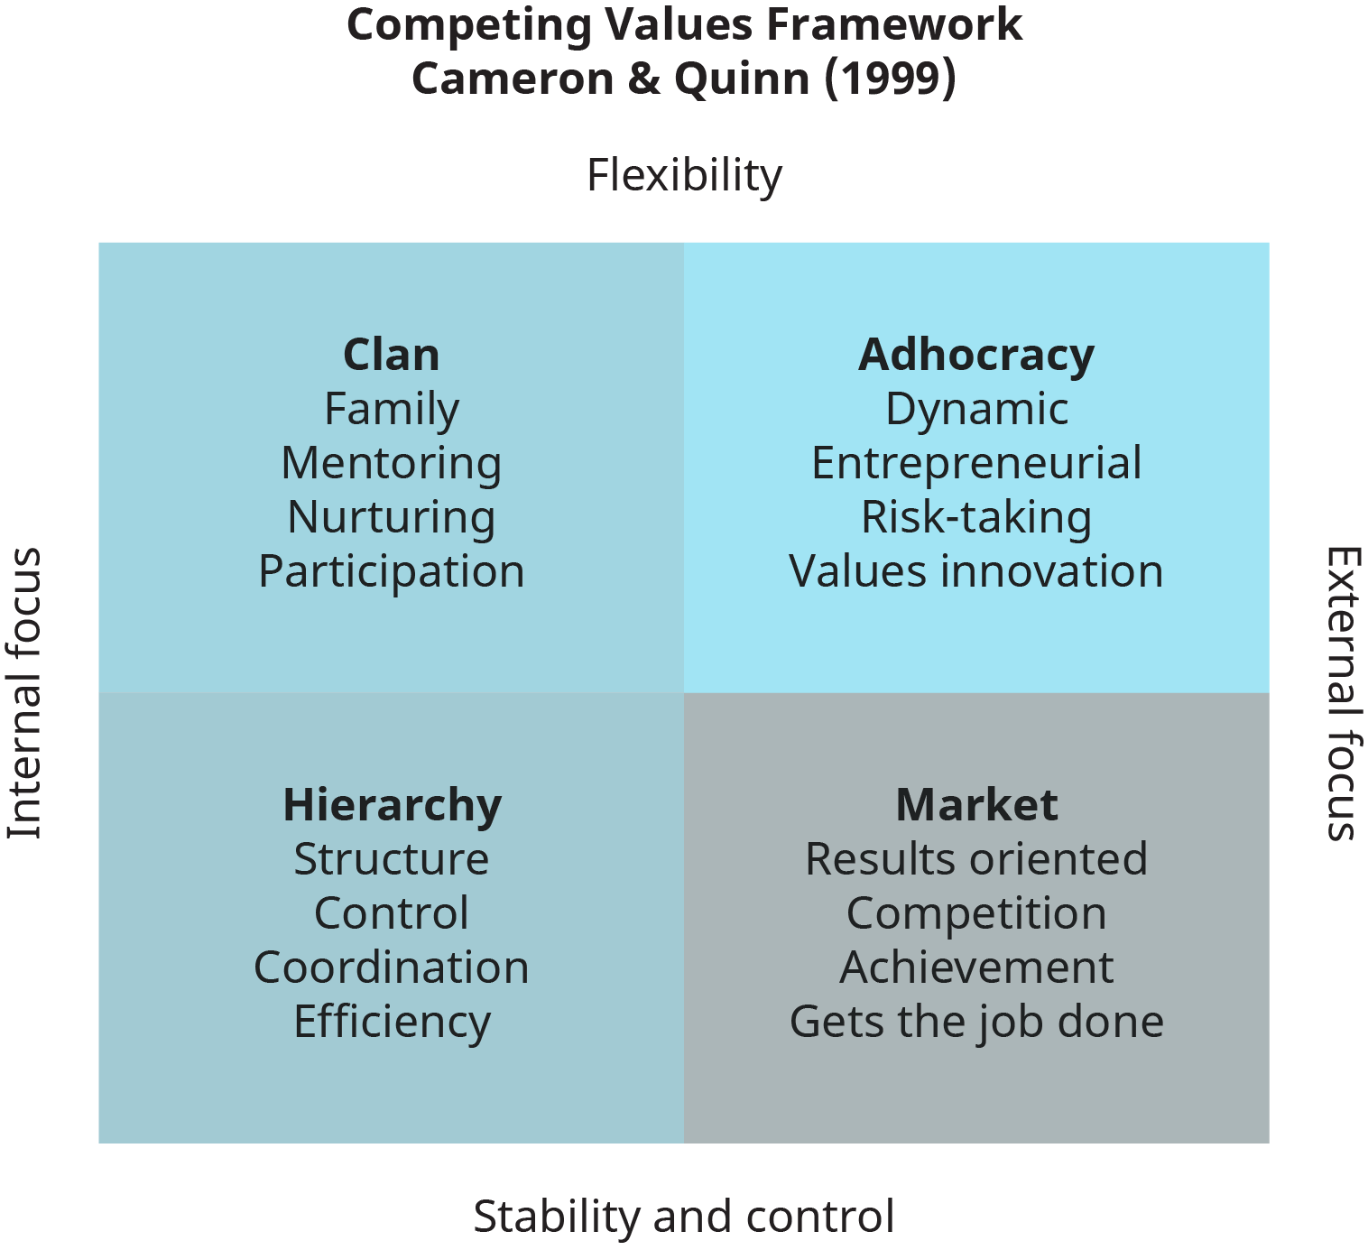
3.3 Frameworks for Assessing Organizational Culture II
The Competing Values Framework (CVF) is one of the most cited and tested models for diagnosing an organization’s cultural effectiveness and examining its fit with its environment.
Notes:
The CVF, shown in this figure, has been tested for over 30 years; the effectiveness criteria offered in the framework were discovered to have made a difference in identifying organizational cultures that fit with particular characteristics of external environments (Cameron et al., 2004; Cameron & Quinn, 2006).
The two axes in the framework, external focus versus internal focus, indicate whether or not the organization’s culture is externally or internally oriented. The other two axes, flexibility versus stability and control, determine whether a culture functions better in a stable, controlled environment or a flexible, fast-paced environment.
The adhocracy culture profile of an organization emphasizes creating, innovating, visioning the future, managing change, risk-taking, rule-breaking, experimentation, entrepreneurship, and uncertainty.
The Clan Culture type focuses on relationships, team building, commitment, empowering human development, engagement, mentoring, and coaching.
The Hierarchy Culture emphasizes efficiency, process and cost control, organizational improvement, technical expertise, precision, problem solving, elimination of errors, logical, cautious and conservative, management and operational analysis, and careful decision-making.
The Market Culture focuses on delivering value, competing, delivering shareholder value, goal achievement, driving and delivering results, speedy decisions, hard driving through barriers, directive, commanding, and getting things done.

Slide 15
3.4 Organizational Codes and Discipline I
While culture can be a powerful mechanism of behavioural control within organizations, often these standards are often outlined in company codes. Formalization is the extent to which policies, procedures, job descriptions, and rules are written and explicitly articulated.
Notes:
In other words, formalized structures are those in which there are many written rules and regulations. These structures control employee behavior using written rules, and employees have little autonomy to make decisions on a case-by-case basis.
Formalization makes employee behavior more predictable. Whenever a problem at work arises, employees know to turn to a handbook or a procedure guideline. Therefore, employees respond to problems in a similar way across the organization, which leads to consistency of behavior.

Slide 16
3.4 Organizational Codes and Discipline II
Types of Codes
Professional Codes of Ethics
Corporate Codes of Ethics
Corporate Credos
Statements of Values
Notes:
1. Professions such as engineering and accounting have developed codes of ethics. These set forth the ideals of the profession as well as more mundane challenges faced by members.
2. Corporate codes are adopted by many companies to provide guidelines on particularly sticky issues (When does a gift become a bribe?) They also set forth provisions that express the core values of the corporation.
3. Some companies have shortened their lengthy codes into a few general provisions that form a creed.
4. Some companies express their core value commitments in Statements of Values. These form the basis of values-based decision-making. While codes of ethics clearly establish minimum standards of acceptable conduct, Statements of Values outline the aspirations that can drive companies toward continuous improvement.

Slide 17
3.4 Organizational Codes and Discipline III
Codes and policies can serve a number of functions within the organization including the following:
Discipline
Educate
Inspire
Stimulate Dialogue
Empower and Protect
Codes capture or express a community’s identity
Notes:
Discipline. This function gets all the attention. Most codes are set forth to establish clearly and forcefully an organization’s standards, especially its minimum standards of acceptable conduct.
Educate. This can range from disseminating standards to enlightening members.
Inspire- Codes can set forth ideals in a way that inspires a community’s members to strive for excellence.
Stimulate Dialogue. Engineering professional codes of ethics have changed greatly over the last 150 years.
Empower and Protect. Codes empower and protect those who are committed to doing the right thing.
Codes capture or express a community’s identity. They provide the occasion to identify, foster commitment, and disseminate the values with which an organization wants to be identified publicly.

Slide 18
3.4 Organizational Codes and Discipline IV
Appropriate Level of Discipline
It is important to determine the proper level of discipline in each situation. In other words, “the punishment must fit the crime.” Company policies on discipline should strive for fairness by adhering to certain criteria.
Notes:
Develop clear, fair rules and consequences.
Clearly communicate policies.
Conduct a fair investigation.
Balance consistency with flexibility.
Use corrective action, not punishment.

Slide 19
3.4 Organizational Codes and Discipline V
Steps of Progressive Discipline
Notes:
Verbal counselling is usually the initial step. Verbal counselling sessions are used to bring a problem to the attention of the employee before it becomes so serious that it has to become part of a written warning and placed in the employee’s file.
If the problem is not resolved, you will need to prepare the written warning. Include in the warning information, responses, and commitments already made in the verbal counselling session. The written warning has three parts: A statement that the verbal discussion has occurred, a statement about the present, including a description of the current situation and including the employee’s explanation or response and a statement of the future, describing your expectations and the consequences of continued failure to correct the problem.
Depending on the situation there are times when it is appropriate to suspend an employee and times when it is not.
If a problem is not resolved after appropriate warning, you may have to terminate an employee.

Slide 20
3.5 Key Takeaways
Organizational culture refers to a system of shared assumptions, values, and beliefs that show employees what is appropriate and inappropriate behavior
Organizational culture consists of three levels: assumptions, values, and artifacts.
Organizations vary in the strength of their culture.
Organization cultures are created by a variety of factors
Culture is maintained through attraction-selection-attrition, new employee onboarding, leadership, and organizational reward systems.
Organizations change in response to changes in the environment and in response to the way decision makers interpret these changes.
When it comes to organizational change, one of the biggest obstacles is resistance to change.
There are a number of frameworks that can be used to assess and understand organizational culture
In addition to organizational culture, codes and other policies can formalize the expectations for behaviour at work.
Performance issues and misconduct can result in disciplinary action at work.
Discipline should match the level of offense.
When designing and implementing codes in the workplace, it is important to be aware of various legislation which outlines human rights and employment standards.

