Slide 1
CONFLICT MANAGEMENT
CHAPTER 2: CONFLICT RESOLUTION, NEGOTIATIONS, AND LABOUR RELATIONS
Unless otherwise noted, this work is licensed under a Creative Commons Attribution-NonCommercial-ShareAlike 4.0 International (CC BY-NC-SA 4.0) license. Feel free to use, modify, reuse or redistribute any portion of this presentation.

Slide 2
Learning Outcomes
Upon successful completion of this chapter, you will be able to:
Summarize stages in the conflict process.
Recognize characteristics of conflict escalation.
Describe common approaches to conflict and explain when to use them.
Explore common strategies for preventing and managing conflict at work.
Define negotiations.
Contrast distributive and integrated approaches to bargaining.
Summarize the steps in the negotiation process.
Demonstrate awareness of the history of labour relations in Canada.
Describe how the collective bargaining agreement impacts negotiation and conflict management in the workplace.

Slide 3
2.1 The Conflict Process I
The most commonly accepted model of the conflict process was developed by Kenneth Thomas (1976).
Notes:
Frustration- As we have seen, conflict situations originate when an individual or group feels frustration in the pursuit of important goals. This frustration may be caused by a wide variety of factors, including disagreement over performance goals, failure to get a promotion or pay raise, a fight over scarce economic resources, new rules or policies, and so forth.
Conceptualization- In the conceptualization stage of the model, parties to the conflict attempt to understand the nature of the problem, what they themselves want as a resolution, what they think their opponents want as a resolution, and various strategies they feel each side may employ in resolving the conflict.
Behavior- As a result of the conceptualization process, parties to a conflict attempt to implement their resolution mode by competing or accommodating in the hope of resolving problems. A major task here is determining how best to proceed strategically.
Outcome- as a result of efforts to resolve the conflict, both sides determine the extent to which a satisfactory resolution or outcome has been achieved. Where one party to the conflict does not feel satisfied or feels only partially satisfied, the seeds of discontent are sown for a later conflict.

Slide 4
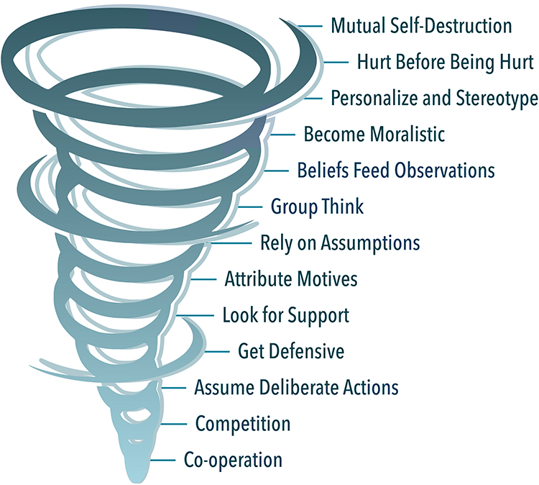
2.1 The Conflict Process II
Conflict Escalation
Notes:
Conflict is often discussed as though it is a separate entity, and in fact it is true that an escalating dispute may seem to take on a life of its own.
Conflict will often escalate beyond reason unless a conscious effort is made to end it.
This figure is called the conflict escalation tornado. It demonstrates how conflict can quickly escalate out of control.
By observing and listening to individuals in dispute, it is often possible to determine where they are in the escalation process and anticipate what might occur next.

Slide 5
2.2 Approaches to Conflict I
Every individual or group manages conflict differently. In the 1970s, consultants Kenneth W. Thomas and Ralph H. Kilmann developed a tool for analyzing the approaches to conflict resolution. This tool is called the Thomas-Kilmann Conflict Mode Instrument (TKI) (Kilmann Diagnostics, 2017).

Slide 6
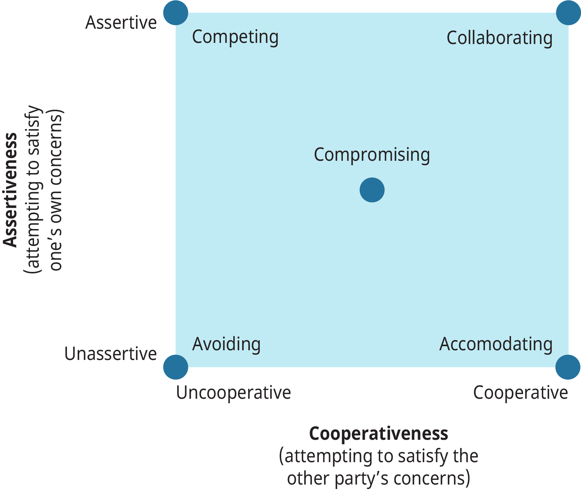
2.2 Approaches to Conflict II
Notes:
Thomas and Kilmann suggest that in a conflict situation, a person’s behaviour can be assessed on two factors:
Commitment to goals or assertiveness—the extent to which an individual (or a group) attempts to satisfy his or her own concerns or goals. A person may behaviour in behaviour that is not assertive or is highly assertive.
2. Commitment to relationships or cooperation—the extent to which an individual (or a group) attempts to satisfy the concerns of the other party, and the importance of the relationship with the other party. A person may behave in a may that is uncooperative or highly cooperative.
Thomas and Kilmann use these factors to explain the five different approaches to dealing with conflict: avoiding, competing, accommodating, compromising, and collaborating.

Slide 7
2.3 Conflict Resolution Strategies I
Common Strategies that Seldom Work
Nonaction
Administrative Orbiting
Due Process Nonaction
Secrecy
Character Assassination
Notes:
We have discovered that conflict is pervasive throughout organizations and that some conflict can be good for organizations. People often grow and learn from conflict, as long as the conflict is not dysfunctional. The challenge is to select a resolution strategy appropriate to the situation and individuals involved.
A review of past management practice in this regard reveals that managers often make poor strategy choices. At leave five conflict resolution techniques commonly found in organizations prove to be ineffective fairly consistently (Miles, 1980). Let’s review these strategies and why they are ineffective.

Slide 8
2.3 Conflict Resolution Strategies II
Strategies for Preventing and Reducing Conflict
Strategies for Preventing Conflict
Emphasizing organization-wide goals and effectiveness
Providing stable, well-structured tasks.
Facilitating intergroup communication.
Avoiding win-lose situations
Notes:
On the more positive side, there are many things managers can do to reduce or actually solve dysfunctional conflict when it occurs. These fall into two categories: actions directed at conflict prevention and actions directed at conflict reduction.
1. Focusing on organization-wide goals and objectives should prevent goal conflict. If larger goals are emphasized, employees are more likely to see the big picture and work together to achieve corporate goals.
2. When work activities are clearly defined, understood, and accepted by employees, conflict should be less likely to occur. Conflict is most likely to occur when task uncertainty is high; specifying or structuring jobs minimizes ambiguity
3. Misperception of the abilities, goals, and motivations of others often leads to conflict, so efforts to increase the dialogue among groups and to share information should help eliminate conflict. As groups come to know more about one another, suspicions often diminish, and greater intergroup teamwork becomes possible.
4. If win-lose situations are avoided, less potential for conflict exists. When resources are scarce, management can seek some form of resource sharing to achieve organizational effectiveness.

Slide 9
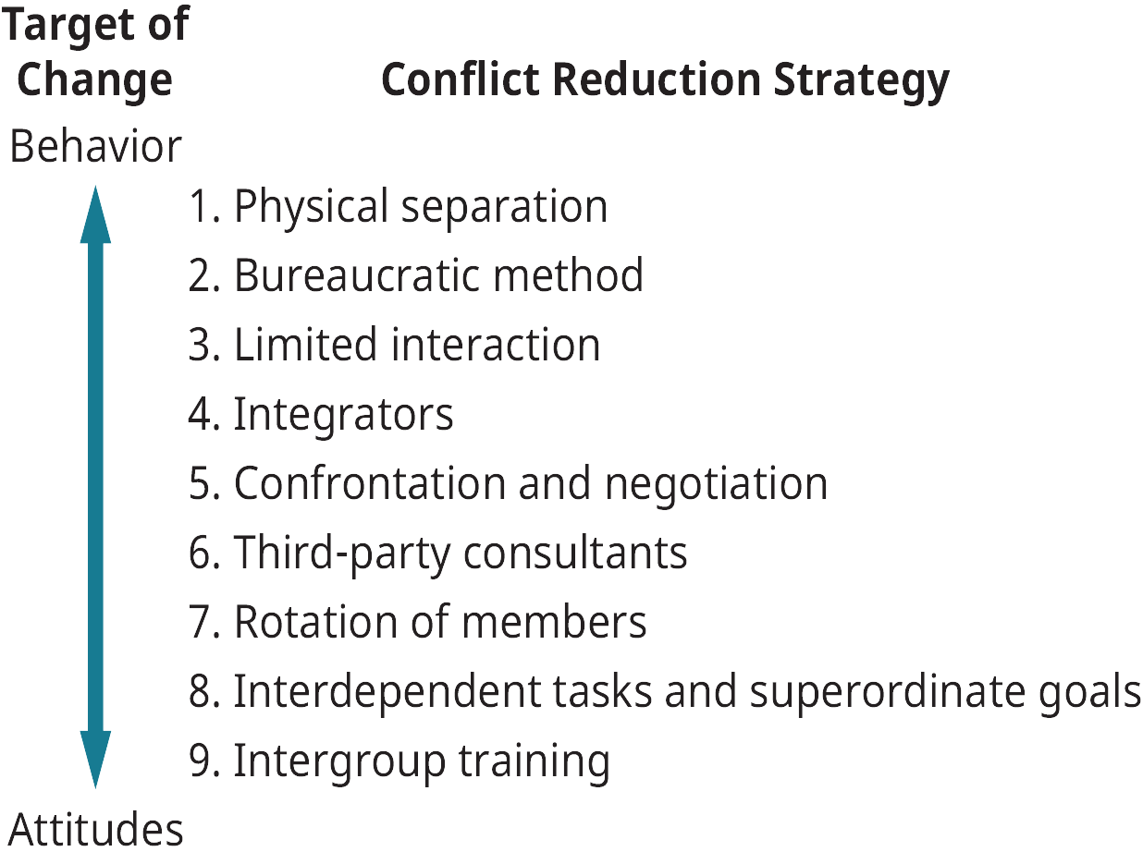
2.3 Conflict Resolution Strategies III
Strategies for Reducing Conflict
Notes:
Where dysfunctional conflict already exists, something must be done, and managers may pursue one of at least two general approaches: they can try to change employee attitudes, or they can try to change employee behaviors
Nine conflict reduction strategies are shown in this figure. The techniques should be viewed as a continuum, ranging from strategies that focus on changing behaviors near the top of the scale to strategies that focus on changing attitudes near the bottom of the scale.

Slide 10
2.4 Negotiation I
Negotiation is the process by which individuals or groups attempt to realize their goals by bargaining with another party who has at least some control over goal attainment.
Image by Gerd Altmann from Pixabay
Notes:
Where two people come in contact with one another, there is a potential for conflict. In this way, conflict can result in the need for negotiation. Alternatively, the need for negotiation can arise out of two parties’ willingness to exchange goods and services.
All negotiations share four common characteristics:
1. The parties involved are somehow interdependent
2. The parties are each looking to achieve the best possible result in the interaction for themselves
3. The parties are motivated and capable of influencing one another
4. The parties believe they can reach an agreement
NB…If these conditions don’t exist, neither can a negotiation.

Slide 11
2.4 Negotiation II
Approaches to Bargaining
Distributive bargaining is “win-lose” or fixed-pie bargaining.
Integrative bargaining, is referred to as a ‘win–win’ approach.
Notes:
In a negotiation, parties must select an approach to that they believe will assist them in the attainment of their objectives. In general, two rather distinct approaches to negotiation can be identified. These are distributive bargaining and integrative bargaining. Let’s compare these strategies.
Distributive Bargaining- With this type of bargaining, the goals of one party are in fundamental and direct conflict with those of the other party. Negotiators see the situation as a pie that they have to divide between them. Each tries to get more of the pie and “win.” Resources are fixed and limited, and each party wants to maximize their share of these resources.
In this approach, both parties look for ways to integrate their goals. That is, they look for ways to expand the pie, so that each party gets more. The first step of the integrative approach is to enter the negotiation from a cooperative rather than an adversarial stance. The second step is all about listening. Listening develops trust as each party learns what the other wants and everyone involved arrives at a mutual understanding.

Slide 12
2.4 Negotiation III
Phases of Negotiation
Notes:
Investigation- The first step in negotiation is investigation or information gathering stage. This is a key stage that is often ignored.
Determine you BATNA- One important part of the investigation and planning phase is to determine your BATNA. Thinking through your BATNA is important to helping you decide whether to accept an offer you receive during the negotiation. You need to know what your alternatives are.
Presentation- At this stage, they do not focus directly on the task or issue of the negotiation. This is called non-task time. In Canadian culture, this stage is often filled with small talk. However, it is usually not very long and is not seen as important as other stages. As such, many Canadian textbooks (including this one) do not even include non-task time as a discrete phase in the negotiation process.
Barganing- During the bargaining phase, each party discusses their goals and seeks to get an agreement.
Closure- The final stage of any negotiation is the closing. The closing may result in an acceptable agreement between the parties involved or it may result in failure to reach an agreement.

Slide 13
2.5 Labour Relations I
According to Statistics Canada (2022), 30.9% of employees in the Canadian workforce are unionized employees.
A labour union, or union, is defined as workers banding together to meet common goals, such as better pay, benefits, or promotion rules.
Notes:
At some time in your career in Canada, you may encounter labour relations/negotiations in a unionized work environment..
Rates of unionized workplaces vary by industry and also by geographical region (Statistics Canada, 2019).

Slide 14
2.5 Labour Relations II
Collective Bargaining
Collective bargaining is the process of negotiations between the company and representatives of the union. The goal is for management and the union to reach a contract agreement, which is put into place for a specified period of time.
Notes:
When employees of an organization vote to unionize, the process for collective bargaining begins.
Some examples of bargaining topics include: Pay rate and structure, Health benefits, Incentive programs, Job classification, Performance assessment procedure, Vacation time and sick leave, Health plans, Layoff procedures, Seniority, Training process, Severance pay, Tools provided to employees, Process for new applicants

Slide 15
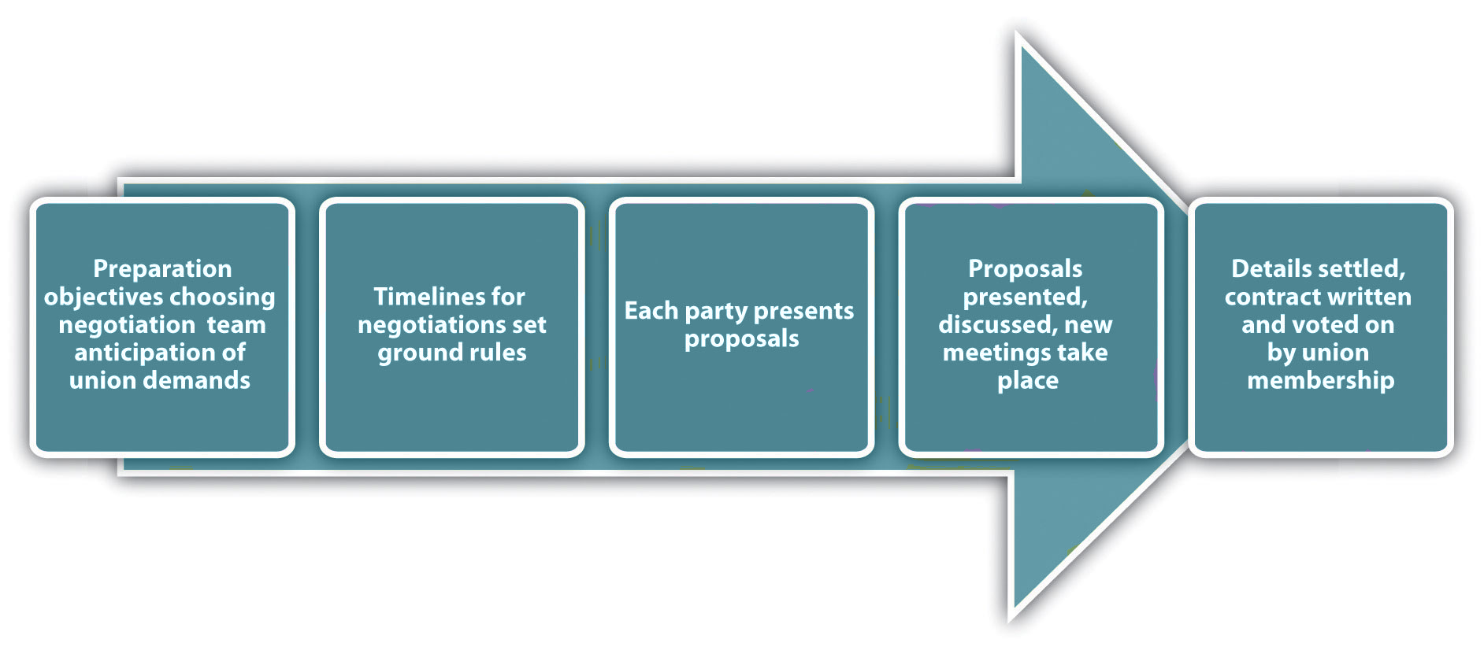
2.5 Labour Relations III
The Collective Bargaining Process
Notes:
The first step is the preparation of both parties. The negotiation team should consist of individuals with knowledge of the organization and the skills to be an effective negotiator.
The second step of the process involves both parties agreeing on how the timelines will be set for the negotiations.
In the third step, each party comes to the table with proposals. It will likely involve initial opening statements and options that exist to resolve any situations that exist. The key to a successful proposal is to come to the table with a “let’s make this work” attitude.
An initial discussion is had and then each party generally goes back to determine which requests it can honor and which it can’t. At this point, another meeting is generally set up to continue further discussion.
Once the group comes to an agreement or settlement (which may take many months and proposals), a new contract is written and the union members vote on whether to accept the agreement. If the union doesn’t agree, then the process begins all over again.

Slide 16
2.6 Key Takeaways
The conflict process consists of four stages
Conflict can often escalate in similar patterns.
The Thomas and Kilmann model identifies five approaches to conflict
Ineffective conflict resolution strategies include nonaction, administrative orbiting, due process nonaction, secrecy, and character assassination.
Negotiation is the process by which individuals or groups attempt to realize their goals by bargaining with another party who has at least some control over goal attainment.
Different negotiation strategies include the distributive approach and the integrative approach.
Negotiation consists of five phases
Collective bargaining is the process of negotiating the contact with union representatives.
The collective bargaining process can take time.

