Slide 1
Conflict Management
CHAPTER 1: INTRODUCTION TO CONFLICT
Unless otherwise noted, this work is licensed under a Creative Commons Attribution-NonCommercial-ShareAlike 4.0 International (CC BY-NC-SA 4.0) license. Feel free to use, modify, reuse or redistribute any portion of this presentation.

Slide 2
Learning Outcomes
Upon successful completion of this chapter, you will be able to:
Define conflict.
Describe the key elements of conflict.
Recognize how conflict can be differentiated from disputes, competitions, and interpersonal violence.
Identify three views to understanding conflict in the workplace.
Explain different levels at which conflict can occur.
Review common sources of conflict in the workplace.
Discuss the potential benefits and costs of conflict in the workplace.
Recognize the importance of conflict management skills for success in your personal and professional relationships.

Slide 3
1.1 Conflict Defined
There are many different definitions of conflict existing in the literature.
Conflict can vary in severity from mild to severe and can be expressed verbally or nonverbally along a continuum ranging from a nearly imperceptible cold shoulder to a very obvious blowout.
For our purposes, Conflict occurs in interactions in which there are real or perceived incompatible goals, scare resources, or opposing viewpoints.
Notes:
Psychology is a common area of study for students, a popular topic in the public media, and a part of our everyday lives. Since we are frequently exposed to the work of psychologists in our everyday lives, most of us have an idea about what psychology is and type of work that psychologists perform.
Throughout the course, I expect that you may find that at least some of your preconceptions about psychology will be challenged and changed, and you will learn that psychology is a field that will provide you with new ways of thinking about your own thoughts, feelings, and actions.

Slide 4
1.1 Conflict Defined II
Elements of conflict.
Conflict is inevitable
Conflict by itself is neither good nor bad; it is what happens that has good or bad outcomes.
Conflict is a process (rather than a moment in time).
Conflict consumes energy, but so does NOT dealing with conflict.
Conflict has elements of both content and feeling/relationships.
Finally, one has a choice in conflict to be proactive or reactive.
Notes:
There are six elements to a conflict described by Rice (2006).
1...Unless there is a way that we could be cloned or the same as everyone else, there WILL be disagreements.
2…In Chinese writing, the characters for the word conflict are actually the characters for two other words–danger and opportunity. In essence, the danger of unresolved or ineffectively resolved conflict can lead to bad outcomes, and the opportunity of working through a conflict can lead to good outcomes.
3…We each make choices every time we respond to the other person in a conflict, and those choices dictate what happens next.
4… Most of us are familiar with that knot-in-the-stomach feeling that goes along with avoiding someone with whom one has an unresolved conflict.
5… A conflict is rarely just about what it is about (content); it usually has more to do with the feelings and state of the relationship underneath. For example, if two people repetitively argue about who takes out the trash, the argument is probably really about feeling respected and validated, rather than the garbage!
6…the more non-violent one chooses to be, the more proactive a person will become. The participant will learn to act when he/she senses conflict, so that it can be resolved before it festers and grows.
***While this book uses a psychological lens to examine communication and other behaviours in the workplace, it is also important to acknowledge that OB draws from other disciplines to create a unique field.***

Slide 5
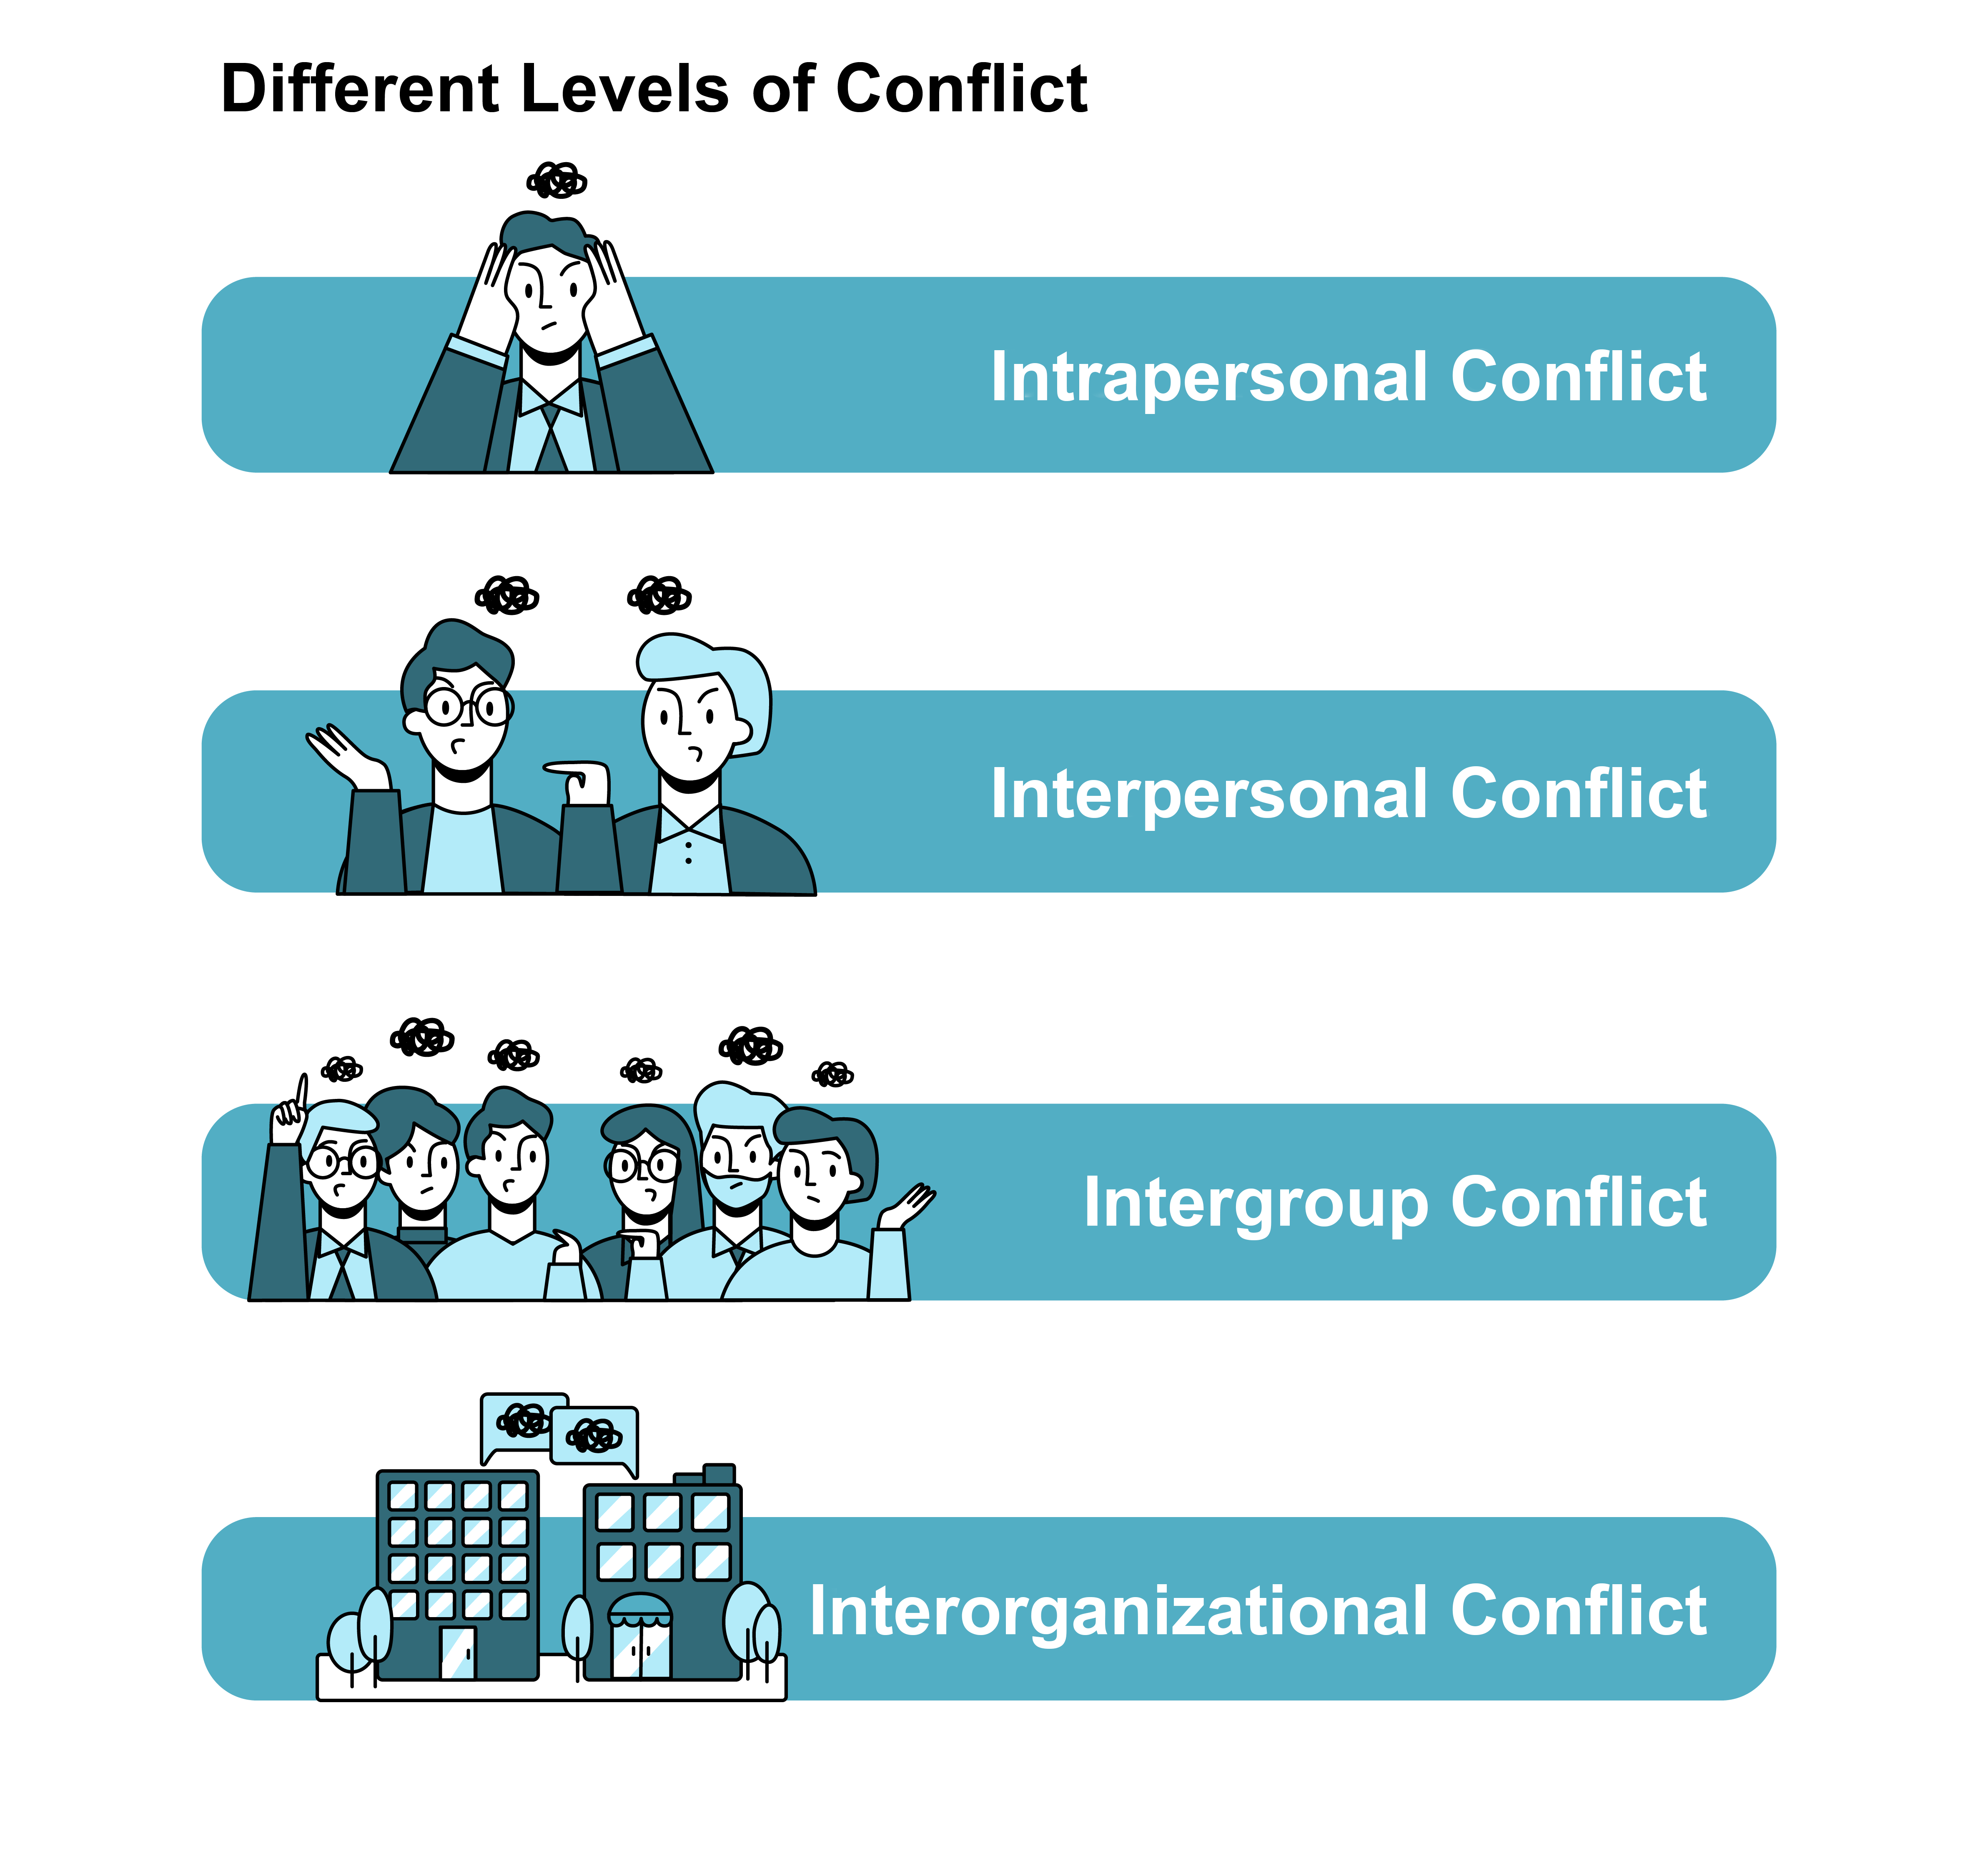
1.2 Levels and Types of Conflict I
Notes:
In addition to different views of conflict, there exist several different levels of conflict. By level of conflict, we are referring to the number of individuals involved in the conflict.

Slide 6
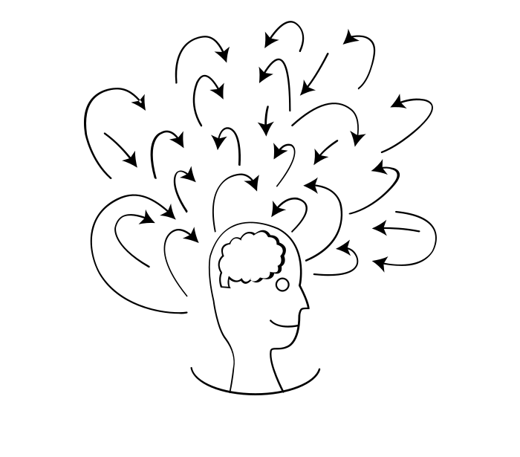
1.2 Levels and Types of Conflict II
Intrapersonal Conflict
Intrapersonal conflict arises within a person. In the workplace, this is often the result of competing motivations or roles. We often hear about someone who has an approach-avoidance conflict; that is, they are both attracted to and repelled by the same object.
Photo by Alex Dirksen from NounProject.com
Notes:
Another type of intrapersonal conflict involves role ambiguity. Perhaps you’ve been given the task of finding a trainer for a company’s business writing training program. You may feel unsure about what kind of person to hire—a well-known but expensive trainer or a local, unknown but low-priced trainer. If you haven’t been given guidelines about what’s expected, you may be wrestling with several options.

Slide 7
1.2 Levels and Types of Conflict III
Interpersonal conflict
Interpersonal conflict is among individuals such as coworkers, a manager and an employee, or CEOs and their staff. Many companies suffer because of interpersonal conflicts as it results in loss of productivity and employee turnover.
Photo by winnievinzence from NounProject.com
Notes:
According to one estimate, 31.9 percent of CEOs resigned from their jobs because they had conflict with the board of directors (Whitehouse, 2008). Such conflicts often tend to get highly personal because only two parties are involved and each person embodies the opposing position in the conflict.

Slide 8
1.2 Levels and Types of Conflict IV
Intergroup Conflict
Intergroup conflict is conflict that takes place among different groups and often involves disagreement over goals, values, or resources. Types of groups may include different departments, employee unions, or management in a company.
Notes:
Departments may conflict over budget allocations, unions and management may disagree over work rules, and suppliers may conflict with each other on the quality of parts.
Merging two groups together can lead to friction between the groups—especially if there are scarce resources to be divided among the group. For example, in what has been called “the most difficult and hard-fought labor issue in an airline merger,” Canadian Air and Air Canada pilots were locked into years of personal and legal conflict when the two airlines’ seniority lists were combined following the merger (Stoykewch, 2003).

Slide 9
1.2 Levels and Types of Conflict V
Interorganizational Conflict
We can see interorganizational conflict in disputes between two companies in the same industry (for example, a disagreement between computer manufactures over computer standards), between two companies in different industries or economic sectors (for example, a conflict between real estate interests and environmentalists over land use planning).
Notes:
In each case, both parties inevitably feel the pursuit of their goals is being frustrated by the other party.

Slide 10
1.2 Levels and Types of Conflict VI
Types of Conflict
If we are to try to understand conflict, we need to know what type of conflict is present. At least four types of conflict can be identified:
Goal Conflict
Cognitive Conflict
Affective Conflict
Behavioral Conflict
Notes:
Each of these types of conflict is usually triggered by different factors, and each can lead to very different responses by the individual or group. It is important to note that there are many types of conflict and that not all researchers use this same four-type classification.
1. Goal Conflict--- can occur when one person or group desires a different outcome than others do. This is simply a clash over whose goals are going to be pursued.
2. Cognitive conflict-- can result when one person or group holds ideas or opinions that are inconsistent with those of others. Often cognitive conflicts are rooted in differences in attitudes, beliefs, values, and worldviews, and ideas maybe tied to deeply held culture, politics, and religion. This type of conflict emerges when one person’s or group’s feelings or emotions (attitudes) are incompatible with those of others.
3. Affective conflict is seen in situations where two individuals simply don’t get along with each other.
4. Behavioral conflict-- exists when one person or group does something (i.e., behaves in a certain way) that is unacceptable to others. Dressing for work in a way that “offends” others and using profane language are examples of behavioral conflict.

Slide 11
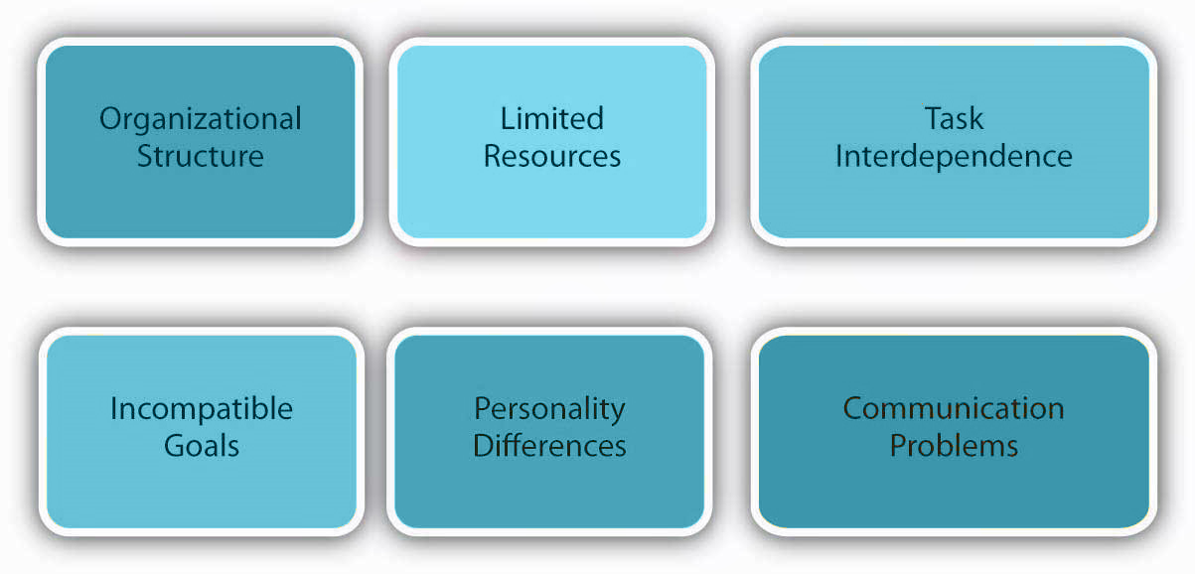
1.3 Common Sources of and Response to Conflict in the Workplace I
Six common sources of workplace conflict
Notes:
Anything that leads to a disagreement can be a cause of conflict. Although conflict is common to organizations, some organizations have more than others. A number of factors are known to facilitate organizational conflict (Miles, 1980). We’ll go over six common sources of workplace conflict.
1. Organizational Structure- Conflict tends to take different forms, depending upon the structure of an organization. For example, if a company uses a matrix structure as its organizational form, it will have decisional conflict built in because the structure specifies that each manager report to two bosses. For example, global company ABB Inc. is organized around a matrix structure based on the dimensions of country and industry.
2. Limited Resources- Another previously discussed factor that contributes to conflict is dependence on common resource pools. Resources such as money, time, and equipment are often scarce. Competition among people or departments for limited resources is a frequent cause for conflict.
3. Task Independence- Another cause of conflict is task interdependence; that is, when accomplishment of your goal requires reliance on others to perform their tasks the greater the extent of task interdependence among individuals or groups
4. Incompatible Goals- Sometimes conflict arises when two parties think that their goals are mutually exclusive. Within an organization, incompatible goals often arise because of the different ways department managers are compensated.
5. Personality Differences- Personality differences among coworkers are common. By understanding some fundamental differences among the way people think and act, we can better understand how others see the world.
6. Communication Problems- Various communication problems or ambiguities in the communication process can create a breeding ground for conflict. When one person misunderstands a message or when information is withheld, the person often responds with frustration and anger.

Slide 12
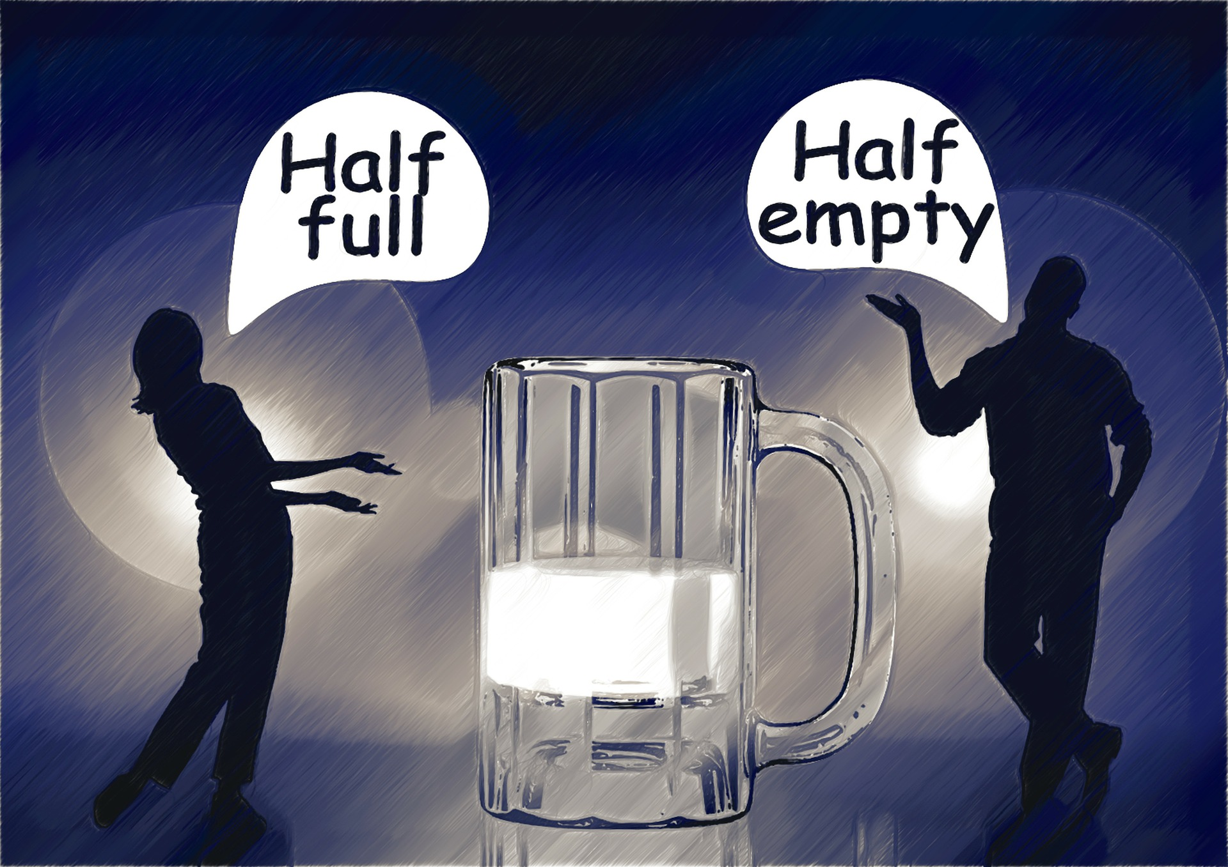
1.3 Common Sources of and Response to Conflict in the Workplace II
Responses to Conflict
There are a variety of individual responses to conflict that you may see as a team member. Some people take the constructive and thoughtful path when conflicts arise, while others may jump immediately to destructive behaviors.
Image by Gerd Altmann from Pixabay
Notes:
There are many possible responses to conflict that we will explore throughout this book. Some of these strategies try to end the conflict, conflict resolution, while other strategies merely seek to minimize the negative effects of a conflict on a on team performance, conflict management.
In Managing Conflict Dynamics: A Practical Approach, Capobianco et al. (2005) recognized that there are both constructive and destructive responses to conflict, as well as active and passive responses that we need to recognize. In the event of conflict, the goal is to have a constructive response in order to encourage dialogue, learning, and resolution (Capobianco et al., 2005).

Slide 13
1.4 Benefits and Challenges of Conflict I
Benefits and Challenges of Conflict
As we discussed with the traditional view of conflict, many people often assume that all conflict is necessarily bad and should be eliminated or avoided at all costs. On the contrary, there are some circumstances in which a moderate amount of conflict can be helpful a bring energy and focus to a task.
Notes:
For instance, conflict can lead to the search for new ideas and new mechanisms as solutions to organizational problems. It can also facilitate employee motivation in cases where employees feel a need to excel and, as a result, push themselves in order to meet performance objectives.

Slide 14
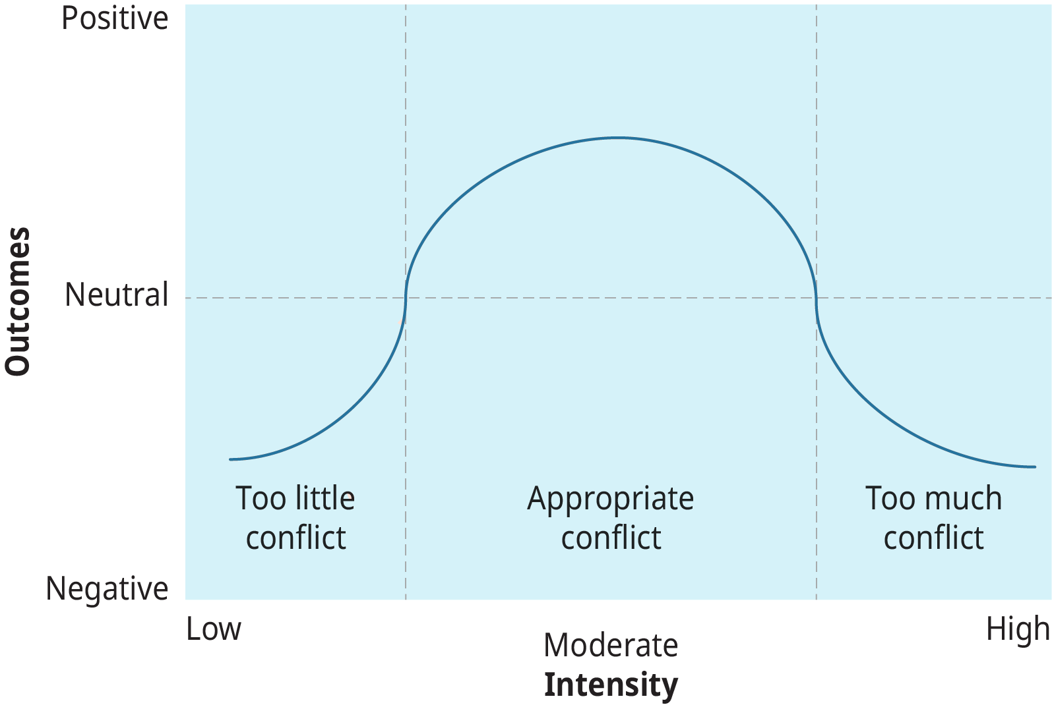
1.4 Benefits and Challenges of Conflict II
Notes:
Conflict can at times help individuals and group members grow, develop self-identities, and to create change and stability (Coser, 1954). Conflict can stimulate the conversations of important issues and spur change. Within a group, productive conflict can lead to consensus and group cohesiveness.
Conflict can, on the other hand, have negative consequences for both individuals and organizations when people divert energies away from performance and goal attainment and direct them toward resolving the conflict. During conflict, it can be easy for judgement to get clouded and to lose sight of end-goals.
Indeed, both too much and too little conflict can lead to a variety of negative outcomes, This is shown in the figure here. In such circumstances, a moderate amount of conflict may be the best course of action. The issue for management, therefore, is not how to eliminate conflict but rather how to manage and resolve it when it occurs.

Slide 15
1.5 Key Takeaways
Conflict occurs in interactions
Conflict will inevitably occur and isn’t inherently good or bad.
Conflict may be marked by disputes, competitions, and/or interpersonal violence.
There are several views of conflict.
Conflict can occur at different levels.
There are four types of conflict.
There are many potential sources of conflict in the workplace.
When faced with conflict, we have many choices on how to respond.
Depending on its characteristics, a conflict in the workplace can provide benefits or challenges.

