Slide 1
CONFLICT MANAGEMENT
CHAPTER 8:MOTIVATION
Unless otherwise noted, this work is licensed under a Creative Commons Attribution-NonCommercial-ShareAlike 4.0 International (CC BY-NC-SA 4.0) license. Feel free to use, modify, reuse or redistribute any portion of this presentation.

Slide 2
Learning Outcomes
Upon successful completion of this chapter, you will be able to:
Define motivation.
Identify the relationship between needs, equity and conflict at work.
Recognize how strategies like job enrichment, job enlargement and employee empowerment can help fulfil esteem needs.
Review principles of communication climate.
Explore types of confirming and disconfirming messages.
Describe characteristics of supportive and defensive communication climates.
Explain styles of communication on the passive-assertive-aggressive continuum.
Compare using I and You statements.
List steps in the assertion process.
Analyze how framing and reframing can help assert needs and boundaries.
Review goals in conflict and the SCARF model.

Slide 3
8.1 THEORIES OF MOTIVATION I
Motivation refers to an internally generated drive to achieve a goal or follow a particular course of action. Highly motivated employees focus their efforts on achieving specific goals.
Notes:
Motivated employees call in sick less frequently, are more productive, and are less likely to convey bad attitudes to customers and coworkers. They also tend to stay in their jobs longer, reducing turnover and the cost of hiring and training employees.
You might be wondering: what is the connection is between motivation and conflict? In Chapter 7 we learned that both affect and emotion drive our behaviours. If we perceive that someone is the source of our inability to meet our needs or goals, a conflict may arise. In this section we will discuss two theories of motivation and how they might help us to understand conflict at work.

Slide 4
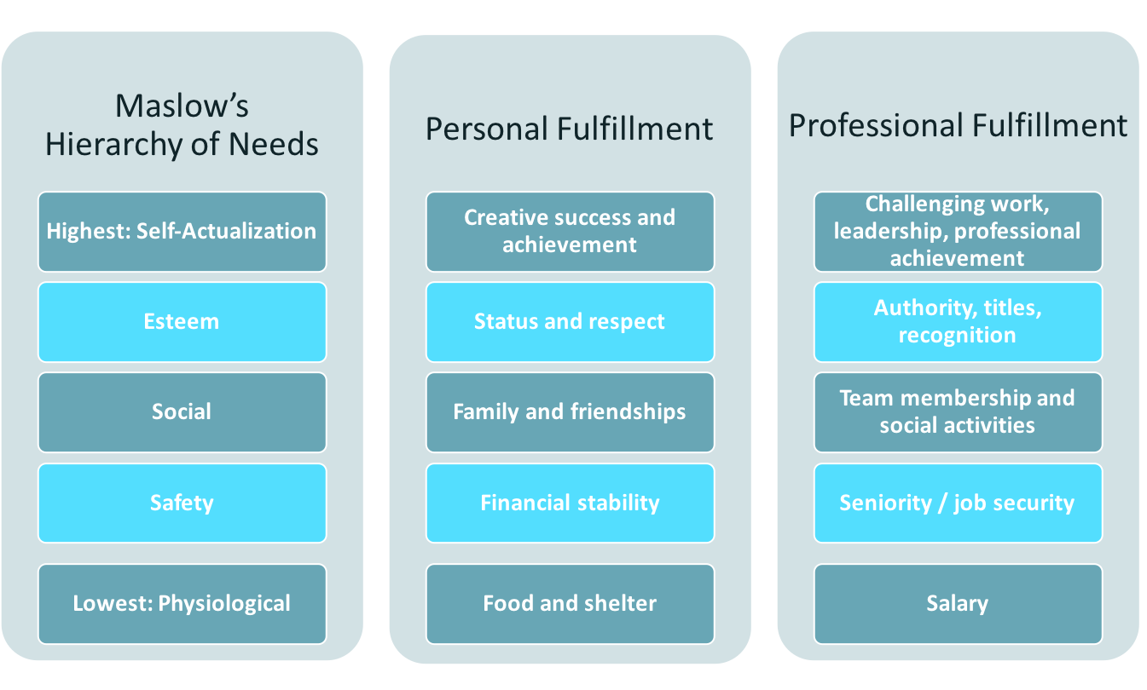
8.1 THEORIES OF MOTIVATION II
Hierarchy of Needs Theory
Image by Pamplin College of Business and Virginia Tech Libraries, Fundamentals of Business: Canadian Edition, CC BY-NC-SA 4.0. Color alerted from the original.
Notes:
Psychologist Abraham Maslow’s hierarchy of needs theory (1943, 1954), proposed that we are motivated by the five initially unmet needs, arranged in the hierarchical order shown below, which also lists specific examples of each type of need in both the personal and work spheres of life.
Look, for instance, at the list of personal needs in the middle column. At the bottom are physiological needs (such life-sustaining needs as food and shelter). Working up the hierarchy we experience safety needs (financial stability, freedom from physical harm), social needs (the need to belong and have friends), esteem needs (the need for self-respect and status), and self-actualization needs (the need to reach one’s full potential or achieve some creative success).

Slide 5
8.1 THEORIES OF MOTIVATION III
Needs Theory and Conflict
The idea of meeting these needs at work ties into many of the ideas discussed in previous chapters of this book. For example, I think that it’s fair to say that most of us are not functioning at our best when our most basic human physiological needs are unmet. If you find yourself irritable and having difficulty controlling your emotions, it can be helpful to reflect on whether you are hungry, sick, or tired.

Slide 6
8.1 THEORIES OF MOTIVATION IV
Meeting Esteem Needs through Job Design, Job Enlargement, and Empowerment
One of the reasons for job dissatisfaction and conflict is the job itself. Ensuring our skills set and what we enjoy doing matches with the job is important. Some companies will use a change in job design, enlarge the job or empower employees to motivate them and help people to meet their esteem needs.
Notes:
Job enrichment means to enhance a job by adding more meaningful tasks to make our work more rewarding. For example, if we as retail salespersons are good at creating eye-catching displays, allowing us to practice these skills and assignment of tasks around this could be considered job enrichment.
Employee empowerment involves management allowing us to make decisions and act upon those decisions, with the support of the organization. When we are not micromanaged and have the power to determine the sequence of our own workday, we tend to be more satisfied than those employees who are not empowered. Empowerment can include the following:
Encourage innovation or new ways of doing things.
Make sure we, as employees, have the information we need to do our jobs; for example, we are not dependent on managers for information in decision making.
Management styles that allow for participation, feedback, and ideas from employees.

Slide 7
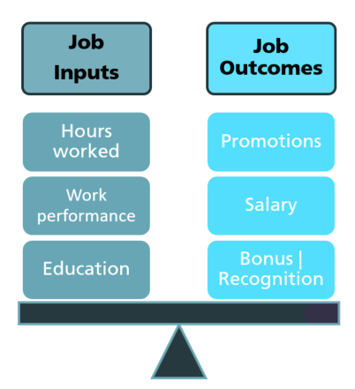
8.1 THEORIES OF MOTIVATION V
Equity Theory
Image by Pamplin College of Business and Virginia Tech Libraries, Fundamentals of Business: Canadian Edition, CC BY-NC-SA 4.0. Color alerted from the original.
Notes:
A second theory of motivation that we will discuss in relationship to conflict at work is equity theory, which focuses on our perceptions of how fairly we’re treated relative to others. Applied to the work environment, this theory proposes that employees analyze their contributions or job inputs (hours worked, education, experience, work performance) and their rewards or job outcomes (salary, bonus, promotion, recognition). Then they create a contributions/rewards ratio and compare it to those of other people. The basis of comparison can be any one of the following:
Someone in a similar position
Someone holding a different position in the same organization
Someone with a similar occupation
Someone who shares certain characteristics (such as age, education, or level of experience)
Oneself at another point in time

Slide 8
8.2 MEETING NEEDS THROUGH COMMUNICATION CLIMATE I
Needs and Communication Climate
One way that we can help ensure that safety, social and esteem needs are being consistently met in the workplace is by creating a positive communication climate in which people feel seen, heard and valued. In this section, we will talk more about the nature of communication climate and how to generate messages that help others meet their needs.

Slide 9
8.2 MEETING NEEDS THROUGH COMMUNICATION CLIMATE II
Principles of Communication Climate
Communication climate is the “overall feeling or emotional mood between people” (Wood, 1999). If you dread going to visit your family during the holidays because of tension between you and your sister, or you look forward to dinner with a particular set of friends because they make you laugh, you are responding to the communication climate—the overall mood that is created because of the people involved and the type of communication they bring to the interaction.
Notes:
In this section we will discuss the five principles of communication climate: messages contain relational subtexts that can be felt; climate is conveyed through words, action, and non-action; climate is perceived; climate is determined by social and relational needs; and relational messages are multi-leveled.
Messages Contain Relational Subtexts That Can Be Felt- In addition to generating and perceiving meaning in communicative interactions, we also subtly (and sometimes not so subtly) convey and perceive the way we feel about each other. Almost all messages operate on two levels: content and relational.
Climate is Conveyed through Words, Action, and Non-Action-- Relational subtexts can be conveyed through direct words and actions. A student making a complaint to an instructor can be worded with respect, as in “Would you have a few minutes after class to discuss my grade?” or without, as in “I can’t believe you gave me such a terrible grade, and we need to talk about it right after class!” We can often find more of the relational meaning in the accompanying and more indirect nonverbals—in the way something is said or done.
Climate is Perceived—Relational meanings are not inherent in the messages themselves. They are not literal, and they are not facts. The subtext of any communicative message is in the eye of the beholder.
Climate is Determined by Social and Relational Needs--While relational messages can potentially show up in dozens of different communicative forms, they generally fall into categories that align with specific types of human social needs that vary from person to person and situation to situation.

Slide 10
8.2 MEETING NEEDS THROUGH COMMUNICATION CLIMATE III
Confirming and Disconfirming Messages
Positive and negative climates can be understood by looking at confirming and disconfirming messages. We experience positive climates when we receive messages that demonstrate our value and worth from those with whom we have a relationship.
Notes:
Conversely, we experience negative climates when we receive messages that suggest we are devalued and unimportant. Obviously, most of us like to be in positive climates because they foster emotional safety as well as personal and relational growth. However, it is likely that your relationships fall somewhere between the two extremes.

Slide 11
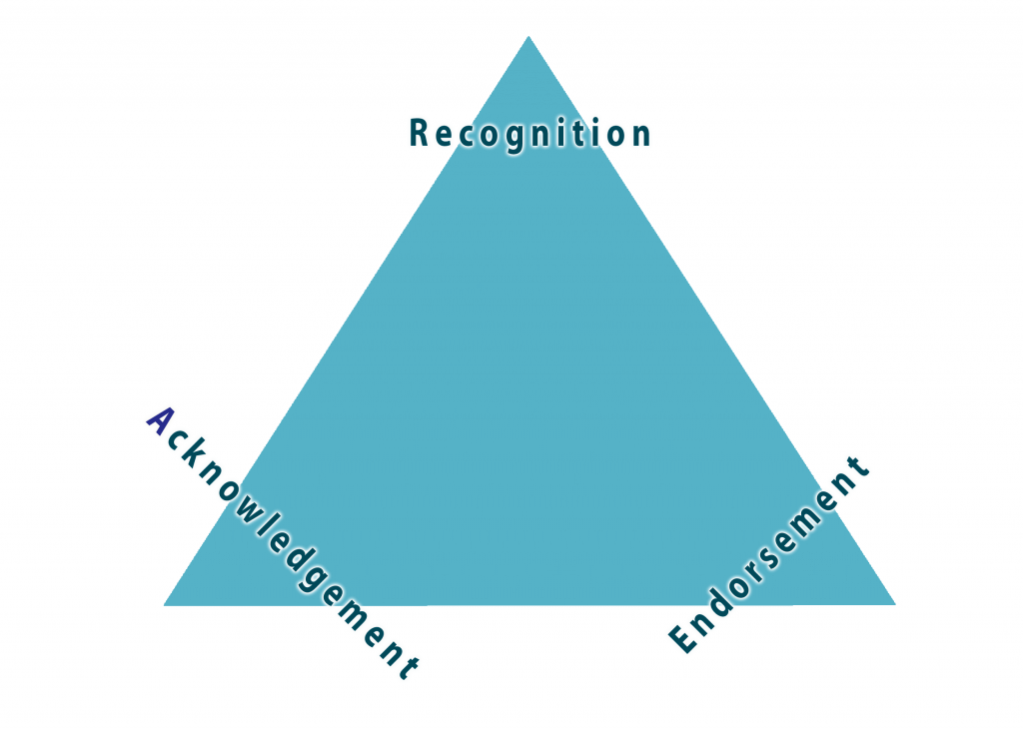
8.2 MEETING NEEDS THROUGH COMMUNICATION CLIMATE IV
Types of Confirming Messages
Recognition messages
Acknowledgement messages
Endorsement messages
Image by Maricopa Community College, Exploring Relationship Dynamics, CC BY-NC-SA 4.0. Color altered from the original.
Notes:
Recognition messages either confirm or deny another person’s existence. For example, if a friend enters your home and you smile, hug him, and say, “I’m so glad to see you” you are confirming his existence.
Acknowledgement messages go beyond recognizing another’s existence by confirming what they say or how they feel. Nodding our head while listening, or laughing appropriately at a funny story, are nonverbal acknowledgment messages.
Endorsement messages go one step further by recognizing a person’s feelings as valid. Suppose a friend comes to you upset after a fight with his girlfriend. If you respond with, “Yeah, I can see why you would be upset” you are endorsing his right to feel upset.

Slide 12
8.2 MEETING NEEDS THROUGH COMMUNICATION CLIMATE V
Disconfirming Messages
Unfortunately, sometimes when we are interacting with others, disconfirming messages are used. These messages imply, “You don’t exist. You are not valued.” There are seven types of disconfirming messages:
Impervious response
Interrupting response
Irrelevant responses
Tangential response
Impersonal response
Ambiguous responses
Incongruous responses
Notes:
Impervious response fails to acknowledge another person’s communication attempt through either verbal or nonverbal channels. Failure to return phone calls, emails, and text messages are examples.
In an interrupting response, one person starts to speak before the other person is finished.
Irrelevant responses are comments completely unrelated to what the other person was just talking about. They indicate that the listener wasn’t really listening at all, and therefore doesn’t value with the speaker had to say.
In a tangential response, the speaker is acknowledged, but with a comment that is used to steer the conversation in a different direction.
In an impersonal response, the speaker offers a monologue of impersonal, intellectualized, and generalized statements that trivializes the other’s comments (e.g., what doesn’t kill you makes you stronger).
Ambiguous responses are messages with multiple meanings, and these meanings are highly abstract, or are a private joke to the speaker alone.
Incongruous responses communicate two messages that seem to conflict along the verbal and nonverbal channels. The verbal channel demonstrates support, while the nonverbal channel is disconfirming. An example might be complimenting someone’s cooking, while nonverbally indicating you are choking.

Slide 13
8.2 MEETING NEEDS THROUGH COMMUNICATION CLIMATE VI
Supportive and Defensive Climates
Communication is key to developing positive climates. This requires people to attend to the supportive and defensive communication behaviors taking place in their interpersonal relationships and groups. Defensive communication is defined as that communication behavior that occurs when an individual perceives threat or anticipates threat in the group.
Notes:
Those who behave defensively, even though they also give some attention to the common task, devote an appreciable portion of energy to defending themselves. Besides talking about the topic, they think about how they appear to others, how they may be seen more favorably, how they may win, dominate, impress or escape punishment, and/or how they may avoid or mitigate a perceived attack.

Slide 14
8.2 MEETING NEEDS THROUGH COMMUNICATION CLIMATE VII
Notes:
The converse, moreover, also is true. The more “supportive” or defense-reductive the climate, the less the receiver reads into the communication distorted loadings that arise from projections of their own anxieties, motives, and concerns. As defenses are reduced, the receivers become better able to concentrate upon the structure, the content, and the cognitive meanings of the message.
Jack Gibb (1961) developed six pairs of defensive and supportive communication categories presented below. Behavior which a listener perceives as possessing any of the characteristics listed in the left-hand column arouses defensiveness, whereas that which he interprets as having any of the qualities designated as supportive reduces defensive feelings. The degree to which these reactions occur depends upon the person’s level of defensiveness and the general climate in the group at the time.

Slide 15
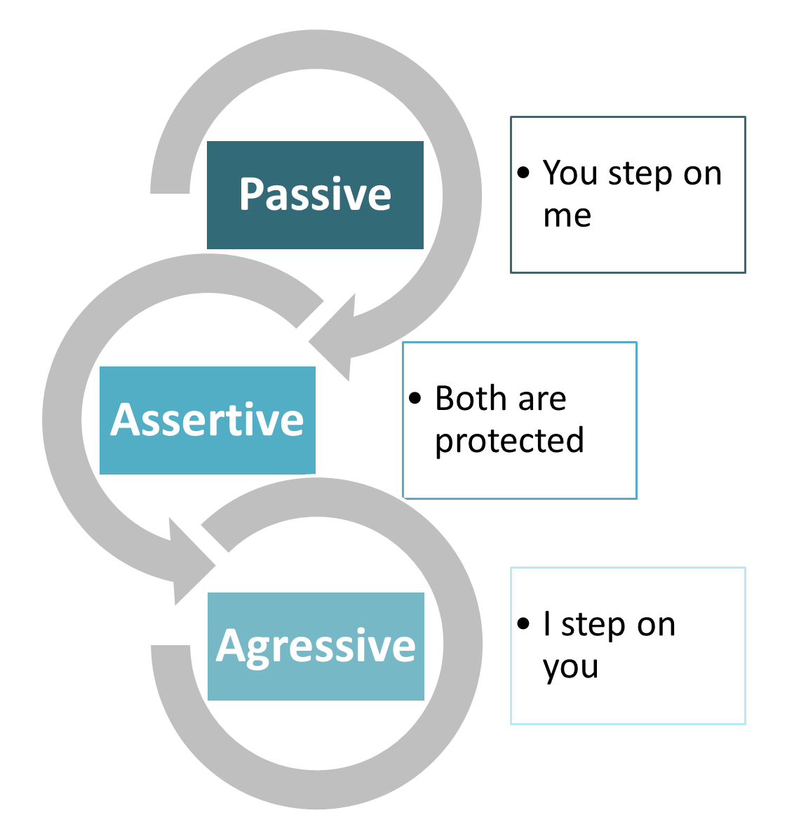
8.3 ASSERTING YOUR NEEDS I
The Passive-Assertive-Aggressive Continuum
Image by Fanshawe College, CC BY-NC-SA 4.0.
Notes:
People tend to relate to communicate their needs using one of three strategies:
Passive communicators tend to put the rights of others before their own. Passive communicators tend to be apologetic or sound tentative when they speak. They do not speak up if they feel like they are being wronged.
Assertive communicators respect their rights and the rights of others when communicating. This person tends to be direct but not insulting or offensive. The assertive communicator stands up for his or her own rights but makes sure the rights of others aren’t affected.
Aggressive communicators, on the other hand, will come across as standing up for their rights while possibly violating the rights of others. This person tends to communicate in a way that tells others they don’t matter or their feelings don’t matter.

Slide 16
8.3 ASSERTING YOUR NEEDS II
Being Assertive – I Statements
One word that is often used for being assertive in our society today is to draw or hold our “boundaries”.
I-statements allow you to directly express your thoughts, needs, feelings, and experiences to the people around you. I-statements allow us to take responsibilities for our experiences and places the power of our lives in our hands. I-statements look like this:
I feel…
I think…
I experienced it like this…
I want…
I need…

Slide 17
8.3 ASSERTING YOUR NEEDS III
The Assertion Process
Imagine you know it’s time to draw a boundary with someone close to you, you’ve thought long and hard about what is important to you, you know what you want to say, So what do you do now? Robert Bolton (1979), gives us a process to follow when delivering our assertion:
Preparation
Delivering the Message
Silence
Active Listening
Recycle steps 2-4 (as necessary)
Focus on a Solution
Notes:
Preparation – In the preparation stage you spend time, before you enter into a conversation with the other person, reflecting on what is important for you to convey, developing your framing (see below) and assertion message, and preparing yourself for this process and active listening.
Deliver the Message – Share your frame and your assertion message
Silence – Allow the other person time to process what you have just said. Sometimes after we assert ourselves, we want to justify ourselves, or jump in when there is silence because it can be awkward and uncomfortable. Take a deep breath while they consider what you have just said, they may have not considered this topic before this very moment.
Active Listening – Once the person responds to your assertion, your job is to reflect back what their response is. This response could be defensive, it could be off track from your original topic, or they could shut down. Actively listening to the other person will likely be the last thing you want to do, so make sure to prepare for this part of the process as much as you can in the preparation step.
Recycle Steps 2-4 (as necessary) – You will likely have to reassert yourself, provide more silence, and actively listen a few times, before you can move into the next step in the process. This part of the process allow you and the other person to really understand each other and get on the same page.
Focus on A Solution – Often times in conflict we jump to this step without taking the time to go through steps 1-5. Only focus on a solution after you have understood the other person, they have understood you, and you are both ready and capable of focusing on a solution.

Slide 18
8.3 ASSERTING YOUR NEEDS IV
Framing and Reframing
Framing, in communication, is essentially the act of intentionally setting the stage for the conversation you want to have. In framing a conversation you express why you want to engage in this topic, what your intent is, and what you hope the outcome can be for resolving the conflict, as well as the impact/importance of your relationship.
Notes:
When you frame a conversation, you take out the need for the other person to assume what your intentions and motives are or why you are bringing this topic up right now.
There are many ways to frame a conversations, here are a few ideas for how to frame a conversation effectively.

Slide 19
8.3 ASSERTING YOUR NEEDS V
Reframing
Framing happens at the beginning of a conversation, Reframing happens when things get off track and you need to bring a conversation back on topic. Consider this picture:
Image by Framing the Ocean, Ashley Orme Nichols, Making Conflict Suck Less: The Basics, CC BY-NC-SA 4.0.
Notes:
In the center of the picture is a frame, that is only covering part of the ocean and cliff. If we expanded that frame to surround the entire picture, that would be reframing. Reframing, in a conversation, helps us see more of what is going on, helps us focus on the larger picture or our end goals, and helps defuse tense situations. Reframing can be used for many things when managing conflict.
Defusing inflammatory language
Recasting negatives into neutral or positive statements
Refocusing attention
Acknowledging strong emotions in a productive manner
Translating communication so that it is more likely to be heard and acknowledged by other parties
Recontextualizing the dispute, providing a broader perspective

Slide 20
8.4 UNDERSTANDING GOALS IN CONFLICT AND THE SCARF MODEL I
Understanding Goals in Conflict
Think back to our definition of conflict in Chapter 1 and the importance of “real or perceived incompatible goals.” McCorkle and Reese (2009) provide us with a very simple framework for analyzing what is happening with conflict in relation to goal incompatibility and interference. They identify four types of goals: substantive, process, relationship, and face goals. These goals are summarized in the table below.
Notes:
Substantive Ability to secure tangible resources and/or something measurable/visible
Process-Desire to have events and processes unfold in a certain way, these processes include how decision are made and how/when communication happens
Relationship- How we relate to one another, in any relationship setting
Face- Ability to uphold ones self-imagine as it is perceived in a social setting
This framework allows us, first, to start understanding ourselves in a conflict situation. Think about a conflict you are currently experiencing. Ask yourself, which type of goals do you have? Which goals do you perceive some type of incompatibility or interference with? If you have more than one goal, which goal is most important? Once you understand what goals you really have in a conflict, you can start addressing the real issue and move towards resolving the conflict you are experiencing.

Slide 21
8.4 UNDERSTANDING GOALS IN CONFLICT AND THE SCARF MODEL II
The SCARF Model in Conflict
The second framework we will examine, The SCARF model, comes from David Rock out the Neuroscience Leadership Institute (2008).
Status
Certainty
Autonomy
Relatedness
Fairness
Notes:
The SCARF model provides a framework to understand the five domains of human social experiences. David Rock and his team found that there are 5 areas of our brains that light up (via brain scan technology) during our social experiences.
Status - Sense of respect and importance in relation to others. “I am respected by my family, friends, and colleagues.”
Certainty– Sense of clarity to predict future outcomes. “I am confident I know what is coming next in my life.”
Autonomy - Sense of control over events that impact the future. “I am the master of my own destiny.”
Relatedness - Sense of connection with others in your groups. “I am connected to those around me.”
Fairness – Sense of non-biased and just treatment between people. “I am treated justly.”
These five areas can either be interpreted by us as a reward or threat based on the type of social experience we are having. Conflict is, by its very nature, a social experience. When we experience conflict we are experiencing the threat response side of the SCARF model. The different ways our brain interprets social experiences in the SCARF model is summarized in the table below.

Slide 22
8.5 Key Takeaways
Motivation describes a generated drive that propels people to achieve goals or pursue particular courses of action.
Hierarchy-of-needs theory proposes that we’re motivated by five unmet needs— physiological, safety, social, esteem, and self-actualization— and must satisfy lower-level needs before we seek to satisfy higher-level needs.
Equity theory focuses on our perceptions of how fairly we’re treated relative to others. This theory proposes that employees create rewards ratios that they compare to those of others and will be less motivated when they perceive an imbalance in treatment.
Confirming messages include recognition, acknowledgement and endorsement. They all provide affirmation and help foster a positive communication climate.
Disconfirming messages include impervious messages, interrupting, irrelevant, tangential, impersonal, ambiguous, and incongruous responses. Disconfirming messages provide the relational message that people are not respected or valued and contribute to a negative communication climate.
Gibb provides six characteristics of supportive and defensive communication climates.
Empathy is an important ability for our interpersonal relationships. It has three components: cognitive, affective, and compassionate.
Communication styles can be described on a continuum from passive to assertive to aggressive.
Using “I” statements, selective inattention and withdrawal are all strategies that we can use to assert our boundaries with others.
There’s six steps in the assertion process. We should try to assert boundaries when in person (compared to over other channels) and should avoid asserting when we are hungry, angry, alone or tired (HALT).
An important part of asserting our needs includes framing the situation and if needed, refocusing the conversation using reframing.
When our substantive, process, relationship or face goals are threatened or impeded, it can cause conflict.
In the SCARF model of conflict, we can understand conflict in terms of our need for status, certainty, autonomy, relatedness and fairness.

