Slide 1
CONFLICT MANAGEMENT
CHAPTER 7:EMOTIONS
Unless otherwise noted, this work is licensed under a Creative Commons Attribution-NonCommercial-ShareAlike 4.0 International (CC BY-NC-SA 4.0) license. Feel free to use, modify, reuse or redistribute any portion of this presentation.

Slide 2
Learning Outcomes
Upon successful completion of this chapter, you will be able to:
Define affect and emotion.
Describe the physiology of emotions, including the actions of the sympathetic nervous system, the parasympathetic nervous system, and the amygdala.
Differentiate the basic and secondary emotions and explain their functions.
Explain the concept of emotional intelligence.
Describe emotional awareness and its importance to interpersonal communication.
Review the known about cultural differences in the experience and expression of emotion.
Define stress.
Identify types of stressors.
Recognize the impact of acute and chronic stress on the body.
Describe the general adaptation syndrome and how stress influences the HPA axis and the release of hormones.
Review the negative outcomes of stress on health.
Explore four different approaches to reduce the impact of stressors.
Review a model of workplace stress.
Summarize individual and organizational techniques for coping with stress at work.
Appreciate the role of positive affect and emotional intelligence in stress and conflict management.

Slide 3
7.1 EMOTIONS AND INTELLIGENCE I
An emotion is a mental and physiological feeling state that directs our attention and guides our behaviour.
Image by Gino Crescoli licensed by Pixabay
Notes:
The topic of this section is affect, defined as the experience of feeling or emotion. Affect is an essential part of the study of conflict. As we will see, affect guides behaviour, helps us make decisions, and has a major impact on our mental and physical health.
The two fundamental components of affect are emotions and motivation. Both of these words have the same underlying Latin root, meaning “to move.”
Whether it is the thrill of a roller-coaster ride that elicits an unexpected scream, the flush of embarrassment that follows a public mistake, or the feeling of anger rising when your coworker blames you for their mistake, emotions move our actions. Emotions normally serve an adaptive role

Slide 4
7.1 EMOTIONS AND INTELLIGENCE II
The Physiology of Emotion
Our emotions are determined in part by responses of the sympathetic nervous system (SNS)—the division of the autonomic nervous system that is involved in preparing the body to respond to threats by activating the organs and the glands in the endocrine system. The SNS works in opposition to the parasympathetic nervous system (PNS), the division of the autonomic nervous system that is involved in resting, digesting, relaxing, and recovering.
Notes:
When it is activated, the SNS provides us with energy to respond to our environment. The liver puts extra sugar into the bloodstream, the heart pumps more blood, our pupils dilate to help us see better, respiration increases, and we begin to perspire to cool the body. The sympathetic nervous system also acts to release stress hormones including epinephrine and norepinephrine. At the same time, the action of the PNS is decreased.

Slide 5
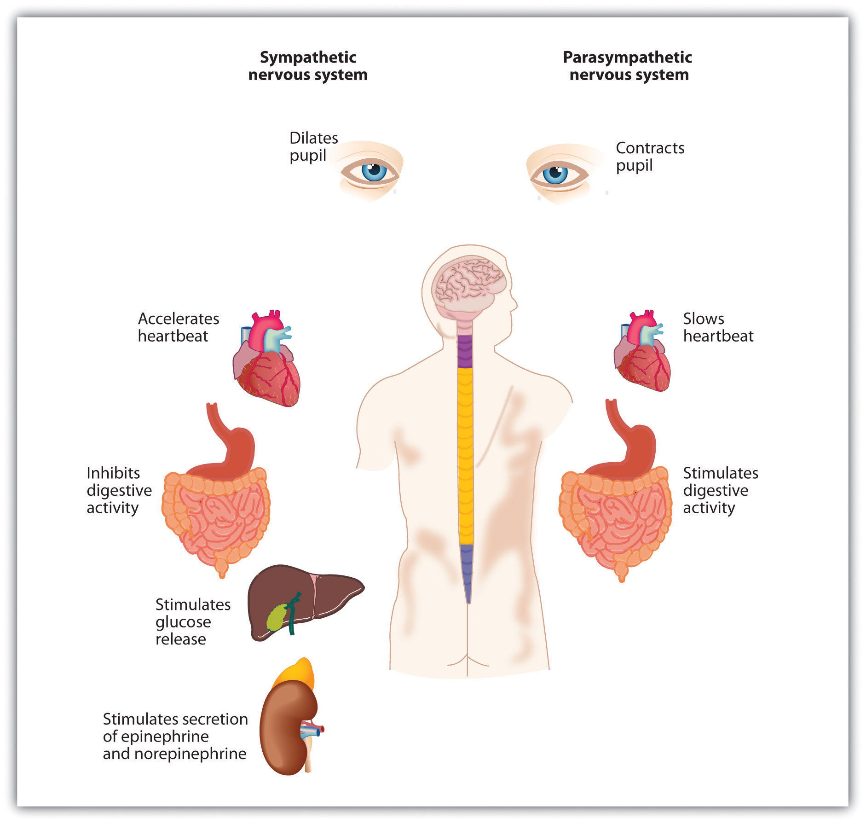
7.1 EMOTIONS AND INTELLIGENCE III
Image by University of Minnesota, Principles of Social Psychology, licensed by CC BY-NC-SA 4.0
Notes:
The arousal that we experience as part of our emotional experience is caused by the activation of the sympathetic nervous system. The experience of emotion is also controlled in part by one of the evolutionarily oldest parts of our brain—the part known as the limbic system—which includes several brain structures that help us experience emotion.

Slide 6
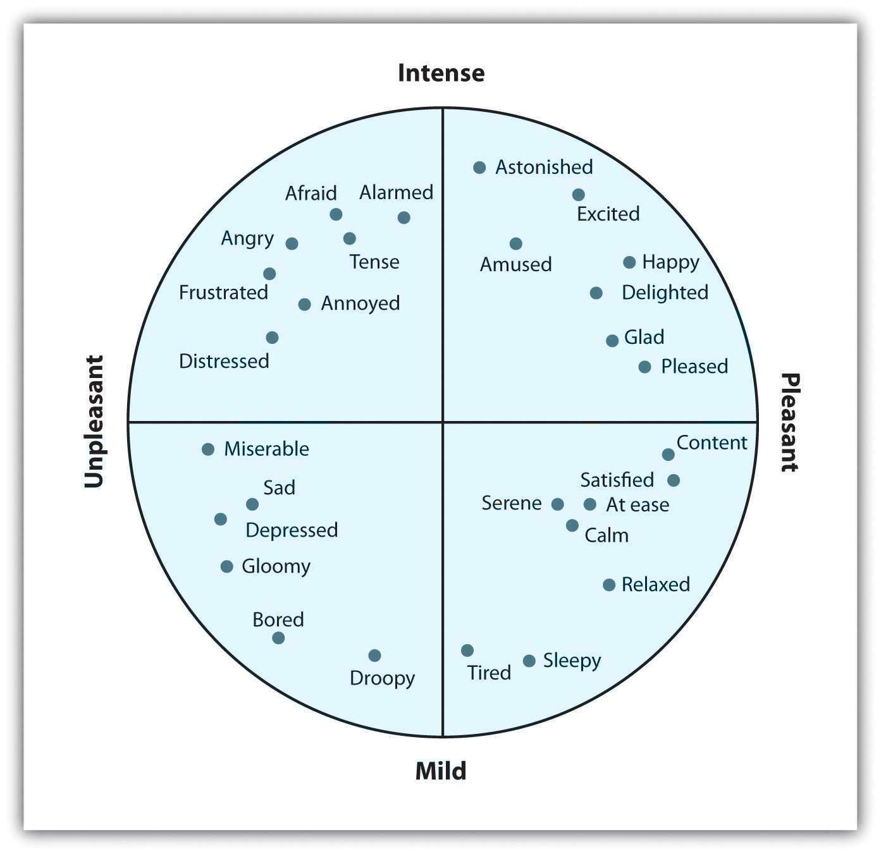
7.1 EMOTIONS AND INTELLIGENCE IV
Cognitive Components of Emotions
Image by Psychology – 1st Canadian Ed., Sally Walters, licensed by CC BY-NC-SA 4.0.
Notes:
The secondary emotions are those that have a major cognitive component. They are determined by both their level of arousal, ranging from mild to intense, and their valence, ranging from pleasant to unpleasant
Not all of our emotions come from the old parts of our brain; we also interpret our experiences to create a more complex array of emotional experiences. For instance, the amygdala may sense fear when it senses that the body is falling, but that fear may be interpreted completely differently, perhaps even as excitement, when we are falling on a roller-coaster ride than when we are falling from the sky in an airplane that has lost power.

Slide 7
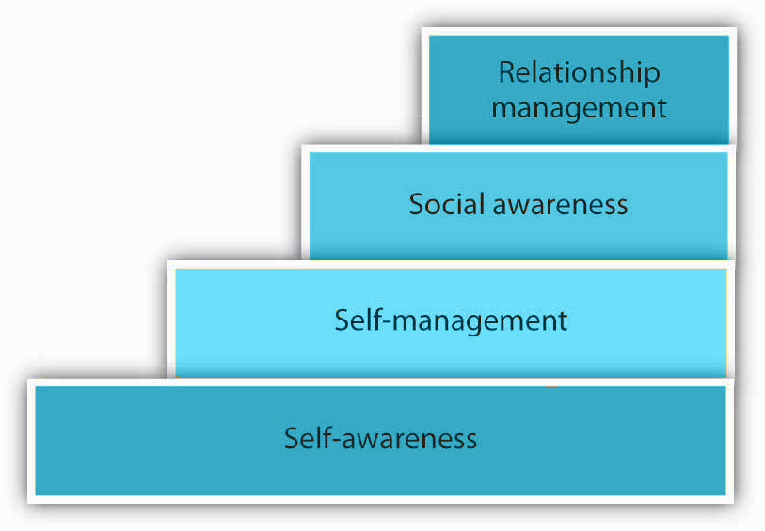
7.1 EMOTIONS AND INTELLIGENCE V
Emotional Intelligence
Emotional intelligence(EQ) as an individual’s appraisal and expression of their emotions and the emotions of others in a manner that enhances thought, living, and communicative interactions.
Image by University of Minnesota and NSCC, NSCC Organizational Behaviour. licensed by CC BY-NC-SA 4.0.
Notes:
EQ is built by four distinct emotional processes: perceiving, understanding, managing, and using emotions (Salovey & Mayer, 2000). All four components of emotional intelligence are important for our ability to manage conflict situations at work.
Self-awareness refers to a person’s ability to understand their feelings from moment to moment. It might seem as if this is something we know, but we often go about our day without thinking or being aware of our emotions that impact how we behave in work or personal situations
Self-management refers to our ability to manage our emotions and is dependent on our self-awareness ability. How do we handle frustration, anger, and sadness? Are we able to control our behaviors and emotions? Self-management also is the ability to follow through with commitments and take initiative at work.
Relationship management refers to our ability to communicate clearly, maintain good relationships with others, work well in teams, and manage conflict. Relationship management relies on your ability to use the other three areas of EQ to manage relationships effectively.
Social awareness is our ability to understand social cues that may affect others around us. In other words, understanding how another is feeling, even if we do not feel the same way. Social awareness also includes having empathy for another, recognizing power structure and unwritten workplace dynamics.

Slide 8
7.2 STRESS I
Social psychologists define stress as the physical and psychological reactions that occur whenever we believe that the demands of a situation threaten our ability to respond to the threat.
(Lazarus, 2000; Lazarus & Folkman, 1984).
Image by 1388843 licensed by Pixabay
Notes:
Emotions matter because they influence our behavior. And there is no emotional experience that has a affect more powerful influence on us than stress.
Stress is a function of the objective environment but also of individuals’ subjective interpretation of events and their consequences.
Both body and mind are involved the process. It is important for both firms and individuals to take preventive measures before the cumulative effects of stress manifest themselves in ways that cost both the individual and the company.
Stress can have a positive effect, making us more alert or more prepared to take on an important challenge. Stress can also have a negative effect, causing a range of physical and mental ailments.

Slide 9
7.2 STRESS II
Stressors.
We all experience stress at some point in our lives. Situations causing stress are known as stressors. There are four types of stressors:
Acute Stressors
Episodic (or daily) stressors
Chronic stressors
Catastrophic stressors
Notes:
Acute stressors are time-specific events of high intensity and short duration that occur infrequently, such as a performance review, a car accident, or unexpected encounter.
Episodic (or daily) stressors may be similar to acute stressors but occur more frequently, have a longer duration, and may be of lower intensity. Making repeated requests of a worker to work overtime is an example of an episodic stressor.
Chronic stressors are stressors that persist over a sustained period of time, and include job insecurity, work overload, or lack of control.
Catastrophic stressors are a subset of acute stressors but differ in their intensity, threatening life, safety, or property. Robbery and physical assault are examples of catastrophic stressors.
Thomas Holmes and Richard Rahe (1967) developed a measure of some everyday life events that might lead to stress. Rahe and his colleagues (1970) asked 2,500 members of the military to complete the rating scale and then assessed the health records of the soldiers over the following 6 months. The results were clear: The higher the scale score, the more likely the soldier was to end up in the hospital.

Slide 10
7.2 STRESS III
Responses to Stress
Not all people experience and respond to stress in the same way, and these differences can be important.
Recent research has shown that the strongest predictor of a physiological stress response from daily hassles is the amount of negative emotion that they evoke. People who experience strong negative emotions as a result of everyday hassles and who respond to stress with hostility experience more negative health outcomes than do those who react in a less negative way (McIntyre et al., 2008; Suls & Bunde, 2005).
Notes:
The cardiologists Meyer Friedman and R. H. Rosenman (1974) were among the first to study the link between stress and heart disease. In their research, they noticed that even though the partners in married couples often had similar lifestyles, diet, and exercise patterns, the husbands nevertheless generally had more heart disease than did the wives. As they tried to explain the difference, they focused on the personality characteristics of the partners, finding that the husbands were more likely than the wives to respond to stressors with negative emotions and hostility.

Slide 11
7.2 STRESS IV
Stress and the Immune System
We experience stress when we find ourselves in situations where we are not sure how to respond or whether we are going to be able to adequately cope. Extreme social situations, such as being the victim of a terrorist attack, a natural disaster, or a violent crime, may produce an extreme form of stress known as post-traumatic stress disorder (PTSD),a medical syndrome that includes symptoms of anxiety, sleeplessness, nightmares, and social withdrawal.
Notes:
Stress is accompanied by increases in arousal. When we experience stress, our heart rate, breathing, and blood pressure increase, and our body begins to secrete adrenaline and other hormones. Perspiration increases to cool down the body. In addition, sugar is released to provide energy, and the pupils dilate to improve our vision. At the same time, the less immediately essential body activities controlled by the parasympathetic nervous system (PNS), including digestion, are reduced in order to divert more energy to allow the body to react to the threat.

Slide 12
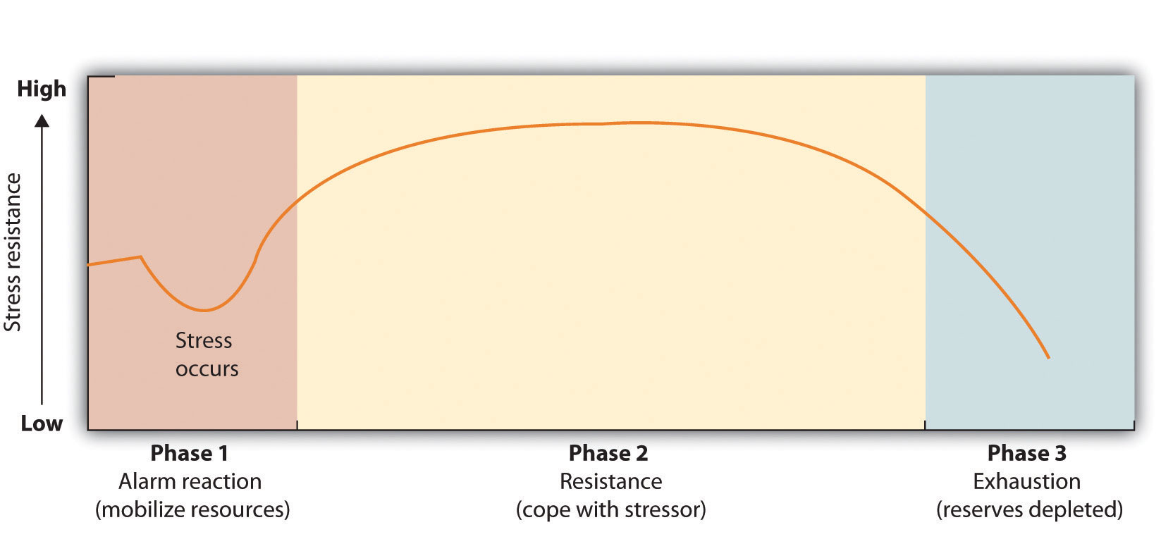
7.2 STRESS V
General Adaptation Syndrome
Image by University of Minnesota, Principles of Social Psychology, CC BY-NC-SA 4.0. Modified from the original. Cropped for accessibility.
Notes:
The physiologist Hans Seyle (1907–1982) studied stress by examining how rats responded to being exposed to stressors such as extreme cold, infection, shock, and excessive exercise. Seyle found that regardless of the source of the stress, the rats experienced the same series of physiological changes as they suffered the prolonged stress.
Seyle created the term general adaptation syndrome to refer to the three distinct phases of physiological change that occur in response to long-term stress: alarm, resistance, and exhaustion.
Stage one: General alarm reaction. The first reaction to stress The body releases stress hormones, including cortisol
Stage two: Resistance. After a period of chronic stress the body adapts to the ongoing threat and tries to its normal function. Glucose levels increase to sustain energy, and blood pressure increases.
Stage three: Exhaustion. In this stage, the body has run out of its reserves of energy and immunity. Blood sugar levels decrease, leading to decreased stress tolerance, progressive mental and physical exhaustion, illness, and collapse. The body’s organs being to fail, and eventually illness or death occurs.

Slide 13
7.2 STRESS VI
Managing Stress
We all experience stress at one time or another. However, we can take action to assess and relieve the stress in our life.
Image by Saylor Academy, Human Relations, CC BY-NC-SA 3.0. Color altered from the original.
Notes:
First, we do some self-analysis to determine the stressors in our life and how we handle it. This emotional intelligence skill (self-awareness) allows us to see what we need to improve upon. Then, we can apply self-management tools to help us manage the stress in our lives. The benefit of this identification and management is that it allows us to relate better to others both in our work life and personal life.
Once we do some self-analysis, we can use a method called the four As. The four As gives us four choices for dealing with a stressor:
Avoid the Stressor- We can try to avoid situations that stress us out. If watching certain television programs causes stress, stop watching them! Spend time with people who help you relax.
Alter the Stressor- Another option in dealing with stress is to try to alter it, if you can’t avoid it. When changing a situation, you can be more assertive, manage time better, and communicate your own needs and wants better.
Adapt to the Stressor- If you are unable to avoid or change the stressor, getting comfortable with the stressor is a way to handle it. Creating your own coping mechanisms for the stress and learning to handle it can be an effective way to handle the stress.
Accept the Stressor- Some stressors are unavoidable. We all have to go to work and manage our home life. So, learning to handle the things we cannot change by forgiving, developing tolerances, and letting going of those things we cannot control is also a way to deal with a stressor.

Slide 14
7.3 STRESS AT WORK I
Stress at Work
Our definition of stress points to a poor fit between individuals and their environments. Either excessive demands are being made, or reasonable demands are being made that individuals are ill-equipped to handle.
Notes:
Under stress, individuals are unable to respond to environmental stimuli without undue psychological and/or physiological damage, such as chronic fatigue, tension, or high blood pressure. This damage resulting from experienced stress is usually referred to as strain.
Before we examine the concept of work-related stress in detail, several important points need to be made. First, stress is pervasive in the work environment (McGrath, 1976). Most of us experience stress at some time.

Slide 15
7.3 STRESS AT WORK II
Types of Stress at Work: Frustration and Anxiety
Two common types of stress in the workplace are frustration and anxiety. Frustration refers to a psychological reaction to an obstruction or impediment to goal-oriented behavior.
Whereas frustration is a reaction to an obstruction in instrumental activities or behavior, anxiety is a feeling of inability to deal with anticipated harm. Anxiety occurs when people do not have appropriate responses or plans for coping with anticipated problems.
Notes:
Frustration occurs when an individual wishes to pursue a certain course of action but is prevented from doing so. This obstruction may be externally or internally caused. Examples of people experiencing obstacles that lead to frustration include a salesperson who continually fails to make a sale, a machine operator who cannot keep pace with the machine, or even a person dealing with a team member who is not contributing to the group.

Slide 16
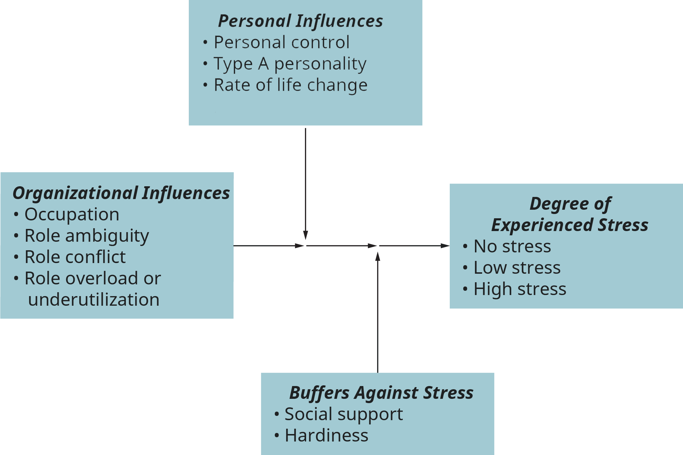
7.3 STRESS AT WORK III
Major Influences on
Job-Related Stress
Image by Rice University, Organizational Behavior, licensed by CC BY 4.0. Color and text altered from original.
Notes:
We will now consider several factors that have been found to influence both frustration and anxiety; we will present a general model of stress, including its major causes and its outcomes. Following this, we will explore several mechanisms by which employees and their managers cope with or reduce experienced stress in organizations.
The model presented here draws heavily on the work of several social psychologists at the Institute for Social Research of the University of Michigan, including John French, Robert Caplan, Robert Kahn, and Daniel Katz.

Slide 17
7.3 STRESS AT WORK IV
Occupational Differences
Tension and job stress are prevalent in our contemporary society and can be found in a wide variety of jobs.
Stress is experienced by workers in many jobs: administrative assistants, assembly-line workers, servers and managers. In fact, it is difficult to find jobs that are without some degree of stress.
Notes:
The work roles that people fill have a substantial influence on the degree to which they experience stress (Cooper & Payne, 1978; Hall & Savery, 1986). These differences do not follow the traditional blue-collar/white-collar dichotomy, however.
a person’s occupation or profession represents a major cause of stress-related problems at work. In addition to occupation, however, and indeed closely related to it, is the problem of one’s role expectations in the organization. Three interrelated role processes will be examined as they relate to experienced stress: role ambiguity, role conflict, and role overload or underutilization.
The first role process variable to be discussed here is role ambiguity. When individuals have inadequate information concerning their roles, they experience role ambiguity. Uncertainty over job definition takes many forms, including not knowing expectations for performance, not knowing how to meet those expectations, and not knowing the consequences of job behavior.
The second role-related factor in stress is role conflict. This may be defined as the simultaneous occurrence of two (or more) sets of pressures or expectations; compliance with one would make it difficult to comply with the other. In other words, role conflict occurs when an employee is placed in a situation where contradictory demands are placed upon them.
Finally, in addition to role ambiguity and conflict, a third aspect of role processes has also been found to represent an important influence on experienced stress—namely, the extent to which employees feel either overloaded or underutilized in their job responsibilities. Role overload is a condition in which individuals feel they are being asked to do more than time or ability permits.
the concept of role underutilization should also be acknowledged as a source of experienced stress. Role underutilization occurs when employees are allowed to use only a few of their skills and abilities, even though they are required to make heavy use of them.

Slide 18
7.3 STRESS AT WORK V
Personal Influences on Stress
The second major influence on job-related stress can be found in the employees themselves. As such, we will examine three individual-difference factors as they influence stress at work: personal control, Type A personality, and rate of life change.
Notes:
To begin with, we should acknowledge the importance of personal control as a factor in stress. Personal control represents the extent to which an employee actually has control over factors affecting effective job performance.
Type A Personality- Research has focused on what is perhaps the single most dangerous personal influence on experienced stress and subsequent physical harm. This characteristic was first introduced by Friedman and Rosenman (1974) and is called Type A personality
Rate of Life Change- A third personal influence on experienced stress is the degree to which lives are stable or turbulent. Recall our previous discussion of the work of Holmes and Rahe (1967). As a result of their research, a variety of life events were identified and assigned points based upon the extent to which each event is related to stress and illness

Slide 19
7.3 STRESS AT WORK VI
Buffering Effects of Workplace Stress
We have seen in the previous discussion how a variety of organizational and personal factors influence the extent to which individuals experience stress on the job. Although many factors, or stressors, have been identified, their effect on psychological and behavioral outcomes is not always as strong as we might expect.
Notes:
this lack of a direct stressor-outcome relationship suggests the existence of potential moderator variables that buffer the effects of potential stressors on individuals. Recent research has identified two such buffers: the degree of social support the individual receives and the individual’s general degree of what is called hardiness.
Social Support-- First, let us consider social support. Social support is simply the extent to which organization members feel their peers can be trusted, are interested in one another’s welfare, respect one another, and have a genuine positive regard for one another. When social support is present, individuals feel that they are not alone as they face the more prevalent stressors.
The second moderator of stress is hardiness. Hardiness represents a collection of personality characteristics that involve one’s ability to perceptually or behaviorally transform negative stressors into positive challenges. These characteristics include a sense of commitment to the importance of what one is doing, an internal locus of control, and a sense of life challenge.

Slide 20
7.3 STRESS AT WORK VII
Degrees of Experienced Stress
In exploring major influences on stress, it was pointed out that the intensity with which a person experiences stress is a function of organizational factors and personal factors, moderated by the degree of social support in the work environment and by hardiness. We come now to an examination of major consequences of work-related stress.

Slide 21
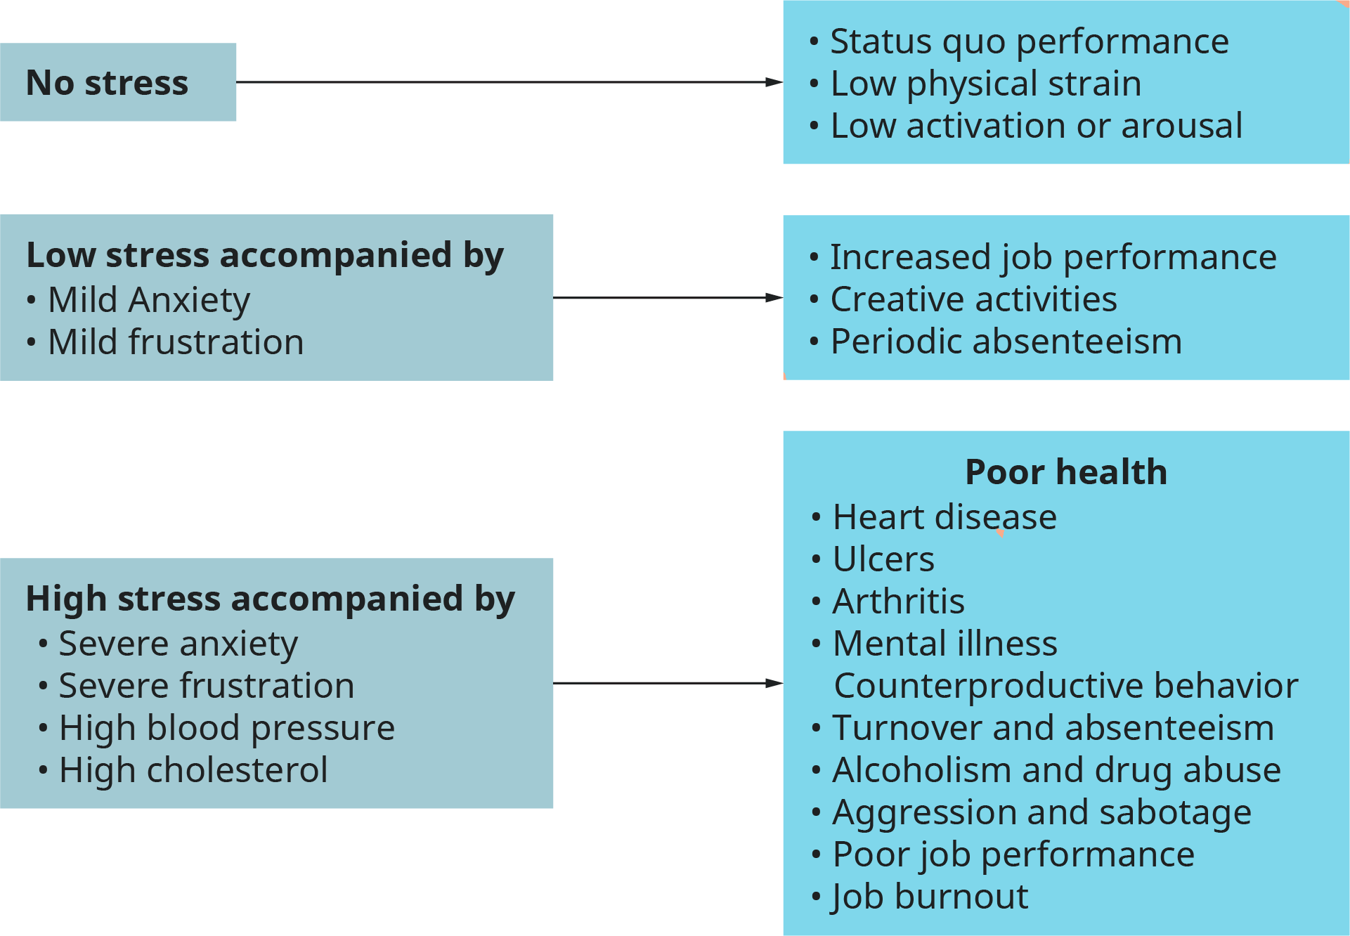
7.3 STRESS AT WORK VIII
Image by Rice University, Organizational Behavior, licensed by CC BY-NC-SA 4.0. Color altered from the original.
Notes:
Stress and Health- High degrees of stress are typically accompanied by severe anxiety and/or frustration, high blood pressure, and high cholesterol levels. These psychological and physiological changes contribute to the impairment of health in several different ways. Most important, high stress contributes to heart disease (Cooper & Payne, 1986).
The relationship between high job stress and heart disease is well established.
Stress and Counterproductive Behavior- It is useful from a managerial standpoint to consider several forms of counterproductive behavior that are known to result from prolonged stress. These counterproductive behaviors include turnover and absenteeism, alcoholism and drug abuse, and aggression and sabotage.
Turnover and Absenteeism- Turnover and absenteeism represent convenient forms of withdrawal from a highly stressful job. Results of several studies have indicated a fairly consistent, if modest, relationship between stress and subsequent turnover and absenteeism (Allen & Bryant, 2013; Mobley, 1982; Rhodes & Steers, 1990).
Abuse of Drugs and Alcohol-It has long been known that stress is linked to substance use and abuse by employees at all levels in the organizational hierarchy.
Aggression and Sabotage- Severe frustration can also lead to overt hostility in the form of aggression toward other people and toward inanimate objects. Aggression occurs when individuals feel frustrated and can find no acceptable, legitimate remedies for the frustration.
Stress and Job Performance- A major concern of management is the effects of stress on job performance. The relationship is not as simple as might be supposed.
Stress and Burnout
When job-related stress is prolonged, poor job performance such as that described above often moves into a more critical phase, known as burnout. Burnout is a general feeling of exhaustion that can develop when a person simultaneously experiences too much pressure to perform and too few sources of satisfaction (Jackson et al., 1986).

Slide 22
7.4 COPING WITH STRESS I
In terms of addressing and mitigating the effects of stress at work, there are many evidence-based suggestions. We will review some from both the individual level (that is to say, what a person can do to manage their own stress) and at the level of the organization.

Slide 23
7.4 COPING WITH STRESS II
Individual Strategies for Managing Stress
There are many things people can do to help eliminate the level of experienced stress or, at the very least, to help cope with continuing high stress. Consider the following:
Developing Self-Awareness
Developing Outside Interests
Leaving the Organization
Finding a Personal or Unique Solution.
Physical Exercise
Cognitive Perspective
Notes:
Developing Self-Awareness- Individuals can increase awareness of how they behave on the job. They can learn to know their own limits and recognize signs of potential trouble. Employees should know when to withdraw from a situation (known to some as a “mental health day” instead of absenteeism) and when to seek help from others on the job in an attempt to relieve the situation.
Developing Outside Interests- In addition, individuals can develop outside interests to take their minds off work. This solution is particularly important for Type A people, whose physical health depends on toning down their drive for success.
Leaving the Organization- Sometimes an employee may be unable to improve her situation and, as a result, may find it necessary (i.e., healthful) simply to leave the organization and find alternative employment. Although this is clearly a difficult decision to make, there are times when turnover is the only answer.
Finding a Personal or Unique Solution- Another means individuals can use to cope with stress is through a variety of personal or unique solutions. If an employee cannot leave a stressful situation (e.g., a nurse helping a patient), this may be a good temporary way out of it.
Physical Exercise- Because part of the cause of the fatigue resulting from stress is the body’s physical reaction, exercise can be an effective means of enabling the body to more effective deal with the physical components of stress. Regular exercise can be an important and effective individual strategy.
Cognitive Perspective- Finally, because stress is in part a function of how events are perceived and interpreted, controlling one’s cognitive perspective of events can also be an effective strategy. Positively framing situations as well as distinguishing factors that are within as well as outside your control and influence can be effective means of reducing stress.

Slide 24
7.4 COPING WITH STRESS III
Organizational Strategies for Managing Stress
Because managers usually have more control over the working environment than do subordinates, it seems only natural that they have more opportunity to contribute to a reduction of work-related stress. Among their activities, managers may include the following eight strategies.
Personnel Selection and Placement
Skills Training
Job Redesign
Company-Sponsored Counseling Programs
Increased Participation and Personal Control
Work Group Cohesiveness
Improved Communication
Health Promotion Programs
Notes:
Personnel Selection and Placement- First, managers can pay more attention in the selection and placement process to the fit between job applicants, the job, and the work environment. Current selection and placement procedures are devoted almost exclusively to preventing qualitative role overload by ensuring that people have the required education, ability, experience, and training for the job.
Skills Training- Second, stress can be reduced in some cases through better job-related skills training procedures, where employees are taught how to do their jobs more effectively with less stress and strain. For instance, an employee might be taught how to reduce overload by taking shortcuts or by using new or expanded skills. These techniques would only be successful, however, if management did not follow this increased effectiveness by raising work quotas.
Job Redesign-Third, managers can change certain aspects of jobs or the ways people perform these jobs. Much has been written about the benefits of job redesign. Enriching a job may lead to improved task significance, autonomy, responsibility, and feedback. For many people, these jobs will present a welcome challenge, which will improve the job-person fit and reduce experienced stress.
Company-Sponsored Counseling Programs- Several companies have begun experimenting with counseling programs. Once again, much work-related stress can be reduced simply by encouraging managers to be more supportive and to provide the necessary tools for people to cope with stress.
Increased Participation and Personal Control- Fifth, managers can allow employees greater participation and personal control in decisions affecting their work. As noted above, participation increases job involvement and simultaneously reduces stress by relieving ambiguity and conflict.
Work Group Cohesiveness- Sixth, managers can attempt to build work group cohesiveness. Team-building efforts are common in industry today. These efforts focus on developing groups that will be both more productive and mutually supportive.
Improved Communication- Managers can open communication channels so employees are more informed about what is happening in the organization. With greater knowledge, role ambiguity and conflict are reduced.
Health Promotion Programs
Finally, many companies have recently embarked on a more systematic and comprehensive approach to stress reduction and wellness in the workplace.

Slide 25
7.4 COPING WITH STRESS IV
Developing Emotional Intelligence
The importance of emotional intelligence, as we introduced at the start of this section, is imperative to being successful at work. Figuring out a plan on how we can increase our emotional intelligence skills can also benefit us personally in our relationships with others.
Notes:
To increase our self-awareness skills, we should spend time thinking about our emotions to understand why we experience a specific emotion. We should look at those things that cause a strong reaction, such as anger to help us understand the underlying reasons for that reaction. By doing this, we can begin to see a pattern within ourselves that helps explain how we behave and how we feel in certain situations. This allows us to handle those situations when they arise.

Slide 26
7.4 COPING WITH STRESS V
The Power of Positive Emotions
In a very general sense, positive psychology can be thought of as the science of happiness; it is an area of study that seeks to identify and promote those qualities that lead to greater fulfillment in our lives.
Photo by Kirill Vasilev licensed by Unsplash
Notes:
This field looks at people’s strengths and what helps individuals to lead happy, contented lives, and it moves away from focusing on people’s pathology, faults, and problems.
According to Seligman and Csikszentmihalyi (2000), positive psychology, at the subjective level is about valued subjective experiences: well-being, contentment, and satisfaction (in the past); hope and optimism (for the future); and… happiness (in the present). At the individual level, it is about positive individual traits: the capacity for love and vocation, courage, interpersonal skill, aesthetic sensibility, perseverance, forgiveness, originality, future mindedness, spirituality, high talent, and wisdom. (p. 5)

Slide 27
7.5 KEY TAKEAWAYS I
Affect helps us engage in behaviors that are appropriate to our perceptions of a social situation.
Our emotions are determined in part by responses of the sympathetic nervous system (SNS) and the limbic system (particularly the amygdala). The outcome of the activation of the SNS is the experience of arousal.
The basic emotions of anger, contempt, disgust, fear, happiness, sadness, and surprise are expressed and experienced consistently across many different cultures. Cultural display rules help dictate when and how to show emotions to others. These display rules are different across cultures.
There are also a large number of secondary emotions, such as guilt, shame, and embarrassment, that provide us with more complex feelings about our social worlds and that are more cognitively based. Cognitive appraisal also allows us to experience a variety of secondary emotions.
We express our emotions to others through nonverbal behaviours, and we learn about the emotions of others by observing them.

Slide 28
7.5 KEY TAKEAWAYS II
Emotional intelligence is the degree to which an individual has the ability toperceive (recognizing emotions when they occur – self-awareness), understand (the ability to understand why emotions and feelings arise – self-management), communicate (articulating one’s emotions and feelings to another person – social awareness), and manage emotions and feelings (being able to use emotions effectively during interpersonal relationships – relationship management).
Emotional awareness involves an individual’s ability to recognize their feelings and communicate about them effectively. One of the common problems that some people have with regards to emotional awareness is a lack of a concrete emotional vocabulary for both positive and negative feelings. When people cannot adequately communicate about their feelings, they will never get what they need out of a relationship.
Stress as the physical and psychological reactions that occur whenever we believe that the demands of a situation threaten our ability to respond to the threat
Situations causing stress are known as stressors. Stressors can vary in length and intensity.
People who have recently experienced extreme negative situations experience stress, but everyday minor hassles can also create stress.
The general adaptation syndrome is the common pattern of events that characterizes someone who experiences stress. The three stages of the syndrome are alarm, resistance, and exhaustion.

Slide 29
7.5 KEY TAKEAWAYS III
The experience of prolonged stress creates an increase in general arousal in the SNS and physiological changes through the HPA axis.
Not all people experience and respond to stress in the same way, and these differences can be important. One difference in response is between the fight-or-flight response and the tend-and-befriend response.
The four As of stress reduction can help us reduce stress. They include: avoid, alter, adapt, and accept. By using the four As to determine the best approach to deal with a certain stressor, we can begin to have a more positive outlook on the stressor and learn to handle it better.
Two common types of stress at work are frustration when goals are impeded and anxiety if an individual feels that they are not capable of dealing with future problems. The damage resulting from stress is called strain.
Four organization influences on stress can be identified: occupational differences, role ambiguity, role conflict, and role overload or underutilization.
Three personal influences on stress are: personal control, or the desire to have some degree of control over one’s environment; rate of life change; and Type A personality.
The effects of potential stress can be buffered by two factors: social support from one’s coworkers or friends and hardiness, or the ability to perceptually and behaviorally transform negative stressors into positive challenges.

Slide 30
7.5 KEY TAKEAWAYS IV
Sustained stress can lead to health problems; counterproductive behavior, such as turnover, absenteeism, drug abuse, and sabotage; poor job performance; and burnout.
Burnout is defined as a general feeling of exhaustion that can develop when a person simultaneously experiences too much pressure to perform and too few sources of satisfaction.
Individual strategies to reduce stress include developing one’s self-awareness about how to behave on the job, developing outside interests, leaving the organization, and finding a unique solution.
Organizational strategies to reduce stress include improved personnel selection and job placement, skills training, job redesign, company-sponsored counseling programs, increased employee participation and personal control, enhanced work group cohesiveness, improved communication, and health promotion programs.
Developing emotional intelligence and using positive self-talk can help us to better manage stressors.

