Slide 1
CONFLICT MANAGEMENT
CHAPTER 10:COMMUNICATION IN CONFLICT
Unless otherwise noted, this work is licensed under a Creative Commons Attribution-NonCommercial-ShareAlike 4.0 International (CC BY-NC-SA 4.0) license. Feel free to use, modify, reuse or redistribute any portion of this presentation.

Slide 2
Learning Outcomes
Upon successful completion of this chapter, you will be able to:
Define communication.
Explain the process of communication using the transactional model.
Identify possible directions of communication within organizations.
List the characteristics of written, oral and verbal communication.
Recognize barriers to effective communication.
Appreciate the relationship between communication and self-esteem.
Explore how self-esteem, communication dispositions and relational dispositions impact how we see and interact with others.
Contrast hearing and listening.
Describe steps in the listening process.
Summarize four different listening styles.
Explain barriers to effective listening.
Review bad listening practices and strategies for engaging in active listening.
Describe guidelines for giving and receiving constructive feedback.
Compare common communication behaviours during conflict.
Explain conflict management strategies.
Recognize the four steps in the STLC conflict model.

Slide 3
10.1 COMMUNICATION I
For our purposes in this book, we will define Communication as the process of generating meaning by sending and receiving verbal and nonverbal symbols and signs that are influenced by multiple contexts.
Notes:
Before we explore different forms of communication, it is important that we have a shared understanding of what we mean by the word communication.

Slide 4
10.1 COMMUNICATION II
The Communication Process
Interpersonal communication is an important part of being effective in the workplace. It helps us to:
influence the opinions, attitudes, motivations, and behaviors of others;
express our feelings, emotions, and intentions to others;
exchange information regarding events or issues; and
reinforce the formal structure of the organization by such means as making use of formal channels of communication.
Notes:
Interpersonal communication allows employees at all levels of an organization to interact with others, to secure desired results, to request or extend assistance, and to make use of and reinforce the formal design of the organization. These purposes serve not only the individuals involved, but the larger goal of improving the quality of organizational effectiveness.

Slide 5
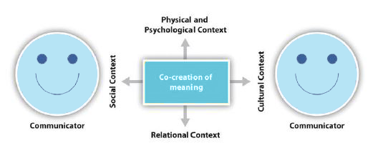
10.1 COMMUNICATION III
The Transaction Model of Communication
Image by Andy Schmitz, from Process of Communication, CC BY-NC-SA 3.0. Color altered from original.
Notes:
The transactional model that we present here is an oversimplification of what really happens in communication, but this model will be useful in creating a diagram to be used to discuss the topic. This figure illustrates a simple communication episode where a communicator encodes a message and a receiver decodes the message (Shannon & Weaver, 1948).
The transactional model of communication describes communication as a process in which communicators generate social realities within social, relational, and cultural contexts. In this model, you don’t just communicate to exchange messages; you communicate to create relationships, form intercultural alliances, shape your self-concepts, and engage with others in dialogue to create communities. In short, you don’t communicate about your realities; communication helps to construct your realities (and the realities of others).
The roles of sender (source) and receiver in the transaction model of communication differ significantly from the other models. Instead of labeling participants as senders and receivers, the people in a communication encounter are referred to as communicators.

Slide 6
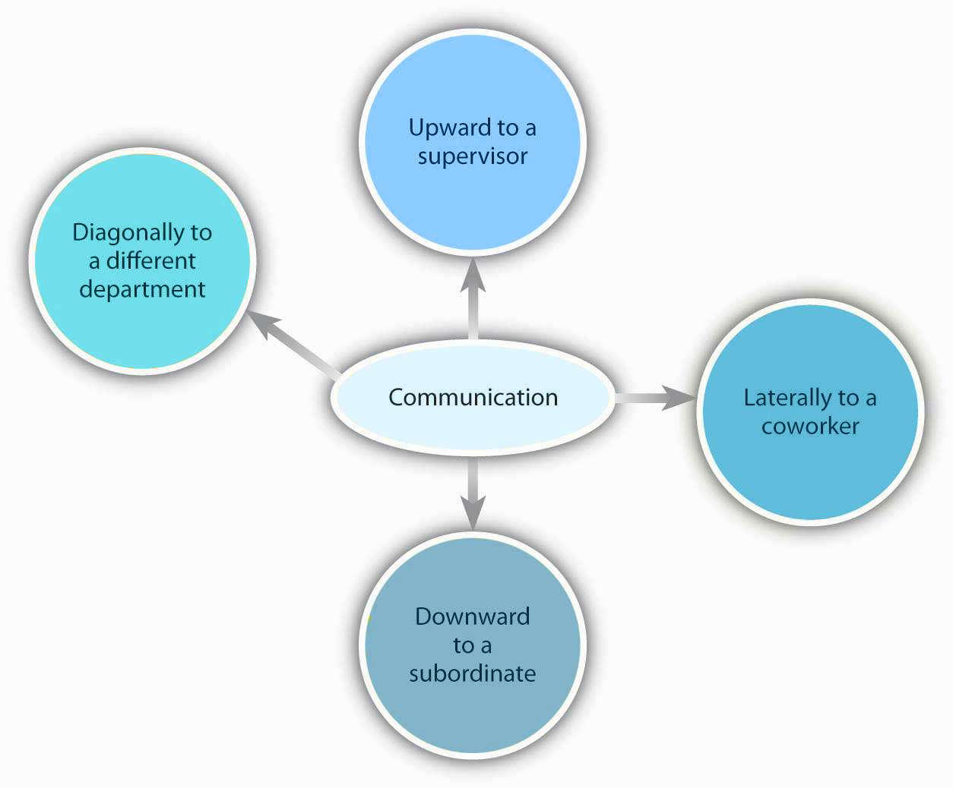
10.1 COMMUNICATION IV
Direction of Communication Within Organizations
Image adapted from Principles of Management for Leadership Communication by University of Minnesota information . CC BY-NC-SA 4.0. Color altered from original.
Notes:
Information can move between communicators in a variety of directions throughout an organization’s hierarchy. It can move laterally through sharing of information between coworkers, diagonally when information is shared between different branches or areas within an organization.
Information can also flow upwards or downwards to supervisors and subordinates. Another powerful means of information dissemination in organizations that is not depicted in the image below is an informal network of gossip that travels through an organization often referred to as the grapevine.

Slide 7
10.1 COMMUNICATION V
Types of Communication
Written Communication
Oral Communication
Nonverbal Communication
Photo by Quino Al licensed by Unsplash
Notes:
Written communications include e-mail, texts, letters, reports, manuals, and annotations on sticky notes. Written communications may be printed on paper or appear on the screen.
Oral Communication- This consists of all messages or exchanges of information that are spoken, and it’s the most prevalent type of communication. Compared to written communication, oral communication is synchronous and has greater channel richness due to the availability of nonverbal cues in addition to the content of the message.
Nonverbal Communication- It’s not just what we say to others, but also how we say it. Research also shows that 55% of in-person communication comes from nonverbal cues such as facial expressions, body stance, and tone of voice.

Slide 8
10.1 COMMUNICATION VI
Barriers to Effective Communication
Communicating can be more of a challenge than you think, when you realize the many things that can stand in the way of effective communication. These include filtering, selective perception, information overload, emotional disconnects, lack of source familiarity or credibility, workplace gossip, lies, bribery and coercion, semantics, gender differences, differences in meaning between communicators, biased language, and ineffective listening.
Notes:
It is important to be aware of these barriers and how they might create or escalate a conflict situation.. Let’s examine each of these barriers.
Filtering is the distortion or withholding of information to manage a person’s reactions. Some examples of filtering include a manager who keeps her division’s poor sales figures from her boss, the vice president, fearing that the bad news will make them angry.
Recall, selective perception refers to filtering what we see and hear to suit our own needs. This process is often unconscious. Small things can command our attention when we’re visiting a new place—a new city or a new company.
Information overload can be defined as “occurring when the information processing demands on an individual’s time to perform interactions and internal calculations exceed the supply or capacity of time available for such processing (Schick, et. al., 1990).” Messages reach us in countless ways every day.
Emotional disconnects happen when the communicators are upset, whether about the subject at hand or about some unrelated incident that may have happened earlier. An effective communication requires communicators who are open to speaking and listening to one another, despite possible differences in opinion or personality.
Lack of source familiarity or credibility can derail communications, especially when humor is involved. Have you ever told a joke that fell flat? You and the other communicator may lacked the common context that could have made it funny. (Or yes, it could have just been a lousy joke.) Sarcasm and irony are subtle, and potentially hurtful.

Slide 9
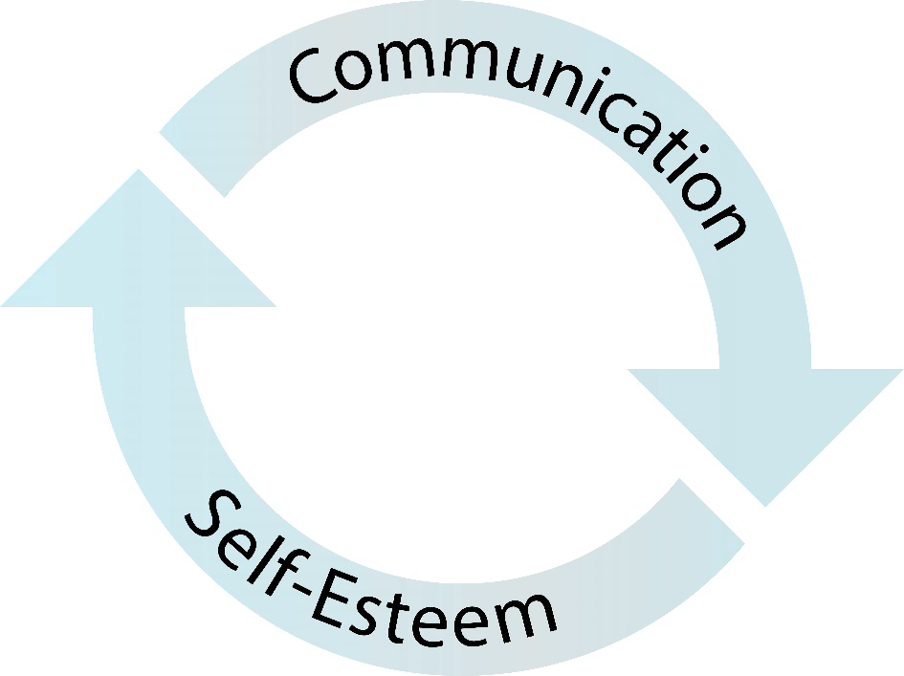
10.2 SELF-ESTEEM, COMMUNICATION AND RELATIONSHIP DISPOSITIONS I
Image by Interpersonal Communication by Jason S. Wrench; Narissra M. Punyanunt-Carter; and Katherine S. Thweatt, CC BY-NC-SA 4.0. Color altered from original.
Notes:
Self-esteem is an individual’s subjective evaluation of their abilities and limitations. You may be wondering the importance of self-esteem in interpersonal communication. Self-esteem and communication have a reciprocal relationship (as depicted in Figure 10.3). Our communication with others impacts our self-esteem, and our self-esteem impacts our communication with others. As such, our self-esteem and communication are constantly being transformed by each other.

Slide 10
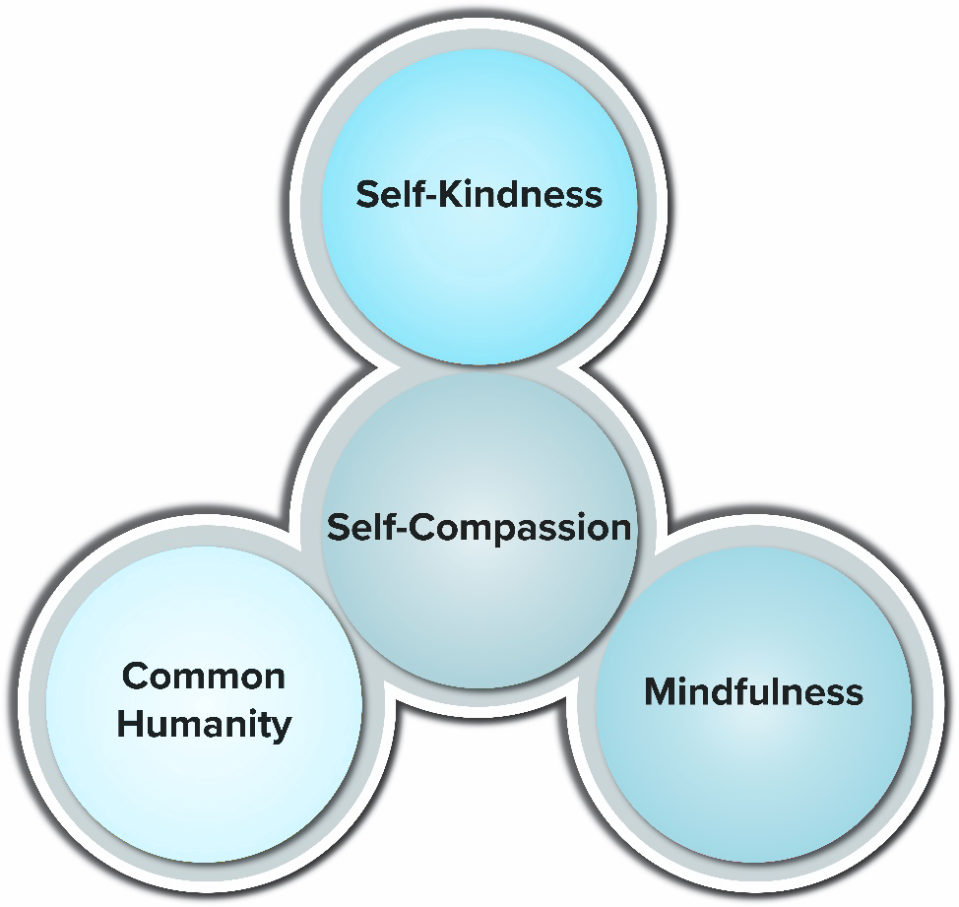
10.2 SELF-ESTEEM, COMMUNICATION AND RELATIONSHIP DISPOSITIONS II
Three Factors of Self-Compassion
Image by Interpersonal Communication by Jason S. Wrench; Narissra M. Punyanunt-Carter; and Katherine S. Thweatt, CC BY-NC-SA 4.0. Color altered from original.
Notes:
Some researchers have argued that self–esteem as the primary measure of someone’s psychological health may not be wise because it stems from comparisons with others and judgments. As such, Kristy Neff (2003) has argued for the use of the term self-compassion.
Self-compassion also involves offering nonjudgmental understanding to one’s pain, inadequacies and failures, so that one’s experience is seen as part of the larger human experience” (Neff, 2003, p. 86-87). Neff argues that self-compassion can be broken down into three distinct categories: self-kindness, common humanity, and mindfulness.
Self-kindness is simply extending the same level of care and understanding to ourselves as we would to others. Instead of being harsh and judgmental, we are encouraging and supportive. Instead of being critical, we are empathic towards ourselves.
Common Humanity--The second factor of self-compassion is common humanity, or “seeing one’s experiences as part of the larger human experience rather than seeing them as separating and isolating” (Neff, 2003, p. 89). As Kristen Neff and Christopher Germer (2018) realize, we’re all flawed works in progress. No one is perfect. No one is ever going to be perfect. We all make mistakes (some big, some small).
Mindfulness-- The final factor of self-compassion is mindfulness. Although Neff (2003) defines mindfulness in the same terms we’ve been discussing in this text, she specifically addresses mindfulness as a factor of pain, so she defines mindfulness, with regards to self-compassion, as “holding one’s painful thoughts and feelings in balanced awareness rather than over-identifying with them”

Slide 11
10.2 SELF-ESTEEM, COMMUNICATION AND RELATIONSHIP DISPOSITIONS III
Communication Dispositions
Communication dispositions are general patterns of communicative behavior. In this section, we will explore the nature of introversion/extraversion
approach and avoidance traits,
argumentativeness /verbal aggressiveness,
sociocommunicative orientation (Daly, 2011).
Notes:
Introversion/Extraversion--The concept of introversion/extraversion is one that has been widely studied by both psychologists and communication researchers. The idea is that people exist on a continuum that exists from highly extraverted (an individual’s likelihood to be talkative, dynamic, and outgoing) to highly introverted (an individual’s likelihood to be quiet, shy, and more reserved).
Approach and Avoidance Traits--The second set of communication dispositions are categorized as approach and avoidance traits. According to Virginia Richmond, Jason Wrench, and James McCroskey (2018), approach and avoidance traits depict the tendency an individual has to either willingly approach or avoid situations where they will have to communicate with others.
Argumentativeness and Verbal Aggressiveness-- Starting in the mid-1980s, Dominic Infante and Charles Wigley (1986) defined verbal aggression as “the tendency to attack the self-concept of individuals instead of, or in addition to, their positions on topics of communication” (p. 61). Notice that this definition specifically is focused on the attacking of someone’s self-concept or an individual’s attitudes, opinions, and cognitions about one’s competence, character, strengths, and weaknesses.
Sociocommunicative Orientation-- In the mid to late 1970s, Sandra Bem began examining psychological gender orientation. In her theorizing of psychological gender, Bem (1974) measured two constructs, masculinity and femininity, using a scale she created called the Bem Sex-Role Inventory (BSRI). Her measure was designed to evaluate an individual’s femininity or masculinity. Bem defined masculinity as individuals exhibiting perceptions and traits typically associated with males, and femininity as individuals exhibiting perceptions and traits usually associated with females.

Slide 12
10.2 SELF-ESTEEM, COMMUNICATION AND RELATIONSHIP DISPOSITIONS IV
Relational Dispositions
Relational dispositions are general patterns of mental processes that impact how people view and organize themselves in relationships. For our purposes, we’ll examine two unique relational dispositions:
attachment
rejection sensitivity.
Notes:
Attachment---In a set of three different volumes, John Bowlby (1969, 1983, 1980) theorized that humans were born with a set of inherent behaviors designed to allow proximity with supportive others. These behaviors were called attachment behaviors, and the supportive others were called attachment figures.
Rejection sensitivity can be defined as the degree to which an individual expects to be rejected, readily perceives rejection when occurring, and experiences an intensely adverse reaction to that rejection.

Slide 13
10.3 LISTENING I
When it comes to daily communication, we spend about 45% of our listening, 30% speaking, 16% reading, and 9% writing (Hayes, 1991). However, most people are not entirely sure what the word “listening” is or how to do it effectively.
Photo by Jackson Simmer licensed by Unsplash
Notes:
Hearing Is Not Listening---Hearing refers to a passive activity where an individual perceives sound by detecting vibrations through an ear. Hearing is a physiological process that is continuously happening.
Listening, on the other hand, is generally seen as an active process. Listening is “focused, concentrated attention for the purpose of understanding the meanings expressed by a [source]” (Wrench et al., 2017, p. 50).

Slide 14
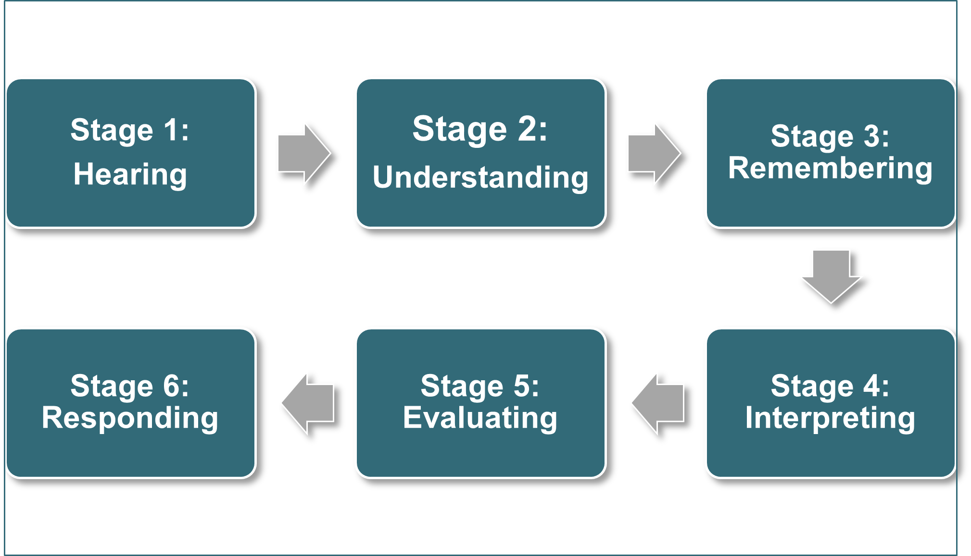
10.3 LISTENING II
The Listening Process
Image by Original Image, Fanshawe College, CC BY-NC-SA 4.0.
Notes:
Judi Brownell (1985) created one of the most commonly used models for listening – the HURIER model. Although not the only model of listening that exists, we like this model because it breaks the process of hearing down into clearly differentiated stages: hearing, understanding, remembering, interpreting, evaluating, and responding
Hearing---From a fundamental perspective, for listening to occur, an individual must attend to some kind of communicated message. Now, one can argue that hearing should not be equated with listening (as we did above), but it is the first step in the model of listening. Simply, if we don’t attend to the message at all, then communication never occurred from the receiver’s perspective.
Understanding---The second stage of the listening model is understanding, or the ability to comprehend or decode the source’s message. When we discussed the basic models of human communication, we discussed the idea of decoding a message.
Remembering---Once we’ve decoded a message, we have to actually remember the message itself, or the ability to recall a message that was sent. We are bombarded by messages throughout our day, so it’s completely possible to attend to a message and decode it and then forget it minutes later.
Interpreting--The next stage in the HURIER model of listening is interpreting. According to Brownell (1985), “interpreting messages involves attention to all of the various speaker and contextual variables that provide a background for accurately perceived messages” (p. 43).
Evaluating-- The next stage is the evaluating stage, or judging the message itself. One of the biggest hurdles many people have with listening is the evaluative stage. Our personal biases, values, and beliefs can prevent us from effectively listening to someone else’s message.
Responding---It’s important to realize that effective listening starts with the ear and centers in the brain, and only then should someone provide feedback to the message itself. Often, people jump from hearing and understanding to responding, which can cause problems as they jump to conclusions that have arisen by truncated interpretation and evaluation.

Slide 15
10.3 LISTENING III
Listening Styles
Kittie Watson, Larry Barker, and James Weaver (1995) defined listening styles as “attitudes, beliefs, and predispositions about the how, where, when, who, and what of the information reception and encoding process.” Watson et al. (1992) identified four distinct listening styles: people, content, action, and time.
Notes:
The first listening style is the people-oriented listening style. People-oriented listeners tend to be more focused on the person sending the message than the content of the message. As such, people-oriented listeners focus on the emotional states of senders of information.
The second listening style is the action-oriented listener. Action-oriented listeners are focused on what the source wants. The action-oriented listener wants a source to get to the point quickly. Instead of long, drawn-out lectures, the action-oriented speaker would prefer quick bullet points that get to what the source desires.
The third type of listener is the content-oriented listener, or a listener who focuses on the content of the message and process that message in a systematic way. Of the four different listening styles, content-oriented listeners are more adept at listening to complex information.
The final listening style is the time-oriented listening style. Time-oriented listeners are sometimes referred to as “clock watchers” because they’re always in a hurry and want a source of a message to speed things up a bit.

Slide 16
10.3 LISTENING IV
Barriers to Effective Listening
Barriers to effective listening are present at every stage of the listening process (Hargie, 2011).
At the receiving stage, noise can block or distort incoming stimuli. At the interpreting stage, complex or abstract information may be difficult to relate to previous experiences, making it difficult to reach understanding
Notes:
At the recalling stage, natural limits to our memory and challenges to concentration can interfere with remembering. At the evaluating stage, personal biases and prejudices can lead us to block people out or assume we know what they are going to say. At the responding stage, a lack of paraphrasing and questioning skills can lead to misunderstanding. In the following section, we will explore how environmental and physical factors, cognitive and personal factors, and bad listening practices present barriers to effective listening.

Slide 17
10.3 LISTENING V
Bad Listening Practices
Some “bad listening” practices may be habitual, but they are easier to address with some concerted effort. These bad listening practices include interrupting, distorted listening, eavesdropping, aggressive listening, narcissistic listening, and pseudo-listening.
Notes:
The previously discussed barriers to effective listening may be difficult to overcome because they are at least partially beyond our control. Physical barriers, cognitive limitations, and perceptual biases exist within all of us, and it is more realistic to believe that we can become more conscious of and lessen them than it is to believe that we can eliminate them altogether.
Interrupting- Conversations unfold as a series of turns, and turn taking is negotiated through a complex set of verbal and nonverbal signals that are consciously and subconsciously received. In this sense, conversational turn taking has been likened to a dance where communicators try to avoid stepping on each other’s toes. One of the most frequent glitches in the turn-taking process is interruption, but not all interruptions are considered “bad listening.”
Distorted listening occurs in many ways. Sometimes we just get the order of information wrong, which can have relatively little negative effects if we are casually recounting a story, annoying effects if we forget the order of turns (left, right, left or right, left, right?) in our driving directions, or very negative effects if we recount the events of a crime out of order, which leads to faulty testimony at a criminal trial.
Eavesdropping is a bad listening practice that involves a calculated and planned attempt to secretly listen to a conversation. There is a difference between eavesdropping on and overhearing a conversation. Many if not most of the interactions we have throughout the day occur in the presence of other people.
Aggressive listening is a bad listening practice in which people pay attention in order to attack something that a speaker says (McCornack, 2007). Aggressive listeners like to ambush speakers in order to critique their ideas, personality, or other characteristics. Such behavior often results from built-up frustration within an interpersonal relationship
Narcissistic listening is a form of self-centered and self-absorbed listening in which listeners try to make the interaction about them (McCornack, 2007). Narcissistic listeners redirect the focus of the conversation to them by interrupting or changing the topic. When the focus is taken off them, narcissistic listeners may give negative feedback by pouting, providing negative criticism of the speaker or topic, or ignoring the speaker.
Pseudo-listening is behaving as if you’re paying attention to a speaker when you’re actually not (McCornack, 2007).

Slide 18
10.4 GIVING AND RECEIVING FEEDBACK I
Feedback
Performing work of a high quality is vital not only to your success in any profession but to the success of your team and company. How do you know if the quality of your work is meeting client, manager, co-worker, and other stakeholder expectations? Feedback.
Notes:
Whether this comes as a formal evaluation or informal comments, they’ll tell you whether you’re doing a great job, merely a good one, satisfactory, or a poor one that needs improving because their success depends on the quality of work you do. Poor leadership will merely point out what you’re doing wrong, which is negative feedback or mere criticism, and tell you to fix it without being much help. Good leadership may start with negative feedback and then tell you what you must do to improve. Inspiring leadership skips the negative criticism altogether and surrounds the constructive criticism with praise to effectively boost morale and motivate the worker to seek more praise. This is leading by carrot rather than stick.

Slide 19
10.4 GIVING AND RECEIVING FEEDBACK II
Constructive criticism differs from mere negative criticism in that it is focused on improvement with clear, specific instructions for what exactly the receiver must do to meet expectations. If you merely wanted to criticize a report, for instance, you could say it’s terribly written and demand that it be fixed, leaving the writer to figure it out. Of course, if they don’t know what the expectations are, attempts at fixing it may result in yet more disappointment.

Slide 20
10.4 GIVING AND RECEIVING FEEDBACK III
Receiving Constructive Criticism
No one’s perfect, not even you, so your professional success depends on people telling you how to improve your performance. When you receive well-phrased constructive criticism, accept it in good faith as a gift because that’s what it is.
Notes:
Constructive criticism is an act of benevolence or mercy meant to improve not only your performance but also that of the team and company as a whole. Done well, constructive criticism is a quality assurance task rather than a personal attack. Be grateful and say thank you when someone is nice enough to look out for your best interests that way.

Slide 21
10.5 COMMUNICATION AND CONFLICT I
Common Communication Behaviours During Conflict
In this section, we will discuss some common communication behaviours that observed during conflict including apologies/concessions; excuses/justifications; refusals; appeasement/positivity; avoidance/evasion; gunnysacking; serial arguing; incivility; and hurtful messages.
Notes:
Apologies/Concessions-- Most common of the remedial strategies, an apology is the most straightforward means by which to admit responsibility, express regret, and seek forgiveness.
Excuses/Justifications--Rather than accepting responsibility for a transgression through the form of an apology, a transgressor who explains why they engaged in behavior is engaging in excuses or justifications. While excuses and justifications aim to minimize blame on the transgressor, the two address blame minimization from completely opposite perspectives.
Refusals--Refusals are where a transgressor claims no blame for the perceived transgression. This is a departure from apologies and excuses/justifications which involve varying degrees of blame acceptance.
Appeasement/Positivity--Appeasement is used to offset hurtful behavior through the transgressor ingratiating themselves in ways such as promising never to commit the hurtful act or being overly kind to their partner.
Avoidance/Evasion--Avoidance involves the transgressor making conscious efforts to ignore the transgression (also referred to as “silence”). Avoidance can be effective after an apology is sought and forgiveness is granted (i.e., minimizing discussion around unpleasant subjects once closure has been obtained).
Gunnysacking may be expressed by bringing up previous behaviors the other has engaged in or previous arguments you felt were unresolved. Bottling up your frustrations only hurts you and can cause your current relationships to suffer.
Serial arguments do not necessarily indicate negative or troubled relationships, but any kind of patterned conflict is worth paying attention to. There are three patterns that occur with serial arguing: repeating, mutual hostility, and arguing with assurances (Johnson & Roloff, 2000).
Our strong emotions regarding our own beliefs, attitudes, and values can sometimes lead to incivility in our verbal communication. Incivility occurs when a person deviates from established social norms and can take many forms, including insults, bragging, bullying, gossiping, swearing, deception, and defensiveness, among others (Miller, 2001).
Hurtful Messages--We have all been in the position of having our feelings hurt or hurting the feelings of another. When feelings are hurt, individuals respond in many different ways. Though hurtful messages have existed since humans began interacting, it was in 1994 that Anita L. Vangelisti (1994) first developed a typology of hurtful messages.

Slide 22
10.5 COMMUNICATION AND CONFLICT II
Conflict Management Strategies
Empathy
Managing your Emotions
Listen without Interrupting
Determine the Speaker’s Intent
Indicate You Are Listening
Paraphrase
Learn from Experience
Notes:
Empathy--Communication involves not only the words we write or speak, but how and when we write or say them. The way we communicate also carries meaning, and empathy for the individual involves attending to this aspect of interaction. Empathetic listening involves listening to both the literal and implied meanings within a message.
Managing your Emotions--Have you ever seen red, or perceived a situation through rage, anger, or frustration? Then you know that you cannot see or think clearly when you are experiencing strong emotions. There will be times in the work environment when emotions run high. Your awareness of them can help you clear your mind and choose to wait until the moment has passed to tackle the challenge.
Listen without Interrupting-If you are on the receiving end of an evaluation, start by listening without interruption. Interruptions can be internal and external, and warrant further discussion. If your supervisor starts to discuss a point and you immediately start debating the point in your mind, you are paying attention to yourself and what you think they said or are going to say, and not that which is actually communicated.
Determine the Speaker’s Intent-- We have discussed previews as a normal part of the conversation, and in this context, they play an important role. People want to know what is coming and generally dislike surprises, particularly when the context of an evaluation is present.
Indicate You Are Listening--In mainstream North American culture, eye contact is a signal that you are listening and paying attention to the person speaking. Take notes, nod your head, or lean forward to display interest and listening.
Paraphrase-- Restate the main points to paraphrase what has been discussed. This verbal display allows for clarification and acknowledges receipt of the message.
Learn from Experience--Every communication interaction provides an opportunity for learning if you choose to see it. Sometimes the lessons are situational and may not apply in future contexts. Other times the lessons learned may well serve you across your professional career. Taking notes for yourself to clarify your thoughts, much like a journal, serve to document and help you see the situation more clearly.

Slide 23
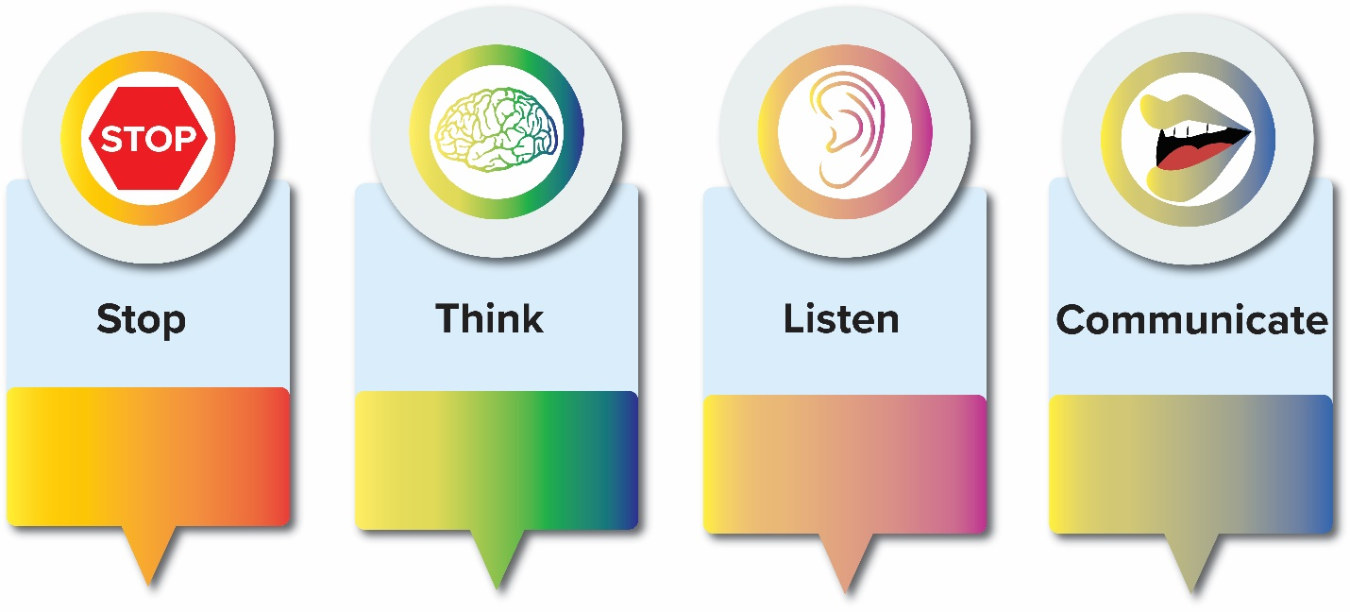
10.5 COMMUNICATION AND CONFLICT III
STLC Conflict Model
Image by Interpersonal Communication by Jason S. Wrench; Narissra M. Punyanunt-Carter; and Katherine S. Thweatt, CC BY-NC-SA 4.0.
Notes:
Ruth Anna Abigail and Dudley Cahn (2014) created a very simple model when thinking about how we communicate during conflict. They called the model the STLC Conflict Model because it stands for stop, think, listen, and then communicate.
Stop-- The first thing an individual needs to do when interacting with another person during conflict is to take the time to be present within the conflict itself. Too often, people engaged in a conflict say whatever enters their mind before they’ve really had a chance to process the message and think of the best strategies to use to send that message.
Think-- Once you’ve stopped, you now have the ability to really think about what you are communicating. You want to think through the conflict itself. What is the conflict really about? Often people engage in conflicts about superficial items when there are truly much deeper issues that are being avoided.
Listen--The third step in the STLC model is listen. Humans are not always the best listeners. Listening is a skill. Unfortunately, during a conflict situation, this is a skill that is desperately needed and often forgotten.
Communicate--Lastly, but certainly not least, we communicate with the other person. Notice that Cahn and Abigail put communication as the last part of the STLC model because it’s the hardest one to do effectively during a conflict if the first three are not done correctly.

Slide 24
10.6 KEY TAKEAWAYS I
Communication is the process of generating meaning by sending and receiving verbal and nonverbal symbols that are influenced by multiple contexts. This process can be summarized using the transactional communication model.
Within organizations, organization can move in many directions – diagonally between departments, laterally to coworkers, upwards to supervisors, downwards to subordinates or through the workplace gossip chaincalled the grapevine.
Types of communication include written, verbal and nonverbal. Workplace communications that contain a lot of detail may be best communicated using written channels. Topics that may be emotional are often more suited to in-person conversations that provide information through verbal and nonverbal channels.
A variety of barriers can impede the creation of understanding and shared meaning between communicators. Barriers to effective communication include filtering, selective perception, information overload, emotional disconnects, lack of source familiarity or credibility, workplace gossip, lies, bribery and coercion, semantics, gender differences, differences in meaning between communicators, biased language, and ineffective listening
Self-esteem is an individual’s subjective evaluation of their abilities and limitations. There is an interrelationship between an individual’s self-esteem and their communication skills. In essence, an individual’s self-esteem impacts how they communicate with others, and this communication with others impacts their self-esteem.

Slide 25
10.6 KEY TAKEAWAYS II
The idea is that people exist on a continuum from highly extraverted (an individual’s likelihood to be talkative, dynamic, and outgoing) to highly introverted (an individual’s likelihood to be quiet, shy, and more reserved).
In this chapter, three approach and avoidance traits were discussed: willingness to communicate, shyness, and communication apprehension.
Where WTC examines initiation of interpersonal interactions, shyness discusses actual reserved interpersonal behavior, and CA is focused on the anxiety experienced (or perceived) in interpersonal interactions.
Argumentativeness refers to an individual’s tendency to engage in the open exchange of ideas in the form of arguments; whereas, verbal aggressiveness is the tendency to attack an individual’s self-concept instead of an individual’s arguments.
Sociocommunicative orientation refers to an individual’s combination of both assertive and responsive communication behaviors. Assertive communication behaviors are those that initiate, maintain, and terminate conversations according to their interpersonal goals during interpersonal interactions.

Slide 26
10.6 KEY TAKEAWAYS III
John Bowlby’s theory of attachment starts with the basic notion that infants come pre-equipped with a set of behavioral skills that allow them to form attachments with their parents/guardians (specifically their mothers).
Karen Horney’s concept of rejection sensitivity examines the degree to which an individual anxiously expects to be rejected, readily perceives rejection when occurring, and experiences an intensely negative reaction to that rejection.
Hearing happens when sound waves hit our eardrums. Listening involves processing these sounds into something meaningful.
The listening process is hearing, understanding, remembering, interpreting, evaluating and responding.
Listening styles include people, action, content, and time-oriented.
Environmental and physical barriers to effective listening include furniture placement, environmental noise such as sounds of traffic or people talking, physiological noise such as a sinus headache or hunger, and psychological noise such as stress or anger
There are several bad listening practices that we should avoid, as they do not facilitate effective listening: interruptions, distorted listening, eavesdropping, aggressive listening, narcissistic listening, and pseudo-listening
Active listening refers to the process of pairing outwardly visible positive listening behaviors with positive cognitive listening practices.

Slide 27
10.6 KEY TAKEAWAYS IV
Constructive criticism differs from mere negative criticism in that it is focused on improvement with clear, specific instructions for what exactly the receiver must do to meet expectations.
One way to soften criticism is to use the sandwich method and include criticism along with praise and positive comments.
When we receive criticism, we can manage our emotions and use verbal and nonverbal beahviour to indicate an openness to feedback and willingness to grow.
Common communication behaviours during conflict includeapologies/concessions; excuses/justifications; refusals; appeasement/positivity; avoidance/evasion; gunnysacking; serial arguing; incivility; and hurtful messages.
Conflict management strategies include fostering a positive communication climate, saving face, practicing empathy, managing emotions, engaging in active listening including paraphrasing and learning from our experiences.
In the STLC model of conflict the steps in conflict are: Stop, Think, Listen, and Communicate.

