Slide 1
Principles of Leadership & Management
CHAPTER 6: LEADERSHIP MISSION & STRATEGY
Unless otherwise noted, this work is licensed under a Creative Commons Attribution-NonCommercial-ShareAlike 4.0 International (CC BY-NC-SA 4.0) license. Feel free to use, modify, reuse or redistribute any portion of this presentation.

Slide 2
Learning Outcomes
Upon successful completion of this chapter, you will be able to:
Consider the roles of mission, strategy and decision making.
Determine how creativity and passion are related to vision.
Incorporate stakeholder interests into mission and vision.
Develop statements that articulate organizational mission and vision.
Apply mission, vision, and values to your personal goals and professional career.
Analyze how strategies emerge.
Interpret strategy as trade-offs, discipline, and focus.
Conduct internal analysis to develop strategy.
Conduct external analysis to develop strategy.
Formulate organizational and personal strategy with the strategy diamond.

Slide 3
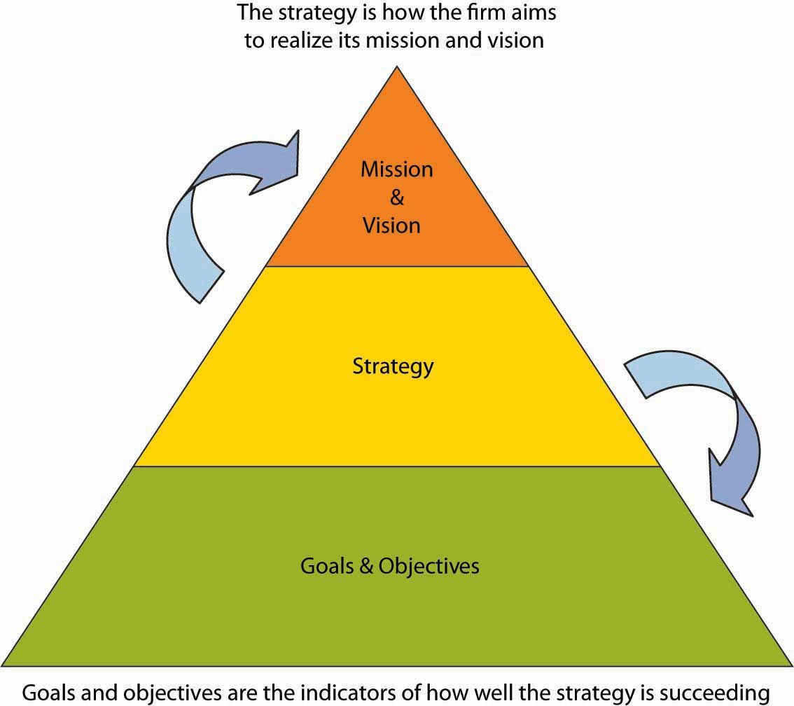
6.1 Mission and Strategy
Notes:
Strategic management, strategizing for short, is essentially about choice—the decisions that will be made in order to achieve specific goals and objectives leading to the realization of the organization’s mission and vision.
Strategy is also about making choices that provide an organization with some measure of competitive advantage or even a sustainable competitive advantage. For the most part, this chapter emphasizes strategy formulation (answers to the “What should our strategy be?” question) as opposed to strategy implementation (answers to questions about “How do we execute a chosen strategy?”). You will also learn how the concept of strategy can be applied to you personally, in addition to professionally.

Slide 4
6.2 The Roles of Mission, Vision, and Values I
A mission statement communicates the organization’s reason for being, and how it aims to serve its key stakeholders. Customers, employees, and investors are the stakeholders most often emphasized, but other stakeholders like government or communities (i.e., in the form of social or environmental impact) can also be discussed.
Notes:
Mission statements are often longer than vision statements. Sometimes mission statements also include a summation of the firm’s values. Values are the beliefs of an individual or group, and in this case the organization, in which they are emotionally invested.

Slide 5
6.2 The Roles of Mission, Vision, and Values II
A vision statement, in contrast, is a future-oriented declaration of the organization’s purpose and aspirations. In many ways, you can say that the mission statement lays out the organization’s ‘purpose for being’, and the vision statement then says, ‘based on that purpose, this is what we want to become’.
Notes:
The strategy should flow directly from the vision, since the strategy is intended to achieve the vision and thus satisfy the organization’s mission. Typically, vision statements are relatively brief.

Slide 6
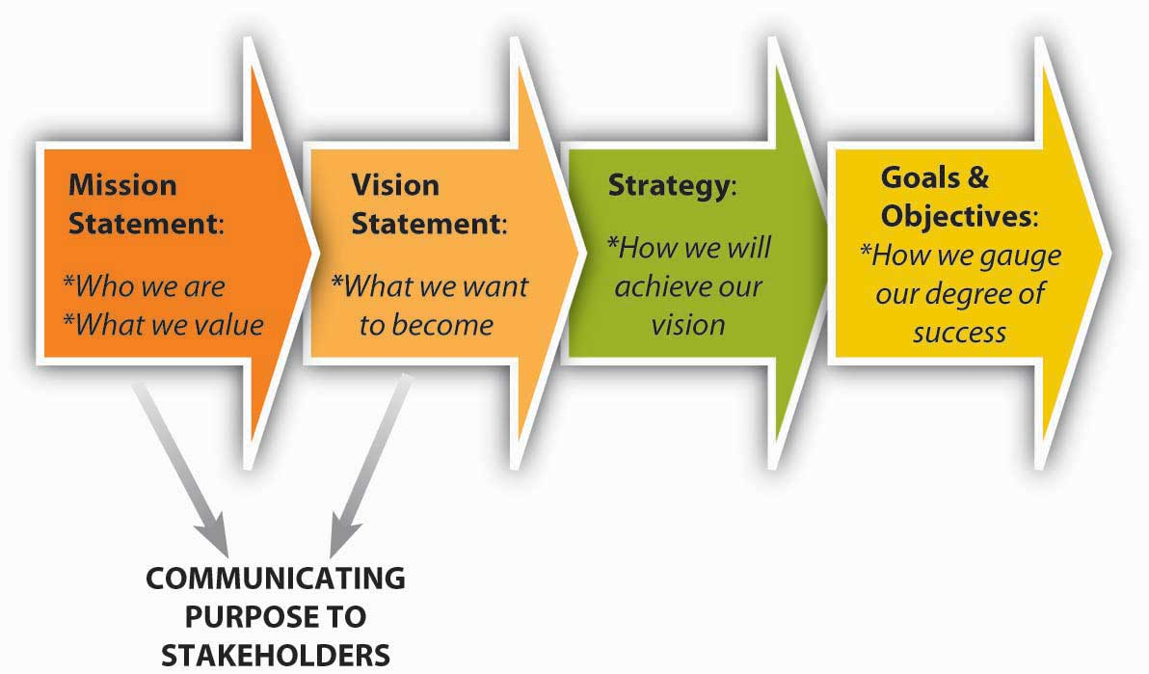
6.2 The Roles of Mission, Vision, and Values III
Roles Played by Mission and Vision
Notes:
Mission and vision statements play three critical roles: (1) communicate the purpose of the organization to stakeholders, (2) inform strategy development, and (3) develop the measurable goals and objectives by which to gauge the success of the organization’s strategy. These interdependent, cascading roles, and the relationships among them, are summarized in the figure.

Slide 7
6.3 Mission and Vision Throughout the Organization I
Thinking back to the P-O-L-C framework, organizing is the function of management that involves developing an organizational structure and allocating human resources to ensure the accomplishment of objectives. The alignment between organizing and the company’s mission and vision is crucial.
Notes:
For instance, organizational design is a formal, guided process for integrating the people, information, and technology of an organization. It is used to match the form of the organization as closely as possible to the purpose(s) the organization seeks to achieve. Through the design process, organizations act to improve the probability that the collective efforts of members will be successful.

Slide 8
6.3 Mission and Vision Throughout the Organization II
Mission, Vision, and Leadership
Leading, influencing others toward the attainment of organizational objectives, and leadership are nearly synonymous with the notions of mission and vision. We might describe a very purposeful person as being “on a mission.”
Notes:
As an example, Steve Demos had the personal mission of replacing cow’s milk with soy milk in U.S. supermarkets, and this mission led to his vision for, and strategy behind, the firm White Wave and its Silk line of soy milk products (Carpenter & Sanders, 2006). Similarly, we typically think of some individuals as leaders because they are visionary. For instance, when Walt Disney suggested building a theme park in a Florida swamp back in the early 1960s, few other people in the world seemed to share his view.

Slide 9
6.3 Mission and Vision Throughout the Organization III
Vision That Pervades the Organization
A broader definition of visionary leadership suggests that, if many or most of an organization’s employees understand and identify with the mission and vision, efficiency will increase because the organization’s members “on the front lines” will be making decisions fully aligned with the organization’s goals.
Notes:
Efficiency is achieved with limited hands-on supervision because the mission and vision serve as a form of cruise control. To make frontline responsibility effective, leadership must learn to trust workers and give them sufficient opportunities to develop quality decision-making skills.

Slide 10
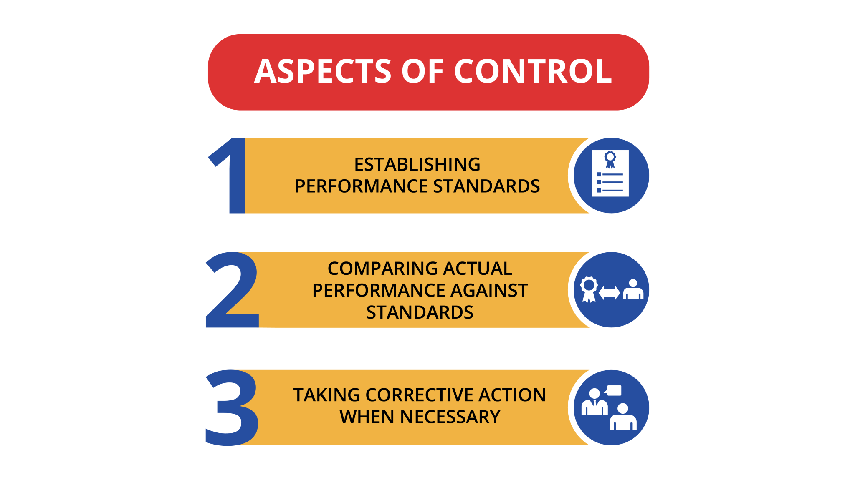
6.3 Mission and Vision Throughout the Organization IV
Vision, Mission, and Controlling
Notes:
The term controlling often conjures up images of exerting power over organizational members akin to puppets on a string, but controlling today involves ensuring that organizations operate efficiently and effectively. Controlling consists of three steps: (1) establishing performance standards, (2) comparing actual performance against standards, and (3) taking corrective action when necessary. Mission and vision are both directly and indirectly related to all three steps.

Slide 11
6.4 Creativity and Passion I
Creativity and Vision
Work by DeGraf and Lawrence, suggest a finer-grained view into the characteristics and types of creativity (DeGraf & Lawrence, 2002). They argued that creativity “types” could be clustered based on some combination of flexibility versus control and internal versus external orientation.

Slide 12
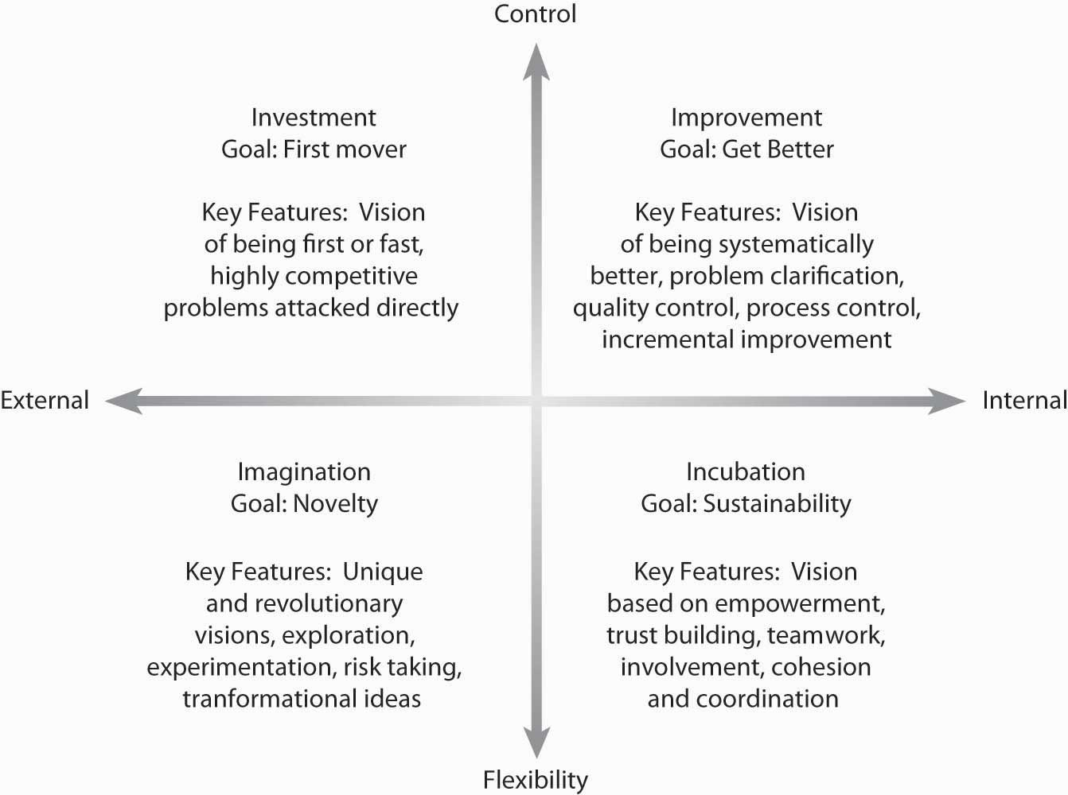
6.4 Creativity and Passion II
Notes:
For the leader, their typology is especially useful as it suggests ways to manage creativity, as in simply hiring creative individuals. As summarized in the figure, their research suggests that there are four types of creativity: (1) investment (external orientation with high control), (2) imagination (external orientation with flexibility emphasis), (3) improvement (internal orientation with high control), and (4) incubation (internal orientation with flexibility emphasis).
The first type of creativity, investment, is associated with speed—being first and being fast. It is also a form of creativity fostered from the desire to be highly competitive.
The second type of creativity, imagination, is the form that most of us think of first. This type of creativity is characterized by new ideas and breakthroughs: Apple’s stylish design of Macintosh computers and then game-changing breakthroughs with its iPod and iPhone. Oftentimes, we can tie this type of creativity to the drive or genius of a single individual, such as Apple’s Steve Jobs.

Slide 13
6.4 Creativity and Passion III
Passion and Vision
Passion is relevant to vision in at least two ways:
Passion about an idea as inspiration of the vision and vision statement
(2) Shared passion among organizational members about the importance of the vision.
Photo by Ian Schneider on Unsplash
Notes:
Passion as we invoke the term in this chapter, refers to intense, driving, or overmastering feeling or conviction. Passion is also associated with intense emotion compelling action.
Passion doesn’t just have benefits for the individual entrepreneur or leader when formulating a vision statement, it can help the whole business thrive. While there is little academic research on the relationship between passion and vision, studies suggest that fostering engagement, a concept related to passion, in employees has a significant effect on the corporate bottom line.

Slide 14
6.5 Stakeholders I
Stakeholders are individuals or groups who have an interest in an organization’s ability to deliver intended results and maintain the viability of its products and services. We’ve already stressed the importance of stakeholders to a firm’s mission and vision.
Notes:
We’ve also explained that firms are usually accountable to a broad range of stakeholders, including shareholders, who can make it either more difficult or easier to execute a strategy and realize its mission and vision. This is the main reason managers must consider stakeholders’ interests, needs, and preferences.

Slide 15
6.5 Stakeholders II
Stakeholders, Mission, and Vision
Stakeholder analysis refers to the range of techniques or tools used to identify and understand the needs and expectations of major interests inside and outside the organization environment.
Notes:
Leaders perform stakeholder analysis to gain a better understanding of the range and variety of groups and individuals who not only have a vested interest in the organization, and ultimately the formulation and implementation of a firm’s strategy, but who also have some influence on firm performance. Leaders thus develop mission and vision statements, not only to clarify the organization’s larger purpose but also to meet or exceed the needs of its key stakeholders.

Slide 16
6.5 Stakeholders III
Steps in Identifying Stakeholders
Identifying all of a firm’s stakeholders can be a daunting task.
Step 1: Determining Influences on Mission, Vision, and Strategy Formulation.
Step 2: Determining the Effects of Key Decisions on the Stakeholder.
Step 3: Determining Stakeholders’ Power and Influence over Decisions.
Notes:
Step 1: Determining Influences on Mission, Vision, and Strategy Formulation. One way to analyze the importance and roles of the individuals who compose a stakeholder group is to identify the people and teams who should be consulted as strategy is developed or who will play some part in its eventual implementation.
Step 2: Determining the Effects of Key Decisions on the Stakeholder. Step 2 in stakeholder analysis is to determine the nature of the effect of the firm’s strategic decisions on the list of relevant stakeholders.
Step 3: Determining Stakeholders’ Power and Influence over Decisions. The third step of a stakeholder analysis is to determine the degree to which a stakeholder group can exercise power and influence over the decisions the firm makes.

Slide 17
6.6 Crafting Mission and Vision Statements I
Mission and Vision-Development Process
Mission and vision development are require strong planning. Start with the people. To the greatest extent possible, let those people responsible for executing the mission and vision drive their development. This generally means soliciting their input and guiding them through the development of the actual statements, but ideally, it means teaching them how to craft those statements themselves.
Notes:
Involve as many key stakeholders as possible in its development; otherwise, they won’t consider it theirs. Assign responsibility so that it’s clear how each person, including each stakeholder, can contribute.
Content

Slide 18
6.6 Crafting Mission and Vision Statements II
Content
Begin by describing the best possible business future for your company, using a target of 5 to 10 years in the future. Your written goals should be dreams, but they should be achievable dreams. Jim Collins (author of Good to Great) suggests that the vision be very bold, or what he likes to call a BHAG—a big, hairy, audacious goal—like the United State’s goal in the 1960s to go to the moon by the end of the decade, or Martin Luther King’s vision for a nonracist America.
Notes:
Content- Begin by describing the best possible business future for your company, using a target of 5 to 10 years in the future. Your written goals should be dreams, but they should be achievable dreams.
Communicate often: Internal communications are the key to success. People need to see the vision, identify with it, and know that leadership is serious about it.

Slide 19
6.6 Crafting Mission and Vision Statements III
Specifically, the O’Hallarons find that the best mission statements have given attention to the following six areas:
What “want-satisfying” service or commodity do we produce and work constantly to improve?
How do we increase the wealth or quality of life or society?
How do we provide opportunities for the productive employment of people?
How are we creating a high-quality and meaningful work experience for employees?
How do we live up to the obligation to provide fair and just wages?
How do we fulfill the obligation to provide a fair and just return on capital?
Notes:
When writing your statements, use the present tense, speaking as if your business has already become what you are describing. Use descriptive statements describing what the business looks like, feels like, using words that describe all of a person’s senses.
Your words will be a clear written motivation for where your business organization is headed. Mission statements, because they cover more ground, tend to be longer than vision statements, but you should aim to write no more than a page. Your words can be as long as you would like them to be, but a shorter vision statement may be easier to remember.

Slide 20
6.7 Developing Your Personal Mission and Vision I
Personal mission and vision communicate the direction in which you are headed, as well as providing some explanation for why you are choosing one direction or set of objectives over others. Thinking about and writing down mission and vision statements for your life can help provide you with a compass as you work toward your own goals and objectives.

Slide 21
6.7 Developing Your Personal Mission and Vision II
Your Mission and Vision
Note that the development of a personal mission and vision, and then a strategy for achieving them, are exactly the opposite of what most people follow. Most people do not plan further ahead than their next job or activity (if they plan their career at all).

Slide 22
6.7 Developing Your Personal Mission and Vision III
The first step in planning a career is obviously a long-term goal. Where do you want to end up, ultimately? Do you really want to be a CEO or prime minister of Canada, now that you know what it “costs” to be either one? There are a couple basic parts to this process.
Notes:
BHAG- First, set out a bold vision—Jim Collins, author of Good to Great, describes this as a BHAG a big, hairy, audacious goal.
Values- Second, sketch out your personal values, or “Guiding Philosophy”—a set of core values and principles like your own Declaration of Independence.
Schedule- Once the vision is set, you have to develop some long-term goal (or goals), then intermediate-term goals, and so on. If you want to be president of the United States, what jobs will you have to take first to get there, and when do you have to get these jobs? Where should you live? What training do you need? What political connections do you need? Then you have to set up an orderly plan for obtaining the connections and training that you need and getting into these steppingstone jobs.

Slide 23
6.8 Strategic Management I
What Is Strategic Management?
Strategic management reflects what a firm is doing to achieve its mission and vision, as seen by its achievement of specific goals and objectives. A more formal definition tells us that the strategic management process “is the process by which a firm manages the formulation and implementation of its strategy” (Carpenter & Sanders, 2009).
Notes:
The strategic management process is “the coordinated means by which an organization achieves its goals and objectives” (Carpenter & Sanders, 2009). Others have described strategy as the pattern of resource allocation choices and organizational arrangements that result from managerial decision making (Mintzberg, 1978).
Planning and strategy formulation sometimes called business planning, or strategic planning, have much in common, since formulation helps determine what the firm should do. Strategy implementation tells managers how they should go about putting the desired strategy into action.

Slide 24
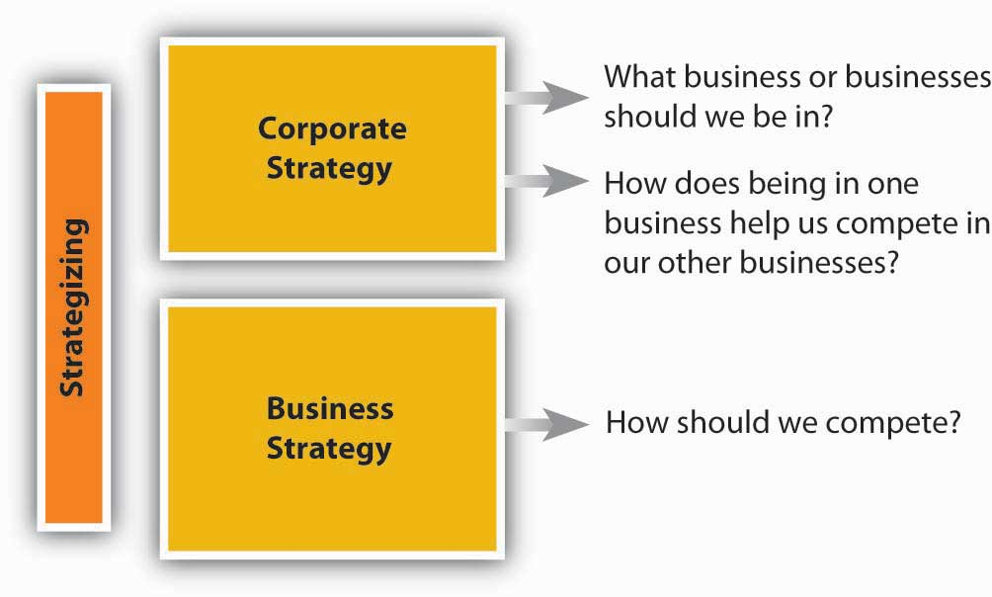
6.8 Strategic Management II
Notes:
At this point, even in terms of strategy formulation, there are two aspects of strategizing that you should recognize. The first, corporate strategy answers strategy questions related to “What business or businesses should we be in?” and “How does our business X help us compete in business Y, and vice versa?”
In many ways, corporate strategy considers an organization to be a portfolio of businesses, resources, capabilities, or activities. You are probably familiar with McDonald’s, for instance, and their ubiquitous golden arches fast-food outlets.

Slide 25
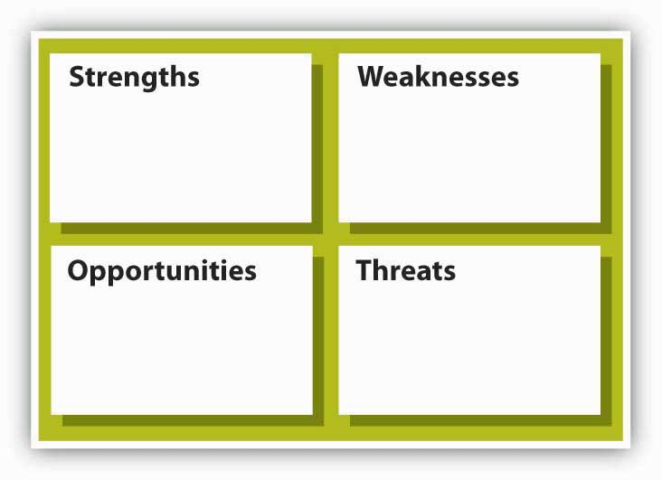
6.8 Strategic Management III
Strategic Inputs
Notes:
So what are the inputs into strategizing? At the most basic level, you will need to gather information and conduct analysis about the internal characteristics of the organization and the external market conditions. This means an internal appraisal and an external appraisal. On the internal side, you will want to gain a sense of the organization’s strengths and weaknesses; on the external side, you will want to develop some sense of the organization’s opportunities and threats.
Together, these four inputs into strategizing are often called SWOT analysis which stands for strengths, weaknesses, opportunities, and threats (see the SWOT analysis figure). It does not matter if you start this appraisal process internally or externally, but you will quickly see that the two need to mesh eventually. At the very least, the strategy should leverage strengths to take advantage of opportunities and mitigate threats, while the downside consequences of weaknesses are minimized or managed
Strengths and Weaknesses- A good starting point for strategizing is an assessment of what an organization does well and what it does less well. In general good strategies take advantage of strengths and minimize the disadvantages posed by any weaknesses. Michael Jordan, for instance, is an excellent all-around athlete; he excels in baseball and golf, but his athletic skills show best in basketball.
Opportunities and Threats- On the basis of what you just learned about competitive advantage and sustainable competitive advantage, you can see why some understanding of the external environment is a critical input into strategy. Opportunities assess the external attractive factors that represent the reason for a business to exist and prosper. These are external to the business. What opportunities exist in its market, or in the environment, from which managers might hope the organization will benefit? Threats include factors beyond your control that could place the strategy, or the business, at risk. These are also external—managers typically have no control over them, but may benefit by having contingency plans to address them if they should occur.

Slide 26
6.9 How Do Strategies Emerge? I
Intended and Realized Strategies
Many things can happen between the development of the plan and its realization, including, but not limited to:
the plan is poorly constructed,
competitors undermine the advantages envisioned by the plan,
the plan was good but poorly executed.
Notes:
While we have been discussing strategy and strategizing as if they were the outcome of a rational, predictable, analytical process, your own experience should tell you that a fine plan does not guarantee a fine outcome.
You can probably imagine a number of other factors that might undermine a strategic plan and the results that follow…think of what happens during a world-wide pandemic, or the effects of strategy on governments and regular citizens when fuel prices double due to war and other factors.

Slide 27
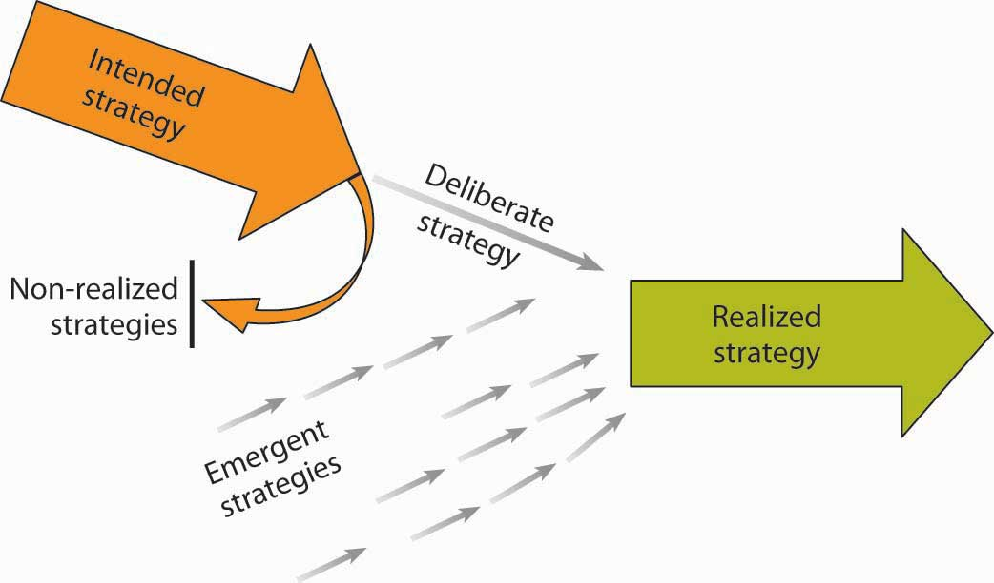
6.9 How Do Strategies Emerge? II
Notes:
These four different aspects of strategy are summarized in the following figure. Intended strategy is strategy as conceived by the top management team. Even here, rationality is limited and the intended strategy is the result of a process of negotiation, bargaining, and compromise, involving many individuals and groups within the organization. However, realized strategy—the actual strategy that is implemented—is only partly related to that which was intended (Mintzberg suggests only 10%–30% of intended strategy is realized).

Slide 28
6.9 How Do Strategies Emerge? III
The Making of Strategy: How Is Strategy Made?
Robert Grant, author of Contemporary Strategy Analysis, shares his view of how strategy is made as follows (Grant, 2002). For most organizations, strategy making combines design and emergence. The deliberate design of strategy (through formal processes such as board meetings and strategic planning) has been characterized as a primarily top-down process.
Notes:
Emergence has been viewed as the result of multiple decisions at many levels, particularly within middle management, and has been viewed as a bottom-up process. These processes may interact in interesting ways. At Intel, the key historic decision to abandon memory chips and concentrate on microprocessors was the result of a host of decentralized decisions taken at divisional and plant level that were subsequently acknowledged by top leadership and promulgated as strategy (Burgelman & Grove, 1996).

Slide 29
6.10 Key Terms I
BHAG is an acronym that stands for a big, hairy, audacious goal – bold enough to ignite energy and enthusiasm but still achievable.
Business strategy focuses on how a given business needs to compete to be effective.
Controlling involves ensuring that organizations operate efficiently and effectively.
Corporate strategy answers strategy questions related to “What business or businesses should we be in?” and “How does being in one business help us compete in our other business(es), and vice versa?”
Creativity is the power or ability to invent.
Deliberate strategy is a rational, analytical process of deliberate planning.
Diversification is where an organization participates in multiple businesses that are in some way distinct from each other.
Emergent strategy is the decisions that emerge from the complex process whereby leaders interpret the intended strategy while accommodating new ideas and changing circumstances.
engagement is determined by how involved and satisfied an employee is; engaged employees perform to their peak ability and are happy to do so.

Slide 30
6.10 Key Terms II
Intended strategy is conceived by the top management team through a process of negotiation, bargaining, and compromise, involving many individuals and groups within the organization – this strategy is not always implemented.
Mission statement communicates the organization’s reason for being, and how it aims to serve its key stakeholders.
Opportunities are external factors that can benefit an organization.
Organizational culture is the workplace environment formulated from the interaction of the employees in the workplace, and is defined by all of their life experiences, strengths, weaknesses, education, upbringing, and other attributes.
Organizational design is a formal, guided process for integrating the people, information, and technology of an organization.
Organizing is the function of management that involves developing an organizational structure and allocating human resources to ensure the accomplishment of objectives.
Passion refers to an intense, driving, or overmastering feeling or conviction.
PESTEL is a strategic management tool used to analyze an organization’s political, economic, sociocultural, technological, environmental, and legal environments.
Realized strategy is the strategy that is actually implemented, generally significantly different from the initial intended strategy.
Social networks are often referred to as the “invisible organization.” They consist of individuals or organizations connected by one or more specific types of interdependency.

Slide 31
6.10 Key Terms III
Stakeholders are individuals or groups who have an interest in an organization’s ability to deliver intended results and maintain the viability of its products and services.
Stakeholder analysis refers to the range of techniques or tools used to identify and understand the needs and expectations of major interests inside and outside the organization environment.
Strategic human resources management (SHRM) reflects the aim of integrating the organization’s human capital—its people—into the mission and vision.
Strategic management reflects what a firm is doing to achieve its mission and vision, as seen by its achievement of specific goals and objectives.
Strategic management process is the process whereby an organization accomplishes goals and objectives to accomplish their mission and vision.
Strategy formulation is also called business planning or strategic planning, and helps determine what the firm should do to accomplish their mission and vision.
Strategy implementation the actions taken to accomplish the organization’s mission and vision.
Strengths are internal factors that are a competitive advantage to an organization.
Sustainable competitive advantage occurs when an organization’s strengths cannot be easily duplicated or imitated by other firms, nor made redundant or less valuable by changes in the external environment.
SWOT analysis is a strategic planning technique to help analyze an organization’s strengths, weaknesses, opportunities, and threats.

Slide 32
6.10 Key Terms IV
Synergy exists when the interaction of two or more activities create a combined effect greater than the sum of their individual effects.
Threats are external factors beyond your control that could place the strategy, or the business, at risk.
Value chain includes the step by step process of all the activities or parts of an organization that combine to form the product or service offered.
Values are the core beliefs of an individual, group, or organization that help determine behaviors and priorities.
Values statement states the organization’s core beliefs and guiding principles.
Visionary leadership suggests that if many or most of an organization’s employees understand and identify with the mission and vision, efficiency will increase because the organization’s members “on the front lines” will be making decisions fully aligned with the organization’s goals.
Vision statement is a future-oriented declaration of the organization’s purpose and aspirations.
VRIO is a framework that suggests that a capability or a resource, such as a patent or great location, is likely to yield a competitive advantage to an organization when it can be shown that it is valuable, rare, difficult to imitate, and supported by the organization.
Weaknesses are internal factors that are disadvantageous to the organization.

