Slide 1
Principles of Leadership & Management
CHAPTER 9: GLOBAL LEADERSHIP
Unless otherwise noted, this work is licensed under a Creative Commons Attribution-NonCommercial-ShareAlike 4.0 International (CC BY-NC-SA 4.0) license. Feel free to use, modify, reuse or redistribute any portion of this presentation.

Slide 2
Learning Outcomes
Upon successful completion of this chapter, you will be able to:
Explain the importance of international leadership in today’s world.
Describe how culture can be understood through Hofstede’s cultural framework.
Identify why an understanding of cultural stereotyping is important.
Discuss the GLOBE framework, and its importance to cross-cultural leadership.
Outline the steps to prepare for cross-cultural assignments.
Explain the main strategies that companies can use to expand internationally.
Discuss why a company would go international.

Slide 3
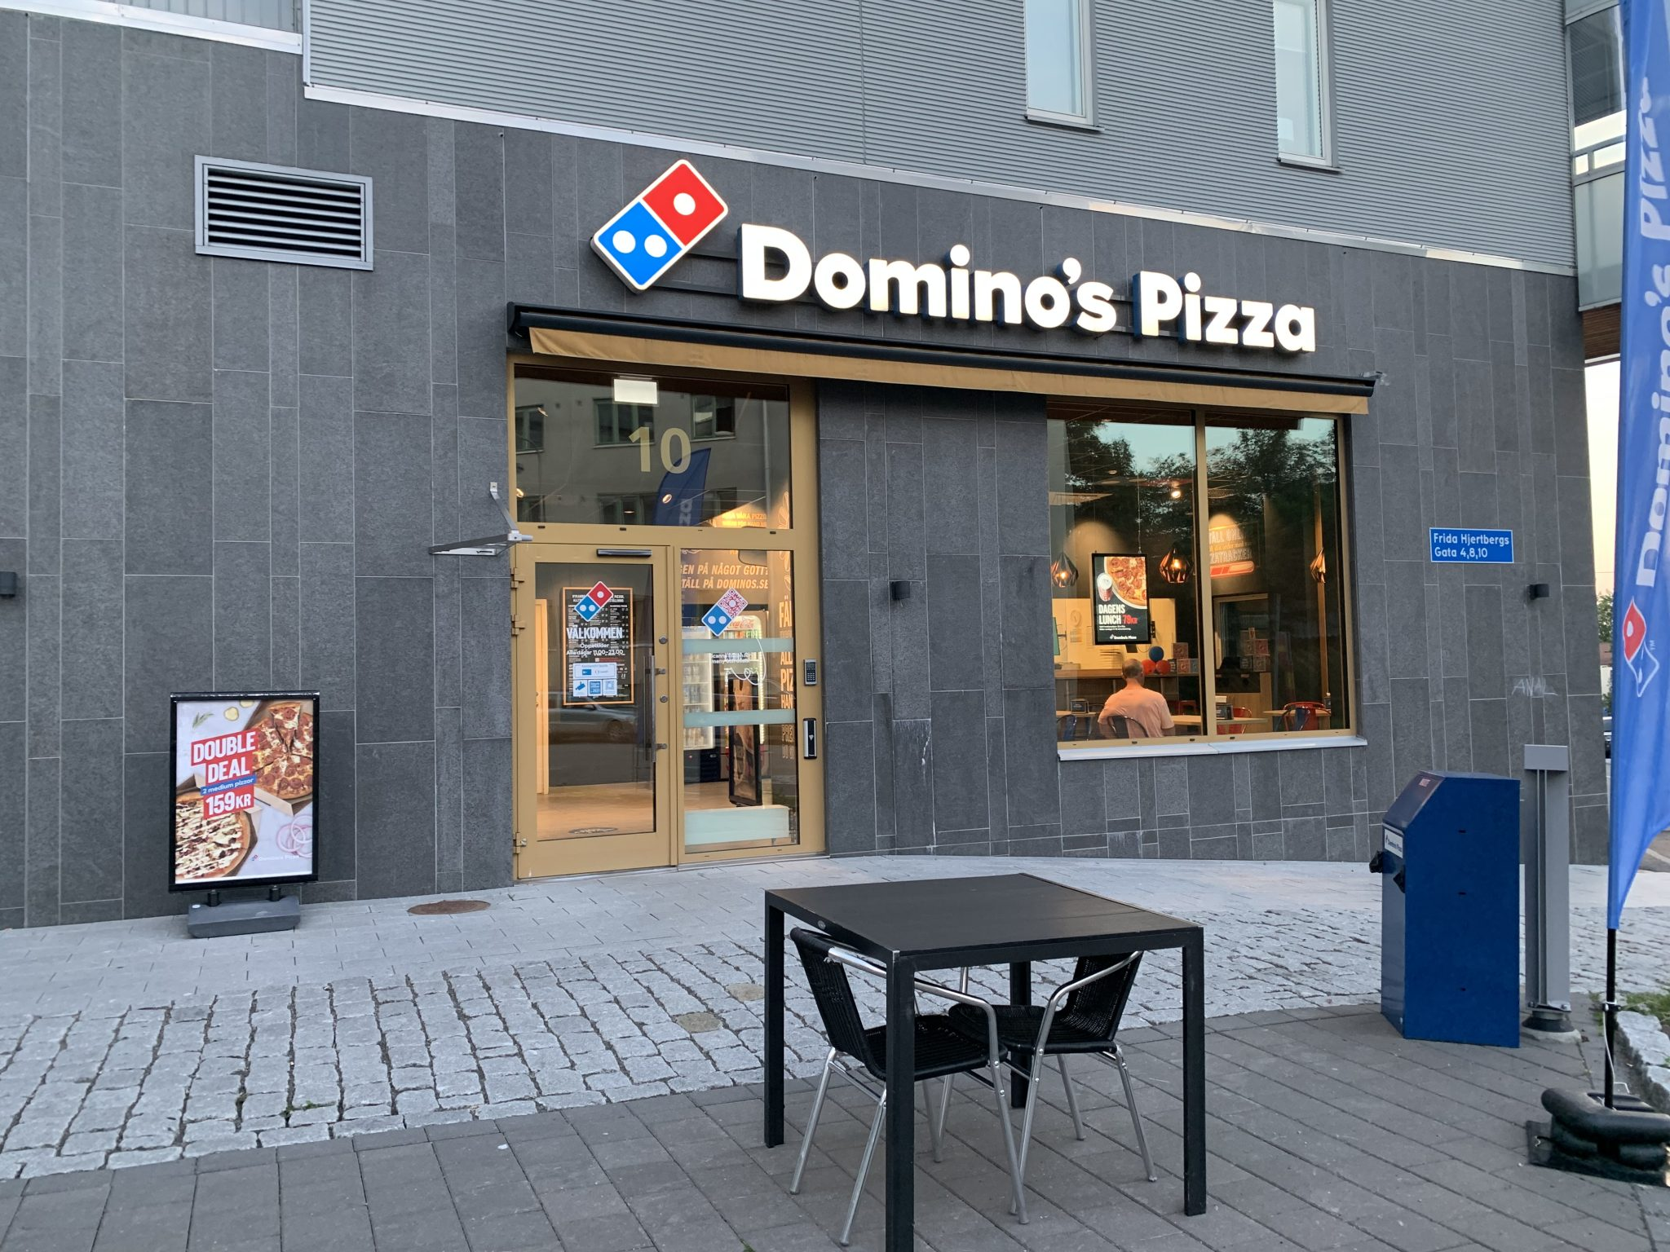
9.1 Introduction
Domino’s Pizza has more than 14,000 stores worldwide. As executive vice president of Domino’s Pizza’s international division, Mike Schlater
is president of Domino’s Canada with more than 440 stores. Originally from Ohio, Schlater started his career with Domino’s as a pizza delivery driver and worked his way up into management.
Notes:
Schlater saved his earnings, and with some help from his brother, he was able to accept the opportunity to have the first international Domino’s franchise in Winnipeg, Manitoba, in 1983. Within weeks, Schlater’s store in Canada reached higher sales than his previous store in Ohio had ever attained.
However, it was not an easy start. Schlater faced a number of challenges going international. First, he had to identify the international suppliers and get them approved to sell their products to Domino’s. This shows one of the challenges that organizations face when entering new global markets. To meet quality standards designed to protect a brand, companies must undertake an extensive review of potential new suppliers to ensure consistent product quality.
The above example shows that Domino’s has successfully managed global challenges to become the largest pizza chain in the world (Witzil, 2018). For many business leaders over the past few decades, the business world was becoming “flat” because barriers to trade were slowly disappearing. The expectation was that soon global companies would operate unconstrained by national borders. However, recent trends suggest that the business world is now seeing a barrage of protectionism and nationalism as many countries and their leaders emphasize the negatives of globalization. We have also seen the downside of globalization with sourcing and supply chain issues during the pandemic, as well as the accelerated spread of disease with heightened interconnection and travel across borders.

Slide 4
9.2 Importance of International Leadership I
International leadership is a critical area for any serious student of leadership because of globalization, the worldwide phenomenon whereby the countries of the world are becoming more interconnected and where many trade barriers among nations are disappearing.
Notes:
Even one-person start-ups are no longer limited to producing and selling their goods and services in domestic markets. In fact, companies are encouraged to explore global markets to stay competitive and are thus likely to have business activity anywhere in the world. Despite some leaders who are promoting protectionism, globalization is being facilitated by several key factors, and companies that want to succeed in this environment must understand the key factors contributing to a more globally connected business world.

Slide 5
9.2 Importance of International Leadership II
Globalization Factor 1: Lowering Trade Barriers
The first critical factor is the lowering of trade barriers through trade agreements and government policies through which countries agree to eliminate cross-border barriers to trade and promote global integration. To understand the importance of trade agreements, it is necessary to note that countries have long used tariffs to protect local industries and companies.
Notes:
Tariffs are taxes that are added to the price of imported international products. Because these tariffs are usually passed along to the consumer in the form of higher prices, imposing tariffs on imported goods gives domestic companies a price advantage and protects them from foreign competition. (Divesh, 2017). The goal of most trade agreements has been to reduce or eliminate tariffs and other barriers to make cross-border trade easier.

Slide 6
9.2 Importance of International Leadership III
Globalization Factor 2: Foreign Direct Investment
Foreign direct investment (FDI) refers to the deliberate efforts of a country or company to invest in another country through the form of ownership positions in companies in another country. In 2017, global
FDI flows amounted to USD $1.52 trillion

Slide 7
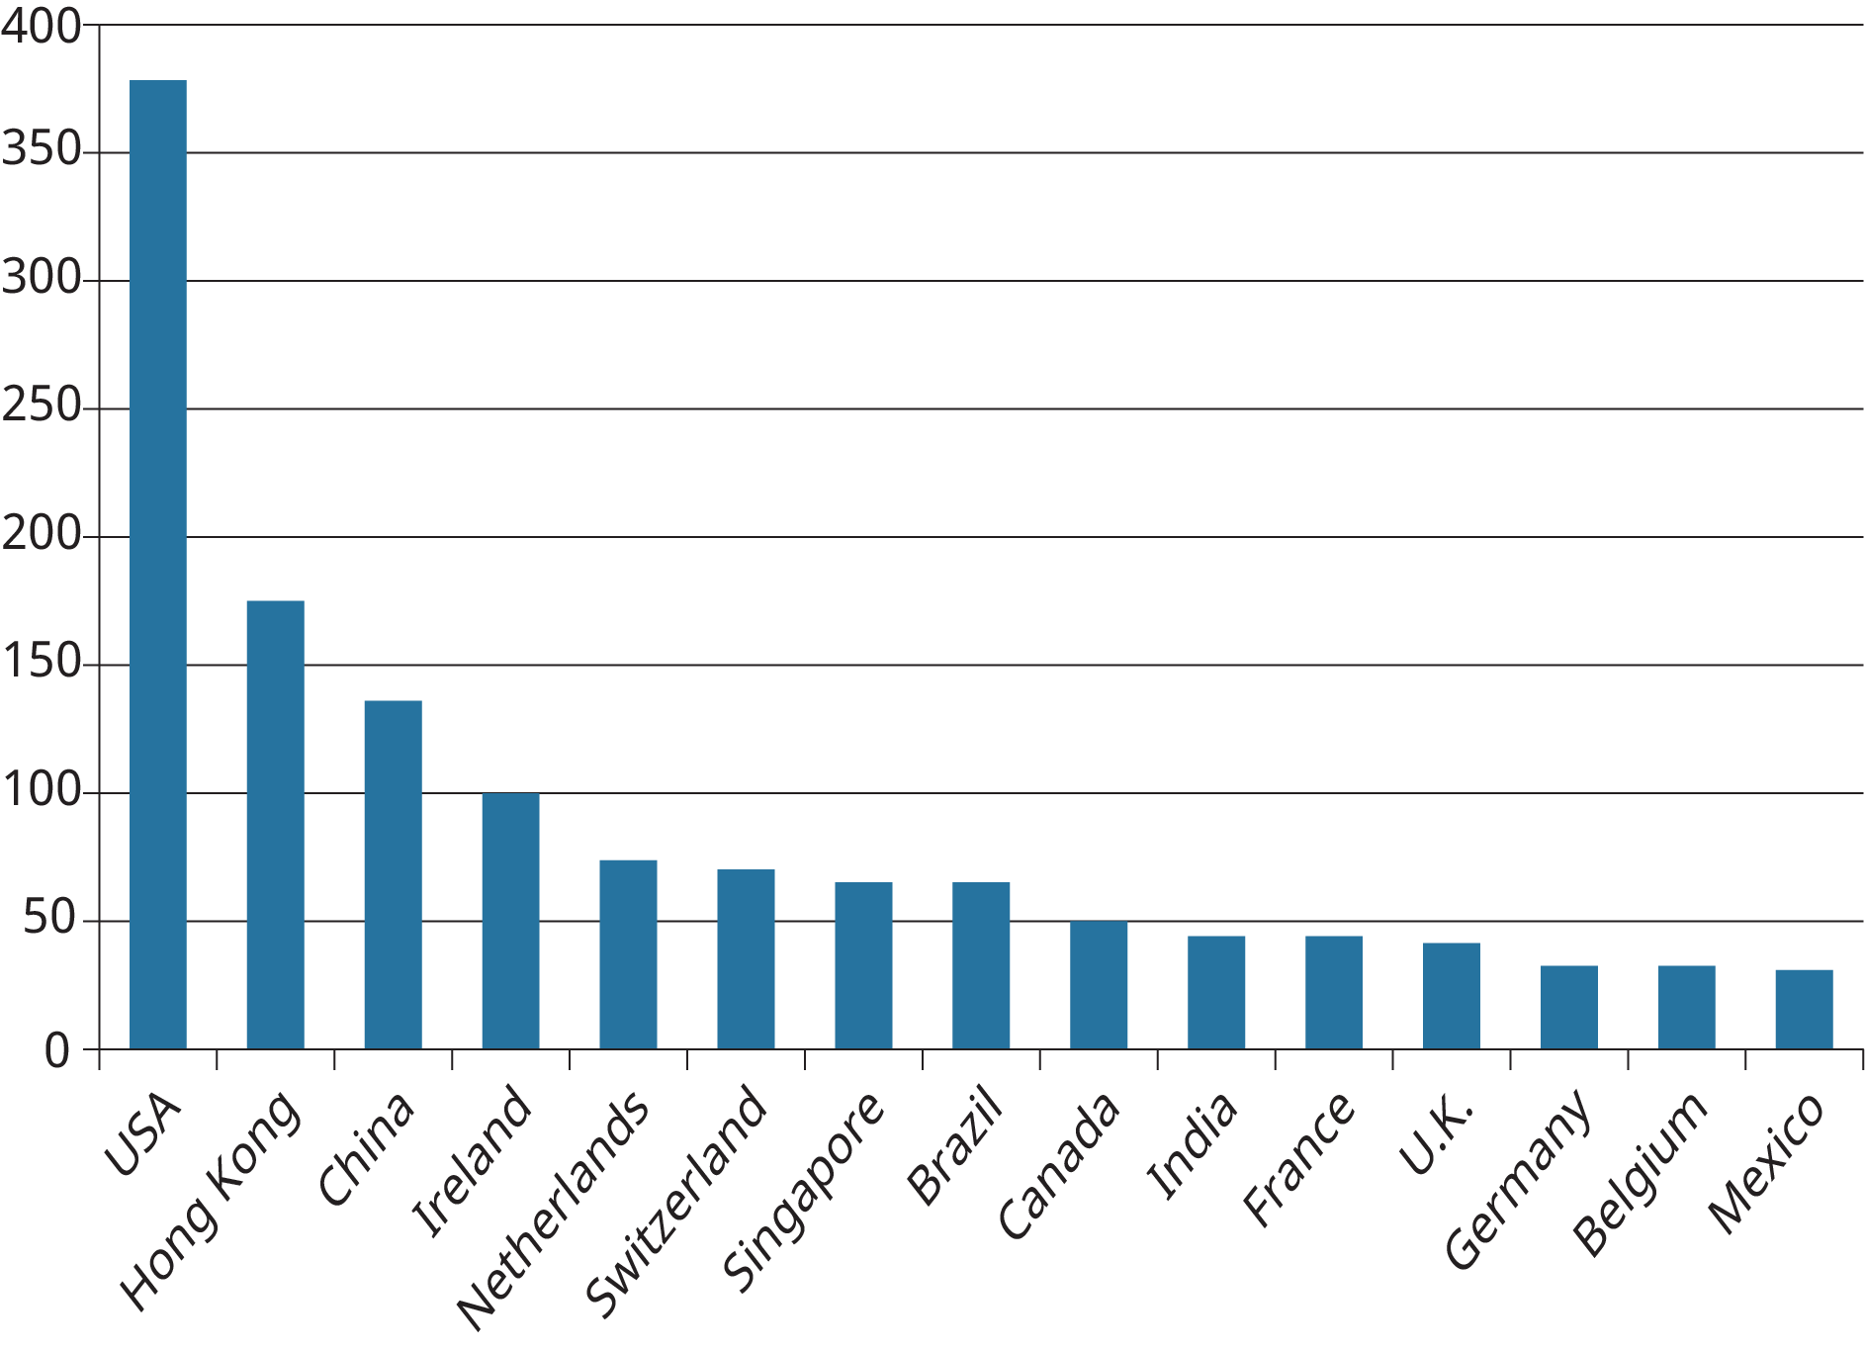
9.2 Importance of International Leadership IV
Notes:
Figure 9.2.1 shows the top 15 recipients of FDI in 2016. As you can see, many of the world’s developed economies, such as the U.S., Germany, Canada, and France, are among the top recipients of FDI. However, it is also important to note that many emerging markets, such as China, Brazil, Mexico, and India, figure prominently on this list. Emerging markets, defined as those markets in non-developed countries that present tremendous potential for multinationals, have played a critical role in the global business environment for the last decade. Countries such as Brazil, India, China, and South Africa have all experienced tremendous growth and are driving business trends.

Slide 8
9.2 Importance of International Leadership V
Globalization Factor 3: The Internet
Thanks to the pervasiveness of the Internet today, any company in the world can sell its products to anyone in the world. In fact, the developments in information technology and the reduction in costs of technological equipment mean that any multinational can reach anyone in the world. Social media, such as Twitter and Facebook, also provide a means for multinationals to build relationships with customers worldwide.
Notes:
What are the implications of this factor for international leadership? As mentioned earlier, companies located anywhere in the world will be able to find new markets and new ways to reach new customers. Consider the case of Russian entrepreneur Dmitrii Dvornikov, who was selling jewelry and table clocks made from Russian semiprecious stones.

Slide 9
9.3 Hofstede’s Cultural Framework I
According to Geert Hofstede (2001), a Dutch social psychologist,
culture is “the collective programming of the mind which distinguishes the member of one group or category of people from another.” It tells people who they are, which behaviors are appropriate, and which are not acceptable in any society. It affects almost everything we do, see, feel, and believe.
Notes:
Consider any aspect of your life, and it is likely influenced by your culture. The food you eat, the clothes you wear, and even how you address your boss or teacher are influenced by your culture. Societies develop cultural norms, values, and beliefs to assist their members in adapting to their environments.

Slide 10
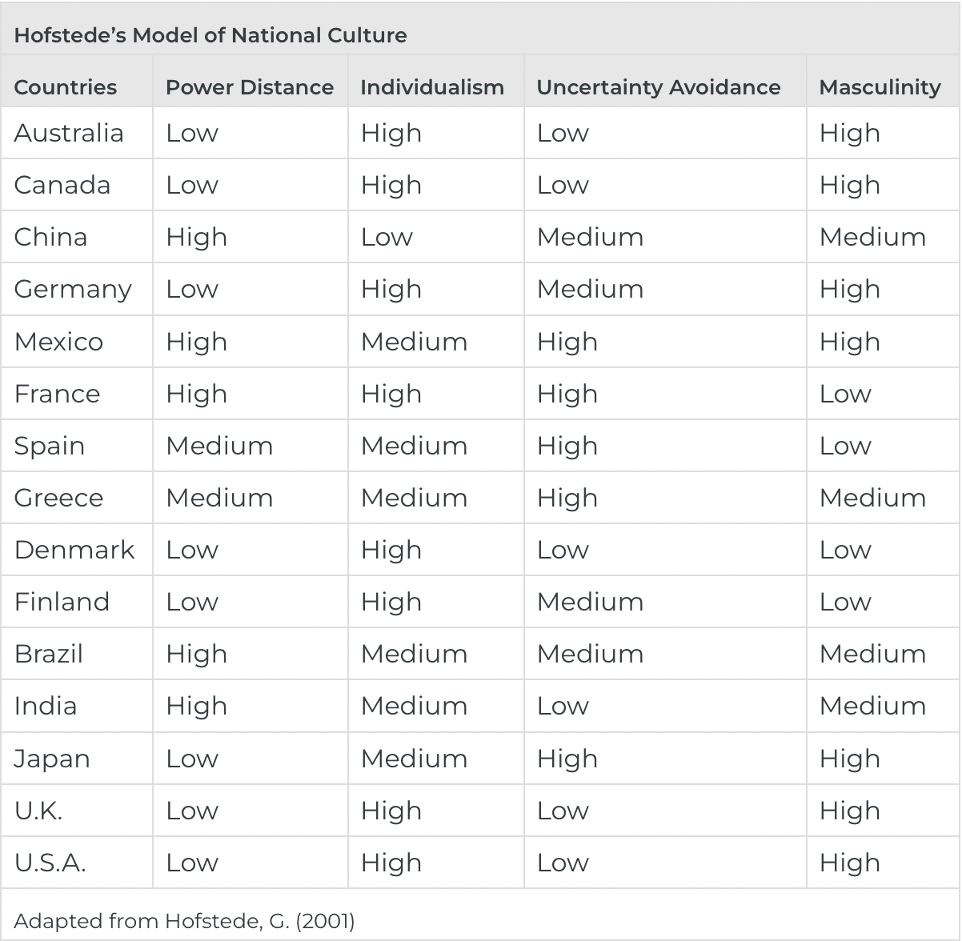
9.3 Hofstede’s Cultural Framework II
Notes:
Hofstede is a Dutch social scientist who developed his model by surveying over 88,000 employees in IBM subsidiaries from 72 countries. Hofstede developed this cultural model primarily on the basis of differences in values and beliefs regarding work goals. Hofstede’s framework is especially useful because it provides important information about differences between countries and how to manage such differences. Recent reviews of research have shown the utility of Hofstede’s framework for a wide variety of managerial activities, such as change management, conflict management, leadership, negotiation, and work-related attitudes (Kirkman et al., 2006).

Slide 11
9.3 Hofstede’s Cultural Framework III
Cultural Dimension 1: Power Distance
Hofstede’s original survey of more than 88,000 employees from 72 countries revealed four major cultural dimensions. The first cultural dimension is power distance, the degree to which members of a society accept differences in power and authority. In societies with high power distance, people are more likely to accept that power inequality is good and acceptable. People in high power distance societies are more likely to accept that there are some powerful people who are in charge and that these people are entitled to special benefits
Notes:
In contrast, societies with low power distance tend to consider that all members are equal.

Slide 12
9.3 Hofstede’s Cultural Framework IV
Cultural Dimension 2: Individualism and Collectivism
Individualism refers to the degree to which a society focuses on the relationship of the individual to the group.
Collectivism refers to the degree to which a society focuses on the relationship of the group as a whole.
Notes:
In societies with high individualism (or low collectivism) scores, individuals are valued for their achievements and are rewarded and recognized for such achievements. In contrast, people who live in societies with low individualism (high collectivism) are seen as being part of a wider group, known as the in-group.

Slide 13
9.3 Hofstede’s Cultural Framework V
Cultural Dimension 3: Uncertainty Avoidance
Hofstede’s third cultural dimension is uncertainty avoidance, the degree to which people in a society are comfortable with risk, uncertainty, and unpredictable situations. People in high uncertainty avoidance societies tend to want to avoid uncertainty and unpredictability. As a result, work environments in such countries try to provide stability and certainty through clear rules and instructions.
Notes:
In contrast, societies with low uncertainty avoidance are comfortable with risk, change, and unpredictability. In these countries, risky and ambiguous situations are less likely to upset people.

Slide 14
9.3 Hofstede’s Cultural Framework VI
Cultural Dimension 4: Masculinity
The fourth and final dimension we consider is masculinity, the degree to which a society emphasizes traditional masculine qualities such as advancement and earnings. In high-masculinity societies, work tends to be very important to people, gender roles are clear, and work takes priority over other aspects of a person’s life, such as family and leisure.
Notes:
In addition, masculine societies emphasize earnings and achievements, and employees tend to work very long hours and take very little vacation time.

Slide 15
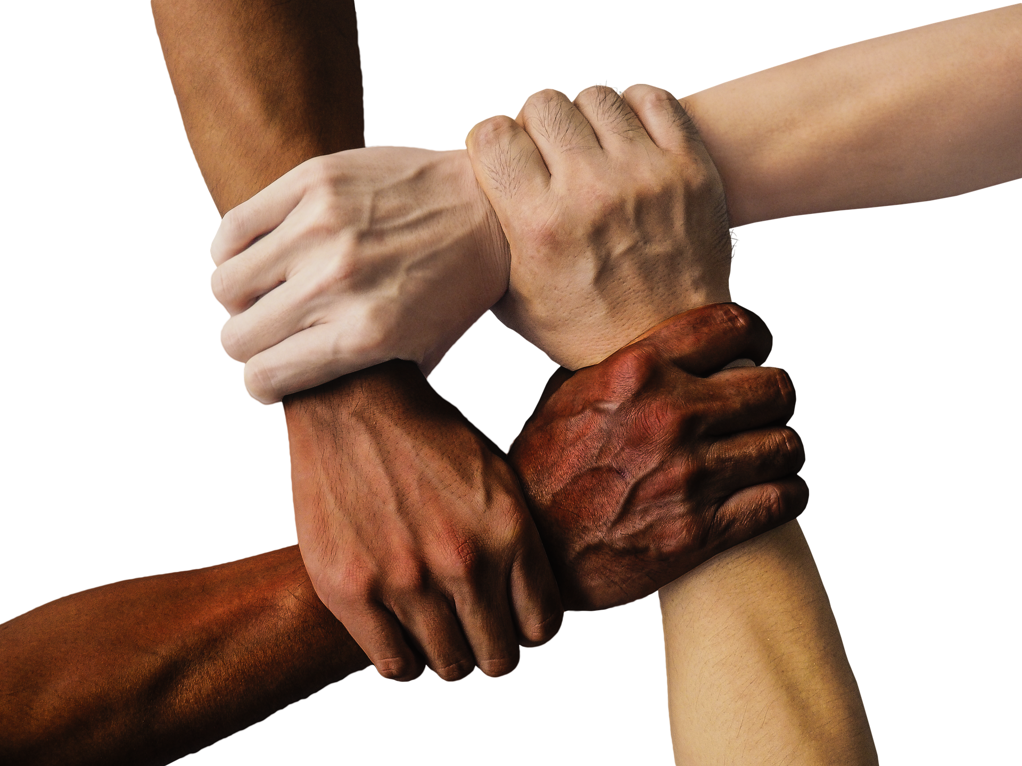
9.4 Cultural Stereotyping and Social Institutions I
Earlier sections provided you with some strong insights into cultural differences. However, despite these observations, cultural scholars often find examples where cultural realities don’t necessarily fit neatly or completely into the categories proposed by models.
Notes:
Consider, for instance, that American leaders tend to think of themselves as very egalitarian and will typically ask their subordinates to address them by their first name. American leaders will also encourage subordinates to share their views on work-related matters. In contrast, Japanese leaders are often seen as autocratic, and decisions are driven by those at the top

Slide 16
9.4 Cultural Stereotyping and Social Institutions II
The Role of Social Institutions in International Leadership
A social institution is “a complex of positions, roles, norms, and values lodged in particular types of social structures and organizing relatively stable patterns of human resources with respect to fundamental problems in . . . sustaining viable societal structures within a given environment”
(Turner, 1997, p. 6).
Notes:
In other words, as can be seen below, social institutions and the degree of social inequality impact how individuals within society behave
Similar to national cultures, social institutions have strong effects on how people think, act, and behave. While there are many social institutions in any given country or culture, we limit ourselves to the three institutions that are most relevant in the workplace: social stratification, level of education, and religion.

Slide 17
9.4 Cultural Stereotyping and Social Institutions III
Social Stratification
Social stratification refers to the degree to which “social benefits are unequally distributed and those patterns . . . are perpetuated for life” (Olsen, 1994, p. 375). These social benefits include wealth and the distribution of income. Through school and parenting, children are taught to accept such inequality, and over time, it becomes a solidly established, taken-for-granted fact of life. Because the level of social stratification in a country impacts how work elements are perceived, it is important for leaders to understand a country’s level of social stratification.
Notes:
Current research suggests that the level of social stratification typically results in societies where only the privileged few have access to jobs with work-related advantages such as the ability to work at enriched jobs that can contribute to personal growth or that may not be under close supervision. In countries with a high level of social stratification, employees may not have a very positive outlook on work.

Slide 18
9.5 The GLOBE Framework I
A second important cultural framework, the Global Leadership and Organizational Behavior Effectiveness (GLOBE) project provides leaders with an additional lens through which they can better understand how to perform well in an international environment. While the Hofstede framework was developed in the 1960s, the GLOBE project developed in the 1990s is a more recent attempt to understand cultural dimensions
(House et al., 2004).
Notes:
The GLOBE project involves 170 researchers from over 60 countries who collected data on 17,000 managers from 62 countries around the world.

Slide 19
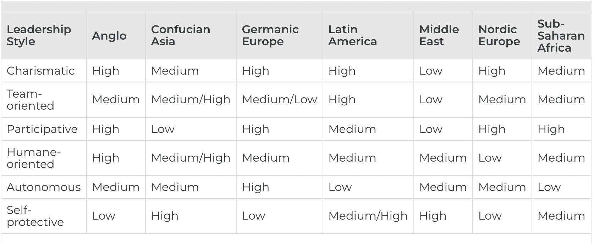
9.5 The GLOBE Framework II
Notes:
To compare how the different clusters rate different forms of leadership, the GLOBE researchers considered six leadership profiles:
Charismatic type (the degree to which the leader can inspire and motivate others)
Team-oriented (the degree to which the leader can foster a high-functioning team),
Participative type (the degree to which leaders involve others in decision-making)
Humane-oriented type (the degree to which the leader shows compassion and generosity)
Autonomous (the degree to which the leader reflects independent and individualistic leadership)
Self-protective (the degree to which the leader is self-centered and uses a face-saving approach)

Slide 20
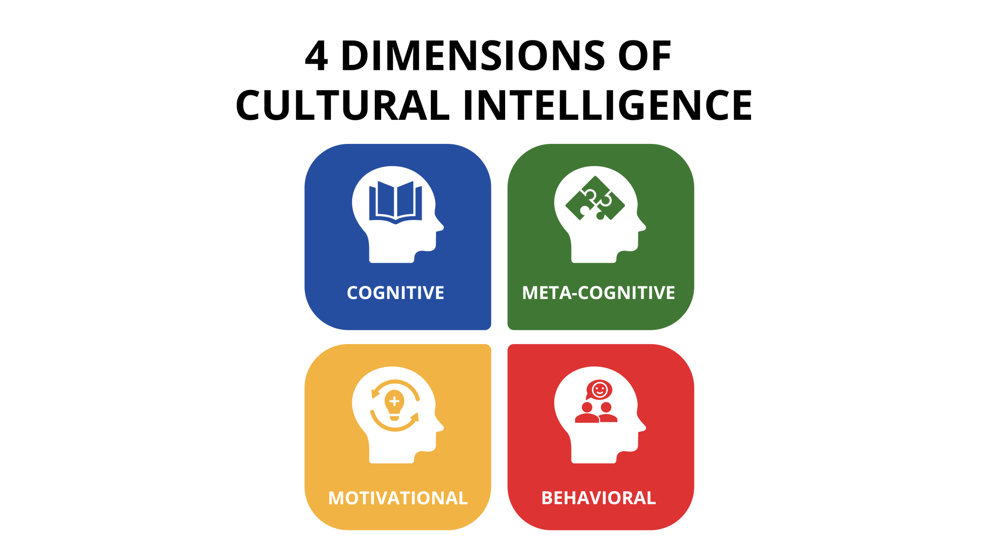
9.6 Cross-Cultural Assignments
Notes:
One of the goals of any cross-cultural training is to increase an employee’s cultural intelligence. Cultural intelligence refers to “individuals’ capabilities to function and manage effectively in culturally diverse settings” (Eisenberg et al., 2013).
A culturally intelligent leader is someone who can operate without difficulty in cross-national settings. Recent research suggests that cultural intelligence is made up of four dimensions:
a cognitive dimension, focusing on the individual’s knowledge of values and practices inherent in the new culture acquired through education and personal experiences
a meta-cognitive dimension, which reflects an individual’s ability to use cross-cultural knowledge to understand and adapt to the cultural environment they are exposed to
a motivational dimension, which reflects the ability and desire to continuously learn new aspects of cultures and adapt to them
a behavioral dimension, based on the ability of the individual to exhibit the appropriate forms of verbal and nonverbal behaviors when interacting with people from another culture

Slide 21
9.7 Strategies for Expanding Globally I
Global strategy
A global strategy is based on the assumption that the world is extremely interconnected and that patterns of consumption and production are fairly homogeneous worldwide (Verbeke et al., 2016).
Notes:
In such cases, the company simply extends its domestic strategy to the global arena.
Global strategies represent a potential solution to reduce costs. Using standardized products and processes in each of the markets it enters allows a company to possibly achieve economies of scale and scope. The global company will scan the world for opportunities and respond by expanding into those areas where there is potential. Furthermore, it will deploy those activities worldwide depending on where the most value is achieved.

Slide 22
9.7 Strategies for Expanding Globally II
Regional Strategy
A regional strategy is one in which the company decides that it makes sense to organize its functional activities, such as marketing, finance, etc., around geographical regions that play a critical role in terms of sales. Toyota is an example of a company that has successfully implemented a regional strategy.
Notes:
Because regions such as Europe and North America are sufficiently large but different markets, Toyota has decided that it is worth customizing its operations by region. In this case, the company has several regional offices that operate independently of the Japanese headquarters.

Slide 23
9.7 Strategies for Expanding Globally III
Local Strategy
The local strategy is the one in which a company adapts its products to meet the needs of the local market. For instance, experts argue that despite the perception that customers want global products, significant cultural and national value differences still suggest that some level of customization is necessary.
Notes:
This is especially critical for some functional areas, such as marketing. People across cultures have different purchasing and usage habits. Furthermore, they respond differently to promotional campaigns and other advertising messages. In such cases, a local strategy may be necessary.

Slide 24
9.8 The Necessity of Global Markets I
Navigating cross-cultural environments is fraught with dangers but holds the possibility of great success.
Notes:
Before we get into how companies can go international, let’s look at why a company might want to expand internationally in the first place.
Trade Facilitation- At a basic level, relying on a domestic market can be problematic. Because of the many factors enhancing globalization, companies of all sizes and types want to take advantage of global markets to expand and achieve sustainable competitive advantage.
Growth Opportunities- Another critical factor that supports internationalization is that emerging markets such as China, India, Brazil, and Malaysia will continue to grow and present companies with tremendous opportunities

Slide 25
9.8 The Necessity of Global Markets II
How to Go International 1: Exporting
Because exporting is one of the easiest ways to go international, it can bring many benefits (Government of Canada, 2021).
Current research suggests that companies that export tend to be 17% more profitable than companies that don’t.
Notes:
Additionally, exporting provides the ability for companies to defend their markets by becoming more competitive in other markets. Furthermore, by exploring international markets, a company can acquire critical cross-cultural management skills, thereby increasing the value of the company. Consider the case of DeFeet International, a U.S. maker of socks for cyclists (International Trade Administration, n.d.).

Slide 26
9.8 The Necessity of Global Markets III
How to Go International 2: Strategic Alliances
Because of some of the dangers of licensing and franchising, companies can often get even more involved in global operations by engaging in strategic alliances. International strategic alliances occur when two or more companies from different countries enter into an agreement to conduct joint business activities. Strategic alliances are often the preferred means of entry in emerging markets because they make it easier to do business in the country.
Notes:
A strategic alliance is a way for a foreign company to bypass barriers imposed by local governments.
A prominent example of one of the most successful strategic alliances is the one entered into by Nissan and Renault in 1999 (Kumar, 2014).

Slide 27
9.8 The Necessity of Global Markets IV
How to Go International 3: Foreign Direct Investment
Given the difficulties associated with strategic alliances, some companies elect to be wholly vested in the host country. This final form of international entry, which we discussed at the beginning of the chapter, is a foreign direct investment (FDI), which occurs when a company invests in another country by constructing facilities and buildings in that country.
Notes:
FDI can also occur through mergers and acquisitions, whereby a multinational company fully acquires a company in another country. Many car companies, such as Toyota, Honda, BMW, and Nissan, have fully operational plants in the United States. For example, many of the BMW SUVs, such as the BMW X3 and X5, are fully built in the BMW plant in Spartanburg, South Carolina.

Slide 28
9.9 Key Terms I
Culture is the way of life of a group of people and includes such things as values, beliefs, customs, food, music, religion, etc. that distinguish one group or category of people from another.
Collectivism refers to the degree to which a society focuses on the relationship of the group as a whole.
Education as a social institution includes the socializing experiences and transmission of knowledge that prepares individuals to act in society.
Foreign direct investment (FDI) refers to the deliberate efforts of a country or company to invest in another country through the form of ownership positions in companies in another country.
High power distance societies are more likely to accept that power inequality is good and acceptable.
Humane orientation is the extent to which societies place importance on fairness, altruism, and caring.
Individualism refers to the degree to which a society focuses on the relationship of the individual to the group.
Low power distance societies tend to consider that all members are equal.

Slide 29
9.9 Key Terms II
Masculinity refers to the degree to which a society emphasizes traditional masculine qualities such as achievement and earnings.
Performance orientation is the degree to which societies emphasize performance and achievement.
Psychic distance refers to the many differences that exist between countries because of language, cultural characteristics, social institutions, and business practices.
Religion is a social institution consisting of the shared set of beliefs, activities, behaviors and values based on faith in a higher power.
Social stratification refers to the degree to which a society accepts the unequal distribution of social benefits such wealth, employment and income.
Tariffs are taxes that are added to the price of imported international products.
Uncertainty avoidance is the degree to which people in a society are comfortable with risk, uncertainty, and unpredictable situations.

