Slide 1
Principles of Leadership & Management
CHAPTER 8: LEADERSHIP & THE ORGANIZATION
Unless otherwise noted, this work is licensed under a Creative Commons Attribution-NonCommercial-ShareAlike 4.0 International (CC BY-NC-SA 4.0) license. Feel free to use, modify, reuse or redistribute any portion of this presentation.

Slide 2
Learning Outcomes
Upon successful completion of this chapter, you will be able to:
Describe what organizational culture is and why it is important for an organization.
Identify the dimensions that make up a company’s culture.
Appraise the creation and maintenance of organizational culture.
Evaluate the factors that create cultural change.
Identify environmental trends, demands, and opportunities facing organizations.
Develop personal culture management skills.

Slide 3
8.1 Organizational Environment and Culture
Water is invisible to the fish swimming in it, yet it affects their actions; culture consists of unseen elements in organizations, such as assumptions and values, but these aspects affect the behavior of those who exist in that environment. Just as fish must scan their internal and external environments to be aware of what is occurring and to stay on track, businesses must continually do the same.

Slide 4
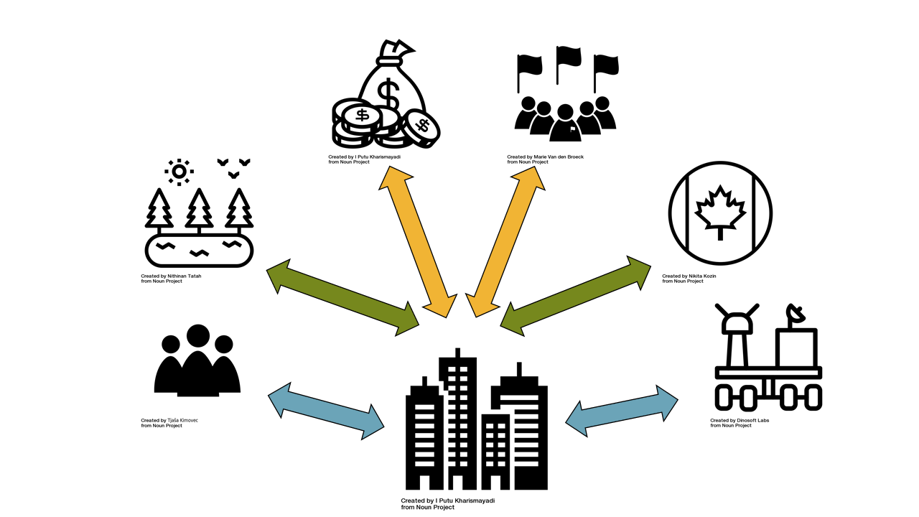
8.2 External Environments and Internal Structures I
External Forces that Influence Business Activities
Notes:
Businesses don’t operate in a vacuum – they are influenced by a number of external factors. These include the economy, government, consumer trends, technological developments, public pressure to act as good corporate citizens, and a variety of other elements. Collectively, these forces constitute what is known as the macro or general environment – essentially the big picture world outside over which the business exerts very little if any control.
“Business and Its Environment” sums up the relationship between a business and the external forces that influence its activities. One industry that’s clearly affected by all these factors is the fast-food industry.

Slide 5
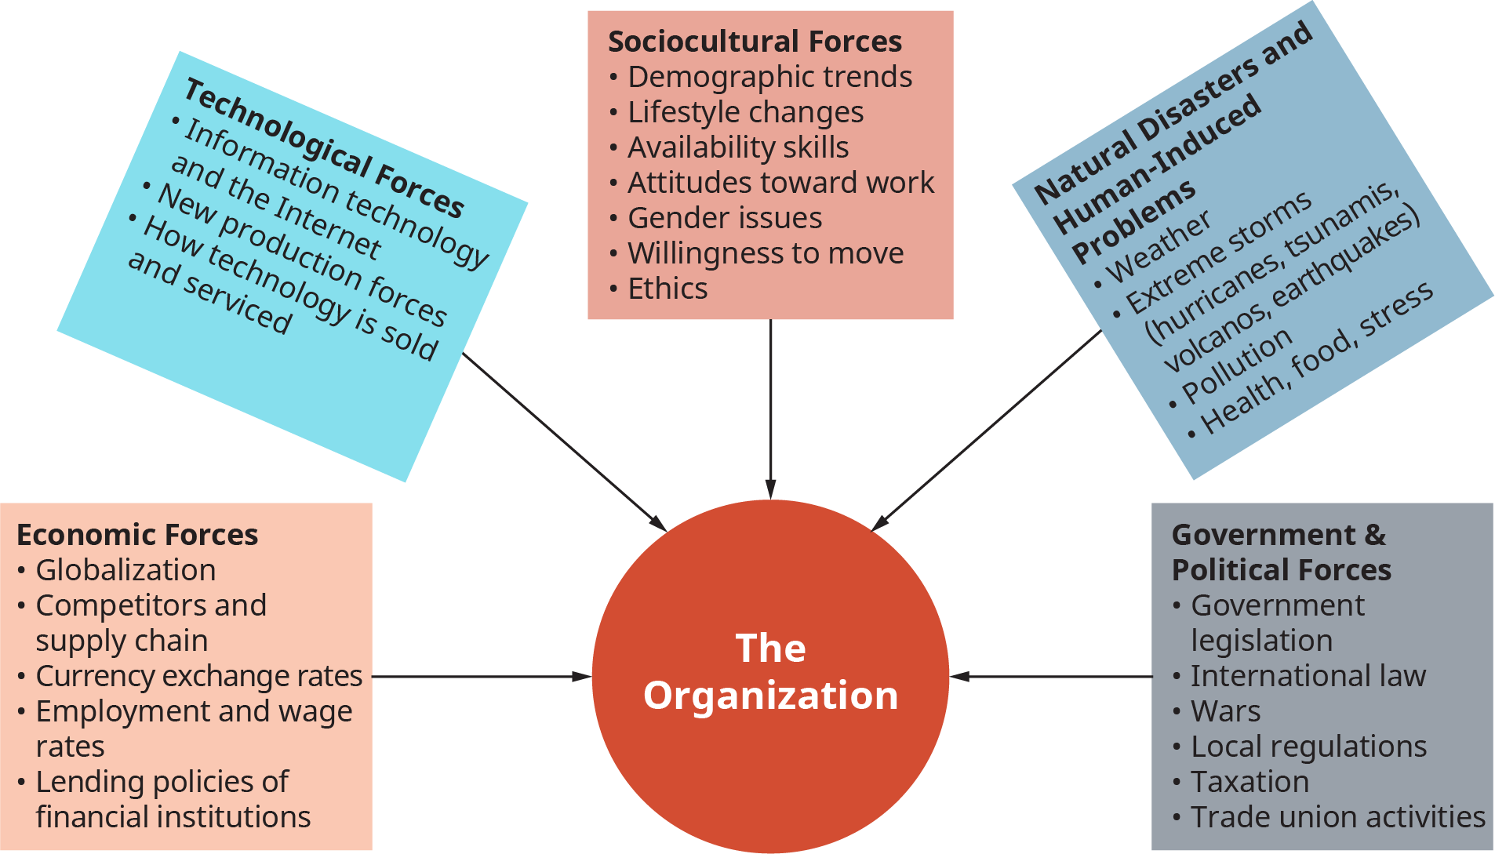
8.2 External Environments and Internal Structures II
“Macro Forces and Environments”
Notes:
The big picture of an organization’s external environment, also referred to as the general environment, is an inclusive concept that involves all outside factors and influences that impact the operation of a business that an organization must respond or react to in order to maintain its flow of operations (Johns & Cena, 2016).
Figure 8.2.2 illustrates types of general macro environments and forces that are interrelated and affect organizations: sociocultural, technological, economic, government and political, natural disasters, and human-induced problems that affect industries and organizations.

Slide 6
8.2 External Environments and Internal Structures III
Types of Organizational Structures
The six types of organizational structures discussed here include functional, divisional, geographic, matrix, networked/team, and virtual (Burton & Obel, 2018; Daft, 2016; Rahnema & Van Durme, 2017).

Slide 7
8.2 External Environments and Internal Structures IV
Functional Structure
Notes:
The functional structure, shown in Figure 8.2.4, is among the earliest and most used organizational designs. This structure is organized by departments and expertise areas, such as R&D (research & development), production, accounting, and human resources. Functional organizations are referred to as pyramid structures since they are governed as a hierarchical, top-down control system. Small companies, start-ups, and organizations working in simple, stable environments use this structure, as do many large government organizations and divisions of large companies for certain tasks.

Slide 8
8.2 External Environments and Internal Structures V
Divisional Structure
Divisional structures are, in effect, many functional departments grouped under a division head. Each functional group in a division has its own marketing, sales, accounting, manufacturing, and production team. This structure resembles a product structure that also has profit centers.
Notes:
These smaller functional areas or departments can also be grouped by different markets, geographies, products, services, or other whatever is required by the company’s business. The market-based structure is ideal for an organization that has products or services that are unique to specific market segments and is particularly effective if that organization has advanced knowledge of those segments.

Slide 9
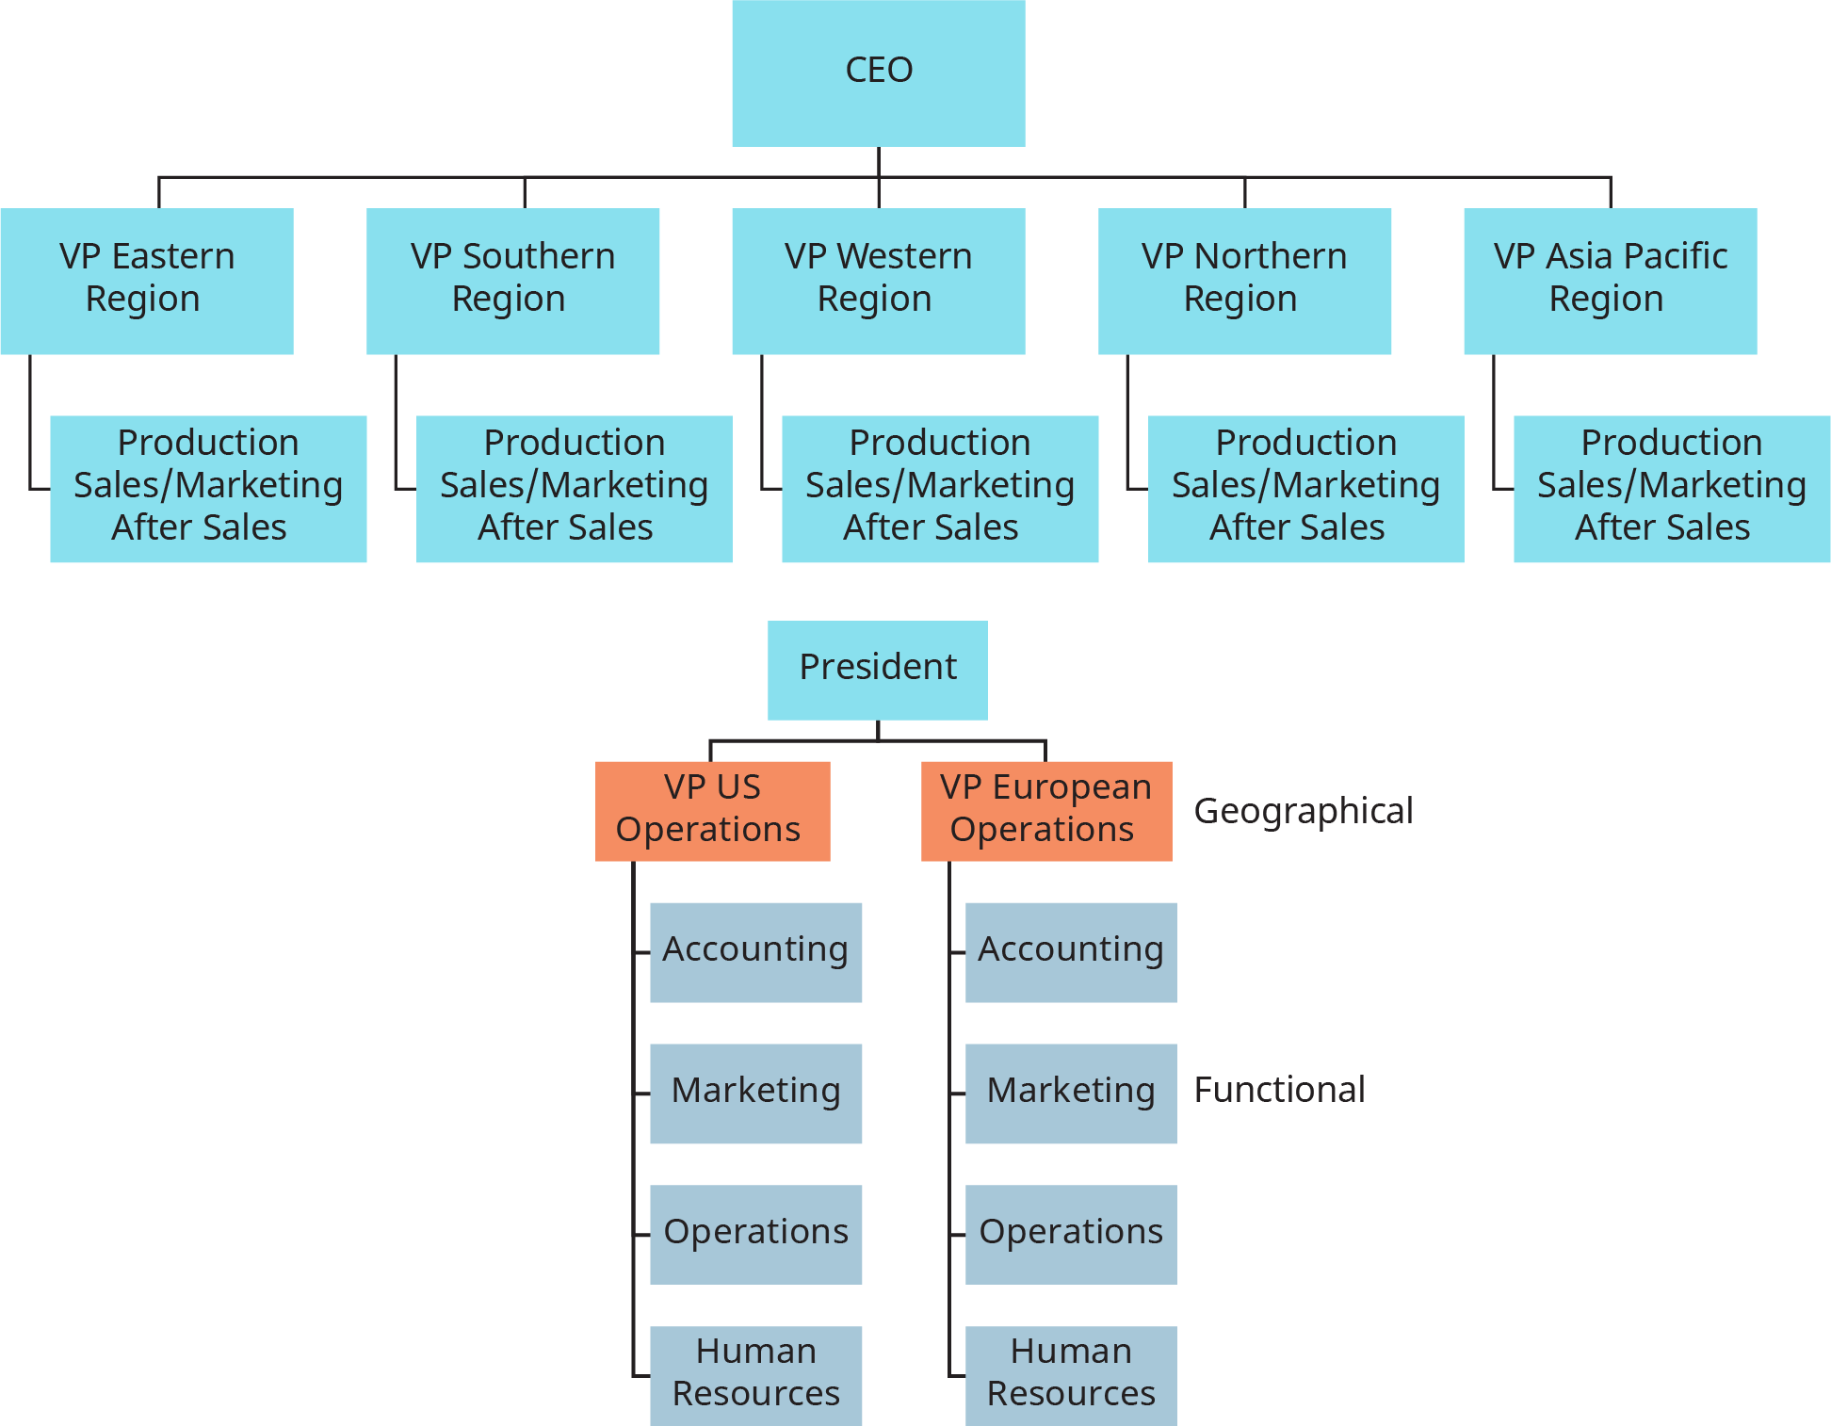
8.2 External Environments and Internal Structures VI
Geographic Structure
Notes:
A geographic structure, Figure 8.2.5, is another option aimed at moving from a mechanistic to more organic design to serve customers faster and with relevant products and services; as such, this structure is organized by locations of customers that a company serves. This structure evolved as companies became more national, international, and global. Geographic structures resemble and are extensions of the divisional structure.

Slide 10
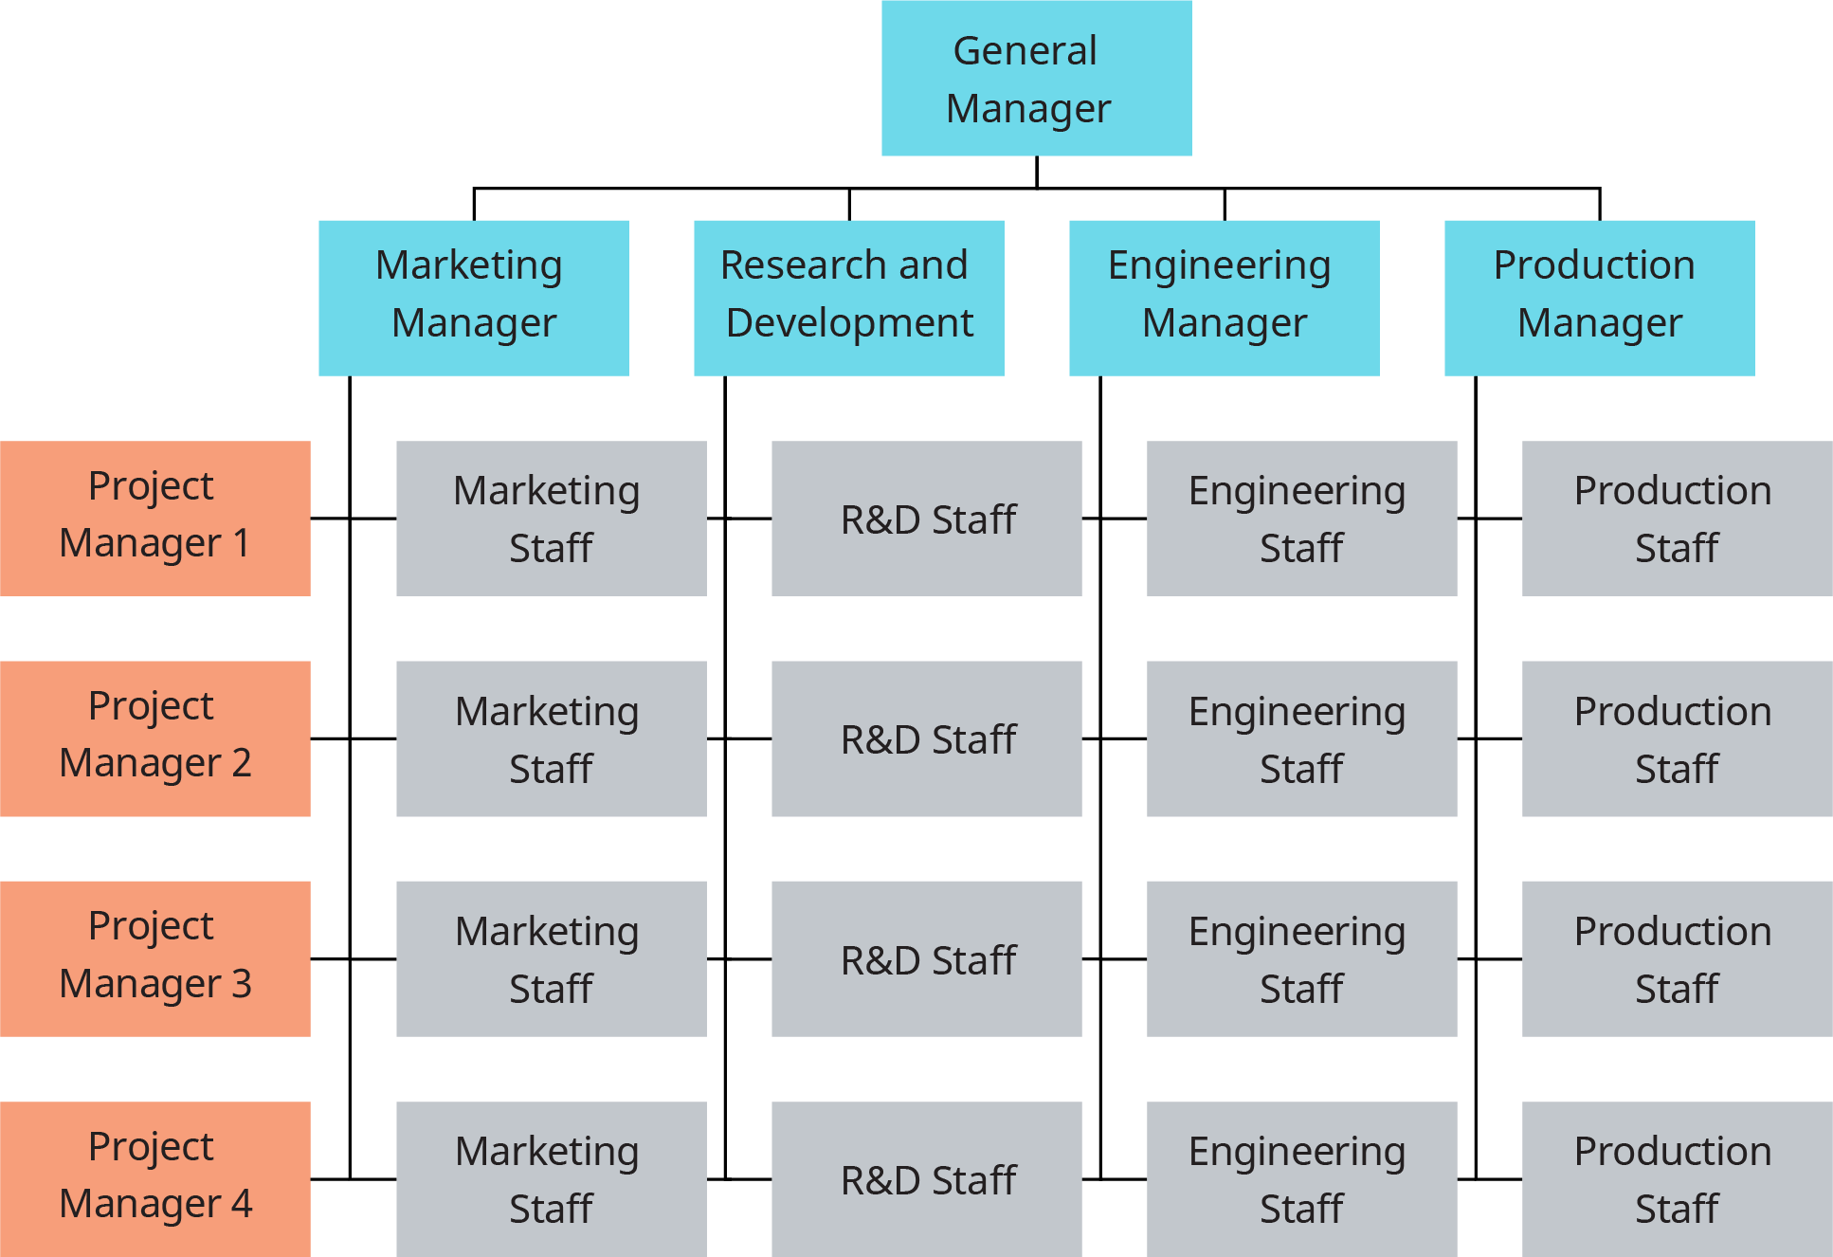
8.2 External Environments and Internal Structures VII
Matrix Structure
Notes:
Matrix structures, depicted in Figure 8.2.6, move closer to organic systems in an attempt to respond to environmental uncertainty, complexity, and instability. The matrix structure actually originated at a time in the 1960s when U.S. aerospace firms contracted with the government. Aerospace firms were required to “develop charts showing the structure of the project management team that would be executing the contract and how this team was related to the overall leadership structure of the organization.”

Slide 11
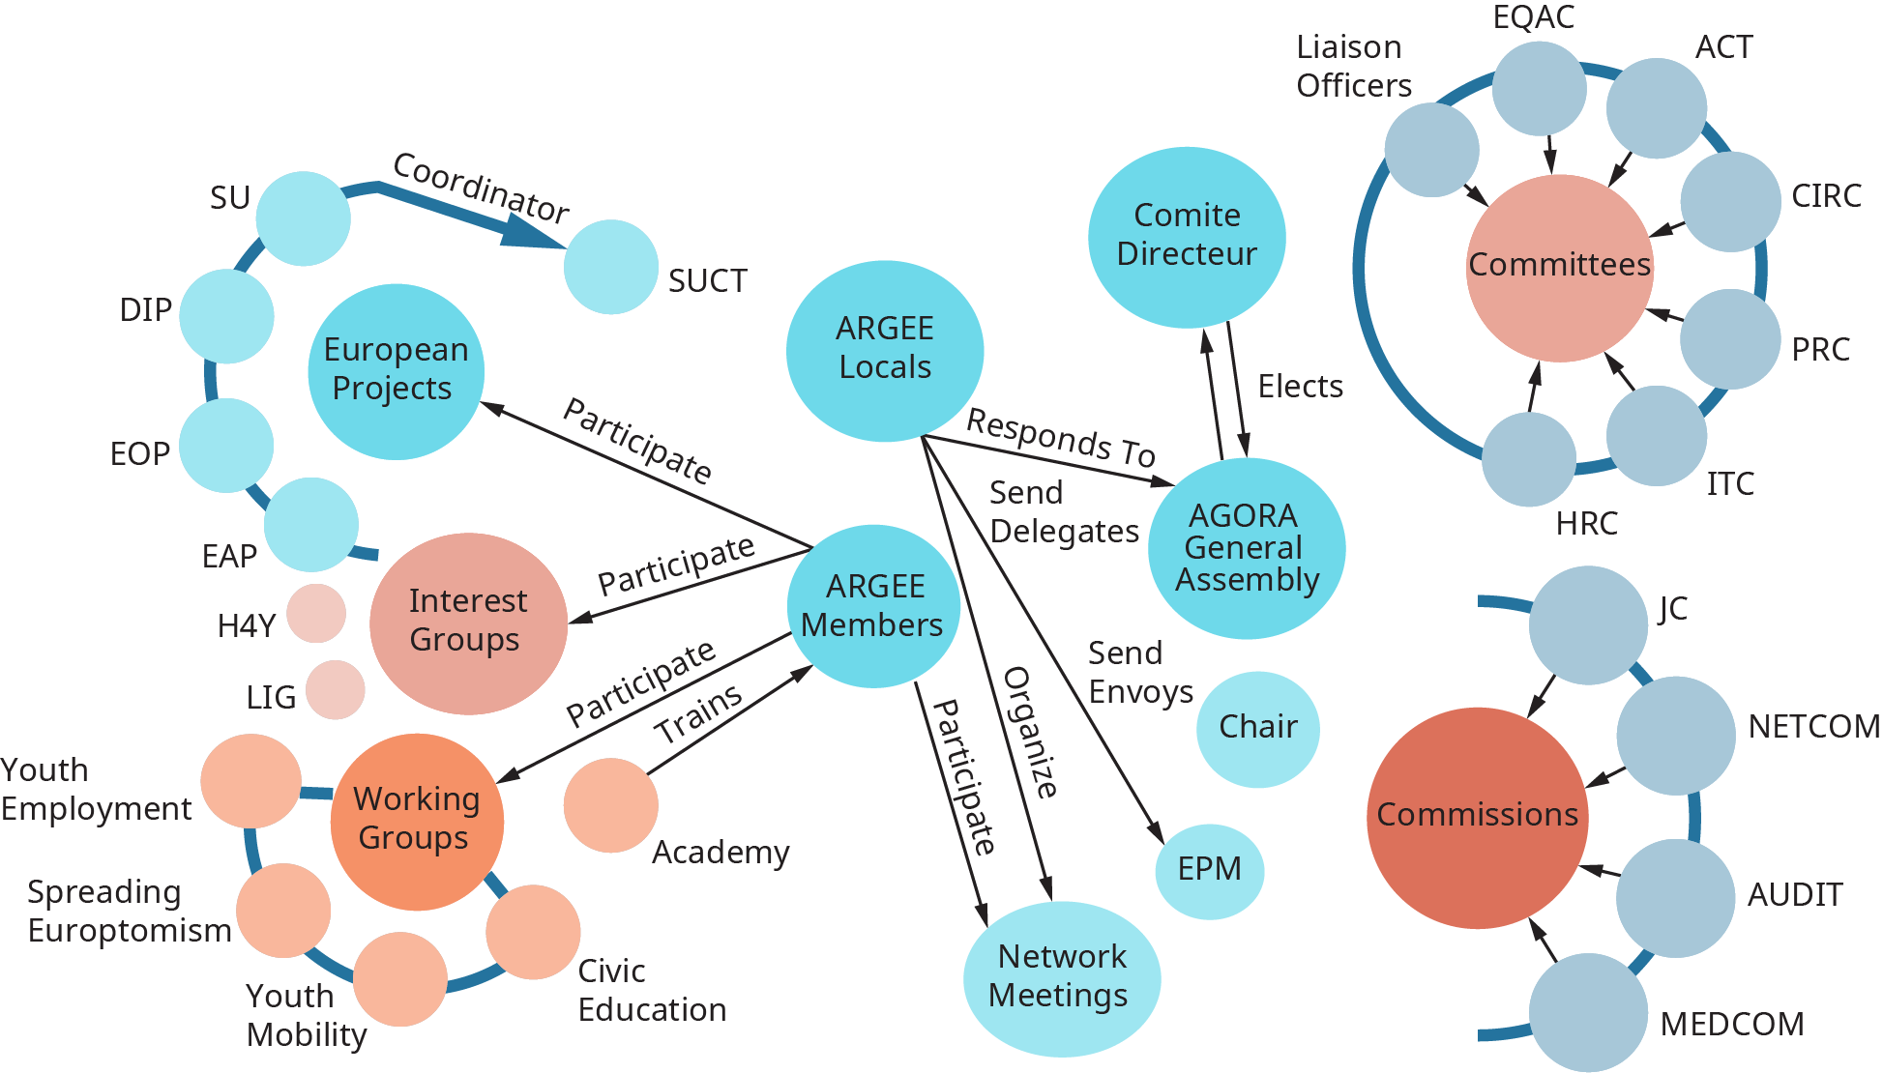
8.2 External Environments and Internal Structures VIII
Network Structure
Notes:
Networked team structures are another form of the horizontal organization. Moving beyond the matrix structure, networked teams are more informal and flexible. “[N]etworks have two salient characteristics: clustering and path length. Clustering refers to the degree to which a network is made up of tightly knit groups while path lengths is a measure of distance—the average number of links separating any two nodes in the network” (Satell, 2015).

Slide 12
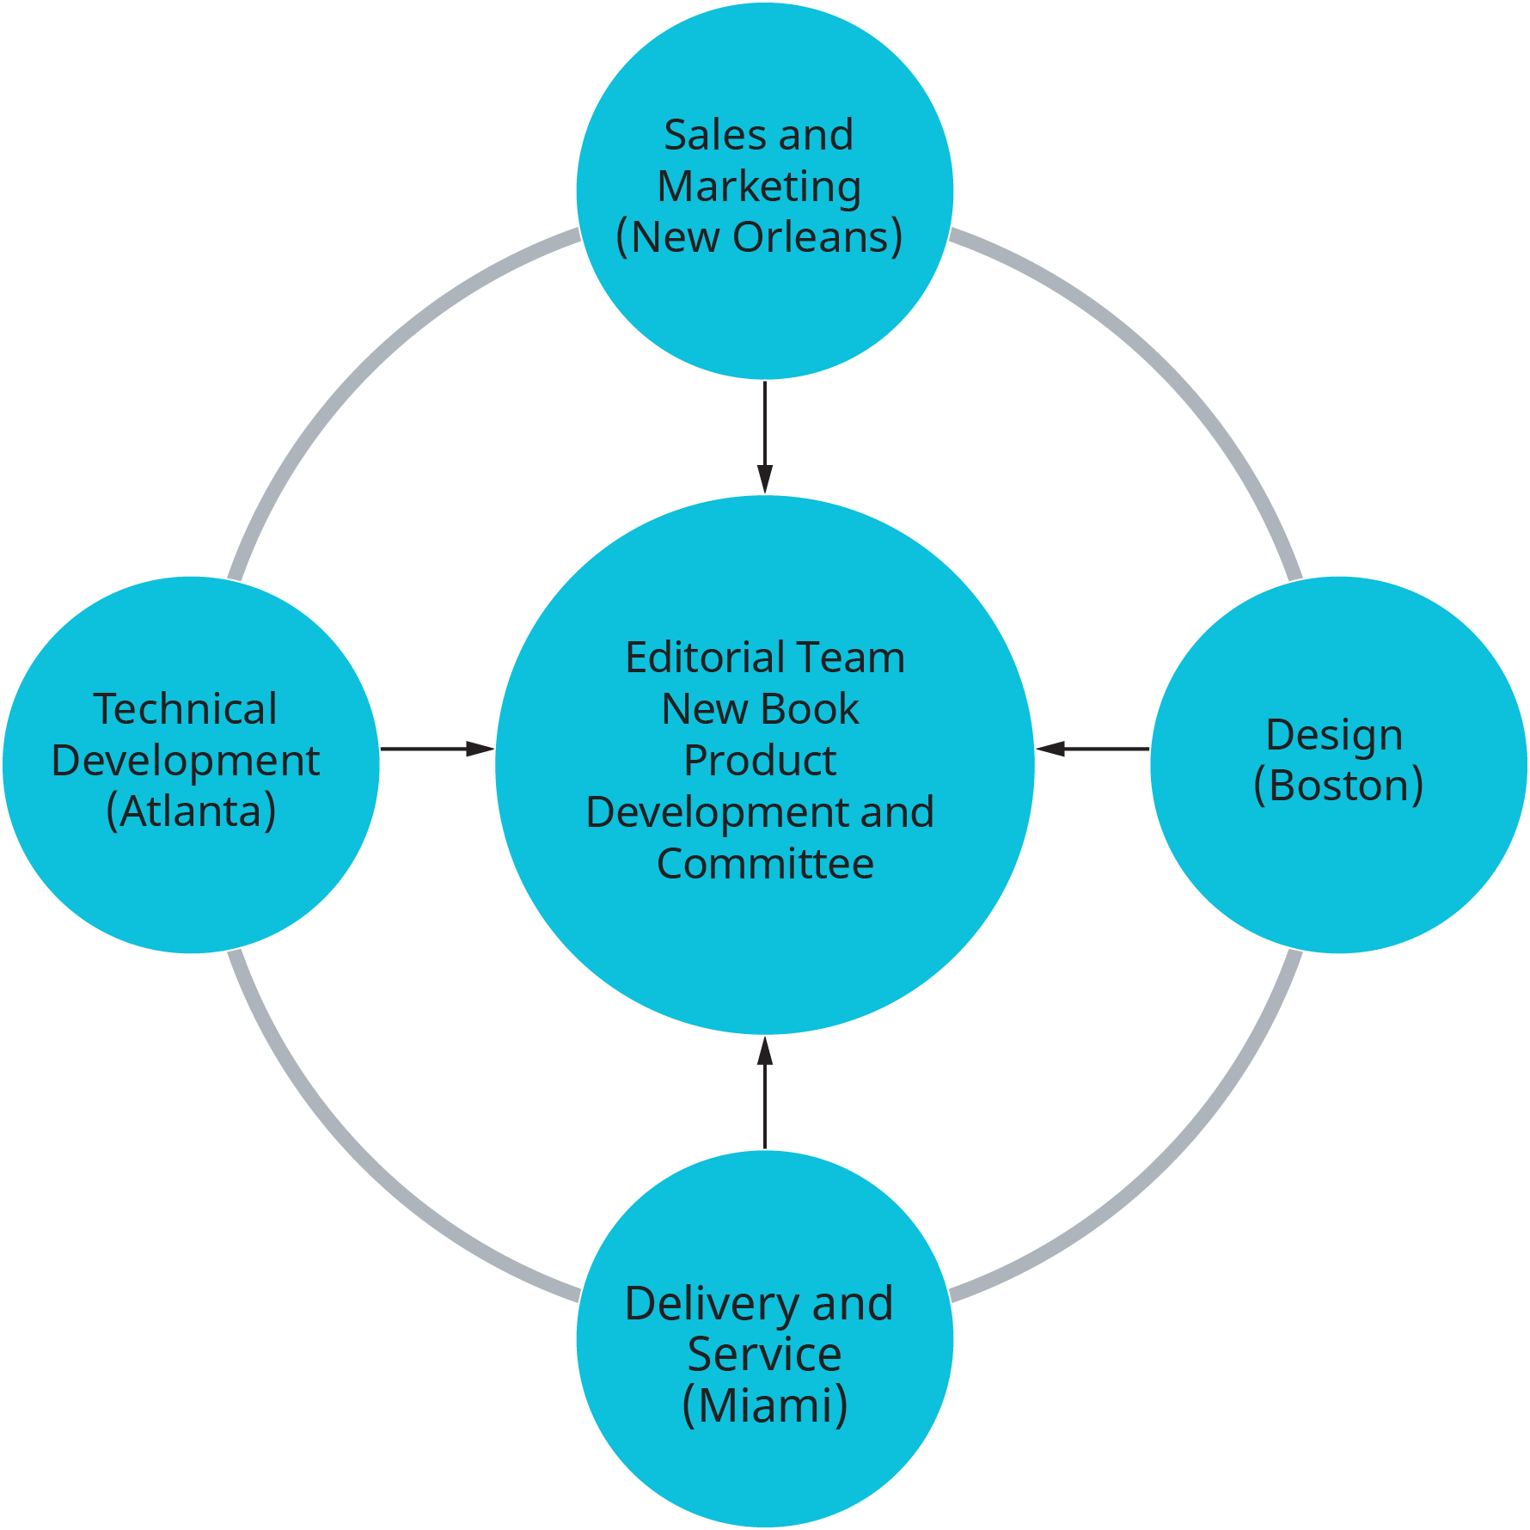
8.2 External Environments and Internal Structures IX
Virtual Structure
Notes:
Virtual structures and organizations emerged in the 1990s as a response to requiring more flexibility, solution-based tasks on demand, fewer geographical constraints, and accessibility to dispersed expertise (Onley, 2015). Virtual structures are depicted in Figure 8.2.8. Related to so-called modular and digital organizations, virtual structures are dependent on information communication technologies (ICTs).

Slide 13
8.3 Organizational Culture I
What Is Organizational Culture?
Organizational culture refers to a system of shared assumptions, values, and beliefs that show people what is appropriate and inappropriate behavior (Chatman & Eunyoung, 2003; Kerr & Slocum, 2005).
Notes:
These values have a strong influence on employee behavior as well as organizational performance. In fact, the term organizational culture was made popular in the 1980s when Peters and Waterman’s best-selling book In Search of Excellence made the argument that company success could be attributed to an organizational culture that was decisive, customer-oriented, empowering, and people-oriented.

Slide 14
8.3 Organizational Culture II
Why Does Organizational Culture Matter?
An organization’s culture may be one of its strongest assets or its biggest liability. In fact, it has been argued that organizations that have a rare and hard-to-imitate culture enjoy a competitive advantage (Barney, 1986)
Notes:
In a survey conducted by the management consulting firm Bain & Company in 2007, worldwide business leaders identified corporate culture to be as important as corporate strategy for business success (Hannaway, 1989). This comes as no surprise to leaders of successful businesses, who are quick to attribute their company’s success to their organization’s culture.
Culture, or shared values within the organization, may be related to increased performance. Researchers found a relationship between organizational cultures and company performance, with respect to success indicators such as revenues, sales volume, market share, and stock prices (Kotter & Heskett, 1992; Marcoulides & heck, 1993)

Slide 15
8.3 Organizational Culture III
Levels of Organizational Culture
Organizational culture consists of some aspects that are relatively more visible, as well as aspects that may lie below one’s conscious awareness. Organizational culture can be thought of as consisting of three interrelated levels (Schein, 1992).
Notes:
At the deepest level, below our awareness, lie basic assumptions. These assumptions are taken for granted and reflect beliefs about human nature and reality. At the second level, values exist. Values are shared principles, standards, and goals. Finally, at the surface, we have artifacts, or visible, tangible aspects of organizational culture.

Slide 16
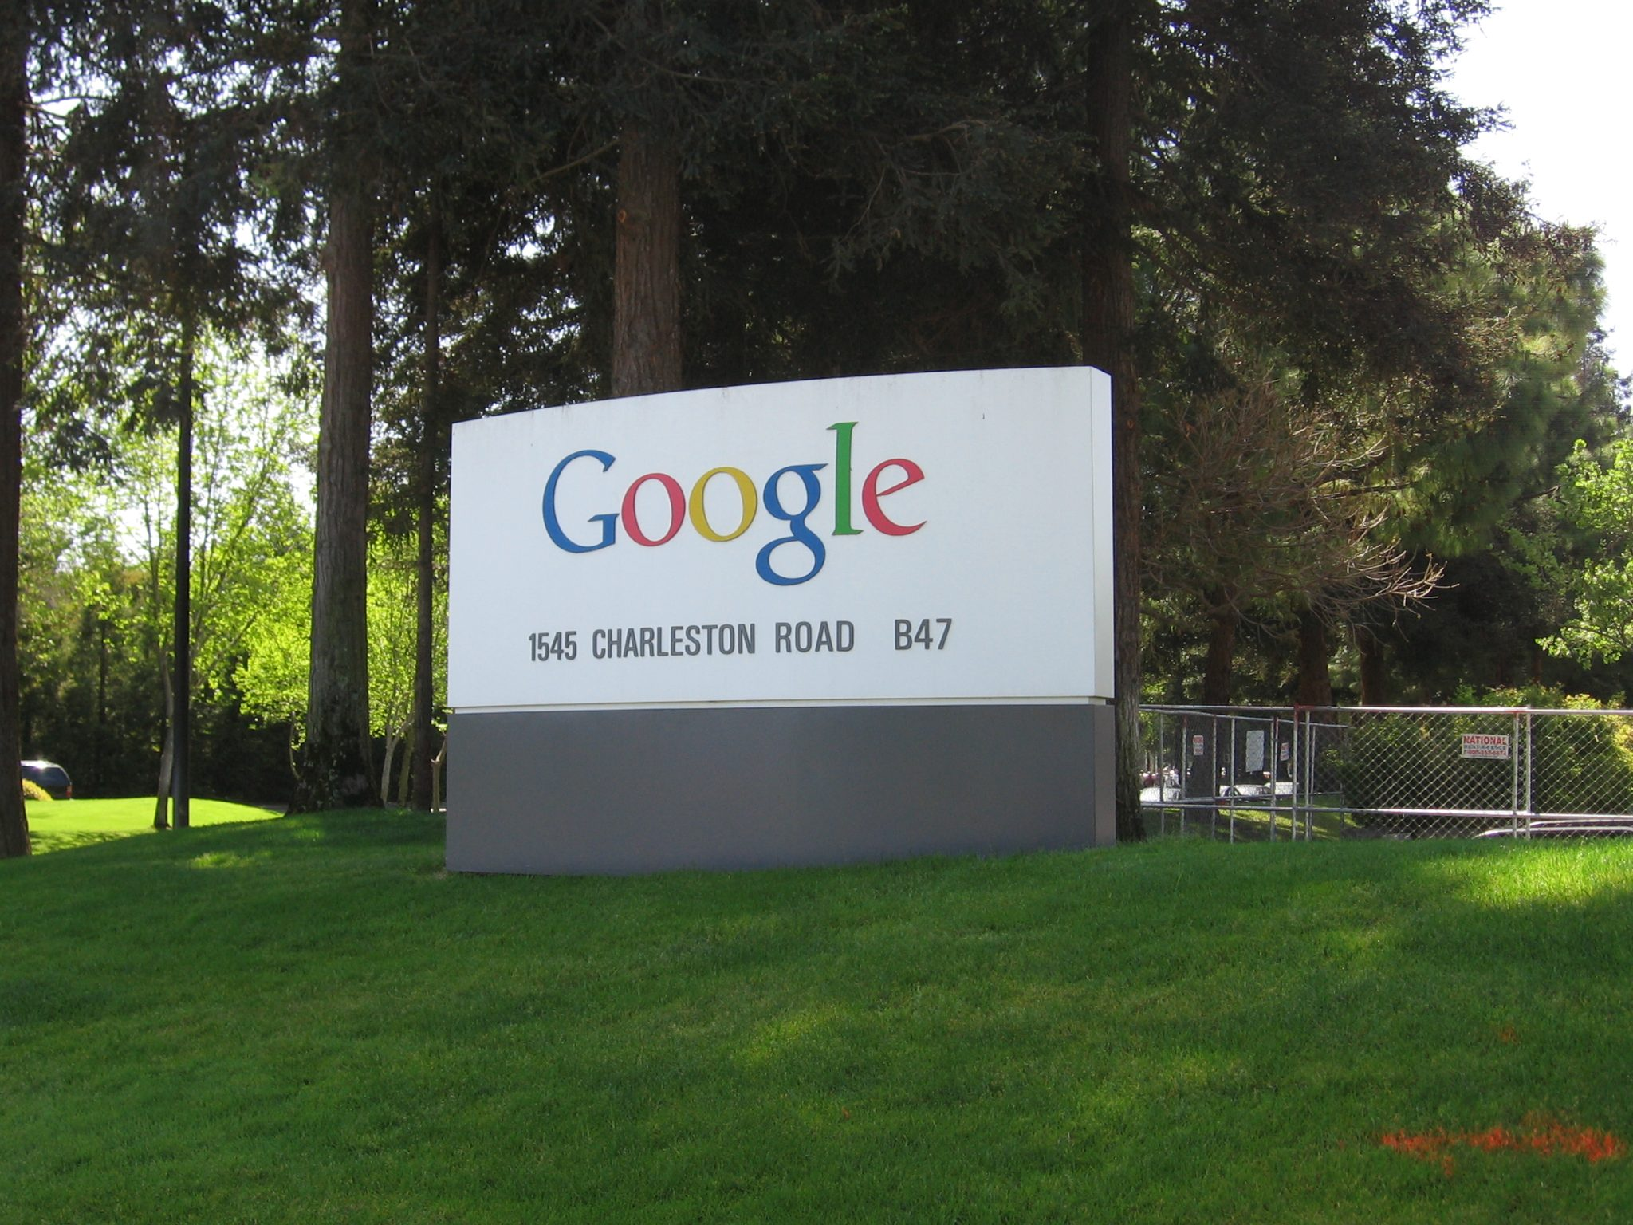
8.4 Case in Point: Google Creates Unique Culture
Google (NASDAQ: GOOG) is one of the best-known and most admired companies around the world, so much so that “googling” is the term many use to refer to searching information on the Web. What started out as a student project by two Stanford University graduates—Larry Page and Sergey Brin—in 1996, Google became the most frequently used Web search engine on the Internet with 1 billion searches per day in 2009, as well as other innovative applications such as Gmail, Google Earth, Google Maps, and Picasa.
Notes:
Google grew from 10 employees working in a garage in Palo Alto to 10,000 employees operating around the world by 2009. What is the formula behind this success?
Google strives to operate based on solid principles that may be traced back to its founders. In a world crowded with search engines, they were probably the first company that put users first. Their mission statement summarizes their commitment to end-user needs: “To organize the world’s information and to make it universally accessible and useful.” While other companies were focused on marketing their sites and increasing advertising revenues, Google stripped the search page of all distractions and presented users with a blank page consisting only of a company logo and a search box

Slide 17
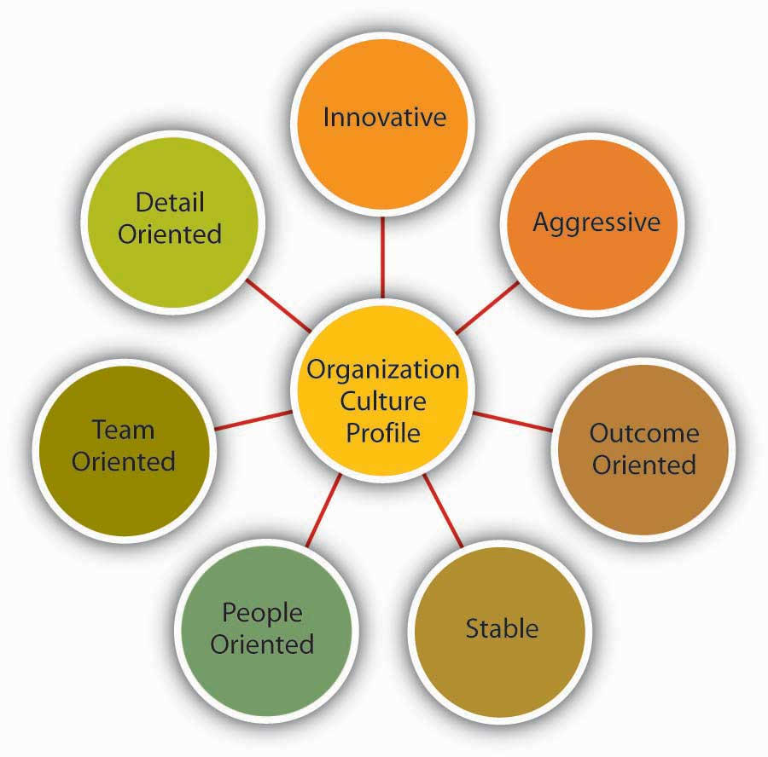
8.5 Measuring Organizational Culture I
Dimensions of Culture
Notes:
Which values characterize an organization’s culture? Even though culture may not be immediately observable, identifying a set of values that might be used to describe an organization’s culture helps us identify, measure, and manage culture more effectively. For this purpose, several researchers have proposed various culture typologies. One typology that has received a lot of research attention is the Organizational Culture Profile (OCP) where culture is represented by seven distinct values (Chatman & Jehn, 1991; O’Reilly, et. al., 1991).
According to the OCP framework, companies that have innovative cultures are flexible, adaptable, and experiment with new ideas. These companies are characterized by a flat hierarchy and titles and other status distinctions tend to be downplayed.
Companies with aggressive cultures value competitiveness and outperforming competitors; by emphasizing this, they often fall short in corporate social responsibility.
The OCP framework describes outcome-oriented cultures as those that emphasize achievement, results, and action as important values. A good example of an outcome-oriented culture may be the electronics retailer Best Buy.
Stable cultures are predictable, rule-oriented, and bureaucratic. When the environment is stable and certain, these cultures may help the organization to be effective by providing stable and constant levels of output (Westrum, 2004).
People-oriented cultures value fairness, supportiveness, and respecting individual rights. In these organizations, there is a greater emphasis on and expectation of treating people with respect and dignity (Erdogan, et. al., 2006).
Companies with a team-oriented culture are collaborative and emphasize cooperation among employees.
Organizations with a detail-oriented culture are characterized in the OCP framework as emphasizing precision and paying attention to details. Such a culture gives a competitive advantage to companies in the hospitality industry by helping them differentiate themselves from others.

Slide 18
8.5 Measuring Organizational Culture II
Strength of Culture
A strong culture is one that is shared by organizational members (Arogyaswamy & Byles, 1987; Chatman & Eunyoung, 2003)).—that is, a culture in which most employees in the organization show consensus regarding the values of the company.
Notes:
The stronger a company’s culture, the more likely it is to affect the way employees think and behave. For example, cultural values emphasizing customer service will lead to higher-quality customer service if there is widespread agreement among employees on the importance of customer-service-related values (Schneider, et. al., 2002).

Slide 19
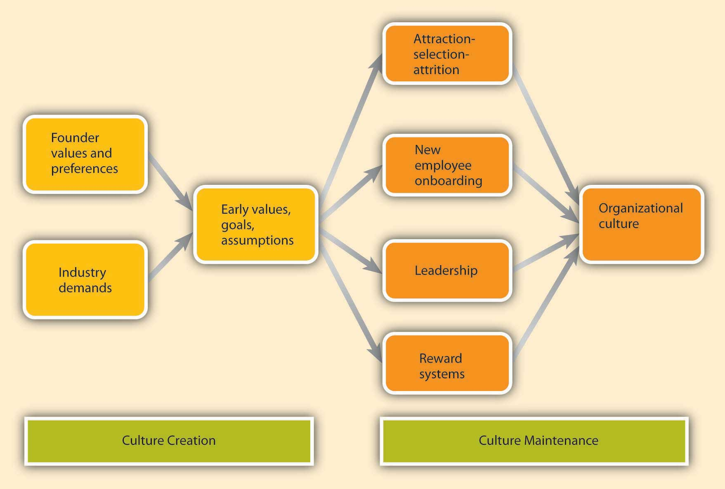
8.6 Creating and Maintaining Organizational Culture I
How Are Cultures Created?
Notes:
Where do cultures come from? Culture is considered to be one of the most difficult things to change in an organization, so understanding this question is important in understanding how to create change . An organization’s culture is shaped as the organization faces external and internal challenges and learns how to deal with them. When the organization’s way of doing business provides a successful adaptation to environmental challenges and ensures success, those values are retained. These values and ways of doing business are taught to new members as the way to do business (Schein, 1992).
The factors that are most important in the creation of an organization’s culture include founder and leaders’ values, preferences, and industry demands.

Slide 20
8.6 Creating and Maintaining Organizational Culture II
Signs of Organizational Culture
How do you find out about a company’s culture?
As mentioned, culture influences the way members of the organization think, behave, and interact with one another. Thus, one way of finding out about a company’s culture is by observing employees or interviewing them. At the same time, culture manifests itself in some visible aspects of the organization’s environment. In this section, we discuss five ways in which culture shows itself to observers and employees.

Slide 21
8.7 Creating a Culture of Diversity I
What Is Diversity in the Workplace?
Leaders who oversee a diverse workforce may find certain advantages and challenges in their jobs. Until the 1950s and 1960s, diversity was not considered an issue. In general, people were hired based on their gender, race, social status, and religion.
Notes:
Women were often asked to leave their jobs if they married or became pregnant. No accommodation was made for disability except by special arrangement. Fast-forward to the twenty-first century, and diversity in the workplace is not just a matter of ethics. Diversity is required by law and is a recommended strategy. Diversity is required by law and is a recommended strategy. In the US, Federally protected classes include race, colour, religion or creed, national origin or ancestry, gender, age, disability, veteran status, and, in two cases, genetic information

Slide 22
8.7 Creating a Culture of Diversity II
Advantages of Employee Diversity
Here are some ways that diversity can positively impact an organization:
Diversity enhances creativity. People from different places, ethnicities, and lifestyles can bring fresh ideas to an older corporation.
Diversity enhances image. Today’s marketplace is diverse; so, too, are customers. When a company can present itself as diverse, clients and buyers respond positively.
Diversity improves outreach. Employees from different parts of the world or different communities can help a corporation to understand and reach out to new markets.
Diversity improves morale. When employees of all backgrounds and abilities feel valued, they are more likely to be loyal, engaged, and productive. Employees are also more likely to feel a sense of pride and belonging when they are associated with an employer that clearly cares about the well-being of all.
Notes:
First, diversity builds resilience. Enduring systems comprise a broad variety of agents, which behave and respond to external stimuli in varying ways. As a result, a challenge to the system is less likely to break it.
Second, diversity is the basis of adaptiveness. Diversity of problem-solving heuristics and behavior permits a system to evolve and learn from experience. Internal variety—diversity—provides the grist for the system to test ideas and actions and select the most effective in each environment.
When a workplace employs only people of similar background, education, and lifestyle, it’s easy for employees to reinforce one another’s preconceptions and prejudices. When people of different cultures and backgrounds are valued and heard, however, new ideas and opportunities emerge.

Slide 23
8.8 Gender and Sexual Orientation I
Gender
Increasingly more women are entering the workforce (U.S. Department of Labor, Bureau of Labor Statistics, 2017). This is true in Canada and the United States, with both countries having very similar statistics. In 2018, according to the World Bank (2019), the participation rate of women aged 15 and above in the Canadian labor force was 61% and that of men was 70%. At the same time, 59% of women were part-time workers.
Notes:
In the United States, the labor force participation rate of women aged 15 and above in 2018 was 56%, and men’s participation rate was 68%; 59% of women aged 15 and above worked part-time (U.S. Bureau of Labor Statistics, 2019).

Slide 24
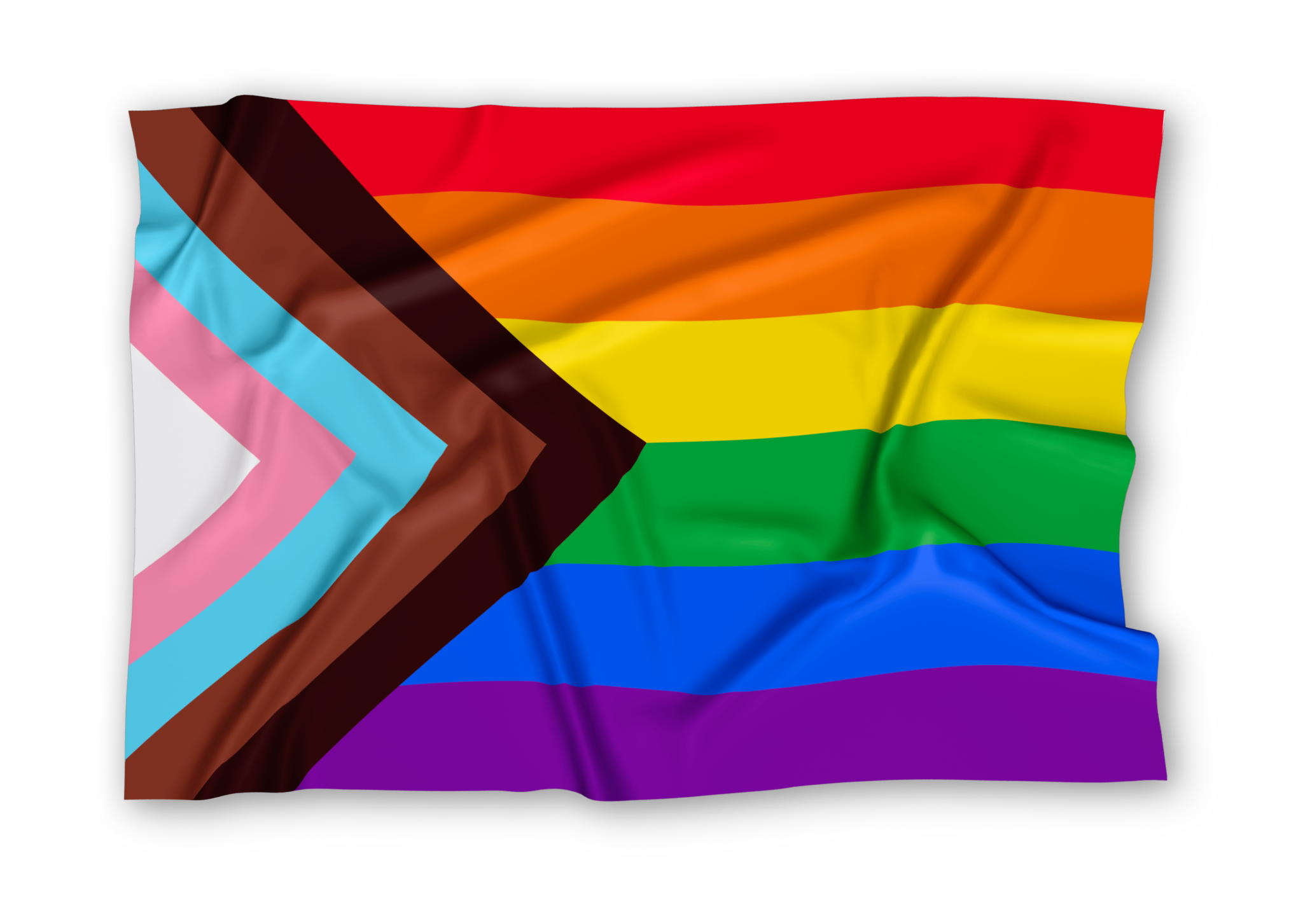
8.8 Gender and Sexual Orientation II
Sexual Orientation and Gender Identity
Sexual orientation diversity is increasing in the workforce. In June, 2020, the US Supreme Court ruled that the Civil Rights Act prohibits discrimination based on sexual orientation and gender identity to help ensure individuals cannot be discriminated against for employment or fired for their sexual orientation, gender identity, or gender expression (Ragins et al., 2003),
Notes:
however lesbian, gay, bisexual and transgender, queer/questioning and other (LGBTQ+) employees, still face other types of discrimination inside and outside of the workplace. In Canada, there is an anti-discrimination measure in the Human Rights’ Act that also prohibits discrimination based on gender and sexual orientation, including wage discrepancies.

Slide 25
8.9 Case in Point: Uber Pays the Price
Uber revolutionized the taxi industry and the way people commute. With the simple mission “to bring transportation—for everyone, everywhere,” today Uber has reached a valuation of around $70 billion and claimed a market share high of almost 90% in 2015. However, in June 2017 Uber experienced a series of bad press regarding an alleged culture of sexual harassment, which is what most experts believe caused their market share to fall to 75%.
Notes:
In February of 2017 a former software engineer, Susan Fowler, wrote a lengthy post on her website regarding her experience of being harassed by a manager who was not disciplined by human resources for his behavior. In her post, Fowler wrote that Uber’s HR department and members of upper management told her that because it was the man’s first offense, they would only give him a warning. During her meeting with HR about the incident, Fowler was also advised that she should transfer to another department within the organization.

Slide 26
8.10 Developing Your Personal Skills: Learning to Fit In I
Before You Join
How do you find out about a company’s culture before you join? Here are several tips that will allow you to more accurately gauge the culture of a company you are interviewing with.
First, do your research
Second, observe the physical environment
Third, read between the lines.
Fourth, reflect on how you are treated. Fifth, ask questions
Finally, listen to your gut.
(Daniel & Brandon, 2006; Sacks, 2005).
Notes:
First, do your research. Talking to friends and family members who are familiar with the company, doing an online search for news articles about the company, browsing the company’s Web site, and reading its mission statement would be a good start.
Second, observe the physical environment. Do people work in cubicles or in offices? What is the dress code? What is the building structure? Do employees look happy, tired, or stressed? The answers to these questions are all pieces of the puzzle.
Third, read between the lines. For example, the absence of a lengthy employee handbook or detailed procedures might mean that the company is more flexible and less bureaucratic.
Fourth, reflect on how you are treated. The recruitment process is your first connection to the company. Were you treated with respect? Do they maintain contact with you or are you being ignored for long stretches at a time?
Fifth, ask questions. What happened to the previous incumbent of this job? What does it take to be successful in this firm? What would their ideal candidate for the job look like? The answers to these questions will reveal a lot about the way they do business.
Finally, listen to your gut. Your feelings about the place in general, and your future manager and coworkers in particular, are important signs that you should not ignore (Daniel & Brandon, 2006; Sacks, 2005).

Slide 27
8.10 Developing Your Personal Skills: Learning to Fit In II
You’ve Got a New Job! Now How Do You Get on Board?
Gather information
Manage your first impression.
Invest in relationship development
Seek feedback
Show success early on
Notes:
Gather information. Try to find as much about the company and the job as you can before your first day. After you start working, be a good observer, gather information, and read as much as you can to understand your job and the company.
Manage your first impression. First impressions may endure, so make sure that you dress properly, are friendly, and communicate your excitement to be a part of the team. Be on your best behavior!
Invest in relationship development. The relationships you develop with your manager and with coworkers will be essential for you to adjust to your new job. Take the time to strike up conversations with them.
Seek feedback. Ask your manager or coworkers how well you are doing and whether you are meeting expectations. Listen to what they are telling you and listen to what they are not saying.
Show success early on. To gain the trust of your new manager and colleagues, you may want to establish a history of success early. Volunteer for high-profile projects where you will be able to demonstrate your skills.

Slide 28
8.11 Key Terms I
Aggressive cultures value competitiveness and outperforming competitors.
Counterculture is a group with shared values and beliefs that are substantially different or even directly opposed to those of the overall organizational culture.
Divisional structure is a type of organization design based on many functional departments grouped under a division head. Each functional group in a division has its own marketing, sales, accounting, manufacturing, and production team.
Detail-oriented cultures emphasize precision and paying attention to detail.
Functional structure is type of organization design based on departments and expertise areas, such as R&D (research & development), production, accounting, and human resources.
Formal orientation program indoctrinates new employees to the company culture, as well as introducing them to their new jobs and colleagues.
Geographic structure is a type of organization design based on locations of customers that a company serves.
Innovative cultures are flexible, adaptable, and experiment with new ideas.

Slide 29
8.11 Key Terms II
Matrix structure is a type of organization design around vertical and horizontal team-based structures where individuals in the team may report to multiple leaders.
Macro, General, or External environment is essentially the big picture world in which an organization exists, consisting of political, economic, social, technological, legal and environmental factors that affect the business, but over which leaders have very little if any control.
Mentor is a trusted person who provides an employee with advice and support regarding career-related matters.
Mission statement is a statement of purpose, describing who the company is and what it does.
Networked team structure is a type of organization design based on horizontal teams that are part of an informal, flexible and decentralized network rather than hierarchical lines of authority.
Outcome-oriented cultures emphasize achievement, results, and action as important values.
Onboarding refers to the process through which new employees learn the attitudes, knowledge, skills, and behaviors required to function effectively within an organization.

Slide 30
8.11 Key Terms III
People-oriented cultures value fairness, supportiveness, respecting individual rights and dignity.
Rituals are repetitive activities within an organization that help teach corporate values, increase motivation and morale, and create identification with the organization.
Stable cultures are predictable, rule-oriented, and bureaucratic.
Strong cultures consist of a majority of employees in the organization showing consensus regarding the values of the company.
Subcultures are cultures that emerge within different departments, branches, or geographic locations.
Team-oriented cultures are collaborative and emphasize cooperation among employees.
Virtual structure is a type of organization design considered boundaryless due to its dependence on information communication technologies (ICTs), where the headquarters may be the only part of a stable organizational base due to structuring around virtual connection and possibly outsourced tasks, positions, and projects.
Values are shared principles, standards, and goals.

Slide 31
1.1 Introduction to Principles of Leadership and Management
A manager’s primary challenge is to solve problems creatively, and you should view management as “the art of getting things done through the efforts of other people”
Notes:
Interestingly, if you look up the definition of a leader, you will find that many individuals and organizations use the same basic description as that of a manager – but we will discuss that more as we move through the chapter and the book as a whole.

