Slide 1
Principles of Leadership & Management
CHAPTER 7: GOALS & MOTIVATIONAL
LEADERSHIP
Unless otherwise noted, this work is licensed under a Creative Commons Attribution-NonCommercial-ShareAlike 4.0 International (CC BY-NC-SA 4.0) license. Feel free to use, modify, reuse or redistribute any portion of this presentation.

Slide 2
Learning Outcomes
Upon successful completion of this chapter, you will be able to:
Appraise the nature of goals and objectives and why they are important.
Determine how our thinking about goals and objectives has evolved.
Analyze what characterizes good goals and objectives.
Apply the roles of goals and objectives in employee performance reviews.
Determine relationships among economic, social, and environmental goals and objectives.
Develop and manage your own goals and objectives.
Compare need-based theories of motivation with process-based theories of motivation.
Describe how fairness perceptions are determined and their consequences.
Assess how performance appraisals can be used in a motivational way.
Analyze how to apply organizational rewards in a motivational way.
Develop your personal motivation skills.

Slide 3
7.1 Case in Point: Nucor Aligns Company Goals With Employee Goals
Manufacturing steel is not a glamorous job. The industry is beset by many problems, and more than 40 steel manufacturers have filed for bankruptcy in recent years. Most young employees do not view working at a steel mill as their dream job.
Notes:
Yet, one company distinguished itself from all the rest by remaining profitable for over 130 quarters and by providing an over 350% return on investment (ROI) to shareholders. The company is clearly doing well by every financial metric available and is the most profitable in its industry.
How do they achieve these amazing results? For one thing, every one of Nucor Corporation’s (NYSE: NUE) 12,000 employees acts like an owner of the company. The overarching goal is “take care of our customers.” Employees are encouraged to fix the things they see as wrong and have real power on their jobs. When there is a breakdown in a plant, a supervisor does not have to ask employees to work overtime; employees volunteer for it. In fact, the company is famous for its decentralized structure and for pushing authority and responsibility down to lower levels in the hierarchy. Tasks that previously belonged to management are performed by line workers. Management listens to lower level employees and routinely implements their new ideas.

Slide 4
7.2 The Nature of Goals and Objectives I
What Are Goals and Objectives?
Goals and objectives provide the foundation for measurement. While the terms are often used interchangeably, goals are outcome statements that define what an organization is trying to accomplish, both programmatically and organizationally.
Notes:
Goals are usually a collection of related programs, a reflection of major actions of the organization, and provide rallying points for leaders. For example, Wal-Mart might state a financial goal of growing its revenues 20% per year or have a goal of growing the international parts of its empire. Try to think of each goal as a large umbrella with several spokes coming out from the center. The umbrella itself is a goal.
In contrast to goals, objectives are very precise, time-based, measurable actions that support the completion of a goal – you have likely heard of SMART goals. Objectives typically must:
be related directly to the goal
be clear, concise, and understandable
be stated in terms of results
begin with an action verb
specify a date for accomplishment
be measurable

Slide 5
7.2 The Nature of Goals and Objectives II
Goals and Objectives
One of the major challenges is that goals and objectives is that they are often not tied to strategy, and ultimately to vision and mission. Instead, you may often see a laundry list of goals and objectives that lack any larger organizing logic.
Broadly speaking, goals and objectives serve to:
Gauge and report performance
Improve performance
Align effort
Manage accountabilities
Notes:
Or the organization may have adopted boilerplate versions of nonfinancial measurement frameworks such as Kaplan and Norton’s Balanced Scorecard, Accenture’s Performance Prism, or Skandia’s Intellectual Capital Navigator (Ittner & Larcker, 2003).

Slide 6
7.2 The Nature of Goals and Objectives III
Goals, Objectives, and Planning
Planning typically starts with a vision and a mission. Then leaders develop a strategy for realizing the vision and mission, and must communicate this well; their success and progress in achieving vision and mission will be indicated by how well the underlying goals and objectives are achieved.
Notes:
A vision statement usually describes some broad set of goals—what the organization aspires to look like in the future. Mission statements too have stated goals—what the organization aspires to be for its stakeholders. For instance, Mars, Inc., the global food giant, sets out five mission statement goals in the areas of quality, responsibility, mutuality, efficiency, and freedom. Thus, goals are typically set for the organization as a whole and set the stage for a hierarchy of increasingly specific and narrowly set goals and objectives.

Slide 7
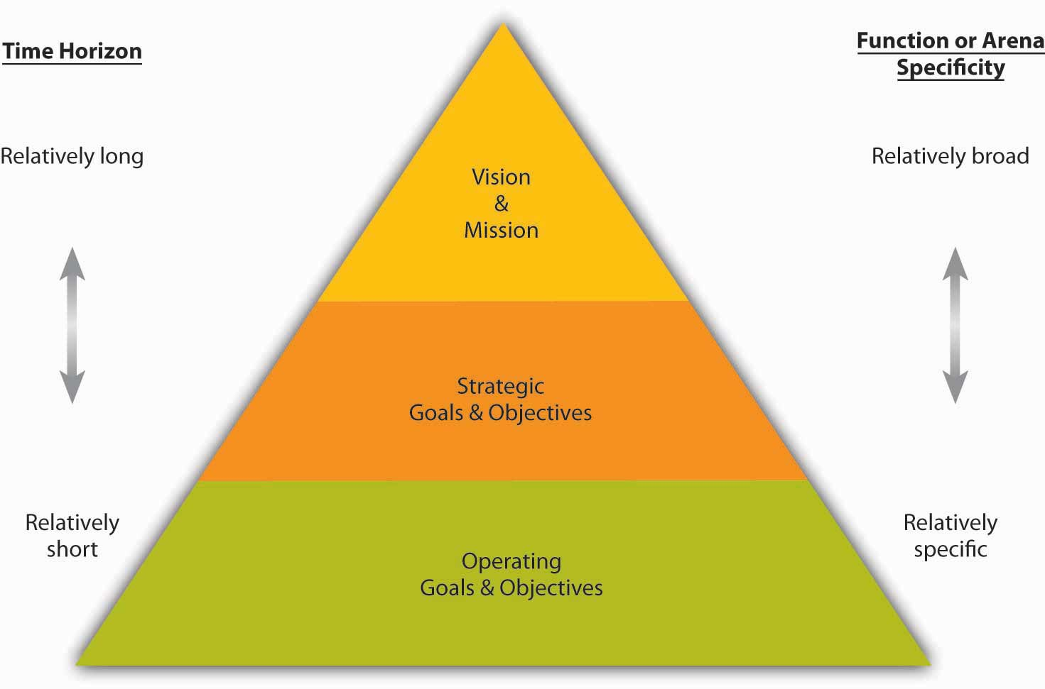
7.2 The Nature of Goals and Objectives IV
Notes:
goals and objectives can provide a form of control since they create a feedback opportunity regarding how well or how poorly the organization executes its strategy. Goals and objectives also are a basis for reward systems and can align interests and accountability within and across business units. For instance, in an organization with several divisions, you can imagine that leaders and employees may behave differently if their compensation and promotion are tied to overall company performance, the performance of their division, or some combination of the two.

Slide 8
7.3 From Management by Objectives to the Balanced Scorecard I
Management by Objectives
MBO is a systematic and organized approach that allows leaders to focus on achievable goals and to attain the best possible results from available resources. MBO aims to increase organizational performance by aligning the subordinate objectives throughout the organization with the overall goals that leadership has set.
Notes:
Ideally, employees get strong input to identify their objectives, time lines for completion, and so on. MBO includes ongoing tracking and feedback in the process to reach objectives.

Slide 9
7.3 From Management by Objectives to the Balanced Scorecard II
MBO is about setting goals and then breaking these down into more specific objectives or key results. MBO involves:
Setting company-wide goals derived from corporate strategy
Determining team- and department-level goals
Collaboratively setting individual-level goals that are aligned with corporate strategy
Developing an action plan
Periodically reviewing performance and revising goals
(Greenwood, 1981; Muczyk & Reimann, 1989; Reif & Bassford, 1975)
Notes:
MBO was first outlined by Peter Drucker in 1954 in The Practice of Management. One of Drucker’s core ideas in MBO was where managers should focus their time and energy. According to Drucker, effective MBO managers focus on the result, not the activity. They delegate tasks by “negotiating a contract of objectives” with their subordinates and by refraining from dictating a detailed road map for implementation.

Slide 10
7.3 From Management by Objectives to the Balanced Scorecard III
The Balanced Scorecard
The Balanced Scorecard is a framework designed to translate an organization’s mission and vision statements and overall business strategy into specific, quantifiable goals and objectives and to monitor the organization’s performance in terms of achieving these goals.
Notes:
In 2001, the Gartner Group estimated that at least 40% of all Fortune 1000 companies were using Balanced Scorecard; however, it can be complex to implement, so it is likely that the format of its usage varies widely across firms.
Developed by Robert Kaplan and David Norton in 1992, the Balanced Scorecard approach to management has gained popularity worldwide since the 1996 release of their text, The Balanced Scorecard: Translating Strategy into Action
Among other criticisms of MBO, one was that it seemed disconnected from a firm’s strategy, and one of Balanced Scorecard’s innovations is explicit attention to vision and strategy in setting goals and objectives

Slide 11
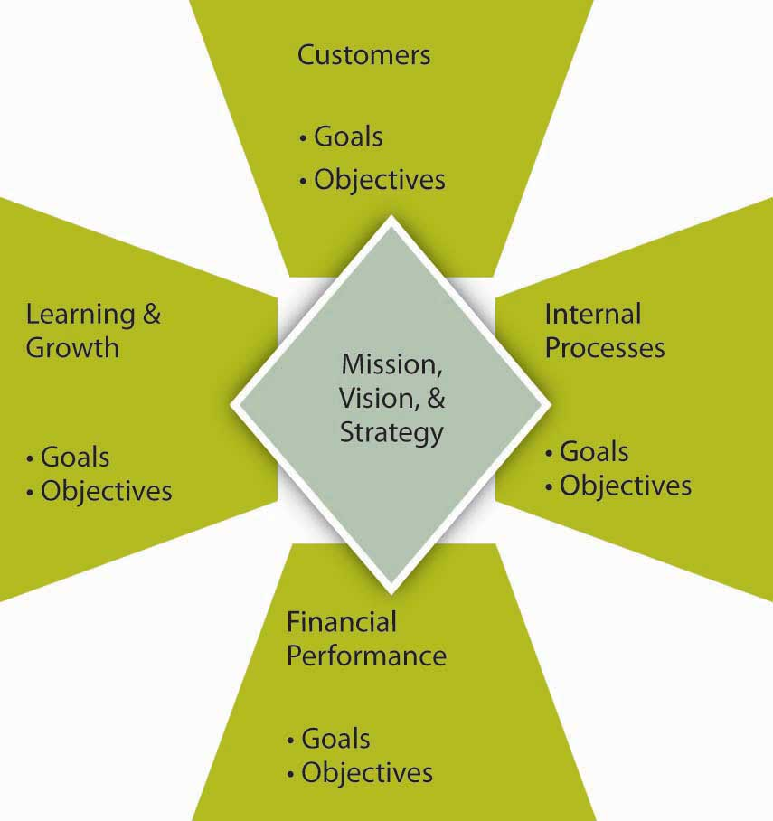
7.3 From Management by Objectives to the Balanced Scorecard IV
The Balanced Scorecard.
Notes:
Balanced Scorecard shares several common features.
First, as summarized in the following figure, it spells out goals and objectives for the subareas of customers, learning and growth, internal processes, and financial performance. The customer area looks at customer satisfaction and retention.
Learning and growth explore the effectiveness of leadership in terms of measures of employee satisfaction and retention and information system performance.
The internal area looks at production and innovation, measuring performance in terms of maximizing profit from current products and following indicators for future productivity.
Finally, financial performance, the most traditionally used performance indicator, includes assessments of measures such as operating costs and return-on-investment.

Slide 12
7.4 Characteristics of Effective Goals and Objectives
Eight Characteristics of Appropriate Goals and Objectives
Less is more
Tie measures to drivers
Don’t just measure the past
Take stakeholders into account
Cascade goals into objectives
Simplify
Adapt
Base objectives on facts.
Notes:
We tend to think that goals and objectives are easy to set, and yet, this intuition is often wrong in the organizational context. Goals and objectives are difficult to set because we might not know what they should cover or because we lay out too many of them with the hope that we are covering all the bases. Similarly, goals and objectives can proliferate in organizations because new ones are set, while old ones are not discarded.
Less is more, fewer is better, and simple rules are the common mantra here. Eisenhardt suggests that organizations should have two to seven key goals, or rules, using her vocabulary (Eisenhardt & Sull, 2001).
Tie Measures to Drivers of Success- One of the key litmus tests for setting goals, objectives, and measures is whether they are linked in some way to the key factors driving an organization’s success or competitive advantage. This means that they must provide a verified path to the achievement of a firm’s strategy, mission, and vision.
Don’t Just Measure the Past- For a variety of reasons it is important to capture past performance. After all, many stakeholders such as investors, owners, customers, and regulators have an interest in how the firm has lived up to it obligations.
Take Stakeholders Into Account- While it is important to track the goals and objectives most relevant to the needs of the business, relevance is subjective.
Cascade Goals Into Objectives- The less-is-more concept can apply to the way that goals cascade into objectives, which cascade into measures. Tying goals and objectives to drivers of success means that vision, mission, and strategy cascade down to goals, and so on.
Simplify- Information overload is a challenge facing all leaders (and students and teachers!), and simplification builds on the idea that leaders can attend to a few things well but many things poorly. Simplification refers both to the use of fewer, not more, metrics, objectives and goals, and the idea that multiple measures should be distilled down into single measures like an index or a simple catch-all question
Adapt- An organization’s circumstances and strategies tend to change over time. Since goals, objectives, and measures need to tie directly to the organization’s strategy, they should be changed as well when the strategy changes.
Base Objectives on Facts- Finally, while goals may sometimes be general (such as performance goals in which leaders simply state, grow profits 10%), the objectives and the metrics that gauge them should be quite specific and set based on facts and information, not intuition.

Slide 13
7.5 Using Goals, Objectives and Feedback in Employee Performance Evaluation I
Goals, Objectives, and Performance Reviews
Since leadership is tasked with accomplishing things through the efforts of others, an important part of your principles of management tool kit is the development and performance evaluation of people. A performance evaluation is a constructive process to acknowledge and provide feedback on an employee’s performance.
Notes:
Goals and objectives are a critical component of effective performance evaluations, so we need to cover the relationship among them briefly in this section. For instance, the example evaluation form needs to have a set of measurable goals and objectives spelled out for each area. Some of these, such as attendance, are more easy to describe and quantify than others, such as knowledge. Moreover, research suggests that individual and organizational performance increase 16% when an evaluation system based on specific goals and objectives is implemented (Rynes et al., 2002).

Slide 14
7.5 Using Goals, Objectives and Feedback in Employee Performance Evaluation II
Role and Limitations of Performance Evaluations
Most organizations conduct employee performance evaluations at least once a year, but they can occur more frequently when there is a clear rationale for doing so—for instance, at the end of a project, at the end of each month, and so on. For example, McKinsey, a leading strategy consulting firm, has managers evaluate employees at the end of every consulting engagement.
Notes:
So, in addition to the annual performance evaluation, consultants can receive up to 20 mini-evaluations in a year. Importantly, the timing should coincide with the needs of the organization and the development needs of the employee.
Performance evaluations and feedback are critical. Organizations are hard-pressed to find good reasons why they can’t dedicate an hour-long meeting at least once a year to ensure the mutual needs of the employee and organization are being met.

Slide 15
7.6 Integrating Goals and Objectives with Corporate Social Responsibility I
Corporate Social Responsibility
The corporate social responsibility (CSR) movement is not new and has been gathering momentum for well over a decade (Crawford & Scaletta, 2005). CSR is about how companies manage their business processes to produce an overall positive effect on society
Notes:
This growth has raised questions—how to define the concept and how to integrate it into the larger body of an organization’s goals and objectives. The Dow Jones Sustainability Index created a commonly accepted definition of CSR: “a business approach that creates long-term shareholder value by embracing opportunities and managing risks deriving from economic, environmental and social developments” (Dyllick, & Muff, 2015)

Slide 16
7.6 Integrating Goals and Objectives with Corporate Social Responsibility II
Specifically, the Dow Jones Sustainability Index looks at competence in five areas:
Strategy
Financial
Customer and Product
Governance and Stakeholder
Human
Notes:
Strategy: Integrating long-term economic, environmental, and social aspects in their business strategies while maintaining global competitiveness and brand reputation.
Financial: Meeting shareholders’ demands for sound financial returns, long-term economic growth, open communication, and transparent financial accounting.
Customer and Product: Fostering loyalty by investing in customer relationship management, and product and service innovation that focuses on technologies and systems, which use financial, natural, and social resources in an efficient, effective, and economic manner over the long term.
Governance and Stakeholder: Setting the highest standards of corporate governance and stakeholder engagement, including corporate codes of conduct and public reporting.
Human: Managing human resources to maintain workforce capabilities and employee satisfaction through best-in-class organizational learning and knowledge management practices and remuneration and benefit programs.

Slide 17
7.6 Integrating Goals and Objectives with Corporate Social Responsibility III
CSR and the Balanced Scorecard
“One of the fundamental opportunities for the CSR movement is how to effectively align consumer and employee values with strategy to generate long-term benefits—a better understanding of precisely with whom, what, when, where, how and why an enterprise makes a profit or surplus. CSR requires more holistic strategic thinking and a wider stakeholder perspective. Because the Balanced Scorecard is a recognized and established management tool, it is well positioned to support a knowledge-building effort to help organizations make their CSR values and visions a reality.
(Crawford & Scaletta, 2005)
Notes:
The Balanced Scorecard enables individuals to make daily decisions based upon values and metrics that can be designed to support these long-term cognizant benefits”

Slide 18
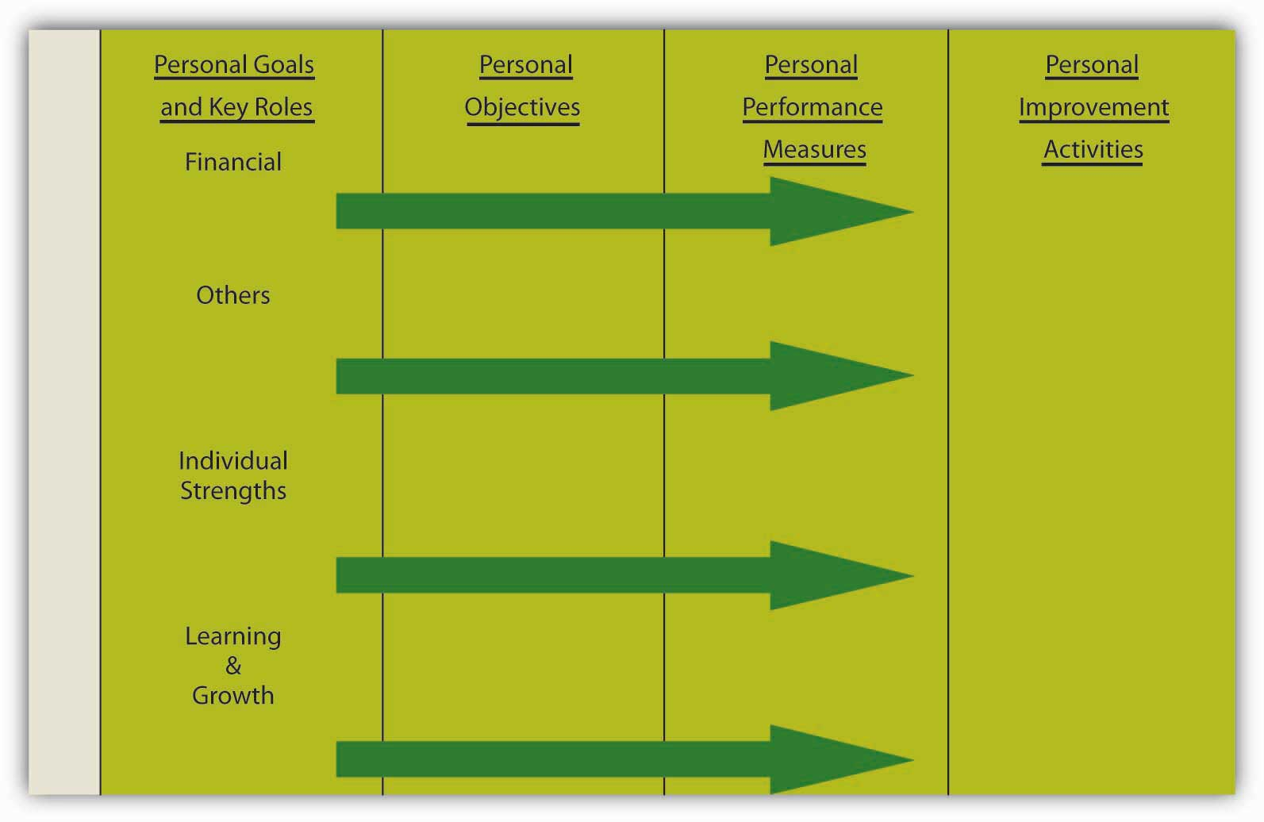
7.7 Your Personal Balanced Scorecard I
Notes:
The Balanced Scorecard, championed by Kaplan and Norton, can be translated into your own individual scorecard, one that helps you achieve your personal and professional goals and objectives. Recall that the scorecard for an organization starts with vision and mission, followed by goals (financial, internal business processes, customer, and learning and growth), which have corresponding objectives, metrics, and tactical activities. When these components are applied to you as an individual, you might see the pieces of the scorecard labeled as shown in this figure.

Slide 19
7.7 Your Personal Balanced Scorecard II
Using SMART Criteria
For personal objectives and performance measures to be most effective, you might try seeing how they measure up to SMART criteria. These characteristics, based on specific, measurable, attainable, realistic, and time bound yield the acronym SMART (Drucker, 1954).
Notes:
Specific- A specific objective has a much greater chance of being accomplished than a general one. To set a specific objective, you must answer the six “W” questions:
Who, What, Where, When, Which, Why.
Measurable- Establish concrete criteria for measuring progress toward the attainment of each objective you set. When you measure your progress, you stay on track, reach your target dates, and experience the exhilaration of achievement that spurs you on to continued effort required to reach your objective.
Attainable- When you identify objectives that are most important to you, you begin to figure out ways you can make them come true. You develop the attitudes, abilities, skills, and financial capacity to reach them.
Realistic- To be realistic, an objective must represent an objective toward which you are both willing and able to work.
TimelyAn objective should be grounded within a time frame. With no time frame tied to it, there’s no sense of urgency. If you want to lose 10 pounds, when do you want to lose it by? “Someday” won’t work. But if you anchor it within a time frame, “by May 1st,” then you’ve set your unconscious mind into motion to begin working on the objective.

Slide 20
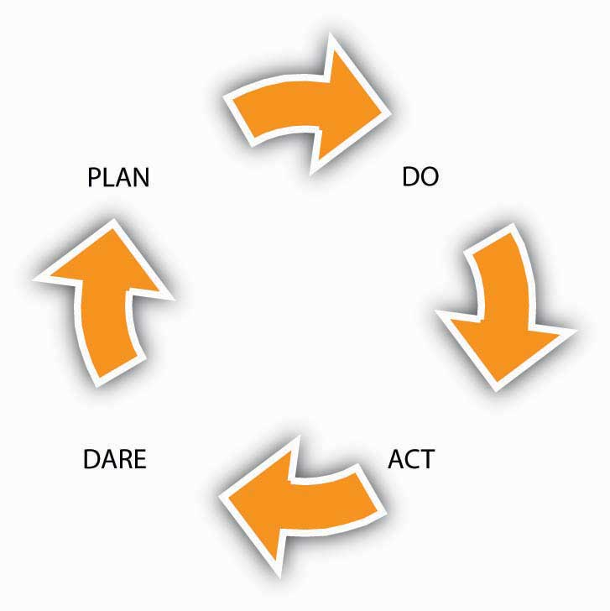
7.7 Your Personal Balanced Scorecard III
Personal Improvement Activities
Notes:
The next step is implementation. One way to think about implementation of your Balanced Scorecard is through the plan-do-act-dare cycle (PDAD cycle), to be followed continuously (Rampersad, 2005). As summarized in the following figure, the PDAD cycle consists of the following four phases: Plan, Do, Act, Dare.
Plan- Formulate or update your scorecard, which focuses on your work as well as on your spare time. This spans vision and mission through personal objectives and performance metrics.
Do- Start with a simple objective from your scorecard with corresponding improvement activity, keeping in mind the priorities that have been identified.
Act- Check whether the improvement activity is working and take action when it is not.
Dare- Accept larger challenges by daring to take on a more difficult objective and corresponding improvement action from your scorecard and get on with it.

Slide 21
7.8 Motivation I
Motivation is defined as “the intention of achieving a goal, leading to goal-directed behavior” (2021). When we refer to someone as being motivated, we mean that the person is trying hard to accomplish a certain task. Motivation is clearly important for someone to perform well.
Notes:
However, motivation alone is not sufficient. Ability—having the skills and knowledge required to perform the job—is also important and is sometimes the key determinant of effectiveness. Finally, environmental factors—having the resources, information, and support one needs to perform well—are also critical to determine performance.
What makes employees willing to “go the extra mile” to provide excellent service, market a company’s products effectively, or achieve the goals set for them? Answering questions like this is of utmost importance to understand and manage the work behavior of our peers, subordinates, and even supervisors. As with many questions involving human beings, the answers are anything but simple. Instead, there are several theories explaining the concept of motivation.

Slide 22
7.8 Motivation II
According to this equation, motivation, ability, and environment are the major influences over employee performance.

Slide 23
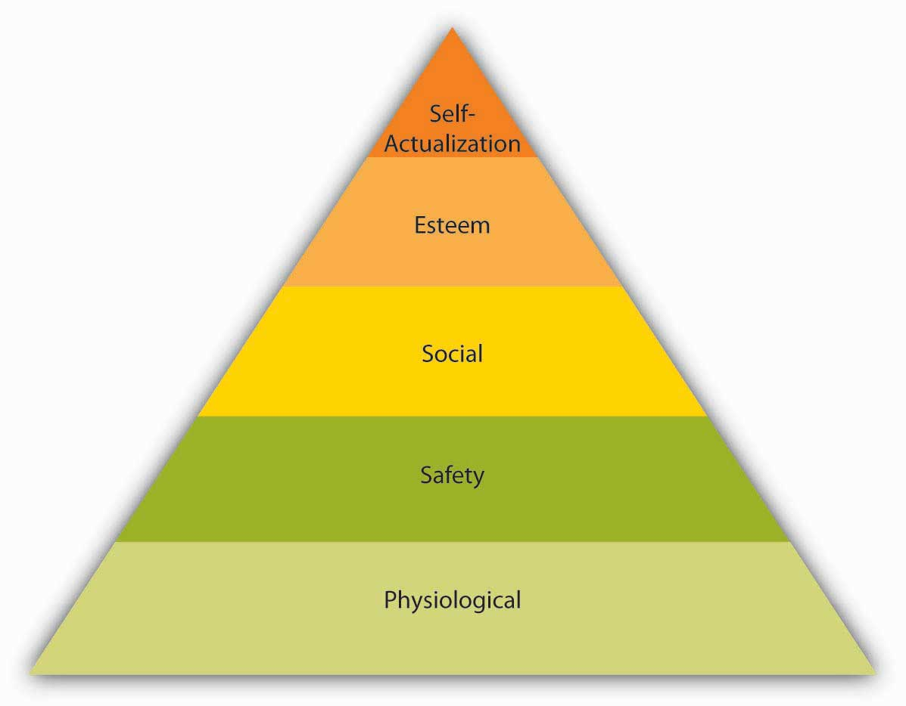
7.9 Need-Based Theories of Motivation I
Maslow’s Hierarchy of Needs.
Notes:
Abraham Maslow is among the most prominent psychologists of the 20th century and the hierarchy of needs, accompanied by the pyramid representing how human needs are ranked, is an image familiar to most business students and managers.
Maslow’s theory is based on a simple premise: Human beings have needs that are hierarchically ranked (Maslow, 1943; Maslow, 1954).
There are some needs that are basic to all human beings, and in their absence, nothing else matters. As we satisfy these basic needs, we start looking to satisfy higher-order needs. Once a lower-level need is satisfied, it no longer serves as a motivator.
The most basic of Maslow’s needs are physiological needs. Physiological needs refer to the need for air, food, and water.
Once physiological needs are satisfied, people tend to become concerned about safety. Are they safe from danger, pain, or an uncertain future?
One level up, social needs refer to the need to bond with other human beings, to be loved, and to form lasting attachments.
The satisfaction of social needs makes esteem needs more salient. Esteem needs refer to the desire to be respected by one’s peers, feeling important, and being appreciated.
Finally, at the highest level of the hierarchy, the need for self-actualization refers to “becoming all you are capable of becoming.” This need manifests itself by acquiring new skills, taking on new challenges, and behaving in a way that will lead to the satisfaction of one’s life goals.

Slide 24
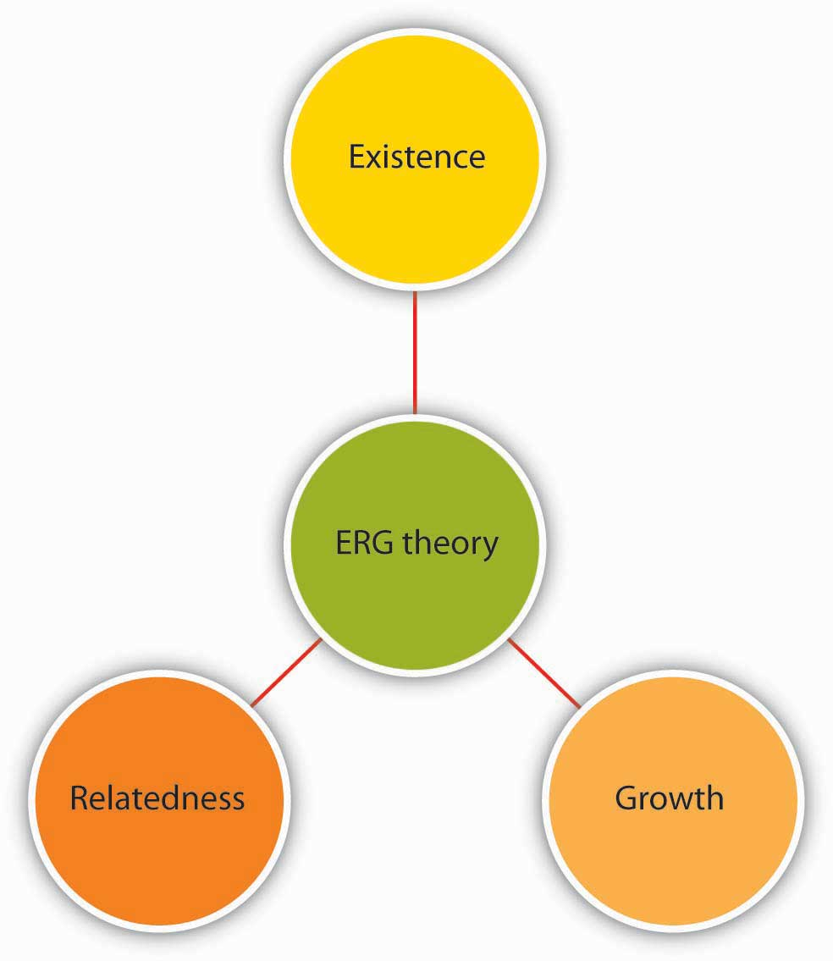
7.9 Need-Based Theories of Motivation II
ERG Theory
Notes:
ERG theory of Clayton Alderfer is a modification of Maslow’s hierarchy of needs (Alderfer, 1969).
Instead of the five needs that are hierarchically organized, Alderfer proposed that basic human needs may be grouped under three categories, namely, Existence, Relatedness, and Growth
Existence need corresponds to Maslow’s physiological and safety needs, relatedness corresponds to social needs, and growth need refers to Maslow’s esteem and self actualization.
ERG theory’s main contribution to the literature is its relaxation of Maslow’s assumptions. For example, ERG theory does not rank needs in any particular order and explicitly recognizes that more than one need may operate at a given time.

Slide 25
7.9 Need-Based Theories of Motivation III
Two-Factor Theory of Motivation
Notes:
Frederick Herzberg approached the question of motivation in a different way. By asking individuals what satisfies them on the job and what dissatisfies them, Herzberg came to the conclusion that aspects of the work environment that satisfy employees are very different from aspects that dissatisfy them (Herzberg, et. al., 1959; Herzberg, 1965). Herzberg labeled factors causing dissatisfaction of workers as “hygiene” factors because these factors were part of the context in which the job was performed, as opposed to the job itself.
Hygiene factors include company policy, supervision and relationships, working conditions, salary and security
In contrast, motivators are factors that are intrinsic to the job, such as achievement, recognition, interesting work, increased responsibilities, advancement, and growth opportunities. According to Herzberg’s research, motivators are the conditions that truly encourage employees to try harder.

Slide 26
7.9 Need-Based Theories of Motivation IV
Acquired Needs Theory
Among the need-based approaches to motivation, Douglas McClelland’s acquired needs theory is the one that has received the greatest amount of support. According to this theory, individuals acquire three types of needs as a result of their life experiences. These needs are need for achievement, need for affiliation, and need for power. All individuals possess a combination of these needs.
Notes:
Those who have high need for achievement have a strong need to be successful. A worker who derives great satisfaction from meeting deadlines, coming up with brilliant ideas, and planning his or her next career move may be high in need for achievement. Individuals high on need for achievement are well suited to positions such as sales where there are explicit goals, feedback is immediately available, and their effort often leads to success (Harrell & Stahl, 1981; Trevis & Certo, 2005; Turban & Keon, 1993).

Slide 27
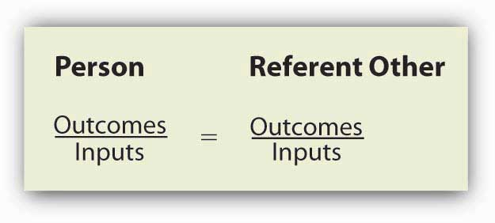
7.10 Process-Based Theories I
Equity Theory
Notes:
According to this theory, individuals are motivated by a sense of fairness in their interactions. Moreover, our sense of fairness is a result of the social comparisons we make. Specifically, we compare our inputs and outputs with someone else’s inputs and outputs. We perceive fairness if we believe that the input-to-output ratio we are bringing into the situation is similar to the input/output ratio of a comparison person, or a referent. Perceptions of inequity create tension within us and drive us to action that will reduce perceived inequity. This process is illustrated in the Equity Formula.

Slide 28
7.10 Process-Based Theories II
What Are Inputs and Outputs?
Inputs are the contributions the person feels he or she is making to the environment. In the previous example, the hard work Marie was providing, loyalty to the organization, the number of months she has worked there, level of education, training, and her skills may have been relevant inputs. Outputs are the rewards the person feels he or she is receiving from the situation.

Slide 29
7.10 Process-Based Theories III
Fairness Beyond Equity: Procedural and Interactional Justice
Equity theory looks at perceived fairness as a motivator. However, the way equity theory defines fairness is limited to fairness regarding rewards. Starting in the 1970s, researchers of workplace fairness began taking a broader view of justice. Equity theory deals with outcome fairness, and therefore, it is considered to be a distributive justice theory.
Notes:
Distributive justicerefers to the degree to which the outputs received from the organization are fair. Two other types of fairness have been identified: Procedural justice and interactional justice.

Slide 30
7.10 Process-Based Theories IV
Expectancy Theory
Notes:
According to expectancy theory, individual motivation to put forth more or less effort is determined by a rational calculation (Porter & Lawler, 1968; Vroom, 1964). According to this theory, individuals ask themselves three questions.
The first question is whether the person believes that high levels of effort will lead to desired outcomes. This perception is labeled as expectancy.
The second question is the degree to which the person believes that performance is related to secondary outcomes such as rewards. This perception is labeled as instrumentality.
Finally, individuals are also concerned about the value of the rewards awaiting them as a result of performance. The anticipated satisfaction that will result from an outcome is labeled as valence

Slide 31
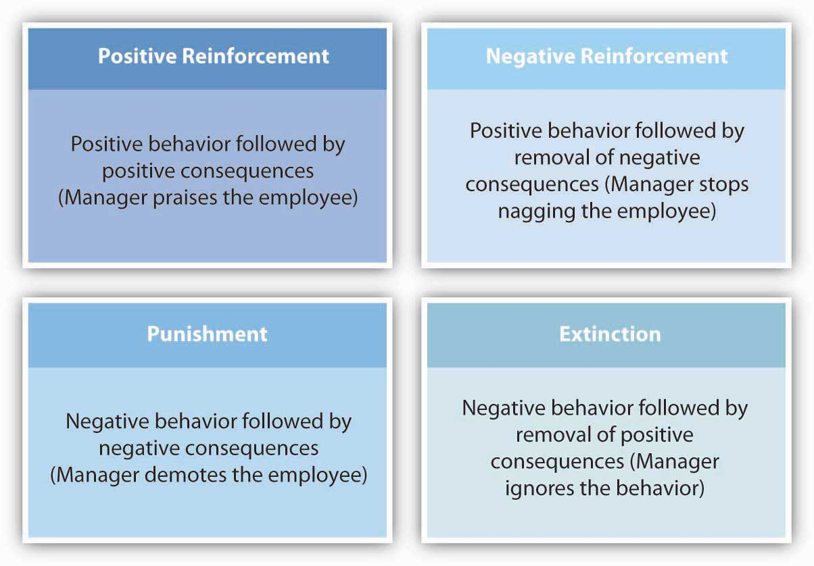
7.10 Process-Based Theories V
Reinforcement Theory
Notes:
Reinforcement theory is based on the work of Ivan Pavlov in behavioral conditioning and the later work B. F. Skinner did on operant conditioning (Skinner, 1953). According to this theory, behavior is a function of its consequences
Reinforcement theory describes four interventions to modify employee behavior. Two of these are methods of increasing the frequency of desired behaviors while the remaining two are methods of reducing the frequency of undesired behaviors.
Positive reinforcement is a method of increasing the desired behavior (Beatty & Schneier, 1975). Positive reinforcement involves making sure that behavior is met with positive consequences.
Negative reinforcement is also used to increase the desired behavior. Negative reinforcement involves removal of unpleasant outcomes once desired behavior is demonstrated.
Extinction occurs when a behavior ceases as a result of receiving no reinforcement. For example, suppose an employee has an annoying habit of forwarding e-mail jokes to everyone in the department, cluttering up people’s in-boxes and distracting them from their work.
Punishment is another method of reducing the frequency of undesirable behaviors. Punishment involves presenting negative consequences following unwanted behaviors.

Slide 32
7.10 Process-Based Theories VI
Job Characteristics Model
Notes:
The job characteristics model is one of the most influential attempts to design jobs to increase their motivational properties (Hackman & Oldham, 1975). Proposed in the 1970s by Hackman and Oldham, the model describes five core job dimensions, leading to three critical psychological states, which lead to work-related outcomes. In this model, shown in the following figure, there are five core job dimensions.
Skill variety refers to the extent to which the job requires the person to use multiple high-level skills.
Task identity refers to the degree to which the person completes a piece of work from start to finish.
Task significance refers to whether the person’s job substantially affects other people’s work, health, or well-being.
Autonomy is the degree to which the person has the freedom to decide how to perform tasks.
Feedback refers to the degree to which the person learns how effective he or she is at work. Feedback may come from other people such as supervisors, peers, subordinates, customers, or from the job.

Slide 33
7.10 Process-Based Theories VII
Goal Setting Theory
Goal setting theory (Locke & Latham, 1990) is one of the most influential and practical theories of motivation. It has been supported in over 1,000 studies with employees, ranging from blue-collar workers to research and development employees, and there is strong evidence that setting goals is related to performance improvements (Ivancevich & McMahon, 1982; Latham & Locke, 2006; Umstot et al., 1976).
Notes:
In fact, according to one estimate, goal setting improves performance between 10% and 25% or more (Pritchard et al., 1988). On the basis of evidence such as this, thousands of companies around the world are using goal setting in some form, including companies such as Coca-Cola, PricewaterhouseCoopers, Nike, Intel, and Microsoft to name a few.

Slide 34
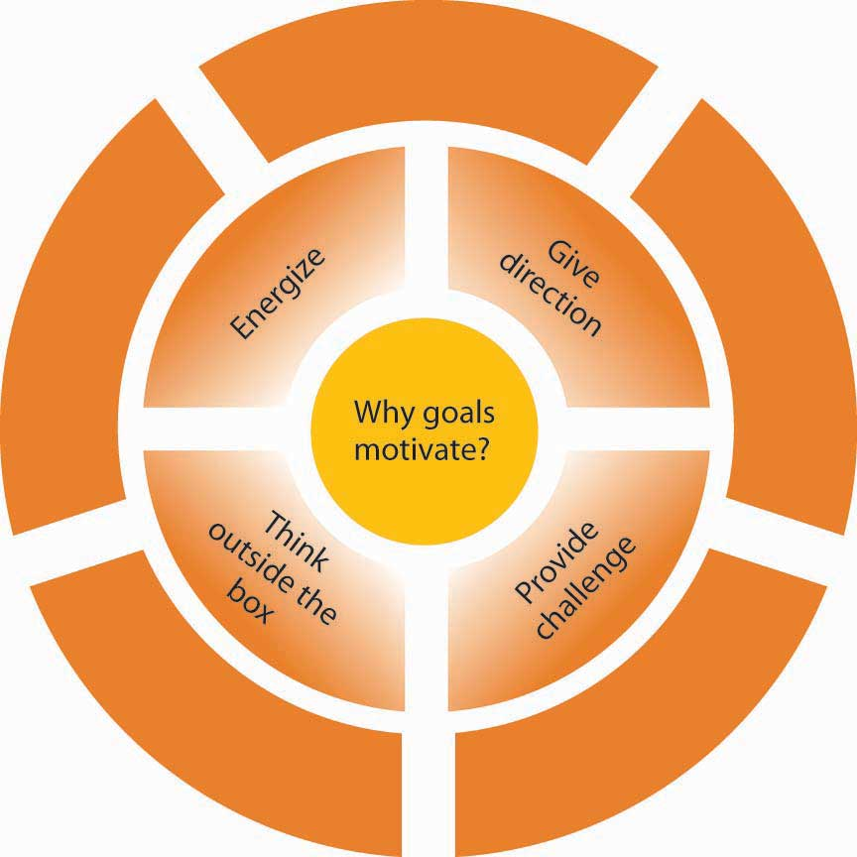
7.10 Process-Based Theories VIII
Why Do SMART Goals Motivate?
There are at least four reasons why goals motivate (Latham, 2004; Seijts & Latham, 2005; Shaw, 2004).
Notes:
First, goals give us direction; therefore, goals should be set carefully. Giving employees goals that are not aligned with company goals will be a problem because goals will direct employee’s energy to a certain end.
Second, goals energize people and tell them not to stop until they reach that point.
Third, having a goal provides a challenge. When people have goals and when they reach them, they feel a sense of accomplishment.
Finally, SMART goals urge people to think outside the box and rethink how they are working. If a goal is substantially difficult, merely working harder will not get you the results.

Slide 35
7.11 Developing Motivation Skills I
Guidelines for Giving Feedback in a Performance Appraisal Meeting
Before the meeting, ask the person to complete a self-appraisal. This is a great way of making sure that employees become active participants in the process and are heard. Complete the performance appraisal form and document your rating using several examples. Be sure that your review covers the entire time since the last review, not just recent events.
Notes:
Handle the logistics. Be sure that you devote sufficient time to each meeting. If you schedule them tightly back to back, you may lose your energy in later meetings. Be sure that the physical location is conducive to a private conversation.
During the meeting, be sure to recognize effective performance through specific praise. Do not start the meeting with a criticism. Starting with positive instances of performance helps establish a better mood and shows that you recognize what the employee is doing right. Give employees opportunities to talk.

Slide 36
7.11 Developing Motivation Skills II
Five Guidelines for Seeking Feedback
Consider seeking regular feedback from your boss.
Be genuine in your desire to learn.
Develop a good relationship with your manager as well as the employees you manage.
Consider finding trustworthy peers who can share information with you regarding your performance.
Be gracious when you receive unfavorable feedback.
Notes:
Consider seeking regular feedback from your boss. This also has the added benefit of signaling to the manager that you care about your performance and want to be successful.
Be genuine in your desire to learn. When seeking feedback, your aim should be improving yourself as opposed to creating the impression that you are a motivated employee. If your manager thinks that you are managing impressions rather than genuinely trying to improve your performance, feedback seeking may hurt you.
Develop a good relationship with your manager as well as the employees you manage. This would have the benefit of giving you more feedback in the first place. It also has the upside of making it easier to ask direct questions about your own performance.
Consider finding trustworthy peers who can share information with you regarding your performance. Your manager is not the only helpful source of feedback.
Be gracious when you receive unfavorable feedback. If you go on the defensive, there may not be a next time. Remember, even if it may not feel like it sometimes, feedback is a gift. You can improve your performance by using feedback constructively. Consider that the negative feedback giver probably risked your goodwill by being honest. Unless there are factual mistakes in the feedback, do not try to convince the person that the feedback is inaccurate.

Slide 37
7.12 Key Terms I
Autonomy is the degree to which the person has the freedom to decide how to perform tasks.
Balanced Scorecard is a focused set of key financial and nonfinancial indicators. These indicators include leading, pacing, and lagging measures.
Benevolents are individuals who give the expectation of something in return.
Corporate social responsibility (CSR) is the manner by which companies manage their business processes to produce an overall positive effect on society.
Continuous schedules describe reinforcement that occurs when rewards are provided following all instances of positive behavior, such as providing a sales commission every time a sale is made.
Distributive justice refers to the degree to which the outputs received from the organization are fair.
Esteem needs refer to the desire to be respected by one’s peers, feeling important, and being appreciated.
ERG theory modifies Maslow’s hierarchy of five needs into three categories that can impact an individual at the same time, namely existence, relatedness and growth.
Existence needs as part of ERG theory correspond with Maslow’s physiological and safety needs.
Equity theory is based on the idea that individuals are motivated by a sense of fairness determined by comparisons; specifically, we compare our inputs and outputs with those of a referent (someone else’s inputs and outputs). Perceptions of inequity create tension within us and drive us to action that will reduce perceived inequity.
Equity sensitivity individuals expect to maintain equitable relationships so experience distress when they feel they are over rewarded or under rewarded.

Slide 38
7.12 Key Terms II
Entitleds who expect to receive a lot without giving much in return.
Expectancy is the perception that high levels of effort will lead to desired outcomes.
Extinction is a method of reducing the frequency of undesired behaviors by ignoring the behavior with the expectation that the behavior will cease as a result of receiving no reinforcement.
Feedback is communication about our behavior and its effects on others, including ourselves, colleagues, clients and the organization itself.
Fixed ratio schedules describe reinforcement that occurs when rewards are provided after a specific number of times that the right behavior is demonstrated, such as giving a sales bonus once sales hit a $10,000.
Fixed interval schedules describe reinforcement that occurs when rewards are provided after a specified period of time, such as a monthly sales bonus.
Feedback refers to the degree to which the person learns how effective he or she is at work and may come from other people such as supervisors, peers, subordinates, customers, or from the job itself.
Goals are outcome statements that define what an organization is trying to accomplish, both programmatically and organizationally.
Growth needs as part of ERG theory correspond with Maslow’s esteem and self actualization.
Hygiene factors are elements of a job causing dissatisfaction of workers and include company policies, supervision, working conditions, salary, safety, and security on the job.
High need for affiliation is an individual who wants to be liked and accepted by others.
Interactional justice refers to the degree to which people are treated with respect, kindness, and dignity in interpersonal interactions.
Instrumentality is the degree to which the person believes that performance is related to secondary outcomes such as rewards.

Slide 39
7.12 Key Terms III
Job specialization entails breaking down tasks to their simplest components and assigning them to employees so that each person would perform few tasks in a repetitive manner.
Job rotation involves moving employees from job to job at regular intervals to build skills, crosstrain, and relieve the monotony and boredom prevalent in repetitive jobs.
Job enlargement refers to expanding the tasks performed by employees to add more variety.
Job enrichment is a job redesign technique that allows workers more control over how they perform their own tasks, giving them more experience and responsibility.
Job characteristics model describes five core job dimensions (skill variety, task identity, task significance, autonomy and feedback) leading to three critical psychological states (meaningfulness, responsibility and knowledge of results), which can result in positive work-related outcomes related to motivation, performance, satisfaction, absenteeism and turnover.
Lifestyles of Health and Sustainability (LOHAS) is a group of ethical consumers of goods and services focused on health, the environment, social justice, personal development, and sustainable living and demand the necessary data to make informed decisions.
Measures are the actual metrics used to gauge performance on objectives.
Motivation is the process whereby an individual is moved to action to accomplish their goals.
Motivators are elements of a job causing satisfaction of workers and encouraging them to increase their performance such as achievement, recognition, interesting work, increased responsibilities, advancement, and growth opportunities.
Need for power is an individual with the desire to influence others and control their environment.
Negative reinforcement is a method of increasing the frequency of desired behaviors by removing negative consequences.
Objectives are very precise, time-based, measurable actions that support the completion of a goal.
Organizational Behavior Modification (or OB Mod) is a systematic application of reinforcement theory to modify employee behaviors consisting of five stages: (1) identifying the behavior that will be modified(2) measuring the baseline level of behavior, (3) determining the behavior’s antecedents and outcomes, (4) implementing an intervention, and (5) evaluating and maintaining the behavior.

Slide 40
7.12 Key Terms IV
Performance management systems include a continual process of improvement through which organizations assist employees to create performance plans and assist them in achieving their goals.
Performance evaluation is a constructive process to acknowledge and provide feedback on an employee’s performance.
Physiological needs refer to the need for air, food, and water.
Procedural justice refers to the degree to which fair decision-making procedures are used.
Positive reinforcement is a method of increasing the frequency of desired behaviors by rewarding positive behavior with positive consequences.
Punishment is a method of reducing the frequency of undesired behaviors by presenting negative consequences (imposing a penalty and taking away something desirable) following unwanted behaviors.
Reinforcement Schedules is the idea that the timing or schedule on which reinforcement is delivered has a bearing on behavior.
Relatedness needs as part of ERG theory correspond with Maslow’s social needs.
Referent in terms of equity theory, is the comparison person or group of people used to determine the input-to-output ratio in a given situation.
Reinforcement theory is based on the idea that behavior is a function of its consequences and describes four interventions to modify employee behavior: positive reinforcement, negative reinforcement, extinction and punishment. Two of these are methods of increasing the frequency of desired behaviors while the remaining two are methods of reducing the frequency of undesired behaviors.
Safety needs refer to feeling safe from anything that would threaten one’s security.

Slide 41
7.12 Key Terms V
Social needs refer to the need to bond with other human beings, to be loved, and to form lasting attachments.
Self-actualization refers to “becoming all you are capable of becoming.”
SMART goals are considered most effective because they ensure that goals are “S” specific, “M” measurable, “A” achievable, “R” realistic, and “T” timely.
Skill variety refers to the extent to which the job requires the person to use multiple high-level skills.
Triple bottom line (TBL) measures an organization’s economic, social, and environmental performance (people, planet, profit) and is related to its corporate social responsibility.
Task identity refers to the degree to which the person completes a piece of work from start to finish.
Task significance refers to whether the person’s job substantially affects other people’s work, health, or well-being.
Valence the anticipated satisfaction of the value of the rewards that will result from an outcome.
Variable ratios describe reinforcement that occurs when rewards are provided in a random pattern, such as giving a sales bonus every time the manager is in a good mood.

