Slide 1
Principles of Leadership & Management
CHAPTER 5: LEADERSHIP IN COMMUNICATION
& DECISION MAKING
Unless otherwise noted, this work is licensed under a Creative Commons Attribution-NonCommercial-ShareAlike 4.0 International (CC BY-NC-SA 4.0) license. Feel free to use, modify, reuse or redistribute any portion of this presentation.

Slide 2
Learning Outcomes
Upon successful completion of this chapter, you will be able to:
Define communication and analyze the communication process.
Recognize and overcome barriers to effective communication.
Compare and contrast different types of communication and communication channels.
Develop your own communication skills.

Slide 3
5.1 Communication and Case in Point: Edward Jones Communicates Caring
How has Edward Jones maintained this favorable reputation in the eyes of both its employees and its customers?
It begins with the perks offered, including profit sharing and telecommuting. But if you ask the company’s CEO, Tim Kirley, he will likely tell you that it goes beyond the financial incentives, and at the heart of it is the culture of honest communication that he adamantly promotes. Kirley works with senior leaders and team members in what makes up an open floor plan and always tries to maintain his approachability.
Notes:
Examples of this include direct communication, letters to staff and video, and Internet-posted talks. In addition, regular meetings are held to celebrate achievements and reinforce the firm’s ethos. Staff surveys are frequently administered and feedback is widely taken into consideration so that the 10,000 employees feel heard and respected.
According to Fortune’s managing editor, Hank Gilman, “The most important considerations for this year’s list were hiring and the ways in which companies are helping their employees weather the recession” (Fortune, 2010). Edward Jones was able to persevere through the trauma of the recent financial crisis with no layoffs and an 8% one-year job growth. While a salary freeze was enacted, profit sharing continued. Kirley insists that the best approach to the recent economic downturn is to remain honest with his employees even when the news he is delivering is not what they want to hear.

Slide 4
5.2 Understanding Communication I
Communication is vital to organizations—it’s how we coordinate actions, support and motivate one another, and achieve goals. It is defined in the Merriam-Webster’s dictionary as “a process by which information is exchanged between individuals through a common system of symbols, signs, or behavior (Merriam-Webster, 2008).”
Notes:
We know that 50%–90% of a manager’s time is spent communicating (Schnake et. al., 1990) and that communication ability is related to a manager’s performance (Penley et. al., 1991). In most work environments, a miscommunication is an annoyance—it can interrupt workflow by causing delays and interpersonal strife. And in some work arenas, like operating rooms and airplane cockpits, communication can be a matter of life and death.

Slide 5
5.2 Understanding Communication II
The Communication Process
Communication fulfills three main functions within an organization:
Transmitting information;
Coordinating effort;
Sharing emotions and feelings.

Slide 6
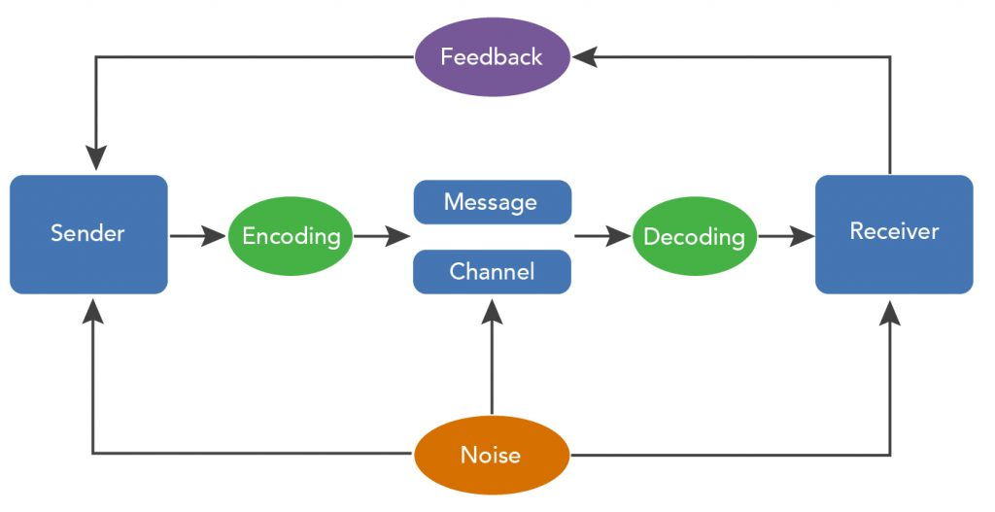
5.2 Understanding Communication III
Notes:
The Sender encodes the Message, translating the idea into words.
The medium/channel of this encoded Message is the manner in which information is exchanged – oral, written (text, email, advertisement, etc.), or non-verbal.
The receiver is the person who receives the Message.
The Receiver decodes the Message by assigning meaning to the words.

Slide 7
5.3 Communication Barriers I
Barriers to Effective Communication
Communicating can be more of a challenge than you think, when you realize the many things that can stand in the way of effective communication. These include filtering, selective perception, information overload, emotional disconnects, lack of source familiarity or credibility, workplace gossip, semantics, gender differences, differences in meaning between Sender and Receiver, and biased language. Let’s briefly examine each of these barriers.

Slide 8
5.3 Communication Barriers II
Notes:
Filtering is the distortion or withholding of information to manage a person’s reactions. Some examples of filtering include a manager who keeps her division’s poor sales figures from her boss, the vice president, fearing that the bad news will make him angry. The old saying, “Don’t shoot the messenger!” illustrates the tendency of Receivers (in this case, the vice president) to vent their negative response to unwanted Messages on the Sender. A gatekeeper (the vice president’s assistant, perhaps) who doesn’t pass along a complete Message is also filtering. The vice president may delete the e-mail announcing the quarter’s sales figures before reading it, blocking the Message before it arrives.
As you can see, filtering prevents members of an organization from getting a complete picture of the way things are. To maximize your chances of sending and receiving effective communications, it’s helpful to deliver a Message in multiple ways and to seek information from multiple sources. In this way, the effect of any one person’s filtering the Message will be diminished.
Here are some of the criteria that individuals may use when deciding whether to filter a Message or pass it on:
Past experience: Was the Sender rewarded for passing along news of this kind in the past, or was she criticized?
Knowledge, perception of the speaker: Has the Receiver’s direct superior made it clear that “no news is good news?”
Emotional state, involvement with the topic, level of attention: Does the Sender’s fear of failure or criticism prevent him from conveying the Message? Is the topic within his realm of expertise, increasing his confidence in his ability to decode it, or is he out of his comfort zone when it comes to evaluating the Message’s significance? Are personal concerns impacting his ability to judge the Message’s value?

Slide 9
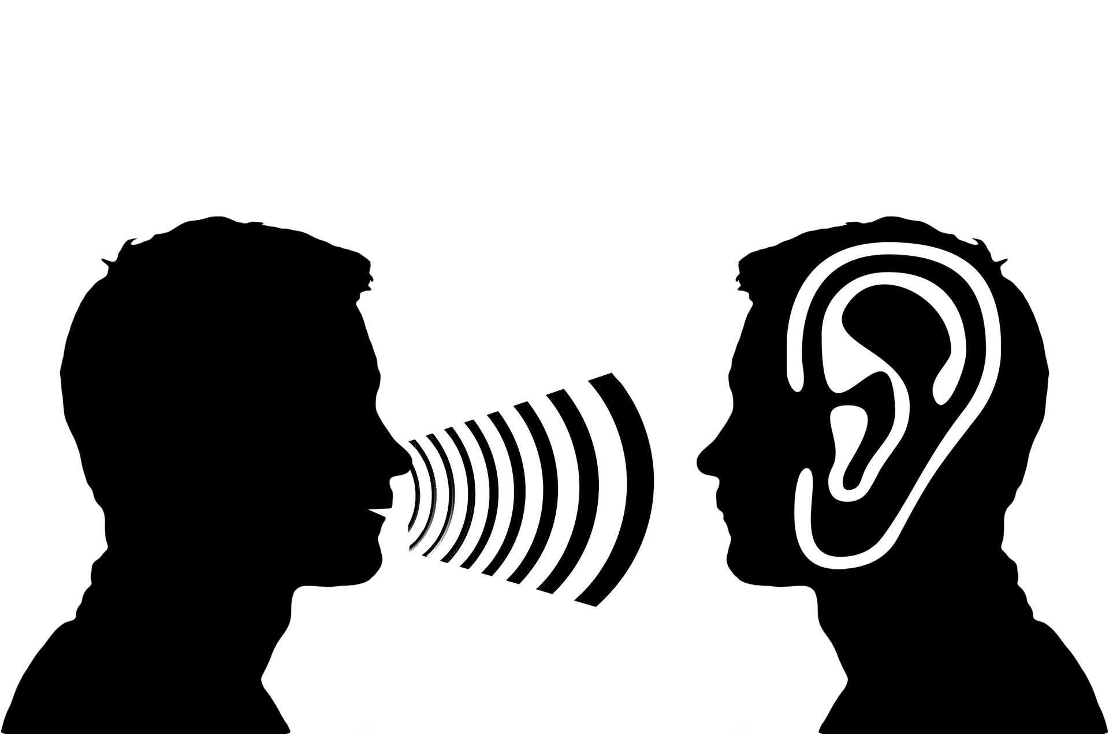
5.3 Communication Barriers III
Poor Listening and Active Listening
A Sender may strive to deliver a Message clearly, but the Receiver’s ability to listen effectively is equally vital to effective communication. The average worker spends 55% of her workdays listening, leaders listen up to 70% each day, but listening doesn’t lead to understanding in every case. Listening takes practice, skill, and concentration.
Image by Gerd Altmann from Pixabay
Notes:
Active listening can be defined as giving full attention to what other people are saying, taking time to understand the points being made, asking questions as appropriate, and not interrupting at inappropriate times (O*NET Resource Center, n.d). Active listening creates a real-time relationship between the Sender and the Receiver by acknowledging the content and receipt of a Message

Slide 10
5.4 Different Types of Communication and Communication Channels I
Communication can be categorized into three basic types: (1) verbal communication, in which you listen to a person to understand their meaning; (2) written communication, in which you read their meaning; and (3) nonverbal communication, in which you observe a person and infer meaning. Each has its own advantages, disadvantages, and even pitfalls.

Slide 11
5.4 Different Types of Communication and Communication Channels II
Verbal Communication
Verbal communication in business takes place via phone, web based calls or conferences, media, or in person.
The medium of the Message is oral.
Photo by Wonderlane on Unsplash
Notes:
Storytelling has been shown to be an effective form of verbal communication; it serves an important organizational function by helping to construct common meanings for individuals within the organization. Stories can help clarify key values and help demonstrate how things are done within an organization, and story frequency, strength, and tone are related to higher organizational commitment (McCarthy, 2008).
Crucial Conversations- While the process may be the same, high-stakes communications require more planning, reflection, and skill than normal day-to-day interactions at work. Examples of high-stakes communication events include asking for a raise or presenting a business plan to a venture capitalist.

Slide 12
5.4 Different Types of Communication and Communication Channels III
Written Communication
In contrast to verbal communications, written business communications are printed messages. Examples of written communications include memos, proposals, e-mails, texts, letters, training manuals, and operating policies.
Photo by Austin Distel on Unsplash
Notes:
They may be printed on paper, handwritten, or appear on the screen. Normally, a verbal communication takes place in real time. Written communication, by contrast, may be constructed over a longer period of time. Written communication is often asynchronous (occurring at different times).

Slide 13
5.4 Different Types of Communication and Communication Channels IV
Nonverbal Communication
What you say is a vital part of any communication. But what you don’t say can be even more important. Research also shows that 55% of in-person communication comes from nonverbal cues like facial expressions, body stance, and tone of voice
Image by Valeria Lo Iacono from Pixabay
Notes:
According to one study, only 7% of a Receiver’s comprehension of a Message is based on the Sender’s actual words; 38% is based on paralanguage (the tone, pace, and volume of speech), and 55% is based on nonverbal cues (body language) (Mehrabian, 1981).
Research shows that nonverbal cues can also affect whether you get a job offer. Judges examining videotapes of actual applicants were able to assess the social skills of job candidates with the sound turned off.

Slide 14
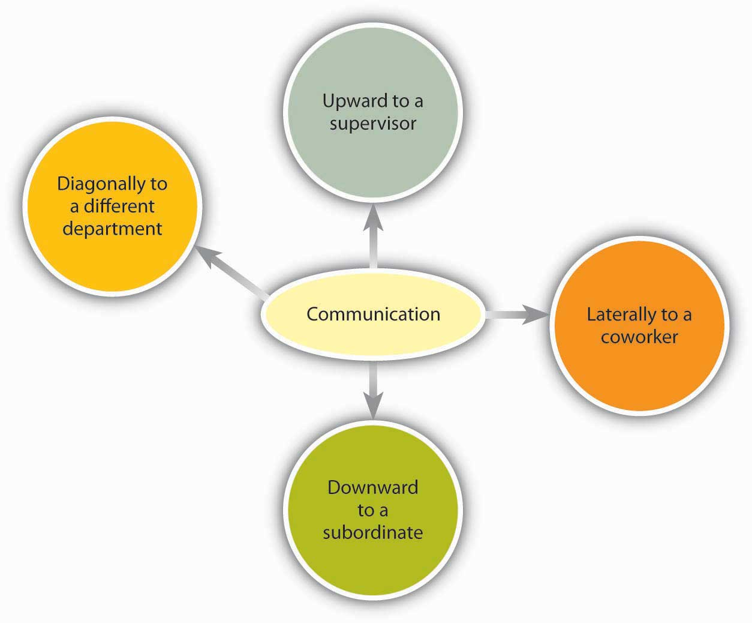
5.4 Different Types of Communication and Communication Channels V
Direction of Communication Within Organizations
Notes:
Communication flows in many different directions within an organization.
Information can move horizontally, from a Sender to a Receiver, as we’ve seen. It can also move vertically, down from top leadership or up from the front line. Information can also move diagonally between and among levels of an organization, such as a Message from a customer service representative up to a manager in the manufacturing department, or a Message from the chief financial officer sent down to all department heads.

Slide 15
5.5 Decision Making I
What Is Decision Making?
Decision making refers to making choices among alternative courses of action—which may also include inaction. While it can be argued that leadership is decision making, half of the decisions made by leaders within organizations fail.
(Ireland & Miller, 2004; Nutt, 2002; Nutt, 1999)
Notes:
Therefore, increasing effectiveness in decision making is an important part of maximizing your effectiveness at work. This chapter will help you understand how to make decisions alone or in a group while avoiding common decision-making traps.
Individuals throughout organizations use the information they gather through a variety of communications to make a wide range of decisions. These decisions may affect the lives of others and change the course of an organization.

Slide 16
5.5 Decision Making II
Types of Decisions
Decision making can also be classified into three categories based on the level at which they occur. Strategic decisions set the course of organization. Tactical decisions are decisions about how things will get done. Finally, operational decisions are decisions that employees make each day to run the organization.
Notes:
For example, remember the restaurant that routinely offers a free dessert when a customer complaint is received. The owner of the restaurant made a strategic decision to have great customer service. The manager of the restaurant implemented the free dessert policy as a way to handle customer complaints, which is a tactical decision. And, the servers at the restaurant are making individual decisions each day evaluating whether each customer complaint received is legitimate to warrant a free dessert.

Slide 17
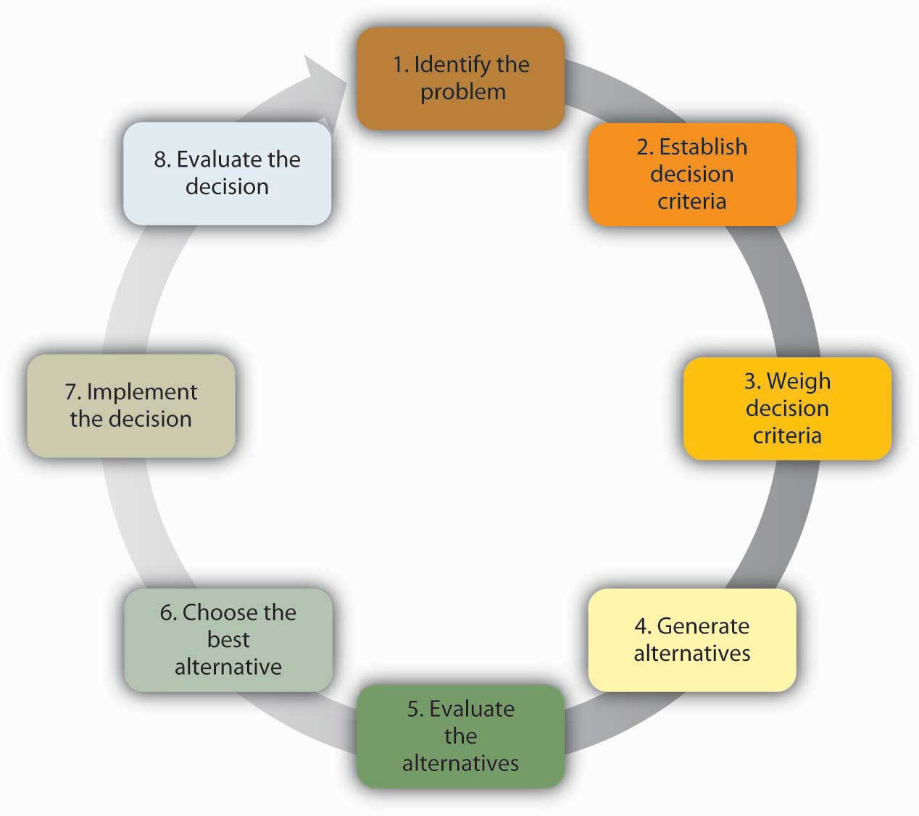
5.5 Decision Making III
Making Rational Decisions
Notes:
The rational decision-making model describes a series of steps that decision makers should consider if their goal is to maximize the quality of their outcomes. In other words, if you want to make sure you make the best choice, going through the formal steps of the rational decision-making model may make sense.
The rational decision-making model has important lessons for decision makers. First, when making a decision you may want to make sure that you establish your decision criteria before you search for all alternatives. This would prevent you from liking one option too much and setting your criteria accordingly.

Slide 18
5.5 Decision Making IV
The Creative Decision-Making Process
Notes:
In addition to the rational decision making, bounded rationality models, and intuitive decision making, creative decision making is a vital part of being an effective decision maker. Creativity is the generation of new, imaginative ideas. With the flattening of organizations and intense competition among organizations, individuals and organizations are driven to be creative in decisions ranging from cutting costs to creating new ways of doing business.
The five steps to creative decision making are similar to the previous decision-making models in some keys ways. All of the models include problem identification, which is the step in which the need for problem solving becomes apparent. If you do not recognize that you have a problem, it is impossible to solve it
Immersion is the step in which the decision maker thinks about the problem consciously and gathers information.
Incubation- During incubation, the individual sets the problem aside and does not think about it for a while. At this time, the brain is actually working on the problem unconsciously.
Illumination or the insight moment- when the solution to the problem becomes apparent to the person, usually when it is least expected.
The verification and application stage happens when the decision maker consciously verifies the feasibility of the solution and implements the decision.

Slide 19
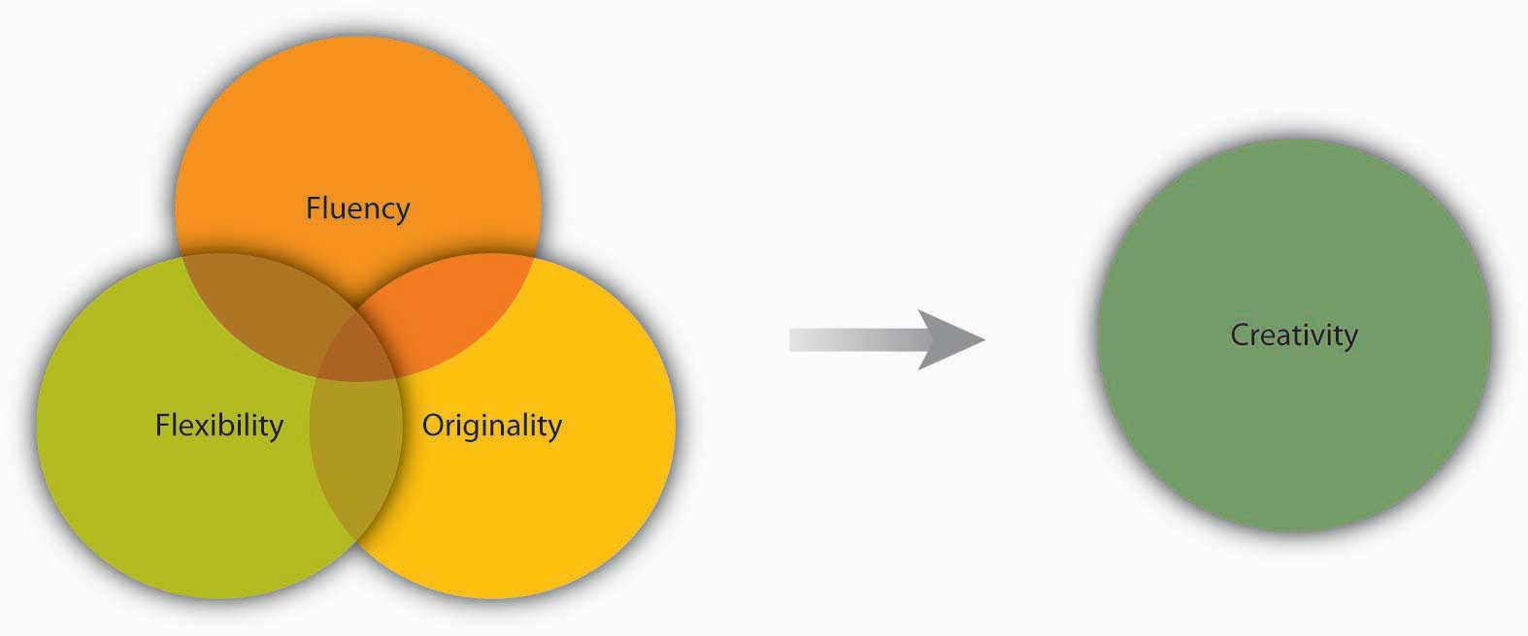
5.5 Decision Making V
Dimensions of Creativity
Notes:
Researchers focus on three factors to evaluate the level of creativity in the decision-making process. Fluency refers to the number of ideas a person is able to generate. Flexibility refers to how different the ideas are from one another. If you are able to generate several distinct solutions to a problem, your decision-making process is high on flexibility. Originality refers to an idea’s uniqueness.

Slide 20
5.6 Faulty Decision Making
Notes:
No matter which model you use, you need to know and avoid the decision-making traps that exist. Daniel Kahnemann (another Nobel prize winner) and Amos Tversky spent decades studying how people make decisions. They found that individuals are influenced by overconfidence bias, hindsight bias, anchoring bias, framing bias, and escalation of commitment.
Overconfidence bias occurs when individuals overestimate their ability to predict future events. Many people exhibit signs of overconfidence
Hindsight bias is the opposite of overconfidence bias, as it occurs when looking backward in time where mistakes made seem obvious after they have already occurred. In other words, after a surprising event occurred, many individuals are likely to think that they already knew this was going to happen.
Anchoring refers to the tendency for individuals to rely too heavily on a single piece of information.
Framing bias refers to the tendency of decision makers to be influenced by the way that a situation or problem is presented.
Escalation of commitment occurs when individuals continue on a failing course of action after information reveals this may be a poor path to follow. It is sometimes called sunk costs fallacy because the continuation is often based on the idea that one has already invested in this course of action.

Slide 21
5.7 Decision Making in Groups I
When It Comes to Decision Making, Are Two Heads Better Than One?
Notes:
When it comes to decision making, are two heads better than one? The answer to this question depends on several factors. Group decision making has the advantages of drawing from the experiences and perspectives of a larger number of individuals.
Hence, they have the potential to be more creative and lead to a more effective decision. In fact, groups often achieve results beyond what they could have done as individuals. Groups also make the task more enjoyable for members in question.
Finally, when the decision is made by a group rather than a single individual, implementation of the decision will be easier because group members will be invested in the decision.

Slide 22
5.7 Decision Making in Groups II
Groupthink is characterized by eight symptoms that include:
Illusion of invulnerability shared by most or all of the group members that creates excessive optimism and encourages them to take extreme risks.
Collective rationalizations where members downplay negative information or warnings that might cause them to reconsider their assumptions.
An unquestioned belief in the group’s inherent morality that may incline members to ignore ethical or moral consequences of their actions.
Stereotyped views of out-groups are seen when groups discount rivals’ abilities to make effective responses.
Direct pressure on any member who expresses strong arguments against any of the group’s stereotypes, illusions, or commitments.
Self-censorship when members of the group minimize their own doubts and counterarguments.
Illusions of unanimity based on self-censorship and direct pressure on the group; the lack of dissent is viewed as unanimity.
The emergence of self-appointed mindguards where one or more members protect the group from information that runs counter to the group’s assumptions and course of action.
Notes:
Groupthink is a group pressure phenomenon that increases the risk of the group making flawed decisions by leading to reduced mental efficiency, reality testing, and moral judgment. (Janis, 1972):
While research on groupthink has not confirmed all of the theory, groups do tend to suffer from symptoms of groupthink when they are large and when the group is cohesive because the members like each other (Esser, 1998; Mullen, et. al., 1994). The assumption is that the more frequently a group displays one or more of the eight symptoms, the worse the quality of their decisions will be.
However, if your group is cohesive, it is not necessarily doomed to engage in groupthink.

Slide 23
5.8 Key Terms I
Active listening creates a real-time relationship between the Sender and the Receiver by paying full attention to what other people are saying without interrupting, reflecting on the message and asking questions to ensure understanding.
Analysis paralysis where more and more time is spent on gathering information and thinking about it, but no decisions actually get made.
Anchoring refers to the tendency for individuals to rely too heavily on a single piece of information.
Biased language consists of words or phrases that may stereotype, offend, exclude or disrespect an individual or group based on age, ethnicity, sexual preference, or political beliefs personal or group affiliation.
Bounded rationality model of decision making limits options to a manageable set from which to choose the best alternative without conducting an exhaustive search for alternatives.
Brainstorming is a group process of generating ideas that follows a set of guidelines including no criticism of ideas, no idea is too wild, and the process of building or piggybacking on other ideas.
Communication is the exchange of information.
Consensus is decision making where the entire group must agree on the idea or plan of action.
Creativity is the generation of new, imaginative ideas.
Crucial conversations are communications involving personal risk and high stress due to participants’ differing opinions and strong emotions

Slide 24
5.8 Key Terms II
Decision making refers to making choices among alternative courses of action—which may also include inaction.
Decision rule is the automated response we use to make programmed decisions.
Decision trees are diagrams in which answers to yes or no questions lead decision makers to address additional questions until they reach the end of the tree.
Delphi Technique is a group decision making process using written responses to a series of questionnaires instead of physically bringing individuals together to make a decision.
Differences in meaning occur because different words mean different things to different people; age, education, and cultural background are all factors that influence how a person interprets words.
Emotional disconnects happen when the Sender or the Receiver is upset, whether about the subject at hand or about some unrelated incident. An emotionally upset Receiver tends to ignore or distort what the Sender is saying. A Sender who is emotionally upset may be unable to present ideas or feelings effectively.
Escalation of commitment occurs when individuals continue on a failing course of action because they are already invested in it, even after information reveals this may be a poor path to follow.
Filtering is the distortion or withholding of information to manage a person’s reactions.
Flexibility refers to how different the ideas are from one another in the creative decision making process.

Slide 25
5.8 Key Terms III
Fluency refers to the number of ideas a person is able to generate in the creative decision making process.
Framing bias refers to the tendency of decision makers to be influenced by the way that a situation or problem is presented.
Gendered language words, phrases, or titles that are linked to either males or females, for example chairman versus chair.
Grapevine involves unofficial communication amongst colleagues where information is shared that may or may not be accurate (including gossip).
Group decision support systems (GDSS) are interactive computer-based systems that combine communication and decision technologies to help groups make better decisions.
Groupthink the tendency to avoid critically evaluating ideas that the group favors.
Hindsight bias occurs when looking backward in time where mistakes made seem obvious after they have already occurred.
Idea quotas determine the number of ideas a group must generate.
Illumination is the decision making step also known as the insight moment, when the solution to the problem becomes apparent to the person – often when it is least expected.
Immersion is the decision making step involving information gathering and conscious thought about the problem.

Slide 26
5.8 Key Terms IV
Incubation is the decision making step that allows the brain to work on the problem unconsciously while the individual sets the problem aside and does not focus on it.
Information overload a state of imbalance when we are receiving more information than we can take in.
Jargon is the language of specialized terms used by a group or profession.
Lack of source familiarity or credibility occurs when the Sender and the Receiver lack common context, are unfamiliar with one another so misinterpret messages, or when the Sender lacks credibility or is untrustworthy.
Majority rule refers to decision making where each member of the group is given a single vote, and the option that receives the greatest number of votes is selected.
Medium/channel is the manner by which information is exchanged – this can be oral, written (text, email, advertisement, etc.), or non-verbal.
Noise is anything that interferes with or distorts the Message being exchanged.
Nominal Group Technique (NGT) ensures that all members participate fully in group decision making through four steps: (1) each member records ideas independently, (2) the group shares their ideas, (3) discussion, clarification, and evaluation of ideas occurs, and (4) individuals vote for their favorite ideas by using either ranking or rating techniques.
Nonprogrammed decisions are unique and important, requiring conscious thinking, information gathering, and careful consideration of alternatives.

Slide 27
5.8 Key Terms V
Operational decisions are shorter term decisions that employees make to run an organization on a day to day basis.
Originality refers to the uniqueness of ideas in the creative decision making process.
Overconfidence bias occurs when individuals overestimate their abilities.
Political correctness includes using language in a non-gendered unbiased way to defuse the volatile nature of words and avoid stereotyping.
Problem identification is the first step in decision making where the root cause of the issue is determined.
Programmed decisions are decisions that occur frequently enough that we develop an automated response to them.
Rational decision-making model describes a series of steps that decision makers should consider if their goal is to maximize the quality of their outcomes.
Receiver is the person who receives the Message. The Receiver decodes the Message by assigning meaning to the words or nonverbal communication.
Satisfice refers to accepting the first alternative that meets your minimum criteria.
Selective perception refers to filtering what we see and hear, often unconsciously, to suit our own needs.
Semantics is the study of meaning in communication. Words and phrases can mean different things to different people, or they might not mean anything to another person.

Slide 28
5.8 Key Terms VI
Sender the originator of the information to be exchanged who encodes a message by translating an idea into words.
Social loafing the tendency of some members to put forth less effort while working within a group.
Storytelling is communication through the use of stories to help construct common meanings and provide clarity.
Strategic decisions are long term decisions that set the course of an organization.
Tactical decisions are more detailed mid term decisions including action plans to achieve an organization’s overall strategy.
The intuitive decision-making model is based on intuition or experience rather than following a formal process.
Verbal communication takes place via phone, web based calls or conferences, through media, or in person.
Verification and application is the final decision making step where the decision maker consciously verifies the feasibility of the solution and implements the decision.
Wildstorming occurs when a group focuses on generating seemingly impossible ideas then determine ways to make the impossible possible.
Written business communications are printed messages.

