Slide 1
Principles of Leadership & Management
CHAPTER 4: VALUES-BASED LEADERSHIP
& CONTEMPORARY APPROACHES
Unless otherwise noted, this work is licensed under a Creative Commons Attribution-NonCommercial-ShareAlike 4.0 International (CC BY-NC-SA 4.0) license. Feel free to use, modify, reuse or redistribute any portion of this presentation.

Slide 2
Learning Outcomes
Upon successful completion of this chapter, you will be able to:
Analyze the context for contemporary principles of leadership and management.
Identify key global trends.
Determine how globalization is affecting leadership and management principles and practices.
Explain the importance of value-based leadership (ethics).

Slide 3
4.1 Values-Based and Contemporary Approaches to Leadership
The realm of managers is expanding, and the capacity to lead is a necessity in
21st-century workplaces. You will need to be a role model in the organization, setting the tone not just for what gets done but how it gets done.
Notes:
Increasingly, good business practice extends to stewardship, not just of the organization, but of the environment and community at large. Ethics and values-based leadership aren’t just good ideas—they’re vital to attracting talent and retaining loyal customers and business partners.

Slide 4
4.2 Case in Point: Hanna Andersson Corporation Changes for Good
Born from a desire to bring quality European-style children’s clothing to the United States, Hanna Andersson Corporation has sold colorful clothing and accessories since 1983. Husband and wife co-founders, Tom and Gun (pronounced “gōōn”) Denhart, started the Portland, Oregon–based company by distributing imported Swedish clothing from their home. Named for Gun’s Swedish grandmother, the company now boasts over $100 million in annual sales and employs over 500 people.
Notes:
Growing from an exclusive mail-order catalog business in the early 1980s, today Hanna Andersson also distributes products online, in 29 retail stores nationwide, and through select specialty retailers.
Over the years, Hanna Andersson has shown that it deeply values its employees. The company provides supplemental child-care reimbursement to all employees—even part-time sales associates. Additional employee benefits include part-time and flexible work hours, considerable paid time off, and 8 hours per year of paid time for employees to volunteer in the community. More important, though, employees feel like they are part of the Hanna Andersson family. In fact, in the beginning, many of the employees were friends and family members of the Denharts.

Slide 5
4.3 Contemporary Approaches to Leadership I
Transformational Leadership
Transformational leaders lead employees by aligning employee goals with the leader’s goals. Thus, employees working for transformational leaders start focusing on the company’s well-being rather than on what is best for them as individual employees.
However, transactional leaders ensure that employees demonstrate the right behaviors because the leader provides resources in exchange
(Bass, 1985; Burns, 1978).
Notes:
Transformational leadership theory is a recent addition to the literature, but more research has been conducted on this theory than all the contingency theories combined. The theory distinguishes between transformational and transactional leaders.
Transformational leaders have four tools in their possession, which they use to influence employees and create commitment to the company goals (Bass, 1985; Burns, 1978; Row et al., 1995; Judge & Piccolo, 2004). First, transformational leaders are charismatic.

Slide 6
4.3 Contemporary Approaches to Leadership II
Leader-Member Exchange Theory
Leader-member exchange (LMX) theory proposes that the type of relationship leaders have with their followers is the key to understanding how leaders influence employees.
Notes:
In high-quality LMX relationships, the leader forms a trust-based relationship with the member. The leader and members like each other, help each other when needed, and respect one another. In these relationships, the leader and the member are both ready to go above and beyond their job descriptions to promote the other’s ability to succeed.
In contrast, in low-quality LMX relationships, the leader and the member have lower levels of trust, liking, and respect toward each other. These relationships do not have to involve actively disliking each other, but the leader and member do not go beyond their formal job descriptions in their exchanges.

Slide 7
4.3 Contemporary Approaches to Leadership III
Servant Leadership
Servant leadership approach defines the leader’s role as serving the needs of others. According to this approach, the primary mission of the leader is to develop employees and help them reach their goals. Servant leaders put their employees first, understand their personal needs and desires, empower them, and help them develop in their careers.
Notes:
Unlike mainstream management approaches, the overriding objective in servant leadership is not necessarily getting employees to contribute to organizational goals. Instead, servant leaders feel an obligation to their employees, customers, and the external community.

Slide 8
4.3 Contemporary Approaches to Leadership IV
Authentic Leadership
The authentic leadership approach embraces this value: its key advice is “be yourself.” Think about it: We all have different backgrounds, different life experiences, and different role models. These trigger events over the course of our life that shape our values, preferences, and priorities. Instead of trying to fit into societal expectations about what a leader should be like, act like, or look like, authentic leaders derive their strength from their own past experiences.
Notes:
Leaders have to be a lot of things to a lot of people. They operate within different structures, work with different types of people, and they have to be adaptable. At times, it may seem that a leader’s smartest strategy would be to act as a social chameleon, changing his or her style whenever doing so seems advantageous. But this would lose sight of the fact that effective leaders have to stay true to themselves.
Thus, one key characteristic of authentic leaders is that they are self-aware. They are introspective, understand where they are coming from, and have a thorough understanding of their own values and priorities. Second, they are not afraid to act the way they are. In other words, they have high levels of personal integrity. They say what they think.

Slide 9
4.3 Contemporary Approaches to Leadership V
Leadership Needs in the 21st Century
People talk about the transnational organization, the boundaryless company, the post-hierarchical organization. By the end of the decade, the organizations that we will be living in, working with, and competing against are likely to be vastly different from what we know today.
Notes:
The transition will not be easy; uncertainty tends to breed resistance. We are driven by linear and rational thinking, which leads us to believe that “we can get there from here” by making some incremental changes in who we are and what we are currently doing. Existing paradigms frame our perceptions and guide our thinking. Throwing away paradigms that have served us well in the past does not come easily.

Slide 10
4.4 Vulnerability in Leadership I
Vulnerability: Definition and Myths
Displaying vulnerability can also be a chance to embrace changes and challenges while feeling safe enough to acknowledge failure (Ito & Bligh, 2017).
Vulnerability is emotional exposure (Brown, 2012a) that threatens the loss “of our own sense of self” (Crouch, 2016, p. 41). Cléro (2018) adds that “vulnerability should be differentiated from weakness or from the frailty that results from it”
(p. 6).
Notes:
Brown goes on further to state that “we think about vulnerability as a dark emotion. We think of vulnerability at the core of fear and shame and grief and disappointment, things that we do not want to feel” (Brown, 2012a). Yet facing the difficult “dark emotion” can lead to “every positive emotion that we need in our lives: love, belonging, joy, empathy” (Brown, 2012a).
Vulnerability is “the emotion we experience during times of uncertainty, risk, and emotional exposure” (Brown, 2018, p. 19).
“When a leader embraces failure and shares vulnerability with humility, followers are able to connect with the leader at an emotional level and are more likely to share feelings of vulnerability themselves” (Ito & Bligh, 2017, p. 67). Some examples of actions that a vulnerable leader might take include reaching out to an employee with an ill child or family member, checking in with a coworker who experienced a recent loss, or taking responsibility for a mistake at work (Seppälä, 2014).

Slide 11
4.4 Vulnerability in Leadership II
Vulnerability and Trust
Vulnerability directly involves the issue of trust (Brown, 2012a). Leaders “must be truthful and consistent in their behavior and must not arbitrarily disregard employees’ suggestions and opinions on a regular basis” (Thrash, 2012, p. 4)
Notes:
The best place to work “is one where employees trust the people they work with, have pride in the work they do, and enjoy the people they work with” (Bush & Lewis-Kulin, 2018).
One leadership theory that directly relates to vulnerability and trust is the leader-member exchange theory. This is the theory “that leaders form relationships with their subordinates that fall into two broad groups: an in-group characterized by strong exchange relationships, and an out-group that lacks solid leader connections” (Miller, 2013)

Slide 12
4.4 Vulnerability in Leadership III
Leadership Styles
While there are numerous leadership theories and styles, Copeland (2016) found values-based leadership styles to be most effective in her research, namely authentic, ethical, and transformational leadership styles (p. 79). These three styles of leadership all involve some level of risk and will be featured in the study.

Slide 13
4.4 Vulnerability in Leadership IV
Authentic Leadership
Authentic leadership has been described as “the process whereby leaders are aware of their thoughts and behaviors within the context in which they operate” (Maximo et al., 2019, p. 2)
Notes:
Walumbwa et al. (2008) outline the components of authentic leadership as self-awareness (a leader’s understanding of themselves including strengths and weaknesses), balanced processing (a leader’s ability to make objective decisions after weighing all the evidence), and relational transparency (a leader’s strength in communicating honest and genuine information as well as opinions) (Maximo et al., 2019, p. 2).

Slide 14
4.4 Vulnerability in Leadership V
Ethical Leadership
Brown et al. (2005) define ethical leadership as “the demonstration of normatively appropriate conduct through personal actions and interpersonal relationships, and the promotion of such conduct to followers through two-way communication, reinforcement, and decision-making” (p. 120).
Notes:
Kaptein (2019) adds that an ethical leader is not just a moral person and manager but also a “moral entrepreneur who creates new norms” (p. 1136). This entrepreneurship should lead to the “development of both society and the trust of stakeholders” (Kaptein, 2019, p. 1136). Brown and Treviño (2014) find that “leaders who have had ethical role models are more likely to become ethical leaders” (Kaptein, 2019, p. 1135).

Slide 15
4.4 Vulnerability in Leadership VI
Transformational Leadership
Bass and Riggio (2006) describe transformational leadership as motivating others through a common mission or challenge that empowers followers and encourages them to develop as leaders (p. 3).
Notes:
Transformational leaders tend to have more satisfied, committed followers with elevated work performances (Bass & Riggio, 2006). This style of leadership addresses “the follower’s sense of self-worth” (Bass & Riggio, 2006, p. 4). Carleton, Barling, and Trivisonno (2018) also found a strong connection between a leader’s trait mindfulness and their positive actions as a transformational leader.

Slide 16
4.5 Contemporary Principles of Leadership and Management I
Corporations as Social Movements
The term social movement refers to a type of group action that is focused on specific political or social issues; examples include the civil rights movement, the feminist movement, and the gay rights movement. Leaders of social movements depend on charisma rather than authority to motivate participants to action.
Notes:
Traditionally, we’ve thought of corporations as organizations that had clear boundaries, formal procedures, and well-defined authority structures. In contrast, social movements are seen as more spontaneous and fluid.
Corporations can implement initiatives that mimic a social movement.
Consider how the CEO of one bank described a program he introduced: “The hierarchical management structure will give way to some collective activities that will improve our effectiveness in the marketplace. Decisions won’t flow from a management level to people on the line who are expected to implement those decisions…We’re telling everyone, choose a process, figure out what and where the problems are, work together to come up with solutions, and then put your solutions to work” (Davis et al., 2005).

Slide 17
4.5 Contemporary Principles of Leadership and Management II
Social Networking
Social networking refers to systems that allow members of a specific group to learn about other members’ skills, talents, knowledge, or preferences. Companies use these systems internally to help identify experts.
Notes:
Today, social networks are starting points for corporate innovation: potentially limitless arrangements of individuals inspired by opportunities, affinities, or tasks. This new attitude toward social networks in the workplace has been fueled by the growth of social networking sites like Facebook.
The use of online social networking principles can open the door to outside collaborations. For example, Netflix offered a million-dollar reward to anyone in the company’s social network of interested inventors who could improve the algorithm that matches movie lovers to new titles they might enjoy. Companies like Procter & Gamble and InnoCentive are tapping social networks of scientists to improve their products.

Slide 18
4.5 Contemporary Principles of Leadership and Management III
Learning Organizations
In a 1993 article, Harvard Business School professor David Garvin defined a learning organization as “an organization skilled at creating, acquiring, and transferring knowledge, and at modifying its behavior to reflect new knowledge and insights” (Garvin, 1993). The five building blocks of learning organizations are:
Systematic problem solving
Experimentation
Learning from past experience
Learning from others
Transferring knowledge
Notes:
Systematic problem solving: The company must have a consistent method for solving problems, using data and statistical tools rather than assumptions.
Experimentation: Experiments are a way to test ideas in small steps. Experiments let companies hunt for and test new knowledge, such as new ways of recycling waste or of structuring an incentive program.
Learning from past experience: It’s essential for companies to review projects and products to learn what worked and what didn’t. Boeing, for example, systematically gathered hundreds of “lessons learned” from previous airplane models, such as the 737 and 747, which the company applied to the 757s and 767s, making those the most successful, error-free launches in Boeing’s history.
Learning from others: Recognizing that good ideas come from anywhere, not just inside the company, learning organizations network with other companies in a continual search for good ideas to adapt and adopt.
Transferring knowledge: Sharing knowledge quickly throughout the organization is the way to make everyone a smart, contributing member.

Slide 19
4.5 Contemporary Principles of Leadership and Management IV
Virtual Organizations
A virtual organization is one in which employees work remotely—sometimes within the same city, but more often across a country and across national borders. The company relies on computer and telecommunications technologies instead of a physical presence for communication between employees.
Notes:
E-mail, wikis, Web meetings (i.e., like Webex or GoToMeeting), phone, and Internet relay chat (IRC) are used extensively to keep everyone in touch. Virtual companies present special leadership challenges because it’s essential for leaders to keep people informed of what they are supposed to be doing and what other arms of the organization are doing. Communication in a commons area is preferable to one-on-one communication because it keeps everyone up to speed and promotes learning across the organization.

Slide 20
4.6 Global Trends I
The world is changing in dramatic ways, and as a leader, you’re in the best position to take advantage of these changes. Let’s look at 10 major ways in which the world is changing; we’ll characterize the first five as challenges and the next five as solutions.

Slide 21
4.6 Global Trends II
Top 5 Challenge Trends
Increasing Concern for the Environment
Greater Personalization and Customization
Faster Pace of Innovation
Increasing Complexity
Increasing Competition for Talent
Notes:
Increasing Concern for the Environment- The number of catastrophic weather events is on the rise. People are seeing the growing threat of global warming. Effects of climate change are failing crops, rising sea levels, shortages of drinking water, and increasing death tolls from disease outbreaks such as malaria and dengue fever
Greater Personalization and Customization- We’re no longer happy with cookie-cutter products. Consumers are demanding more say in products and services. One size no longer fits all, and that means tailoring products and services to meet specific customer preferences.
Faster Pace of Innovation- We all want the next new thing, and we want it now. New models, new products, and new variations—companies are speeding new products to market in response to customer demands
Increasing Complexity- Our world is becoming more and more complex due to environmental challenges, increasing urbanization, and health impacts . VUCA refers to the increasingly volatile, uncertain, complex, and ambiguous environment in which we live (Kraaijenbrink, 2019).
Increasing Competition for Talent- We need people who can solve all these tough problems, and that’s a challenge all by itself. According to McKinsey’s global survey of trends (2007), business executives think that this trend, among all trends, will have the greatest effect on their companies in the next five years.

Slide 22
4.6 Global Trends III
Top 5 Solution Trends
Becoming More Connected
Becoming More Global
Becoming More Mobile
Rise of the Creative Class
Increasing Collaboration
Notes:
Becoming More Connected- We can now use the Internet and the web to connect people as never before. According to Statista (2022) there are 5 billion internet users worldwide which represents 63% of the world’s population.
Becoming More Global- We can now tap into more global suppliers and global talent. Whatever problem a manager faces, someone in the world probably has the innovative products, the knowledge, or the talent to address the problem.
Becoming More Mobile- We can now reach employees, suppliers, and customers wherever they are. In June of 2021, almost half the world was using a smartphone (BusinessWire, 2021), and similar to Internet use, mobile phone adoption continues to grow.
Rise of the Creative Class- With blogs, Flickr, TikTok, and YouTube, anyone can post their creative efforts. And with open source and wikis, anyone can contribute ideas and insights.
Increasing Collaboration- These solution trends combine to foster a rise in collaboration across space and time. We can now bring more people together to solve more problems more quickly. To design new products quickly—and make sure they meet consumer needs—companies are now looking beyond their four walls for innovation.

Slide 23
4.7 Globalization and Principles of Leadership I
Globalization and Cross-Cultural Lessons
Despite the growing importance of global business, companies find it difficult to recruit mangers with the skills necessary to operate in a global environment (Gregersen et al., 1998).
Some experts have argued that most U.S. companies are not positioned to implement global strategies due to a lack of global leadership capabilities (Hollenbeck & McCall, 2003)
Notes:
It’s easy to understand the problem: communicating and working with people from different countries can be a challenge—not just because of language issues but also because of different cultural norms.
For example, in Canada, we tend to be more direct in our communication. If you ask a Canadian manager a question, you’ll tend to get a direct answer. In other cultures, particularly in southern Europe and Japan, the answer to a question begins with background and context—not the bottom line—so that the listener will understand how the person arrived at the conclusion.

Slide 24
4.7 Globalization and Principles of Leadership II
Inclusive Leadership and Potential Barriers
Despite advances in diversity that have occurred in the past, women continue to be excluded from top leadership positions in the corporate environment. Today’s diverse and constantly changing environment requires more than masculinity as the norm and a command and control leadership approach.
Notes:
It needs a leadership style that will advocate for inclusivity of traditionally excluded voices in leadership. It needs a leadership style that will enhance the four critical processes that are mobilized by leadership (setting mission, actualizing goals, sustaining commitment, responding to change) (Raelin, 2003).

Slide 25
4.7 Globalization and Principles of Leadership III
What is Inclusive Leadership?
Inclusive leadership is about including everyone. This leadership style puts a particular focus on “having the courage to take conscious steps to break down barriers for people at risk of being excluded from society ”
(Bortini et al., 2019, p. 19)
Notes:
The inclusive leadership approachappreciates diversity and the contributions of everyone. Furthermore, this model encourages full engagement in all aspects of organizational functioning. The objective the authors added, is “to create, change and innovate whilst balancing everybody’s needs” (p. 9). Essentially, inclusive leadership is centered around relationships and valuing differences.

Slide 26
4.7 Globalization and Principles of Leadership IV
What Do Inclusive Leaders Do?
Dillon and Bourke (2016) identified six key characteristics that distinguish inclusive leaders.
Commitment.
Courage
Cognizance of bias
Curiosity
Cultural intelligence
Collaborative
Notes:
Champions of inclusive leadership are motivated by their values, including a “deep-seated sense of fairness that, for some, is rooted in personal experience” (p. 3).
Courage is the second characteristic found in inclusive leaders. They demonstrate courage in challenging organizations to think beyond homogeneous attitudes and practices.
Cognizance of bias- Inclusive leaders understand that both personal and organizational biases can negatively impact diversity and inclusion. As a result, they implement policies, processes, and structures to prevent infiltration of such biases in the workplace or any organization.
The fourth characteristic found in inclusive leaders is curiosity. This includes being open-minded and having a passion for learning and a desire for exposure to diverse perspectives
Cultural intelligence is the fifth characteristic identified in inclusive leaders. These leaders understand that knowledge of other cultures is fundamental in fostering inclusiveness.
Lastly, inclusive leaders are collaborative, which is coupled with an ability to willingly share ideas.

Slide 27
4.7 Globalization and Principles of Leadership V
Potential Barriers to Inclusive Leadership
Although the benefits of inclusive leadership are clear, smarter teams, better decision making, effective problem solving, better financial gains, and customer satisfaction, to name a few, there are common barriers that can hinder an organization’s ability/efforts to implement inclusive leadership practices.
Notes:
These barriers can influence companies away from becoming inclusive and prevent them from making the most of any diversity within their organization. According to Gully and Phillips (2012), some of the common obstacles are the “like me” bias, stereotypes, the perceived threat of loss, and ethnocentrism.

Slide 28
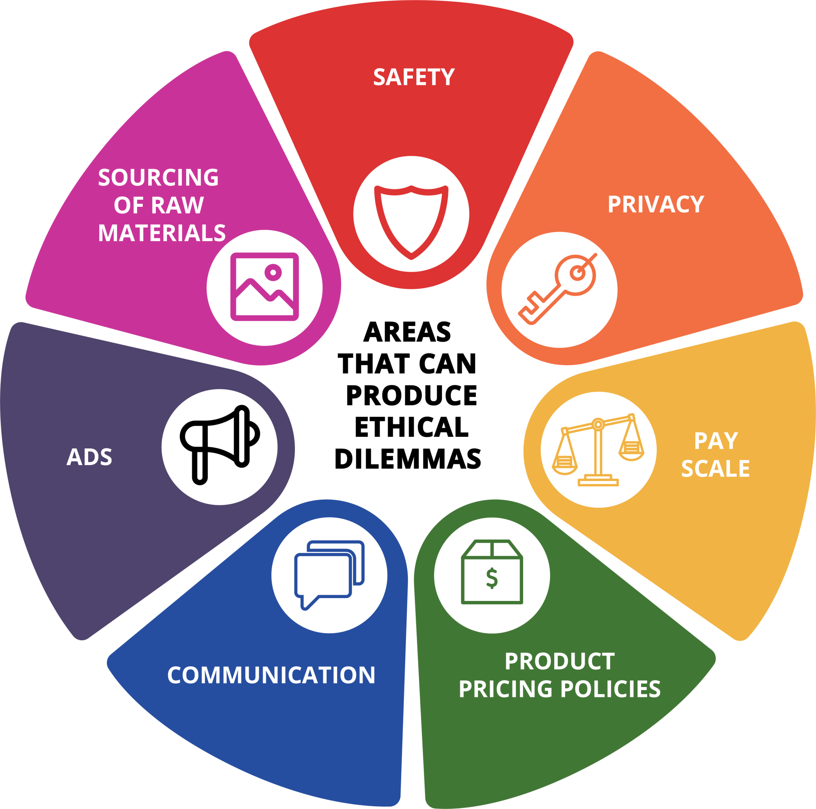
4.8 Developing Your Own Values-Based Leadership Skills I
Notes:
It’s late at night and the office is quiet—except that you’ve got a nagging voice in your head. Your product is already two weeks behind schedule. You’ve got to get it out this week or lose the deal. But you’ve discovered a problem. To correct the problem would mean another 3-week delay—and you know the client won’t go for that. It’s a small error—it’ll probably never become an issue. What do you do?
Managers face these kinds of issues all the time. Ethical dilemmas can arise from a variety of areas, such as:
Advertising (desire to present your product or service in the best light)
Sourcing of raw materials (does the company buy from a supplier who may be underpaying their people or damaging the environment?)
Privacy (should the company have access to private e-mails that employees write on company time? or the Web sites they visit during work hours?)
Safety (employee and community)
Pay scales (relation of the pay of top executives to the rest of the company)
Product pricing policies (variable pricing, discounts)
Communication (with stockholders, announcements of plant closings, etc.)

Slide 29
4.8 Developing Your Own Values-Based Leadership Skills II
Importance of Ethics in Management
Ethical behavior among managers is even more important in organizations because leaders set the moral tone of the organization and serve as role models. Ethical leaders build trust in organizations.
Notes:
If employees see leaders behaving unethically, chances are the employees may be less inclined to behave ethically themselves. Companies may have printed codes of ethics, but the key standard is whether leaders uphold those values and standards. We tend to watch leaders for cues on appropriate actions and behavior that the company expects. Decisions that managers make are an indicator of their ethics. If the company says it cares about the safety of employees but then does not buy enough protective gear for them, it is not behaving in line with its code. Likewise, if managers exhibit unsafe behavior or look the other way when employees act unsafely, their behavior is not aligned with their stated code.
Without integrity, there can be no trust. Leadership is based on trust. Ethics drive effectiveness because employees know they can do the right thing decisively and with confidence.

Slide 30
4.8 Developing Your Own Values-Based Leadership Skills III
Integrating Ethics into Managerial Decision Making
Ethics implies making a choice between decision-making rules. For instance, when choosing between two suppliers, do you choose the cheapest (Decision Rule 1) or the highest quality (Decision Rule 2). Ethics also implies deciding on a course of action when no clear decision rule is available.
Notes:
Dilemmas occur when the choices are incompatible and when one course of action seems to better serve your self-interest but appears to violate a moral principle. One way to tackle ethical dilemmas is to follow an ethical decision-making process.

Slide 31
4.8 Developing Your Own Values-Based Leadership Skills IV
Steps in an Ethical Decision-Making Process
Assess the situation:
Identify the stakeholders and consider the situation from their point of view.
Consider the alternatives you have available to you and how they affect the stakeholders
How does the action make you feel about yourself?
Make a decision.
Monitor outcomes.
Notes:
If you see unethical behavior in others, confronting it early is better. Early on, you have more of an opportunity to talk with the person in a fact-finding (rather than an accusatory) way. The discussion may nip the problem in the bud and prevent it from escalating. Keeping silent because you want to avoid offending the person may lead to much greater problems later on.

Slide 32
4.9 Developing Your Charismatic, Servant and Authentic Leadership Skills I
Develop Your Charismatic Leadership Skills
Charismatic individuals have a “magnetic” personality that is appealing to followers. While many people assume that charisma is inborn, it is possible to improve your charisma by following these suggestions (Frese et al., 2003; Shamir et al., 1993):
Have a vision around which people can gather.
Tie the vision to history
Watch your body language.
Make sure that employees have confidence in themselves.
Challenge the status quo

Slide 33
4.9 Developing Your Charismatic, Servant and Authentic Leadership Skills II
Develop Your Servant Leadership Skills
Servant leadership might be considered a difficult transition for an achievement-oriented and success-driven manager who rises to high levels. Here are some tips to achieve servant leadership (Buchanan, 2007; Douglas, 2005; Ramsey, 2005).
Don’t ask what your employees can do for you. Think of what you can do for them
One of your key priorities should be to help employees reach their goals.
Be humble. You are not supposed to have all the answers and dictate to others.
Be open with your employees. Ask them questions. Give them information so that they understand what is going on in the company.
Find ways of helping the external community.

Slide 34
4.9 Developing Your Charismatic, Servant and Authentic Leadership Skills III
Develop Your Authentic Leadership Skills
Understand Your History
Reflect on Your Successes and Challenges
Make Integrity a Priority
Understand the Power of Words
Notes:
Authentic leaders have high levels of self-awareness and their behavior is driven by their core personal values. This leadership approach recognizes the importance of self-reflection and understanding one’s life history. Address the following questions to gain a better understanding of your own core values and authentic leadership style.

Slide 35
4.10 Key Terms I
Active management by exception involves leaving employees to do their jobs without interference, but at the same time proactively predicting potential problems and providing the assistance necessary to prevent them from occurring.
Authentic leadership requires a leader to be “real” and is achieved through introspection, self-awareness and behaving in a way consistent with their values.
Charisma refers to a leader’s charm, attractiveness or magnetism and their ability to inspire the confidence, commitment, and admiration necessary to influence followers.
Contingent rewards are awarded based on the ability of employees to accomplish their goals.
Ethical leadership focuses on the common good and models strong moral conduct and values, adhering to socially appropriate norms, and respecting others.
Ethnocentrism is a belief that one’s language, native country, and cultural rules/norms are superior to all others.
Experimentation is the process of searching for and testing new knowledge, ideas, and methods.
High-quality LMX relationships the leader forms a trust-based relationship with the member.
Inclusive leadership is centered around relationships and valuing differences while advocating for traditionally excluded voices, appreciating diversity and welcoming the contributions of all parties.

Slide 36
4.10 Key Terms II
Individualized consideration occurs when leaders show personal care and concern for the well-being of their followers.
Inspirational motivation means come up with a vision that is inspiring to others.
Intellectual stimulation allows for members to challenge organizational norms and status quo, encouraging employees to think creatively and work harder.
Learning organizations consist of individuals who create, acquire and share knowledge, experiment, and modify organizational behaviors based on insights gained. Learning organizations participate in a continual process of transformation through growth and development.
Low-quality LMX relationships the leader and the member have lower levels of trust, liking, and respect toward each other.
Passive management by exception involves leaving employees to do their jobs without interference, and waiting until something goes wrong before coming to the rescue.
Servant leadership approach defines the leader’s role as serving the needs of others. According to this approach, the primary mission of the leader is to develop employees and help them reach their goals.
Social movement refers to a type of group action that is focused on specific political or social issues; examples include the civil rights movement, the feminist movement, and the gay rights movement.
Social networking refers to systems that allow members of a specific group to learn about and access other members’ skills, talents, knowledge, or preferences.

Slide 37
4.10 Key Terms III
Strategic opportunists are able to take advantage of strategic opportunities before competitors.
Systematic problem solving a consistent method for solving problems, using data and statistical tools rather than assumptions.
Transactional leaders influence employee behavior through the use of rewards and punishment.
Transformational leaders use their influence to align employee goals with company goals through charisma, inspiration, intellectual stimulation, and by showing care and concern for their followers.
Transformational leadership motivates others through a common mission or challenge that empowers followers and encourages them to develop as leaders (Bass & Riggio, 2006, p. 3).
Trust is the belief that the leader will show integrity, fairness, and predictability in his or her dealings with others.
Virtual organization is one in which employees work remotely— sometimes within the same city, but more often across a country and across national borders.
Visionary leadership is based on communicating a “picture” or vision of a goal and the inspirational motivation to achieve it.
Vulnerability includes taking risks and exposing oneself emotionally by being transparent, sharing feelings and exposing weaknesses.
Wiki is an online document or discussion that allows many people to collaborate and contribute.

