Slide 1
Principles of Leadership & Management
CHAPTER 3: LEADERSHIP APPROACHES
Unless otherwise noted, this work is licensed under a Creative Commons Attribution-NonCommercial-ShareAlike 4.0 International (CC BY-NC-SA 4.0) license. Feel free to use, modify, reuse or redistribute any portion of this presentation.

Slide 2
Learning Outcomes
Upon successful completion of this chapter, you will be able to:
Define what leadership is and identify traits of effective leaders.
Describe behaviors that effective leaders demonstrate.
Specify the contexts in which various leadership styles are effective.
Explain the concepts of transformational, transactional, charismatic, servant, and authentic leadership.
Develop your own leadership skills.

Slide 3
3.1 Leading People and Organizations
What is Leadership?
Leadership may be defined as the act of influencing others to work toward a goal. Leaders exist at all levels of an organization. Some leaders hold a position of authority and may use the power that comes from their position, as well as their personal power, to influence others; they are called formal leaders. In contrast, informal leaders are without a formal position of authority within the organization but demonstrate leadership by influencing others through personal forms of power.
Notes:
One caveat is important here: Leaders do not rely on the use of force to influence people. Instead, people willingly adopt the leader’s goal as their own goal. If a person is relying on force and punishment, the person is a dictator, not a leader. Leaders give their followers direction. Leaders are key players in determining the success or failure of coordinated tasks and organizational initiatives.
What makes leaders effective? What distinguishes people who are perceived as leaders from those who are not perceived as leaders? More importantly, how do we train future leaders and improve their leadership ability? These are important questions that have attracted scholarly attention in the past several decades.

Slide 4
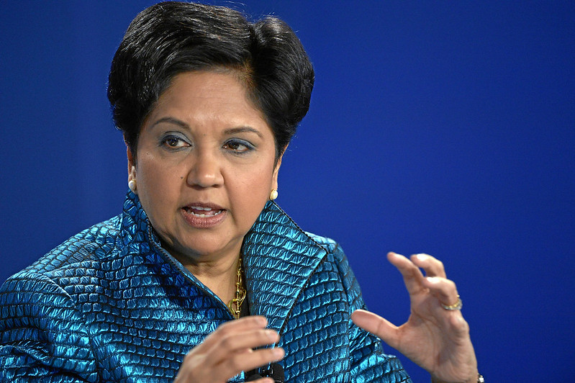
3.2 Case in Point: Indra Nooyi Draws on Vision and Values to Lead
Indra Nooyi is among the top 100 most influential people according to Time magazine’s 2008 list. She has also ranked number 4 in Forbes’s “Most Influential Women in the World” (2010), number 1 in Fortune’s “50 Most Powerful Women” (2006 through 2009), and number 22 in Fortune’s “25 Most Powerful People in Business” (2007). The lists go on and on.
Notes:
To those familiar with her work and style, this should come as no surprise: Even before she became the CEO of PepsiCo Inc. (NYSE: PEP) in 2006, she was one of the most powerful executives at PepsiCo and one of the two candidates being groomed for the coveted CEO position. Born in Chennai, India, Nooyi graduated from Yale’s School of Management and worked in companies such as the Boston Consulting Group Inc., Motorola Inc., and ABB Inc. She also led an all-girls rock band in high school, but that is a different story.

Slide 5
3.3 The Nature of Leadership I
The Nature of Leadership
The many definitions of leadership each have a different emphasis. Some definitions consider leadership an act or behavior, such as initiating structure so group members know how to complete a task. Others consider a leader to be the center or nucleus of group activity, an instrument of goal achievement who has a certain personality, a form of persuasion and power, and the art of inducing compliance (Bass, 1990).
Notes:
Some look at leadership in terms of the management of group processes. In this view, a good leader develops a vision for the group, communicates that vision (Bennis, 1989; Bennis & Nanus, 1985), orchestrates the group’s energy and activity toward goal attainment, “[turns] a group of individuals into a team,” and “[transforms] good intentions into positive actions” (Pickens, 1992).

Slide 6
3.3 The Nature of Leadership II
Leader versus Manager
According to many, the dual concepts of leader and manager/leadership and management, are not interchangeable, nor are they redundant. This can be confusing, as generally, to be a good manager one needs to be an effective leader. Many CEOs have been hired in the hope that their leadership skills, their ability to formulate a vision, and get others to “buy into” that vision, will propel the organization forward.
Notes:
This is not always the case. Effective leadership necessitates the ability to manage—to set goals; plan, devise, and implement strategy; make decisions and solve problems; and organize and control. Effective leadership calls for the ability to manage, and effective management requires leadership.

Slide 7
3.4 The Leadership Process I
Leadership is a process, a complex and dynamic exchange relationship built over time between leader and follower and between leader and the group of followers who depend on each other to attain a mutually desired goal.
(Hollander & Julian, 1969)

Slide 8
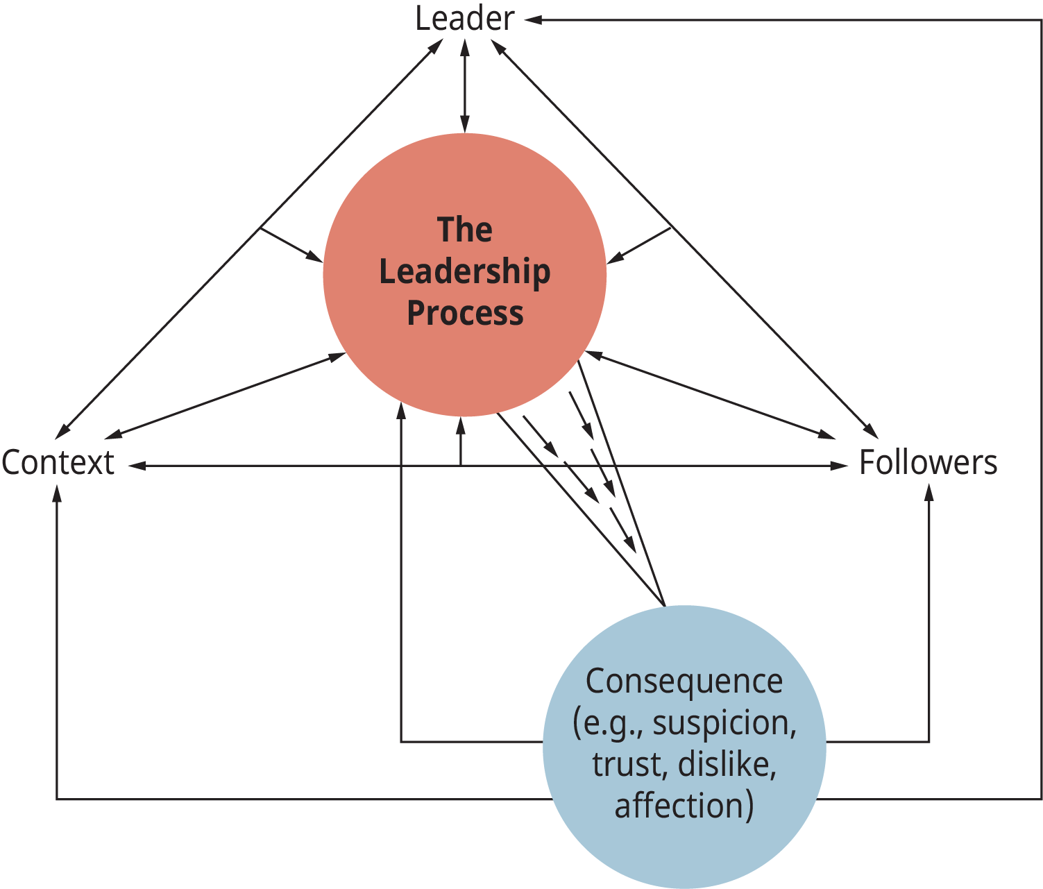
3.4 The Leadership Process II
Notes:
There are several key components to this “working relationship”: the leader, the followers, the context (situation), the leadership process per se, and the consequences (outcomes) (see Figure 3.4.1) (Stogdill, 1948). Across time, each component interacts with and influences the other components, and whatever consequences (such as leader-follower trust) are created influence future interactions. As any one of the components changes, so too will leadership (Murphy, 1941).
Leaders are people who take charge of or guide the activities of others. They are often seen as the focus or orchestrater of group activity, the people who set the tone of the group so that it can move forward to attain its goals
The follower is not a passive player in the leadership process. Edwin Hollander, after many years of studying leadership, suggested that the follower is the most critical factor in any leadership event (Hollander, 1964).
The Context- Situations make demands on a group and its members, and not all situations are the same. Context refers to the situation that surrounds the leader and the followers. Situations are multidimensional.
The Process- The process of leadership is separate and distinct from the leader (the person who occupies a central role in the group). The process is a complex, interactive, and dynamic working relationship between leader and followers.
The Consequences- A number of outcomes or consequences of the leadership process unfold between leader, follower, and situation

Slide 9
3.5 Paths to Leadership and Influence I
How do leaders influence and move their followers to action?
Leaders hold a unique position in their groups, exercising influence and providing direction. Leonard Bernstein was part of the symphony, but his role as the New York Philharmonic conductor differed dramatically from that of the other symphony members. Besides conducting the orchestra, he created a vision for the symphony. In this capacity, leadership can be seen as a differentiated role and the nucleus of group activity.

Slide 10
3.5 Paths to Leadership and Influence II
Paths to Leadership
Notes:
People come to leadership positions through two dynamics. In many instances, people are put into positions of leadership by forces outside the group. University-based ROTC programs and military academies (like West Point) formally groom people to be leaders.
We refer to this person as the designated leader (in this instance the designated and formal leader are the same person). Emergent leaders, on the other hand, arise from the dynamics and processes that unfold within and among a group of individuals as they endeavor to achieve a collective goal.

Slide 11
3.5 Paths to Leadership and Influence III
Leadership as an Exercise of Influence
French and Raven provide us with a useful typology that identifies the sources and types of power that may be at the disposal of leaders:
Reward power
Coercive power
Referent power
Expert power
Legitimate power
Notes:
As we have noted, leadership is the exercise of influence over those who depend on one another for attaining a mutual goal in a group setting. But how do leaders effectively exercise this influence? Social or (interpersonal) influence is one’s ability to effect a change in the motivation, attitudes, and/or behaviors of others. Power, then, essentially answers the “how” question: How do leaders influence their followers? The answer often is that a leader’s social influence is the source of his power.
Reward power—the power a person has because people believe that they can bestow rewards or outcomes, such as money or recognition that others desire
Coercive power—the power a person has because people believe that the person can punish them by inflicting pain or by withholding or taking away something that they value
Referent power—the power a person has because others want to associate with or be accepted by him
Expert power—the power a person has because others believe that the person has and is willing to share expert knowledge that they need
Legitimate power—the power a person has because others believe that the person possesses the “right” to influence them and that they ought to obey.

Slide 12
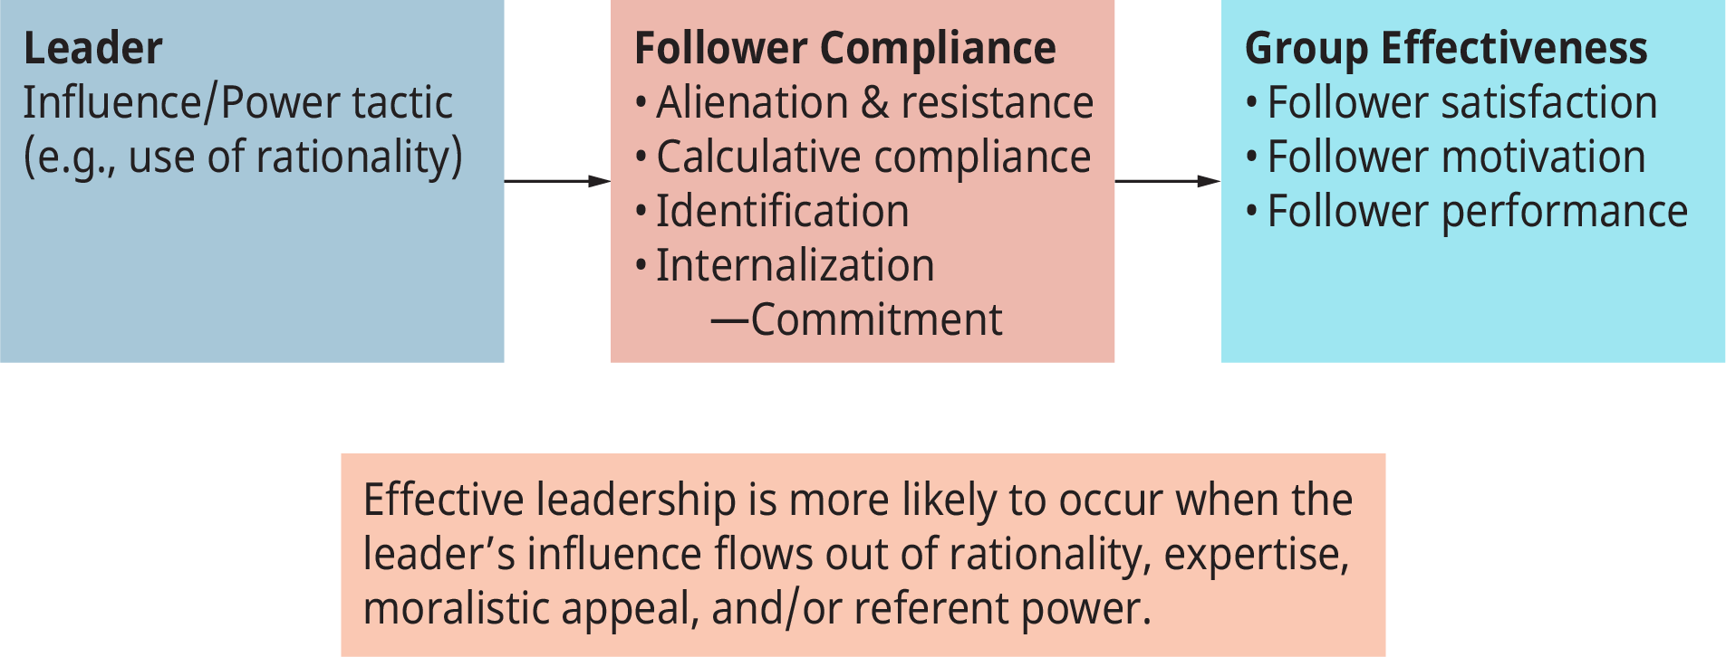
3.5 Paths to Leadership and Influence IV
The Leader-Follower Power Relationship
Notes:
Leaders who use referent and expert power commonly experience a favorable response in terms of follower satisfaction and performance. Research suggests that rationality is the most effective influence tactic in terms of its impact on follower commitment, motivation, performance, satisfaction, and group effectiveness (Yukl & Tracey, 1992; Hinkin & Schriesheim, 1990; Podsakoff & Schriesheim, 1985).
Reward and legitimate power (that is, relying on one’s position to influence others) produce inconsistent results. Sometimes these powers lead to follower performance and satisfaction, yet they also sometimes fail. Coercive power can result in favorable performance, yet follower and resistance dissatisfaction are not uncommon.

Slide 13
3.6 Who Is a Leader? Trait Approaches to Leadership I
Traits of a Successful Leader
The [successful] leader is characterized by a strong drive for responsibility and task completion, vigor and persistence in pursuit of goals, venturesomeness and originality in problem-solving, drive to exercise initiative in social situations, self-confidence and sense of personal identity, willingness to accept consequences of decision and action, readiness to absorb interpersonal stress, willingness to tolerate frustration and delay, ability to influence other person’s behavior, and capacity to structure social interaction systems to the purpose at hand.
(Stogdill, 1948).

Slide 14
3.6 Who Is a Leader? Trait Approaches to Leadership II
Notes:
The last three decades of the 20th century witnessed continued exploration of the relationship between traits and both leader emergence and leader effectiveness. Edwin Locke from the University of Maryland and a number of his research associates reviewed the trait research and observed that successful leaders possess a set of core characteristics that are different from those of other people (Kirkpatrick & Locke, 1991; Locke et al., 1991).
Although these core traits do not solely determine whether a person will be a leader—or a successful leader—they are seen as preconditions that endow people with leadership potential. Among the core traits identified are:
Drive—a high level of effort, including a strong desire for achievement as well as high levels of ambition, energy, tenacity, and initiative
Leadership motivation—an intense desire to lead others
Honesty and integrity—a commitment to the truth, where word and deed correspond
Self-confidence—an assurance in one’s self, one’s ideas, and one’s ability
Cognitive ability—conceptually skilled, capable of exercising good judgment, having strong analytical abilities, possessing the capacity to think strategically and multidimensionally
Knowledge of the business—a high degree of understanding of the company, industry, and technical matters
Other traits—charisma, creativity/originality, and flexibility/adaptiveness
(Kirkpatrick & Locke, 1991)

Slide 15
3.6 Who Is a Leader? Trait Approaches to Leadership III
The Big Five Personality Traits
Psychologists have proposed various systems for categorizing the characteristics that make up an individual’s unique personality; one of the most widely accepted is the Big Five model, which rates an individual according to openness to experience, conscientiousness, extraversion, agreeableness, and Neuroticism.
Notes:
Openness- Being curious, original, intellectual, creative, and open to new ideas.
Conscientious- Being organized, systematic, punctual, achievement-oriented, and dependable
Extraversion- Being outgoing, talkative, sociable, and enjoying social situations.
Agreeableness- Being affable, tolerant, sensitive, trusting, kind, and warm.
Neuroticism- Being anxious, irritable, temperamental, and moody.

Slide 16
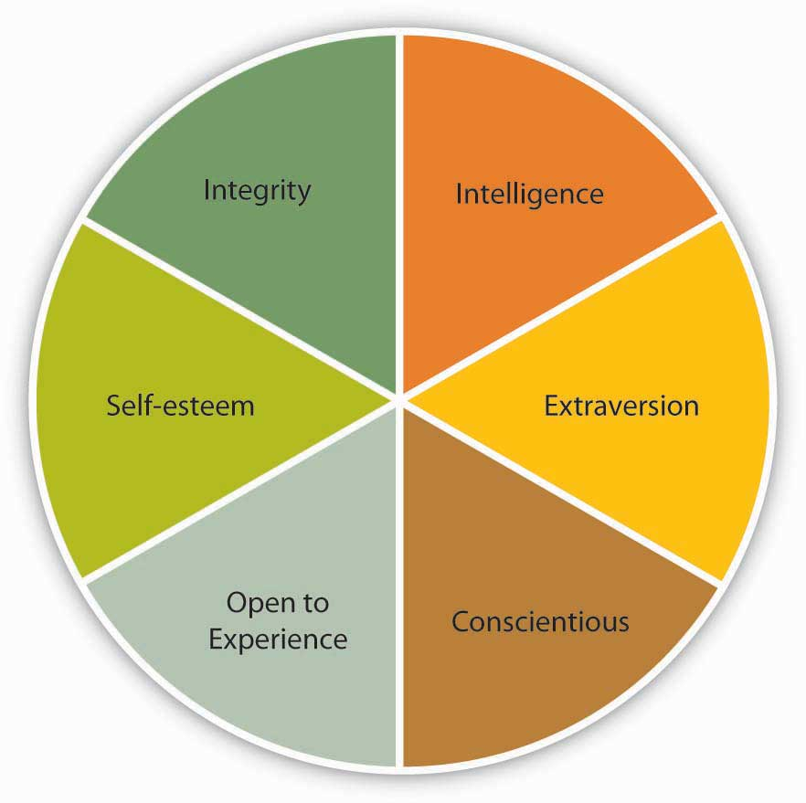
3.6 Who Is a Leader? Trait Approaches to Leadership IV
Notes:
Intelligence- General mental ability, which psychologists refer to as “g” and which is often called IQ in everyday language, has been related to a person’s emerging as a leader within a group. Specifically, people who have high mental abilities are more likely to be viewed as leaders in their environment (House & Aditya, 1997; Ilies et al., 2004; Lord et al., 1986; Taggar et al., 1999).
Self-Esteem- Self-esteem is not one of the Big Five personality traits, but it is an important aspect of one’s personality. The degree to which people are at peace with themselves and have an overall positive assessment of their self-worth and capabilities seems to be relevant to whether they will be viewed as a leader.
Integrity- Research also shows that people who are effective as leaders tend to have a moral compass and demonstrate honesty and integrity (Reave, 2005). Leaders whose integrity is questioned lose their trustworthiness, and they hurt their company’s business along the way.

Slide 17
3.7 What Do Leaders Do? Behavioral Approaches to Leadership I
Leader Behaviors
Task-oriented leader behaviors involve structuring the roles of subordinates, providing them with instructions, and behaving in ways that will increase the performance of the group. Task-oriented behaviors are directives given to employees to get things done and to ensure that organizational goals are met.
People-oriented leader behaviors include showing concern for employee feelings and treating employees with respect. People-oriented leaders genuinely care about the well-being of their employees and they demonstrate their concern in their actions and decisions.
Notes:
In order to understand behaviors of effective leaders, researchers at Ohio State University and University of Michigan used many different techniques such as observing leaders in laboratory settings as well as surveying them. This research stream led to the discovery of two broad categories of behaviors: task-oriented behaviors (sometimes called initiating structure) and people-oriented behaviors (also called consideration)

Slide 18
3.7 What Do Leaders Do? Behavioral Approaches to Leadership II
Leader Decision Making
Three types of decision-making styles were studied. In authoritarian decision-making, leaders make the decision alone without necessarily involving employees in the decision-making process. When leaders use democratic decision-making, employees participate in the making of the decision. Finally, leaders using laissez-faire decision-making leave employees alone to make the decision; the leader provides minimum guidance and involvement in the decision.
Notes:
Another question behavioral researchers focused on was how leaders actually make decisions, and the influence of decision-making styles on leader effectiveness and employee reactions.
The effectiveness of each style seems to depend on who is using it. There are examples of effective leaders using both authoritarian and democratic styles. For example, Larry Page and Sergey Brin at Google are known for their democratic decision-making styles. At Hyundai USA, high-level managers use authoritarian decision-making styles, and the company is performing well (Deutschman, 2004; Welch et al, 2008).

Slide 19
3.7 What Do Leaders Do? Behavioral Approaches to Leadership III
Limitations of Behavioral Approaches
Behavioral approaches, similar to trait approaches, fell out of favor because they neglected the environment in which behaviors are demonstrated. The hope of the researchers was that the identified behaviors would predict leadership under all circumstances, but it may be unrealistic to expect that a given set of behaviors would work under all circumstances.
Notes:
What makes a high school principal effective on the job may be very different from what makes a military leader, which would be different from behaviors creating success in small or large business enterprises. It turns out that specifying the conditions under which these behaviors are more effective may be a better approach.

Slide 20
3.8 What Is the Role of the Context? Contingency Approaches to Leadership I
Fiedler’s Contingency Theory
According to Fiedler’s theory, different people can be effective in different situations. The LPC score is akin to a personality trait and is not likely to change. Instead, placing the right people in the right situation or changing the situation is important to increase a leader’s effectiveness.
Notes:
The earliest and one of the most influential contingency theories was developed by Frederick Fiedler (1967). According to the theory, a leader’s style is measured by a scale called Least Preferred Coworker (LPC) scale.
The theory predicts that in “favorable” and “unfavorable” situations, a low LPC leader—one who has feelings of dislike for coworkers who are difficult to work with—would be successful. When situational favorableness is medium, a high LPC leader—one who is able to personally like coworkers who are difficult to work with—is more likely to succeed.

Slide 21
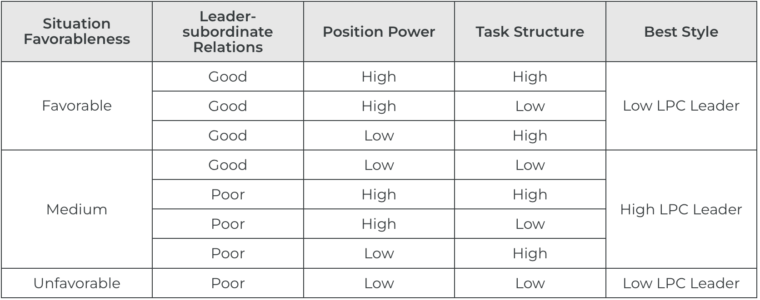
3.8 What Is the Role of the Context? Contingency Approaches to Leadership II
Situational Leadership
Notes:
Another contingency approach to leadership is Kenneth Blanchard and Paul Hersey’s Situational Leadership Theory (SLT) which argues that leaders must use different leadership styles depending on their followers’ development level (Hersey et al., 2007). According to this model, employee readiness (defined as a combination of their competence and commitment levels) is the key factor determining the proper leadership style.

Slide 22
3.8 What Is the Role of the Context? Contingency Approaches to Leadership III
Path-Goal Theory of Leadership
Robert House’s path-goal theory of leadership is based on the expectancy theory of motivation (1971). Expectancy theory of motivation suggests that employees are motivated when they believe—or expect—that
their effort will lead to high performance
their high performance will be rewarded
the rewards they will receive are valuable to them
Notes:
According to the path-goal theory of leadership, the leader’s main job is to make sure that all three of these conditions exist. Thus, leaders will create satisfied and high-performing employees by making sure that employee effort leads to performance, and that their performance is rewarded. The leader removes roadblocks along the way and creates an environment that subordinates find motivational.
The theory also makes specific predictions about what type of leader behavior will be effective under which circumstances (House, 1996; House & Mitchell, 1974). The theory identifies four leadership styles: directive, supportive, participative, and achievement-oriented. Each of these styles can be effective, depending on the characteristics of employees (such as their ability level, preferences, locus of control, achievement motivation) and characteristics of the work environment (such as the level of role ambiguity, the degree of stress present in the environment, the degree to which the tasks are unpleasant).
Directive leaders provide specific directions to their employees. They lead employees by clarifying role expectations, setting schedules, and making sure that employees know what to do on a given workday.
Supportive leaders provide emotional support to employees. They treat employees well, care about them on a personal level, and are encouraging. Supportive leadership is predicted to be effective when employees are under a lot of stress or when they are performing boring and repetitive jobs.
Participative leaders make sure that employees are involved in making important decisions. Participative leadership may be more effective when employees have high levels of ability and when the decisions to be made are personally relevant to them.
Achievement-oriented leaders set goals for employees and encourage them to reach their goals. Their style challenges employees and focuses their attention on work-related goals.

Slide 23
3.8 What Is the Role of the Context? Contingency Approaches to Leadership IV
Vroom and Yetton’s Normative Decision Model
Yale School of Management professor Victor Vroom and his colleagues Philip Yetton and Arthur Jago developed a decision-making tool to help leaders determine how much involvement they should seek when making decisions (Vroom, 2000; Vroom & Yetton, 1973; Jago & Vroom, 1980; Vroom & Jago, 1988). The model starts by having leaders answer several key questions and working their way through a funnel based on their responses.
Notes:
Imagine that you want to help your employees lower their stress so that you can minimize employee absenteeism. There are a number of approaches you could take to reduce employee stress, such as offering gym memberships, providing employee assistance programs, establishing a nap room, and so forth. Let’s refer to the model and start with the first question. As you answer each question as high (H) or low (L), follow the corresponding path down the funnel.

Slide 24
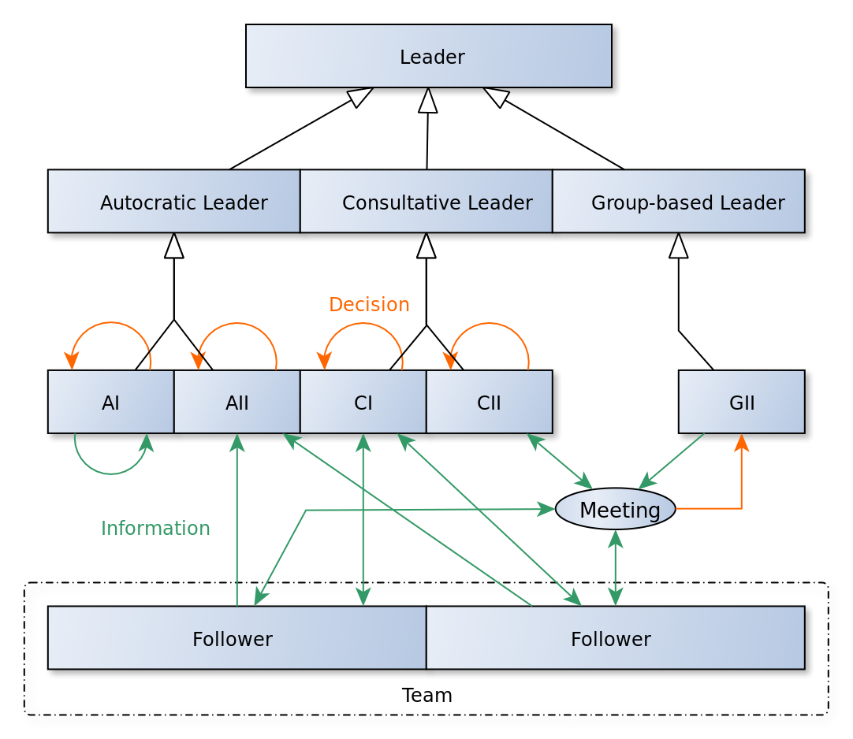
3.8 What Is the Role of the Context? Contingency Approaches to Leadership V
“Vroom-Yetton Leader Styles”
Notes:
Vroom and Yetton’s model is somewhat complicated, but research results support the validity of the model. On average, leaders using the style recommended by the model tend to make more effective decisions compared with leaders using a style not recommended by the model (Vroom & Jago, 1978).

Slide 25
3.9 Substitutes for and Neutralizers of Leadership
What does the concept “substitute for leadership” mean?
Substitutes for leadership behavior can clarify role expectations, motivate organizational members, or satisfy members (making it unnecessary for the leader to attempt to do so). In some cases, these substitutes supplement the behavior of a leader. Sometimes it is a group member’s characteristics that make leadership less necessary, as when a master craftsperson or highly skilled worker performs up to his or her own high standards without needing outside prompting.
Notes:
Sometimes the task’s characteristics take over, as when the work itself—solving an interesting problem or working on a familiar job—is intrinsically satisfying. Sometimes the characteristics of the organization make leadership less necessary, as when work rules are so clear and specific that workers know exactly what they must do without help from the leader.

Slide 26
3.10 Key Terms I
Achievement-oriented leaders set goals for employees and encourage them to reach their goals.
Authoritarian decision-making occurs when leaders make the decision alone without involving employees in the process.
Coercive power is the ability a person has through their formal role in the organization to bestow punishment by withholding or taking away something that they value.
Context refers to the situation that surrounds the leader and the followers.
Democratic decision-making occurs when employees participate in the process of decision making.
Directive leaders provide specific directions to their employees.
Emergent leaders arise from the dynamics and processes that unfold within and among a group of individuals as they endeavor to achieve a collective goal.

Slide 27
3.10 Key Terms II
Expert power is personal power bestowed by those who believe an individual has the knowledge and skill sets that they themselves need.
Followers actively support and accept a leader’s influence.
Formal leader is an individual who is recognized by those outside the group as the official leader of the group.
Formal leaders hold a position of authority and may use the power that comes from their position, as well as their personal power, to influence others.
Informal leader is not chosen by the organization but whom members of the group acknowledge as their leader.
Informal leaders are without a formal position of authority within the organization but demonstrate leadership by influencing others through personal forms of power.
Laissez-faire decision-making occurs when employees are left alone to make decisions with minimal guidance and involvement from the leader.
Leaders are people who influence the actions of others.

Slide 28
3.10 Key Terms
Leadership may be defined as the act of influencing others to work toward a goal.
Legitimate power is formally bestowed by the organization and gives an individual the “right” to influence them through a title which followers ought to obey.
Neutralizers of leadership can negate the influence a leader has by preventing them from acting as they wish.
Participative leaders make sure that employees are involved in making important decisions.
People-oriented leader behaviors focus on relationships and include showing concern for employee feelings and treating employees with respect.
Process of leadership is a complex, interactive, and dynamic working relationship between leader and followers that is built over time and is directed toward fulfilling the group’s maintenance and task needs.
Referent power is not formally bestowed by the organization but rather by colleagues who want to associate and be accepted by an individual due to their admiration and respect for them.

Slide 29
3.10 Key Terms
Reward power is the ability a person has through their formal role in the organization to bestow rewards or outcomes.
Self-esteem the degree to which people are at peace with themselves and have an overall positive assessment of their self-worth and capabilities.
Self-monitoring refers to an individual’s ability and willingness to read social cues and regulate their self-presentation to fit a particular situation.
Situational Leadership Theory (SLT) suggests the use of different leadership styles depending on the competence and commitment levels of followers.
Supportive leaders provide emotional support to employees.
Task-oriented leader behaviors involve structuring the roles of subordinates, providing them with instructions, and behaving in ways that will increase the performance of the group.

