Slide 1
Principles of Leadership & Management
CHAPTER 2: PERSONALITY & LEADERSHIP
Unless otherwise noted, this work is licensed under a Creative Commons Attribution-NonCommercial-ShareAlike 4.0 International (CC BY-NC-SA 4.0) license. Feel free to use, modify, reuse or redistribute any portion of this presentation.

Slide 2
Learning Outcomes
Upon successful completion of this chapter, you will be able to:
Describe the roles of personality and values in determining work behaviors.
Explain the process of perception and how it affects work behaviors.
Identify the major work attitudes that affect work behaviors.
Define the concept of person-organization fit and how it affects work behaviors.
List the key set of behaviors that matter for organizational performance.
Demonstrate positive attitude skills.

Slide 3
2.1 Personality and Leadership Introduction I
Individuals bring a number of differences to work. They have a variety of personalities, values, and attitudes. When they enter into organizations, their stable or transient characteristics affect how they behave and perform. Moreover, companies hire people with the expectation that they have certain knowledge, skills, abilities, personalities, and values.
Notes:
It is important for leaders to understand the individual characteristics that matter for employee and manager behavior. In this chapter, you will begin to see the terms leader and manager intermingling more in the text. For some, this may be an affront to leadership principles, but the fact remains that good managers are leaders. As management professor and researcher Henry Mintzberg said, “Being an engaged leader means you must be reflective while staying in the fray – the hectic, fragmented, never-ending world of managing” (Mintzberg, 2009). Read more to support this concept by Henry Mintzberg.

Slide 4
2.1 Personality and Leadership Introduction II
Notes:
Recall the approach to principles of leadership and management through the planning-organizing-leading-controlling (P-O-L-C) framework as shown in Table 2.1.1. Employees’ personalities, attitudes, and work behaviors affect how managers approach each P-O-L-C dimension.
Here are just a few examples:
When conducting environmental scanning during the planning process, a manager’s perceptions color the information that is absorbed and processed.
Employee preferences for job design and enrichment (aspects of organizing) may be a function of individuals’ personalities and values.
Leading effectively requires an understanding of employees’ personalities, values, and attitudes.
Absenteeism can challenge a manager’s ability to control costs and performance (at both the group and individual levels).

Slide 5
2.2 Case in Point: SAS Institute Invests in Employees
SAS has perfected the art of employee management. It has been ranked on Fortunemagazine’s best places to work list every year since the list was first published. Employees seem to genuinely enjoy working at SAS and are unusually attached to the company, resulting in a turnover rate that is less than 4% in an industry where 20% is the norm. In fact, when Google designed their own legendary campus in California, they visited the SAS campus to get ideas.
Notes:
Who are your best customers? Which customers are bringing you the most profits and which are the least profitable? Companies are increasingly relying on complicated data mining software to answer these and other questions. More than 92% of the top 100 companies on the Fortune Global 500 list are using software developed by SAS Institute Inc., the world’s largest privately held software company, for their business intelligence and analytical needs.
The Cary, North Carolina, company is doing extremely well by any measure. They have over 10,000 employees worldwide, operates in over 100 countries, ranked number 1 on Fortune’s 2010 list of the “Best Companies to Work For,” and reported $2.31 billion in revenue in 2009 (their 33rd consecutive year of growth and profitability). They reinvested 23% of their 2009 revenue into research and development (R&D) activities. The company is quick to attribute its success to the performance and loyalty of its workforce. This is directly correlated with how they treat their employees.

Slide 6
2.3 Personality and Values I
Personality
Personality encompasses a person’s relatively stable feelings, thoughts, and behavioral patterns. Each of us has a unique personality that differentiates us from other people, and understanding someone’s personality gives us clues about how that person is likely to act and feel in a variety of situations.
Notes:
To lead effectively, it is helpful to understand the personalities of different employees. Having this knowledge is also useful for placing people into jobs and organizations.

Slide 7
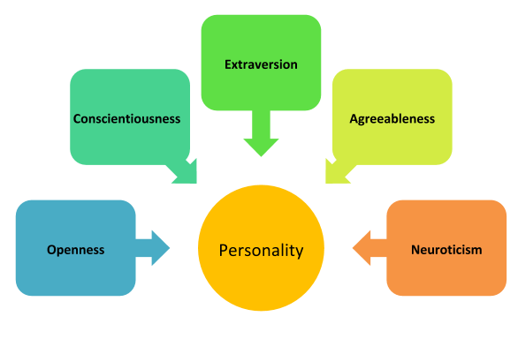
2.3 Personality and Values II
Notes:
These five are not necessarily the only traits out there. There are other, specific traits that represent other dimensions not captured by the Big Five. Still, understanding them gives us a good start for describing personality.
How many personality traits are there? How do we even know? In every language, there are many words describing a person’s personality. In fact, in the English language, more than 15,000 words describing personality have been identified. When researchers analyzed the traits describing personality characteristics, they realized that many different words were actually pointing to a single dimension of personality. When these words were grouped, five dimensions (known as the Big Five) seemed to emerge, and these explain much of the variation in our personalities (Goldberg, 1990).

Slide 8
2.3 Personality and Values III
Notes:
As you can see, the Big Five dimensions are openness, conscientiousness, extraversion, agreeableness, and Neuroticism—if you put the initials together, you get the acronym OCEAN. Everyone has some degree of each of these traits; it is the unique configuration of how high a person rates on some traits and how low on others that produces the individual quality we call personality.
Openness is the degree to which a person is curious, original, intellectual, creative, and open to new ideas. People high in openness seem to thrive in situations that require flexibility and learning new things. They are highly motivated to learn new skills, and they do well in training settings (Barrick & Mount, 1991; Lievens et al., 2003).
Conscientiousness refers to the degree to which a person is organized, systematic, punctual, achievement-oriented, and dependable. Conscientiousness is the one personality trait that uniformly predicts how high a person’s performance will be across a variety of occupations and jobs (Barrick & Mount, 1991).
Extraversion is the degree to which a person is outgoing, talkative, sociable, and enjoys socializing. One of the established findings is that they tend to be effective in jobs involving sales (Barrick & Mount, 1991; Vinchur et al., 1998).
Agreeableness is the degree to which a person is affable, tolerant, sensitive, trusting, kind, and warm. In other words, people who are high in agreeableness are likable people who get along with others. Not surprisingly, agreeable people help others at work consistently; this helping behavior does not depend on their good mood (Ilies et al., 2006).
Neuroticism refers to the degree to which a person is anxious, irritable, temperamental, and moody. It is perhaps the only Big Five dimension in which scoring high is undesirable. Neurotic people have a tendency to have emotional adjustment problems and habitually experience stress and depression. People with very high neuroticism experience a number of problems at work.

Slide 9
2.3 Personality and Values IV
Values
Values refer to people’s stable life goals, reflecting what is most important to them. Values are established throughout one’s life as a result of accumulating life experiences, and values tend to be relatively stable (Lusk & Oliver, 1974; Rokeach, 1973).
Notes:
The values that are important to a person tend to affect the types of decisions they make, how they perceive their environment, and their actual behaviors. Moreover, a person is more likely to accept a job offer when the company possesses the values he or she cares about (Judge & Bretz, 1992; Ravlin & Meglino, 1987)
Value attainment is one reason people stay in a company. When a job does not help them attain their values, they are likely to decide to leave if they are dissatisfied with the job (George & Jones, 1996).

Slide 10
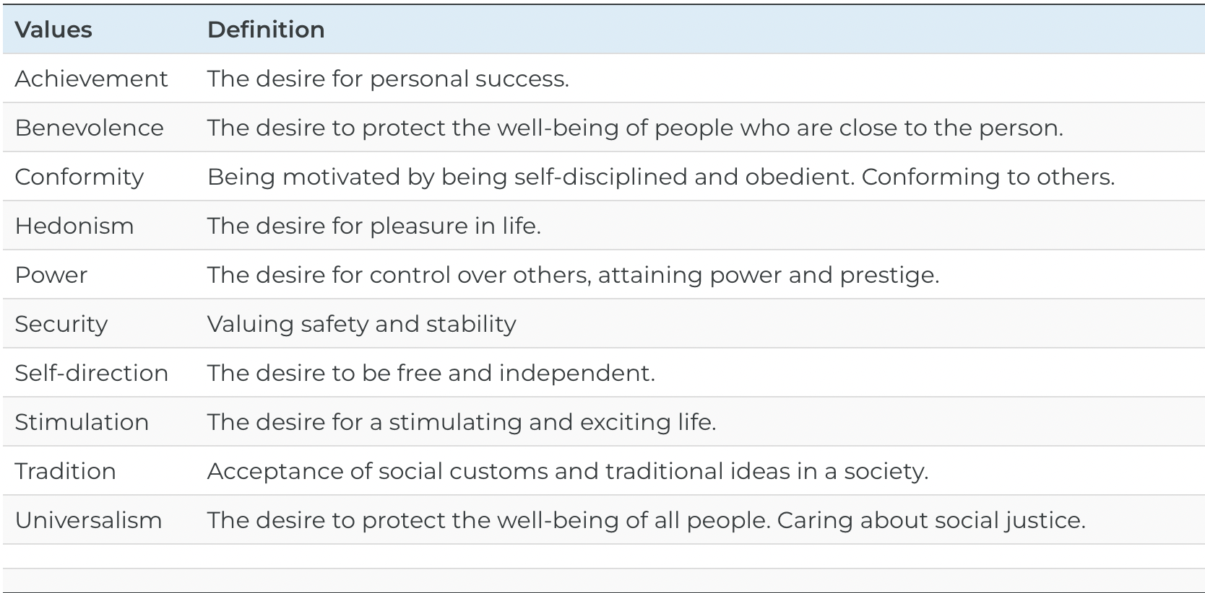
2.3 Personality and Values V
Notes:
Values a person holds will affect their employment. For example, someone who values stimulation highly may seek jobs that involve fast action and high risk, such as firefighter, police officer, or emergency medicine. Someone who values achievement highly may be likely to become an entrepreneur or intrapreneur.

Slide 11
2.4 Perception I
Our behavior is not only a function of our personality and values but also of the situation. We interpret our environment, formulate responses, and act accordingly. Perception may be defined as the process by which individuals detect and interpret environmental stimuli.
Notes:
What makes human perception so interesting is that we do not solely respond to the stimuli in our environment. We go beyond the information that is present in our environment, pay selective attention to some aspects of the environment, and ignore other elements that may be immediately apparent to other people.

Slide 12
2.4 Perception II
Visual Perception
Our visual perception definitely goes beyond the physical information available to us; this phenomenon is commonly referred to as “optical illusions.” Artists and designers of everything from apparel to cars to home interiors make use of optical illusions to enhance the look of the product.
Notes:
Leaders and managers rely on their visual perception to form their opinions about people and objects around them and to make sense of data presented in graphical form. Therefore, understanding how our visual perception may be biased is important.
First, we extrapolate from the information available to us. Take a look at Figure 2.4.1. The white triangle you see in the middle is not really there, but we extrapolate from the information available to us and see it there. Similarly, when we look at objects that are partially blocked, we see the whole (Kell

Slide 13
2.4 Perception III
Now, let’s look at this figure. What do you see?
Most people look at this figure and see two faces or a goblet, depending on which color—black or white—they focus upon. Our visual perception is often biased because we do not perceive objects in isolation. The contrast between our focus of attention and the remainder of the environment may make an object appear bigger or smaller.
Notes:
How do these tendencies influence behavior in organizations? The fact that our visual perception is faulty means that leaders should not always take what they see at face value. Let’s say that you do not like one of your peers and you think that you saw this person surfing the Web during work hours. Are you absolutely sure, or are you simply filling the gaps? Have you really seen this person surf unrelated Web sites, or is it possible that the person was searching for work-related purposes? The tendency to fill in the gaps also causes our memory to be faulty.

Slide 14
2.4 Perception IV
Self-Perception
Human beings are prone to errors and biases when perceiving themselves. Moreover, the type of bias people have depends on their personality. Many people suffer from self-enhancement bias. This is the tendency to overestimate our performance and capabilities and see ourselves in a more positive light than others see us.
Notes:
People who have a narcissistic personality are particularly subject to this bias, but many others also have this bias to varying degrees (John & Robins, 1994). At the same time, other people have the opposing extreme, which may be labeled as self-effacement bias (or modesty bias).
This is the tendency to underestimate our performance and capabilities and to see events in a way that puts us in a more negative light. We may expect that people with low self-esteem may be particularly prone to making this error. These tendencies have real consequences for behavior in organizations.

Slide 15
2.4 Perception V
Social Perception
One of the factors biasing our perception is stereotypes. Stereotypes are generalizations based on a group characteristic. For example, believing that women are more cooperative than men or that men are more assertive than women are stereotypes. Stereotypes may be positive, negative, or neutral.
Notes:
How we perceive other people in our environment is also shaped by our biases. Moreover, how we perceive others will shape our behavior, which in turn will shape the behavior of the person we are interacting with.
In the abstract, stereotyping is an adaptive function—we have a natural tendency to categorize the information around us to make sense of our environment. Just imagine how complicated life would be if we continually had to start from scratch to understand each new situation and each new person we encountered!

Slide 16
2.5 Work Attitudes I
How we behave at work often depends on how we feel about being there. Therefore, making sense of how people behave depends on understanding their work attitudes. An attitude refers to our opinions, beliefs, and feelings about aspects of our environment. We have attitudes toward the food we eat, people we meet, courses we take, and things we do. At work, two job attitudes have the greatest potential to influence how we behave. These are job satisfaction and organizational commitment.

Slide 17
2.5 Work Attitudes II
Job satisfaction refers to the feelings people have toward their job. If the number of studies conducted on job satisfaction is an indicator, job satisfaction is probably the most important job attitude.
Notes:
Institutions such as Gallup or the Society for Human Resource Management (SHRM) periodically conduct studies of job satisfaction to track how satisfied employees are at work. According to a recent Gallup survey, 90% of the employees surveyed said that they were at least somewhat satisfied with their jobs. A recent SHRM study revealed 40% who were very satisfied (Sandberg, 2008).

Slide 18
2.5 Work Attitudes III
Organizational commitment is the emotional attachment people have toward the company they work for. A highly committed employee is one who accepts and believes in the company’s values, is willing to put out the effort to meet the company’s goals, and has a strong desire to remain with the company.
Notes:
People who are committed to their company often refer to their company as “we” as opposed to “they” as in “in this company, we have great benefits.” The way we refer to the company indicates the type of attachment and identification we have with the company.

Slide 19
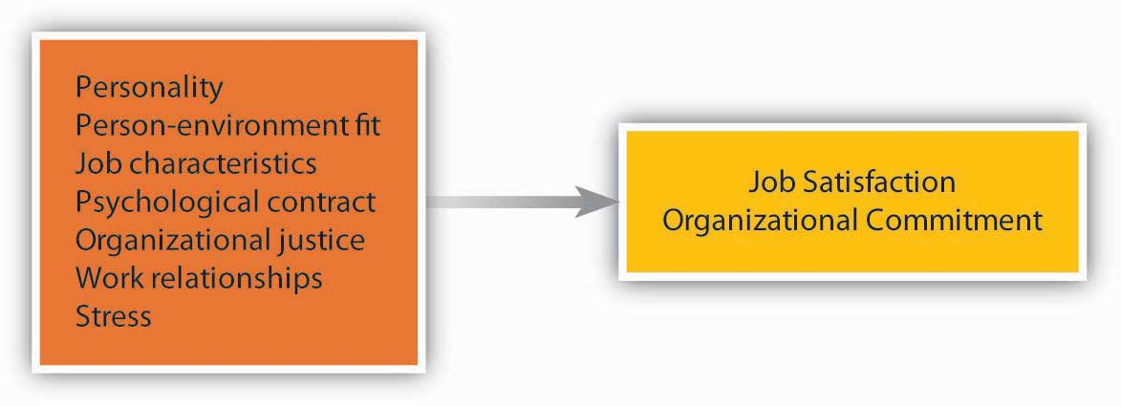
2.5 Work Attitudes IV
What Causes Positive Work Attitudes?
Notes:
What makes you satisfied with your job and develop a commitment to your company? Research shows that people pay attention to several factors of their work environment, including characteristics of the job (a function of Organizing activities), how they are treated (related to Leadership actions), the relationships they form with colleagues and managers (also Leadership related), and the level of stress the job entails.
As we have seen earlier in this chapter, personality and values play important roles in how employees feel about their jobs.
Employees tend to be more satisfied and committed to jobs that involve certain characteristics. The ability to use a variety of skills, having autonomy at work, receiving feedback on the job, and performing a significant task, are some job characteristics that are related to satisfaction and commitment.

Slide 20
2.5 Work Attitudes V
Organizational Justice and the Psychological Contract
A strong influence over our satisfaction level is how fairly we are treated. People pay attention to the fairness of company policies and procedures, fair and kind treatment from supervisors, and fairness of their pay and other rewards they receive from the company (Cohen-Charash & Spector, 2001; Colquitt et al., 2001; Meyer et al., 2002).
Notes:
Organizational justice can be classified into three categories: (1) procedural (fairness in the way policies and processes are carried out), (2) distributive (the allocation of resources or compensation and benefits), and (3) interactional (the degree to which people are treated with dignity and respect). At the root of organizational justice is trust, something that is easier to break than to repair if broken.

Slide 21
2.5 Work Attitudes VI
Stress
Not surprisingly, the amount of stress present in a job is related to employee satisfaction and commitment. Stressors range from environmental ones to interpersonal ones to organizational ones.
Notes:
Stressors range from environmental ones (noise, heat, inadequate ventilation) to interpersonal ones (organizational politics, conflicts with coworkers) to organizational ones (pressure to avoid making mistakes, worrying about the security of the job).
Some jobs, such as intensive care unit nurse and military fighter pilot, are inherently very stressful.
Another source of stress has to do with the roles people are expected to fulfill on and off the job. Role ambiguity is uncertainty about what our responsibilities are in the job. Role conflict involves contradictory demands at work; it can also involve conflict between fulfilling one’s role as an employee and other roles in life, such as the role of parent, friend, or community volunteer.

Slide 22
2.6 The Interactionist Perspective: The Role of Fit I
As we have seen in the earlier sections of this chapter, human beings bring in their personality, values, attitudes, perceptions, and other stable traits to work. Imagine that you are interviewing an employee who is proactive, creative, and willing to take risks. Would this person be a good job candidate? What behaviors would you expect this person to demonstrate?
The questions we pose here are misleading. While human beings bring their traits to work, every organization is also different, and every job is different.
Notes:
According to the interactionist perspective, behavior is a function of the person and the situation interacting with each other. Think about it. Would a shy person speak up in class? While a shy person may not feel like speaking if he or she is very interested in the subject, knows the answers to the questions, feels comfortable within the classroom environment, and knows that class participation is 30% of the course grade, this person may speak up in class regardless of his or her shyness. Similarly, the behavior you may expect from someone who is proactive, creative, and willing to take risks will depend on the situation.

Slide 23
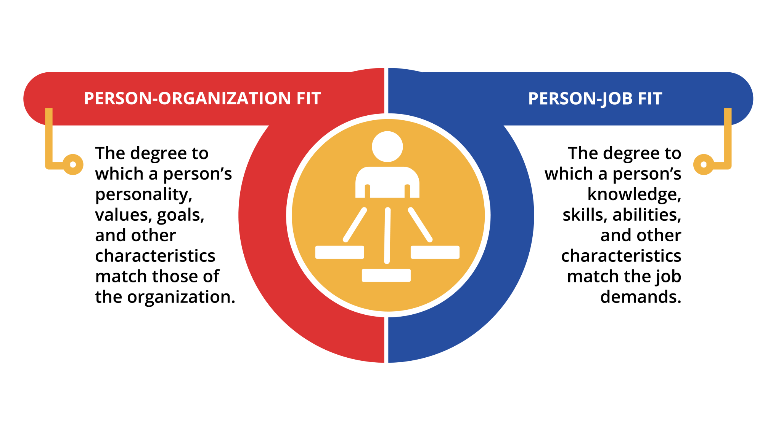
2.6 The Interactionist Perspective: The Role of Fit II
Notes:
When companies hire employees, they are interested in assessing at least two types of fit.
Person-organization fit refers to the degree to which a person’s personality, values, goals, and other characteristics match those of the organization.
Person-job fit is the degree to which a person’s knowledge, skills, abilities, and other characteristics match the job demands.
When people fit into their organization, they tend to be more satisfied with their jobs, more committed to their companies, are more influential in their company, and remain longer in their company (Anderson et al., 2008; Cable & DeRue, 2002; Kristof-Brown et al., 2005; O’Reilly et al., 1991; Saks & Ashforth, 2002).

Slide 24
2.7 Work Behaviors I
One of the important objectives of the field of organizational behavior is to understand why people behave the way they do; understanding organizational behavior is crucial for leaders.

Slide 25
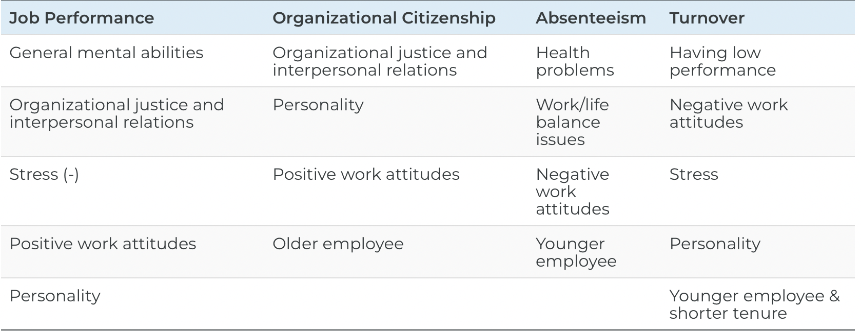
2.7 Work Behaviors II
Notes:
We will focus on four key work behaviors: (1) job performance, (2) organizational citizenship behaviors, (3) absenteeism, and (4) turnover.
Note that the first two behaviors are desirable ones, whereas the other two are often regarded as undesirable. While these four are not the only behaviors organizational behavior is concerned about, if you understand what we mean by these behaviors and the major influences over each type of behavior, you will gain more clarity about analyzing the behaviors of others in the workplace.
Job performance refers to the level to which an employee successfully fulfills the factors included in the job description. For each job, the content of job performance may differ.
Organizational citizenship behaviors (OCB) are voluntary behaviors employees perform to help others and benefit the organization. Helping a new coworker understand how things work in this company, volunteering to organize the company picnic, and providing suggestions to leadership about how to improve business processes are some examples of citizenship behaviors.
Absenteeism refers to unscheduled absences from work. Such absences are costly to companies because of their unpredictable nature, affecting a leader’s ability to control the budget.
Turnover refers to an employee’s leaving an organization. Employee turnover has potentially harmful consequences, such as poor customer service and poor company-wide performance. When employees leave, their jobs still need to be performed by someone, so companies spend time recruiting, hiring, and training new employees, all the while suffering from lower productivity.

Slide 26
2.8 Emotional Intelligence III
Emotional intelligence (or EI, also known as emotional quotient or EQ) has been found to be an important indicator of life and career success – more specifically, success in leadership. Developing your emotional intelligence skills will benefit your personal and professional relationships.
Notes:
EQ refers to a form of social intelligence that involves the ability to monitor one’s own and others’ feelings and emotions, to discriminate among them, and to use this information to guide one’s thinking and actions (Cherniss, 2000). This is different from intelligence quotient (IQ) in that IQ measures intelligence based on a score derived from intelligence tests. Emotional intelligence is the foundation of our interpersonal skills, and these skills are in high demand by employers.

Slide 27
2.8 Emotional Intelligence IV
According to Goleman, many people believe that EI means “being nice”, however this misnomer “prevents leaders from having powerful, productive conversations that build up their ability to influence and lead in all their relationships” (Goleman, 2020).
Goleman’s work outlines four key aspects of emotional intelligence necessary to creating better relationships: self-awareness, self-management, social awareness, and relationship management (Goleman, 1995).

Slide 28
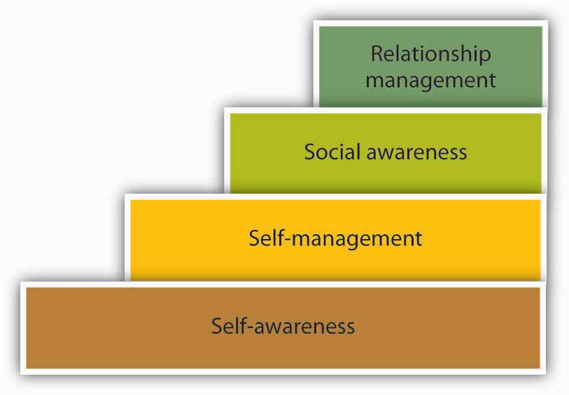
2.8 Emotional Intelligence V
Notes:
The four steps of emotional intelligence build upon one another.
Self-awareness. Self-awareness refers to a person’s ability to understand their feelings from moment to moment. It might seem as if this is something we know, but we often go about our day without thinking or being aware of our emotions that impact how we behave in work or personal situations.
Self-management. Self-management refers to our ability to manage our emotions and is dependent on our self-awareness ability. How do we handle frustration, anger, and sadness? Are we able to control our behaviors and emotions? Self-management also is the ability to follow through with commitments and take initiative at work.
Social awareness. Social awareness is our ability to understand social cues that may affect others around us. In other words, understanding how another is feeling, even if we do not feel the same way. Social awareness also includes having empathy for another and recognizing power structure and unwritten workplace dynamics. Social awareness is akin to social radar.
Relationship management. Relationship management refers to our ability to communicate clearly, maintain good relationships with others, connect with those from other cultures, work well in teams, and manage conflict. Relationship management relies on your ability to use the other three areas of EQ to manage relationships effectively.

Slide 29
2.8 Emotional Intelligence VI
Increase Self-Awareness
To increase self-awareness we should spend time thinking about our emotions to understand why we experience specific emotions. Journaling may be helpful in this process. If we look at those things that cause us strong emotional reactions, such as anger or anxiety, we can begin to understand the underlying reasons for our reactions.
Notes:
This introspection can alert us to patterns within ourselves, give us insight as to how our feelings may affect our behavior, and allow us to better manage those emotions when they arise.

Slide 30
2.8 Emotional Intelligence VII
Increase Self-Management (Self-Leadership)
Notes:
To increase our self-management/self-leadership skills, we can also focus on the positive instead of the negative. Taking deep breaths increases blood flow, which helps us handle difficult situations. Although seemingly childish, counting to ten before reacting can help us manage emotions such as anger. This may provide the time we need to calm down and think about how we will handle the situation
Practicing positive self-talk can help increase our ability to lead ourselves into a better space emotionally, which can affect all areas of our lives. Self-talk refers to the thoughts we have about ourselves and situations throughout the day. Since we have over 60,000 thoughts per day getting into the habit of managing those thoughts is important (Tseng & Poppenk, 2020). Table 2.8.2 provides some examples of both positive and negative thoughts. By recognizing the negative thoughts, we can change them for the positive.

Slide 31
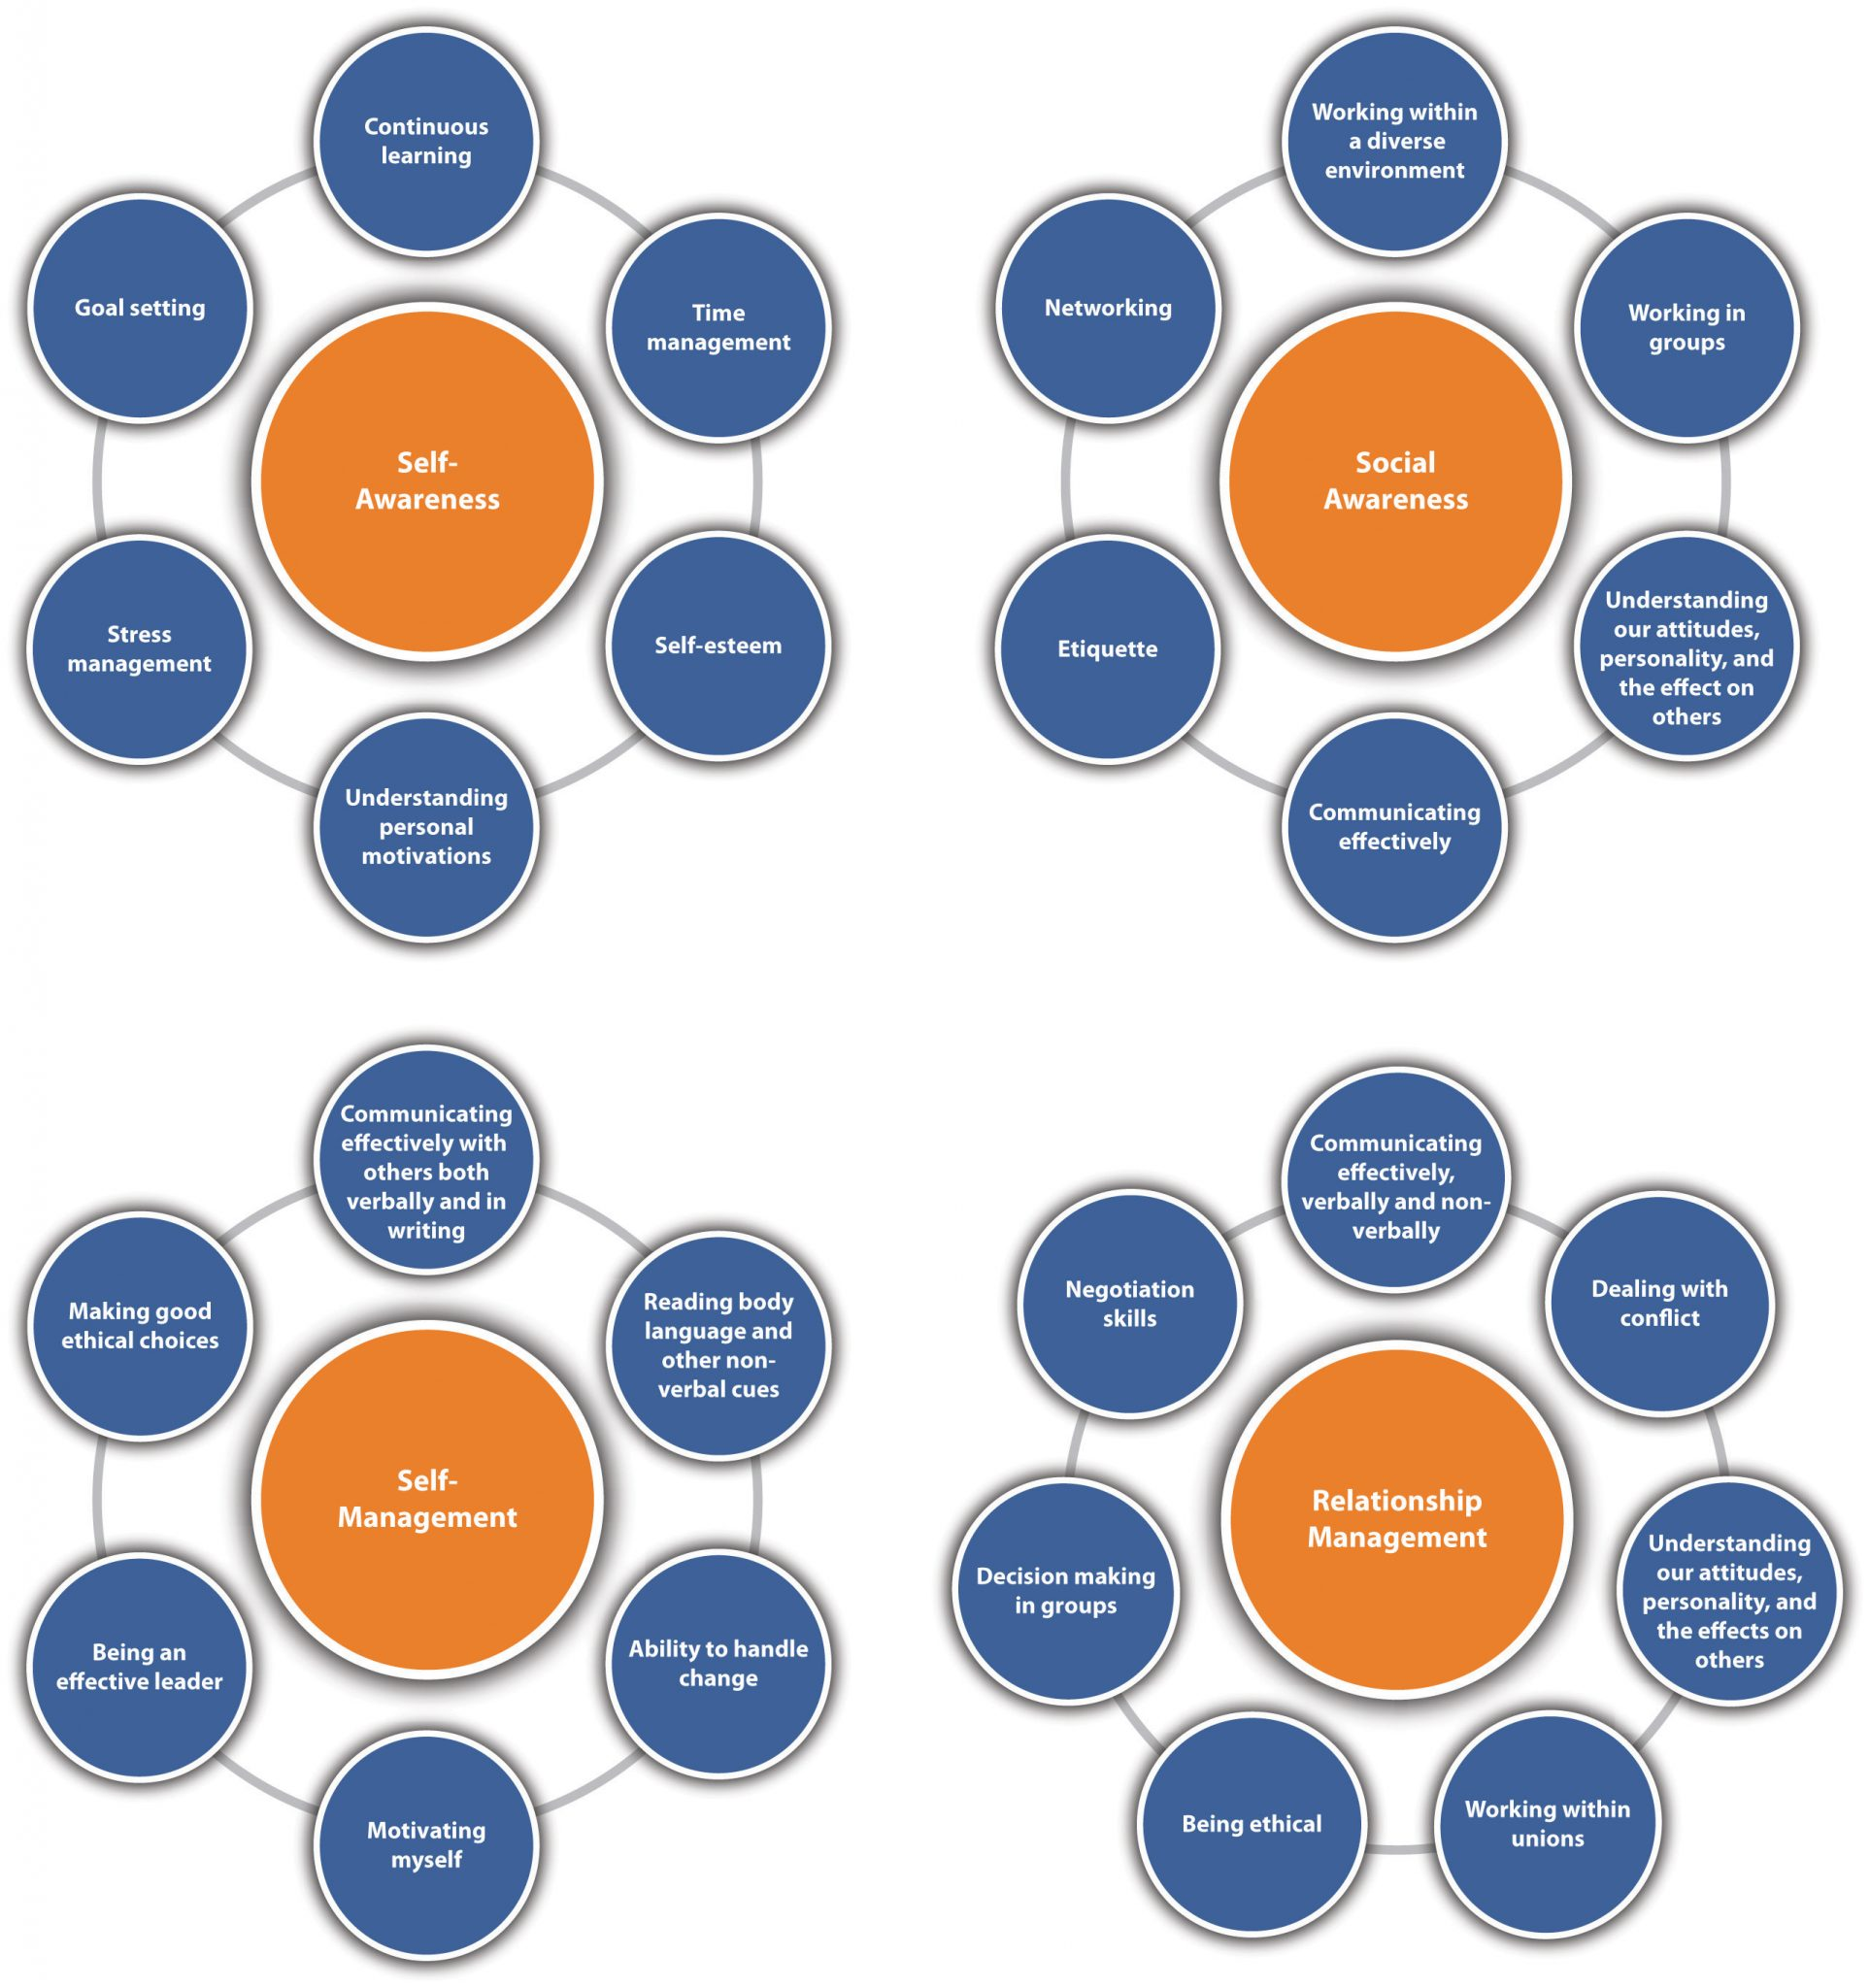
2.8 Emotional Intelligence VIII
Increase Relationship Management
Notes:
Strategies for relationship management might include being open, acknowledging another’s feelings, and showing that you care. Taking the time to really listen to colleagues and employees and understand them on a personal level can help enhance relationship management skills. Being willing to accept feedback and grow from that feedback can help people be more comfortable talking with you.
Emotional intelligence applies to all areas of our lives but is especially important to those leading in the midst of our fast-paced globally interconnected society. If leadership is about influence, then today’s leaders need emotional intelligence to connect with diverse groups of individuals in order to have any impact at all on others.

Slide 32
2.9 Developing Your Positive Attitude Skills
Have you ever wondered how you could be happier at work and how greater work satisfaction could improve your overall effectiveness?
Here are some ideas that may help you achieve a great sense of peace for yourself as well as when you are working with a negative co-worker.
Notes:
Leverage your Big Five traits. Your personality is a big part of your happiness. Which of the Big Five positive traits are you strongest on? Be aware of them and look for opportunities to express them at work. Are you high on Neuroticism? If so, work to overcome this challenge: If you choose to find the negative side of everything, you will.
Find a job and company that fit you well. A good fit with the job and company is important to your happiness. This starts with knowing yourself, your chosen career, and the particular job in question: What do you want from the job? What do you enjoy doing?
Get accurate information about the job and the company. Ask detailed questions about what life is like in this company. Do your research. Read about the company; use your social network to understand the company’s culture.
Develop good relationships at work. Make friends. Try to get a mentor if your company does not have a formal mentoring program. Approach a person you admire and attempt to build a relationship with this person. An experienced mentor can be a great help in navigating life at a company. Your social network can help you weather the bad days and provide you with emotional and instrumental support during your time at a company as well as afterward.
Pay is important, but job characteristics matter more to your job satisfaction. So don’t sacrifice the job itself for a bit more money. When choosing a job, look at the level of challenge and the potential of the job to make you feel engaged.
Be proactive in managing organizational life. If the job is stressful, cope with it through effective time management and having a good social network, as well as being proactive in getting to the source of stress. If you don’t have enough direction, ask for it!
Know when to leave. If the job makes you unhappy over an extended period of time and there is little hope of solving the problems, it may be time to look elsewhere.

Slide 33
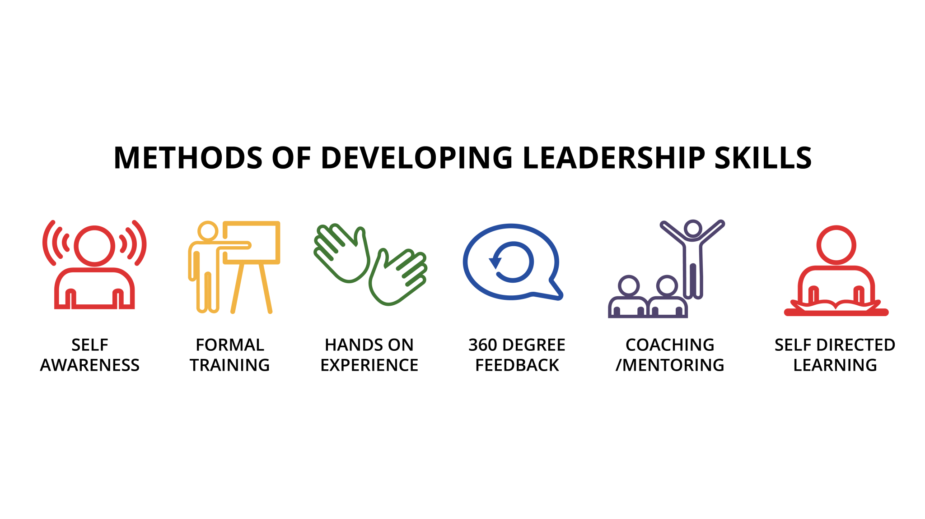
2.10 Developing Leadership Skills
Notes:
When we think of developing leadership skills we can look at leader development(singular), as in developing our own personal ability to lead, or the ability of one individual in an organization.
Leadership development (plural) looks at developing groups of individuals, for example, a training program set up in an organization to assist with succession planning, or for employees who are interested in moving into management roles. Leadership skills are developed through multiple mechanisms: self-awareness, formal instruction, hands-on experience, developmental coaching and mentoring, 360-degree feedback, and self-directed learning.
These approaches may occur independently but are more effective in combination.
Self-Awareness- As discussed earlier, self-awareness is key to good leadership. Higher productivity and more satisfied followers may be correlated with leaders who are more self-aware (Moshavi et al., 2003).
Formal Training- Organizations often provide individuals with leadership development opportunities, however many larger entities build formal leadership development programs
Hands-on experience- Following formal training, organizations can assign leaders to jobs that target newly acquired skills. A job that helps to develop leadership is one in which employees learn, undergo personal change, and gain leadership skills resulting from the roles, responsibilities, and tasks involved in that job
360-Degree Feedback- The 360-degree feedback approach allows leaders to maximize learning opportunities from their current assignment. It systematically provides leaders with perceptions of their performance from a full circle of viewpoints, including subordinates, peers, superiors, and the leader’s own self-assessment.
Developmental Relationships – Coaching and Mentoring- Leadership coaching focuses on enhancing the leader’s effectiveness, along with the effectiveness of the team and organization. It involves a structured, one-on-one relationship aimed at imparting important lessons through assessment, challenge, and support.
Self-directed Learning- Using self-directed learning, individual leaders teach themselves new skills by selecting areas for development, choosing learning avenues, and identifying resources.

Slide 34
2.11 Key Terms I
Absenteeism refers to unscheduled absences from work.
Agreeableness is the degree to which a person is affable, tolerant, sensitive, trusting, kind, and warm.
Attitude refers to our opinions, beliefs, and feelings about aspects of our environment.
Conscientiousness refers to the degree to which a person is organized, systematic, punctual, achievement-oriented, and dependable.
EQ refers to a form of social intelligence that involves the ability to monitor one’s own and others’ feelings and emotions, to discriminate among them, and to use this information to guide one’s thinking and behavior.
Exit interviews involve a meeting with the departing employee to determine reasons for leaving and feelings toward an organization.
Extraversion is the degree to which a person is outgoing, talkative, sociable, and enjoys socializing.
False consensus error is the tendency to overestimate how similar we are to other people and assume that our behaviors, attitudes and beliefs are commonly shared by a larger number of people than they really are.
First impressions are mental images formed about a person based on our perception of “who they are” during an initial encounter.
General mental ability is also known as cognitive ability or intelligence, and often abbreviated as “g.” General mental ability can be divided into several components—reasoning abilities, verbal and numerical skills, and analytical skills.

Slide 35
2.11 Key Terms II
Intelligence quotient (IQ) measures an individual’s mental ability based on a score derived from standardized intelligence tests.
Job satisfaction refers to the degree of contented feelings people have toward their job.
Leadership development (plural) looks at developing leadership amongst a group of individuals.
Leader development (singular) is developing one individual’s ability to lead.
Neuroticism refers to the degree to which a person is anxious, irritable, temperamental, and moody.
Openness is the degree to which a person is curious, original, intellectual, creative, and open to new ideas.
Organizational citizenship behaviors (OCB) are voluntary behaviors employees perform to help others and benefit the organization.
Organizational commitment is the emotional attachment people have toward the company they work for.
Perception may be defined as the process by which individuals detect and interpret environmental stimuli.
Personality encompasses a person’s relatively stable feelings, thoughts, and behavioral patterns.
Person-job fit is the degree to which a person’s knowledge, skills, abilities, and other characteristics match the job demands.
Person-organization fit refers to the degree to which a person’s personality, values, goals, and other characteristics match those of the organization.

Slide 36
2.11 Key Terms III
Proactive personality refers to a person’s inclination to fix what is wrong, change things, and use initiative to solve problems.
Psychological capital includes positive emotions gained through self- awareness and self-management such as hope, optimism and resilience to increase one’s ability to cope with the demands of life and work.
Psychological contract is the unspoken, informal understanding that an employee will contribute certain things to the organization (e.g., work ability and a willing attitude) and will receive certain things in return (e.g., reasonable pay and benefits).
Relationship management refers to our ability to communicate clearly, maintain good relationships with others, connect with those from other cultures, work well in teams, and manage conflict.
Selective perception occurs when we sort through the variety of stimuli in our environment by paying selective attention to those things that confirm our previous beliefs while ignoring those which do not.
Self-awareness refers to a person’s ability to evaluate and understand their own feelings, thoughts, desires, and actions.
Self-effacement bias (or modesty bias) is the tendency to underestimate our performance and capabilities and to see events in a way that puts us in a more negative light.
Self-efficacy is a belief that one can perform a specific task successfully.
Self-enhancement bias is the tendency to overestimate our performance and capabilities and see ourselves in a more positive light than others see us.

Slide 37
2.11 Key Terms IV
Self-esteem is the degree to which a person has overall positive feelings about himself or herself.
Self-fulfilling prophecy happens when an established stereotype or false belief causes those expectations to be fulfilled in a way that confirms the stereotypic behavior.
Self-management (self-leadership) is dependent upon our self-awareness and refers to our ability to manage our emotions, follow through with commitments, and take initiative.
Self-monitoring refers to the extent to which a person is capable of monitoring his or her actions and appearance in social situations.
Self-talk refers to our internal dialogue, or the thoughts we have about ourselves and situations throughout the day. Positive self-talk can increase our ability to lead ourselves into a better space emotionally.
Social awareness is our ability to understand social cues and includes having empathy along with recognizing power structure and unwritten workplace dynamics. Social awareness is akin to social radar.
Stereotypes are generalizations based on a group characteristic.
Turnover refers to the number and rate of employees leaving an organization during a certain period of time.
Values refer to people’s stable life goals, reflecting what is most important to them. Values are established throughout one’s life as a result of accumulating life experiences, and values tend to be relatively stable.

