Slide 1
Principles of Leadership & Management
CHAPTER 11: LEADING INNOVATION & CHANGE
Unless otherwise noted, this work is licensed under a Creative Commons Attribution-NonCommercial-ShareAlike 4.0 International (CC BY-NC-SA 4.0) license. Feel free to use, modify, reuse or redistribute any portion of this presentation.

Slide 2
Learning Outcomes
Upon successful completion of this chapter, you will be able to:
Explain what creativity has to do with business.
Outline why innovation is vital to an organization.
Analyze why some organizations fail at innovation.
Describe how social networks can increase the likelihood of organizational innovation.
Determine what causes organizations to change.
Explain how leaders can encourage change.
Describe how leaders can create an innovative culture in the workplace.
Outline how employees can be rewarded for innovation and creativity.
Determine how a strategic business partner or co-creation may help a company innovate.
Compare how company structure can support or hinder innovation.
Analyze why some organizations fail at innovation.

Slide 3
11.1 Introduction to Leading Innovation and Change
Creating an innovative culture at work can improve employee satisfaction, team productivity, and the quality of the company’s products and services. It can also help grow brands, attract prospective employees, keep talent in the workforce, and help generate revenue (Indeed Editorial Team, 2021).
Notes:
While innovation strategy varies depending on the market and business goals, some challenges are universal. For example, if an executive may be struggling to manage the company’s innovation efforts to produce the results planned for. The leader of an innovation project may be finding it hard to garner the support needed from senior management (Swisher2016).

Slide 4
11.2 Creating an Innovative Culture
What is an Innovative Culture?
An innovative culture is a work environment that fosters and rewards employee creativity instead of focusing on deadlines and revenue. Tech companies often have an innovative culture since the tech industry constantly changes and generates new ideas.
Notes:
Key characteristics of an innovative culture include (Indeed Editorial Team, 2021):
Unique strategy: An innovative strategy often involves specific goals and a strategy specifically designed for and by the company.
Autonomy: When the workplace has an innovative culture, it often gives employees freedom in how they work to accomplish goals.
Trust: An environment of trust encourages employees to share ideas and attempt new methods to accomplish goals.
Accepting failures: Innovation may lead to some failures along the way. Allowing these failures helps employees be more creative without the fear of defeat or making a mistake.
Leadership: Good leaders with effective management abilities help maintain an innovative culture. However, it’s best implemented when employees act as leaders, too.

Slide 5
11.2 Creating an Innovative Culture
Why Have an Innovative Work Culture?
To summarize, the benefits of having an innovative work culture include the following (Swisher, 2016):
Sets a course for improvement
Helps develop new ideas
Leads to company growth
Gives a competitive advantage
Increases team efficiency
Develops an adaptive nature
Appeals to more talented professionals
Improves the company brand
Notes:
An innovative work culture encourages continuous improvements which can help the company produce improved products and services to retain existing customers and attract new customers. An innovative company also attracts investors and new talent (new employees). Innovation can improve the company’s image and make it a leader in the industry, again bringing more customers, investors, and profit.

Slide 6
11.2 Creating an Innovative Culture
How Can Leaders Build an Innovative Work Culture?
Here are some tips for how leaders can build an innovative work culture:
Actively motivate and encourage innovation from employees. Invite them to share ideas during company meetings and discuss company problems and solutions in a group environment.
Build trust within the team–be honest, admit mistakes, take ownership, be dependable, collaborate. Try team-building exercises to help people feel free to share ideas without being judged.
Ask customers for feedback/invite customers to feedback rounds
Ask stakeholders for feedback
Invest in training for employees
Actively invest resources in research and development (R&D)
Notes:
Partner with startups and innovative companies
Build an intrapreneurship program
Express that failure is an option. Make sure everyone understands that a part of getting to success often includes some failures.
Actively research on the Internet (industry news, tech news, etc.)
Survey/interview/meet with experts
Incorporate innovation into the business strategy. Establish a company innovation vision, set goals, and share values to promote innovation in the workplace.
Establish a reward system for innovative thinking, such as rewarding employees’ progress in innovation with commission-based pay, promotions, bonuses, time off, treats, events, special recognition, or sharing in the innovation profits.

Slide 7
11.2 Creating an Innovative Culture
How Can Leaders Nurture Innovation?
Internal Collaboration
It is important to create cross-departmental teams and make communicating across departments easy. When, for example, the marketing team only speaks to the marketing team this creates a recipe for GroupThink.
Notes:
To ensure employees understand how the different parts of the company work and how they must work together to achieve progress, leaders might, for example, create a policy whereby anyone who wishes to become a business unit general manager must have worked in at least two functional areas for two or more years. The CEO of a very successful technology company requires the R&D people to spend about 10% of their time in marketing and sales and vice versa (Gupta et al., 2017).
More ways to nurture innovation include:
Innovation Labs and Intrapreneurship
Innovation Time for Employees
Partnerships and Acquisitions
Open Labs for Co-Creation

Slide 8
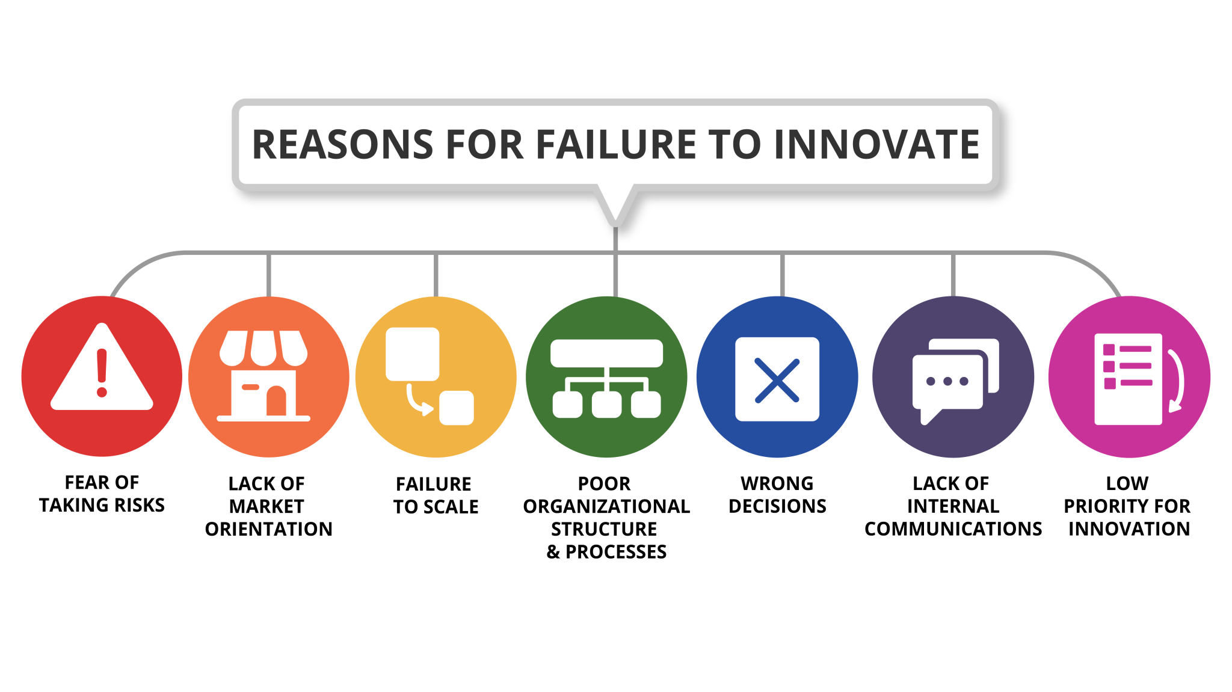
11.3 Failure to Innovate
Notes:
Companies need to facilitate creative ideation; they also need processes to capture the outputs of creative ideation and transform them into profitable and scalable innovations. There are many reasons why innovation projects or new products fail in the market.
Fear of taking risks. The innovative process carries no guarantees, and the consequences of fear of risk tend to make organizations prefer the status quo.
Lack of market orientation. The lack of market orientation and understanding of customer needs is another main reason why new products fail on the market.
Failure to scale. Scaling is the part where most of the value creation and impact comes from.
Poor Organizational Structure and Processes. An organizational structure that does not support innovation. The larger an organization is, the slower the processes often become.
Wrong decisions. Management may set the wrong course in innovation projects or when selecting ideas.
Lack of Internal Communication. Despite working hard, being isolated in groups/departments can hinder collaboration by creating unnecessary competition within departments.
Low priority for innovation. The unrealized commitment and the lack of support for innovation are certainly some of the main reasons why innovations fail.

Slide 9
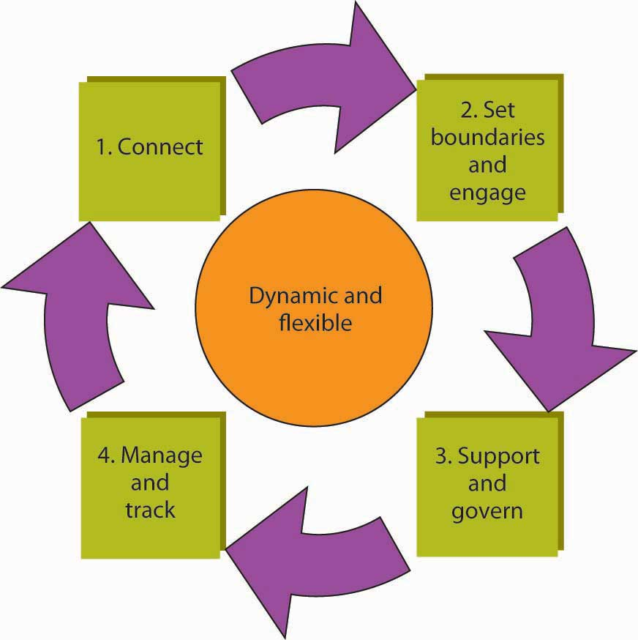
11.4 Social Networks and Innovation
The Innovation Network
Notes:
Strategy consultant McKinsey & Company points to research that finds differences in individual creativity and intelligence matter far less for organizational innovation than connections and networks. That is, networked employees can realize their innovations and make them catch on more quickly than nonnetworked employees can (Fleming & Marx, 2006).
The first step, connect, involves the identification of key people in the organization with an innovation mind-set.
The second step, set boundaries and engage, is where the network’s goals and objectives are defined. It is important to make it clear how the network’s goals and objectives will contribute to the organization’s goals and larger strategy, mission, and vision.
In the third step, support and govern, the leadership structure for the network is decided on, along with any protocols for meeting, sharing ideas, and decision making.
The fourth step involves managing and tracking. This last step covers a spectrum of needs, ranging from how network members will be recognized and rewarded for their contributions, the agreement about process-tracking criteria, and some guidelines on how new members join the network and others leave.

Slide 10
11.5 Organizational Change
Organizational change is the movement of an organization from one state of affairs to another. A change in the environment often requires change within the organization operating within that environment.
Notes:
Organizational change is the movement of an organization from one state of affairs to another. A change in the environment often requires change within the organization operating within that environment.
Considering our current environment, at the tail end of a global pandemic and a few months into Russia’s invasion of Ukraine, there has been a great deal of change affecting individuals and their organizations. While it is said that the only constant is change, most people resist change. This is also true in organizations. Change in almost any aspect of a company’s operation can be met with resistance, and different cultures can have different reactions to both the change and the means to promote the change.

Slide 11
11.5 Organizational Change
Workplace Demographics
Organizational change is often a response to changes to the environment. For example, agencies that monitor workplace demographics have reported that the average age of the workforce will increase as the baby boom generation nears retirement age and the numbers of younger workers are insufficient to fill the gap in the U.S. (Toosi, 2015) and in Canada (Statistics Canada, 2019).
Notes:
What does this mean for companies? Organizations may realize that as the workforce gets older, the types of benefits workers prefer may change. Work arrangements such as flexible work hours and job sharing may become more popular as employees remain in the workforce even after retirement.
Other reasons for organizational changes:
Technology
Globalization
Changes in the Market Conditions
Growth
Poor Performance

Slide 12
11.5 Organizational Change
Resistance to Change
Changing an organization is often essential for a company to remain competitive. Failure to change may influence the ability of a company to survive. Yet employees do not always welcome changes in methods.
Notes:
Active resistance is the most negative reaction to a proposed change attempt. Those who engage in active resistance may sabotage the change effort and be outspoken objectors to the new procedures, encouraging those in their social networks to resist as well
In contrast, passive resistance involves being disturbed by changes without necessarily voicing these opinions. Instead, passive resisters may dislike the change quietly, feel stressed and unhappy, and even look for a new job without necessarily bringing their concerns to the attention of decision makers.
In contrast, compliance involves going along with proposed changes with little enthusiasm.
Finally, those who show enthusiastic support are defenders of the new way and actually encourage others in their networks to give support to the change effort as well.

Slide 13
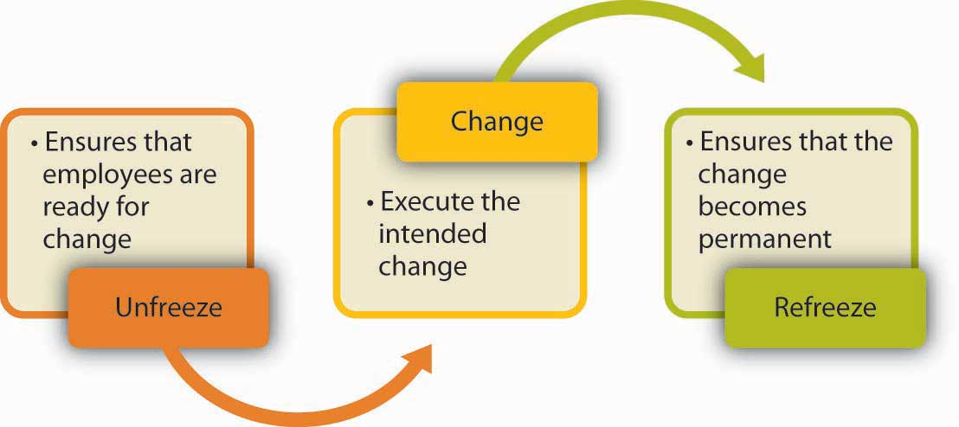
11.6 Planning and Executing Change Effectively
Lewin’s three-stage model of planned change
Notes:
One of the most useful frameworks in this area is the three-stage model of planned change developed in the 1950s by psychologist Kurt Lewin (Lewin, 1951).
This model assumes that change will encounter resistance. Therefore, executing change without prior preparation is likely to lead to failure. Instead, organizations should start with unfreezing, or making sure that organizational members are ready for and receptive to change.
This is followed by change, or executing the planned changes.
Finally, refreezing involves ensuring that change becomes permanent and the new habits, rules, or procedures become the norm.

Slide 14
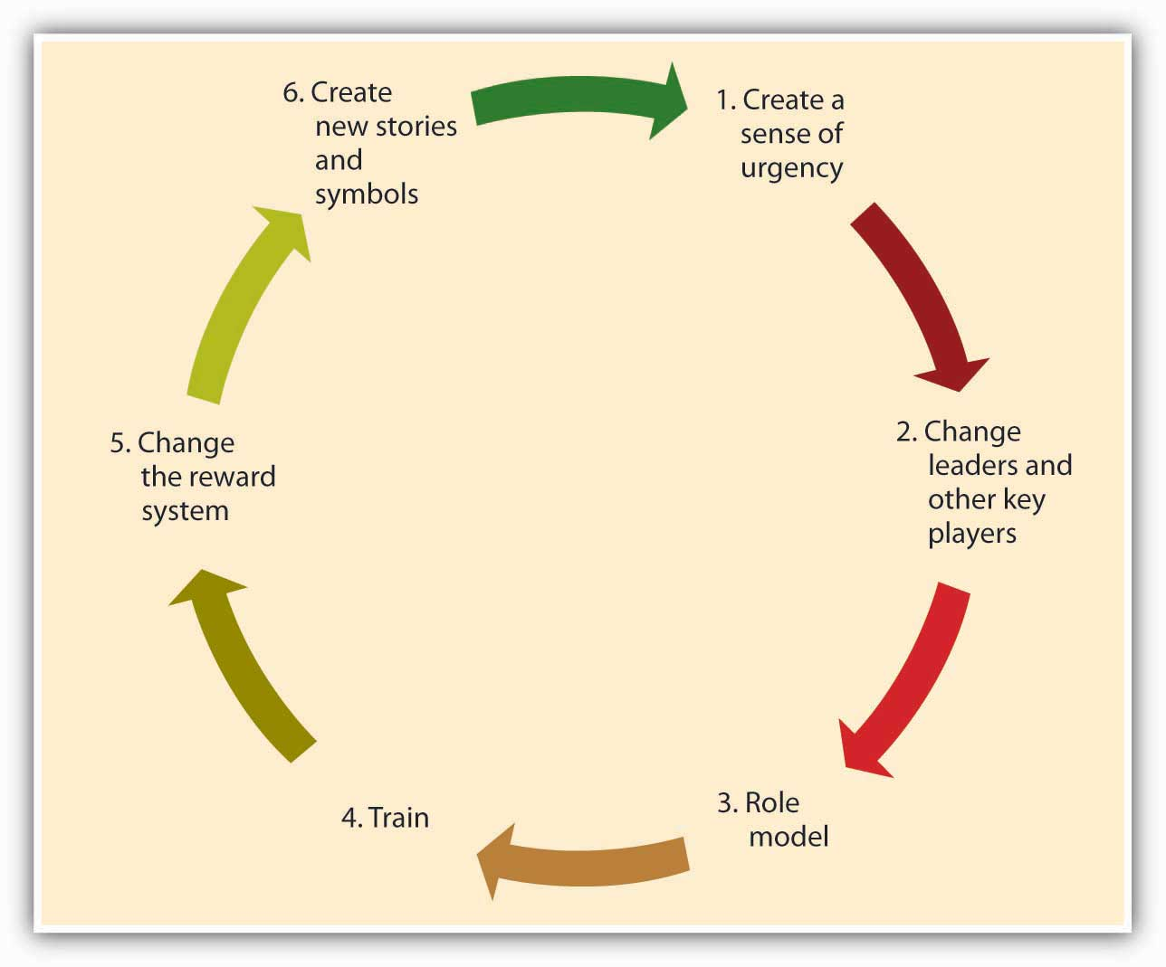
11.7 Creating Culture Change
Process of Culture Change
Notes:
Achieving culture change is challenging, and there are many companies that ultimately fail in this mission. Research and case studies of companies that successfully changed their culture indicate that the following six steps increase the chances of success (Schein, 1990).
Creating a Sense of Urgency- For the change effort to be successful, it is important to communicate the need for change to employees. One way of doing this is to create a sense of urgency on the part of employees, explaining to them why changing the fundamental way in which business is done is so important.
Changing Leaders and Other Key Players- A leader’s vision is an important factor that influences how things are done in an organization. Thus, culture change often follows changes at the highest levels of the organization.
Role Modeling- Role modeling is the process by which employees modify their own beliefs and behaviors to reflect those of the leader (Kark & Van Dijk, 2007). Leaders need to model the behaviors that are expected of employees to change the culture because these behaviors will trickle down to lower-level employees.
Training- Well-crafted training programs may be instrumental in bringing about culture change by teaching employees the new norms and behavioral styles.
Changing the Reward System- The criteria with which employees are rewarded and punished have a powerful role in determining the cultural values of an organization. Switching from a commission-based incentive structure to a straight salary system may be instrumental in bringing about customer focus among sales employees.
Creating New Symbols and Stories- Finally, the success of the culture change effort may be increased by developing new rituals, symbols, and stories.

Slide 15
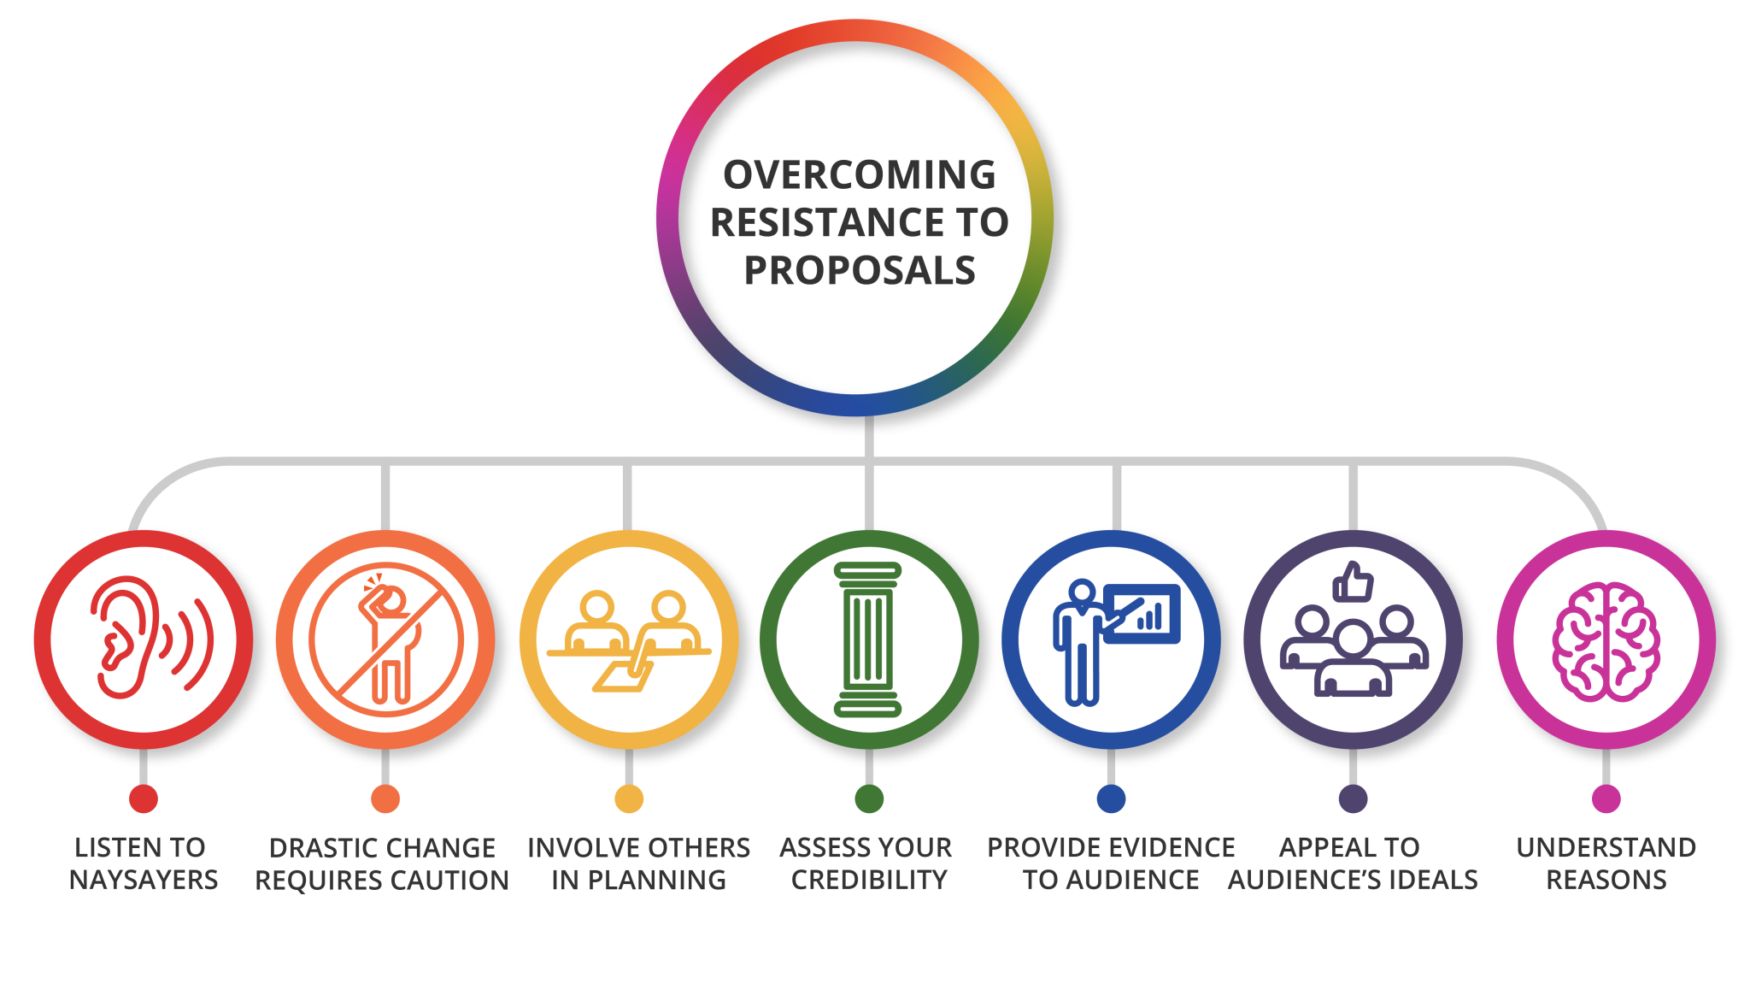
11.8 Building Your Change Management Skills
Notes:
You feel that a change is needed. You have a great idea. But people around you do not seem convinced. They are resisting your great idea. How do you make change happen?
Listen to naysayers. You may think that your idea is great, but listening to those who resist may give you valuable ideas about why it may not work and how to design it more effectively.
Is your change revolutionary? If you are trying to change dramatically the way things are done, you will find that resistance is greater. If your proposal involves incrementally making things better, you may have better luck.
Involve those around you in planning the change. Instead of providing the solutions, make them part of the solution. If they admit that there is a problem and participate in planning a way out, you would have to do less convincing when it is time to implement the change.
Assess your credibility. When trying to persuade people to change their ways, it helps if you have a history of suggesting implementable changes. Otherwise, you may be ignored or met with suspicion. This means you need to establish trust and a history of keeping promises over time before you propose a major change.
Present data to your audience. Be prepared to defend the technical aspects of your ideas and provide evidence that your proposal is likely to work.
Appeal to your audience’s ideals. Frame your proposal around the big picture. Are you going to create happier clients? Is this going to lead to a better reputation for the company? Identify the long-term goals you are hoping to accomplish that people would be proud to be a part of.
Understand the reasons for resistance. Is your audience resisting because they fear change? Does the change you propose mean more work for them? Does it affect them in a negative way? Understanding the consequences of your proposal for the parties involved may help you tailor your pitch to your audience (McGoon, 1995; Michelman, 2007; Stanley, 2002).

Slide 16
11.9 Key Terms
Balanced innovation portfolio is a combination of core, adjacent, and transformative innovation initiatives.
Innovative culture is a work environment that fosters and rewards employee creativity instead of focusing on deadlines and revenue.
Innovation Strategy is about mapping an organization’s mission, vision, and value proposition for defined customer markets.
Innovation Council evaluates ideas and allocates funding.
Organizational change is the movement of an organization from one state of affairs to another.
Organizational structure is a way or method by which organizational activities are divided, organized, and coordinated.
Refreezing involves ensuring that change becomes permanent and the new habits, rules, or procedures become the norm.
Unfreezing refers to ensuring that organizational members are ready for and receptive to change.

