Slide 1
Principles of Leadership & Management
CHAPTER 10: LEADING TEAMS
Unless otherwise noted, this work is licensed under a Creative Commons Attribution-NonCommercial-ShareAlike 4.0 International (CC BY-NC-SA 4.0) license. Feel free to use, modify, reuse or redistribute any portion of this presentation.

Slide 2
Learning Outcomes
Upon successful completion of this chapter, you will be able to:
Discuss the benefits of working in teams.
Outline how teams develop over time.
List the key considerations in managing teams.
Discuss the benefits of conflict for a team.
Describe the impact of team diversity on decision-making and problem-solving.
Discuss social networks and their value.
Analyze the key dimensions of social networks.
Analyze how social networks create value.
Determine the actions required to take to develop a network.
Identify the gaps in your network and develop a plan to fill those gaps.

Slide 3
10.1 Focus on Teamwork
You have probably been part of many teams throughout your life. Think back to the group of students in your classes growing up, teams you played on or bands that you played in, religious and community groups, etc. You are currently in a group that is a cohort of students, may be part of a team at work, or live with a group of roommates. Going forward you will see that most work is done in teams, and today’s organizations require employees that are both good team leaders and good team players.
Notes:
Collaboration and teamwork are crucial in our globally connected high-tech workplaces. As tasks have become more complex, groups and teams have become essential to solving the wicked problems of our time while negotiating a constant barrage of change. Teams are part of a social network. Social networks are the pathways through which communication and resources flow, and the channels through which work actually gets done. Networks provide unique advantages both personally and professionally.

Slide 4
10.2 Teamwork in the Workplace I
Teamwork has never been more important in organizations than it is today. Whether you work in a manufacturing environment and utilize self-directed work teams, or if you work in the “knowledge economy” and derive benefits from collaboration within a team structure, you are harnessing the power of a team.
Notes:
A team, according to Katzenbach and Smith (1993) in their Harvard Business Review (HBR) article “The Discipline of Teams,” is defined as “people organized to function cooperatively as a group”

Slide 5
10.2 Teamwork in the Workplace II
Notes:
A team has a specific purpose that it delivers on, has shared leadership roles, and has both individual and mutual accountabilities. Teams discuss, make decisions, and perform real work together, and they measure their performance by assessing their collective work products. This is very different from the classic working group in an organization (usually organized by functional area) in which there is a focused leader, individual accountabilities and work products, and a group purpose that is the same as the broader organizational mission.

Slide 6
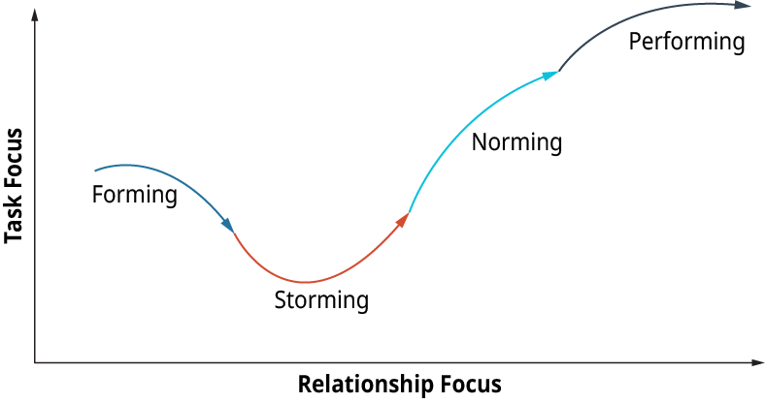
10.3 Team Development Over Time I
The ‘original’ four stages of the Tuckman model:
Notes:
If you have been a part of a team—as most of us have—then you intuitively have felt that there are different “stages” of team development. Teams and team members often start from a position of friendliness and excitement about a project or endeavor, but the mood can sour and the team dynamics can go south very quickly once the real work begins.
The Forming Stage- The Forming stage begins with the introduction of team members. This is known as the “polite stage” in which the team is mainly focused on similarities and the group looks to the leader for structure and direction
The Storming Stage- The Storming stage begins as team members begin vying for leadership and testing the group processes. This is known as the “win-lose” stage, as members clash for control of the group and people begin to choose sides.
The Norming Stage- After what can be a very long and painful Storming process for the team, slowly the Norming stage may start to take root. During Norming, the team is starting to work well together, and buy-in to group goals occurs.
The Performing Stage- Finally, as the team builds momentum and starts to get results, it is entering the Performing stage. The team is completely self-directed and requires little management direction.

Slide 7
10.4 Things to Consider When Leading Teams I
What are some key considerations in leading teams?
For those of us who have had the pleasure of managing or leading a team, we know that it can feel like a dubious distinction. Leading a team is fulfilling—especially if the task or organizational mandate at hand is so critical to the organization that people are happy to be a part of the team that drives things forward.
Notes:
It can also be an exercise in frustration, as the charge is to lead a group composed of various individuals, which at various times will act both like a group and like a bunch of individuals. Managing teams is no small feat, and the most experienced leaders truly understand that success ultimately depends on their ability to build a strong and well-functioning team.

Slide 8
10.4 Things to Consider When Leading Teams II
What are some key considerations in leading teams?
In Gabarro’s (1987) The Dynamics of Taking Charge, he quotes a manager who had successfully worked to turn around a number of organizations:
“People have to want to work together; they have to see how to do it. There has to be an environment for it and that takes time. It’s my highest priority right now but I don’t write it down anywhere because it’s not like other priorities. If I told corporate that building a team was my prime goal they’d tell me, so what? They’d expect that as part of making things better” (pp. 85–87).
Notes:
This quotation is indicative of the state of most organizations today. The focus is on corporate goals and priorities—very task-driven and outcome-driven—but it is the people dynamics and how people work together in the company and in TEAMS that can make a real difference to the goals and outcome.

Slide 9
10.5 Opportunities and Challenges to Team Building
There are many sources of conflict for a team, whether it is due to a communication breakdown, competing views or goals, power struggles, or conflicts between different personalities. The perception is that conflict is generally bad for a team and that it will inevitably bring the team down and cause them to spiral out of control and off track
Notes:
Conflict does have some potential costs. If handled poorly, it can create distrust within a group, it can be disruptive to group progress and morale, and it could be detrimental to building lasting relationships. It is generally seen as a negative, even though constructive conflicts and constructive responses to conflicts can be an important developmental milestone for a team.
Some potential benefits of conflict are that it encourages a greater diversity of ideas and perspectives and helps people to better understand opposing points of view. It can also enhance a team’s problem-solving capability and can highlight critical points of discussion and contention that need to be given more thought.
Another key benefit or outcome of conflict is that a team that trusts each other—its members and members’ intentions—will arise from conflict being a stronger and higher-performing team.

Slide 10
10.6 Team Diversity and Multicultural Teams
How does team diversity enhance decision-making and problem-solving?
The multiple diverse perspectives can enhance both the understanding of the problem and the quality of the solution. Diversity is a word that is very commonly used today; leaders must ensure that diversity and building diverse teams does not become lost in the normal processes of doing business.
Notes:
As discussed earlier, decision-making and problem-solving can be much more dynamic and successful when performed in a diverse team environment.
In the Harvard Business Review article “Why Diverse Teams are Smarter” (Nov. 2016), David Rock and Heidi Grant support the idea that increasing workplace diversity is a good business decision. A 2015 McKinsey report on 366 public companies found that those in the top quartile for ethnic and racial diversity in management were 35% more likely to have financial returns above their industry mean, and those in the top quartile for gender diversity were 15% more likely to have returns above the industry mean. Similarly, in a global analysis conducted by Credit Suisse, organizations with at least one female board member yielded a higher return on equity and higher net income growth than those that did not have any women on the board.

Slide 11
10.7 Social Networks I
Social networks can be considered “the invisible organization”—they are the pathways through which communication and resources flow between individuals and groups, and how work actually gets done.
Notes:
An organization flowchart might communicate who reports to whom, but it is ultimately the internal (i.e., within the organization) and external (i.e., ties between members of the organization and people outside the organization such as suppliers or customers) social networks that really explain productivity (or impediments to productivity).

Slide 12
10.7 Social Networks II
Networks provide leaders with three unique advantages:
access to information and knowledge
access to diverse skill sets; and
power.
Image by Gerd Altmann from Pixabay
Notes:
While leaders see these advantages at work every day, they might not pause to consider how their networks regulate them. In this chapter you will learn about the role and importance of social networking groups, and social network analysis. You can take the opportunity to map and evaluate your own social network and evaluate its effectiveness personally and professionally.

Slide 13
10.8 An Introduction to the Lexicon of Social Networks I
Social networks often complement or compete with such aspects of organizations as the formal organizational structure outlined in a flowchart, work processes (think “job description”), human resource practices, leadership style, and organization culture. This is particularly problematic in knowledge-intensive settings where management is counting on collaboration among employees with different types of expertise.
Notes:
Just as with social networking sites like Facebook, LinkedIn, and Instagram, organization members rely heavily on their networks of workplace relationships to find information and solve problems—one of the most consistent findings in the social science literature is that who you know often has a great deal to do with what you come to know (Kilduff & Tsai, 2004).

Slide 14
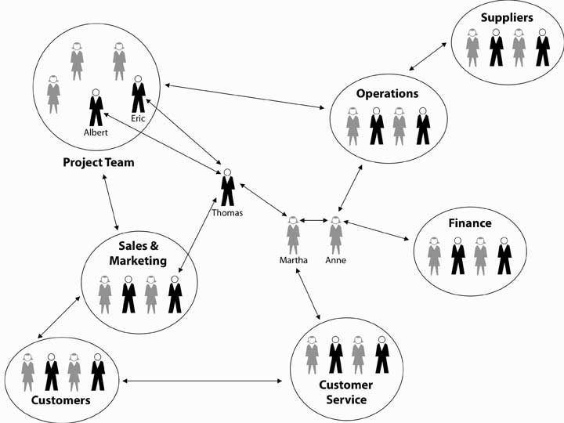
10.8 An Introduction to the Lexicon of Social Networks II
What Is a Social Network?
Notes:
A social network can be characterized as a patterned set of relationships between two or more people—or, as they are called in the social science literature, actors. It can be depicted in a sociogram, as shown in Figure 10.8.1.

Slide 15
10.9 How Leaders Can Use Social Networks to Create Value I
The Benefits of Social Networks
You probably have an intuitive sense of how and why social networks are valuable for you, personally and professionally. The successful 2008 U.S. presidential campaign of Barack Obama provides a dramatic example of how individuals can benefit when they understand and apply the principles and power of social networking (Cox, 2008).
Notes:
In this section, we discuss three fundamental principles of social network theory, then help you see how social networks create value in your career and within and across organizations, before describing social network analysis (SNA) and making note of some of the ethical implications of SNA.

Slide 16
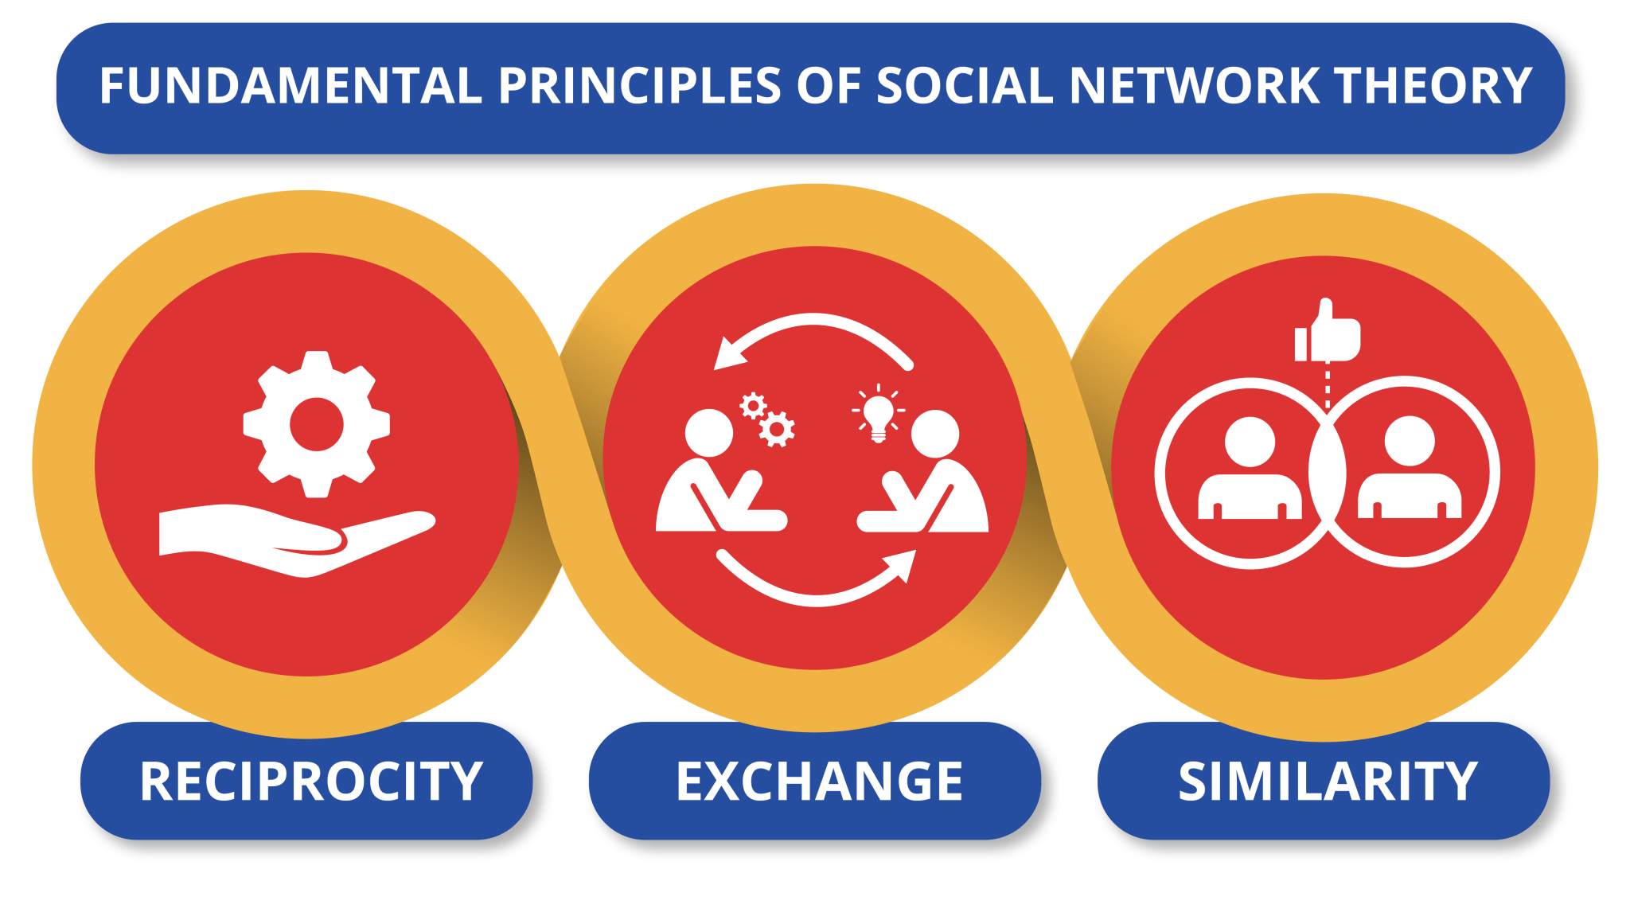
10.9 How Leaders Can Use Social Networks to Create Value II
Notes:
Across all social networks, performance depends on the degree to which three fundamental principles are accounted for (Kilduff & Tsai, 2004). The first is the principle of reciprocity, which simply refers to the degree to which you trade favors with others.
The second principle is the principle of exchange. Like the reciprocity principle, it refers to “trading favors,” but it is different in this way: the principle of exchange proposes that there may be greater opportunity for trading favors when the actors are different from one another.
The third principle is the principle of similarity. Psychologists studying human behavior have observed that relationships, and therefore network ties, tend to develop spontaneously between people with common backgrounds, values, and interests.

Slide 17
10.10 Personal, Operational, and Strategic Networks I
Three Types of Networking
To succeed as a leader, Ibarra recommends building three types of networks:
Personal—kindred spirits outside your organization who can help you with personal advancement.
Operational—people you need to accomplish your assigned, routine tasks.
Strategic—people outside your control who will enable you to reach key organizational objectives.
Notes:
Strong, useful networks don’t just happen at the water cooler. They have to be carefully constructed. What separates successful leaders from the rest of the pack? Networking, as defined in Section 10.8, is creating a fabric of personal contacts to provide the support, feedback, and resources needed to get things done. Yet many leaders avoid networking. Some think they don’t have time for it. Others disdain it as manipulative.

Slide 18
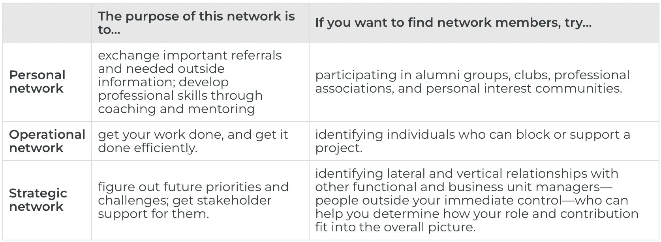
10.10 Personal, Operational, and Strategic Networks II
Three Types of Networking
Notes:
The three types of networking are: personal, operational, and strategic.
Personal network’s purpose is to exchange important information and develop professional skills. People can build their social network by participating in alumni groups, clubs and professional associations.
Operational network’s purpose if to get work done efficiently. People can build their operational network by identifying individuals who can block or support a project.
Strategic network’s purpose is to figure out future priorities and identify challenges and gain stakeholder support. People can build their strategic network by identifying lateral and vertical relationships that can help you determine your role and contribution to the bigger picture.

Slide 19
10.11 Mapping and Your Own Social Network
Mapping Out Your Own Social Network
Social network analysis is not the same thing as networking, where networking is the activities you might engage in to build your social network. In this section, you will learn the basics of mapping your own social network. It will give you a sense of the size of your network, along with some other useful characteristics to work with such as density.
Notes:
As you have already learned, the mapping and measuring of relationships and flows between people, groups, organizations, computers, Web sites, and other information/knowledge processing entities is called social network analysis.

Slide 20
10.11 Mapping and Your Own Social Network II
Mapping Out Your Own Social Network
Step One: What Purpose Should the Network Serve?
Step Two: Who Are Your Contacts and What Is Your Relationship with Them?
Step Three: Who Knows Whom? Computing Network Density
Step Four: Assess and Take Action
Notes:
Step One: What Purpose Should the Network Serve?- There are a number of possible purposes for a social network.¹ As a leader, you are probably most concerned with these six (Cross et al., 2002). First, a communication network is the informal structure of an organization as represented in ongoing patterns of interaction, either in general or with respect to a given issue. Second, an information network shows who goes to whom for advice on work-related matters. Third, a problem-solving network indicates who goes to whom to engage in dialogue that helps people solve problems at work. Fourth, a knowledge network captures who is aware of whose knowledge and skills, and an access network (fifth) shows who has access to whose knowledge and expertise. The sixth and final purpose is a career network, which reflects those individuals in your network who are likely to be helpful in your search for a new job or quest for a promotion
Step Two: Who Are Your Contacts and What Is Your Relationship with Them?- Let’s assume that we are mapping your career network. A career network is simply those individuals who might be instrumental in helping you secure a new job or promotion. You can simply draft out a list of names, using names or just initials, but the goal is to develop a fairly complete list.
Step Three: Who Knows Whom? Computing Network Density- Transfer your list of names to a grid. . . Be sure to note your relationship with them, in terms ranging from very close to distant. To complete the grid you place a check in the box where one individual knows another.
Step Four: Assess and Take Action

Slide 21
10.12 Key Terms I
Actors in social networks include all of the individuals, groups or organizations that make up the network.
Access network shows who has access to whose knowledge and expertise.
Activity gauges how active a person is in the network.
Access tells you how easily a person in the network can get the resources that he or she needs to be successful in the organization.
Bridging tie is a tie that provides non-redundant information and resources.
Career network reflects those individuals in your network who are likely to be helpful in your search for a new job or quest for a promotion.
Control gauges how much control a person has over the flow of information in the network.
Conflict can be due to a communication breakdown, competing views or goals, power struggles, or conflicts between different personalities.
Centrality is the extent to which a given actor is in the middle of the network.
Communication network is the informal structure of an organization as represented in ongoing patterns of interaction, either in general, or with respect to a given issue.

Slide 22
10.12 Key Terms II
Density reflects how many people in a network are connected (usually directly) to each other.
Direct ties are those in which a single link spans two actors.
Indirect ties are where connections exist between actors, but only through other actors.
Information network shows who goes to whom for advice on work-related matters.
Knowledge network captures who is aware of whose knowledge and skills.
Network tie is each connection, or relationship, between actors.
Nodes are each actor, or point on the network.
Networking is the range of activities you might engage in to build your social network.

Slide 23
10.12 Key Terms III
Problem-solving networks indicate who goes to whom to engage in dialogue that helps people solve problems at work.
Principle of reciprocity refers to the degree to which you trade favors that are of relatively equal value with others.
Principle of exchange refers to trading favors with those who are different from you and provides greater value due to the differences in resources such as knowledge, capabilities, skill sets, etc.
Principle of similarity refers to the fact that relationships and network ties tend to develop spontaneously between people with common backgrounds, values, and interests.
Social network can be characterized as a patterned set of relationships between two or more people.
Social capital includes the resources available in and through personal and business networks such as ideas, information, money, and trust.

Slide 24
10.12 Key Terms IV
Social network analysis (SNA) is mapping and measuring relationships and flows among people, groups, organizations, computers, websites, and other actors.
Strong ties exist among individuals who know one another well and engage in relatively frequent, ongoing resource exchanges.
Weak ties exist among individuals who know one another, at least by reputation, but who do not engage in a regular exchange of resources.

