Slide 1
Marketing for Golf Management
Chapter 2: Social Media and Marketing
Unless otherwise noted, this work is licensed under a Creative Commons Attribution-NonCommercial-ShareAlike 4.0 International (CC BY-NC-SA 4.0) license. Feel free to use, modify, reuse or redistribute any portion of this presentation.

Slide 2
2.0 Learning Objectives
In this chapter, we will:
Define social media marketing.
Differentiate between the various types of social media networks.
Discuss how social media marketing is important to business.
Explain the 6-step Social Media Marketing Framework.
Detail how social media can be an effective tool within the club industry.

Slide 3
2.1 Social Media Marketing
Social Media Marketing encompasses online applications, networks, blogs, wikis, and other collaborative media for communicating brand messaging, conducting marketing, public relations, and creating rapport
Social media marketing focuses on three primary objectives:
Creating buzz
Fostering community
Facilitating two-way communication
Organizations have opportunities to use social media for marketing purposes in several ways:
Paid
Earned
Owned social media activity
To be effective at using social media to reach target audiences, an organization must:
Create unique content
Ask questions
Create short-form media
Try different formats
Use a clear, immediate call to action

Slide 4
2.1 Advantages and Disadvantages of Social Media Marketing
Advantages
Two-way communication
Better market sentiment understanding
Cultivation of brand advocates
Measurable customer behaviour
Broad audience reach
Targeted content delivery
Disadvantages
The dynamic nature of social media
Difficulty in creating engaging content
Choosing appropriate platforms for target audiences
Managing crisis communications
Deciding who should manage the social media presence

Slide 5
2.2 Social Media Platforms and Use
Blogs
Long- or short-form medium for communicating with audiences
YouTube
X
Facebook
TikTok
Instagram
Pinterest
LinkedIn
Video-hosting social media site
Short-form (140 characters) “microblogging” medium that is intended for text and image sharing
Long-form (up to 2,000 characters per post) medium for sharing text, images, videos, and other multimedia content
Short-form video content, where users can create, share, and view videos ranging from 15 seconds to three minutes in length.
An image-based social network that is intended as a visual medium. Does not have capabilities to drive click-through rate (CTR) because posts offer no link option
Medium for sharing photos and visual content categorized by theme
Long- or short-form medium for sharing text, images, videos, and other multimedia content targeted to the business community

Slide 6
2.3 Social Media in the Club Environment
Technology is a Vehicle for Growth: Technology is integrated into every aspect of our society. Social media dominates how people connect and develop personal or professional relationships
In an always-connected world, golf allows our kids to develop genuine human relationships through physical encounters and unforgettable memories
Areas where social media shines:
Connecting with New Audiences
Building Relationships
Increasing Website Traffic
Distributing Targeted Messaging
Conducting Market Research
Sharing Expertise
Managing Reputation
Evaluating Analytics and Insights

Slide 7
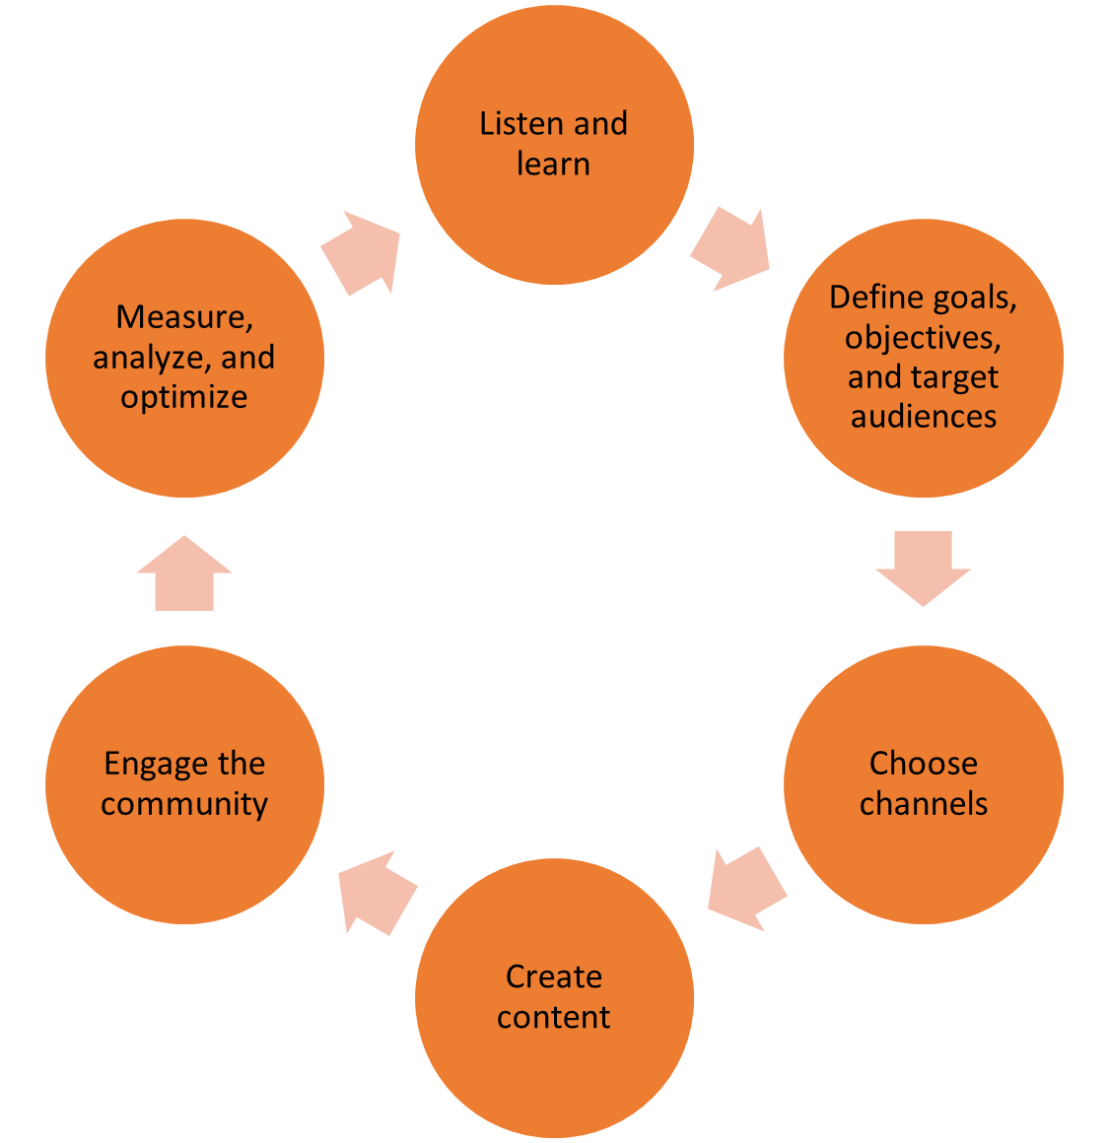
2.4 A 6-Step Social Media Marketing Framework
This 6-step Social Media Marketing Framework aims to ensure your social media strategy and activities are optimized to convert prospective customers into satisfied, paying customers and brand advocates
Using a framework gives you the best chance of implementing the right strategy for your circumstances
This framework will also provide alignment between your chosen strategy and your activities
Figure 2.4.1 Social Media Marketing Framework

Slide 8
2.4 Step 1: Listen and Learn
Social media allows marketers to listen to what their target audiences are saying and doing
Marketers can now listen to their customers’ needs, wants, and desires without any prompting
Listening is the first place for marketers to start when developing a social media strategy.
Listening is key to understanding your target audience’s perceptions related to:
Brand, Products, and Services
Competitors’ Brands, Products, or Services
General topics and trends

Slide 9
2.4 Step 2: Define Goals, Objectives, and Target Audiences
With a well-defined scope, which includes specific goals, objectives, and target audiences, it is possible to achieve positive outcomes, since you know what you are aiming for
Successful marketers and organizations know what they want to achieve, and a clear focus on goals and objectives is what ultimately guides all their actions
Digital marketers should plan to complete this step collaboratively because some of the required information might exist in different areas of the organization
Organizations that don’t align their goals, objectives, and strategies will waste money, time, resources, and effort.

Slide 10
2.4 Step 3: Choose Channels
Is important to focus on achieving those goals and objectives by selecting the appropriate digital marketing channels and platforms
organizations should focus on the type of social media marketing that will work best for their target audiences and build a presence on 2 – 3 platforms that support those activities and cater to those audiences
Remember market segmentation and associate the most appropriate media platform

Slide 11
2.4 Step 4: Create Content
Focus on creating the content that works best for that specific channel and the target audience
Questions to consider include:
What do you want the community to do?
What does the target audience find most engaging?
Think strategically about what you are trying to achieve, which should be clear after the listening stage, and then deliver content based on that
Follow the content strategy, content calendar (seasonal activities), and recommendations

Slide 12
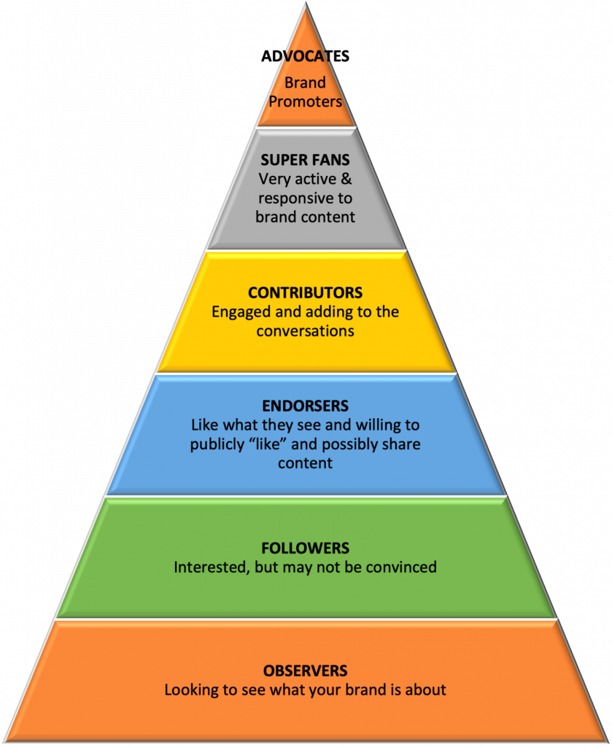
2.4 Step 5: Engage the Community
Engaging your customers with content they find valuable
Usually, the key to successful engagement is conversation
Engagement can take on other forms such as sharing, liking and posting and to a certain extent, your community will determine which form is most suitable
The secret to successful conversation and engagement will be to listen to your community and find out what it is they like to talk about and in what manner
Figure 2.4.2: Engagement Pyramid

Slide 13
2.4 Step 6: Measure, Analyze, and Optimize
Without measurement, marketers have no yardstick and no means of understanding whether their activities are succeeding or not
Through analytics, surveys, and content analysis, it is now possible to measure the success of your social media activities
Collate and collect all your data so that you can analyze how things went during the current cycle of the framework
In addition to your social media analytics and insights, you will potentially need other information, such as:
Online web analytics
A timeline of important events or activities that may have affected the organization in the online, social, and offline worlds
Financial data regarding sales
Email clickthrough
Measure, analyze, and optimize your activities so that you can properly evaluate what worked and what didn’t

Slide 14
2.5 The Influence of Social Media on Marketing in the Golf Industry
Social media platforms have enabled golf courses to foster online communities.
Increased interaction enhances customer service and strengthens the relationship between the club and their customers.
Instagram and TikTok have made the sport appealing to younger audiences
YouTube has transformed how golf content is shared with mini-tour events, lessons, podcasts, and tourism adding additional value to the sport
Social media has also provided a place for athletes to snapshot their lives and show the daily grind and tour life.
Social media is about influence and persuasion using appealing language to the consumer.

