Slide 1
Marketing for Golf Management
Chapter 1: What is Marketing?
Unless otherwise noted, this work is licensed under a Creative Commons Attribution-NonCommercial-ShareAlike 4.0 International (CC BY-NC-SA 4.0) license. Feel free to use, modify, reuse or redistribute any portion of this presentation.

Slide 2
1.0 Learning Objectives
In this chapter, we will:
Define marketing.
Outline the 4P’s of marketing.
Define what value means in marketing.
Discuss the scope and size of the golf industry.
Identify business opportunities within the golf industry.
Explore stakeholders in golf marketing.
Identify the differences between market-oriented, product-orientated, and selling-oriented companies within the golf industry.
Describe the basic types of channels in business-to-consumer (B2C) and business-to-business (B2B) markets.

Slide 3
1.1 Defining Marketing
Marketing is defined by the American Marketing Association as; the activity, set of institutions, and processes for creating, communicating, delivering, and exchanging offerings that have value for customers, clients, partners, and society at large (American Marketing Association, n.d.)
Marketing is more than just banner ads, and television commercials. It’s a complex set of activities and strategies that influences where we live, what we wear, how we conduct business, and how we spend our time and money
There are four activities, or components, of marketing: Creating, Communicating, Delivering, and Exchanging
The traditional way of viewing the components of marketing is via the four Ps: Product, Promotion, Place, and Price
Introduced in the early 1950s, the four Ps were called the marketing mix, meaning that a marketing plan is a mix of these four components.

Slide 4
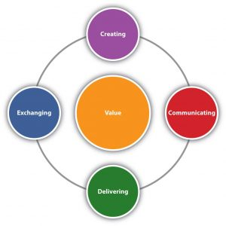
1.1 Value
Value is at the centre of everything marketing does.
Value is what the customer gets by purchasing and consuming a company’s offering.
value = benefits received – [price + hassle]
Hassle is the time and effort the consumer puts into the shopping process
Value varies from customer to customer based on each customer’s needs
Figure 1.1 Marketing comprises four activities centred on customer value: creating, communicating, delivering, and exchanging value.

Slide 5
1.1 Offerings with Value
The offering is the tangible good, the intangible service, and the price.
To communicate the value marketers must understand the unique desires of each market segment.
Communicating means describing the offering and its value to your potential and current customers, as well as learning from customers what it is they want and like.
Value is also provided through the supply chain and the logistics of transportation and storage of materials.

Slide 6
1.2 Marketing for the Golf Industry
The golf industry is worth more than $18.2 billion annually to the Canadian economy and is steadily growing (Golf Course Industry Staff, 2020)
New technology, such as golf simulators, online gaming, international betting, fashion trends, media coverage, social media, and official rules of golf revisions intended to make the game more enjoyable, have provided fresh marketing opportunities for the industry
The Country Club
Public Golf Facilities
Practice Facilities
Municipal Facilities
Golf Simulators
Golf on TV
Golf Gambling

Slide 7
1.3 Why Study Marketing?
Effective Marketing: Why Loyalty?
Products don’t, contrary to popular belief, sell themselves
Marketing Benefits Society
Marketing Costs Money
Marketing Offers People Career Opportunities
Marketing helps facilitate exchanges between buyers and sellers for the mutual benefit of both parties
It facilitates trade
Consumers are able to make more informed decisions about a wider array of choices
Marketing can sometimes be the largest expense associated with producing a product
Marketing is the interface between producers and consumers
Some positions are: Marketing research, merchandising, sales, advertising, product development, direct marketing, digital media, event marketing, nonprofit marketing

Slide 8
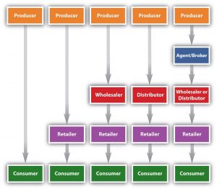
1.4 Typical Marketing Channels - Business-to-customer (B2C)
Direct channel consist of just two parties (producer and costumer)
Indirect channel: the product passes through one or more intermediaries
Figure 1.4.1: Typical Channels in Business-to-Consumer (B2C) Markets

Slide 9
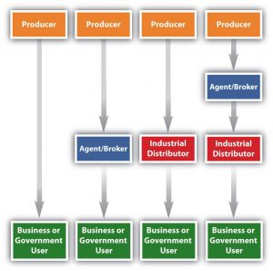
1.4 Typical Marketing Channels - Business-to-business (B2B)
The industrial distributors are firms that supply products that businesses or government departments and agencies use but don’t resell
Figure 1.4.2: Typical Channels in Business-to-Business (B2B) Markets

Slide 10
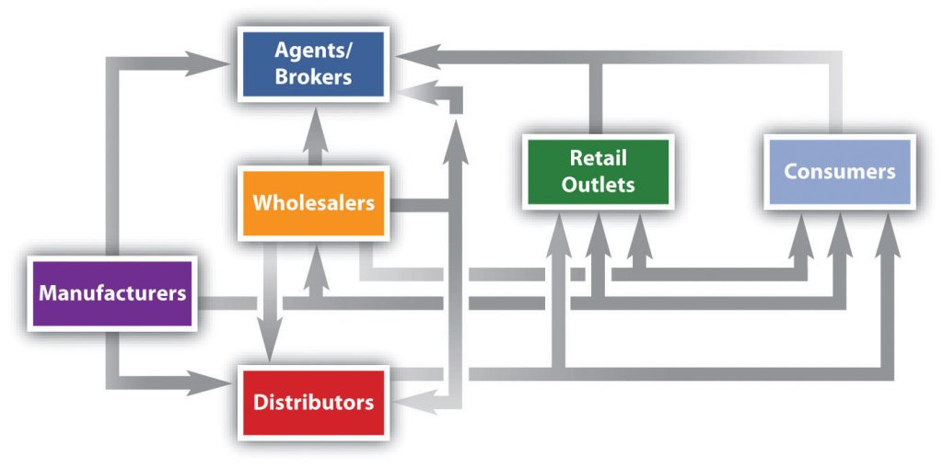
1.4 Typical Marketing Channels
Disintermediation is when you can cut middlemen or intermediaries
Marketing channels can get a lot more complex, and firms can and do utilize multiple channels
Many of the same bases used to segment consumer markets are also used to segment B2B markets
International marketing channels: joint venture, export products, and franchising
Figure 1.4.3: Alternate Channel Arrangements

Slide 11
1.5 Market Segmentation
Target market is the segments or groups of people and organizations you decide to sell
Targeted marketing, or differentiated marketing, means that you may differentiate some aspect of marketing (offering, promotion, price) for different groups of customers selected
Mass marketing, or undifferentiated marketing involves selling the same product to everybody
Figure 1.5.1: Golf Tourism – Global Market Segmentation

Slide 12
1.5 Types of Segmentation Bases
By Behaviour | By Demographics | By Geography | By Psychographics
Benefits sought from the product How often the product is used (usage rate) Usage situation (daily use, holiday use, etc.) Buyer’s status and loyalty to product (nonuser, potential user, first-time users, regular user) | Age/generation Income Gender Family life cycle Ethnicity Family size Occupation Education Nationality Religion Social class | Region (continent, country, state, neighbor) Size of city or town Population density Climate | Activities Interests Opinions Values Attitudes Lifestyles
Table 1.5.1 Common Ways of Segmenting Buyers

