Slide 1
Part 2 Pelvic Exam Findings and Conditions: Dermatosis
eCampus Ontario

Slide 2
Part 2: Dermatosis
This portion of the presentation describes findings and conditions that may present on pelvic exam as dermatosis skin conditions of the vulvovaginal area.
The clinical manifestations may include [but are not limited to] vulvovaginal: burning, itching, irritation, vaginal/vulvar adhesions, pain and/or pain with intercourse [dyspareunia].
NOTE: It is important to note that the lectures (and associated content) is current as of December 2021. For all treatment/management, it is essential that all practitioners consult the most recent evidence-based guidelines prior to initiating therapy. It is also recommended that for infectious conditions, that practitioners check the Public Health Agency of Canada or local province clinical guidelines/recommendations prior to initiating antimicrobial prescriptions and/or recommendations. This will ensure you have the most recent evidence-based treatment recommendations for infectious strains found in your area/region.

Slide 3
Content
Part 2: Vulvovaginal Dermatosis
Genitourinary syndrome of menopause (GSM) [previously: vulvovaginal atrophy]
Vulvodynia/Vestibulitis/Vaginismus
Contact Dermatitis soaps/creams/bubble bath/Vaginal medicines or douching.
Lichen Simplex Chronicus
Lichen Sclerosus
Lichen Planus
Part 3: Vulvovaginitis & Infections
Yeast Infection (Candidiasis)
Bacterial Vaginosis (BV) Gardnerella vaginalis
Sexually Transmitted Infection: Trichomonas vaginalis [strawberry cervix], Chlamydia trachomatis, Neisseria gonorrhoeae,
Pubic Lice and Scabies
Syphilis (Treponema pallidum)
Part 1: Masses/Viral Lesions
Vulvovaginal
Subcutaneous Lesions: Folliculitis, Furuncle (boil), Carbuncle (abscess)
Bartholin’s Cysts & Abscesses
Herpes Simplex Virus [post herpetic neuralgia]
Genital Warts: Human Papilloma Virus,
Molluscum Contagiosum: Poxvirus
Cervical
Normal cervix/os:
  Endocervical Cells/Transformation zone
  Cervical Stenosis
Cervical Nabothian Cyst
Cervical Polyp
Cervical Dysplasia/Cervical Intraepithelial Neoplasm

Slide 4
Genitourinary syndrome of menopause (GSM) [previously: vulvovaginal atrophy]
Define condition/cause: A syndrome of urovaginal symptoms that are often Peri/menopause-related decreases in levels of estrogen and other hormones
Symptoms/Signs: vaginal or vulvar dryness, burning, itching, dyspareunia, bleeding, vaginal discharge, urinary urgency, and recurrent urinary tract infections
Epithelium is typically thin, pale, and/or erythematous/excoriated post sexual intercourse
Other signs include loss of vaginal rugae, introital narrowing, decreased tissue elasticity, mucosal dryness, resorption of the labia minora.
Parish, S. J., Nappi, R. E., Krychman, M. L., Kellogg-Spadt, S., Simon, J. A., Goldstein, J. A., & Kingsberg, S. A. (2013). Impact of vulvovaginal health on postmenopausal women: a review of surveys on symptoms of vulvovaginal atrophy. International Journal of Women’s Health, 5, 437–447. https://doi.org/10.2147/IJWH.S44579
Notes:
Genitourinary syndrome of menopause (GSM), formerly called vulvovaginal atrophy, is a constellation of symptoms associated with changes in vulvar and lower urinary tract anatomy due to menopause-related decreases in levels of estrogen and other hormones.
GSM symptoms are thought to occur in approximately 50% of individuals within three years after the onset of menopause.3
vaginal or vulvar dryness, burning, itching, dyspareunia, bleeding, vaginal discharge, urinary urgency, and recurrent urinary tract infections.
Proactive history
Although patients with GSM are by definition postmeno- pausal, anyone experiencing a hypoestrogenic state may have symptoms of GSM, including those who are breast- feeding, who have central (hypothalamic) amenorrhea, or who are taking medications with antiestrogenic effects (e.g., raloxifene [Evista], tamoxifen, and other selective estrogen receptor modulators; gonadotropin-releasing hormone ago- nists; aromatase inhibitors).

Slide 5
Genitourinary syndrome of menopause (GSM) [previously: vulvovaginal atrophy]
Management: Estrogen replacement and water-based (Hyaluronic Acid lubricants/vaginal moisturizers)
Pelvic Exam considerations:
Pain with speculum/exam due to irritation, dryness, shortening, stenosis with reduced elasticity
  Use of lubricant (in small amounts) on the lower aspect of the speculum
  Use ultra-narrow speculum
  Can use topical lidocaine
  Intravaginal estrogen cream or suppository (e.g. estradiol 10 mcg daily x 14 prior then twice per week ongoing if needed)
  Graded vaginal dilators an support comfortable or if clients are no longer able to participate in penetrative sexual activities (recommend referral to a pelvic floor physio in your area if possible)
Bates, Carroll, N., & Potter, J. (2011). The Challenging Pelvic Examination. Journal of General Internal Medicine: JGIM, 26(6), 651–657. https://doi.org/10.1007/s11606-010-1610-8

Slide 6
Pain Vulvodynia, Vestibulitis, Vaginismus
Vulvodynia/Vestibulitis: Discomfort with touch and/or manipulation of the labia or the vestibule (1st 2/3 vaginal introitus)
Consider lidocaine
Use of lubricant (in small amounts) to reduce friction as much as possible
Small/narrow (pediatric) speculum
With discomfort referral to gynecology who specializes in these conditions is recommended as additional supports and/or sedation maybe required
Vaginismus : vaginal muscle spasm or full occlusion the opening of the introitus/vault
pelvic floor physical therapy,
Graded vaginal dilators,
Cognitive Behavioral therapy and/or Dialectical behaviour therapy may be helpful
Referral to gynecologists who specialize in this condition is recommended as additional supports and/or sedation maybe required
Bates, Carroll, N., & Potter, J. (2011). The Challenging Pelvic Examination. Journal of General Internal Medicine: JGIM, 26(6), 651–657. https://doi.org/10.1007/s11606-010-1610-8

Slide 7
Contact Dermatitis
Define condition: Allergic/contact dermatitis is a Type IV (delayed-type) hypersensitivity reaction
Cause: triggers can be any irritant. The most common for genitals: cleansers, fragrances, lubricants, creams, bubble bath, vaginal medicines, douching, use of sanitary or incontinence pads, or feminine hygiene products [see next slide for list]
Symptoms/Signs: pruritus, burning, irritation of the vulvovaginal tissue. On exam there can be erythema, swollen [hives], scaling, excoriation, fissures, erosion and ulcers
Committee on Practice Bulletins–Gynecology, Diagnosis and Management of Vulvar Skin Disorders: ACOG Practice Bulletin, Number 224. (2020). Obstetrics and Gynecology (New York. 1953), 136(1), e1–e14. https://doi.org/10.1097/AOG.0000000000003944

Slide 8
Common Vulvar Irritants and Allergens*
Condoms (lubricant or spermicide containing) | Sanitary products, including tampons and pads
Lubricants, Contraceptive creams, jellies, foams, nonoxynol-9 | Soaps, bubble bath, bath salts, shampoos, conditioners
Emollients (e.g., lanolin, jojoba oil, glycerin) | Laundry detergents, fabric softeners, and dryer sheets
Dyes (e.g., chemically treated clothing, hygiene products, perfume) | Rubber products (including latex)
* For a more comprehensive list see Box 1 in Committee on Practice Bulletins–Gynecology, Diagnosis and Management of Vulvar Skin Disorders: ACOG Practice Bulletin, Number 224. (2020). Obstetrics and Gynecology (New York. 1953), 136(1), e1–e14. https://doi.org/10.1097/AOG.0000000000003944

Slide 9
Contact Dermatitis
Management:
Acute episodes: Low/Medium potency topical corticosteroid ointment
Avoid triggers [see above slide]
Cleanse vulva with water only
Care with friction and pat vulva dry after bathing
May use peri-care bottle for rinsing with water only after urination
100% cotton, unscented or fragrance-free menstrual pads, tampons, underwear
If required: Apply preservative-free, unscented or fragrance-free emollient to hold moisture in the skin and improve barrier function
Adequate lubricant for intercourse (unscented)
Committee on Practice Bulletins–Gynecology, Diagnosis and Management of Vulvar Skin Disorders: ACOG Practice Bulletin, Number 224. (2020). Obstetrics and Gynecology (New York. 1953), 136(1), e1–e14. https://doi.org/10.1097/AOG.0000000000003944

Slide 10
Lichen Simplex Chronicus
Condition: chronic, non-scarring inflammatory disease of the vulvar skin
Cause: It is often considered a variation of contact dermatitis.
It can be primary or be the secondary cause from other environmental irritants (heat/humidity), other allergens
Associated with an acute phase of a condition (infectious: yeast, sexually transmitted infections or lichen sclerosis)
Risk factors: frequently a family history of allergies, asthma and/or eczema.
Symptoms/Signs: severe persistent pruritus, can be worse at night results in sleep disturbance.
lichen simplex chronicus clinically presents as scaling or lichenified plaques, on an erythema base
Referral to a gynecologist who specializes in this condition is required.
Management:
Acute episodes: Medium/high potency topical corticosteroid ointment
Avoid allergen triggers [see slide]
Cleanse vulva with water only
Care with friction and pat vulva dry after bathing
May use peri-care bottle for rinsing with water only after urination
100% cotton, unscented or fragrance-free menstrual pads, tampons, underwear
Apply preservative-free, unscented or fragrance free emollient to hold moisture in the skin and improve barrier function
Adequate lubricant for intercourse (unscented)
Committee on Practice Bulletins–Gynecology, Diagnosis and Management of Vulvar Skin Disorders: ACOG Practice Bulletin, Number 224. (2020). Obstetrics and Gynecology (New York. 1953), 136(1), e1–e14. https://doi.org/10.1097/AOG.0000000000003944

Slide 11
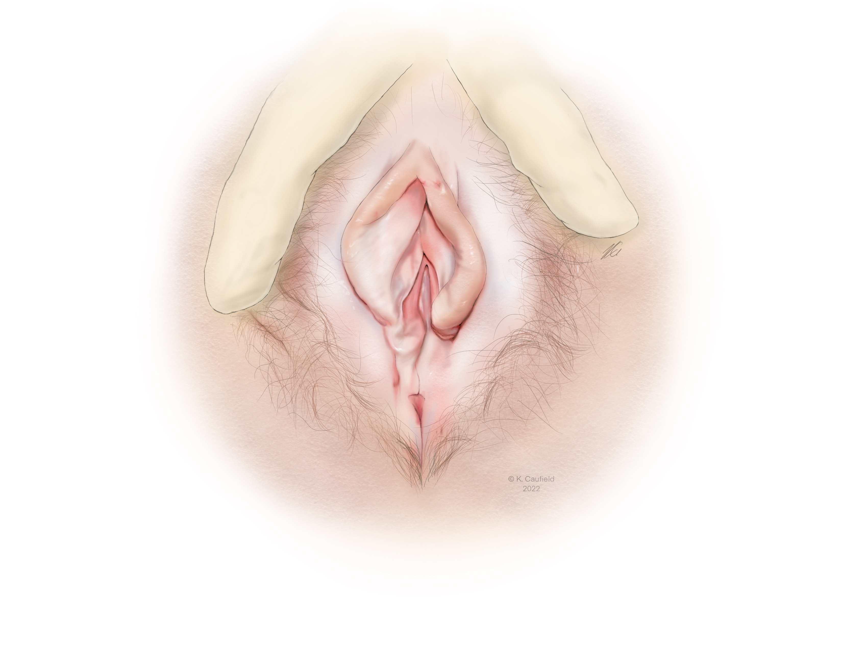
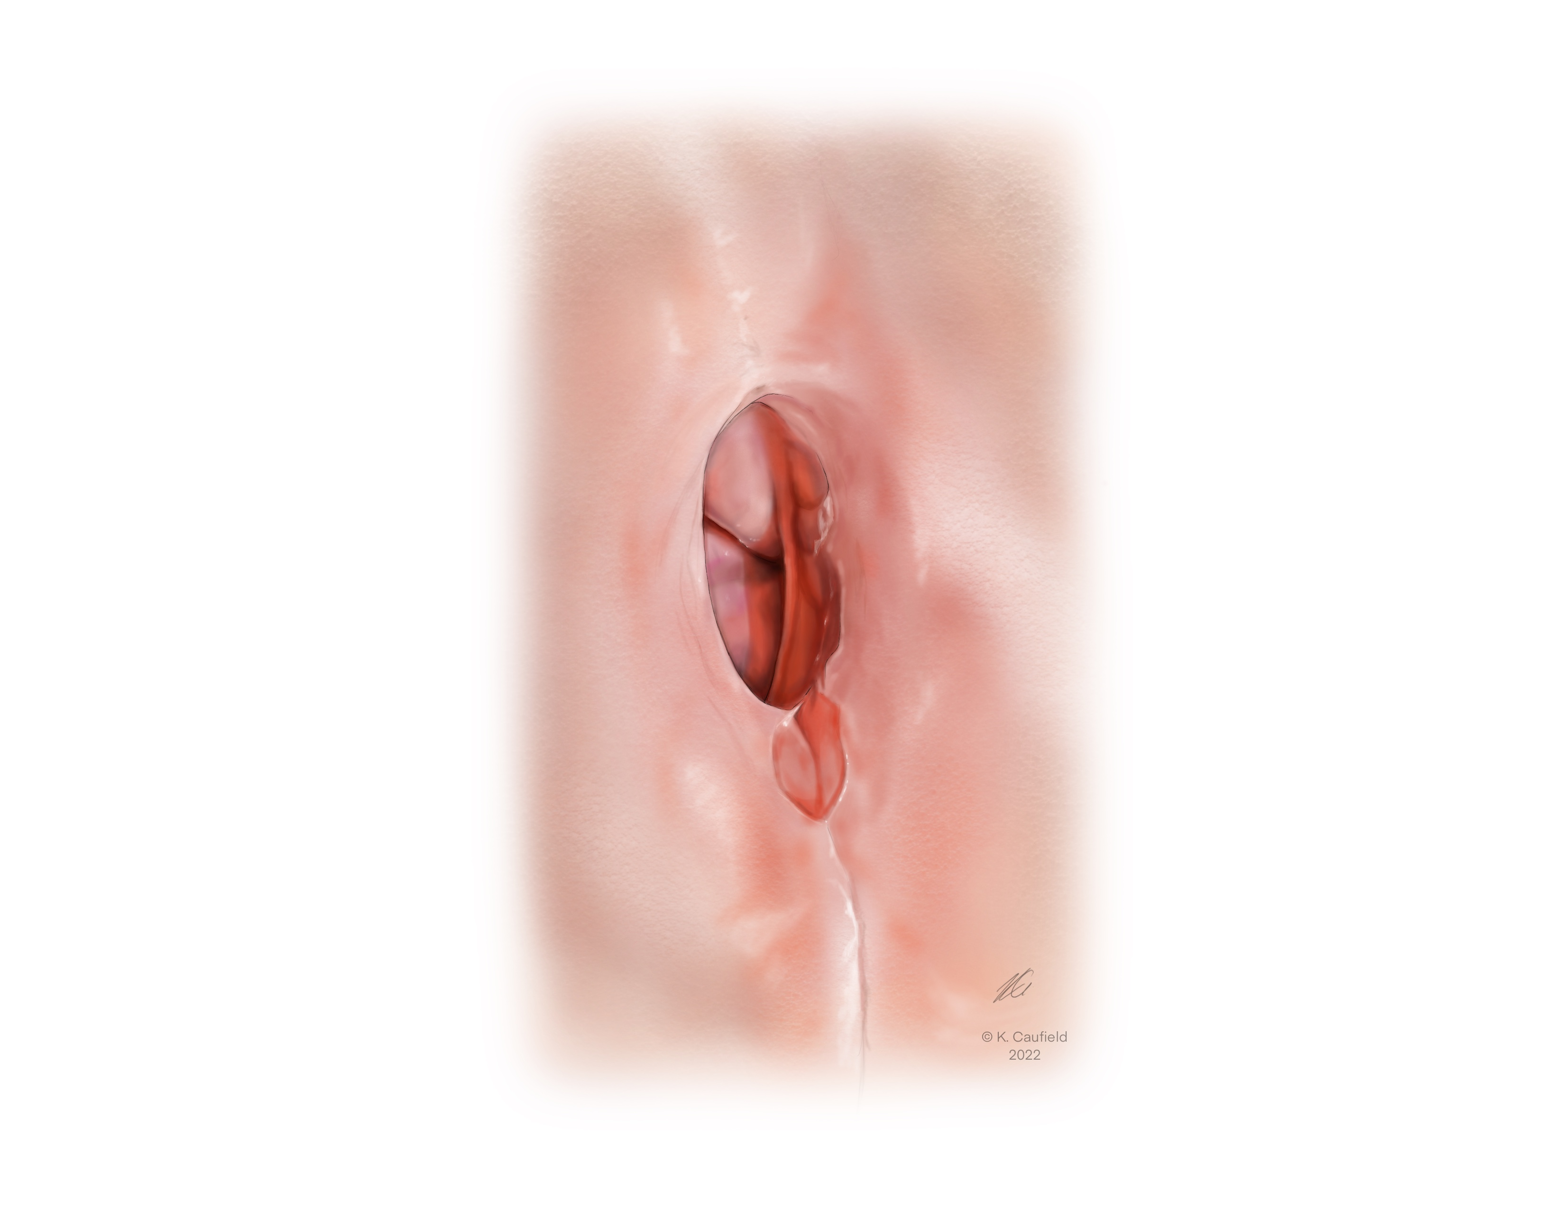
Lichen Sclerosus
Condition: chronic scarring dermatologic disorder that can affect postmenopausal and prepubertal clients
Cause: unknown, autoimmune processes and genetic factors
Symptoms/Signs: vulvar pruritus, irritation, burning, dyspareunia, and tearing
lesions appear as porcelain-white papules and plaques, thinned, whitened, and crinkled (hence the description, “cigarette paper” or “cellophane appearance”), fissures
Vaginal orifice narrowing, adhesions of the labia minora, the clitoral hood
A biopsy to confirm the diagnosis of lichen sclerosus and
untreated lichen sclerosus, are at increased risk of vulvar squamous cell carcinoma
Committee on Practice Bulletins–Gynecology, Diagnosis and Management of Vulvar Skin Disorders: ACOG Practice Bulletin, Number 224. (2020). Obstetrics and Gynecology (New York. 1953), 136(1), e1–e14. https://doi.org/10.1097/AOG.0000000000003944

Slide 12
Lichen Sclerosus (2)
Management:
Referral to a gynecologist who specializes in this condition is required for biopsy and management.
Acute episodes: Medium/high potency topical corticosteroid ointment
Avoid allergen triggers [see slide]
Cleanse vulva with water only
Care with friction and pat vulva dry after bathing
May use peri-care bottle for rinsing with water only after urination
100% cotton, unscented or fragrance-free menstrual pads, tampons, underwear
Apply preservative-free, unscented or fragrance-free emollient to hold moisture in the skin and improve barrier function
Adequate lubricant for intercourse (unscented)
Committee on Practice Bulletins–Gynecology, Diagnosis and Management of Vulvar Skin Disorders: ACOG Practice Bulletin, Number 224. (2020). Obstetrics and Gynecology (New York. 1953), 136(1), e1–e14. https://doi.org/10.1097/AOG.0000000000003944

Slide 13
Lichen planus
Condition: a scarring inflammatory disorder of the skin, oral mucosa, and vulvovaginal area.
Cause: unknown, cell-mediated immunity and is associated with autoimmune disorders, peri/post menopause
Symptoms/signs: dyspareunia, burning, soreness, itching, and increased vaginal discharge, other oral/skin lesions
White “lacy, or fernlike” striae (Wickham striae), dusky pink, poorly demarcated papules
Erythematous, friable erosions, tissue damage, adhesion vaginal orifice and labial majora/minora.
Initially this can overlap – look like Lichen sclerosus
Management:
Referral to a gynecologist who specializes in this condition is required for biopsy and management
Committee on Practice Bulletins–Gynecology, Diagnosis and Management of Vulvar Skin Disorders: ACOG Practice Bulletin, Number 224. (2020). Obstetrics and Gynecology (New York. 1953), 136(1), e1–e14. https://doi.org/10.1097/AOG.0000000000003944
Stockdale, & Boardman, L. (2018). Diagnosis and Treatment of Vulvar Dermatoses. Obstetrics and Gynecology (New York. 1953), 131(2), 371–386. https://doi.org/10.1097/AOG.0000000000002460

Slide 14
Questions?

