Slide 1
Part 1 Pelvic Exam Considerations: Hesitancy, Anxiety or History of Trauma

Slide 2
Part 1: Pelvic Exam Considerations
The purpose of the pelvic exam is to check the size and position of organs, determine the underlying cause of pain, abnormal bleeding or discharge, screen for cervical dysplasia (pap tests), screen for infectious pathology [including sexually transmitted infections STI], and facilitate placement of birth control devices (diaphragm, intrauterine devices). While the pelvic exam is an important assessment tool, for many clients the pelvic exam can be a vulnerable and distressing procedure.
This presentation will address factors that influence hesitancy, anxiety and trigger previous trauma. The presentation aims to heighten the practitioner’s awareness to aspects of the procedure that can be triggering and provide options to assist with optimizing comfort and minimize distress.

Slide 3
Content
Factors that influence hesitancy and anxiety
Discuss pre-examination options to facilitate support
Discuss options to optimize comfort
Voiding Bladder
Positioning
Speculum choice
Temperature and lubrication options
Discuss considerations for previous trauma (physical/sexual)
Discuss female genital cutting/mutilation and practitioner responsibilities
Discuss virginity testing/confirmation and practitioner responsibilities

Slide 4
Pelvic Exam Hesitancy/Anxiety
1st time for a pelvic exam
New Canadians/immigrants with little/no previous exposure to pelvic exam/screening¹
Lack education regarding pelvic anatomy and procedure
Previous negative experience or pain with a pelvic exam
Chronic history of vulvovaginal conditions or dermatosis that cause tissue changes/adhesions, pain/discomfort with pelvic exam
Previous history of trauma/violence [physical, sexual, emotional]
1. Lofters, Glazier, R. H., Agha, M. M., Creatore, M. I., & Moineddin, R. (2007). Inadequacy of cervical cancer screening among urban recent immigrants: A population-based study of physician and laboratory claims in Toronto, Canada. Preventive Medicine, 44(6), 536–542. https://doi.org/10.1016/j.ypmed.2007.02.019
Bates, Carroll, N., & Potter, J. (2011). The Challenging Pelvic Examination. Journal of General Internal Medicine : JGIM, 26(6), 651–657. https://doi.org/10.1007/s11606-010-1610-8
Notes:
Lofters, A., et al (2007) Among 724,584 women, 55.4% had Pap smears within 3 years. Recent immigration, visible minority, foreign language, low income and low education were all associated with significantly lower area rates. Recent registrants had much lower rates than non-recent registrants (36.9% versus 60.9%).
Many countries do not do pelvic exams (or Pap screening). This will be new and advocate from the cultural community may be needed. To assist with recruitment as well as providing insight into cultural concerns/stigma or perceptions.

Slide 5
Pre-examination Considerations
Prior to undressing and/or positioning on the examination table, have the individual describe their concerns and explore options that may assist in decreasing anxiety and/or making the exam more comfortable for them.
Describe the pelvic exam, rational for why it is being done and what can be expected
Ensure that language to describe the procedure and findings are appropriate, normalized and asexual
For persons that English is not their 1st language, provide descriptions in their 1st language and/or use visual aids
Educational materials in 1st language (see this link for many downloads) this is an example of Arabic https://medlineplus.gov/languages/womenshealthcheckup.html#Amharic
A support person (trusted interpreter) should be available for all clients with language/hearing barriers
Bates, Carroll, N., & Potter, J. (2011). The Challenging Pelvic Examination. Journal of General Internal Medicine : JGIM, 26(6), 651–657. https://doi.org/10.1007/s11606-010-1610-8
Olson, B.K. (1981). Patient Comfort During Pelvic Examination. Journal of Obstetric, Gynecologic, and Neonatal Nursing, 10(2), 104–107. https://doi.org/10.1111/j.1552-6909.1981.tb00842.x

Slide 6
Pre-examination Considerations (2)
Community advocate/peer focus groups are helpful to allow for culturally/population appropriate discussion, questions and/or management of stigma etc.
Utilize pelvic models and/or images to visualize the anatomy and pre-demonstrate the procedure to allow for advanced questions
Provide the opportunity to examine of the speculum and other equipment being used
Discuss the presence of a chaperone [regulated health professional] during the exam when needed
Bates, Carroll, N., & Potter, J. (2011). The Challenging Pelvic Examination. Journal of General Internal Medicine : JGIM, 26(6), 651–657. https://doi.org/10.1007/s11606-010-1610-8
Olson, B.K. (1981). Patient Comfort During Pelvic Examination. Journal of Obstetric, Gynecologic, and Neonatal Nursing, 10(2), 104–107. https://doi.org/10.1111/j.1552-6909.1981.tb00842.x
Notes:
This could be cultural/ population groups (teens preparing for the 1st exam or women who have experienced trauma)

Slide 7
Void Bladder Prior to Exam
Bladder distention can cause discomfort during the speculum and/or bimanual pressure,
Distension can interfere with palpation of structures
Bladder distension moves and/or obstructs the uterus therefore making the cervical difficult to localize/visualize resulting in unnecessary repositioning of the speculum
For persons (e.g., post menopausal, multiple pregnancies) with loss of pelvic floor tone, there is less chance of urinary leakage during digital or speculum insertion and exam.
Bates, Carroll, N., & Potter, J. (2011). The Challenging Pelvic Examination. Journal of General Internal Medicine : JGIM, 26(6), 651–657. https://doi.org/10.1007/s11606-010-1610-8

Slide 8
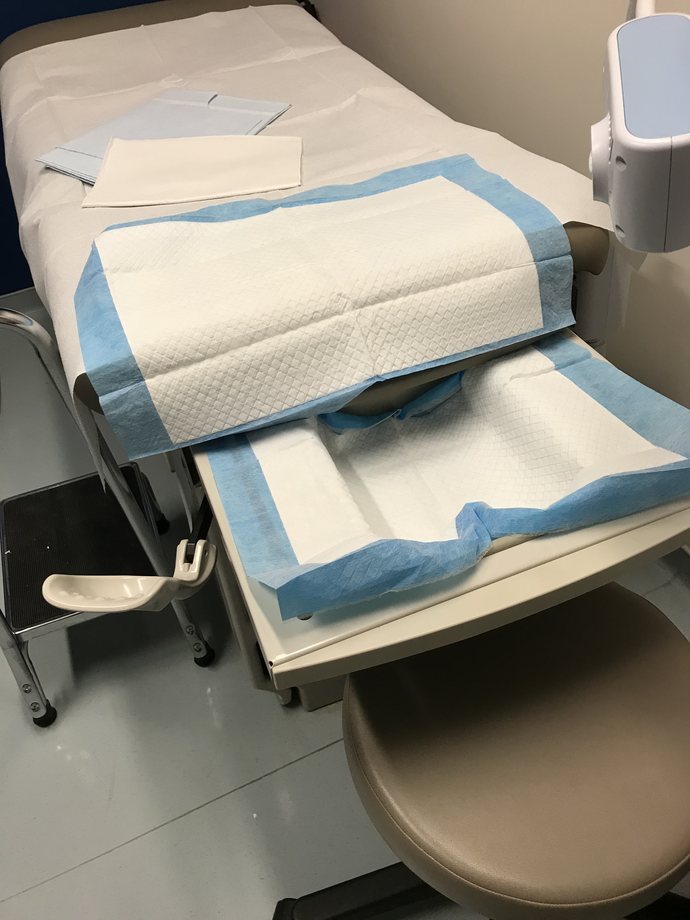
During the Examination: Positioning
Assist the client into position on the exam table, warning with touching or verbal cues [“Please move down to the end of the table”]
Stirrup use can be uncomfortable, cause vulnerability and/or triggering for some patients
Provide alternative positioning [“no-stirrups” method]¹
V position (supine, hips abducted, knees extended)
M position (supine, hips abducted, knees flexed, feet at edges of table)
Diamond position (supine, hips abducted, knees flexed, soles of feet touching)
Lateral position (lying on one side, hips and knees flexed)
Ask to relax abdominal muscles, shoulders, and thigh muscles
Offer relaxation techniques (deep breathing, imagery, soft music) and distraction as per the client’s preference.
1. Bates, Carroll, N., & Potter, J. (2011). The Challenging Pelvic Examination. Journal of General Internal Medicine : JGIM, 26(6), 651–657. https://doi.org/10.1007/s11606-010-1610-8
Sudduth, & Linton, D. (2011). Gynecologic Care of Women with Disabilities. Nursing for Women’s Health, 15(2), 138–148. https://doi.org/10.1111/j.1751-486X.2011.01622.x
Richman. (2007). Gynecologic Care of Women With Physical Disabilities. Obstetrical & Gynecological Survey, 62(7), 421–423. https://doi.org/10.1097/01.ogx.0000268650.18450.9d

Slide 9
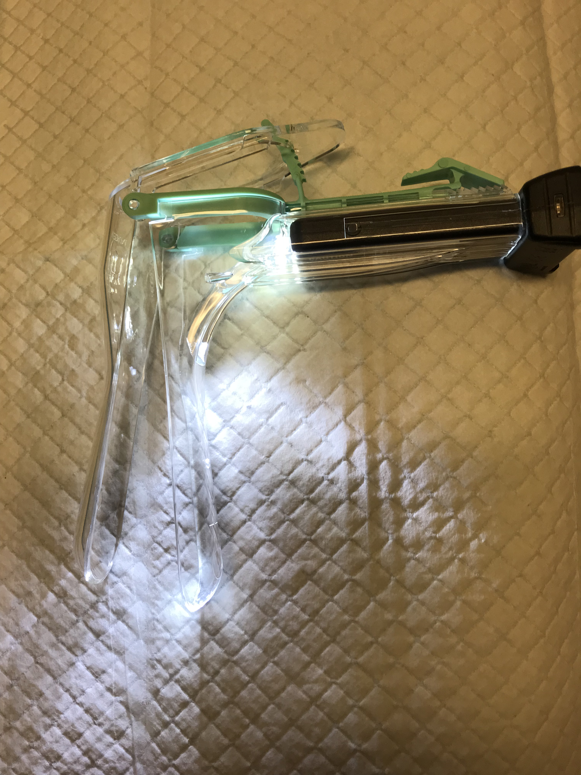
Speculum Choice for Comfort
Multiple speculum choices should be available and select the smallest speculum that permits optimal visualization.¹
A Pederson medium has dimensions of 10 cm length and 2.5 cm width, accommodates most clients.¹
Smaller options maybe needed for individuals with atrophy, dermatosis, adhesions, lesions or infections¹
Women with a micro-perforate or septate hymen should be examined with extra-narrow speculum and referred to a gynecologist.²
The audible and sensible clicks in locking plastic speculum position can be distressing¹ [discuss in advance and/or lift the latch with your thumb to minimize the sound/sensation]
Harmanli, & Jones, K. A. (2010). Using Lubricant for Speculum Insertion. Obstetrics and Gynecology (New York. 1953), 116(2, Part 1), 415–417. https://doi.org/10.1097/AOG.0b013e3181e750f1
Bates, Carroll, N., & Potter, J. (2011). The Challenging Pelvic Examination. Journal of General Internal Medicine : JGIM, 26(6), 651–657. https://doi.org/10.1007/s11606-010-1610-8

Slide 10
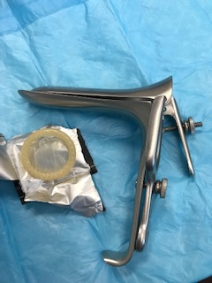
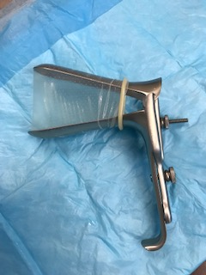
High BMI/Obesity [Additional Vaginal Tissue]
High BMI/Obesity may result in increased vaginal tissue
If it is difficult to visualize the vaginal vault and/or the cervix due to additional tissue falling into the speculum, consider the following:
Utilize a large steel speculum (Graves) to support the tissue [L= 12 cm x 4 cm or XL = 15cm x 4 cm or XXL 18 cm x 4.4]
Cut the tip from a condom and place over the steel speculum to provide a cuff that prevents the tissue from falling into the speculum
Ensure that the condom does not have spermicide and/or other lubricants that will interfere with taking diagnostic samples

Slide 11
Temperature and Lubrication
The speculum can be warmed by placing under warm water. Ask the client if the temperature is comfortable
Water can also serve as a lubricant for most individuals
For individuals who experience dermatosis and other drying conditions (menopause/radiation) lubricant is important for care
Certain types of lubricants containing “carbomers” or “Carbopol polymers” may interfere with liquid mediums for Pap diagnostics and should be avoided²
Water soluble gel lubricants (used sparingly on lower edge of the speculum or applied to the vaginal introitus during bimanual exam) should not impact the pap test or swabs for culture & sensitivity or sexual transmitted infection testing^{1,2}
1. Harmanli, & Jones, K. A. (2010). Using Lubricant for Speculum Insertion. Obstetrics and Gynecology (New York. 1953), 116(2, Part 1), 415–417. https://doi.org/10.1097/AOG.0b013e3181e750f1
2. Lin, Taylor, J., Alperstein, S., Hoda, R., & Holcomb, K. (2014). Does speculum lubricant affect liquid‐based Papanicolaou test adequacy? Cancer Cytopathology, 122(3), 221–226. https://doi.org/10.1002/cncy.21369

Slide 12
Considerations: Trauma (Physical/Sexual)
Speculum or digital examinations may cause trauma flashbacks
Trigger anxiety pre/during/after an exam
Insomnia prior/after an exam
Routine inquiry for all clients regarding history of trauma (physical/sexual) is essential (asking first if it is ok to ask about this information)
This information should be elicited during the initial interview/history taking process while the client is seated in a chair and fully clothed
Discuss options for adjusting the exam to optimize comfort and minimize distress.
See next slide for some suggestions
Bates, C.K., Carroll, N., and Potter, J. (2011) The Challenging Pelvic Examination. J Gen Intern Med 26(6):651–7 https://www.ncbi.nlm.nih.gov/pmc/articles/PMC3101979/pdf/11606_2010_Article_1610.pdf

Slide 13
Consideration Options: Trauma (Physical/Sexual)
Offer the option of mental health counseling (pre/post exam)
Review all aspects of the exam process while supporting/normalize discomfort and/or anxiety
Reassure the patient that they can stop or slow the process at any time
Accommodate support persons/pets/objects/interpreters, female providers whenever possible
Offer multiple visits including 1st visit (history), 2nd (and/or 3rd ) visit (exam – external/internal)
Only remove clothing required for the exam
Offer a mirror to visualize and/or guided self-speculum insertion to allow patient’s sense of control in the process
If anti-anxiety medication are required, it is recommended to refer to a gynecology specialist as this will require a signed consent and a chaperone to be present (severe/rare situations)
Bates, C.K., Carroll, N., and Potter, J. (2011) The Challenging Pelvic Examination. J Gen Intern Med 26(6):651–7 https://www.ncbi.nlm.nih.gov/pmc/articles/PMC3101979/pdf/11606_2010_Article_1610.pdf

Slide 14
Considerations Female Genital Cutting/Mutilation
This information is taken directly from the Society of Obstetrics and Gynecology of Canada (SOGC) Clinical Practice Guidelines¹:
Internationally recognized as a harmful practice, violation of girls’ and women’s rights to life, physical integrity, and health.
The immediate and long-term health risks and complications can be serious and life threatening.
Continues to be practised in many countries, particularly in sub-Saharan Africa, Egypt, and Sudan.
Performing or assisting in female genital cutting is a criminal offense in Canada.
Reporting to appropriate child welfare protection services is mandatory when a child has recently been subjected to female genital cutting or is at risk of being subjected to the procedure.
There continues to be concerns regarding the following:
Infibulation: Excision of part of the external genitalia and stitching of the vulvovaginal opening to partially cover the vaginal opening.
Defibulation: Incision of the vulva to open the vagina of a woman who has undergone infibulation.
Re-infibulation: The re-suturing of the vulvar opening that has been opened with defibulation.
1. Society of Obstetrics and Gynecology of Canada (SOGC) Female Genital Cutting: Clinical Practice Guidelines https://www.jogc.com/article/S1701-2163(15)30792-1/pdf
Notes:
Canada sees this due to Global Migration

Slide 15
Considerations Female Genital Cutting/Mutilation
Health care providers need to be:
Well educated and knowledgeable about the subject
Non-judgemental and supportive
Comfortable with articulating a position of compassionate, non-support, if asked to participate.
Find supportive counselling, gynecology specialists and pelvic floor physio practitioners who are knowledgeable in this area
If pelvic exam is required it is recommended to refer to a knowledgeable gynecologist to ensure safety and comfort
1. Society of Obstetrics and Gynecology of Canada (SOGC) Female Genital Cutting: Clinical Practice Guidelines https://www.jogc.com/article/S1701-2163(15)30792-1/pdf

Slide 16
Considerations Virginity Testing/Confirmation
Visualization of the hymen cannot accurately or reliably determine whether an individual has had intercourse¹
“Virginity testing” is a complex, culturally mediated practice, poorly understood by most Canadian clinicians
“Virginity testing” is a human rights violation¹
In all situations, the practitioner must work in the best interest of the client
Practitioners should be comfortable with articulating a position of compassionate and non-support, if asked to participate“virginity testing”
1. Crosby SS, et al. (2020) Virginity testing: recommendations for primary care physicians in Europe and North America BMJ Global Health;5:e002057. doi:10.1136/bmjgh-2019-002057 https://gh.bmj.com/content/bmjgh/5/1/e002057.full.pdf

Slide 17
Questions?

Slide 18
References
Canadian Society of Obstetrics and Gynecology (SOGC) Female Genital Cutting: Clinical Practice Guidelines https://www.jogc.com/article/S1701-2163(15)30792-1/pdf
Crosby SS, et al. (2020) Virginity testing: recommendations for primary care physicians in Europe and North America BMJ Global Health;5:e002057. doi:10.1136/bmjgh-2019-002057 https://gh.bmj.com/content/bmjgh/5/1/e002057.full.pdf
Bates, Carroll, N., & Potter, J. (2011). The Challenging Pelvic Examination. Journal of General Internal Medicine : JGIM, 26(6), 651–657. https://doi.org/10.1007/s11606-010-1610-8
Diagnosis and Management of Vulvar Skin Disorders: ACOG Practice Bulletin, Number 224. (2020). Obstetrics and Gynecology (New York. 1953), 136(1), e1–e14. https://doi.org/10.1097/AOG.0000000000003944
Edwards, Bates, C. M., Lewis, F., Sethi, G., & Grover, D. (2015). 2014 UK national guideline on the management of vulval conditions. International Journal of STD & AIDS, 26(9), 611–624. https://doi.org/10.1177/0956462414554271
Harmanli, & Jones, K. A. (2010). Using Lubricant for Speculum Insertion. Obstetrics and Gynecology (New York. 1953), 116(2, Part 1), 415–417. https://doi.org/10.1097/AOG.0b013e3181e750f1
Lofters, Glazier, R. H., Agha, M. M., Creatore, M. I., & Moineddin, R. (2007). Inadequacy of cervical cancer screening among urban recent immigrants: A population-based study of physician and laboratory claims in Toronto, Canada. Preventive Medicine, 44(6), 536–542. https://doi.org/10.1016/j.ypmed.2007.02.019
Olson, B.K. (1981). Patient Comfort During Pelvic Examination. Journal of Obstetric, Gynecologic, and Neonatal Nursing, 10(2), 104–107. https://doi.org/10.1111/j.1552-6909.1981.tb00842.x
Richman. (2007). Gynecologic Care of Women With Physical Disabilities. Obstetrical & Gynecological Survey, 62(7), 421–423. https://doi.org/10.1097/01.ogx.0000268650.18450.9d
Schopp, Sanford, T. C., Hagglund, K. J., Gay, J. W., & Coatney, M. A. (2002). REMOVING SERVICE BARRIERS FOR WOMEN WITH PHYSICAL DISABILITIES: PROMOTING ACCESSIBILITY IN THE GYNECOLOGIC CARE SETTING. Journal of Midwifery & Women’s Health, 47(2), 74–79. https://doi.org/10.1016/S1526-9523(02)00216-7

