Slide 1
Part 1 Pelvic Exam
Findings and Conditions: Masses/Viral Lesions
eCampus Ontario

Slide 2
Part 1: Masses/Lesions
Pelvic exam findings can be normal or may represent pathology.
This portion of the presentation describes findings and conditions that may present on pelvic exam as masses/lesions on the vulvovaginal area or cervix.
The clinical manifestations may be asymptomatic or include [but are not limited to]: burning, itching, irritation, erythema/excoriation, pain and/or pain with intercourse [dyspareunia].
NOTE: It is important to note that the lectures (and associated content) is current as of December 2021. For all treatment/management, it is essential that all practitioners consult the most recent evidence-based guidelines prior to initiating therapy. It is also recommended that for infectious conditions, that practitioners check the Public Health Agency of Canada or local province clinical guidelines/recommendations prior to initiating antimicrobial prescriptions and/or recommendations. This will ensure you have the most recent evidence-based treatment recommendations for infectious strains found in your area/region.

Slide 3
Content
Part 2: Vulvovaginal Dermatosis
Genitourinary syndrome of menopause (GSM) [previously: vulvovaginal atrophy]
Vulvodynia/Vestibulitis/Vaginismus
Contact Dermatitis soaps/creams/bubble bath/Vaginal medicines or douching.
Lichen Simplex Chronicus
Lichen Sclerosus
Lichen Planus
Part 3: Vulvovaginitis & Infections
Yeast Candidiasis (yeast), Tinea cruris (yeast),
Bacterial Vaginosis (BV) Gardnerella vaginalis and Strawberry cervix
Ectoparasites (scabies and pediculosis)
Sexually Transmitted Infection: Trichomonas vaginalis, Chlamydia trachomatis, Neisseria gonorrhoeae,
Syphilis (Treponema pallidum)
Foreign body/Toxic Shock Syndrome
Part 1: Masses/Viral Lesions
Vulvovaginal
Subcutaneous Lesions: Folliculitis, Furuncle (boil), Carbuncle (abscess)
Bartholin’s Cysts & Abscesses
Herpes Simplex Virus [post herpetic neuralgia]
Genital Warts: Human Papilloma Virus,
Molluscum Contagiosum: Poxvirus
Cervical
Normal cervix/os:
  Endocervical Cells/Transformation zone
  Cervical Stenosis
Cervical Nabothian Cyst
Cervical Polyp
Cervical Dysplasia/Cervical Intraepithelial Neoplasm

Slide 4
Vulvovaginal : Masses/Lesions

Slide 5
Sub/Cutaneous Lesions: Non-Infectious & Infections
Define condition/cause: Inflammation of hair follicles. Non-infectious or infection of the surrounding subcutaneous (cutaneous) dermis
Non-infectious (Pseudo folliculitis): Inflammation secondary to friction/irritation or occlusion.
Infections: [Uncomplicated] – hair removal S. Aureus (other gram -negative organisms: Enterobacteriacease]
Infections: [Complicated]
Genital/Perirectal Abscesses [polymicrobial]
Pseudomonas – associated with hot tub contamination [swab and empiric antibiotic treatment with coverage for pseudomonas]
Index of suspicion for MRSA [areas where MRSA is commonly isolation in > 10-15% of S. aureus, previous history of recent antibiotic use, hospitalization (over last 3-12 months), or recurrent furunculosis [swab for C&S, MRSA and empiric antibiotic treatment to cover MSRA]
Symptoms/Signs: pain, erythema and pustular lesion(s)
MUM Anti-Infective Guidelines (2019) pg.
Notes:
Define condition/cause: Inflammation of hair follicles. Non-infectious or infection of the surrounding subcutaneous (cutaneous) dermis
Non-infectious (Pseudo folliculitis): Inflammation secondary to friction/irritation or occlusion.
Infections: [Uncomplicated] – hair removal S. Aureus (other gram negative organisms: Enterobacteriacease]
Infections: [Complicated]
Genital/Perirectal Abscesses [polymicrobial]
Pseudomonas – associated with hot tub contamination [swab and empiric antibiotic treatment with coverage for pseudomonas]
Index of suspicion for MRSA [areas where MRSA is commonly isolation in > 10-15% of S. aureus, previous history of recent antibiotic use, hospitalization (over last 3-12 months), or recurrent furunculosis [swab for C&S, MRSA and empiric antibiotic treatment to cover MSRA]
Symptoms/Signs: pain, pustular lesion(s) with an erythematous base or erythema/swelling the surrounding cutaneous/subcutaneous tissue.

Slide 6
Sub/Cutaneous Lesions: Non-Infectious & Infections
Management:
Pseudo folliculitis: avoid causative factors. Topical drying agents are beneficial
Folliculitis/Furuncles: uncomplicated (early onset) 1st line Hot Compresses and anti-septic cleanser +/- topical
Furuncles may need incision & drainage (I&D) (antibiotics post I&D may/may not be needed)
Carbuncles incision and drainage is usually necessary with systemic antibiotic treatment if >5 cm, multiple abscesses, cellulitis, face, constitutional s/s
Complications/red flags:
Systemic symptoms (fever), not responding to treatment and/or progressing infection from superficial to cutaneous dermis or surrounding dermis (cellulitis)
MUM Anti-Infective Guidelines (2019) pg.
Notes:
Folliculitis are usually self limiting with hot compresses and anti-septic cleanser maybe beneficial systemic therapy is not generally required
Second line – may considered mupirocin 2% ung/cream TID sparingly or fusidic acid 2% ung/cream TID
Furuncles (boils) are abscesses that start in a hair follicle. For small uncomplicated furuncles hot compresses are usually sufficient, while for larger ones drainage is necessary. After I&D antibiotics are recommended. Swab of boils should be considered if there is recurrent or abscesses (2 or more in 6 months). High index of suspicion for DM type 2
Carbuncles are deeper and more extensive, incision and drainage is usually necessary. Consider systemic antibiotics if the abscess > 5 cm in diameter, large and/or multiple abscesses, cellulitis to surrounding tissue, presence of systemic symptoms or fever.
Complications/red flags:
Systemic symptoms (fever), not responding to treatment and/or progressing infection from superficial to cutaneous dermis or surrounding dermis (cellulitis)

Slide 7
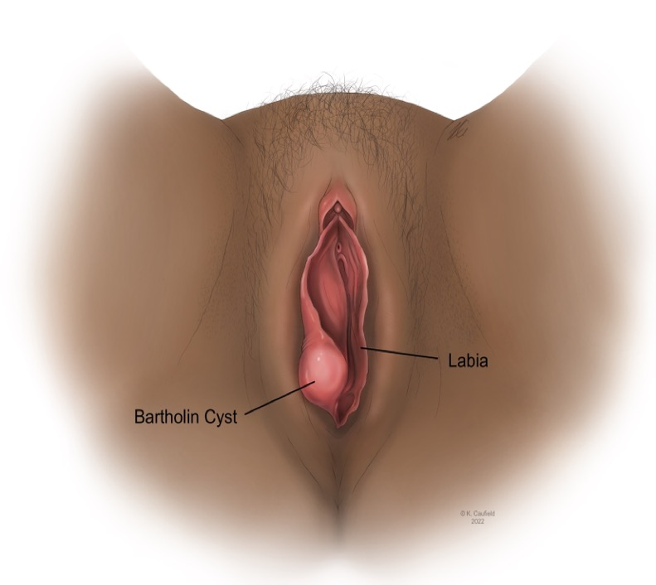
Bartholin’s Gland Cyst (Abscess)
Define condition/cause:
Ducts leading from the Bartholin glands can become obstructed
Non-infectious inflammation due to trauma/friction
Infection (most common Escherichia coli and Staphylococcus aureus) to a lesser degree STI organisms and respiratory organisms.
Symptoms/Signs: dyspareunia, swelling, erythema and pain over the gland/surrounding tissue, fever +/- abscess
Omole, F., Kelsey, R. C., Phillips, K., & Cunningham, K. (2019). Bartholin Duct Cyst and Gland Abscess: Office Management. American Family Physician, 99(12), 760–766.
Lee, M. Y., Dalpiaz, A., Schwamb, R., Miao, Y., Waltzer, W., & Khan, A. (2015). Clinical Pathology of Bartholin’s Glands: A Review of the Literature. Current Urology, 8(1), 22–25.
Notes:
The Bartholin Gland is found bilaterally at 4 and 8 o’clock of the labia minora and drain through ducts 2.0 to 2.5 cm long
Usually, the size of a pea (<1 cm) and often can not be palpated.
During sexual arousal and inter- course, the Bartholin glands secrete vaginal lubricating mucus
Escherichia coli and Staphylococcus aureus are the most common isolates.
Respiratory organisms such as Streptococcus pneumoniae and Haemophilus influenzae are becoming more common, possibly because of the practice of oral sex.
Sexually transmitted infections have a role in a minority of cases.
Red Flag:
The epithelium of the gland is columnar and the duct is squamous, allowing for the possibility of squamous cell carcinoma or adenocarcinoma development.
Enlargement in women older than 40 years should raise suspicion for malignancy, particularly if the gland is firm, fixed, or irregularly shaped
The two most common types of Bartholin gland carcinomas are squamous cell carcinoma and adenocarcinoma. Human papillomavirus, particularly type 16, is associated with the pathogenesis of squamous cell carcinoma of the Bartholin gland.14-16

Slide 8
Bartholin’s Gland Cyst (Abscess)
Asymptomatic small cysts <40 years can be left untreated
Large cysts and/or abscesses require urgent incision and drainage. This also may require catheter/rink fistulisation with/without marsupialization to assist with healing (see picture below)
Antibiotic treatment is usually needed with large abscesses, cellulitis and/or STI suspected organisms
Complications/red flags: Cyst or if caused by infection an abscess can occur. > 40 years consider malignancy
Omole, F., Kelsey, R. C., Phillips, K., & Cunningham, K. (2019). Bartholin Duct Cyst and Gland Abscess: Office Management. American Family Physician, 99(12), 760–766.
Notes:
It is important to reassure your patient that if the Bartholin gland needs removal this should not implicate vaginal lubrication as other glands such as the Skene gland also assists with this.
Asymptomatic cysts in women younger than 40 years can be left untreated, whereas larger cysts and abscesses may require minor surgical procedures and excisions.1,5,8,19 Antibiotic treatment of Bartholin duct cysts and simple gland abscesses is not necessary in the absence of sexually transmitted infection, urinary tract infection, or cellulitis.2,8,17,20
Fistulization and marsupialization are the two most common procedures for Bartholin duct cysts and gland abscesses.17 Fistulization is the traditional approach for treating symptomatic cysts or abscesses, although it is not appropriate for deep cysts.1,8 The introduced foreign body prevents wound closure, resulting in an epithelialized fis- tula (i.e., a new outflow tract).17,21,22 Fistulization is achieved by the placement of a Word catheter or Jacobi ring.17,18 The Word catheter is commercially available, whereas the Jacobi ring is assembled by the clinician. Patient and cli- nician satisfaction with the Jacobi ring is higher compared with the Word catheter.23 The Jacobi ring and the Word catheter result in good resolution, low recurrence, and fewer postprocedure complications; they are also easy and inexpensive.19,23
Marsupialization is appropriate for treatment of a pri- mary or recurrent Bartholin duct cyst or gland abscess. It creates a new outflow tract after the cyst wall shrinks over time and reepithelializes.2,5,21

Slide 9
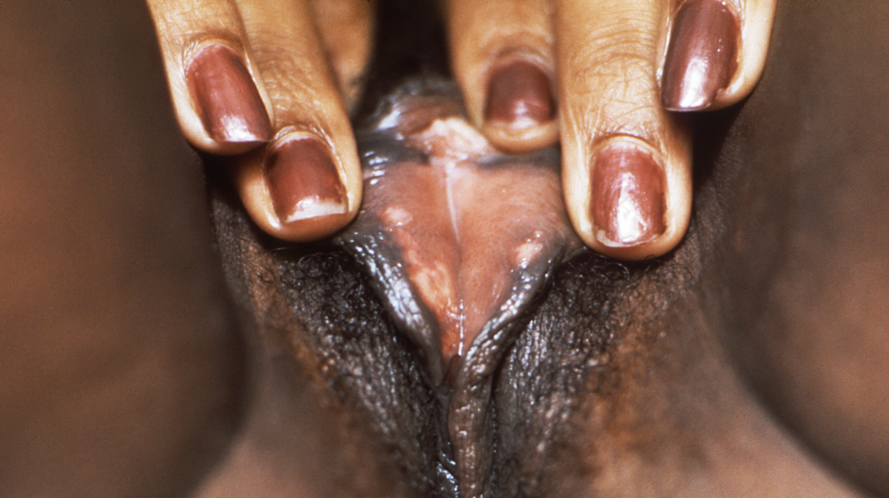
Genital Herpes Simplex Lesions
(CDC Public Image Library #15820) https://phil.cdc.gov/Details.aspx?pid=15820

Slide 10
Ano/Genital Herpes Lesion
Cause:Herpes simplex virus (HSV) types 1 and 2
Symptoms/Signs: approximately 60% are asymptomatic and 40% symptomatic¹
80% of those with symptoms present with typical genital symptoms
Lesions are vesicular in nature and when open create a flat white base with erythematous boarders
Systemic symptoms (fever, myalgia), tender lymphadenopathy in 80%.
20% of those with symptoms have atypical presentations, including non-lesion HSV-2 infections such as genital pain or urethritis,
Complication of 1st infection aseptic meningitis, cervicitis, extragenital lesions and protracted course (women 22.7 days to resolve)
Recurrences may be preceded by warning signs (prodromal symptoms) a few minutes to several days before lesions appear, such as focal burning, itching (most common), tingling or discomfort
Triggers : menstrual cycle, emotional stress, illness (especially with fever), sexual intercourse, surgery and certain medication
Corey L, Adams HG, Brown ZA, Holmes KK. Genital herpes simplex virus infections: clinical manifestations, course, and complications. Ann Intern Med 1983;98:958–972.
PHAC (2021) https://www.canada.ca/en/public-health/services/infectious-diseases/sexual-health-sexually-transmitted-infections/canadian-guidelines/sexually-transmitted-infections/canadian-guidelines-sexually-transmitted-infections-32.html
Notes:
Patients should be advised to abstain from sexual activity when lesions or prodromal symptoms are present
Encouraged to inform their sexual partners that they have genital herpes
Use of condoms with all new sexual partners (but may not be effective in preventing transmission due to location of lesions and asymptomatic shedding
Transmission may occur during symptomatic periods (with no lesions)
Initiate therapy [Acyclovir, Famciclovir, Valcyclovir] within 72 hours of onset of signs/symptoms [patients can be provided with a sypply of medication and/or a prescripton so that self-initiation of treatment care occur immediately when symptoms begin
Pregnancy Acyclovir drug of choice
Topical antivirals offer minimal clinical benefit and are not recommended
Analgesics and/or laxatives may be required
Chronic suppressive therapy (> 6 episodes per year) – non-pregnant individuals suppressive therapy can reduce the recurrence by 70-80%. Usual duration of therapy [same antivirals see PHAC] is 3-6 months – this decreases the frequency, duration, severity and asymptomatic HSV shedding. This is great psychological benefits.
Reassess every 6-12 months since frequency of outbreaks decreases over time and a treatment “holiday” after 12 months can assist with determining if there will be more outbreaks (and/or the frequency moving forward).
1st episode (primary): first clinically evidence episode in a seronegative patient, usually the incubation for symptoms is 2-21 days
Non-primary: first clinically evidence episode in a seropositive patient, short or long incubation (can be years), systemic symptoms are not usual in this case.
Primary outbreaks in the first trimester constitutes a higher risk for perinatal transmission then does recurrent infection and warrant treatment
Risk of vertical transmission when primary outbreak occurs at the time of delivery is about 30-60% , consider caesarean delivery if infection is later in the third trimester. For women with prior infection within the pervious year, prophylaxis at 36 weeks gestation is recommended.

Slide 11
Ano/Genital Herpes Lesion
Management:
Advise to abstain from sexual activity when lesions or prodromal symptoms are present
Encouraged to inform their sexual partners that they have genital herpes
Transmission may occur during asymptomatic periods (with no lesions)
Use of condoms with all new sexual partners (but may not be effective in preventing transmission due to location of lesions and asymptomatic shedding)
Initiate therapy [Acyclovir, Famciclovir, Valcyclovir] [see PHAC] within 72 hours of onset of signs/symptoms [patients can be provided with a supply of medication and/or a prescription so that self-initiation of treatment care occur immediately when symptoms begin]
Pregnancy Acyclovir drug of choice
Analgesics and/or laxatives may be required
Topical antivirals offer minimal clinical benefit and are not recommended
Chronic suppressive therapy (> 6 episodes per year) – non-pregnant individuals suppressive therapy can reduce the recurrence by 70-80%. Usual duration of therapy [same antivirals see PHAC] is 3-6 months – this decreases the frequency, duration, severity and asymptomatic HSV shedding. This is great psychological benefits.
Reassess every 6-12 months since frequency of outbreaks decreases over time and a treatment “holiday” after 12 months can assist with determining if there will be more outbreaks (and/or the frequency moving forward).
PHAC (2021) https://www.canada.ca/en/public-health/services/infectious-diseases/sexual-health-sexually-transmitted-infections/canadian-guidelines/sexually-transmitted-infections/canadian-guidelines-sexually-transmitted-infections-32.html
Notes:
Patients should be advised to abstain from sexual activity when lesions or prodromal symptoms are present
Encouraged to inform their sexual partners that they have genital herpes
Use of condoms with all new sexual partners (but may not be effective in preventing transmission due to location of lesions and asymptomatic shedding
Transmission may occur during symptomatic periods (with no lesions)
Initiate therapy [Acyclovir, Famciclovir, Valcyclovir] within 72 hours of onset of signs/symptoms [patients can be provided with a sypply of medication and/or a prescripton so that self-initiation of treatment care occur immediately when symptoms begin
Pregnancy Acyclovir drug of choice
Topical antivirals offer minimal clinical benefit and are not recommended
Analgesics and/or laxatives may be required
Chronic suppressive therapy (> 6 episodes per year) – non-pregnant individuals suppressive therapy can reduce the recurrence by 70-80%. Usual duration of therapy [same antivirals see PHAC] is 3-6 months – this decreases the frequency, duration, severity and asymptomatic HSV shedding. This is great psychological benefits.
Reassess every 6-12 months since frequency of outbreaks decreases over time and a treatment “holiday” after 12 months can assist with determining if there will be more outbreaks (and/or the frequency moving forward).
1st episode (primary): first clinically evidence episode in a seronegative patient, usually the incubation for symptoms is 2-21 days
Non-primary: first clinically evidence episode in a seropositive patient, short or long incubation (can be years), systemic symptoms are not usual in this case.
Primary outbreaks in the first trimester constitutes a higher risk for perinatal transmission then does recurrent infection and warrant treatment
Risk of vertical transmission when primary outbreak occurs at the time of delivery is about 30-60% , consider caesarean delivery if infection is later in the third trimester. For women with prior infection within the pervious year, prophylaxis at 36 weeks gestation is recommended.

Slide 12
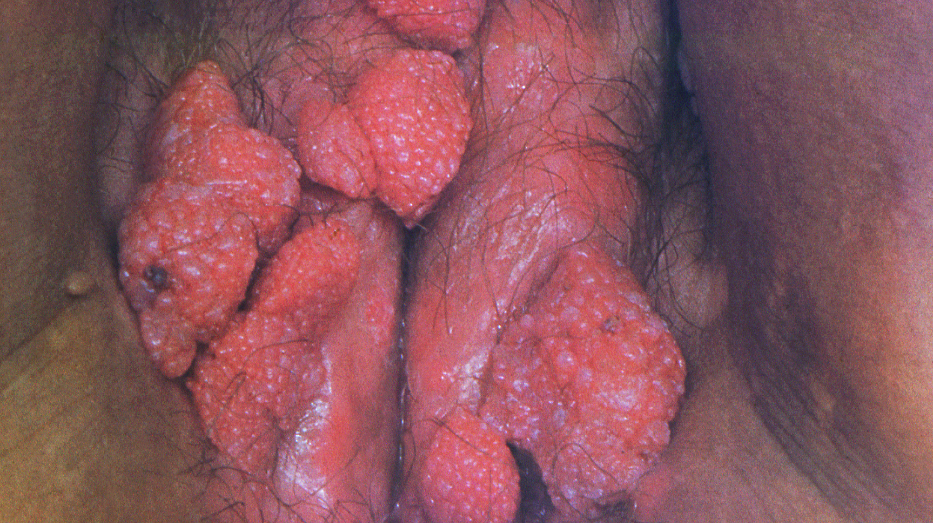
Genital/Perianal Warts: Human Papilloma Virus
(CDC Public Image Library # 16734) https://phil.cdc.gov/Details.aspx?pid=16734

Slide 13
Genital/Perianal Warts: Human Papilloma Virus
Define condition/cause: Infection with Human Papilloma Virus (HPV) (usually type 6 & 11)
Symptoms/Signs:
Asymptomatic, occasional cause pruritus, local discharge and bleeding.
Multiple, asymmetrical polymorphic exophytic fronds or growths on anogenital skin and/or mucous membranes that can vary in appearance from papular to cauliflower-like;
May fluctuate in size and number, or regress.
Tend to increase in size and number during pregnancy, then to resolve spontaneously after delivery [no need for c-section/concern unless obstructing birth canal or excessive bleeding]
Public Health Agency of Canada (2021) https://www.canada.ca/en/public-health/services/infectious-diseases/sexual-health-sexually-transmitted-infections/canadian-guidelines/sexually-transmitted-infections/canadian-guidelines-sexually-transmitted-infections-33.html#t_04b
Notes:
Most patients have < 10 genital lesions (0.5-1 cm.
Warts should be confirmed on biopsy if diagnosis is uncertain, lesions are non-responsive/worsen with treatment, if the patient is immune compromised (as they are more likely to dysplasia) or warts are pigmented, indurated, fixed and/or ulcerated (also cancer concern)
Anogenital warts
Incubation Period: 3 weeks to 8 months.^{(Footnote25)}
Appearance:
multiple, asymmetrical, polymorphic exophytic fronds or growths on anogenital skin and/or mucous membranes that can vary in appearance from papular to cauliflower-like;
may fluctuate in size and number, or regress. For example, AGWs tend to increase in size and number during pregnancy, then to resolve spontaneously after delivery.^{(Footnote65-Footnote67)}
Symptoms: occasionally cause pruritus, local discharge and bleeding.^{(Footnote68)}
Clearance: 10%-30% spontaneous clearance over 3 months;^{(Footnote69)} median time to clearance 6 months.^{(Footnote70)}
Recurrence: common.^{(Footnote25,Footnote71)} For information about recurrence following treatment, refer to the Treatment of anogenital warts section.
Sequelae:
No effect on fertility.
Little impact on labour and delivery, unless they are obstructing the birth canal and may bleed excessively.^{(Footnote65)}
Psychosexual sequelae common, including fear of recurrence, transmission and development of cancer; ^{(Footnote72)} as well as depression, sexual dysfunction and disruption of long-term relationships.^{(Footnote19,Footnote73)}
Other LR HPV 6- and 11-associated lesions
Physical examination and specimen collection
Physical examination should include:
visual inspection of the external genitalia for wart-like lesions (the usual means of diagnosis of AGWs), precancers and cancers;
speculum examination of the vagina and cervix of women for wart-like lesions, precancers and cancers; and to obtain sample for Pap test;
digital anal examination for HIV positive individuals with perianal warts (recommended), given that the likelihood of intra-anal warts or neoplasia is high;
urethroscopy for those with urinary flow problems that may be the result of AGWs in the distal urethra or urethral meatus.
Currently, there is no consensus about the use of anal Pap and high resolution anoscopy for screening those at increased risk of anal cancer (HIV positive and other immunosuppressed individuals; MSM; women with a history of anal intercourse and/or other HPV-related anogenital malignancies; and possibly, individuals with a history of AGWs). ^{(Footnote55)}
However, some experts suggest that those at increased risk may benefit from screening. For more information, refer to Appendix E: Screening for anal cancer.
Until general recommendations are developed, anal Pap testing should be guided by local practice or consensus; and is dependent on the local availability of laboratory professionals with training and/or experience in reading anal cytology.
Patients with positive results should be evaluated further using high-resolution anoscopy.⁽
Laboratory diagnosis of anogenital warts
HPV nucleic acid testing is not recommended because results would not change management.
Laboratory diagnosis of precancers and cancers
Two screening approaches to cervical cancer prevention currently exist:
Pap testing, which identifies HPV-related cytological abnormalities; and
HPV nucleic acid testing, which identifies infection with HPV, whether or not cytological changes are evident. Check provincial/territorial screening guidelines for province/territory-specific screening recommendations.

Slide 14
Genital/Perianal Warts: Human Papilloma Virus
Treatment
Wait/monitor: 10%-30% spontaneous clearance over 3 months
Other options:
Imiquimode 3.75% or 5% cream
Podofilox (podophyllotoxin 0.5% solution
Sinecatechins 10% ointment
Cryotherapy
Podophyllin resin 10-25% in compound tincture of benzoin
Trichloroacetic acid 50%—90% soln. in 70% alcohol
Laser therapy
Surgical removal
Complications/red flags:
Few, some psychosexual sequelae – fear of recurrence, transmission and development of cancer
For details see Public Health Agency of Canada (2021) https://www.canada.ca/en/public-health/services/infectious-diseases/sexual-health-sexually-transmitted-infections/canadian-guidelines/sexually-transmitted-infections/canadian-guidelines-sexually-transmitted-infections-33.html#t_04b
Notes:
Sequelae:
No effect on fertility.
Little impact on labour and delivery, unless they are obstructing the birth canal and may bleed excessively.^{(Footnote65)}
Psychosexual sequelae common, including fear of recurrence, transmission and development of cancer; ^{(Footnote72)} as well as depression, sexual dysfunction and disruption of long-term relationships
Purpose of treatment is to remove symptomatic warts, eradicate the infection, prevent long-term sequelae
No one treatment is idea for all warts and all patients and should be selected based on several factors including:
Wart size, location, number, morphology, patient preference, provider experience, cost, convenience and adverse affects.
Choosing not to treat (regardless of location) as most resolve spontaneously (20% do so within 6 months)
Management of subclinical lesions, anogenital warts, and cervical precancers, and cancers
Subclinical lesions: treatment is not recommended.^{(Footnote65)}
AGWs:
The goal is symptom relief.
Foregoing treatment (an expectant approach) may be an acceptable option for some patients, given that AGWs may resolve spontaneously, and that treatment prevents neither transmission nor recurrence.
Topical treatment of AGWs located in moist, occluded areas may be more effective than treatment of partly keratinized areas such as the penile shaft.^{(Footnote65,Footnote76)}
Treatments may be patient- (self) or clinician-applied. The choice of treatment should be guided by:
patient preference,
availability of resources,
cost,
clinician's experience,
size, shape, number and site of lesions,
convenience, and
potential adverse effects.^{(Footnote65)}
Although self-applied treatments in the privacy of the home may be preferred by some, clinicians should consider whether patients can be expected to
comply with the regimen;
be able to identify and reach all of their lesions.
Advise women with AGWs that:
All topical treatments except trichloroacetic acid (TCA) are contraindicated for use in pregnant and breastfeeding women. For more information, refer to the Treatment section.
Removal may be considered. However, complete resolution may not occur until after delivery.^{(Footnote65)}
The presence of AGWs is not an indication for caesarean section unless they are obstructing the birth canal and may bleed excessively.^{(Footnote65)}

Slide 15
Genital/Perianal Warts: HPV Vaccine
HPV vaccines: Immunizing Agents Authorized for Use in Canada (Jan 2022)
CERVARIX® (bivalent human papillomavirus [types 16, 18], recombinant vaccine), GlaxoSmithKline Inc. (HPV2).
GARDASIL® (quadrivalent human papillomavirus [types 6, 11, 16, 18], recombinant vaccine), Merck Canada Inc. (HPV4).
GARDASIL®9 (nine-valent, human papillomavirus [types 6, 11, 16, 18, 31, 33, 45, 52, 58], recombinant vaccine), Merck Canada Inc. (HPV9)
PHAC (2022) https://www.canada.ca/en/public-health/services/publications/healthy-living/canadian-immunization-guide-part-4-active-vaccines/page-9-human-papillomavirus-vaccine.html
MOHLTC Ontario (2022) https://www.health.gov.on.ca/en/pro/programs/immunization/schedule.aspx

Slide 16
Genital Warts: Molluscum Contagiosum vs HPV
Cause: Poxvirus Infection
Symptoms/signs:
Often also located on other aspects of body extremities, trunk and face
lesion is white/flesh colored, firm, smooth (pin head), round papule with central umbilication (dimpled/pit)
Usually 2 to 5 mm in diameter
Asymptomatic but may become itchy, sore, red, and/or swollen.
HPV is more irregular cauliflower like (see previous slide)
Most resolve without treatment
Treatment
Physical removal of lesions may include cryotherapy (freezing the lesion with liquid nitrogen), curettage (the piercing of the core and scraping of caseous or cheesy material), and laser therapy
Podophyllotoxin cream (0.5%)
Other options for topical therapy include iodine and salicylic acid, potassium hydroxide, tretinoin, cantharidin (a blistering agent usually applied in an office setting), and imiquimod (T cell modifier) – not in children
Complications or red flags: none – may occur if secondary infection occurs at sight
Centre for Disease Control (2021) https://www.cdc.gov/poxvirus/molluscum-contagiosum/index.html

Slide 17
Cervical
Findings/Masses/Lesions

Slide 18
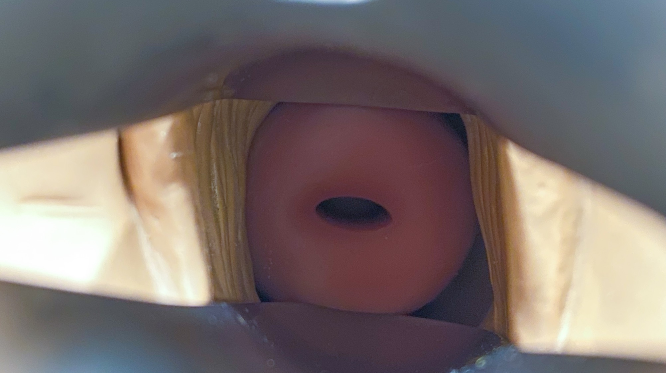
Normal Cervix

Slide 19
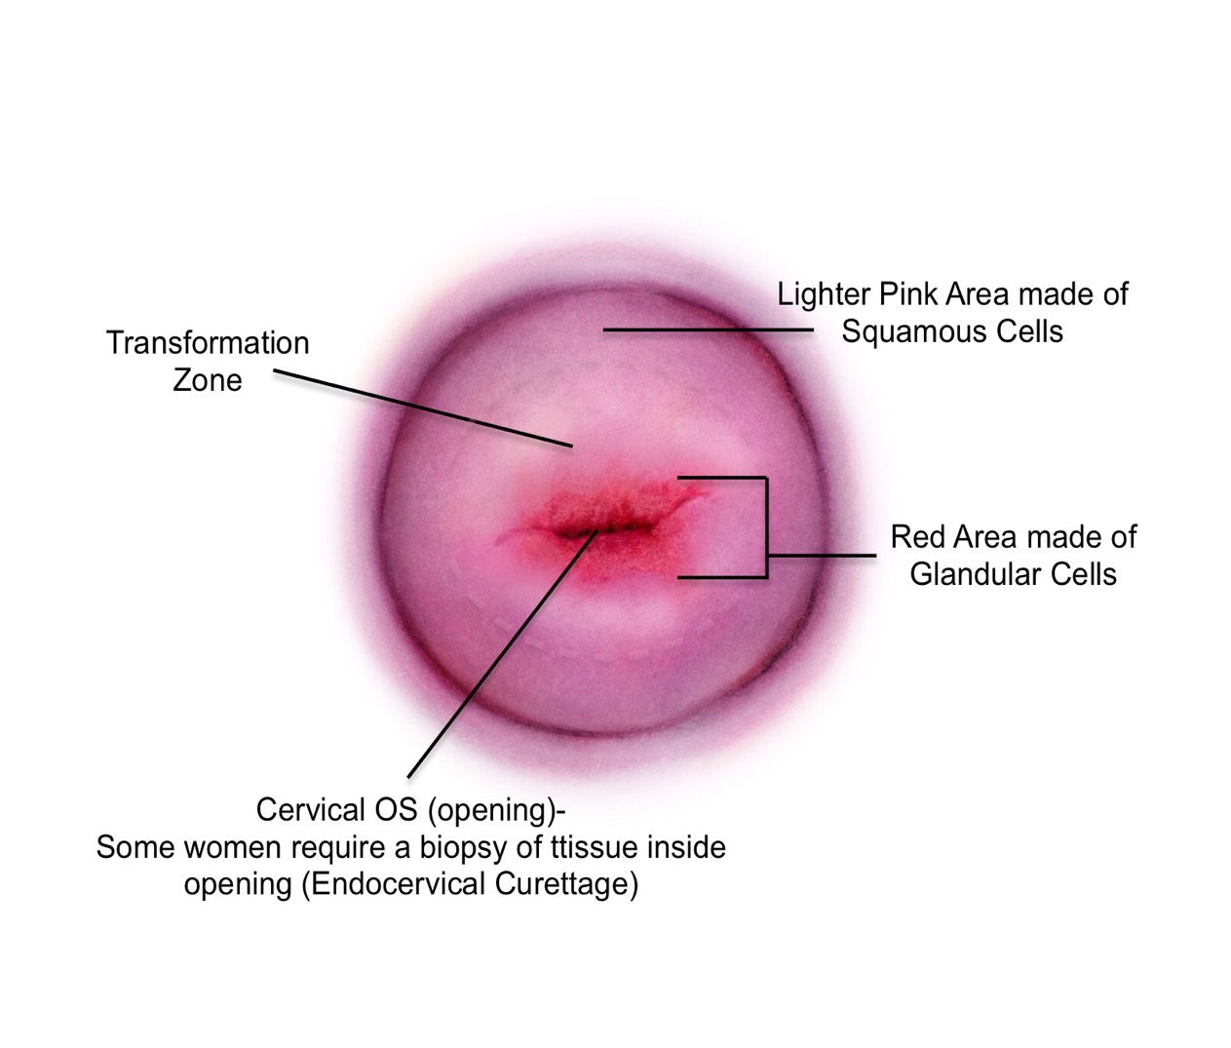
Normal Cervix
Cervix (premenopausal): Endocervical cells with predominant transition zone
Cervix (menopausal): Cervical Stenosis

Slide 20
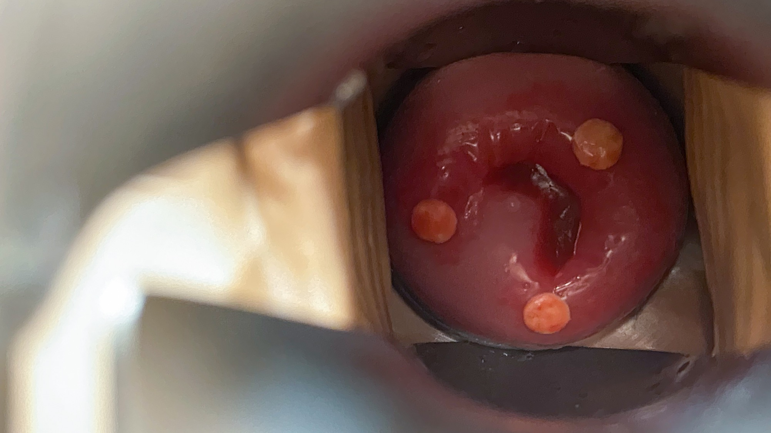
Cervical Nabothian Cyst

Slide 21
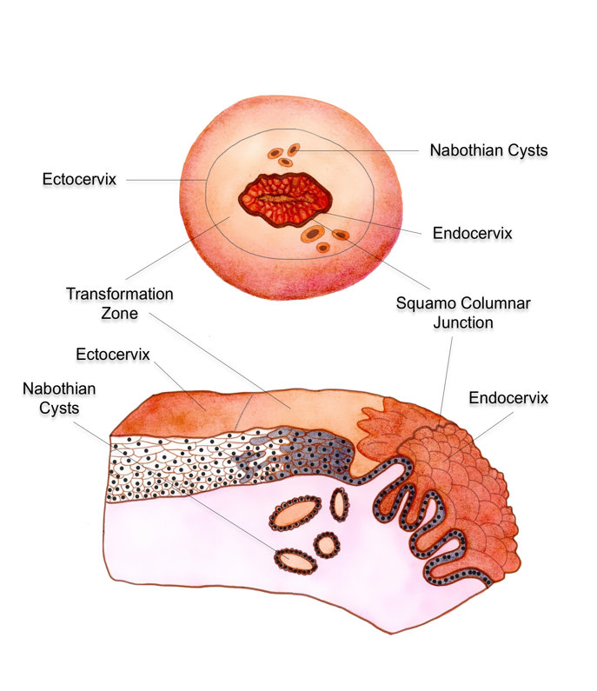
Cervical Nabothian Cyst
Define condition: A Nabothian gland/cyst is a lump filled with mucus on the surface of the cervix or cervical canal
Cause: cervical glands/cells release mucus – build up and get plugged
Symptoms/Signs: asymptomatic appears as a small, white raised bump. There can be more than one.
Management: No treatment is necessary
Complications/red flags: none
Casey, Long, M. E., & Marnach, M. L. (2011). Abnormal Cervical Appearance: What to Do, When to Worry? Mayo Clinic Proceedings, 86(2), 147–151. https://doi.org/10.4065/mcp.2010.0512

Slide 22
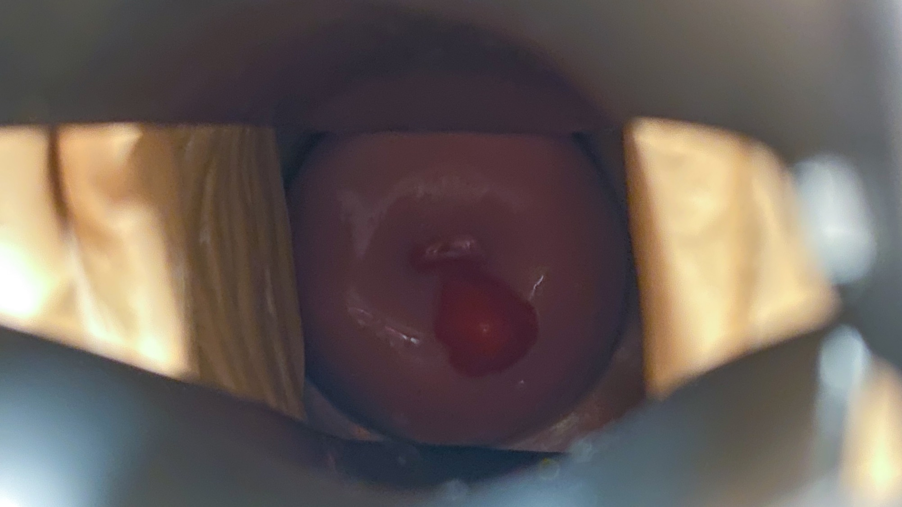
Cervical Polyps

Slide 23
Cervical Polyps
Define condition: smooth, red, tissue growth that extend out of the cervical os btw the uterus and the vagina.
Cause: infection, hormones, congestion of blood vessels, inflammation
Symptoms/Signs: asymptomatic or abnormal vaginal bleeding btw menstrual periods or during sexual intercourse
Management: most are self limiting and no management is required
If symptomatic or become infected removal recommended and referral to gyne (or provider who is trained in removal) is recommended.
Complications/red flags
Complications are very unusual
Rarely polyps can become infected causing vaginal discharge yellow/white mucus
If tissue is not smooth or pigmented referral for removal and histology is required
NOTE: These can be friable when taking a pap test and spotting/bleeding can occur
Casey, Long, M. E., & Marnach, M. L. (2011). Abnormal Cervical Appearance: What to Do, When to Worry? Mayo Clinic Proceedings, 86(2), 147–151. https://doi.org/10.4065/mcp.2010.0512

Slide 24
Pre-cancer and Cervical Intraepithelial Neoplasm (cervical dysplasia)
Screening is recommended after age 25 years (sexually active) and discontinued at age 70 (adequate and negative cytology history in previous 10 years (e.g. 3 or more negative cytology)
Normal cytology every 3 years screening
Finding a squamous cell intraepithelial lesion usually indicates infection with HPV.
For further screening: see provincial guidelines: https://www.cancercareontario.ca/en/guidelines-advice/cancer-continuum/screening/resources-healthcare-providers/cervical-screening-guidelines-summary
Public Health Agency of Canada (2021) https://www.canada.ca/en/public-health/services/infectious-diseases/sexual-health-sexually-transmitted-infections/canadian-guidelines/sexually-transmitted-infections/canadian-guidelines-sexually-transmitted-infections-33.html#fn132
Notes:
Either the conventional or the liquid-based approach to specimen collection for Pap can be used: sensitivity does not differ significantly.^{(Footnote129)}
However, the liquid-based approach allows sample residuals to be tested for HPV.
The collection device should allow for adequate sampling from both the endocervix and exocervix.^{(Footnote130)} The use of an endocervical brush or broom is contraindicated in pregnancy.
Finding a squamous cell intraepithelial lesion usually indicates infection with HPV.
Lesions are classified according to the Bethesda system as:
ASC-US, which indicates atypical squamous cells of undetermined significance, and the need for repeat Pap or HPV nucleic acid testing to clarify;
ASC-H, which indicates atypical squamous cells – cannot exclude HSIL;
LSIL, which indicates low-grade squamous intraepithelial lesion/mild dysplasia or CIN1;
HSIL, which indicates moderate or severe dysplasia/CIN2 or 3, or carcinoma in situ;
Invasive carcinoma.^{(Footnote131)}
Glandular lesions are similarly classified as:
Atypical glandular cells (AGC),
Adenocarcinoma in situ (AIS), and
Adenocarcinoma.
AGCs require careful follow-up as 56% are associated with significant precancerous and cancerous conditions.^{(Footnote132)}
Referral to a colposcopist for further investigation, including biopsy to obtain a sample for histological examination, is indicated when Pap, or Pap plus HPV nucleic acid testing, shows:
persistent ASC-US,
ASC-US in the presence of HR HPV type,
ASC-H,
persistent LSIL,
HSIL,
AGC,
AIS, or
invasive cancer.^{(Footnote133)}
Referral to a colposcopist is also recommended for women whose HPV tests are positive two years in a row.

Slide 25
Pre-cancer and Cervical Intraepithelial Neoplasm (cervical dysplasia)
Lesions are classified according to the Bethesda system¹ as:
  ASC-US, which indicates atypical squamous cells of undetermined significance, and the need for repeat Pap or HPV nucleic acid testing to clarify;
  ASC-H, which indicates atypical squamous cells – cannot exclude HSIL;
  LSIL, which indicates low-grade squamous intraepithelial lesion/mild dysplasia or CIN1;
  HSIL, which indicates moderate or severe dysplasia/CIN2 or 3, or carcinoma in situ;
  Invasive carcinoma
Glandular lesions are similarly classified as:
  Atypical glandular cells (AGC), careful follow-up as 56% are associated with significant precancerous and cancerous conditions²
  Adenocarcinoma in situ (AIS), and
  Adenocarcinoma
Management: see provincial guidelines: https://www.cancercareontario.ca/en/guidelines-advice/cancer-continuum/screening/resources-healthcare-providers/cervical-screening-guidelines-summary
Solomon D, Davey D, Kurman R, Moriarty A, O'Connor D, Prey M, et al. The 2001 Bethesda System: terminology for reporting results of cervical cytology. JAMA 2002;287(16):2114-2119.
Scheiden R, Wagener C, Knolle U, Dippel W, Capesius C. Atypical glandular cells in conventional cervical smears: incidence and follow-up. BMC Cancer 2004;4(37):1-9.
Public Health Agency of Canada (2021) https://www.canada.ca/en/public-health/services/infectious-diseases/sexual-health-sexually-transmitted-infections/canadian-guidelines/sexually-transmitted-infections/canadian-guidelines-sexually-transmitted-infections-33.html#fn132

Slide 26
Questions?

