Slide 1
Principles of Microeconomics
CHAPTER 6: ELASTICITY
Unless otherwise noted, this work is licensed under a Creative Commons Attribution-NonCommercial-ShareAlike 4.0 International (CC BY-NC-SA 4.0) license. Feel free to use, modify, reuse or redistribute any portion of this presentation.

Slide 2
Learning Outcomes
At the end of this chapter, you will be able to:
Discuss the Price Elasticity of Demand and Its Measurement
Explain the Determinants of the Price Elasticity of Demand
Analyze the Relationship between Price Elasticity of Demand and Total Revenue
Elaborate other Demand Elasticities
Describe elasticity of Supply

Slide 3
6.1 Price Elasticity of Demand
Elasticity is an economics concept that measures the responsiveness of one variable to changes in another variable.
Price elasticity of demand is the percentage change in the quantity demanded of a good or service divided by the percentage change in the price. This shows the responsiveness of the quantity demanded to a change in price.
Price Elasticity of Demand = % change in Quantity demanded ÷ % change in Price
Notes:
Because price and quantity demanded move in opposite directions, the price elasticity of demand is always a negative number. Therefore, price elasticity of demand is usually reported as an absolute value, without a negative sign.

Slide 4
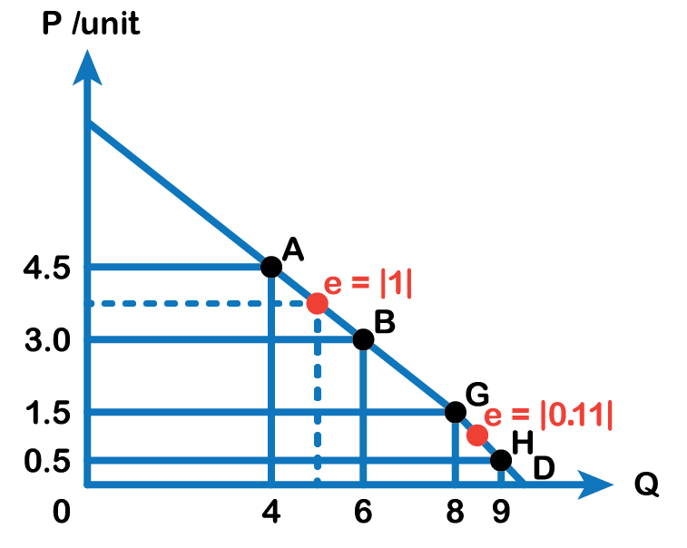
6.1 Price Elasticity of Demand Example
Look at the above figure. When the price of a cup of coffee is $4.5, the quantity demanded is 4 cups an hour and when the price falls to $3.00 a cup, the quantity demanded rises to 6 cups every hour.
Fig 6.1

Slide 5
6.1 Moving from Point A to B
% Change in Price: The coffee price falls from $4.50 to $3.00, meaning the percentage change is…
[(3.00−4.50) ÷ 4.50]×100 = -33%
Price has fallen by 33%
% Change in Quantity Demanded: The quantity of coffee sold increases from 4 to 6, meaning the percentage change is…
[(6−4) ÷ 4]×100 = 50%
The quantity has risen by 50%
Therefore, Elasticity: %change in Quantity demanded ÷ %change in Price.
−50% ÷ 33% = -1.5.
Notes:
In absolute terms, elasticity = 1.5. This is the price elasticity of demand over the range of the demand curve between points A and B.

Slide 6
6.1 Midpoint Method
To calculate elasticity, instead of using simple percentage changes in quantity and price, economists use the average percent change.
Mid-point method for elasticity equations:
% change in quantity demanded
[New Q – Old Q ÷ (New Q +Old Q) ÷ 2]×100%
Average of two quantities
(New Q +Old Q) ÷ 2
% change in price
[New Price – Old Price ÷ (New P +Old P) ÷ 2]×100%
Average of two prices
(New P +Old P) ÷ 2

Slide 7
6.1 Advantage of The Mid-Point Method
The advantage of the mid-point method is that we find the elasticity right at a single point on the demand curve, which is more precise than finding the elasticity over the entire range between the two points A and B, in the above figure.
Using the mid-point method to calculate the elasticity between Point A and Point B:
= [{(6 − 4) ÷ (6 + 4) ÷ 2} × 100] ÷ [{(4.5 − 3.5) ÷ (4.5 + 3.5) ÷ 2} × 100]
= 40 ÷ 40
= 1 (absolute value)
Notes:
This method gives us a sort of average elasticity of demand at the centre point between the two points on our demand curve. The elasticity of demand is interpreted as when the price changes by 1 percent, the quantity demanded also changes by 1 percent.

Slide 8
6.1 Is Elasticity the Slope?
It is a common mistake to confuse the slope of the demand curve with its elasticity. The slope is the rate of change in units along the curve, or the rise/run (change in y over the change in x).
Fig 6.1

Slide 9
6.1 Fig 6.1 Explained
In Fig 6.1, at each point between A and B, shown on the demand curve, price drops by $1.50 and the number of units demanded increases by 2. The slope is –1.5 ÷ 2 = – 0.75 along the entire demand curve and does not change. The price elasticity, however, changes along the curve. The elasticity between points A and B was – 1 and changed to – 0.11 between points G and H. Elasticity is the percentage change, which is a different calculation from the slope and has a different meaning.

Slide 10
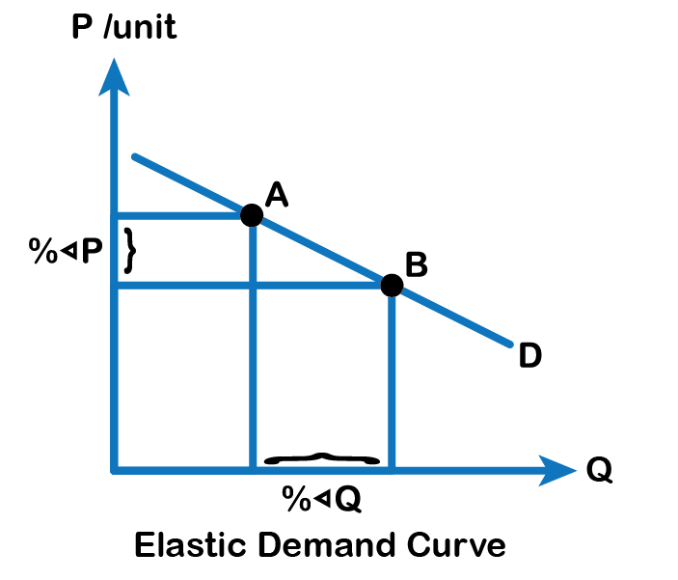
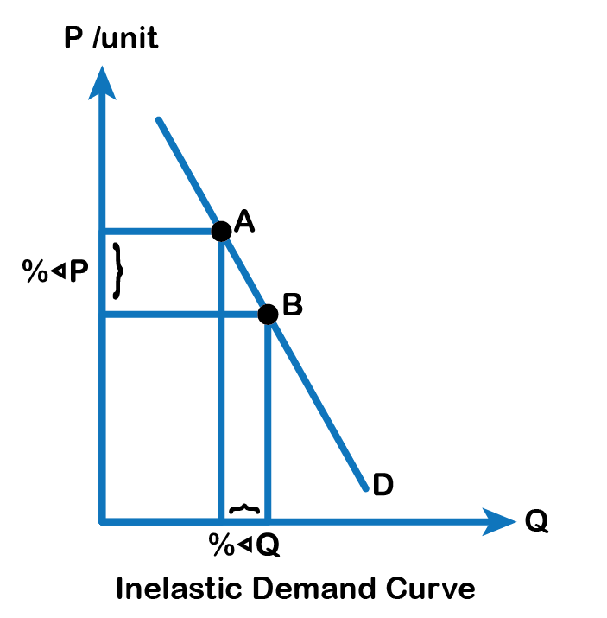
6.1 Different Kinds of Price Elasticities of Demand
We can usefully divide elasticities into three broad categories: elastic, inelastic, and unitary
Fig 6.2A
Fig 6.2B

Slide 11
6.1 Elastic demand...
is one in which the elasticity is greater than one, indicating high responsiveness to changes in price (Fig 6.2 A). Elasticities that are less than one indicate low responsiveness to price changes and correspond to inelastic demand (Fig 6.2 B). An elastic demand curve is relatively flatter than an inelastic demand curve. Unitary elastic demand indicates quantity demanded changes by the same proportion with respect to the price.

Slide 12
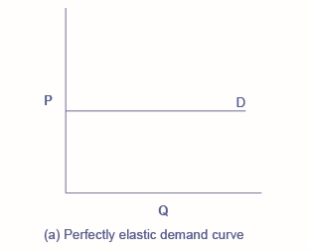
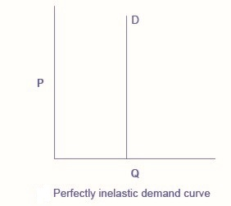
6.1 Infinite Elasticity or Perfect Elasticity
There are two extreme cases of elasticity: when elasticity equals zero and when it is infinite. We will describe each case.
Fig 6.4A
Fig 6.4B
Notes:
Infinite elasticity or perfect elasticity refers to the extreme case where the quantity demanded changes by an infinite amount in response to any change in price at all. In this case, the demand curve is horizontal as Fig 6.3 A shows. Perfectly elastic demand is an extreme example. Examples of such goods are Caribbean cruises and sports vehicles.
Zero elasticity or perfect inelasticity, as Fig 6.3 B depicts, refers to the extreme case in which a percentage change in price, no matter how large, results in zero change in quantity. Again, while perfectly inelastic demand is an extreme case, necessities are likely to have highly inelastic demand curves. This is the case with life-saving drugs and gasoline.

Slide 13
6.1 Fig 6.4A and 6.4B Explained
Infinite elasticity or perfect elasticity refers to the extreme case where the quantity demanded changes by an infinite amount in response to any change in price at all. In this case, the demand curve is horizontal as Fig 6.4 A shows. Perfectly elastic demand is an extreme example. Examples of such goods are Caribbean cruises and sports vehicles.
Zero elasticity or perfect inelasticity, as Fig 6.4 B depicts, refers to the extreme case in which a percentage change in price, no matter how large, results in zero change in quantity. Again, while perfectly inelastic demand is an extreme case, necessities are likely to have highly inelastic demand curves. This is the case with life-saving drugs and gasoline.

Slide 14
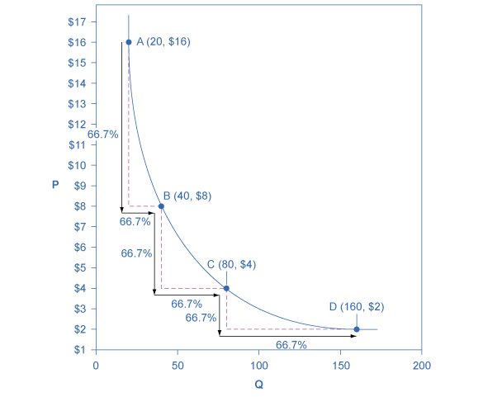
6.1 Constant Unitary Elasticity
Constant unitary elasticity, in a demand curve, occurs when a price change of one percent results in a quantity change of one percent.
Fig 6.4C

Slide 15
6.1 Fig 6.4C Explained
Fig 6.4C shows a demand curve with constant unit elasticity. Using the midpoint method, you can calculate that between points A and B on the demand curve, the price changes by 66.7%, and quantity demanded also changes by 66.7%. Hence, the elasticity equals 1. Between points B and C, price again changes by 66.7% as does quantity, while between points C and D the corresponding percentage changes are again 66.7% for both price and quantity. In each case, then, the percentage change in price equals the percentage change in quantity, and consequently, elasticity equals 1.

Slide 16
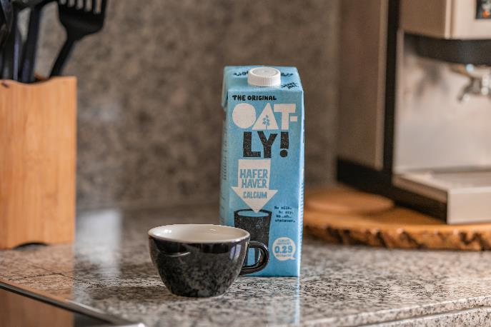
6.2 Determinants of Elasticity of Demand
Factors that determine the elasticity of demand would be the availability of substitutes, the share of the good’s expense in individuals’ income, and the passage of time.
Photo by Leon Seibert, licensed under the Unsplit License
Notes:
More substitutes imply individuals have more choices and therefore consumers are more sensitive to price changes. The availability of substitutes makes the goods relatively more elastic. Conversely, less substitutes give consumers less choices and therefore goods with low substitutes are relatively less elastic or inelastic. Usually, necessities have less substitutes such as gasoline, medicines, and certain food items such as milk. Because consumers have less choices available, they are less sensitive to price changes, i.e. when the price rises, people cannot make significant changes to their consumption.
Also, another factor that determines elasticity is the passage of time. Take the example of gasoline. When gas prices rise, people cannot cut their consumption very much as it is a necessity and also people cannot change their driving habits quickly. However, as gas prices keep rising we will likely see the elasticity of demand for gasoline increase slightly (i.e. gasoline could become relatively less inelastic) as people start carpooling, taking public transportation, and/or switching to hybrid or electric vehicles.

Slide 17
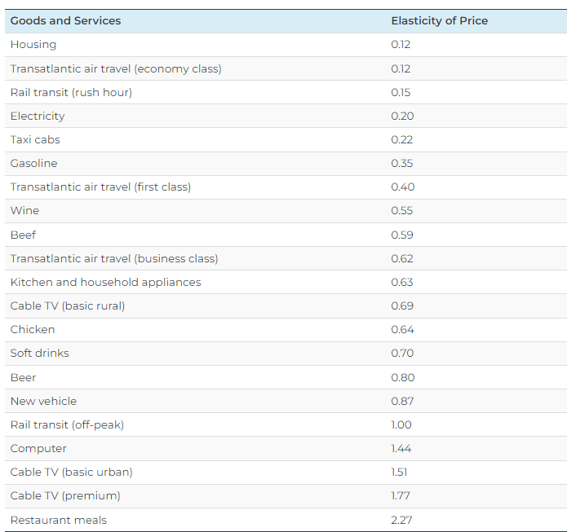
6.2 Selection of Demand Elasticities
Fig 6.5 shows a selection of demand elasticities for different goods and services drawn from a variety of different studies by economists, listed in order of increasing elasticity.
Fig 6.5

Slide 18
6.3 Price Elasticity of Demand and Total Revenue
The key concept in thinking about collecting the most revenue is the price elasticity of demand. Total revenue is price times the quantity of tickets sold. Imagine that the band starts off thinking about a certain price, which will result in the sale of a certain quantity of tickets. The three possibilities are in Fig 6.6.
Fig 6.6

Slide 19
6.3 Price Elasticity of Demand and Total Revenue Continued
If demand is elastic at that price level, then the band should cut the price, because the percentage drop in price will result in an even larger percentage increase in the quantity sold—thus raising total revenue. However, if demand is inelastic at that original quantity level, then the band should raise the ticket price because a certain percentage increase in price will result in a smaller percentage decrease in the quantity sold—and total revenue will rise. If demand has a unitary elasticity at that quantity, then an equal percentage change in quantity will offset a moderate percentage change in the price—so the band will earn the same revenue whether it (moderately) increases or decreases the ticket price.

Slide 20
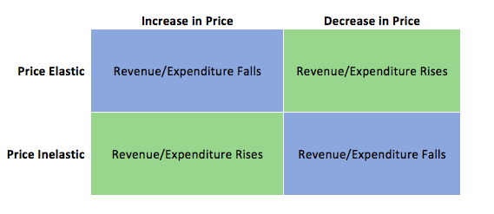
6.3 Relationship Between Price and Total Revenue
What if the band keeps cutting price, because demand is elastic until it reaches a level where it sells all 15,000 seats in the available arena?
The table below summarizes the relationship between price and total revenue.
Fig 6.7

Slide 21
6.3 Relationship Between Price and Total Revenue Continued...
If demand remains elastic at that quantity, the band might try to move to a bigger arena, so that it could slash ticket prices further and see a larger percentage increase in the quantity of tickets sold. However, if the 15,000-seat arena is all that is available or if a larger arena would add substantially to costs, then this option may not work.
Conversely, a few bands are so famous or have such fanatical followings, that demand for tickets may be inelastic right up to the point where the arena is full. These bands can, if they wish, keep raising the ticket price. Ironically, some of the most popular bands could make more revenue by setting prices so high that the arena is not full—but those who buy the tickets would have to pay very high prices.

Slide 22
6.3 What About Expenditure?
You will notice that expenditure is mentioned whenever revenue is. This is because a dollar earned by the band corresponds to a dollar spent by the consumer. Therefore, if the band’s revenue is rising, then the consumer’s expenditure is rising as well. You must understand how to answer questions from both sides.
Photo by Georgia de Lotz, licensed under the Unsplit License

Slide 23
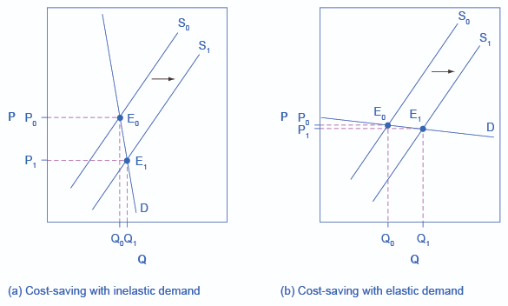
6.3 Can Business Pass Costs on to Consumers?
Imagine that as a consumer of legal pharmaceutical products, you read a newspaper story that a technological breakthrough in the production of aspirin has occurred, so that every aspirin factory can now produce aspirin more cheaply. What does this discovery mean to you?
Fig 6.8

Slide 24
6.3 Fig 6.8 Explained
Fig 6.8 A illustrates two possibilities. In Panel A, the demand curve is highly inelastic. In this case, a technological breakthrough that shifts supply to the right, from S0 to S1, so that the equilibrium shifts from E0 to E1, creates a substantially lower price for the product with relatively little impact on the quantity sold. In Panel B, the demand curve is highly elastic. In this case, the technological breakthrough leads to a much greater quantity sold in the market at very close to the original price. Consumers benefit more, in general, when the demand curve is more inelastic because the shift in the supply results in a much lower price for consumers.
Notes:
Since demand for food is generally inelastic, farmers may often face the situation in Panel A. That is, a surge in production leads to a severe drop in price that can actually decrease the total revenue that farmers receive. Conversely, poor weather or other conditions that cause a terrible year for farm production can sharply raise prices so that the total revenue that the farmer receives, increases.

Slide 25
6.4 Cross-Price Elasticity of Demand
The Cross-price elasticity of demand shows us how quantity demand responds to changes in the price of related goods. Whereas before we could ignore positives and negatives with elasticities, with cross-price, this matters. Our equation is as follows:
Cross Price elasticity of demand:
%change in quantity demanded of Good A ÷ % change in the price of Good B

Slide 26
6.4 Cross-Price Elasticity
A complement will have a negative cross-price elasticity since if the % change in price is positive, the % change in quantity will be negative and vice-versa.
A substitute will have a positive cross-price elasticity since if the % change in price is positive, the % change in quantity will be positive and vice-versa.
Notes:
Consider our discussion of complements and substitutes in chapter 3. We defined complements as goods that individuals prefer to consume with another good, and substitutes as goods individuals prefer to consume instead of another good. If the price of a complement of a good rise, our demand for that good will fall, and if the price of a substitute of a good rise, our demand for the good will rise.
This adds another dimension to our discussion of complements/substitutes. Now we can comment on the strength of the relationship between two goods.

Slide 27
6.4 Income Elasticity of Demand
In Chapter 3, we also explained how goods can be normal or inferior depending on how a consumer responds to a change in income. This responsiveness can also be measured with elasticity by the income elasticity of demand. Our equation is as follows:
Income Elasticity of demand:
% change in Quantity demanded ÷ %change in Income

Slide 28
6.4 Income Elasticity
A normal good will have a positive income elasticity, since if income rises (or falls), the quantity demanded also increases (or decreases).
An inferior good will have a negative income elasticity, since if income rises (or falls), the quantity demanded decreases (or increases).
Notes:
The value of our elasticity will indicate how responsive a good is to a change in income. A good with an income elasticity of 0.05, while technically a normal good (since demand increases after an increase in income) is not nearly as responsive as one with an income elasticity of demand of 5.

Slide 29
6.4 Elasticity of supply
The price elasticity of supply is the percentage change in quantity supplied divided by the percentage change in price.
Price Elasticity of supply = % change in Quantity supplied ÷ % change in Price

Slide 30
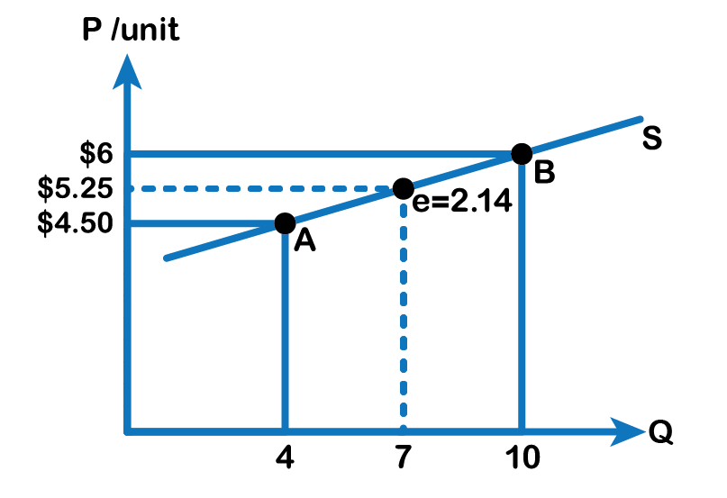
6.5 Elasticity of Supply Continued
Fig 6.9

Slide 31
6.5 Fig 6.9 Explained
In Fig 6.9, when the price of a cup of coffee is $4.5, the quantity supplied is 4 cups an hour as shown by point A and when the price rises to $6.00 a cup, the quantity supplied rises to 10 cups every hour as indicated by point B.
Price Elasticity of supply between points A and B (using midpoint formula)
= {(10 – 4) ÷ (10 + 4) ÷ 2} × 100 ÷ {(6 – 4.5) ÷ (6 + 4.5) ÷ 2} × 100
= 85.7 ÷ 28.5
= 3.00
Price elasticity of supply is always positive because price and quantity, both change in the same direction, following the law of supply.

Slide 32
6.6 Determinants of Price Elasticity of Supply
An elastic supply is one in which the elasticity is greater than one, indicating high responsiveness to changes in price. Elasticities that are less than one indicate low responsiveness to price changes and correspond to inelastic supply. Unit elastic supply indicates proportional responsiveness of quantity supplied with respect to price
Some factors that determine the elasticity of supply would be the availability of inputs. Easier access to inputs allows the producers to increase output relatively faster with respect to a rise in the price and therefore increases supply elasticity.
Notes:
Conversely, limited or scarce inputs lower the elasticity of supply. Just as on the demand side, the passage of time also influences the elasticity of supply. A good is likely to be relatively inelastic or less elastic in the short run time frame while elasticity increases as time go by.

Slide 33
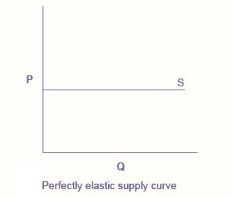
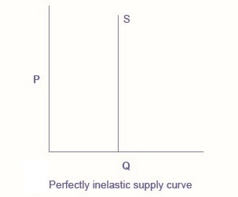
6.6 Perfectly Elastic and Perfectly Inelastic Supplies
Perfectly elastic supply, the supply curve is horizontal as shown in Fig 6.10 A.
Perfectly inelastic supply, as Fig 6.10 B depicts, refers to the extreme case in which a percentage change in price, no matter how large, results in zero change in quantity.
Fig 6.10A
Fig 6.10B
Notes:
While perfectly elastic supply curves are for the most part unrealistic, some examples of perfectly elastic supply include pizza, bread, books, and pencils.
While a perfectly inelastic supply is an extreme example, goods with a limited supply of inputs are likely to feature highly inelastic supply curves. Examples include diamond rings or housing in prime locations such as apartments facing Central Park in New York City.

Slide 34
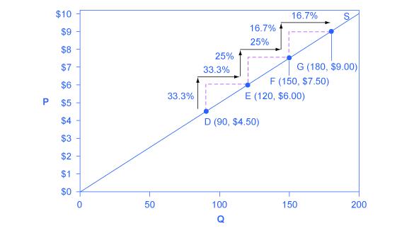
6.6 Constant Unitary Elasticity Example
Fig 6.10C

Slide 35
6.6 Fig 6.10C Explained
Constant unitary elasticity, in a supply curve, occurs when a price change of one percent results in a quantity change of one percent. Consider the price changes moving up the supply curve in Fig 6.10 C. Along the constant unitary elasticity supply curve, the percentage quantity increases on the horizontal axis exactly match the percentage price increases on the vertical axis—so this supply curve has a constant unitary elasticity at all points.

Slide 36
6.6 The Elasticities Summarized
Elasticity of demand > 1 * | Elastic
Elasticity of demand < 1 * | Inelastic
Elasticity of demand = 1 * | Unit elastic
Elasticity of demand = 0 | Perfectly inelastic
Elasticity of demand = Infinity | Perfectly elastic
Income elasticity of demand > 0 | Normal good
Income elasticity of demand < 0 | Inferior good
Cross price elasticity > 0 | Two goods are substitutes
Cross price elasticity < 0 | Two goods are complements
* In absolute values

Slide 37
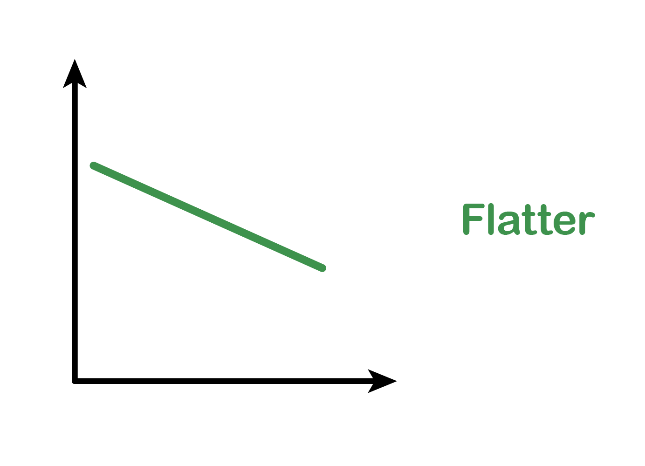
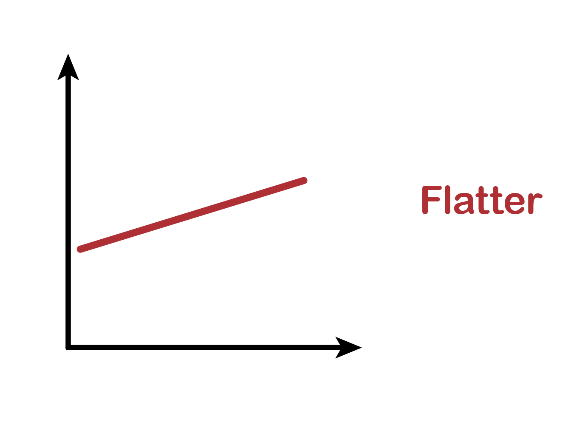
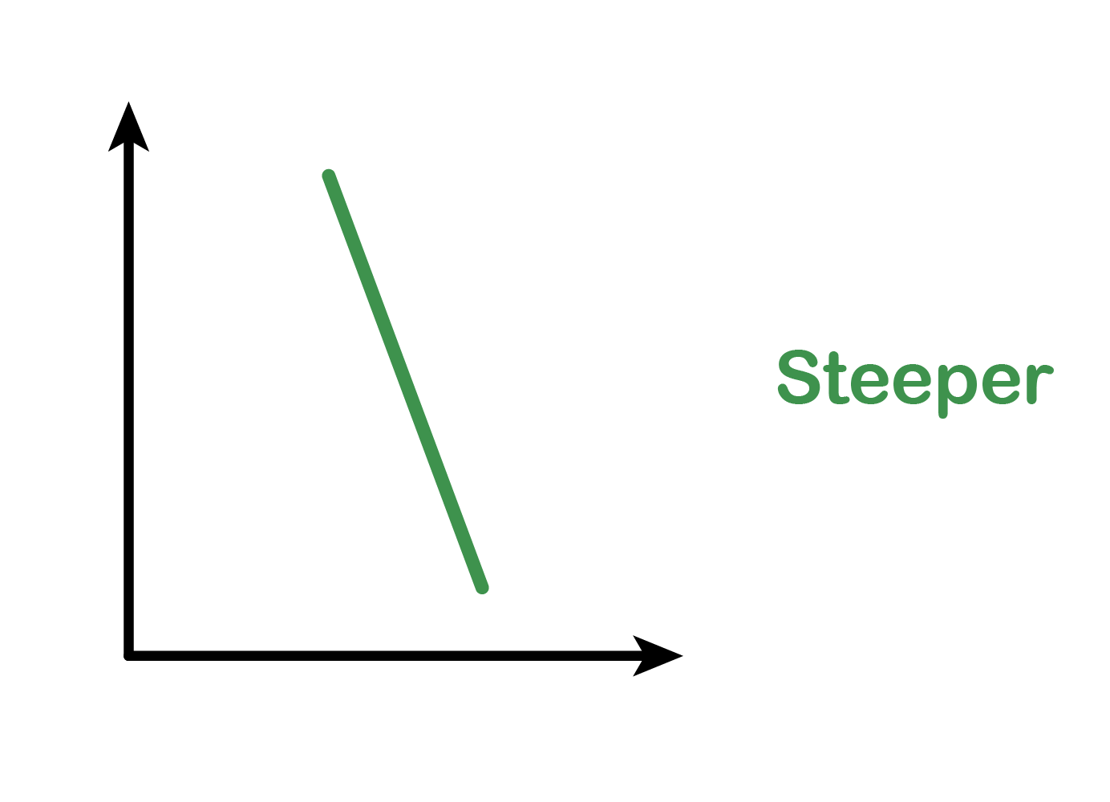
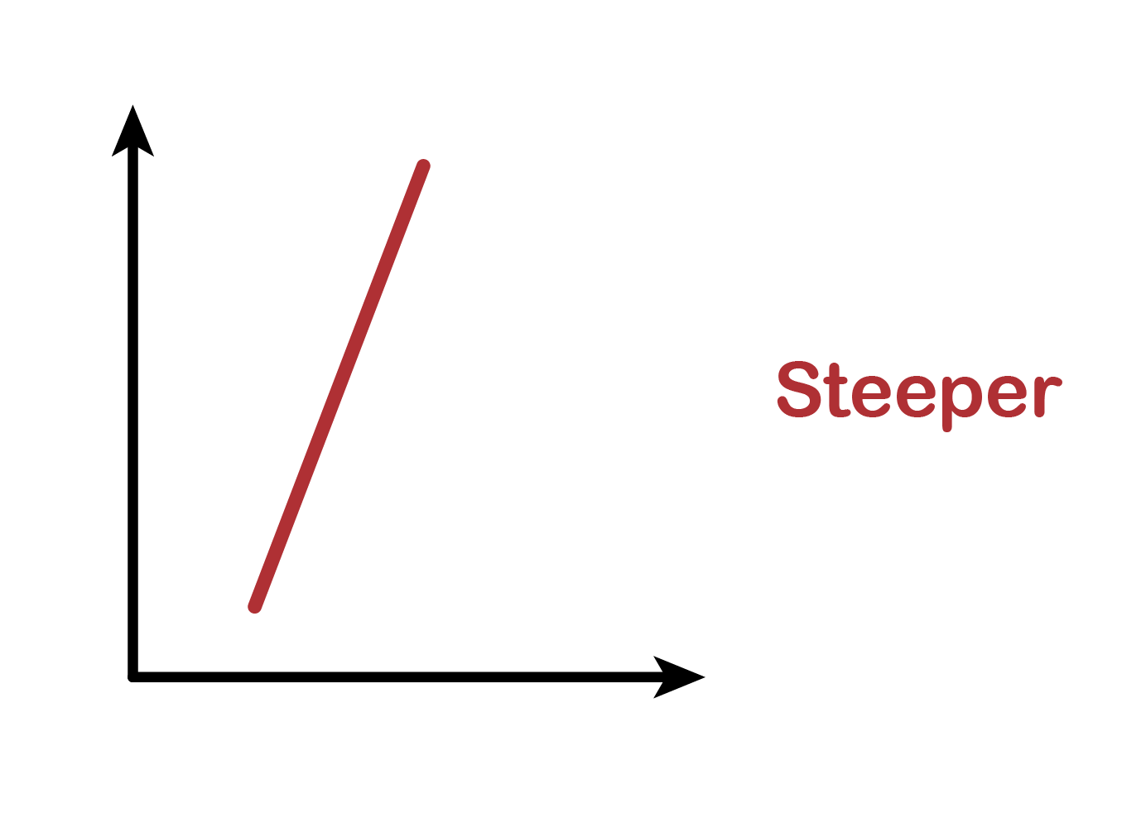
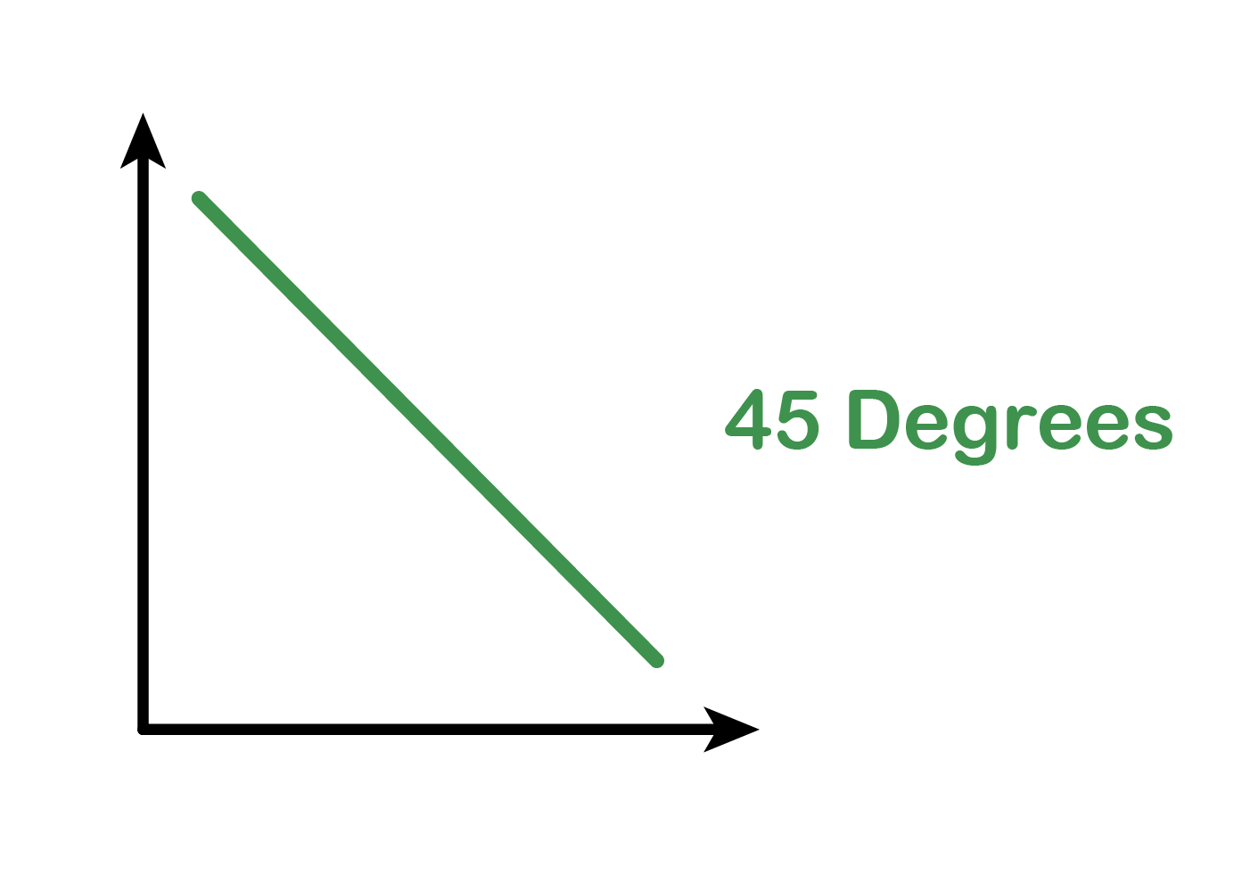
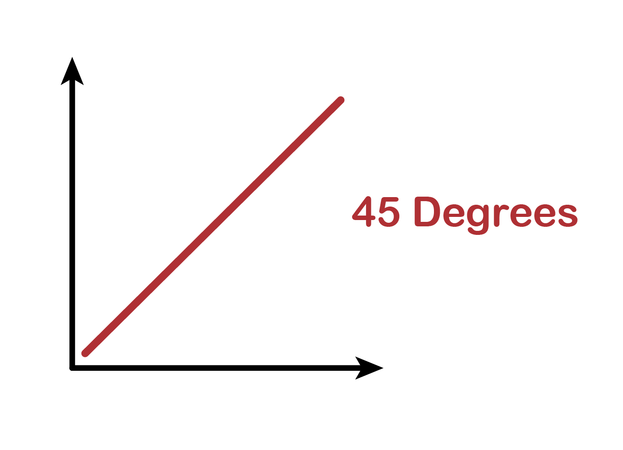
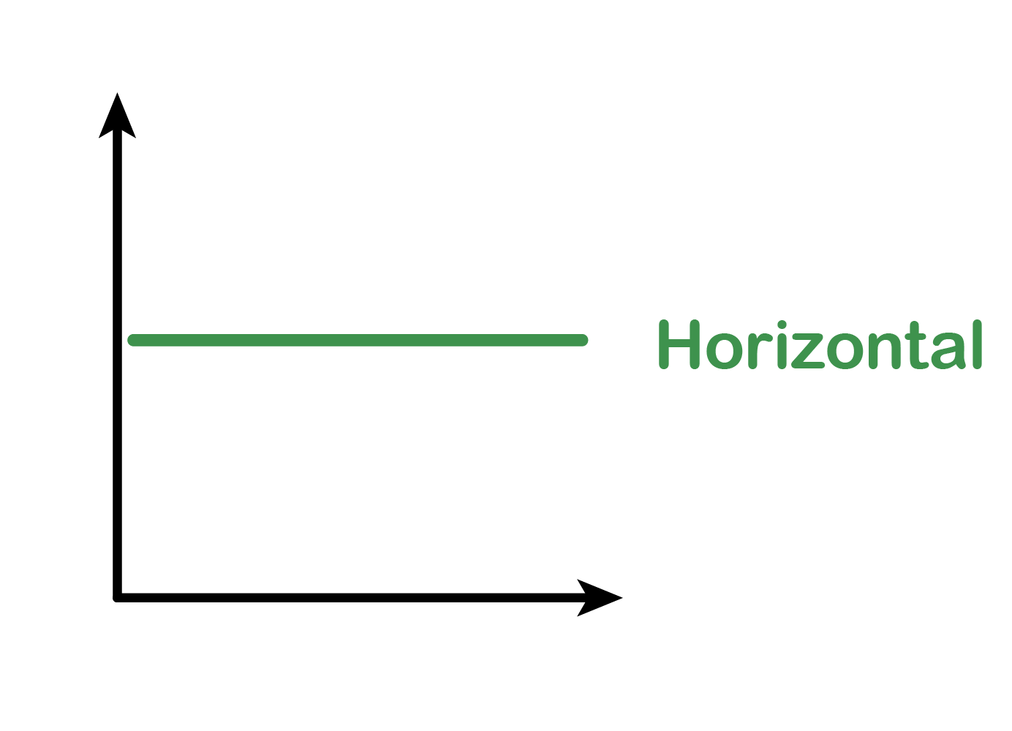
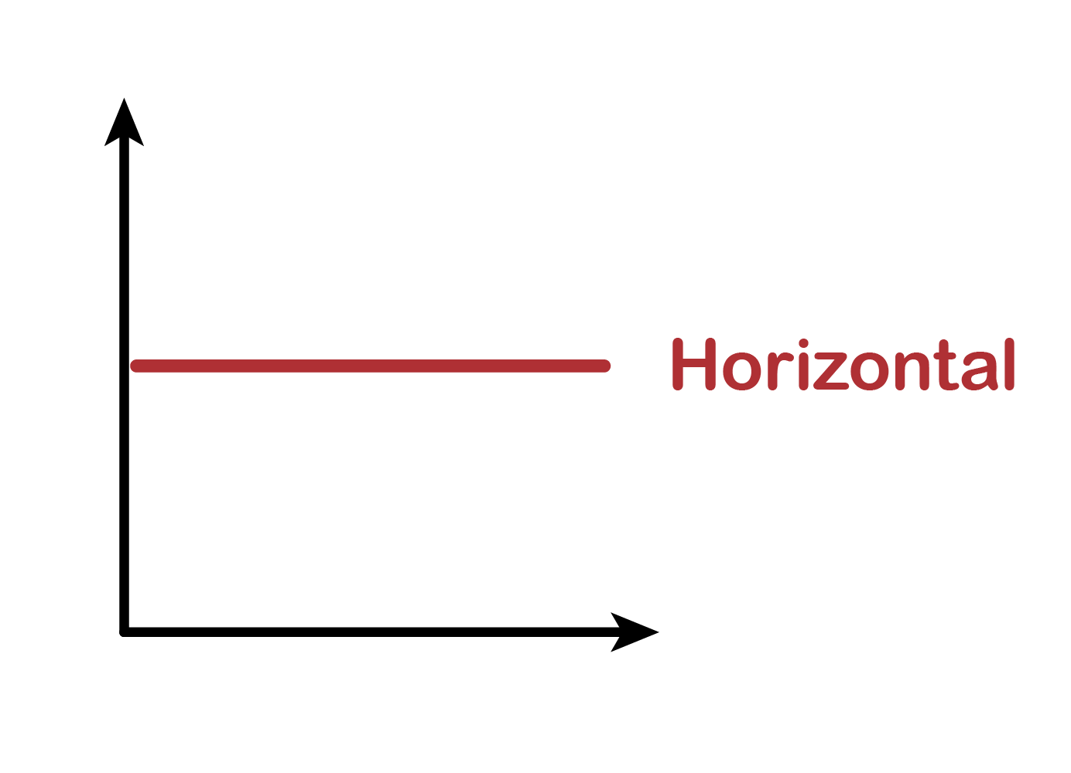
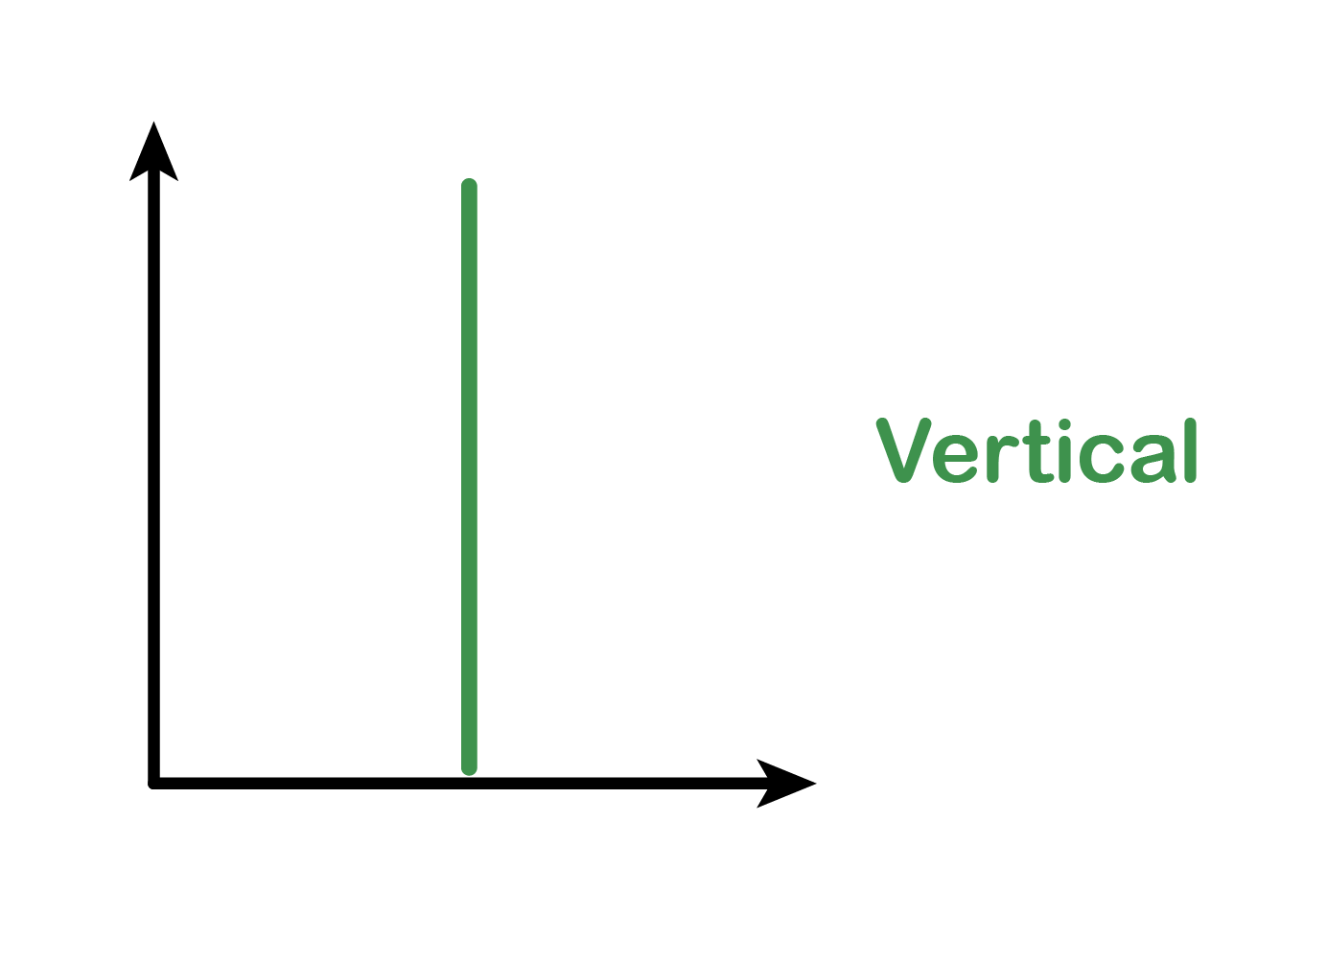
6.6 Type of Elasticities
Type | Condition | Explanation | Demand Graph | Supply Graph
Elastic | E_{D} greater than 1 | Sensitive: QD will change by more than Price changes
Inelastic | E_{D} is between 0 and 1 | Insensitive: QD will change by less than Price changes
Unit Elastic | E_{D} is exactly 1 | Normal: QD will change exactly the same amount as price changes
Perfectly Elastic | E_{D} is infinite | If price changes at all, we will buy nothing
Perfectly Inelastic | E_{D} is zero | If price changes at all, we continue to buy the exact same amount

Slide 38
Key Terms
Constant Unitary Elasticity
Cross-Price Elasticity of Demand
Elasticity
Elastic Demand
Elastic Supply
Income Elasticity
Inelastic Demand
Inelastic Supply
Inferior Good
Mid-Point Method for Elasticity
Normal Good
Perfectly Elastic Demand
Perfectly Elastic Supply
Perfectly Inelastic Demand
Perfectly Inelastic Supply
Positive Cross-Price Elasticity
Price Elasticity of Demand
Price Elasticity of Supply

