Slide 1
Principles of Microeconomics
CHAPTER 5: EXTERNALITIES
Unless otherwise noted, this work is licensed under a Creative Commons Attribution-NonCommercial-ShareAlike 4.0 International (CC BY-NC-SA 4.0) license. Feel free to use, modify, reuse or redistribute any portion of this presentation.

Slide 2
Learning Outcomes
At the end of this chapter, you will be able to:
Describe positive and negative externalities
Identify the economic impact of externalities
Discuss the government policies to achieve efficiency in markets with externalities
Explore Coase Theorem and Private Bargaining

Slide 3
5.1 Externalities
Externality: The effect of market exchange on a third party who is outside or “external” to the exchange.
Externalities that occur in market transactions affect other parties beyond those involved, they are sometimes called spillovers.
Externalities can be negative or positive. If you hate country music, then having it waft into your house every night would be a negative externality. If you love country music, then what amounts to a series of free concerts would be a positive externality.
Notes:
Consider an example of a concert producer who wants to build an outdoor arena that will host country music concerts a half-mile from your neighborhood. You will be able to hear these outdoor concerts while sitting on your back porch—or perhaps even in your dining room. In this case, the sellers and buyers of concert tickets may both be quite satisfied with their voluntary exchange, but you have no voice in their market transaction. The effect of market exchange on a third party who is outside or “external” to the exchange is called an externality.

Slide 4
5.1 Enriching Our Model
The terms consumer surplus, producer surplus, market surplus, and the market equilibrium (note that this will be referred to interchangeably in this chapter as the unregulated market equilibrium) derive their meaning from an analysis of private markets and need to be adapted in a discussion where external costs or external benefits are present.
Notes:
For the purpose of this analysis, the following terminology will be used:
Our chapter three demand curve is equivalent to the marginal private benefit curve or D.
Our chapter three supply curve is equivalent to the marginal private cost curve or S.
We now want to develop a model that accounts for positive and negative externalities. To do so, we must consider the external costs and benefits. External costs and benefits occur when producing or consuming a good or service impose a cost/benefit upon a third party.

Slide 5
5.1 Account for External Costs and Benefits
When we account for external costs and benefits, the following definitions apply:
When we add external benefits to private benefits, we create a marginal social benefit curve or D-social. In the presence of a positive externality (with a constant marginal external benefit), this curve lies above the demand curve at all quantities.
When we add external costs to private costs, we create a marginal social cost curve or S-social. In the presence of a negative externality (with a constant marginal external cost), this curve lies above the supply curve at all quantities.
Notes:
When we were considering private markets, our objective was to maximize market surplus or total private benefits minus total private costs. Our new objective considering all impacted agents in society is to maximize social surplus or total social benefits minus total social costs.

Slide 6
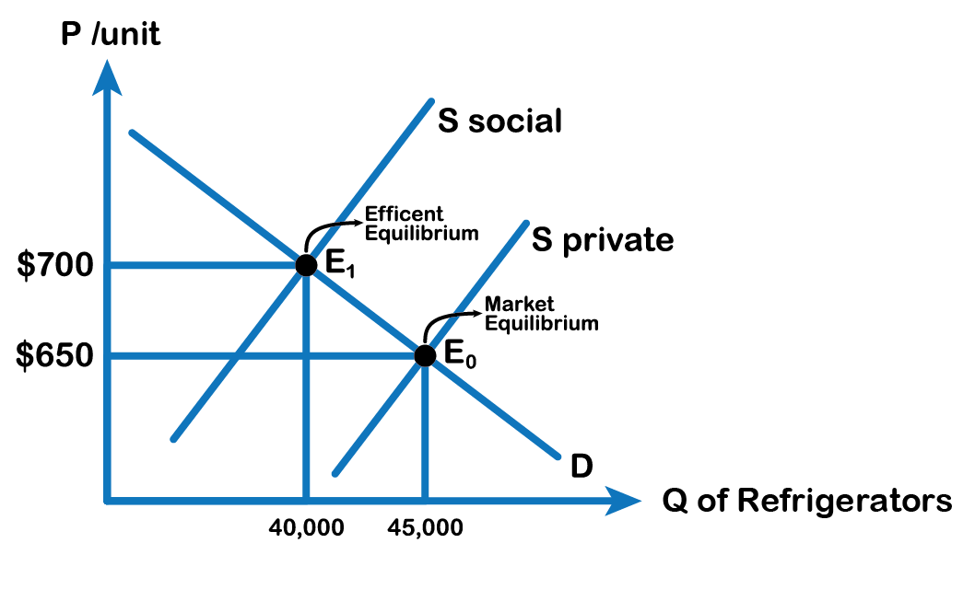
5.1 A Negative Externality: Pollution
Pollution is a negative externality. Economists illustrate the social costs of production with a demand and supply diagram. The social costs include the private costs of production that a company incurs and the external costs of pollution that pass on to society.
Fig 5.1
Notes:
Fig 5.1 shows the demand and supply for manufacturing refrigerators. The demand curve (D) shows the quantity demanded at each price. The supply curve (S) shows the quantity of refrigerators that all firms in the industry supply at each price assuming they are taking only their private costs into account and they are allowed to emit pollution at zero cost. The market equilibrium (E0), where quantity supplied equals quantity demanded, is at a price of $650 per refrigerator and a quantity of 45,000 refrigerators.

Slide 7
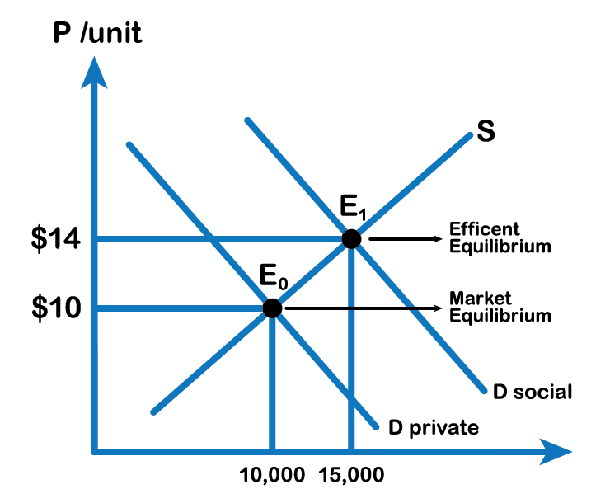
5.1 A Positive Externality: Flu Shot
A positive externality occurs when the market interaction of others presents a benefit to non-market participants. The analysis of positive externalities is almost identical to negative externalities.
Fig 5.2
Notes:
The difference is that instead of the market equilibrium quantity is too much, the market will generate too little Q. Let’s look at an example. Consider the following diagram of a market where a positive externality is present. When someone takes the flu shot, the person not only reduces her own risk of getting the flu but also reduces the chance of people around her contracting the flu. Economists illustrate the social benefits of production with a demand and supply diagram. The social benefits include the private benefits that an individual incurs from the flu shot plus the external benefits of the vaccine that pass on to the community around him.
Fig 5.2 shows the demand and supply of Flu shots. The demand curve (D) shows the quantity demanded at each price, taking only the private benefit of receiving the vaccine. The supply curve (S) shows the quantity of flu shots supplied at each price by the pharma industry. The market equilibrium (E0), where quantity supplied equals quantity demanded, is at a price of $10 per shot and a quantity of 10,000 flu shots.

Slide 8
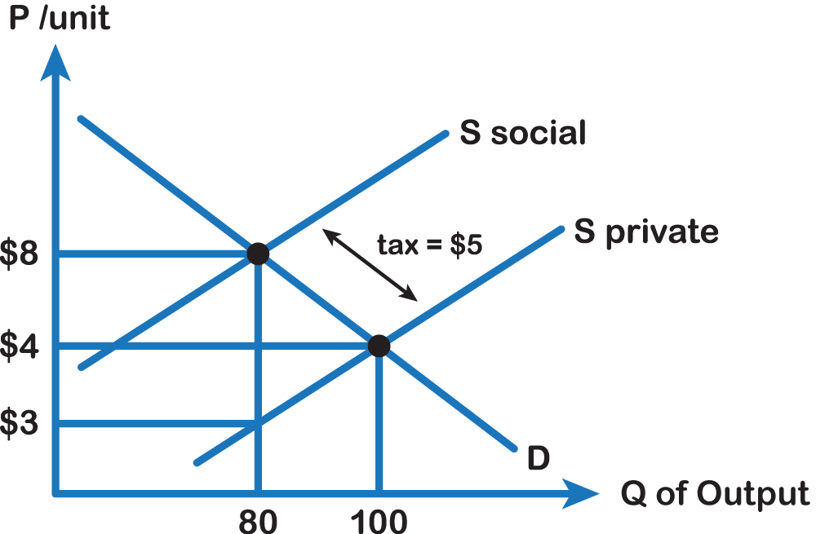
5.2A Tax to "Internalize" Negative Externality
Fig 5.4
Notes:
A common misconception is that introducing a tax in this market eliminates external costs. This is incorrect. In some sense, we are aiming for an “optimal” level of external cost. To get a sense of this, consider the manufacturing industry. We could get external costs (like the adverse effects of carbon dioxide emissions) to equal zero if we stopped production entirely, but then we would have a world with little energy.
In the above graph, the equilibrium quantity is 100 and the socially efficient level of output is 80. The intuition behind the policy response is the same as before, but we have to be careful about the amount of the tax as the marginal external cost is changing. We want to set the level of the tax equal to the marginal external cost at the socially efficient level of output. This value is 8 minus 3 or $5. We know that setting a tax equal to $5 will bring us to 80 units, where social welfare is maximized.

Slide 9
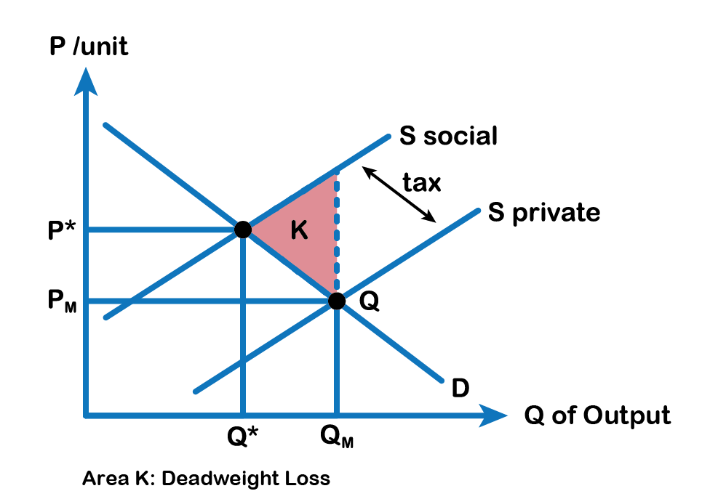
5.2A 'Internalizing’ an Externality: Taxing Pollution
Fig 5.3
Notes:
We know that without regulation, the market will naturally tend to QM (where D-private = S-private) and that this will result in a deadweight loss of area K. Ideally, we want the quantity exchanged to equal Q*, which is the social surplus optimizing the level of production since this level of output is where D-private = S-social. How can we force the market here? One way is to introduce a tax equal to the marginal external cost at the efficient quantity Q*. This makes the producer face a cost curve of S-private + tax, = S-social and since the tax is equal to external costs, this will just cause firms to act as though they recognize the externality.

Slide 10
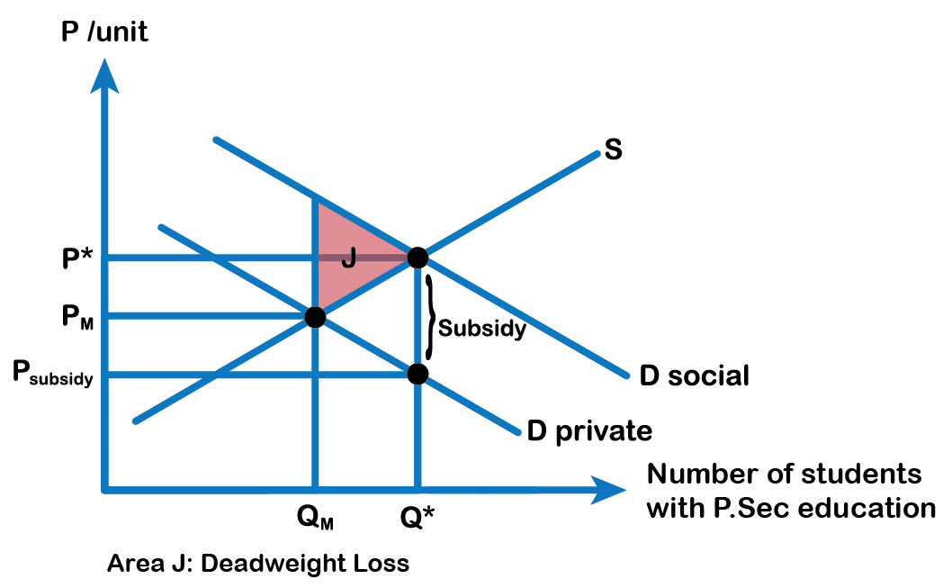
5.2B ‘Internalizing’ an Externality: Subsidizing Post -Secondary Education
Fig 5.5
Notes:
The appropriate public policy response to a positive externality, like post-secondary education, is to help the party creating the positive externality receive a greater share of the social benefits. In the case of education, an effective policy might be to provide a subsidy to those who choose to get a college or university education.
Fig 5.5 above shows the market for post-secondary education. The market demand curve D for post-secondary education reflects only the marginal private benefits that the educated individuals receive such as better career prospects and income. Assuming that there are no spillover costs of education, the market supply curve is given by the marginal private cost of providing post-secondary education.
The equilibrium quantity of people receiving post-secondary education in the market, where D = S is Q-Market and the price of post secondary education is P-Market. However, spillover benefits exist in this market because others, those who chose not to obtain higher education, receive a positive externality from those who attend college or university. When we add the spillover benefits to the marginal private benefit of post-secondary, the marginal social benefit of education is given by D-Social. We see that the socially optimal level of people receiving college/university education is greater than the market quantity (Q* exceeds Q-Market) and the corresponding price of post-secondary education, if the market were to produce Q*, would be at P*. Unfortunately, the marketplace does not recognize the positive externality and the number of people receiving college education tends to go under produced and under-consumed and generates a deadweight loss of area J.

Slide 11
5.3 Types of Private Solutions: Coase Theorem
Private actors will sometimes effectively address externalities and reach efficient outcomes without government intervention. Private actors will sometimes arrive at their own solutions. The Coase theorem, which was developed by Ronald Coase, posits that two parties will be able to bargain with each other to reach an agreement that efficiently addresses externalities. The common feature of all externalities is that there are costs and/or benefits to economic activity that are not accounted for in the price of the activity.
Notes:
Suppose, a factory is causing a lot of air pollution in a neighborhood that is making people sick and raising their medical expenses. The way Coase saw the problem was that property rights—the rights to control the use of a good or resource– are not well defined in the case of an air-polluting factory. That is, if neighbors do not have the well-defined right to clean air there is no incentive for the factory to pay for or take into account the neighbors’ medical bills, and diminished quality of life due to the odor from the factory.

Slide 12
5.3 The Coase Theorem...
states that if property rights are well-defined, and negotiations among the actors are costless, the result will be a socially efficient level of the economic activity in question. It is one of the most important and influential theorems in economics.
Photo by charlesdeluvio, licensed by Unsplash
Notes:
The theorem notes several conditions in order for such a solution to occur, including low transaction costs (the costs the parties incur by negotiating and coming to an agreement) and well-defined property rights. If the conditions are met, the bargaining parties are expected to reach an agreement where everyone is better off. In practice, however, transaction costs do exist, and the bargaining process does not always run smoothly. As a result, private individuals often fail to resolve problems.

Slide 13
5.3 Application of the Coase Theorem
Suppose that the neighbors’ combined medical and other costs, per unit of output, is $10. Also, the marginal private cost incurred by the factory is constant at $100 per unit. The marginal social cost is then the $100 private cost plus the $10 external cost, or $110 per unit of output.
Notes:
Defining clean air as a property right and allowing for free negotiation enables the neighbors to quantify at $10 their willingness to pay for clean air or, conversely, their willingness to accept the dirty air. So, for each unit of output, neighbors will demand to be compensated exactly the amount of their true loss: $10. Since they have the right to clean air, the factory owners are obliged to pay them, and thus the new cost to the factory owners takes into account the social cost or S-social. We know now that this will result in a socially efficient outcome.
Now suppose that the factory owners instead had the right to pollute the air as much as they like. Neighbors would be willing to pay the factory owners $10 a unit (the external cost of the pollution) to reduce emissions from the current level. So again the socially efficient level of output will result. The transfer of wealth is quite different here, so assigning property rights has big implications in terms of the relative welfare of the groups. But in terms of the socially efficient level of output, the assignment of property rights has no impact.
You may think that implementing the Coase theorem is an ideal policy solution for externalities, but a few words of caution are in order. The assumption of costless negotiation is quite improbable in practice. In order for it to be true in the example of the polluting factory, the neighbors all have to be able to identify themselves and band together, correctly assess the values of the damage done to them per unit of output, and be able to demand the money from the factory owners. Costless negotiation is unlikely to be the case in any similar real word situation

Slide 14
5.3 Categorizing Goods and Services
Rival vs Non-Rival
Rival: If I take a good, you can’t also take the same good.
Non-Rival: If I take a good, it doesn’t stop you from taking it as well.
Excludable vs Non-Excludable
Excludable: I can make you pay to use it.
Non-Excludable: You can use it without paying directly.

Slide 15
5.3 Categorizing Goods and Services
 | Excludable | Non-Excludable
Rival | Private Goods Usually this is retail goods or things you buy to own. E.g.: Shoes, cars, fast food. | Common Goods Think of natural goods and resources. E.g.: Fish, lumber, animal pelts.
Non-Rival | Quasi-Public Goods We can use them without stopping others buy have to pay. E.g.: Internet, road tolls, phone network. | Public Goods Generally provided by different levels of government. E.g.: Military, legal system, public parks.

Slide 16
5.3 Why markets fail
Markets are usually thought of as being incredibly useful and good at what they do. However, they are good with every type of Good. Markets are great for private goods, but for the other 3 types, markets have issues.
Common Goods: The Tragedy of the Commons — People over consume and deplete the resource.
Quasi-Public Goods: Firms tend to exclude too many people by charging too high of a price.
Public Goods: Free Rider Problem — You reap the benefits of something without paying or putting effort in

Slide 17
Key Terms
Externality
Marginal Social Cost Curve or S-Social
Marginal Social Benefit Curve or D-Social
Negative Externality
Pigouvian Tax
Positive Externality
Private Markets
Public Good
Spillovers
The Coase Theorem

