Slide 1
Principles of Microeconomics
CHAPTER 9: MONOPOLY
Unless otherwise noted, this work is licensed under a Creative Commons Attribution-NonCommercial-ShareAlike 4.0 International (CC BY-NC-SA 4.0) license. Feel free to use, modify, reuse or redistribute any portion of this presentation.

Slide 2
Learning Outcomes
At the end of this chapter, learners will be able to:
Explain sources of monopoly
Describe monopoly price and output
Recognize how monopoly reduces efficiency
Discuss government policy toward monopoly

Slide 3
9.0 Monopoly
A monopoly, one firm produces all of the output in a market. Since a monopoly faces no significant competition, it can charge any price it wishes, subject to the demand curve. While a monopoly, by definition, refers to a single firm, in practice people often use the term to describe a market in which one firm merely has a very high market share.

Slide 4
9.1 Monopoly and Barriers to Entry
Barriers to entry are the legal, technological, or market forces that discourage or prevent potential competitors from entering a market. Barriers to entry can range from the simple and easily surmountable, such as the cost of renting retail space, to the extremely restrictive. For example, there are a finite number of radio frequencies available for broadcasting. Once an entrepreneur or firm has purchased the rights to all of them, no new competitors can enter the market.
“Monopoly” by Nick Youngson, Pix4free, licensed by CC BY-SA 3.0
Notes:
In some cases, barriers to entry may lead to monopoly. In other cases, they may limit competition to a few firms. Barriers may block entry even if the firm or firms currently in the market are earning profits. Thus, in markets with significant barriers to entry, it is not necessarily true that abnormally high profits will attract new firms, and that this entry of new firms will eventually cause the price to decline so that surviving firms earn only a normal level of profit in the long run.

Slide 5
9.1 Two Types of Monopoly
There are two types of monopoly, based on the types of barriers to entry they exploit.
Natural monopoly, where the barriers to entry are something other than legal prohibition.
Legal monopoly, where laws prohibit (or severely limit) competition.
Ownership Barrier, where ownership of a key resource prevents other firms from entering the market.

Slide 6
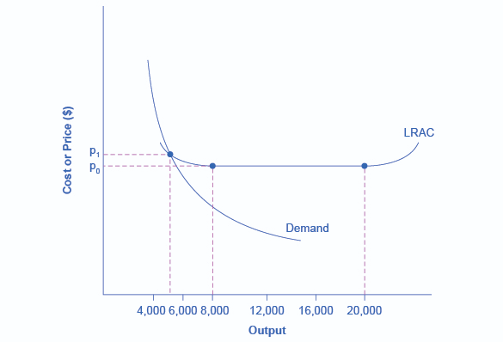
9.1 Natural Monopoly Example
Fig 9.1

Slide 7
9.1 Natural Monopoly Explained
Fig 9.1 presents a long-run average cost curve for the airplane manufacturing industry. It shows economies of scale up to an output of 8,000 planes per year and a price of P0, then constant returns to scale from 8,000 to 20,000 planes per year, and diseconomies of scale at a quantity of production greater than 20,000 planes per year.

Slide 8
9.1 Natural Monopoly Explanation Continued
Now consider the market demand curve in Fig 9.1, which intersects the long-run average cost (LRAC) curve at an output level of 5,000 planes per year and at a price P1, which is higher than P0. In this situation, the market has room for only one producer. If a second firm attempts to enter the market at a smaller size, say by producing a quantity of 4,000 planes, then its average costs will be higher than those of the existing firm, and it will be unable to compete. If the second firm attempts to enter the market at a larger size, like 8,000 planes per year, then it could produce at a lower average cost—but it could not sell all 8,000 planes that it produced because of insufficient demand in the market.

Slide 9
9.1 Natural Monopoly
When economies of scale are large relative to the quantity demanded in the market, a natural monopoly arises.
Natural monopolies often arise in industries where the marginal cost of adding an additional customer is very low, once the fixed costs of the overall system are in place.
This results in situations where there are substantial economies of scale.
Notes:
For example, once a water company lays the main water pipes through a neighborhood, the marginal cost of providing water service to another home is fairly low. Such industries offer an example where, because of economies of scale, one producer can serve the entire market more efficiently than a number of smaller producers that would need to make similar physical capital investments.

Slide 10
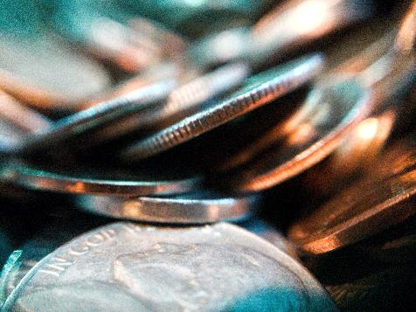
9.1 Ownership barrier arising out of control of a physical Resource
Another type of monopoly occurs when a company has control of a scarce physical resource.
In the Canadian economy, one historical example of this pattern occurred when the International Nickel Company of Canada—controlled most of the supply of nickel, a key mineral used leading manufacturer of specialized forged components made from alloy materials.
Photo by Joshua Hoehne, licensed under the Unsplash License

Slide 11
9.1 Legal Monopoly
Most legal monopolies are utilities—products necessary for everyday life—that are socially beneficial. As a consequence, the government allows producers to become regulated monopolies, to ensure that customers have access to an appropriate amount of these products or services.
Additionally, legal monopolies are often subject to economies of scale, so it makes sense to allow only one provider.
Notes:
For some products, the government erects barriers to entry by prohibiting or limiting competition. Under Canadian law, no organization but Canada Post is legally allowed to deliver residential mail. Many states or cities have laws or regulations that allow households a choice of only one electric company, one water company, and one company to pick up the garbage.

Slide 12
9.1 Patent, Trademark, Copyright & Intellectual Property
A patent gives the inventor the exclusive legal right to make, use, or sell the invention for a limited time.
A trademark is an identifying symbol or name for a particular good, like Chiquita bananas.
A copyright, according to the Canadian Law, “is a form of protection for ‘original works of authorship’ including literary, dramatic, musical, architectural, cartographic, choreographic, pantomimic, pictorial, graphic, sculptural, and audiovisual creations.”
Intellectual Property is the combination of patents, trademarks, and copyrights.

Slide 13
9.2 Single Price Monopoly Demand and Marginal Revenue
So, we know a competitive market faces an elastic demand, what about a single-priced monopoly? This is distinct from other monopolies in that the firm must charge the same price to all consumers. In this case, the aggregate demand is the firm’s demand!

Slide 14
9.2 Example: The Sunglass Market
To explore monopoly, consider the sunglasses market. What do Oakley, Ray-Ban and Persol have in common?
They are all owned by the same brand. That’s right, Luxottica, an Italian-based eyewear company, produces about 70% of all name-brand eyewear.
This is fairly close to a monopoly, as with that high of a market share, Luxottica dominates the market price.
Notice that Luxottica is not a single price monopoly, as it practices a form of price discrimination by having multiple brands aimed at different consumers.
Notes:
Let’s consider what would happen if Luxottica only sold one kind of sunglasses at the same price to all consumers, and if they owned 100% of the market. Whereas the competitive firm was a small player in the aggregate market, the monopolist dictates both the final price and the quantity. If Luxottica decides to lower the price, it must do so for ALL buyers. Consider what implications this has on revenue.

Slide 15
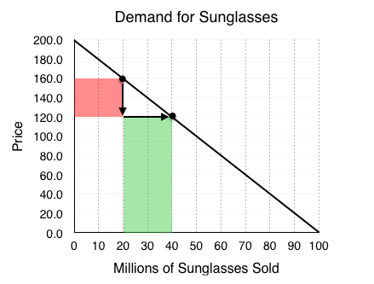
9.2 Example: The Sunglass Market Continued
According to the law of demand, as price falls, the quantity demanded increases. This means that Luxottica can increase revenue by lowering prices, as they sell more sunglasses. This is not what happens from a price decrease however, as the firm decreases its price it loses some of the revenue on the goods it was previously selling.
Fig 9.2

Slide 16
9.2 Fig 9.2 Explained
Luxottica is selling 20 million sunglasses at $160 per pair. When it reduces the price to $120, two things happen:
Luxottica loses $40 on each of the 20 million sunglasses it was selling before. 20 million consumers were willing to pay the full $160 for a pair, and now only have to pay $120. This results in a loss of $800 million for Luxottica. (shown as the red shaded region in Fig 9.2).
Luxottica gains $120 on each of the 20 million new sunglasses it now sells. 20 million consumers were not willing to pay $160 for a pair, but are willing to pay $120. This results in a gain of $2.4 billion for Luxottica (shown as the green shaded region in Fig 9.2).
These changes collectively represent a net gain of $1.6 billion for Luxottica. This net gain is the marginal revenue earned by Luxottica (Total revenue of $120b*40 – $160b*20 = $1.6 billion).

Slide 17
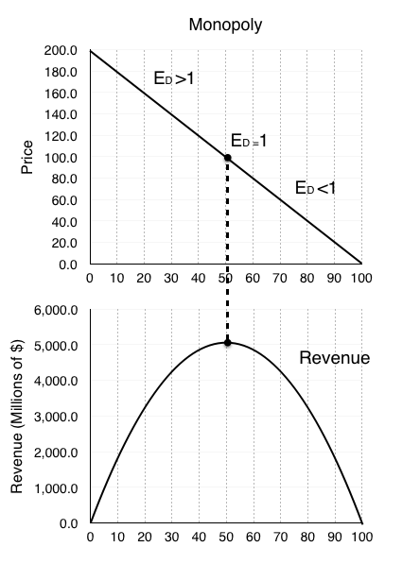
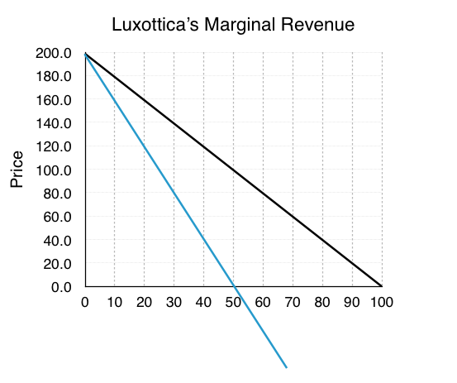
9.2 Single-Price Monopolist
Fig 9.3
Fig 9.4

Slide 18
9.2 Single-Price Monopolist Explained
For a single-price monopolist, marginal revenue is less than the price at each quantity of output (P > MR). Therefore, the marginal revenue curve lies below the demand curve for a monopolist.
Remember, the equation to calculate the elasticity of demand ED is (% change in quantity/% change in price). Looking at the change in revenue from the examples in fig 9.3 , we can see that the decrease in revenue came from the price change, and the increase came from the quantity change. This means that when % change in quantity > % change in price, our revenue increases from a price drop! Put simply, when our ED>1, we should continue to decrease price, maximizing our revenue. Therefore, the monopolist should operate on the elastic portion of the demand curve.

Slide 19
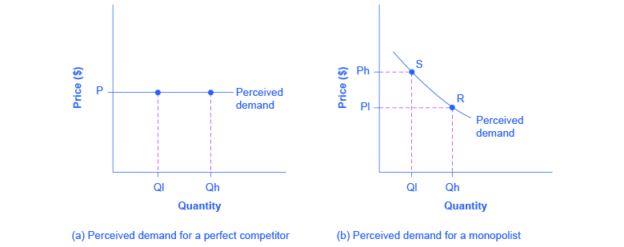
9.2 Competition vs Monopoly
Fig 9.5A
Fig 9.5B
Notes:
A perfectly competitive firm acts as a price taker and faces a perfectly elastic or horizontal demand curve as shown in Fig 9.5 A. The monopolist is a price maker and faces a downward-sloping demand curve as shown in Fig 9.5 B. As the price is lowered, the quantity demanded increases

Slide 20
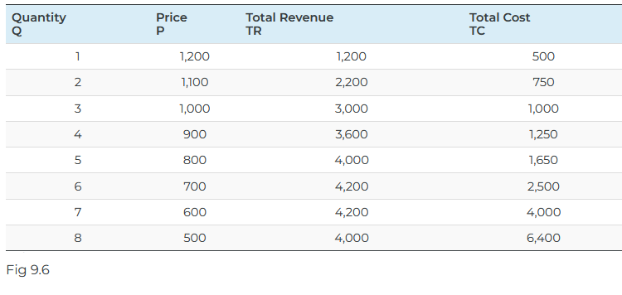
9.3 Single Monopoly Price and Output

Slide 21
9.3 Fig 9.6 Explained
Let’s explore this using the data in the table in Fig 9.6, which shows quantities along the demand curve and the price at each quantity demanded and then calculates total revenue by multiplying price times quantity at each level of output. (In this example, we give the output as 1, 2, 3, 4, and so on, for the sake of simplicity.
As the figure illustrates, total revenue for a monopolist has the shape of a hill, first rising, next flattening out, and then falling. In this example, total revenue is highest at a quantity of 6 or 7.

Slide 22
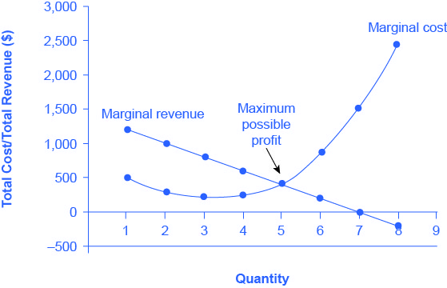
9.3 Health Pill Example
Fig 9.7

Slide 23
9.3 Fig 9.7 Explained
The monopolist is not seeking to maximize revenue, but instead to earn the highest possible profit. In the Health Pill example, the highest profit will occur at the quantity where total revenue is the farthest above total cost.
A monopolist can determine its profit-maximizing price and quantity by analyzing the marginal revenue and marginal costs of producing an extra unit. If the marginal revenue exceeds the marginal cost, then the firm should produce the extra unit.

Slide 24
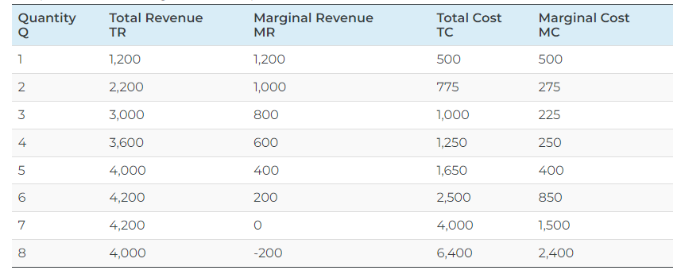
9.3 Health Pill Table Example
Fig 9.8

Slide 25
9.3 Fig 9.8 Explained
For example, at an output of 4 in Fig 9.7, marginal revenue is 600 and marginal cost is 250, so producing this unit will clearly add to overall profits.
At an output of 5, marginal revenue is 400 and marginal cost is 400, so producing this unit still means overall profits are unchanged. However, expanding output from 5 to 6 would involve a marginal revenue of 200 and a marginal cost of 850, so the sixth unit would actually reduce profits.
Thus, the monopoly can tell from the marginal revenue and marginal cost that of the choices in the table, the profit-maximizing level of output is 5.
Thus, a profit-maximizing monopoly should follow the rule of producing up to the quantity where marginal revenue is equal to marginal cost—that is, MR = MC. This quantity is easy to identify graphically, where MR and MC intersect, as shown in Fig 9.8.

Slide 26
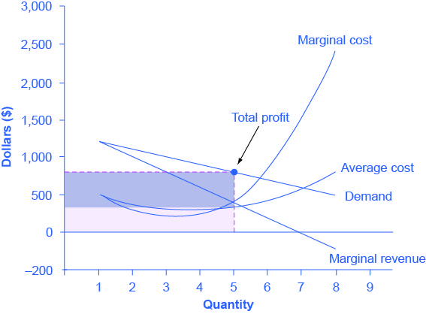
9.3 The Three-Step Process
Fig 9.9 illustrates the three-step process where a monopolist: selects the profit-maximizing quantity to produce; decides what price to charge; determines total revenue, total cost, and profit.
Fig 9.9

Slide 27
9.3 The Monopolist Determines its Profit-Maximizing Level of Output
The firm can use the points on the demand curve D to calculate total revenue, and then, based on total revenue, calculate its marginal revenue curve. The profit-maximizing quantity will occur where MR = MC — or at the last possible point before marginal costs start exceeding marginal revenue. In Fig 9.9, MR = MC occurs at an output of 5.

Slide 28
9.3 The Monopolist What Price to Charge
The monopolist will charge what the market is willing to pay. A dotted line drawn straight up from the profit-maximizing quantity to the demand curve shows the profit-maximizing price which, in Fig 9.9, price is $800. This price is above the average cost curve, which shows that the firm is earning profits.

Slide 29
9.3 Calculate Total Revenue, Total Cost, and Profit
Total revenue is the overall shaded box, where the width of the box is the quantity sold and the height is the price. In Fig 9.9, this is 5 × $800 = $4000. In Fig 9.9, the bottom part of the shaded box, which is shaded more lightly, shows total costs; that is, quantity on the horizontal axis multiplied by average cost on the vertical axis or 5 × $330 = $1650. The larger box of total revenues minus the smaller box of total costs will equal profits, which the darkly shaded box shows. Using the numbers, the profit earned is $4000 – $1650 = $2350.

Slide 30
9.4 Inefficiency of Monopoly
Most people criticize monopolies because they charge too high a price, but what economists object to is that monopolies do not supply enough output to be allocatively efficient. To understand why a monopoly is inefficient, it is useful to compare it with the benchmark model of perfect competition.
Photo by Geralt form Pixabay

Slide 31
9.4 Allocative Efficiency
Allocative efficiency is an economic concept regarding efficiency at the social or societal level. The rule of profit maximization in a world of perfect competition was for each firm to produce the quantity of output where P = MC. Following this rule assures allocative efficiency.
In monopoly, allocative efficiency is NOT achieved, because P > MC at the profit maximizing output (as observed from Fig 9.9 above).
Notes:
If P > MC, then the marginal benefit to society (as measured by P) is greater than the marginal cost to society of producing additional units, and a greater quantity should be produced. However, in the case of monopoly, price is always greater than marginal cost at the profit-maximizing level of output. Thus, consumers will suffer from a monopoly because it will sell a lower quantity in the market, at a higher price, than would have been the case in a perfectly competitive market. As the price exceeds marginal cost, the monopolist charges a markup.

Slide 32
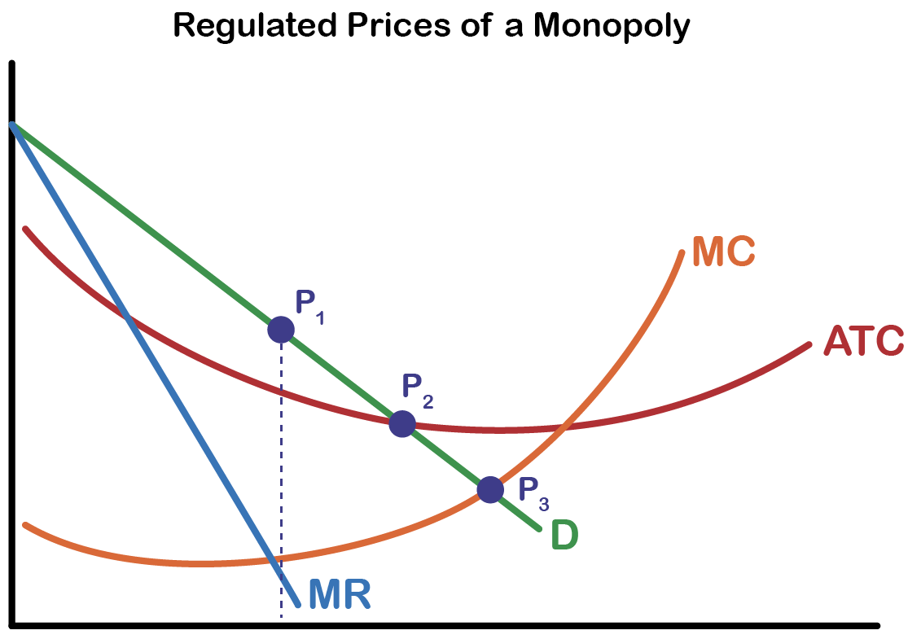
9.5 Monopoly and Antitrust Policy
P1 = Monopoly Price
P2 = Regulated Price
P3 = Efficient Price
MR = MC
D = ATC
D = MC

Slide 33
9.6 Key Terms
Allocative Efficiency
Barriers to Entry
Bid Rigging
Copyright
Intellectual-Property
Legal Monopoly
Monopoly
Natural Monopoly
Patent
Predatory Pricing
Single-Priced Monopoly
Trademark

