Slide 1
CHAPTER 8: PERFECT COMPETITION
Principles of Microeconomics
Unless otherwise noted, this work is licensed under a Creative Commons Attribution-NonCommercial-ShareAlike 4.0 International (CC BY-NC-SA 4.0) license. Feel free to use, modify, reuse or redistribute any portion of this presentation.

Slide 2
Learning Outcomes
At the end of this chapter, learners will be able to:
Describe the characteristics of a market
Explain profit or loss in graphs
Discuss shut down decision
Identify what is entry and exit
Elaborate perfect competition and economic efficiency

Slide 3
8.0 Three Main Metrics to Measure Market’s Structure
The number of firms. More firms mean more competition and more places to which consumers can turn to purchase a good.
The similarity of goods: The more similar the goods sold in the market the more easily consumers can switch firms and the more competitive the market is.
The barriers to entry: The more difficult is it to enter a market for a new firm, the less competitive it is.

Slide 4
8.0 Market Structure
How we categorize market structure and the competitive environments in which firms and consumers interact
The first is relatively straightforward; more firms mean more competition in the sense that it is hard to charge more for a product that consumes can find easily from other sellers.
The second is a little subtler because products can be differentiated by something as simple as a brand or more tangible aspects like colours, features and other characteristics.
Finally, the third can be barriers of law like patents, or technology even if not covered by legal patent protection, or more natural barriers like a very high cost of starting up a firm that is not justified by the expected revenue.

Slide 5
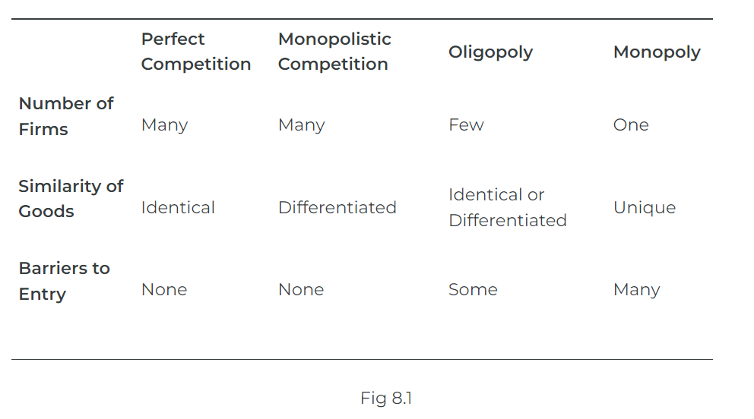
8.0 Three Metrics
Notes:
We will study four market types in more detail where these metrics will be discussed further, but for now, they are described along with the three metrics in Table 8.1.

Slide 6
Characteristics of Perfect Competition
8.1 Many Firms
Many firms, means that from the perspective of one individual firm there is no way to raise or lower the market price for a good.
Price Takers: Meaning that their decision is simply how much to sell at the market price.
Photo by Artem Beliaikin, licensed under the Unsplit License
Notes:
Many firms: Many firms, means that from the perspective of one individual firm there is no way to raise or lower the market price for a good. This is because the individual firm’s output is such a small part of the overall market that it does not make a difference in terms of price.
Firms are, therefore, price takers, meaning that their decision is simply how much to sell at the market price. If they try and sell for a higher price, no one will buy from them, and they could sell for a lower price, but if they did so, they would only be hurting themselves because it would not affect their quantity sold. Thus from an individual firm’s perspective, they face a horizontal demand curve.

Slide 7
8.1 Identical Goods
Identical goods mean there is nothing to distinguish one firm’s goods from another.
For example, corn – once all the corn is dumped into the grain elevator there is absolutely no way to tell from which farm a particular kernel of corn came.
This means there is no way for one seller to differentiate their output to try and sell it at a different price on the premise that it is different.

Slide 8
8.1 Barriers to Entry
It is very easy for firms to start and stop selling in this market.
For example, if a farmer decides to plant corn instead of soybeans, there is nothing preventing them from doing so.
Likewise, a farmer who wishes to plant soybeans instead of corn faces no barriers.
Notes:
In general, free entry and exit mean that there are no legal barriers to entry, like needing a special permit only given to a limited number of firms, and no major cost obstacles, like needing to invest millions of dollars in a manufacturing plant as a new car manufacturer would.
There is an implicit assumption here and that is, buyers and sellers have full information meaning that they know the prices charged by every firm. This is important because without it a firm could possibly charge an uninformed consumer more and this violates the price taker condition.

Slide 9
8.2 Price and Quantity in Perfect Competition
A perfectly competitive firm has only one major decision to make — namely, what quantity to produce. To understand this, consider a different way of writing out the basic definition of profit:
Profit = Total Revenue – Total Cost
= Price × Quantity – Average Total Cost × Quantity
Notes:
Since a perfectly competitive firm must accept the price for its output as determined by the product’s market demand and supply, it cannot choose the price it charges. This is already determined in the profit equation, and so the perfectly competitive firm can sell any number of units at exactly the same price. It implies that the firm faces a perfectly elastic demand curve for its product: buyers are willing to buy any number of units of output from the firm at the market price. When the perfectly competitive firm chooses what quantity to produce, then this quantity — along with the prices prevailing in the market for output and inputs — will determine the firm’s total revenue, total costs, and ultimately, level of profits.

Slide 10
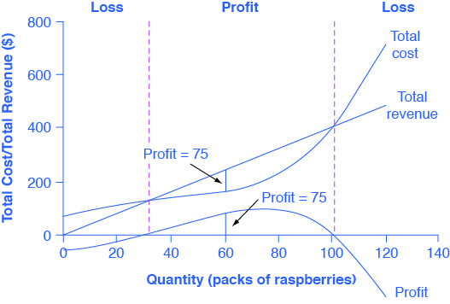
Determining the Highest Profit by Comparing Total Revenue and Total Cost
Total Cost and Total Revenue at the Raspberry Farm
Fig 8.2

Slide 11
8.2 Fig 8.2 Explained
From Fig 8.2, the vertical gap between total revenue and the total cost is profit, for example, at Q = 60, TR = 240 and TC = 165. The difference is 75, which is the height of the profit curve at that output level. The firm doesn’t make a profit at every level of output. In this example, total costs will exceed total revenues at output levels from 0 to approximately 30, and so over this range of output, the firm will be making losses. At output levels from 40 to 100, total revenues exceed total costs, so the firm is earning profits. However, at any output greater than 100, total costs again exceed total revenues and the firm is making increasing losses.
From the table in Fig 8.3, we can calculate the economic profit by subtracting total costs from total revenue. Total profits appear in the final column of Fig 8.3. Maximum profit occurs at an output between 70 and 80 when profit equals $90.

Slide 12
8.2 Explained
A perfectly competitive firm can sell as large a quantity as it wishes, as long as it accepts the prevailing market price. The formula above shows that total revenue depends on the quantity sold and the price charged. If the firm sells a higher quantity of output, then total revenue will increase. If the market price of the product increases, then total revenue also increases whatever the quantity of output sold.
The table in 8.3 is represented graphically in Fig 8.2 which shows the total revenue and total costs for the raspberry farm. The horizontal axis shows the quantity of frozen raspberries produced in packs. The vertical axis shows both total revenue and total costs, measured in dollars. The total cost curve intersects with the vertical axis at a value that shows the level of fixed costs and then slopes upward. All these cost curves follow the same characteristics as the curves that we covered in the chapter on Production and Cost.

Slide 13
8.2 Vertical Gap Between Total Revenue and Total Cost

Slide 14
8.3 Comparing Marginal Revenue and Marginal Costs
The marginal revenue curve shows the additional revenue gained from selling one more unit.
Marginal Revenue = Price
The formula for marginal revenue is:
Marginal Revenue = change in total revenue ÷ change in quantity
Notes:
As mentioned before, a firm in perfect competition faces a perfectly elastic demand curve for its product—that is, the firm’s demand curve is a horizontal line drawn at the market price level. This also means that the firm’s marginal revenue curve is the same as the firm’s demand curve:
Every time a consumer demands one more unit, the firm sells one more unit and revenue increases by exactly the same amount equal to the market price. In this example, every time the firm sells a pack of frozen raspberries, the firm’s revenue increases by $4. Fig 8.4 shows an example of this. This condition only holds for price-taking firms in a perfect competition where:

Slide 15
8.3 Marginal Revenue and Marginal Cost Curves

Slide 16
8.3 Fig 8.4 Explained
Fig 8.4 presents the marginal revenue based on the total revenue and total cost in Fig 8.2.
Firms often do not have the necessary data they need to draw a complete total cost curve for all levels of production. They cannot be sure of what total costs would look like if they, say, doubled production or cut production in half because they have not tried it. Instead, firms experiment. They produce a slightly greater or lower quantity and observe how it affects profits. In economic terms, this practical approach to maximizing profits means examining how changes in production affect marginal revenue and marginal cost.

Slide 17
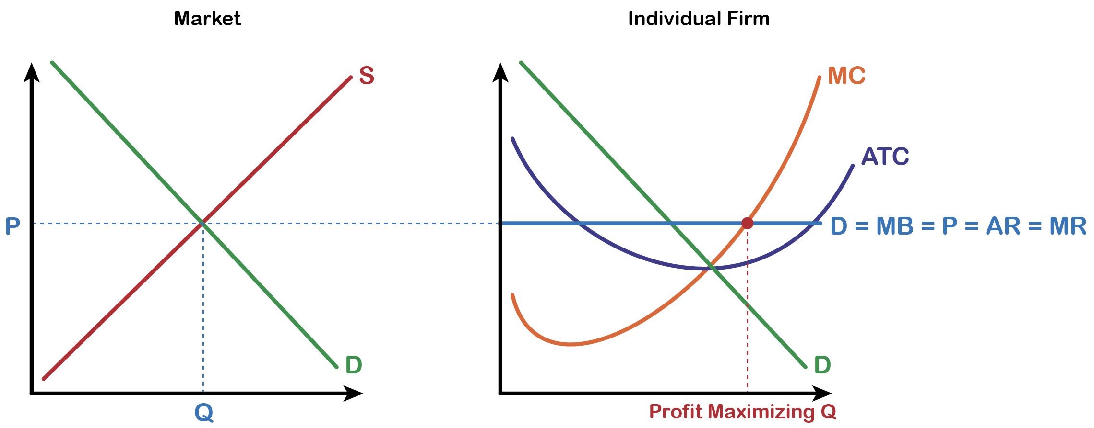
8.3 Market Quantity
The formula for marginal cost is:
Marginal cost = change in total cost ÷ change in quantity
Fig 8.5

Slide 18
8.3 Fig 8.5 Explained
Notice that marginal revenue does not change as the firm produces more output. That is because, under perfect competition, the price is determined through the interaction of supply and demand in the market as shown in Fig 8.5 and does not change as the farmer produces more.
Since a perfectly competitive firm is a price taker, it can sell whatever quantity it wishes at the market-determined price. We calculate marginal cost, the cost per additional unit sold, by dividing the change in total cost by the change in quantity.

Slide 19
8.3 Fig 8.5 Explained Cont.
From Fig 8.5, if the firm is producing at a quantity where MR > MC, like 60 packs of raspberries, then it can increase profit by increasing output because the marginal revenue is exceeding the marginal cost. The revenue from the 60th pack more than compensates for the cost of producing the 60th pack of raspberry. If the firm is producing at a quantity where MC > MR, like 100 packs, then it can increase profit by reducing output because the cost of producing the 100th pack exceeds the revenue obtained from selling the 100th pack. The firm’s profit-maximizing choice of output will occur where MR = MC (i.e. at a quantity of 80 packs). The revenue obtained from selling the 80th pack of raspberry just compensates for the cost of producing the 80th pack.

Slide 20
8.4 Profits and Losses in Perfect Competition
Does maximizing profit (producing where MR = MC) imply an actual economic profit?
The answer depends on the relationship between price and average total cost, which is the average profit or profit margin.
If the market price is higher than the firm’s average cost of production for that quantity produced, then the profit margin is positive, and the firm will earn profits.
Notes:
Conversely, if the market price is lower than the average cost of production, the profit margin is negative and the firm will suffer losses. You might think that, in this situation, the firm may want to shut down immediately. Remember, however, that the firm has already paid for fixed costs, such as equipment, so it may continue to produce for a while and incur a loss.

Slide 21
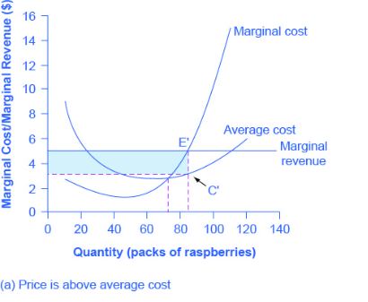
8.4 Three Economic Profit Scenario 1
Where price intersects marginal cost at a level above the average cost curve.
Economic Profit = Total Revenue – Total Cost = 5 × 85 – 3.50× 85 = $127.50
(POSITIVE ECONOMIC PROFIT)
Fig 8.8 A

Slide 22
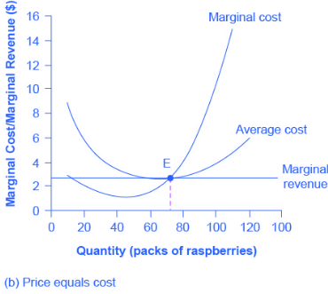
Three Economic Profit Scenario 2
Where price intersects marginal cost at a level equal to the average cost curve
Economic Profit = Total Revenue – Total Cost = 2.75 × 75 – 2.75 × 75 = $0
(ZERO ECONOMIC PROFIT)
Fig 8.8B

Slide 23
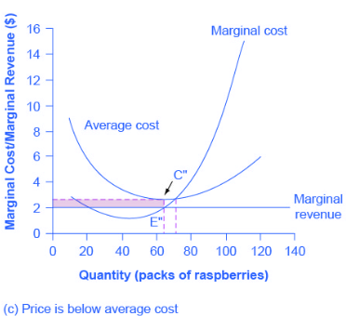
8.4 Three Economic Profit Scenario 3
Where price intersects marginal cost at a level below the average cost curve.
Economic Profit = Total Revenue – Total Cost = 2 × 65 – 2.73 × 65 = – $47.45
(NEGATIVE ECONOMIC PROFIT OR ECONOMIC LOSS)
Fig 8.8 C

Slide 24
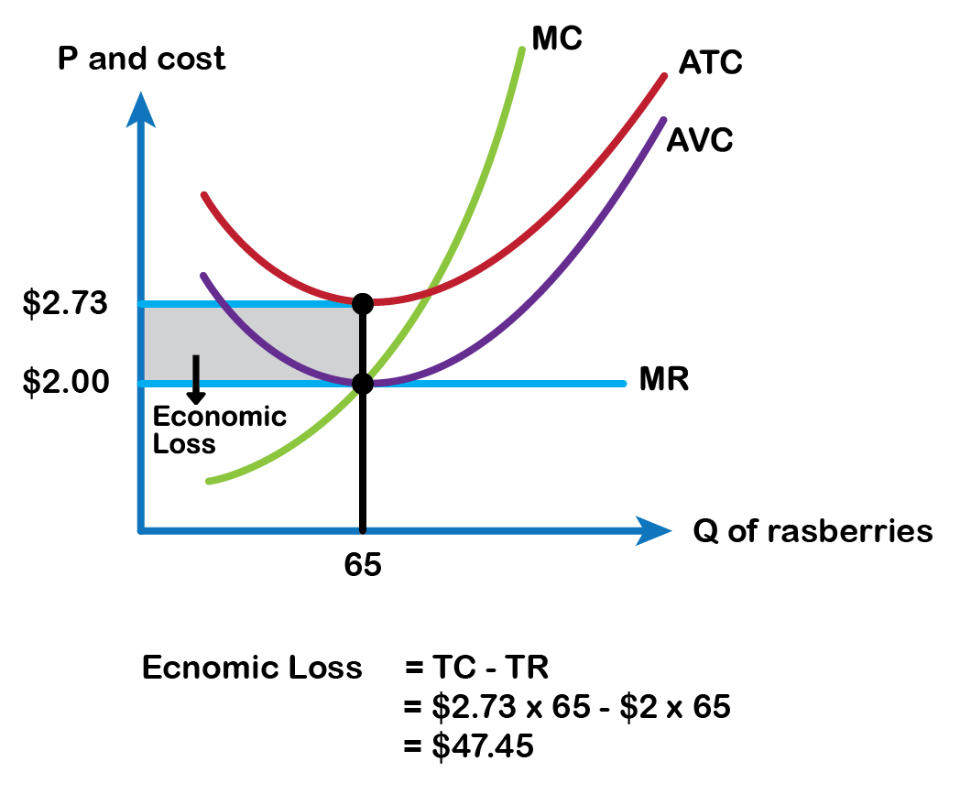
8.5 Economic Loss and Shut Down in the Short Run
Fig 8.10

Slide 25
8.5 Fig 8.10 Explained
Shows the loss minimizing output of 65. The marginal revenue or price received from selling each pack is $2 and the average variable cost of producing 65 packs is also $2. The price just covers the average variable cost of production, which implies the farmer will still be able to manage and continue production because labour cost and raw material cost for producing each pack are paid for by the price received. However, if the firm decides to shut down temporarily and stop production, it still has to incur an economic loss of $47.45 (fixed cost paid out of its own pocket).

Slide 26
8.5 Fig 8.10 Explanation Continued
Therefore, P = AVC is called the shutdown point, at which level the firm is indifferent between producing the loss minimizing output or shutting down. Shut down is a temporary phenomenon where the firm stays in the business but could stop production for a while until market conditions improve. If P > AVC but P < ATC, then the firm continues to produce in the short-run, making economic losses.
However, if P < AVC, then the firm stops producing as the price is not sufficient enough to cover the variable cost and the firm incurs its fixed costs.

Slide 27
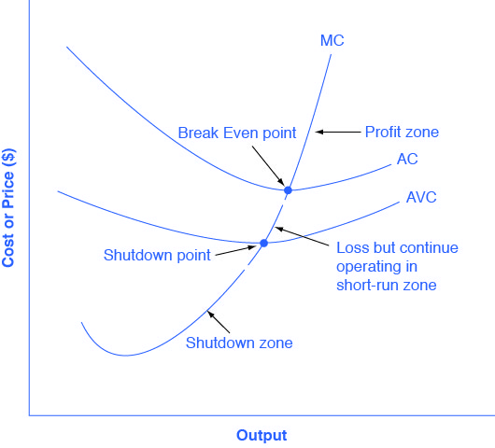
8.5 Marginal Cost and the Firm’s Supply Curve
MC above Minimum AVC is Firms Short Run Supply Curve
MC above Minimum ATC is Firms Long Run Supply Curve
Fig 8.11

Slide 28
8.5 Fig 8.11 Explained
For a perfectly competitive firm, the marginal cost curve is identical to the firm’s supply curve starting from the minimum point on the average variable cost curve.
A firm checks the market price and then looks at its supply curve to decide what quantity to produce.
Now, think about what it means to say that a firm will maximize its profits by producing at the quantity where P = MC.
This rule means that the firm checks the market price, and then looks at its marginal cost to determine the quantity to produce—and makes sure that the price is at least equal to the minimum average variable cost.
Notes:
In other words, the marginal cost curve above the minimum point on the average variable cost curve becomes the firm’s supply curve. The rising portion of the MC curve from the shutdown point becomes the firm’s supply curve in the short run, as shown in fig 8.11

Slide 29
8.6 How Entry and Exit Lead to Zero Profits in the Long Run
No perfectly competitive firm acting alone can affect the market price. However, the combination of many firms entering or exiting the market will affect the overall supply in the market. In turn, a shift in supply for the market will affect the market price. Entry and exit to and from the market are the driving forces behind a process that, in the long run, pushes the price down to minimum average total costs so that all firms are earning zero profit.

Slide 30
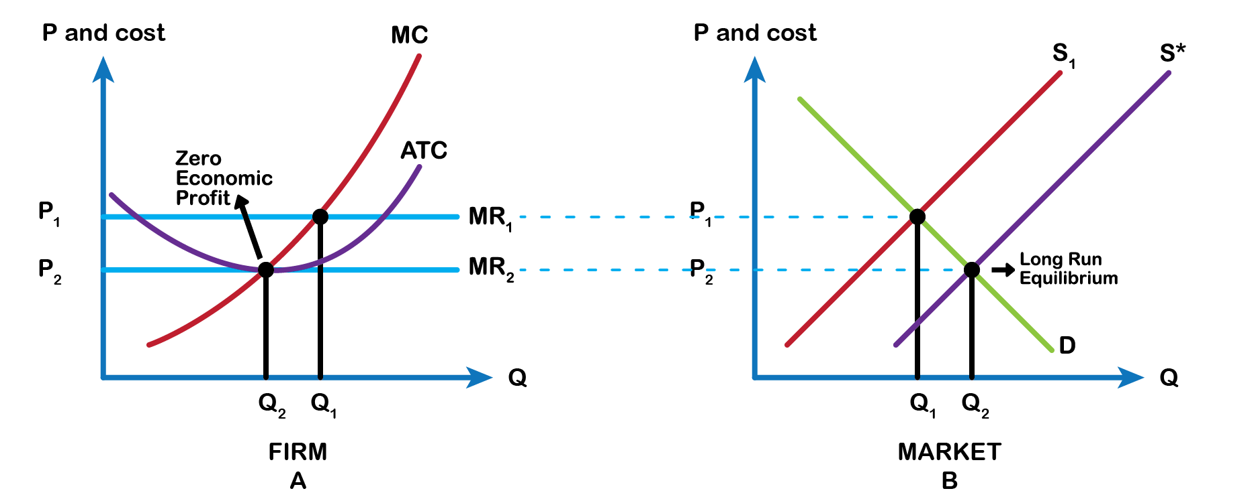
8.6 Entry of New Firms
Fig 8.12

Slide 31
8.6 Entry of New Firms Explained
Let’s say that the product’s demand increases, and with that, the market price goes up.
The existing firms in the industry are now facing a higher price than before, so they will increase production to the new output level where P = MR = MC. Now the existing firms make a positive economic profit at output q1 (Fig 8.12 A).
This induces new firms to enter the market. As new firms enter, market supply increases and shifts the supply curve to the right to S* (Fig 8.12 B).
As the supply curve shifts to the right, the market price starts falling, and with that, economic profits fall for new and existing firms.
Notes:
As long as there are still profits in the market, entry will continue to shift supply to the right. This will stop whenever the market price is driven down to the zero-profit level at output q2, where no firm is earning positive economic profits. This is the long-run equilibrium where the firms continue to produce as long as price equals average total cost and end up earning zero economic profits. Each firm’s share falls but the market output increases.

Slide 32
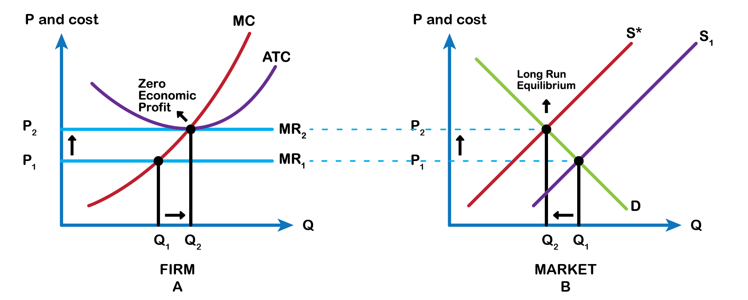
8.6 Exit of Firms
Fig 8.13

Slide 33
8.6 Exit Of Firms Explained
Short-run losses reverse this process as demand decreases market price starts falling.
Existing firms are facing a lower price, it will be below the average cost curve, and they will be making economic losses at output q1 (Fig 8.13 A).
Some firms will continue producing where the new P = MR = MC, if they are able to cover their average variable costs. Other firms will have to shut down as they will not be able to cover their average variable costs.

Slide 34
8.6 Exit Firms Explanation Continued
Many firms exiting causes the market supply curve to shift to the left to S* (Fig 8.13 B).
As the supply curve shifts to the left, the market price starts rising, and economic losses start to be lower.
The process ends whenever the market price rises to the zero-profit level at output q2, where the existing firms are at zero profits again.
Each firm’s share rises but the market output decreases

Slide 35
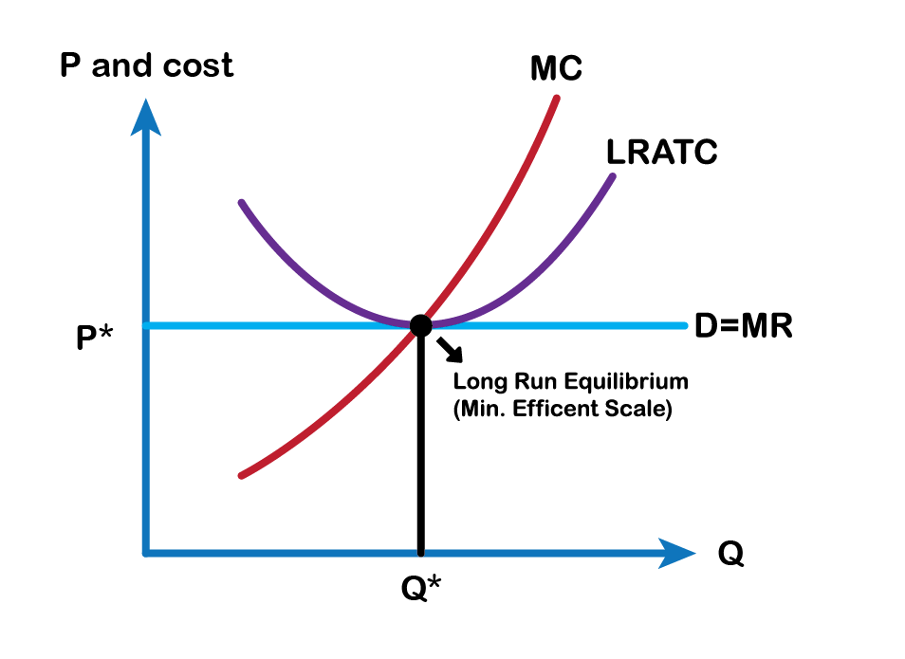
8.7 Perfect Competition and Efficiency
Fig 8.14

Slide 36
8.7 Fig 8.14 Explained
Profit-maximizing firms in perfectly competitive demonstrate both productive and allocative efficiency.
In the long run in a perfectly competitive market, because of the process of entry and exit, the price in the market is equal to the minimum of the long-run average cost curve. In other words, firms produce and sell goods at the lowest possible average cost, as shown in Fig 8.14.
Productive Efficiency: Firm is producing at lowest point on ATC
Allocative Efficiency: Firm is producing where MB = MC

Slide 37
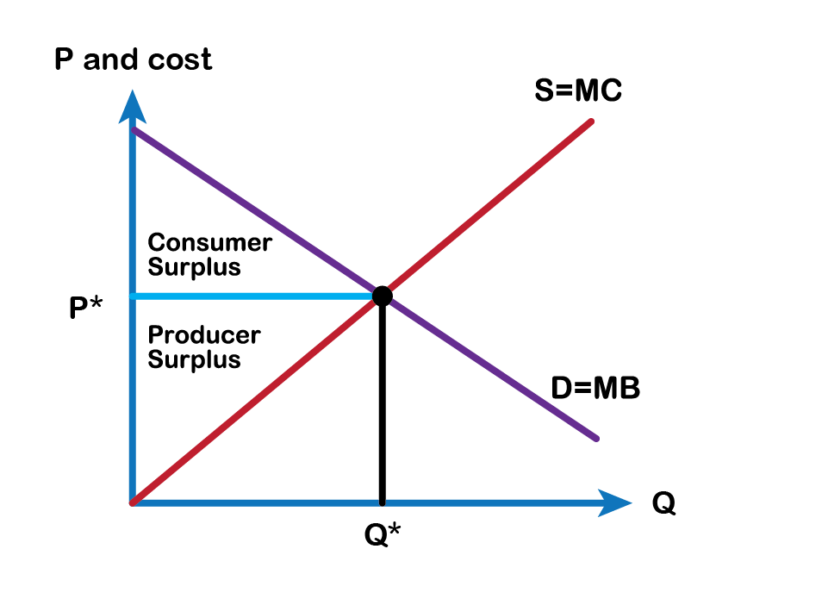
8.7 Perfectly Competitive Market
Fig 8.15

Slide 38
8.7 Fig 8.15 Explained
In a perfectly competitive market, the price will be equal to the marginal cost of production.
Marginal cost of producing the good represents not just the cost, but also the social cost of producing the good.
Perfectly competitive firms following the rule that profits are maximized by producing the quantity where price is equal to marginal cost, are ensuring that the social benefits from production are equal to the social costs of production.
Perfectly competitive markets maximize consumer and producer surpluses resulting in no deadweight or efficiency loss, shown in Fig 8.15.

Slide 39
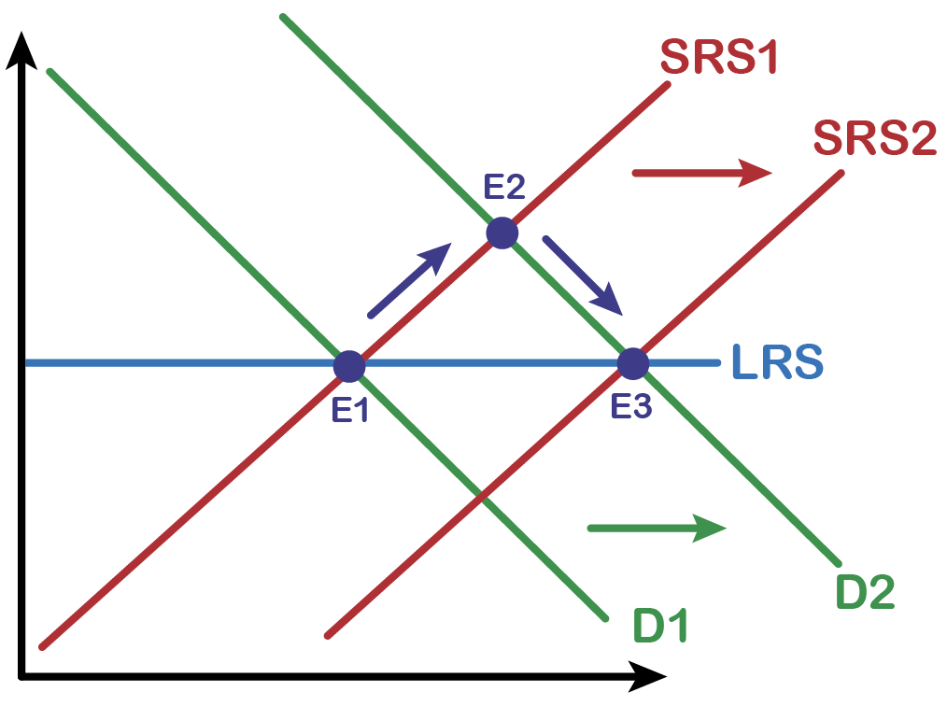
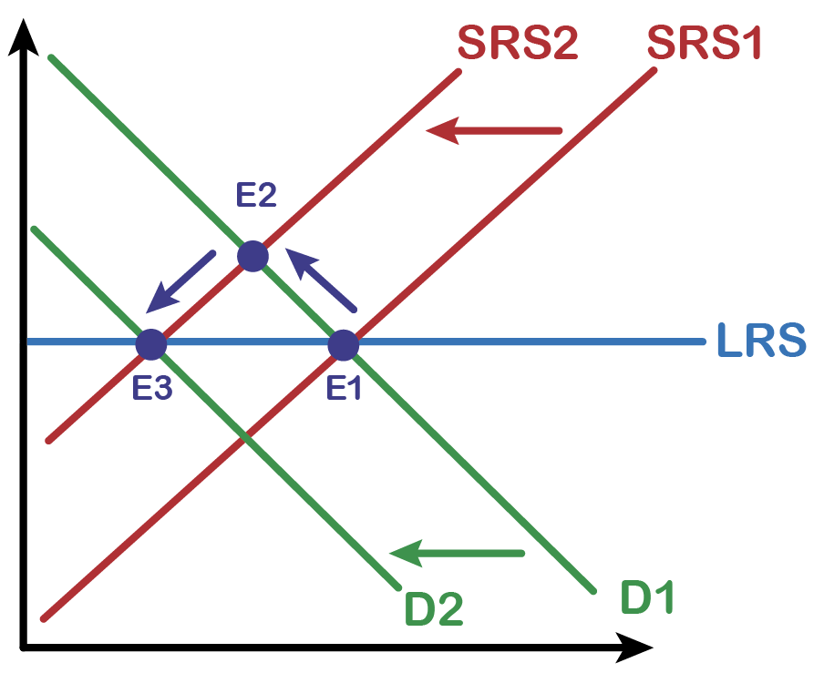
8.7 Demand Shock
Positive Demand Shock
Event happens that causes demand to shift to the right. This raises the equilibrium price above the long run breakeven price. Profit is now being made so new firms enter. This pushes Short Run Supply to the right and back to long run equilibrium.
Negative Demand Shock
Event happens that causes demand to shift to the left. This lowers the equilibrium price below the long run breakeven price. Losses are now being taken so existing firms leave. This pushes Short Run Supply to the left and back to long run equilibrium.

Slide 40
8.8 Key Terms
Barriers to Entry
Identical Goods
Long Run Equilibrium
Many Firms
Marginal Revenue Curve
Market Structure and The Competitive Environments
Price Takers
Shutdown Point

