Slide 1
Principles of Microeconomics
CHAPTER 7: PRODUCTION AND COST
Unless otherwise noted, this work is licensed under a Creative Commons Attribution-NonCommercial-ShareAlike 4.0 International (CC BY-NC-SA 4.0) license. Feel free to use, modify, reuse or redistribute any portion of this presentation.

Slide 2
Learning Outcomes
At the end of this chapter, you will be able to:
Describe technology and examples
Explain short-run and long-run
Describe marginal and average products of labor
Elaborate marginal and average costs
Recognize average costs and marginal costs graphs
Identify firms long-run decisions

Slide 3
7.1 Total Revenue
Profit = Total Revenue – Total Cost
Total revenue is the income the firm generates from selling its products. We calculate it by multiplying the price of the product times the quantity of output sold
Total Revenue = Price × Quantity
Notes:
Total cost is what the firm pays for producing and selling its products. Production involves the firm converting inputs to outputs. Each of those inputs has a cost to the firm. The sum of all those costs is the total cost. We will learn in this chapter that short-run costs are different from long-run costs.

Slide 4
7.1 Explicit and Implicit Costs
Explicit Costs: Are out-of-pocket costs, that is, actual payments. The wage and rent that a firm pays for office space are explicit costs.
Implicit Costs: Are more subtle but just as important. They represent the opportunity cost of using resources that the firm already owns. Often for small businesses, they are resources that the owners contribute.
Notes:
For example, working in the business while not earning a formal salary, or using the ground floor of a home as a retail store are both implicit costs. Implicit costs also include the depreciation of goods, materials, and equipment that are necessary for a company to operate. Depreciation is the decline in the value of any capital due to its constant usage. These two definitions of cost are important for distinguishing between two conceptions of profit, accounting profit, and economic profit.

Slide 5
7.1 Accounting Profit and Economic Profit
Accounting Profit: Is a cash concept. It means total revenue minus explicit costs—the difference between dollars brought in and dollars paid out.
Economic Profit: Is total revenue minus total cost, including both explicit and implicit costs. The difference is important because even though a business pays income taxes based on its accounting profit, whether or not it is economically successful depends on its economic profit.

Slide 6
7.1 Economic Profit
Economic Profit: Current opportunity is better than old opportunity.
E.g.: I make $100,000 but used to make $80,000
Economic Loss: Current opportunity is worse than old opportunity.
E.g.: I make $100,000 but used to make $200,000
Economic Breakeven: Current opportunity is equally as good as old opportunity.
E.g.: I make $100,000 and used to make $100,000

Slide 7
7.1 Calculating Implicit and Explicit Costs
Fred currently works for a corporate law firm. He is considering opening his own legal practice, where he expects to earn $200,000 per year once he establishes himself. To run his own firm, he would need an office and a law clerk. He has found the perfect office, which rents for $50,000 per year. He could hire a law clerk for $35,000 per year. If these figures are accurate, would Fred’s legal practice be profitable?

Slide 8
7.1 Calculating Implicit and Explicit Costs Step 1
Step 1. First you must calculate the costs. You can take what you know about explicit costs and total them:
Office rental + Law clerk’s salary = Total explicit costs: $50,000 + $35,000 = $85,000
Total explicit costs: $85,000

Slide 9
7.1 Calculating Implicit and Explicit Costs Step 2
Step 2. Subtracting the explicit costs from the revenue gives you the accounting profit.
Accounting profit: Revenue minus explicit costs = $200,000 – $85,000 = $115,000
However, these calculations consider only the explicit costs. To open his own practice, Fred would have to quit his current job, where he is earning an annual salary of $125,000. This would be an implicit cost of opening his own firm.

Slide 10
7.1 Calculating Implicit and Explicit Costs Step 3
Step 3. You need to subtract both the explicit and implicit costs to determine the true economic profit:
Economic profit = total revenues – explicit costs – implicit costs = $200,000 – $85,000 – $125,000 = – $10,000 per year
Fred would be losing $10,000 per year. That does not mean he would not want to open his own business, but it does mean he would be earning $10,000 less than if he worked for the corporate firm.
Implicit costs can include other things as well. Maybe Fred values his leisure time and starting his own firm would require him to put in more hours than at the corporate firm. In this case, the lost leisure would also be an implicit cost that would subtract from economic profits.

Slide 11
7.2 Production
Production is the process (or processes) a firm uses to transform inputs (e.g., labour, capital, raw materials) into outputs, i.e., the goods or services the firm wishes to sell.
We can summarize the ideas so far in terms of a production function, a mathematical expression or equation that explains the engineering relationship between inputs and outputs.
Notes:
Consider pizza making. The pizzaiolo (pizza maker) takes flour, water, and yeast to make dough. Similarly, the pizzaiolo may take tomatoes, spices, and water to make pizza sauce. The cook rolls out the dough, brushes on the pizza sauce, and adds cheese and other toppings. The pizzaiolo uses a peel—the shovel-like wooden tool—to put the pizza into the oven to cook. Once baked, the pizza goes into a box (if it’s for takeout) and the customer pays for the goods.

Slide 12
7.2 Assuming labour (L) and capital (K)
Assuming labour (L) and capital (K) are the two main inputs used in the production, we can write the production function as:
Q = f [L, K]

Slide 13
7.2 Fixed Inputs and Variable Inputs
Fixed inputs: Are those that can’t easily be increased or decreased in a short period of time. In the pizza example, the building is a fixed input. Once the entrepreneur signs the lease, he or she is stuck in the building until the lease expires. Fixed inputs define the firm’s maximum output capacity.
Variable inputs: Are those that can easily be increased or decreased in a short period of time. The pizzaiolo can order more ingredients with a phone call, so ingredients would be variable inputs. The owner could hire a new person to work the counter pretty quickly as well. So labour is a variable input.

Slide 14
7.2 Short and Long-Run Production
The Short-Run: Is the period of time during which at least one or more factors of production are fixed. During the period of the pizza restaurant lease, the pizza restaurant is operating in the short run, because it is limited to using the current building (an example of capital) —the owner can’t choose a larger or smaller building. Plant size or capital is a fixed factor of production in the short run.
The Long Run: Is the period of time during which all factors are variable. Once the lease expires for the pizza restaurant, the shop owner can move to a larger or smaller place.

Slide 15
7.2 Total product and Marginal Product
Output (Q) as Total Product (TP): TP is the amount of output produced with a given number of labors and a fixed amount of capital. In this example, one barber can give 8 haircuts in a day. Two barbers can produce 22 haircuts in a day and so on.
Marginal Product: Marginal product is the additional output of one more worker. Mathematically, Marginal Product is the change in total product divided by the change in labour: MP=ΔTP÷ΔL

Slide 16
7.2 The Average Product
The Average Product of labour is the total product divided by the quantity of labour. AP=TP÷L.
As the marginal product rises, so does the average product, and as the marginal product starts to diminish, the average product starts falling too.
Generally, as long as:
MP > AP, AP rises
MP < AP, AP falls
MP = AP, AP is maximum (maximum productivity of the business)

Slide 17
7.2 Relationship Between MP and AP
This relationship between MP and AP is mathematically true. Suppose, 5 friends plan to go for dinner, each carrying $20. In that case, the average amount that each friend is carrying is $20*5/5 = $20. Now suppose a sixth friend joins in for dinner who is carrying $25. Then the average rises to approximately $21. So the amount carried by the sixth friend is like the marginal product in our example, which is greater than the average product of $20, and that pulls up the average to about $21. Conversely, if the sixth friend carries $16, then the average changes to $19. Therefore, we find when the marginal ($16) falls below the average ($20), that pulls the average product down ($19). And when the sixth friend carries the same amount of $20 as the five others, the marginal and average both remain the same at $20.

Slide 18
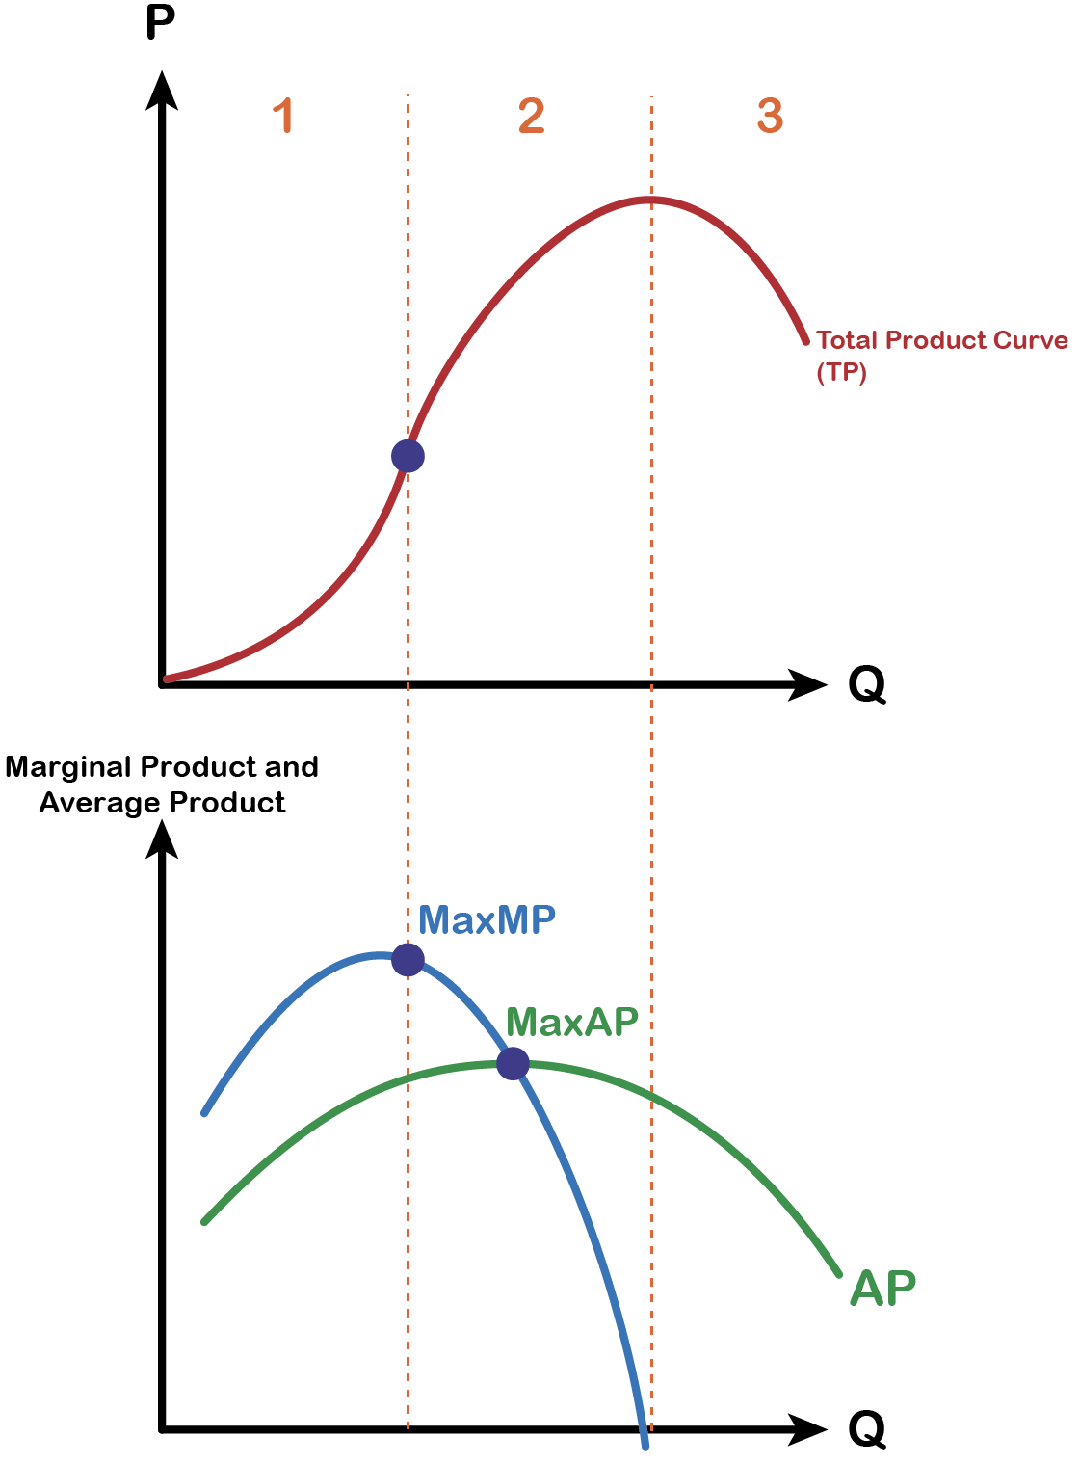
7.2 Total, Marginal and Average Product Curves

Slide 19
7.3 Costs of Production
Total Costs (TC) of production in the short run, a useful starting point is to divide total costs into two categories:
Fixed Cost of production is the cost that does not change as output changes.
Variable Cost is the cost that changes as output changes.

Slide 20
7.3 Total Fixed Costs Example
A salon manager’s total fixed costs are his expenditures that do not change regardless of the number of haircuts offered. Whether he gets a lot or a few customers, his fixed costs are the same.
When the manager signs the lease to rent the salon space, the rent costs him $60 a day, regardless of the number of haircuts given. This lease has now become a sunk cost since there is nothing the manager can do to get his money back.
Notes:
Fixed costs can take many other forms: for example, the cost of equipment such as scissors, hairdryers, mirrors, chairs, and clippers to offer haircuts, and even an expense like advertising to popularize a brand name.

Slide 21
7.3 Total Variable Costs Example
The salon manager’s total variable costs are incurred in the act of producing—the more he produces, the greater the variable cost.
After signing the lease for the salon and purchasing the required hair cutting equipment, the manager now has to find workers to offer haircuts. The more haircuts he wants to offer every hour, the more workers he needs to hire. For this reason, his variable costs are increasing as his production (or service) increases. Assuming the wage cost for each labour is $80/day.

Slide 22
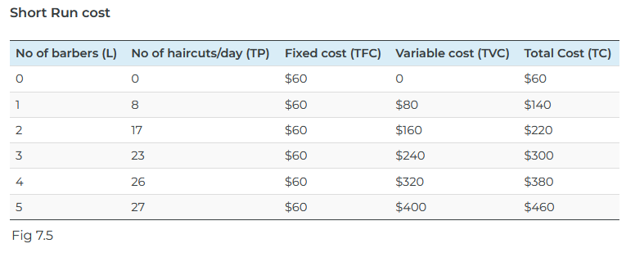
7.3 Example Continued ...
Notes:
The table above (Fig 7.4) shows us the fixed cost and the variable cost of production for haircuts, as the manager keeps hiring more barbers to offer more haircut services each day.
Note when the total output is zero the firm still incurs a fixed cost of $60 as rental cost per day.
The fifth column shows the total cost of production which is the sum of TFC and TVC.
TC = TFC + TVC

Slide 23
7.3 Fig 7.5 Explained
The table above (Fig 7.5) shows us the fixed cost and the variable cost of production for haircuts, as the manager keeps hiring more barbers to offer more haircut services each day.
Note when the total output is zero the firm still incurs a fixed cost of $60 as rental cost per day.
The fifth column shows the total cost of production which is the sum of TFC and TVC.
TC = TFC + TVC

Slide 24
7.3 Marginal Cost and Average Total Cost
Marginal Cost (MC): Is the change in total cost divided by the change in total output or TP.
MC =ΔTC÷ΔTP
Average Total Cost (ATC): Is the total cost divided by total output.
TC = TFC + TVC
TC÷TP = TFC÷TP + TVC÷TP (dividing all three expressions by TP)
ATC = AFC + AVC where, AFC = TFC÷TP and AVC = TVC÷TP

Slide 25
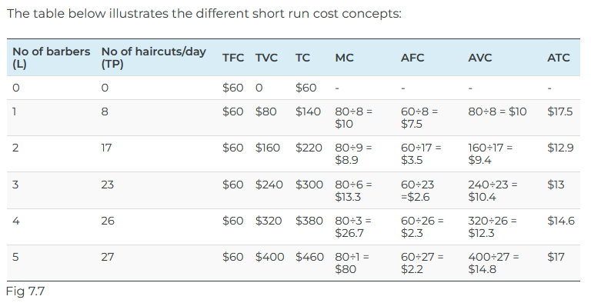
7.3 Different Short Run Cost Concepts:
Notes:
As seen from the numbers in the above table Fig 7.6, marginal cost initially falls and then starts rising. The average fixed cost keeps decreasing as the quantity of output (the number of haircuts) increases. Both average variable cost and average total cost initially decrease and then start increasing.

Slide 26
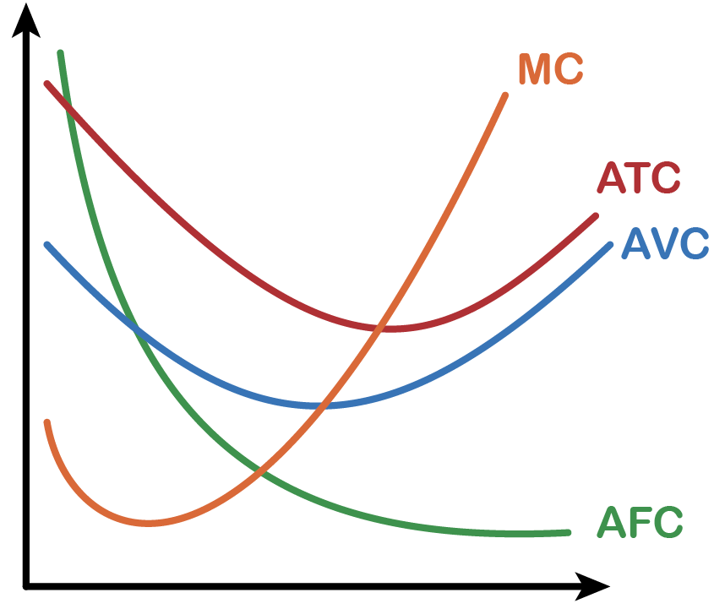
7.3 Marginal and Average Cost Curves
Fig 7.8
Notes:
The graph in Fig 7.7 Above shows the marginal and the average cost curves. The marginal cost and the average cost curves emphasize the division of labor, which we will discuss in the next section.
Notice from Fig 7.7 that the marginal cost curve intersects the average cost curve exactly at the bottom of the average cost curve. This is where the average cost reaches its minimum. The reason why the intersection occurs at this point is built into the economic meaning of marginal and average costs. If the marginal cost of production is below the average cost of producing previous units, as it is for the points to the left of where MC crosses AVC, then producing one additional unit will reduce average costs overall—and the AVC curve will be downward-sloping in this zone. Conversely, if the marginal cost of production for producing an additional unit is above the average cost of producing units, as it is for points to the right of where MC crosses AVC, then producing a marginal unit will increase average costs overall—and the AVC curve must be upward-sloping in this zone. The point of transition, between where MC is pulling AVC down and where it is pulling it up, must occur at the minimum point of the AVC curve. As long as marginal cost is below average cost, it causes AVC to decrease. When MC intercepts AVC and begins to rise, it causes AVC to increase. As we will see, AVCmin is very important in the short run.

Slide 27
7.3 Fig 7.8 Explained
The marginal cost curve intersects the average cost curve exactly at the bottom of the average cost curve.
This is where the average cost reaches its minimum. The reason why the intersection occurs at this point is built into the economic meaning of marginal and average costs.
If the marginal cost of production is below the average cost of producing previous units, as it is for the points to the left of where MC crosses AVC, then producing one additional unit will reduce average costs overall—and the AVC curve will be downward-sloping in this zone.
Notes:
Conversely, if the marginal cost of production for producing an additional unit is above the average cost of producing units, as it is for points to the right of where MC crosses AVC, then producing a marginal unit will increase average costs overall—and the AVC curve must be upward-sloping in this zone. The point of transition, between where MC is pulling AVC down and where it is pulling it up, must occur at the minimum point of the AVC curve. As long as marginal cost is below average cost, it causes AVC to decrease. When MC intercepts AVC and begins to rise, it causes AVC to increase. As we will see, AVCmin is very important in the short run.

Slide 28
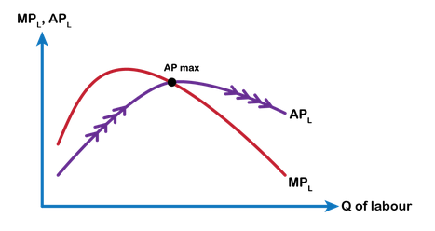
7.4 Relationship between Production and Costs Part 1
Panel A in Fig 7.9 shows the average and marginal product curves. Notice when marginal product lies above average product, average product rises and when marginal product lies below average product, the average product falls. The point where the two are equal is the point of maximum average productivity
Fig 7.9(A)
Notes:
Now notice the bottom Panel which shows the marginal and average cost curves. Looking at both panels, we find that when the average product (AP) increases, the average cost (ATC and AVC) decreases. AP increases when each additional labor adds significantly to the business, such as in our example, the number of haircuts offered by the second barber is greater than that of the first due to division of labor and specialization. The second barber’s greater productivity pulls up the salon’s total product (TP) faster than the total cost (TC). When TP rises faster as each worker is more productive, then a relatively less amount of such labor results in TC rising less faster (relatively less labor, so less wage cost) than TP. Therefore, the average cost falls (Recall, ATC = TC/TP; AP = TP/Labor) as long as the average product increases.

Slide 29
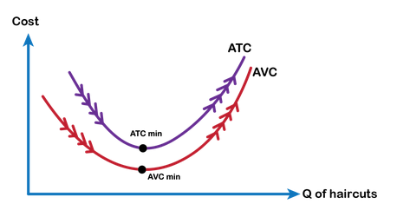
7.4 Relationship between Production and Costs Part 2
When AP starts falling, average costs start increasing. Due to the law of diminishing returns resulting from fixed capital in the short run, adding more labour lowers each worker’s marginal returns.
Fig 7.9(B)
Notes:
In our example, adding the third, fourth, or fifth barber lowers the marginal productivity of each worker due to the salon’s manager’s inability to offer his barbers more capital. Falling productivity lowers the rate of increase in TP and lowers the average productivity of the business. Therefore, TP rises less fast while relatively greater quantities of labor result in TC rising faster than TP. Therefore, the average cost starts increasing as the average product begins to decrease. When the average productivity of the firm reaches its maximum (AP-max), the average cost gets to a minimum (ATC-min or AVC-min).

Slide 30
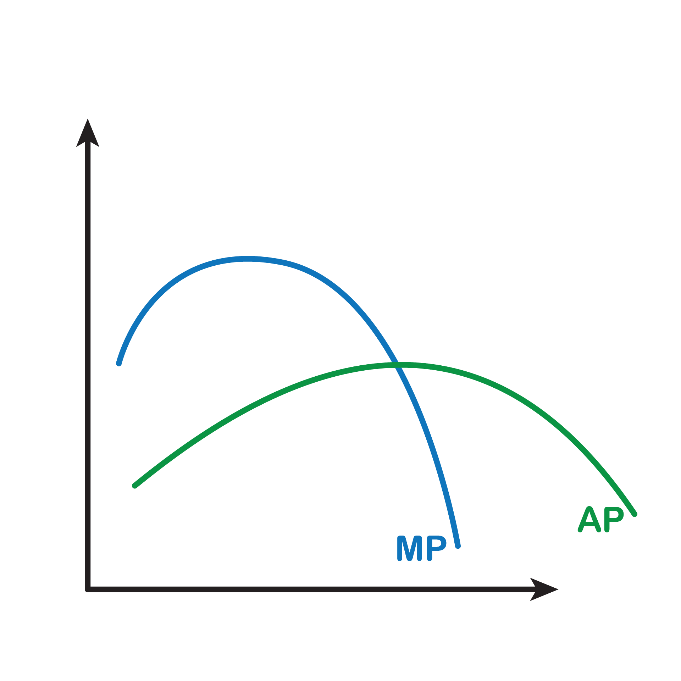
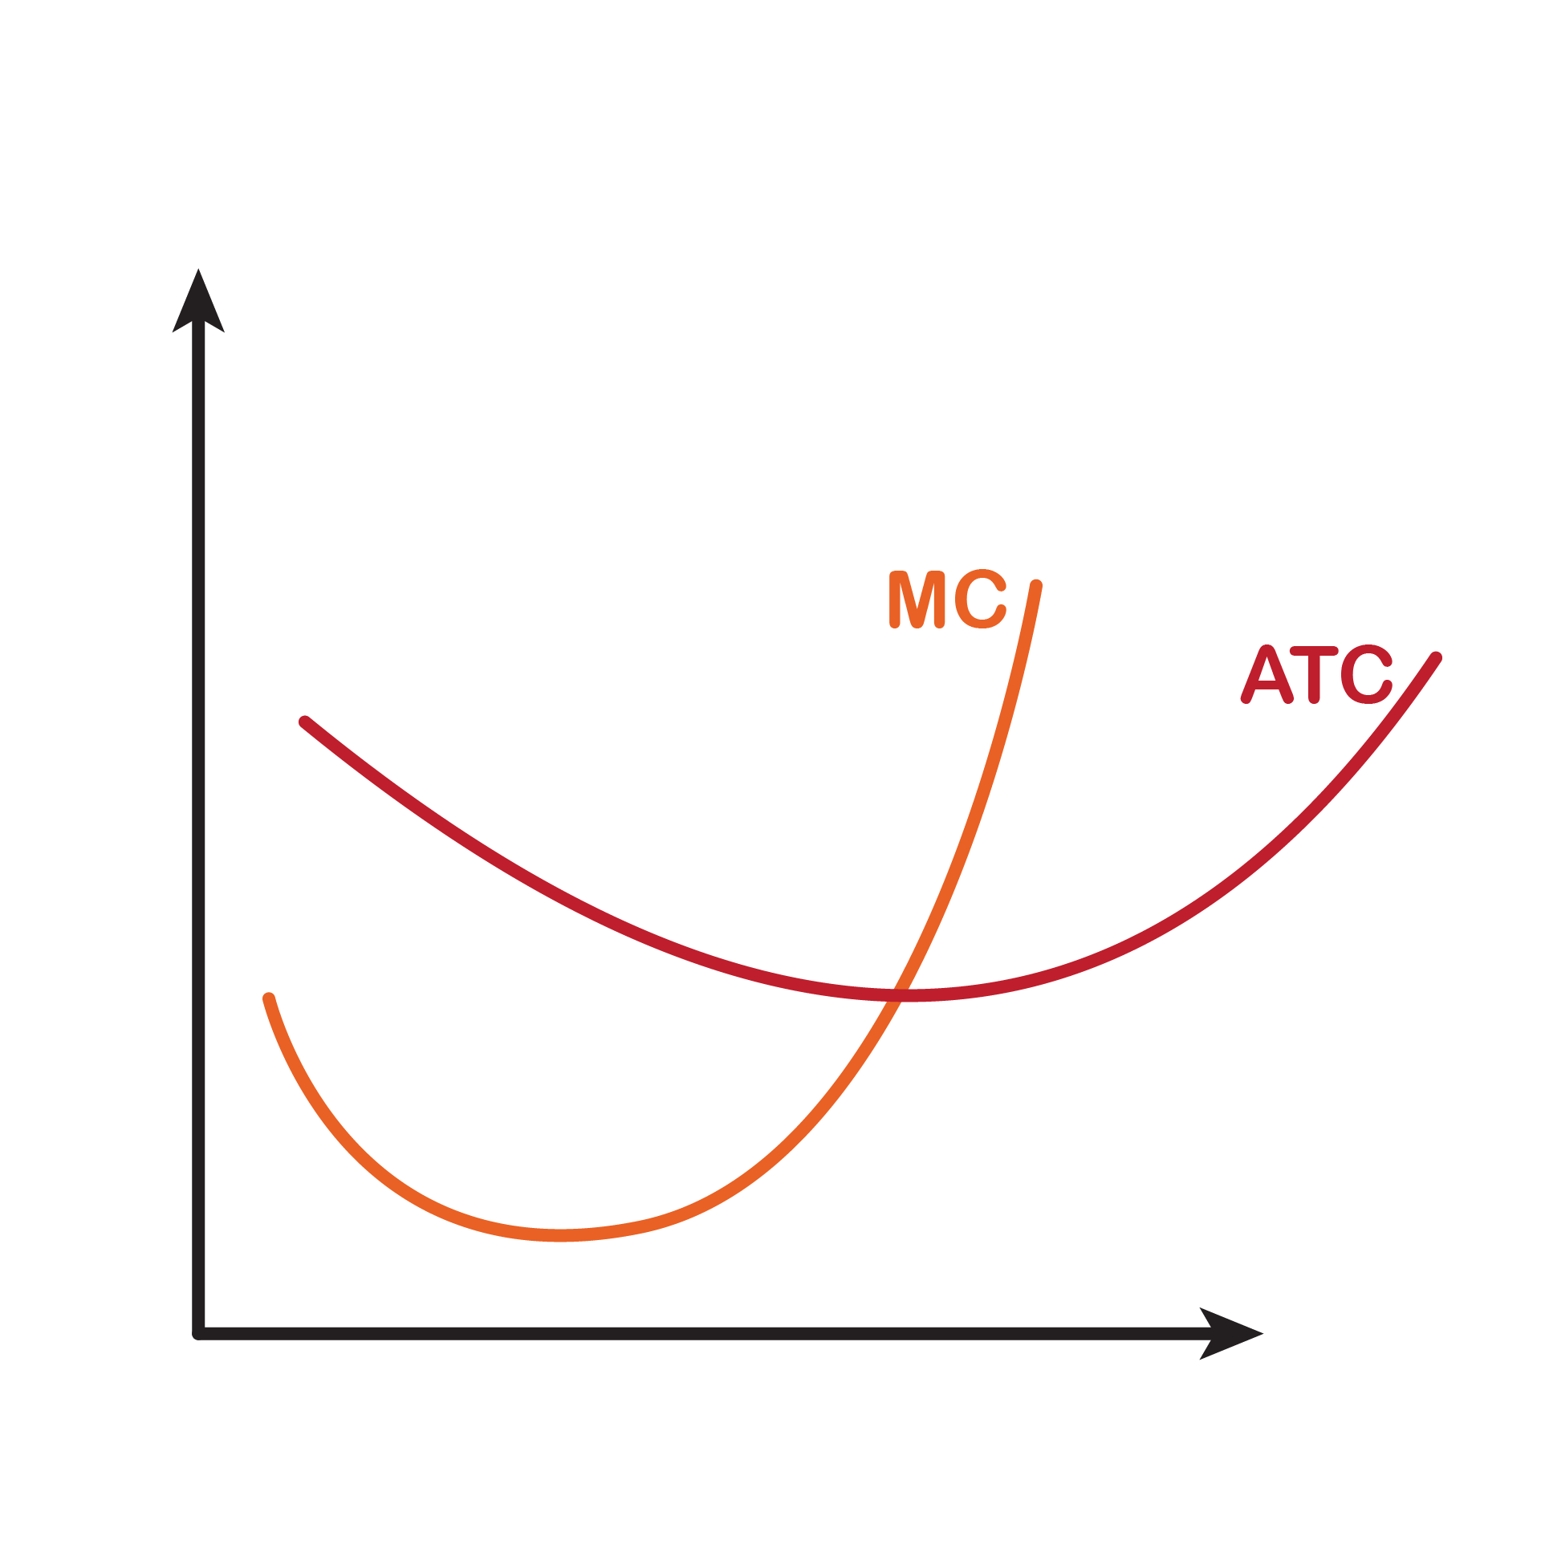
7.4 Relationship between Production and

Slide 31
7.5 Long Run Costs: The Advantage of Flexibility
Short-run average costs are constrained by the presence of a fixed input. So in the long run we can always do at least as well as, and often better than, in the short run with respect to cost. We can see this is true by comparing the long-run and short-run average cost curves.
“Flexibility” by Geralt, licensed by Pixabay

Slide 32
7.5 Shapes of Long-Run Average Cost Curves
The long-Run Average Cost (LRAC) Curve: Is based on a group of short-run average cost (SRAC) curves, each of which represents one specific level of fixed costs.
More precisely, the long-run average cost curve will be the least expensive average cost curve for any level of output.
While in the short run firms are limited to operating on a single average cost curve (corresponding to the level of fixed costs they have chosen), in the long run when all costs are variable, they can choose to operate on any average cost curve.

Slide 33
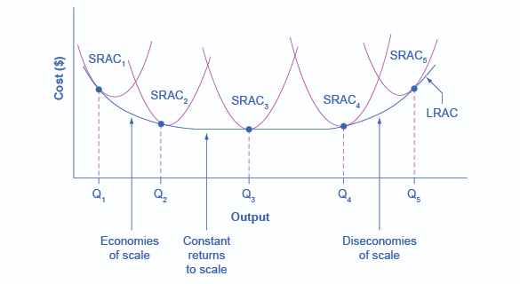
7.5 Long-Run Average Cost Example
Fig 7.10

Slide 34
7.5 Fig 7.10 Explained
Shows how we build the long-run average cost curve from a group of short-run average cost curves.
Five short-run-average cost curves appear on the diagram.
Each SRAC curve represents a different level of fixed costs.
Imagine SRAC1 as a small factory, SRAC2 as a medium factory, SRAC3 as a large factory, and SRAC4 and SRAC5 as very large and ultra-large.
Although this diagram shows only five SRAC curves, presumably there are an infinite number of other SRAC curves between the ones that we show.
Notes:
Think of this family of short-run average cost curves as representing different choices for a firm that is planning its level of investment in fixed cost physical capital—knowing that different choices about capital investment in the present will cause it to end up with different short-run average cost curves in the future.

Slide 35
7.5 Economies of Scale
Economies of Scale occur when the average cost of production falls as output increases.
Economies of Scale refer to the situation where, as the quantity of output goes up, the cost per unit goes down. This is the idea behind “warehouse stores” like Costco or Walmart. In everyday language: a larger factory can produce at a lower average cost than a smaller factory.

Slide 36
7.5 Diseconomies of scale
Diseconomies of scale occur when the average cost of production rises as output increases.
Constant returns to scale occur when the average cost of production does not change as output rises.
In a typical long-run average cost curve, there are sections of both economies of scale and diseconomies of scale.
Minimum efficient scale where the average cost is at its minimum. This is the point where economies of scale are used up and no longer benefit the firm.

Slide 37
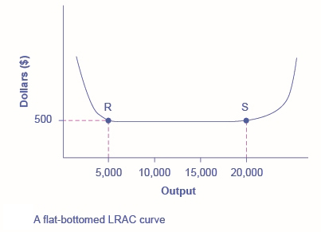
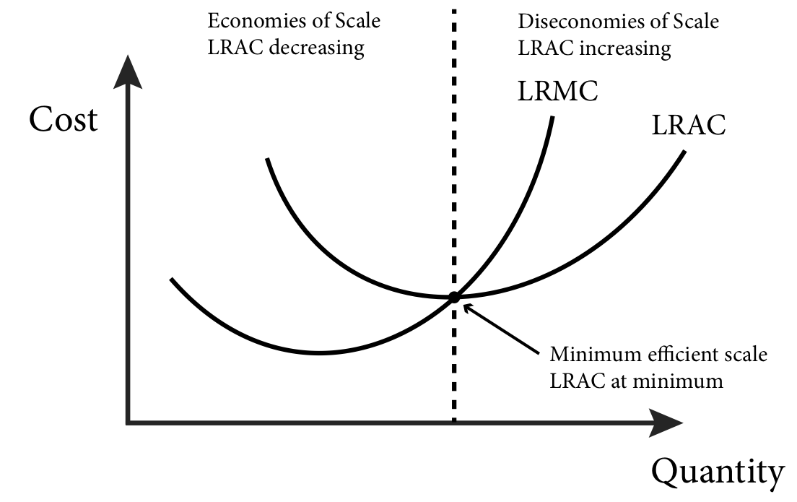
7.5 Constant Returns to Scale
Fig 7.11
Fig 7.12
Notes:
Constant returns to scale (Fig 7.10)
Figure 7.11 illustrates these points.

Slide 38
Key Terms
Accounting Profit
Average Product
Constant Returns to Scale
Diseconomies of Scale
Economic Profit
Economies of Scale
Explicit Costs
Fixed Inputs
Implicit Costs
Short Run
Long Run
Long-Run Average Cost (LRAC)
Marginal Product
Minimum Efficient Scale
Production
Production Function
Short-Run
Total Costs (TC)
Total Fixed Costs
Total Product (TP)
Total Revenue
Total Variable Costs
Variable Inputs

