Slide 1
Principles of Microeconomics
CHAPTER 4: COMPETITIVE EFFICENCY
Unless otherwise noted, this work is licensed under a Creative Commons Attribution-NonCommercial-ShareAlike 4.0 International (CC BY-NC-SA 4.0) license. Feel free to use, modify, reuse or redistribute any portion of this presentation.

Slide 2
Learning Outcomes
At the end of this chapter, you will be able to:
Describe consumer surplus and producer surplus
Explain the economic efficiency
Discuss the economic impact of government-imposed price floors and price ceilings
Demonstrate the economic impact of taxes

Slide 3
4.1 Demand and Consumer Surplus
Demand refers to the amount (price) consumers are willing and able to purchase goods or services at.
Maximum willingness to pay (WTP) serves as a starting point for the demand curve.
A consumer’s maximum Willingness to Pay is equal to that consumer’s Marginal Benefit (MB). This is useful information if we want to use Marginal Analysis.
Notes:
Demand is based on needs and wants, and while consumers can differentiate between a need and a want, from an economist’s perspective, they are the same thing. Demand is also based on the ability to pay. If you cannot pay for it, you have no effective demand. This concept of a consumer’s maximum willingness to pay (WTP) serves as a starting point for the demand curve.

Slide 4
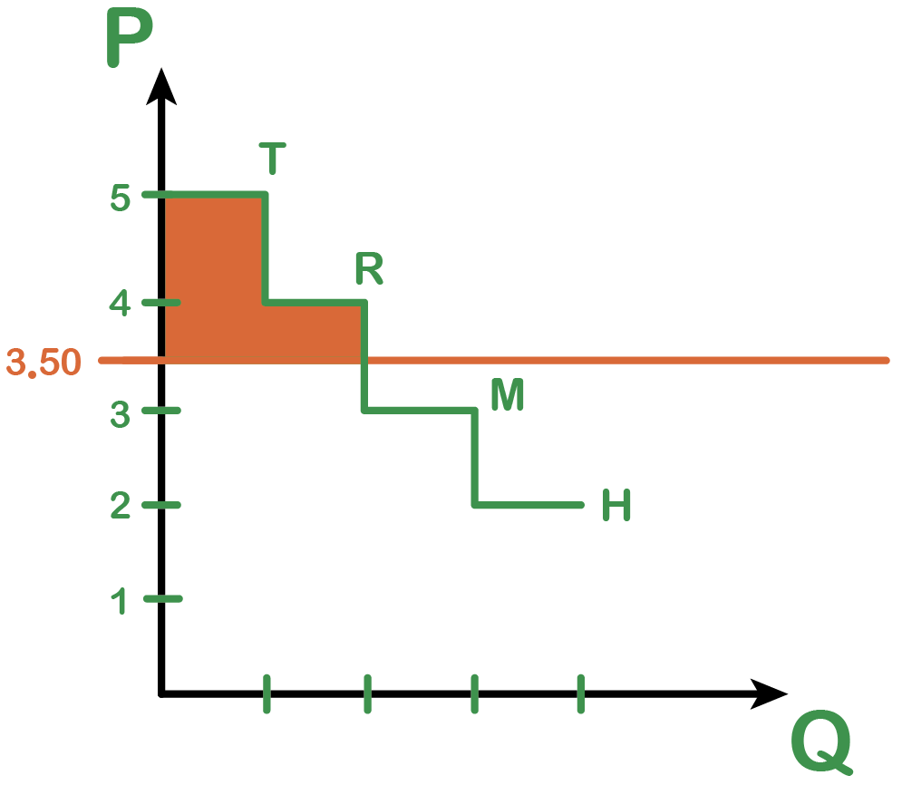
4.1 Willingness To Pay Example
Consumer Surplus: The difference between the highest we are willing to pay for something vs. the amount we pay.
Lowering the price, Consumer Surplus gets bigger.
Raising the price, Consumer Surplus gets smaller.
The Demand Curve reflects consumers maximum willingness to pay.
At $3.50, there will be 2 consumers (Trevor and Ryan.) Their maximum willingness to pay is higher than the market price.
 | Maximum Willingness to Pay
Trevor | $5
Ryan | $4
Meagan | $3
Holly | $2
Trevor’s Surplus Willing to pay $5 − Paid $3.50 = $1.50
Ryan’s Surplus Willing to pay $4 − Paid $3.50 = $0.50
Notes:
By examining the WTP at each level of consumption, we can measure a consumer’s total net benefit from their purchase, or their consumer surplus. Total net benefit or Consumer surplus is the difference between the consumer’s willingness to pay and the amount (price) they actually pay for a given quantity.

Slide 5
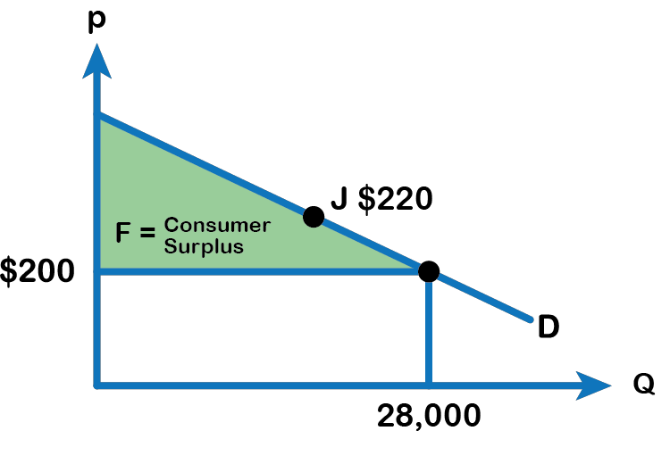
4.1 Demand Curve
Notes:
As noted from fig 4.2, the market price for a tablet computer is $200, therefore Tim’s consumer surplus is $80 ($280 minus $200), Josh’s consumer surplus is $60 ($260 – $200), and so on. Referring to the fig, we also find that Sam’s maximum willingness to pay is the same as the price, so Sam’s consumer surplus is zero. However, as long as the price coincides with his willingness to pay, the consumer can still purchase the good. Rita’s maximum willingness to pay is $190, which is below the price of the tablet, and therefore she does not obtain the good.
Consider the demand curve for tablet computers, as Figure 4.3 shows. The price of a tablet computer is $200 and the quantity demanded at that price is 28 million. To see the benefits to consumers, look at the segment of the demand curve above the price line and to the left. This portion of the demand curve shows that at least some consumers would have been willing to pay more than $200 for a tablet, as shown in the table in fig 4.1. Each point on the demand curve shows the consumers’ maximum willingness to pay for that quantity.
For example, point (J) shows that those consumers who would be willing to pay $220, for a tablet (based on the benefit they expect to receive from it) were able to pay the price of $200, clearly received a benefit beyond what they had to pay. Remember, the demand curve traces consumers’ willingness to pay for different quantities.

Slide 6
4.1 Consumer Surplus
The amount that individuals would have been willing to pay, minus the amount that they actually paid, is called Consumer Surplus. Consumer surplus is the area labeled F—that is, the area above the price and below the demand curve. The value of Consumer surplus is calculated as the Area of the triangle represented by F.
Consumer Surplus = (base * height)/2

Slide 7
4.2 Supply and Producer Surplus
When economists talk about supply, they mean the amount of some good or service a producer is willing to supply at each price.
The supply curve shows the quantity that firms are willing to supply at each price.
Price is what the producer receives for selling one unit of a good or service and willingness to supply depends on the marginal cost of producing each unit.
A producer will be willing to supply a quantity if the price is at least equal to the marginal cost of production.

Slide 8
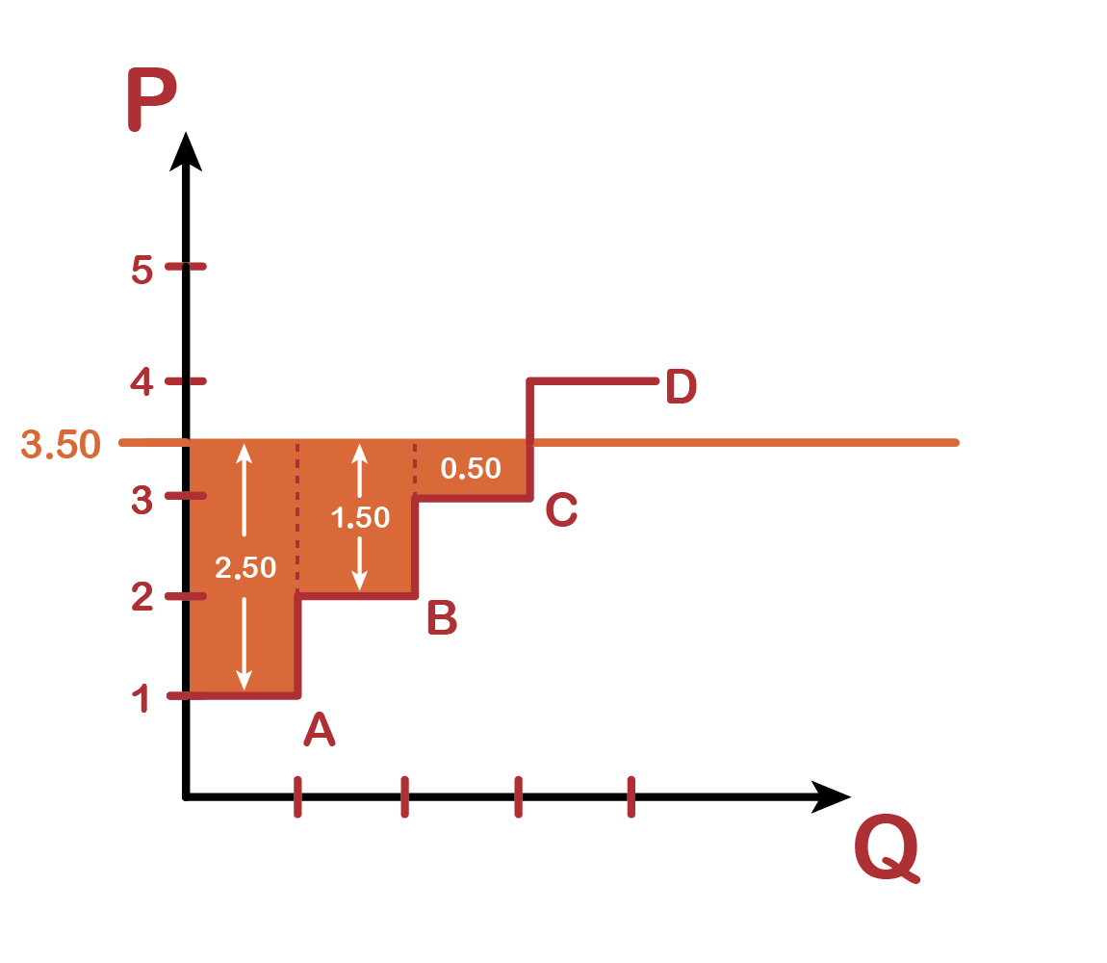
4.2 Supply and Producer Surplus Example
Supply Curve maps out producers' lowest price they will sell at.
At $3.50, there will be 3 producers (A, B, C) because the market price is above their lowest selling price.
Producer Surplus: The difference between the market price and the lowest price a producer is willing to sell at. (The least the seller is willing to receive.)
 | Lowest Willingness to Receive
A | $1
B | $2
C | $3
D | $4
Notes:
Consider a firm that produces tablet computers. Suppose the price received from selling a computer is $200. Refer to Fig 4.4, the marginal cost of producing the first tablet is $170, the same for the second and third tablets are $180 and $190 respectively. The marginal cost of producing the fourth tablet is $200 and for the fifth tablet is $210. Producer surplus is the difference between the price received from the sale of a good minus the cost of producing that unit. Therefore, the producer surplus from the first, second and third tablets are respectively, $30, $20 and $10. The producer can still manage to produce the fourth tablet, even though the surplus gets to zero because the price is still able to cover the marginal cost of production. However, the producer is unwilling to supply the fifth tablet, as the marginal cost ($210) exceeds the price ($200).

Slide 9
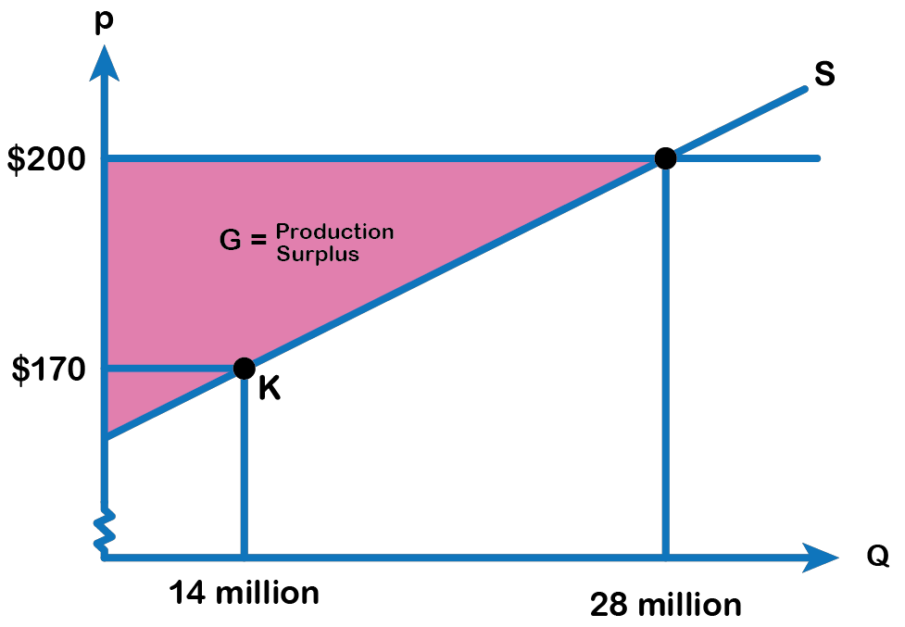
4.2 Supply Curve for Tablet Computers
Fig 4.5
Notes:
Consider the supply curve for tablet computers in Fig 4.5 below. The price received from the sale of a computer is $200 and the quantity supplied is 28 million. Each point on the supply curve shows the quantity the firm is willing to supply, and the willingness depends on the marginal cost of production. The firm would be willing to supply a quantity as long as the price is just enough to cover or exceed the marginal cost of production.
For example, point (K) in Fig 4.5 illustrates that, at $170, firms would still have been willing to supply a quantity of 14 million. Those producers who would have been willing to supply the tablets at $170, but who were instead able to charge a price of $200, clearly received an extra benefit beyond what they required in order to supply the product.

Slide 10
4.2 Producer Surplus
The amount that a seller is paid for a good minus the seller’s actual cost is called producer surplus. In Figure 4.5, producer surplus is the area labeled G—that is, the area between the market price and the segment of the supply curve below the price.
The value of Producer surplus is calculated as the Area of the triangle represented by G.
Producer Surplus = (base * height)/2

Slide 11
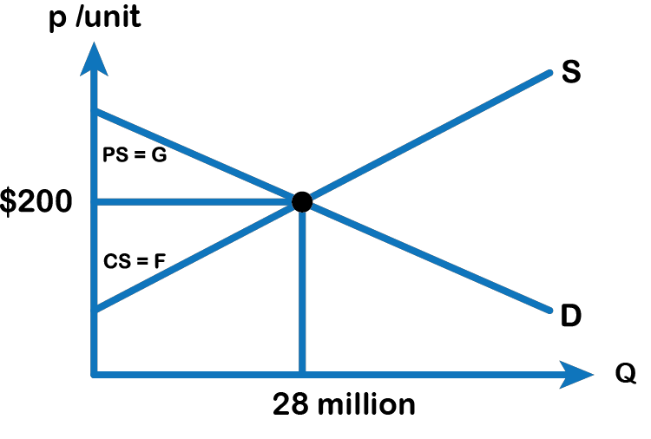
4.2 Total Surplus
Note: G is consumer surplus and F is producer surplus
This is CS
This is PS
Notes:
The sum of consumer surplus and producer surplus is social surplus, also referred to as economic surplus or total surplus. In Fig 4.6, we show social surplus as the area F + G. Social surplus is larger at equilibrium quantity and price than it would be at any other quantity. This demonstrates the economic efficiency of the market equilibrium where the marginal benefit from a good just equals the marginal cost of producing it. At the efficient level of output which is also called the competitive equilibrium, it is impossible to produce greater consumer surplus without reducing producer surplus, and it is impossible to produce greater producer surplus without reducing consumer surplus.

Slide 12
4.3 Inefficiency of Price Floor and Price Ceiling
The imposition of or a price ceiling a price floor will prevent a market from adjusting to its equilibrium price and quantity, and thus will create an inefficient outcome. However, there is an additional twist here. Along with creating inefficiency, price floors and ceilings will also transfer some consumer surplus to producers, or some producer surplus to consumers.
Notes:
Economists believe there are a small number of fundamental principles that explain how economic agents respond in different situations. Two of these principles, which we have already introduced, are the laws of demand and supply. Governments can pass laws affecting market outcomes, but no law can negate these economic principles. Rather, the principles will become apparent in sometimes unexpected ways, which may undermine the intent of the government policy. This is one of the major conclusions of this section.

Slide 13
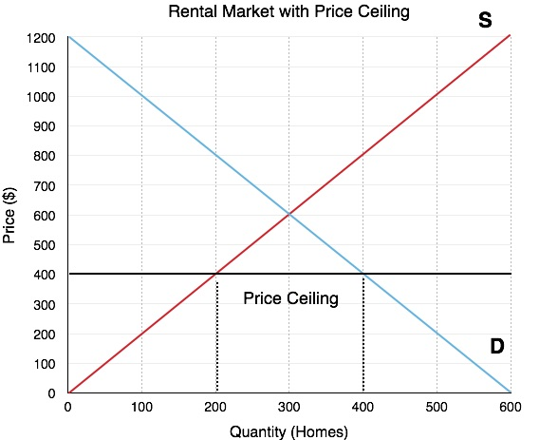
3.2 Price Ceiling
Notes:
A common example of a price ceiling is the rental market. Consider a rental market with an equilibrium of $600/month. If the government wishes to decrease this price to make it more affordable for renters, it may place a binding price ceiling of $400/month. This policy means the landlords cannot charge more than $400 per month. What will this do to our equilibrium? Refer to Fig 4.7. Whereas before 300 homes were rented, there is now a housing shortage. At the lower price of $400/month, the quantity supplied is only 200 housing units and the quantity demanded is 400 housing units. This means that 200 renters who want to rent can no longer find homes! This is important because when quantity demanded and quantity supplied are unequal, the market is restrained by the lower value.

Slide 14
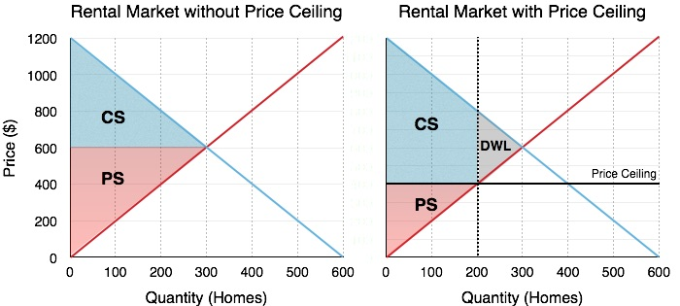
4.3 Calculating Market Surplus
Notes:
To find out the impact of the government’s price ceiling, we must calculate market surplus before, and after a policy. This method will be an important gauge for all our policy analysis on this topic. Consider Fig 4.8 (A & B), where the effects of the Price Ceiling are shown.

Slide 15
4.3 Before the Ceiling
The calculation of market surplus before policy intervention should be straightforward by now. Market surplus is equal to the sum of consumer surplus and producer surplus:
Consumer Surplus (Blue Area): [(1200-600) x 300]/2 = $90,000
Producer Surplus (Red Area): [(600) x 300]/2 = $90,000
Total Surplus: $180,000

Slide 16
4.3 After the ceiling
The calculation of market surplus after the intervention is less obvious. Consumers have lost surplus in some areas, but gained surplus in others (we will look at this closely in the next Fig 4.9). Producers have lost surplus. From Fig 4.8 (B),
Consumer Surplus (Blue Area): [(1200-800) x 200]/2] + (400×200) = $120,000
Producer Surplus (Red Area): [(600) x 300]/2 = $40,000
Total Surplus: $160,000
The rent ceiling results in a loss in the total surplus to the society.

Slide 17
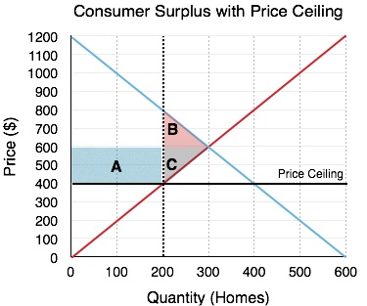
4.3 Redistribution
It’s easy to look at the total numbers and show that market (total) surplus has decreased, but how does this change affect individual consumers and firms?
In Fig 4.9, the areas which change as a result of the policy, are shown.
Fig 4.9

Slide 18
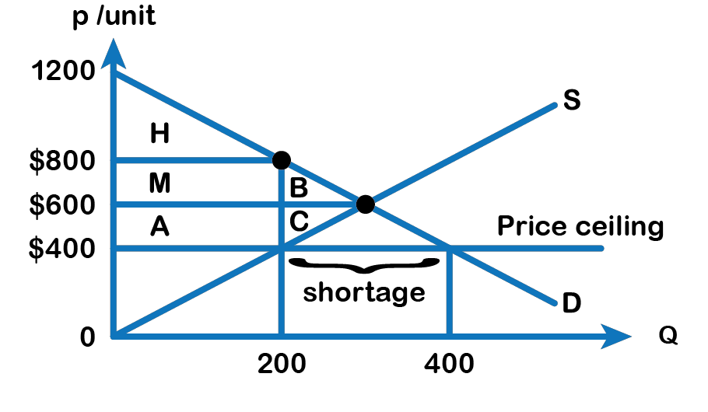
4.3 Example of Redistribution

Slide 19
4.3 Consumers
Consumers gain an area of A and lose an area of B.
The quantity supplied in the market decreases from 300 rental units to 200 under the price ceiling, and there is a shortage of 200 homes due to this policy.
We can assume that some consumers get the advantage of the price ceiling are benefitted. They are now paying $400 a month instead of the earlier rent of $600 a month for a rental home.
This is shown in Fig 4.8 as area A. A price ceiling, as observed from Fig 4.8 above, shows a loss in consumer surplus, identified as area B, and a gain in consumer surplus shown as area A.

Slide 20
4.3 Producers
Producers lose areas C and A.
The price ceiling causes the landlords to reconsider staying in the rental market, as fewer landlords can make a profit with the lower price.
Due to the ceiling, 100 landlords leave the market, thus reducing their producer surplus identified as area B in Fig 4.9.
Like consumers, some producers will remain in the market, but these producers now must face the reality of lower rent revenue and therefore they lose area A.
This area which used to be a part of producer surplus, prior to the rent ceiling, is now transferred to the consumers or renters.

Slide 21
4.3 Black Market due to Rent Ceiling
The shortage increases the difficulty of finding a rental unit.
This could result in some consumers willing to pay most for the homes, a rent as high as $800, to ensure the availability of a rental unit, therefore violating government’s price ceiling. This is a black-market transaction.
If the tenants engage in black market activity by paying a rent of $800, then consumer surplus shrinks to area H. The areas M + A get transferred from renters (consumers) to producers (landlords), as shown in Fig 5.0.

Slide 22
4.3 Deadweight Loss
The deadweight loss or a loss in total surplus to the society due to a price ceiling arises because there are players who are no longer able to be a part of the market.
100 renters and 100 landlords all lose a varied amount based on their willingness to pay and marginal cost.
Notes:
This was a fairly lengthy explanation of price ceilings, but it is one that will lead to the discussion of all policies. Every policy we will look at in microeconomics has both a quantity effect and a price effect, and it is important to understand how the policy impacts individual market players. Some people gain while some people lose as a result of this government policy. Therefore, we can infer price ceiling has a mixed effect and there is a loss of economic efficiency which is represented by areas B + C.

Slide 23
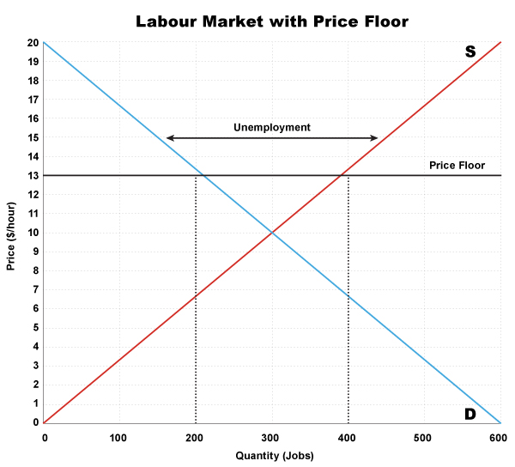
4.3 Price Floor in the Labour Market (Minimum Wage Law)
Notes:
While the price floor has a very similar analysis to the price ceiling, it is important to look at it separately. A common example of a price floor is a minimum wage policy. The labor market is unique in that the workers are the producers of labor and the firms are consumers of labor. Price can be denominated in hourly wage, with the quantity of workers on the x-axis. If the government sets a binding minimum wage (price floor), it must be set above the equilibrium price.
In Fig 411, the equilibrium wage is shown as $10/hour. This is where the demand for labor is equal to the number of workers who want to find jobs. At this level there is no unemployment. However, if the government sets a minimum wage of $13/hour, this will change. The Quantity of Labor Supplied (workers looking for jobs) will be 400, but the quantity demanded will be 200. This means that 200 workers will be unemployed! Again, this is not enough information to determine whether the market is inefficient – we have to calculate the change in total surplus!

Slide 24
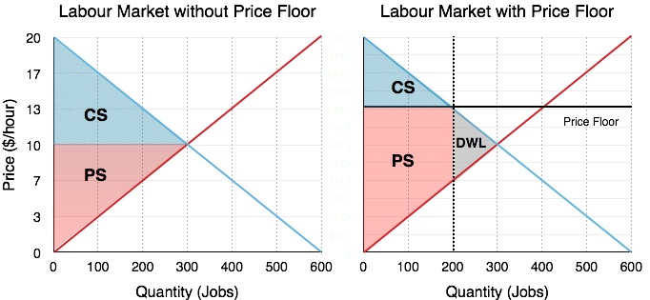
4.3 Labour Market Price Floor Example
Fig 4.11 (A)
Fig 4.11(B)
Notes:
Before (from Fig 4.11 A)
Consumer Surplus (Blue Area): [(20-10) x 300]/2 = $1500
Producer Surplus (Red Area): [(10) x 300]/2 = $1500
Total (Market) Surplus: $3000
After (from Fig 4.11 B)
Consumer Surplus (Blue Area): [(20-13) x 200]/2= $700
Producer Surplus (Red Area): [(13-7) x 200] + (7 x 200)/2 = $1900
Total Surplus: $2600

Slide 25
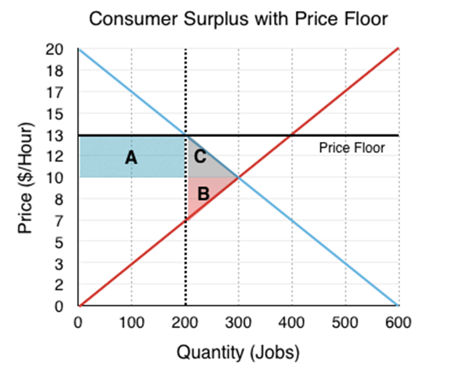
4.3 Consumer Surplus Price Floor Example
Fig 4.12
Notes:
Again, the changes in the market can be categorized as a transfer and a deadweight loss. This time, the transfer is from consumers (firms) to producers (workers), since the workers who are able to find work are better off. This causes no change to market surplus in isolation but is coupled with the deadweight loss caused by workers who are no longer able to find jobs as firms leave the market. The deadweight loss is represented by areas B + C.

Slide 26
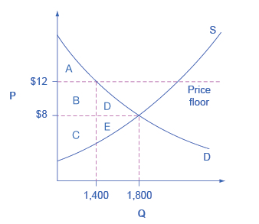
4.3 Price Floor in the market for movie theaters
Fig 4.13
Notes:
Fig 4.13 shows a price floor example using a string of struggling movie theaters, all in the same city. The current equilibrium is $8 per movie ticket, with 1,800 people attending movies. The original consumer surplus is A + B + C, and the producer surplus is D + E. The city government is worried that movie theaters will go out of business, reducing the entertainment options available to citizens, so it decides to impose a price floor of $12 per ticket. As a result, the quantity demanded of movie tickets falls to 1,400. The new consumer surplus is A, and the new producer surplus is D + B. In effect, the price floor causes area B to be transferred from consumer to producer surplus but also causes a deadweight loss of C + E.
The above analysis shows that a price ceiling (including rent controls) and price floor, will transfer some producer surplus to consumers—which helps to explain why consumers often favor them. Conversely, a price floor, like a guarantee that workers and theatre owners will receive a certain price for their good or service, will transfer some consumer surplus to producers, which explains why producers often favor them. However, both price floors and price ceilings block some transactions that buyers and sellers would have been willing to make and create deadweight loss. Removing such barriers, so that prices and quantities can adjust to their equilibrium level, will increase the economy’s social surplus.

Slide 27
4.4 Taxes and Deadweight Loss
Taxes are not the most popular policy, but they are often necessary. We will look at two methods to understand how taxes affect the market: by shifting the curve and using the wedge method.
Photo by GotCredit, Flickr CC-BY 2.0
Notes:
When the government sets a tax, it must decide whether to levy the tax on the producers or the consumers. This is called legal tax incidence. The most well-known taxes are ones levied on the consumer, such as Government Sales Tax (GST) and Provincial Sales Tax (PST). The government also sets taxes on producers, such as the gas tax, which cuts into their profits. The legal incidence of the tax is actually irrelevant when determining who is impacted by the tax. When the government levies a gas tax, the producers will pass some of these costs on as an increased price. Likewise, a tax on consumers will ultimately decrease quantity demanded and reduce producer surplus.
When the government imposed a gas tax for example, from the producer’s perspective, any tax levied on them is just an increase in the marginal costs per unit. To illustrate the effect of a tax, let’s look at the oil market again.

Slide 28
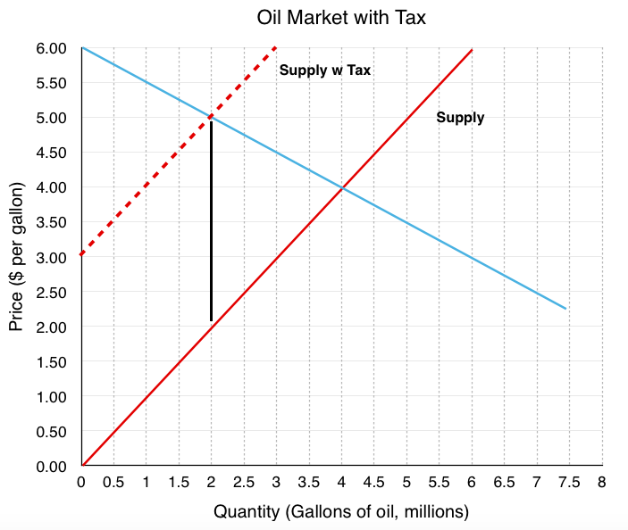
4.4 Oil Market With Tax Example
Fig 4.14
Notes:
If the government levies a $3 gas tax on producers, the supply curve will shift up by $3. As shown in Fig 4.14 above , a new equilibrium is created at P=$5 and Q=2 million barrels. Note that producers do not receive $5, they now only receive $2, as $3 has to be sent to the government. From the consumer’s perspective, this $1 increase in price is no different than a price increase for any other reason and responds by decreasing the quantity demanded the higher priced good.

Slide 29
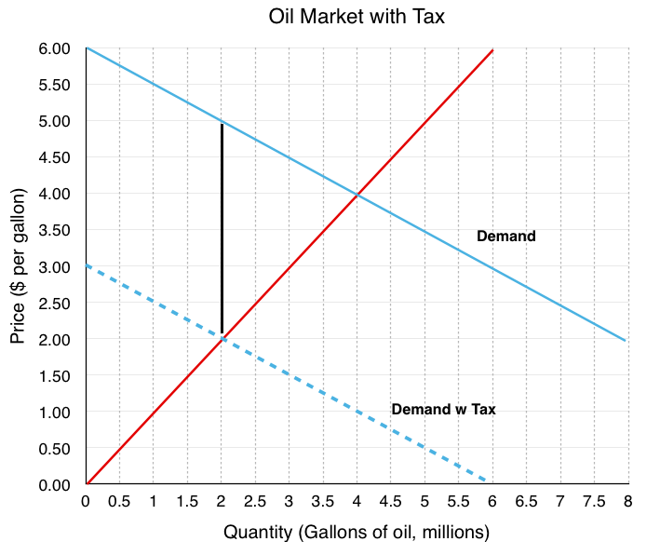
4.4 What if the legal incidence of the tax is levied on the consumers
Fig 4.15
Notes:
Since the demand curve represents the consumers’ willingness to pay, the demand curve will shift down as a result of the tax, as shown in Fig 4.15 adove. If consumers are only willing to pay $4/gallon for 4 million gallons of oil but know they will face a $3/gallon tax, they will only purchase 4 million gallons if gas price is $1. This creates a new equilibrium where consumers pay a $2 per gallon gas price, knowing they will have to pay a $3 tax for a total of $5. The producers will receive the $2 paid before taxes.

Slide 30
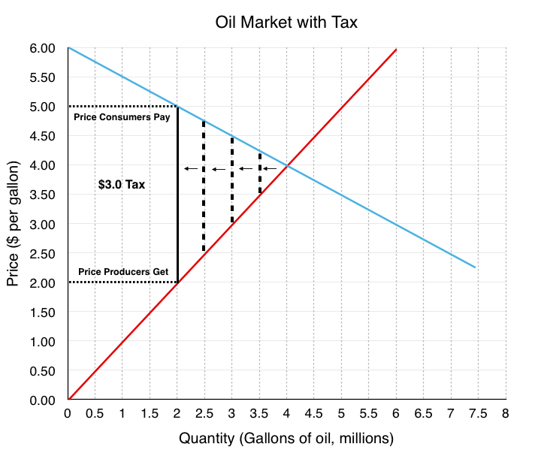
4.4 Tax Wedge
Fig 4.16
Notes:
Another method to view taxes is through the wedge method. This method recognizes that who pays the tax is ultimately irrelevant. Instead, the wedge method illustrates that a tax drives a wedge between the price consumers pay and the revenue producers receive, equal to the size of the tax levied.
As illustrated above in Fig 4.16, to find the new equilibrium, one simply needs to find a $3 wedge between the curves. The first wedge tested is only $0.7, followed by $1.5, until the $3.0 tax is found.

Slide 31
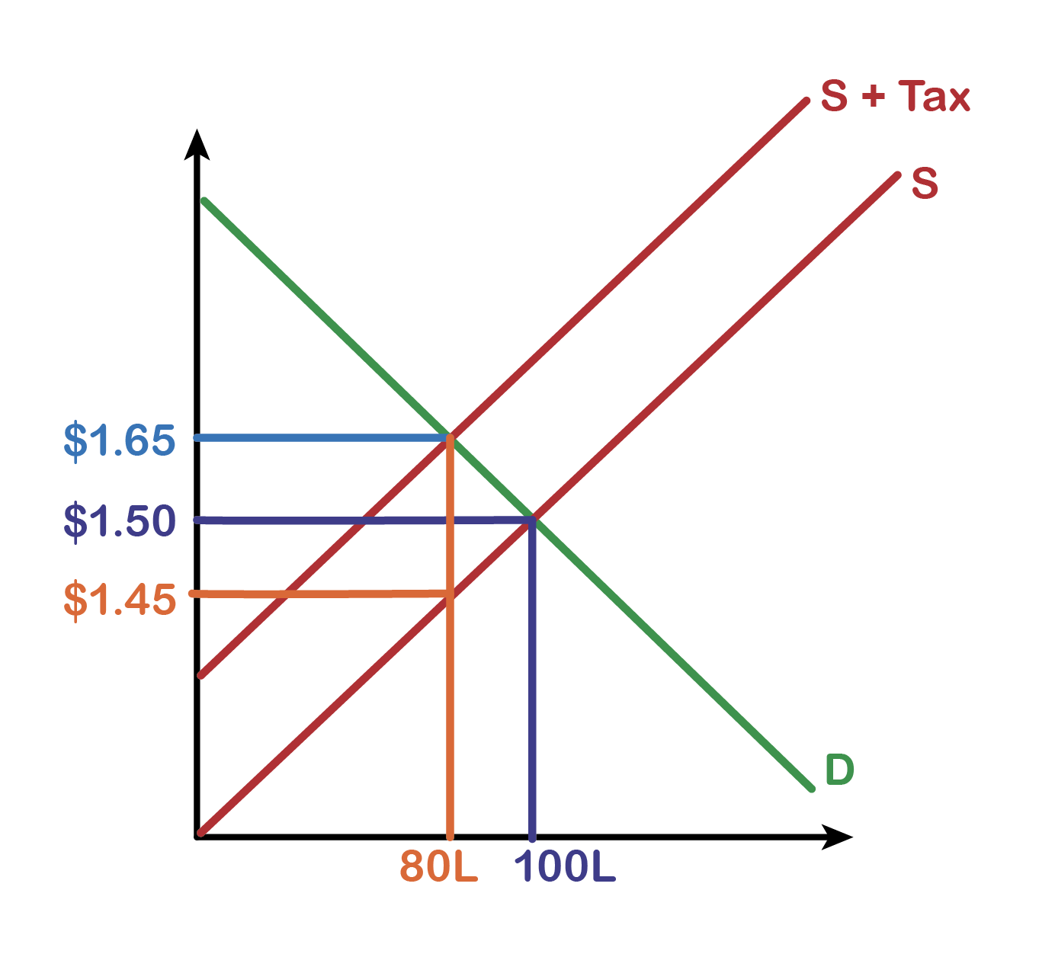
4.4 Solving a Tax Question
Government introduces a $0.20 per Litre gasoline tax on the buyer.
Before the Tax:
Buyers paid $1.50 per Litre
Sellers Received $1.50 per Litre
After the Tax:
Buyers paid $1.65 per Litre
Sellers Received $1.45 per Litre
Government collected $0.20 per Litre in taxes.
Buyer paid $0.15 of the tax.
Seller paid $0.05 of the tax.
Tax Revenue: Tax Amount × Amount Sold
$0.20 × 80
$16 in tax revenue from the new tax
Notes:
Another method to view taxes is through the wedge method. This method recognizes that who pays the tax is ultimately irrelevant. Instead, the wedge method illustrates that a tax drives a wedge between the price consumers pay and the revenue producers receive, equal to the size of the tax levied.
As illustrated above in Fig 4.16, to find the new equilibrium, one simply needs to find a $3 wedge between the curves. The first wedge tested is only $0.7, followed by $1.5, until the $3.0 tax is found.

Slide 32
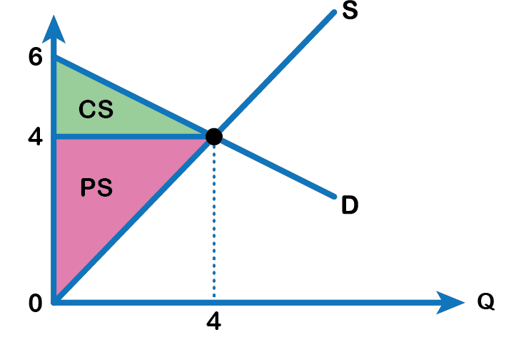
4.4 Economic Impact of Tax Before
Before
The market surplus before the tax can be calculated from Fig 4.17 A. Ensure you understand how to get the following values:
Consumer Surplus = $4 million
Producer Surplus = $8 million
Market Surplus = $12 million
Fig 4.17
Notes:
Like with price and quantity controls, one must compare the market surplus before and after a price change to fully understand the effects of a tax policy on surplus. Before the tax is imposed, economic surplus or market surplus is maximized as shown in Fig 4.17

Slide 33
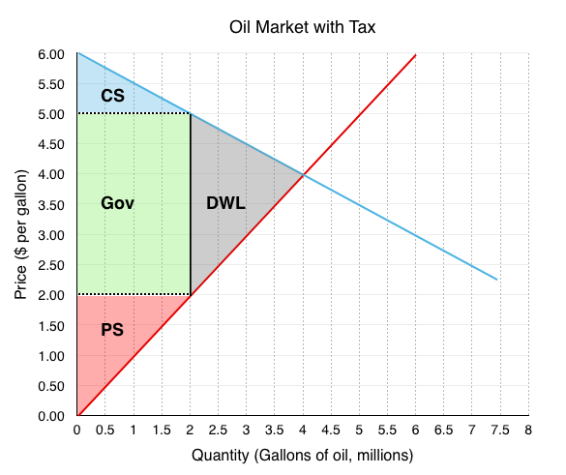
4.4 Economic Impact of tax After
After
The market surplus after the policy can be calculated in reference to Fig 4.17 B.
Consumer Surplus (Blue Area) = $1 million
Producer Surplus (Red Area) = $2 million
Government Revenue (Green Area) = $6 million
Market Surplus = $9 million
Fig 4.17 B

Slide 34
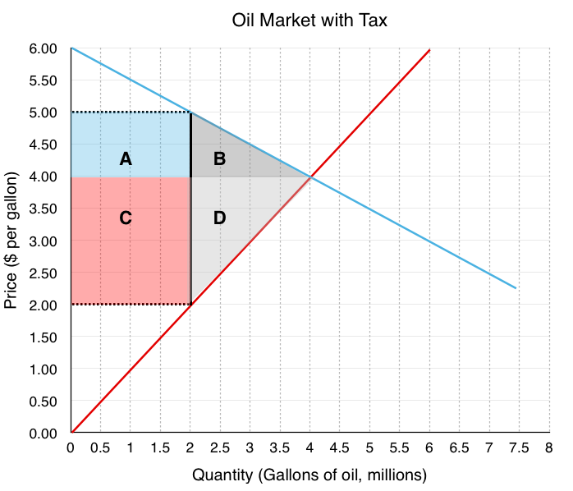
4.4 Transfer and Deadweight Loss
Due to the tax’s effect on the price, areas A and C are transferred from consumer and producer surplus to government revenue.
Fig 4.18
Notes:
Consumers to Government – Area A
Consumers originally paid $4/gallon for gas. Now, they are paying $5/gallon. The $1 increase in price is the portion of the tax that consumers have to bear. This price change means the government collects $1 x 2 million gallons or $2 million in tax revenue from the consumers.
Producers to Government – Area C
Originally, producers received revenue of $4/gallon for gas. Now, they receive $2/gallon. This $2 decrease is the portion of the tax that producers have to bear. This means that the government collects $2 x 2 million gallons or $4 million in tax revenue from the producers. This is a transfer from producers to the government.

Slide 35
4.4 Deadweight Loss – The Impact of Quantity
A higher price for consumers will cause a decrease in the quantity demanded,
A lower price for producers will cause a decrease in quantity supplied.
This reduction from equilibrium quantity is what causes a deadweight loss in the market since there are consumers and producers who are no longer able to buy and supply the good.
Notes:
Taxes are more complicated than price control as they involve a third economic player: the government. As we saw, who the tax is levied on, is irrelevant when looking at how the market ends up. Note that the last three sections have painted a fairly grim picture about policy instruments. This is because our model currently does not include the external costs economic players impose on the macro-environment (pollution, disease, etc.). These concepts will be explored in more detail in the next chapter.

Slide 36
4.5 Key Takeaways
Consumer Surplus
Demand
Economic Efficiency
Economic Surplus or Total Surplus
Price Ceiling
Price Floor
Producer Surplus
Supply
Tax Wedge
Willingness to Pay (WTP)

