Slide 1

Principles of Microeconomics
CHAPTER 2: SCARCITY AND CHOICES
Unless otherwise noted, this work is licensed under a Creative Commons Attribution-NonCommercial-ShareAlike 4.0 International (CC BY-NC-SA 4.0) license. Feel free to use, modify, reuse or redistribute any portion of this presentation.

Slide 2
Learning Outcomes
At the end of this chapter, you will be able to:
Describe how market systems work
Analyze Production Possibilities Frontier (PPF) and opportunity cost
Explain Comparative Advantage and Trade

Slide 3

2.1 The Time at Our Disposal is Limited
There are only twenty-four hours in the day. We must choose between the different uses to which they may be put. Everywhere we turn, if we choose one thing, we must relinquish others which, in different circumstances, we will wish not to have relinquished. Scarcity of means to satisfy given ends is an almost ubiquitous condition of human nature.
Photo by Akram Hyseyn Unsplash License

Slide 4
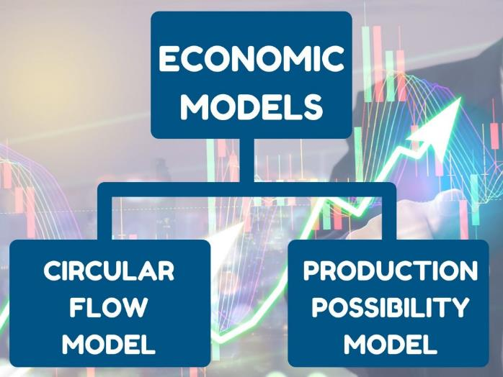
2.1 Economic Model
An Economic Model is a simplified framework that is designed to illustrate complex processes.
The Two Basic Economic Models
  Circular Flow Model
  Production Possibility Model
Notes:
An economic model is a simplified framework that is designed to illustrate complex processes. Oftentimes in introductory Microeconomics, these models seem oversimplified because they hold certain variables constant. While one should remain aware of this, these models are still useful. Holding some information constant can help us understand a concept without being overwhelmed by a vast number of influencing factors. Economic models are the building blocks of most modern economic
theories. By understanding these models, we can develop a mindset to understand the economic world.
The two basic Economic Models we shall consider here are:
Circular Flow Model
Production Possibility Model

Slide 5
2.2 Circular Flow Model
The Circular Flow Diagram (image on next slide) pictures the economy as consisting of two groups—households and firms—that interact in two markets: the goods and services market in which firms sell and households buy and the labor market in which households sell resources to business, firms or other employees who are hired or purchased by them to produce goods and services.
Notes:
Fig 2.1 Circular Flow Diagram The Circular Flow Diagram The circular flow diagram shows how households and firms interact in the goods and services market, and in the labor market. The direction of the arrows shows that in the goods and services market, households receive goods and services and pay firms for them. In the labor market, households provide labor and receive payment from firms through wages, salaries, and benefits.
Firms produce and sell goods and services to households in the market for goods and services (or product market). Arrow “A” indicates this. Households pay for goods and services, which becomes the revenues to firms. Arrow “B” indicates this. Arrows A and B represent the two sides of the product market. Where do households obtain the income to buy goods and services? They provide the labor and other resources (e.g. land, capital, raw materials) firms need to produce goods and services in the market for inputs (or factors of production). Arrow “C” indicates this. In return, firms pay for the inputs (or resources) they use in the form of wages and other factor payments. Arrow “D” indicates this. Arrows “C” and “D” represent the two sides of the factor market.

Slide 6
2.2 Circular Flow Model

Slide 7
2.2 Circular Flow Model
Firms (businesses / producers)
  Produce and sell goods and services
  Hire and use factors of production
    Land, labour, capital and entrepreneurship
Households (individuals / consumers)
  Buy and consume goods and services
  Own and sell factors of production
Notes:
7

Slide 8
2.2 Circular Flow Model
Consumer Market
  Firms sell
  Households buy
Factors Market
  Households sell
  Firms buy
Notes:
7

Slide 9
2.2 Circular Flow Model
Factors of Production
  Inputs used to produce goods and services are…
    Land, labor, capital and entrepreneurship
  Getting paid…
    Rents, wages, interest and profits
Notes:
7

Slide 10
2.3 Production Possibility Model
The production possibilities frontier (PPF) is a graph that shows the combinations of output that the economy can possibly produce given the available factors of production and the available production technology.
Some may refer to the PPF as the production possibilities curve (PPC) – take comfort, they are the same thing!

Slide 11
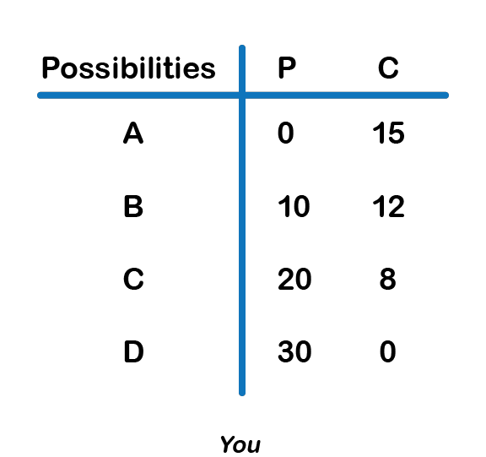
2.3 Production Possibility Model
EXAMPLE
You are stranded on a tropical island alone. On this island, there are only two foods: pineapples and crabs. In other words, you face a trade-off: any time you spend harvesting pineapples is time that cannot be spent looking for crabs. You are forced to make a decision on how to allocate the scarce resource of time.
This scarcity limits the amount of total production.

Slide 12
2.3 Production Possibility Model
A Production Possibility Frontier (PPF) is the graphical representation of the table shown in the previous slide.’
It represents the maximum combination of goods that can be produced given available resources and technology. Each point represents one of the combinations from the table.
Notes:
Figure 2.2 displays a table showing several different combinations of goods that can be harvested in a given week. The table is very logical – if you spend all your time catching crabs, you will have no pineapples. Notice that you can produce either all crabs, all pineapples, or a mix of the two.
Assume you choose to only catch crabs. How many would have to be given up in order to obtain ten pineapples? In this example, three. This is an important concept; even though our scarce resource is time, we can measure the cost of a good, in this case, pineapples, in terms of the foregone good, in this cases crabs.
Notice how the marginal cost changes as you harvest more pineapples. To produce the next ten pineapples, it costs four crabs, and the next ten costs eight. Now there are no more crabs to give up. While marginal opportunity cost is not always increasing, it is intuitive to think that the more pineapples you pick, the harder they will be to find, and therefore the more time you will have to give up to harvest 10 more.

Slide 13
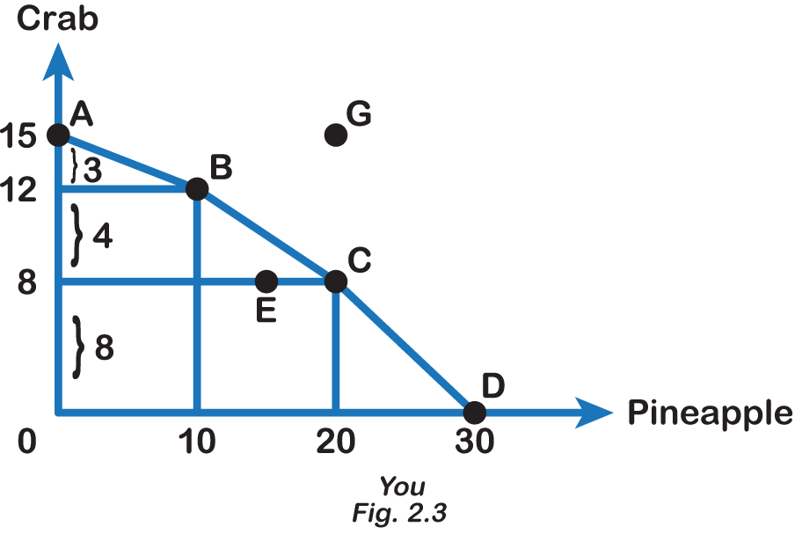
2.3 Production Possibility Model Continued
In our example, while we would love to produce 20 pineapples and 15 crabs, this is out of our realm of possible production. In other words, it is not a point on our PPF. A point outside PPF (G) is unattainable, with the given resources.
Any point on the PPF is efficient, while a point inside (E) is inefficient. Producing inside the PPF implies underutilization of resources, so an individual is not able to produce the maximum combination.
Notes:
Using our terminology from before, each point along our PPF (i.e. Point A) is efficient (in a one-person world) since there is no way to get more pineapples without giving up some crabs and vice-versa. If we are inside the PPF (i.e. Point B), we are not fully using our resources. In this case, we can produce more pineapples without having to give up any more crabs. This point is inefficient. Points outside the PPF (i.e. Point C), while preferable, are unattainable given constraints in resources and time.

Slide 14
2.3 Production Possibility Model Continued
Suppose You are currently producing 10 pineapples and 12 crabs, that is, you are operating at point B on the PPF.
If You want to move from point B to point C, that is, increase pineapple production from 10 to 20, how many crabs do you have to give up?
You give up 4 crabs. So the opportunity cost of producing 10 additional pineapples, is 4 crabs. In other words, the opportunity cost of producing an additional pineapple is 4/10 crab = 0.4 crab

Slide 15
2.3 Production Possibility Model Continued
From our graph (Fig 2.3), we find that one moves down along the PPF, the amount of crabs given up keeps increasing as the number of pineapples increases by an additional 10 units each time. This is called the Law of Increasing Opportunity Cost.

Slide 16
2.3 Production Possibility Model: Another Example

Slide 17

2.4 PPF and Increasing Opportunity Cost
The law of increasing opportunity cost : which holds that as the production of a good or service increases, the marginal opportunity cost of producing it increases as well. This is because resources are given at a particular time period and resources are not equally suited to produce all kinds of goods.
Photo by micheile || visual stories Unsplit License
Notes:
Using our analysis of Marginal Cost (MC) from before, we see that the Slope (absolute value) of the PPF is the amount of the good on the vertical axis given up to obtain additional units of the good on the horizontal axis. Recall that slope is calculated using rise overrun. From Fig 2.2, we see that to gain 10 additional pineapples (from 10 to 20 units), we give up 4 crabs (12 to 8 units). To obtain another 10 units of pineapples (from 20 to 30 units), we give up 8 crabs (8 to 0 units). As we move down the PPF, the slope and MC increase. This pattern is common enough that economists have given it a name: the law of increasing opportunity cost.
This happens because some resources are better suited for producing certain goods and services instead of others. When the producer wants to obtain more pineapples and devotes more resources (time and effort) to it, there will be fewer resources available for obtaining the other goods, crab. Therefore, more pineapples result in the greater sacrifice of crabs.

Slide 18
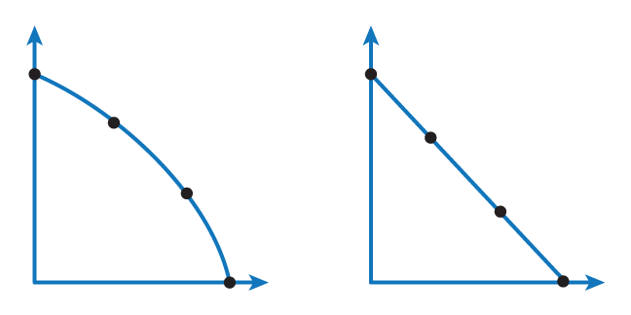
2.5 LINEAR VS CONCAVE PPF
Concave PPF illustrates Increasing opportunity cost Linear PPF implies Constant opportunity cost
As more good X is produced, the producer has As more good X is produced, the producer gives
to give up increasing amounts of good Y up good Y in constant amounts

Slide 19
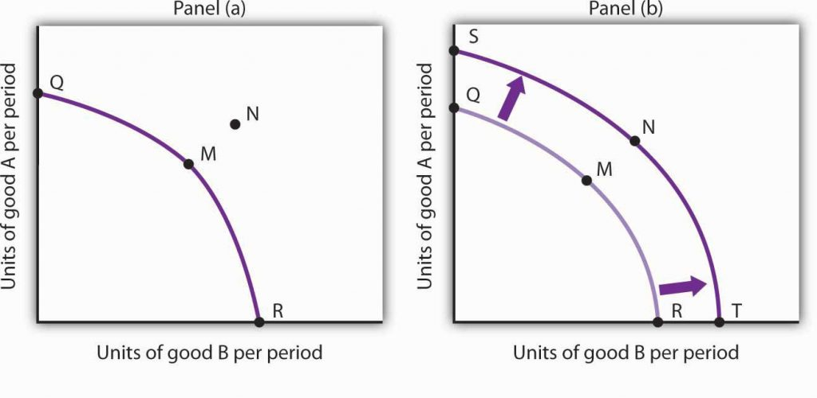
2.6 Economic Growth
Economic Growth: allows countries, individuals, or firms to reach points outside their PPF. Factors that allow shifts in countries’ PPF, resulting in a change in attainable output include:
Advancing Technology
More Physical and
Human capital
Fig 2.4 Economic Growth and the Production Possibilities Curve
Notes:
Economic Growth: allows countries, individuals, or firms to reach points outside their PPF. Factors that allow shifts in countries’ PPF, resulting in a change in attainable output include:
A Shift in Technology: If you were to invent a computer system that showed the location of crabs and pineapples on the island, you would be able to produce more of both goods, shifting the PPF outward.
More Physical capital, Education or Training: If you were to become more skilled at harvesting pineapples or crabs and obtain more equipment, your attainable output would increase, shifting the PPF outward.
An increase in the physical quantity or in the quality of factors of production available to an economy or a technological gain will allow the economy to produce more goods and services; it will shift the economy’s production possibilities curve outward. The process through which an economy achieves an outward shift in its production possibilities curve is called economic growth. An outward shift in a production possibilities curve is illustrated in Fig 2.4. In Panel (a), a point such as N is not attainable; it lies outside the production possibilities curve. Growth shifts the curve outward, as in Panel (b), making previously unattainable levels of production possible.

Slide 20
2.7 Production Possibility Model
Concepts illustrated by the Production Possibilities Frontier
  Efficiency
  Tradeoffs
  Opportunity Cost
  Economic Growth

Slide 21
2.8 Trade and Economic Growth
One of the most important implications of the concepts of the production possibilities curve relates to International Trade. The evidence that international trade confers overall benefits on economies is very strong.
Trade generates economic growth by bringing in technology and/or capital, thus increasing individual's and society's wealth.
To understand the benefits of trade, or why we trade in the first place, we need to understand the concepts of comparative and absolute advantage.
Notes:
Trade has accompanied economic growth in Canada and around the world. Many economies that have shown the most rapid growth in the last few decades—for example, Japan, South Korea, China, and India—have done so by dramatically orienting their economies toward international trade. To understand the benefits of trade, or why we trade in the first place, we need to understand the concepts of comparative and absolute advantage.

Slide 22
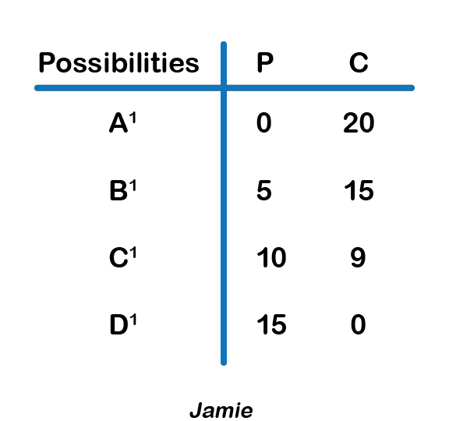
2.9 PPF and Absolute Advantage
Look at Your and Jamie’s production possibilities below:
You have an absolute advantage in pineapples as you can grow a maximum of 30 while Jamie can produce a maximum of 15.

Slide 23
2.9 PPF and Absolute Advantage
Look at Your and Jamie’s production possibilities below:
Jamie has an absolute advantage in crabs as he can produce a maximum of 20 while you can produce a maximum of 15 crabs.

Slide 24
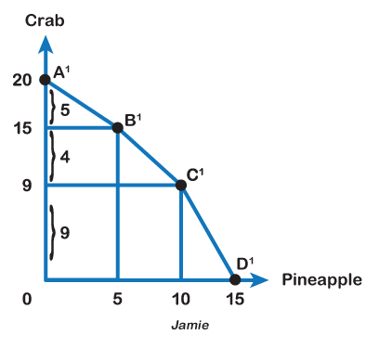
2.9 Comparative Advantage
The graph here shows Jamie’s production possibilities, as illustrated by the table on the previous slide.
Comparative Advantage. When one can produce a good at a lower opportunity cost than another, the person is said to be efficient or have a comparative advantage in producing that good.
Notes:
Finding out Comparative Advantage
Refer to Fig 2.3. When you produce 15 crabs, you give up 30 pineapples. So your opportunity cost of producing 1 crab is 2 pineapples. Referring to Fig 2.6, when Jamie produces 20 crabs, he gives up 15 pineapples. So Jamie’s opportunity cost of producing 1 crab is 0.75 pineapples. Because Jamie has a lower opportunity cost in producing crabs, he has a comparative advantage in crabs. Similarly, we can find your opportunity cost in producing 1 pineapple is 0.5 crabs and Jamie’s opportunity cost is 1.33 crabs. Therefore, we can infer you have a lower opportunity cost or comparative advantage in producing pineapples.

Slide 25
2.10 Gains from Trade
Before Trade Production Possibilities:
Suppose You are currently producing 20 pineapples and 8 crabs (point C on the PPF) while Jamie is currently producing 10 pineapples and 9 crabs (point C¹ on the PPF).
Therefore, Your opportunity cost of producing a pineapple is 8/20 = 0.4 crabs and Jamie’s opportunity cost of producing a pineapple is 9/10 = 0.9 crab.
Your opportunity cost of producing a pineapple is lower than that of Jamie’s, so you have a comparative advantage in pineapples.
Your opportunity cost of producing a crab = 20/8 = 2.5 pineapples, while Jamie’s opportunity cost of producing a crab = 10/9 = 1.1 pineapple. Jamie’s opportunity cost of producing a crab is lower than that of Yours, so Jamie has a comparative advantage in crabs.
 | Pineapple | Crab
You | 20 | 8
Jamie | 10 | 9
Notes:
Suppose, before trade you choose to produce 20 pineapples and 8 crabs and Jamie chooses to produce 10 pineapples and 9 crabs.

Slide 26
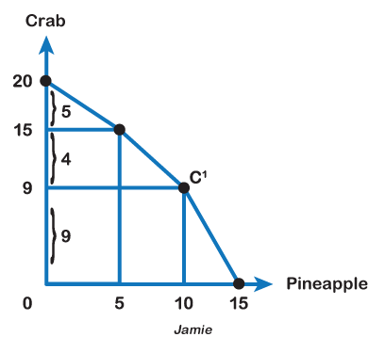
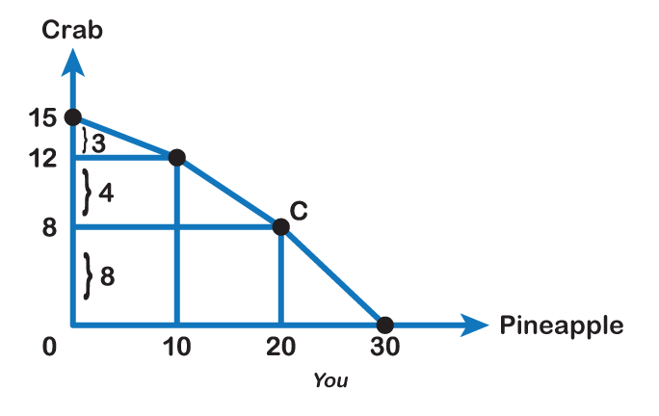
2.10 Gains from Trade
Look at the Before trade production and consumption points for You and Jamie in the graphs below:

Slide 27
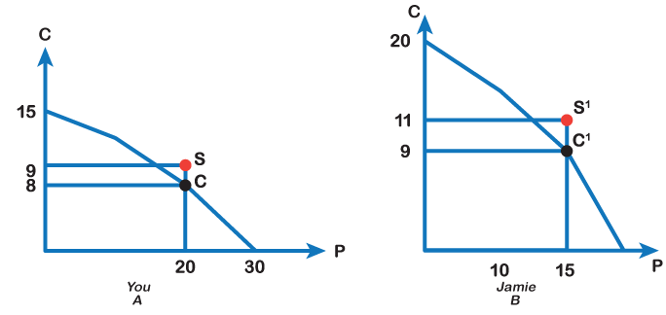
2.11 Exchange
Exchange: If you and Jamie choose to trade 10 pineapples for 9 crabs, then after trade you are left with 20 pineapples and 9 crabs (point S in Fig 2.8 Panel [A]) while Jamie is left with 10 pineapples and 11 crabs (Point S’ in Fig 2.8 Panel [B])
Fig 2.8
Notes:
Therefore, after the trade, You gain +1 crab, and Jamie gains +2 crabs. Both trading partners move to a point outside their current PPF, resulting in economic growth. Figure 2.8 (Panels (A) and (B)) and Fig 2.9 below show Yours’s and Jamie’s production possibilities both before and after the trade.

Slide 28
2.11 Exchange
Therefore, now You are able to consume 20 Pineapples and 9 crabs (one more crab than what you were producing before trade) and Jamie is able to consume 10 pineapples and 11 crabs (one more crab than what he was producing before trade).
So, this exchange resulted in mutual gains for both trading partners.

Slide 29
2.12 Implications
 | You |  | Jamie
 | Pineapples | Crabs | Pineapples | Crabs
Before trade production | 20 | 8 | 10 | 9
Specialization | 30 | 0 | 0 | 20
After trade production and consumption | 20 | 9 | 10 | 11
Gains from trade | - | +1 | - | +2
The implications of our model for trade are that,
trade is mutually beneficial;
certainly, redistributes resources among the two trading partners;
leads to specialization and greater skills.

Slide 30
2.12 Comparative Advantage and Specialization
Specialization allows us to concentrate on what we want to do and makes us more productive in the task. It results in gains from trade, as each person or country, can focus on what it can produce at the lowest cost and then trade it with its partner.
Specialization allows high skill development, more productivity, and gains from trade.
It not only benefits us individually, but the economy too, by increasing economy’s wealth.
Notes:
Note that even though Jamie had the absolute advantage in both goods, his opportunity cost of producing crabs was still higher, since opportunity or marginal cost is based on a trade-off between the two goods. We can liken this example to trade between Canada and a developing country. Canada may be better at producing both computers and textiles (the absolute advantage) but the advantages we have in producing computers are far greater. Any hour we have to give up to produce textiles comes at a much higher cost to us than it would to a developing country, giving us the comparative advantage at producing computers, and the developing country the advantage at producing textiles.
The island example is no different. Even though Jamie is better at producing pineapples, what Jamie is really an expert at is producing crabs, so having to give up time spent catching crabs comes at a high cost. Therefore, you should specialize in producing pineapples and export them to Jamie while Jamie should specialize in producing crabs and export them to you.

Slide 31
2.13 Key Terms
Absolute Advantage
Circular Flow Diagram
Comparative Advantage
Economic Growth
Economic Model
Production Possibility Frontier (PPF)
Specialization
The law of increasing opportunity cost

