Slide 1
CHAPTER 11: OLIGOPOLY
Principles of Microeconomics
Unless otherwise noted, this work is licensed under a Creative Commons Attribution-NonCommercial-ShareAlike 4.0 International (CC BY-NC-SA 4.0) license. Feel free to use, modify, reuse or redistribute any portion of this presentation.

Slide 2
Learning Outcomes
At the end of this chapter, you will be able to:
Explain why oligopolies exist
Contrast collusion and competition
Interpret and analyze the prisoner’s dilemma problem
Explain the role of game theory in understanding the behaviour of oligopolies

Slide 3
11.1 Oligopoly Market Structure
A market structure where a small number of interdependent firms compete.
Firms are large and know the actions of one another.
Barriers to entry exist to avoid new competition.

Slide 4
11.1 Why do Oligopolies exist: Barriers to Entry
A combination of the barriers to entry that create monopolies and the product differentiation that characterizes monopolistic competition can create the setting for an oligopoly.
Notes:
For example, when a government grants a patent for an invention to one firm, it may create a monopoly. When the government grants patents to, for example, three different pharmaceutical companies that each have its own drug for reducing high blood pressure, those three firms may become an oligopoly.
Similarly, a natural monopoly will arise when the quantity demanded in a market is only large enough for a single firm to operate at the minimum of the long-run average cost curve. In such a setting, the market has room for only one firm, because no smaller firm can operate at a low enough average cost to compete, and no larger firm could sell what it produced given the quantity demanded in the market.

Slide 5
11.2 Collusion or Competition
When firms act together in this way to reduce output and keep prices high, it is called collusion. A group of firms that have a formal agreement to collude to produce the monopoly output and sell at the monopoly price is called a cartel.
Notes:
When oligopoly firms in a certain market decide what quantity to produce and what price to charge, they face a temptation to act as if they were a monopoly. By acting together, oligopolistic firms can hold down industry output, charge a higher price, and divide the profit among themselves.
Even when oligopolists recognize that they would benefit as a group by acting like a monopoly, each individual oligopoly faces a private temptation to produce just a slightly higher quantity and earn a slightly higher profit—while still counting on the other oligopolists to hold down their production and keep prices high.

Slide 6
11.2 Game Theory
The study of how individuals/firms make decisions when their own goals depend on their interactions with others.
All games have the same characteristics:
Rules that determine what you can and cannot do
Strategies that players may use to attain their goal
Payoffs that show the result of the interaction between player strategies

Slide 7
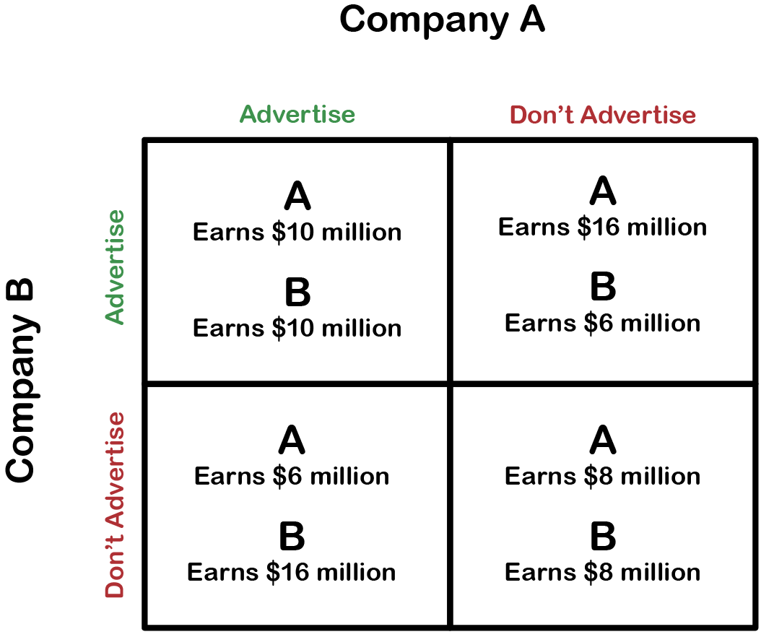
11.2 Duopoly
A duopoly is a game between 2 or more players where each player acts simultaneously.
To solve a duopoly, we use a Payoff Matrix as seen in the example

Slide 8
11.3 The Prisoner's Dilemma I
The prisoner’s dilemma is a scenario in which the gains from cooperation are larger than the rewards from pursuing self-interest. It applies well to oligopoly. The story behind the prisoner’s dilemma goes like this: There are two prisoners (players of the game), who have two strategies: confess and deny the crime, and serve a jail sentence (payoffs)
Notes:
Because of the complexity of oligopoly, which is the result of mutual interdependence among firms, there is no single, generally-accepted theory of how oligopolies behave, in the same way that we have theories for all the other market structures. Instead, economists use game theory, a branch of mathematics that analyzes situations in which players must make decisions and then receive payoffs based on what other players decide to do.
Game theory has found widespread applications in the social sciences, as well as in business, law, and military strategy.
All games have three basic elements: players, strategies and payoffs. The players of the game are the agents actively participating in the game and who will experience outcomes based on the play of all players. The strategies are all of the possible strategic choices available to each player, they can be the same for all players or different for each player. The payoffs are the outcomes associated with every possible strategic combination, for each player.

Slide 9
11.3 The Prisoner's Dilemma II
The game theory situation facing the two prisoners is in this figure.
Notes:
Two co-conspiratorial criminals are arrested. When they are taken to the police station, they refuse to say anything and are put in separate interrogation rooms. Eventually, a police officer enters the room where Prisoner A is being held and says: “You know what? Your partner in the other room is confessing. Your partner is going to get a light prison sentence of just one year, and because you’re remaining silent, the judge is going to stick you with eight years in prison. Why don’t you get smart?
If you confess, too, we’ll cut your jail time down to five years, and your partner will get five years, also.” Over in the next room, another police officer is giving exactly the same speech to Prisoner B. What the police officers do not say is that if both prisoners remain silent, the evidence against them is not especially strong, and the prisoners will end up with only two years in jail each.

Slide 10
11.4 The Oligopoly Version of the Prisoner's Dilemma I
The members of an oligopoly can face a prisoner’s dilemma, also. If each of the oligopolists cooperates in holding down output, then high monopoly profits are possible. Each oligopolist, however, must worry that while it is holding down output, other firms are taking advantage of the high price by raising output and earning higher profits.

Slide 11
11.4 The Oligopoly Version of the Prisoner's Dilemma II
Fig 11.2
Notes:
Fig 11.2 shows the prisoner’s dilemma for a two-firm oligopoly—known as a duopoly. If Firms A and B both agree to hold down output, they are acting together as a monopoly and will each earn $1,000 in profits. However, both firms’ dominant strategy is to increase output. The Nash equilibrium is shown by the bottom right-hand corner payoffs, where each firms earn $400 in profits.
Why do the firms do not trust each other and not co-operate? Consider the situation of Firm A:
If A thinks that B will cheat on their agreement and increase output, then A will increase output, too, because for A the profit of $400 when both firms increase output (the bottom right-hand choice in Fig 11.2) is better than a profit of only $200 if A keeps output low and B raises output (the upper right-hand choice in the table).
If A thinks that B will cooperate by holding down output, then A may seize the opportunity to earn higher profits by raising output. After all, if B is going to hold down output, then A can earn $1,500 in profits by expanding output (the bottom left-hand choice in the table) compared with only $1,000 by holding down output as well (the upper left-hand choice in the table).

Slide 12
11.5 Cartels I
A cartel is an agreement among competing firms to collude in order to attain higher profits. Cartels usually occur in an oligopolistic industry, where the number of sellers is small and the products being traded are homogeneous.
Notes:
Cartel members may agree on such matters are price fixing, total industry output, market share, allocation of customers, allocation of territories, bid rigging, establishment of common sales agencies, and the division of profits.
Game theory suggests that cartels are inherently unstable, because the behavior of cartel members represents a prisoner’s dilemma. Each member of a cartel would be able to make a higher profit, at least in the short-run, by breaking the agreement (producing a greater quantity or selling at a lower price) than it would make by abiding by it. However, if the cartel collapses because of defections, the firms would revert to competing, profits would drop, and all would be worse off.
Whether members of a cartel choose to cheat on the agreement depends on whether the short-term returns to cheating outweigh the long-term losses from the possible breakdown of the cartel. It also partly depends on how difficult it is for firms to monitor whether the agreement is being adhered to by other firms. If monitoring is difficult, a member is likely to get away with cheating for longer; members would then be more likely to cheat, and the cartel will be more unstable.

Slide 13
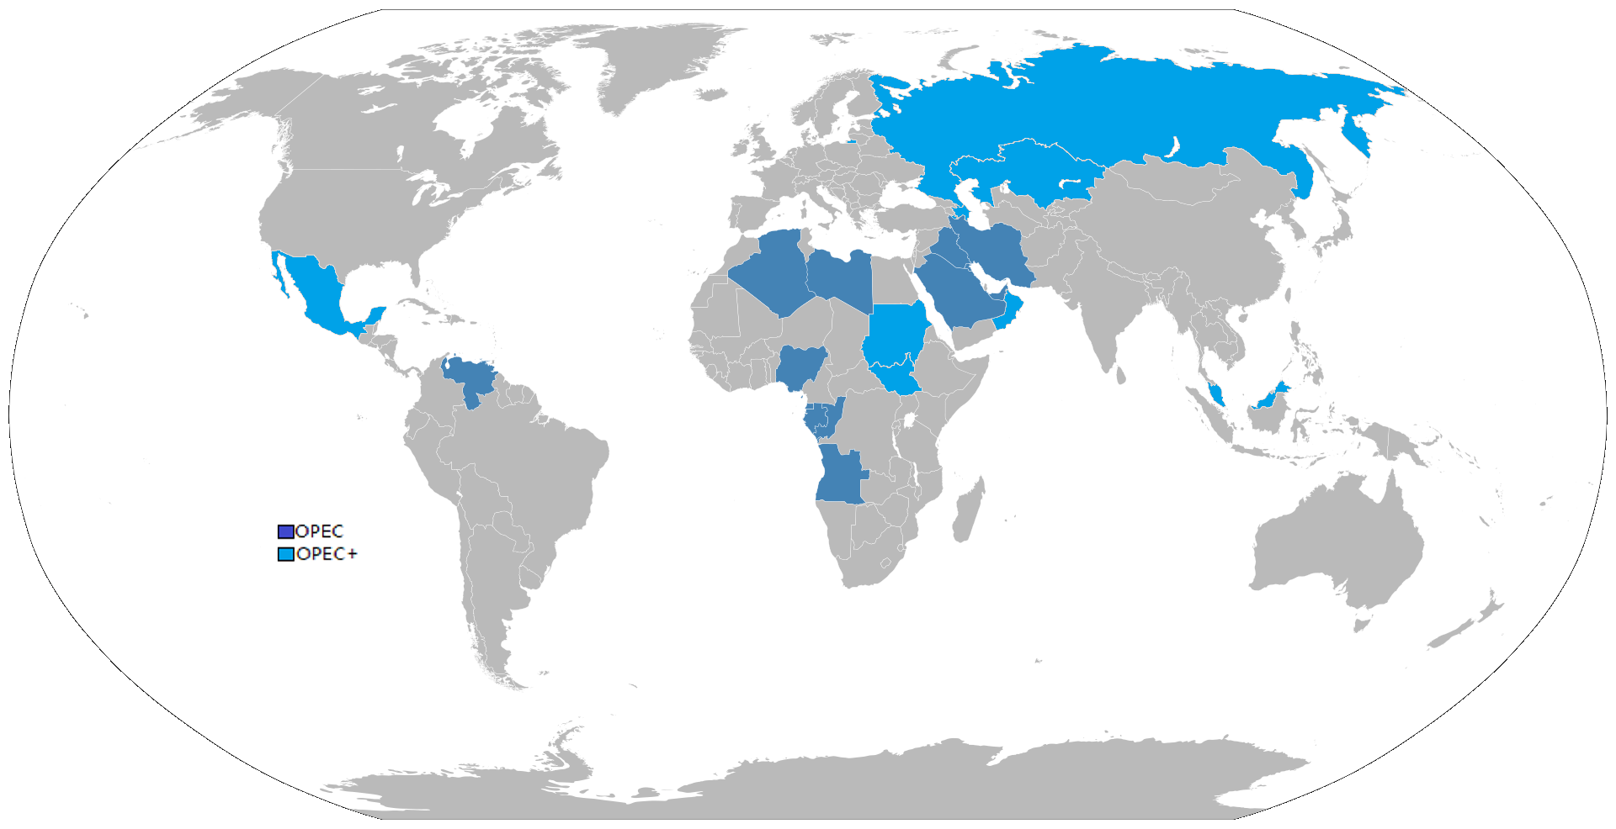
11.5 Cartels II
Notes:
Perhaps the most globally recognizable and effective cartel is OPEC, the Organization of Petroleum Exporting Countries. In 1973 members of OPEC reduced their production of oil. Because crude oil from the Middle East was known to have few substitutes, OPEC member’s profits skyrocketed. From 1973 to 1979, the price of oil increased by $70 per barrel, an unprecedented number at the time. In the mid 1980s, however, OPEC started to weaken. Discovery of new oil fields in Alaska and Canada introduced new alternatives to Middle Eastern oil, causing OPEC’s prices and profits to fall. Around the same time OPEC members also started cheating to try to increase individual profits.
Because oligopolists cannot sign a legally enforceable contract to act like a monopoly, the firms may instead keep close tabs on what other firms are producing and charging. Alternatively, oligopolists may choose to act in a way that generates pressure on each firm to stick to its agreed quantity of output.

Slide 14
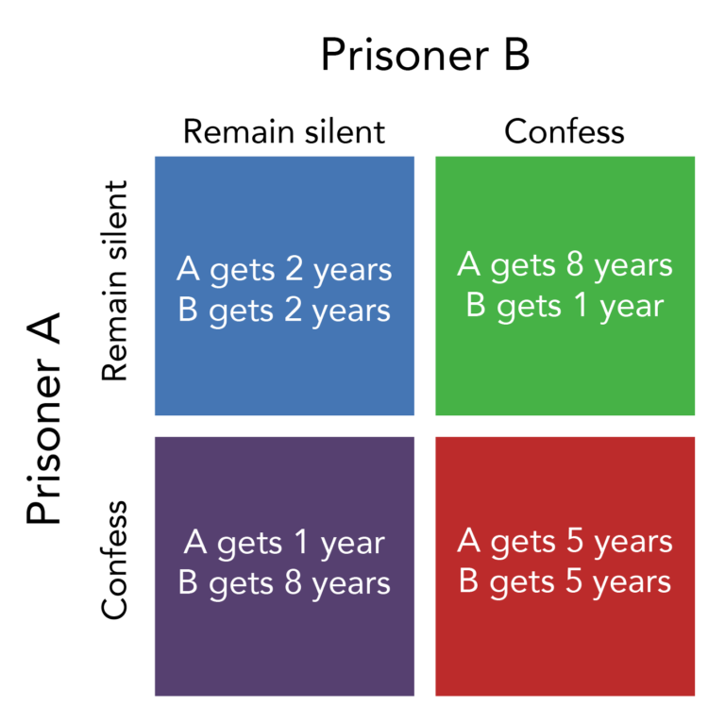
11.5 Cartels III
Fig 11.3
Notes:
One example of the pressure these firms can exert on one another is the kinked demand curve, in which competing oligopoly firms commit to match price cuts, but not price increases.
This situation is shown in Figure 11.3. Say that an oligopoly airline has agreed with the rest of a cartel to provide a quantity of 10,000 seats on the New York to Los Angeles route, at a price of $500. This choice defines the kink in the firm’s perceived demand curve. The reason that the firm faces a kink in its demand curve is because of how the other oligopolists react to changes in the firm’s price. If the oligopoly decides to produce more and cut its price, the other members of the cartel will immediately match any price cuts—and therefore, a lower price brings very little increase in quantity sold.
If one firm cuts its price to $300, it will be able to sell only 11,000 seats. However, if the airline seeks to raise prices, the other oligopolists will not raise their prices, and so the firm that raised prices will lose a considerable share of sales. For example, if the firm raises its price to $550, its sales drop to 5,000 seats sold. Thus, if oligopolists always match price cuts by other firms in the cartel, but do not match price increases, then none of the oligopolists will have a strong incentive to change prices, since the potential gains are minimal. This strategy can work like a silent form of cooperation, in which the cartel successfully manages to hold down output, increase price, and share a monopoly level of profits even without any legally enforceable agreement

Slide 15
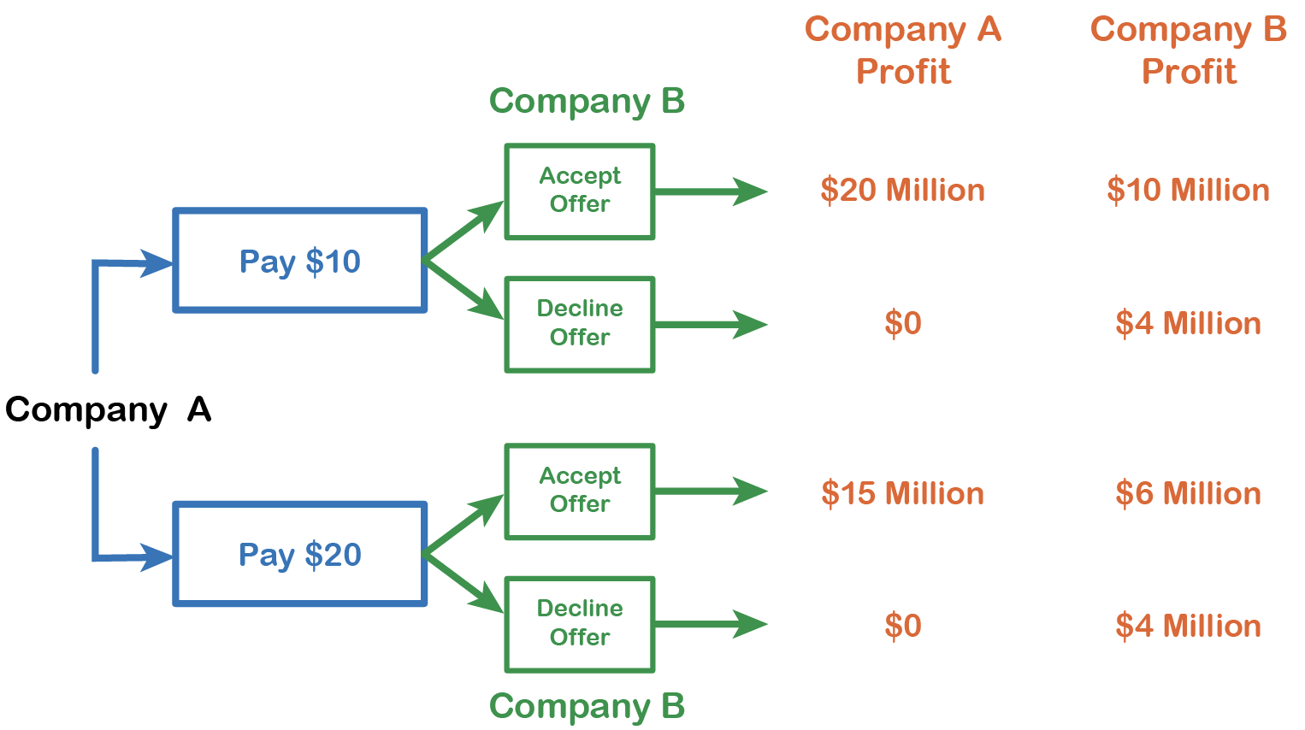
11.5 Sequential Game
A “Sequential Game” between 2 or more players one where players take turns.
To solve a duopoly, we use a Decision Tree as seen in the example.

Slide 16
11.6 KEY TERMS
Oligopoly
Monopoly
Collusion
Cartel
Game theory
Players of the game
Strategies
Payoffs
Single-shot games
Repeated games
Prisoner’s dilemma
Dominant strategy
Nash equilibrium
Duopoly
Kinked demand

