Slide 1
CHAPTER 10: MONOPOLISTIC COMPETITION
Principles of Microeconomics
Unless otherwise noted, this work is licensed under a Creative Commons Attribution-NonCommercial-ShareAlike 4.0 International (CC BY-NC-SA 4.0) license. Feel free to use, modify, reuse or redistribute any portion of this presentation.

Slide 2
Learning Outcomes
At the end of this chapter, you will be able to:
Define demand and marginal revenue
Describe profit maximization in the short run long run profits
Compare perfect and monopolistic competition
Discuss marketing differentiated products

Slide 3
10.0 Monopolistic Competition
Monopolistic competition lies in-between the spectrum. It involves many firms competing against each other but selling products that are distinctive in some way.
Examples of monopolistic competition include:
stores that sell different styles of clothing,
restaurants or grocery stores that sell different kinds of food
products like golf balls or beer that may be at least somewhat similar but differ in public perception because of advertising and brand names

Slide 4
10.1 Differentiated Products
A firm can try to make its products different from those of its competitors in several ways:
physical aspects of the product
selling location
intangible aspects of the product
perceptions of the product.
Products that are distinctive in one of these four ways are called differentiated products.
Notes:
Physical aspects of a product include all the phrases you hear in advertisements: such as an unbreakable bottle, non-stick surface, freezer-to-microwave, non-shrink, extra spicy, newly redesigned for your comfort. The location of a firm can also create a difference between producers.
For example, a gas station located at a busy intersection can probably sell more gas than one located on a small side-road. A supplier to an automobile manufacturer may find that it is advantageous to locate near the car factory.
Intangible aspects can differentiate a product, too. Some intangible aspects may be promises like a guarantee of satisfaction or money back, a reputation for high-quality services like free delivery, or a loan to purchase the product.
Finally, product perception may occur in the minds of the buyers. For example, many people could not tell the difference in taste between common varieties of beer or cigarettes if they were blindfolded, but because of past habits and advertising, they have strong preferences for certain brands. Advertising can play a role in shaping these intangible preferences.

Slide 5
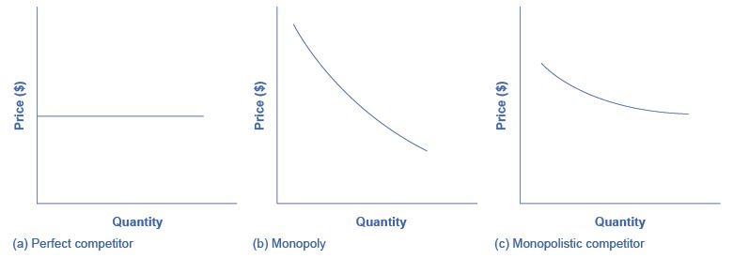
10.2 Perceived Demand for Monopolistic Competitor
A monopolistically competitive firm faces a demand for its goods that is between monopoly and perfect competition.
Notes:
This figure offers a reminder that the demand curve as faced by a perfectly competitive firm is perfectly elastic or flat, because the perfectly competitive firm can sell any quantity it wishes at the prevailing market price. In contrast, the demand curve, as faced by a monopolist, is the market demand curve, since a monopolist is the only firm in the market, and hence is downward sloping.
The demand curve as faced by a monopolistic competitor is not flat, but rather downward-sloping, meaning that the monopolistic competitor, like the monopoly, can raise its price without losing all of its customers or lower its price and gain more customers.

Slide 6
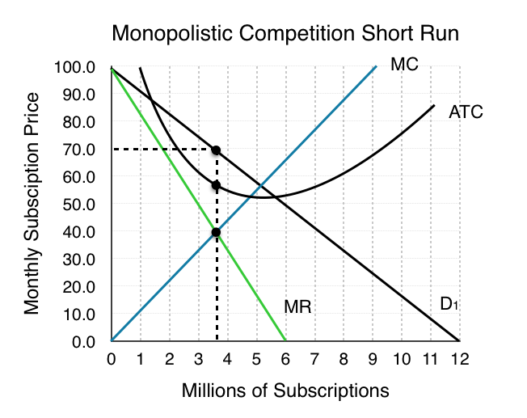
10.3 Monopolistic Competition – Price & Quantity
Rogers faces a downward sloping demand curve and has ATC and MC curves similar to the ones we have seen before.
The profit maximizing price is $70 and the profit maximizing quantity is 3.6 million subscribers.
Notes:
The monopolistically competitive firm decides on its profit-maximizing quantity and price similar to the way that a monopolist does.
Since they face a downward sloping demand curve, the same considerations about how elasticity affects revenue are relevant, and the firm will maximize profits where MR = MC when P > MR. Rogers determines its profit-maximizing level of output. This will occur where MR = MC. MR and MC intersect when Rogers has 3.6 million subscribers.
Although the process by which a monopolistic competitor makes decisions about quantity and price is similar to the way in which a monopolist makes such decisions, two differences are worth remembering.
First, although both a monopolist and a monopolistic competitor face downward-sloping demand curves, the monopolist’s demand curve is the market demand curve, while the perceived demand curve for a monopolistic competitor is based on the extent of its product differentiation and how many competitors it faces.
Second, a monopolist is surrounded by barriers to entry, but a monopolistic competitor who earns profits must expect the entry of firms with similar, but differentiated, products.

Slide 7
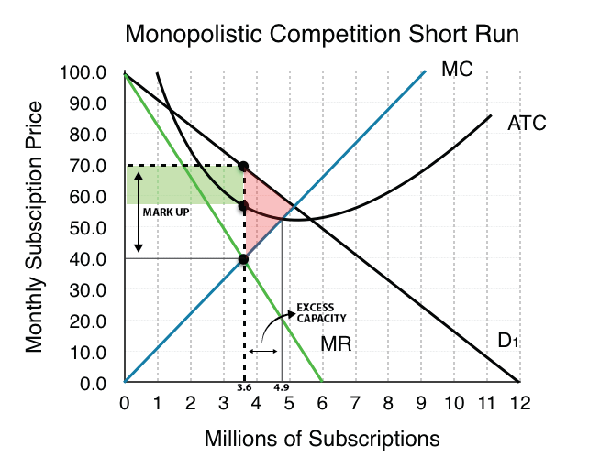
10.4 Mark-up and Excess Capacity
The marginal cost of offering the 3.6 millionth subscription is $40 for Rogers.
Difference between price and the marginal cost at the profit maximizing quantity is called mark up. The mark up in the graph is $70 – $40 = $30.
This difference between profit maximizing quantity of output and the minimum efficient scale is the excess capacity, shown in the graph as1.3 million subscriptions.

Slide 8
10.5 Inefficiency of Monopolistic Competition
The graph in the previous slide confirms monopolistic competition is inefficient because the producer is not producing at the minimum average total cost, rather serves 3.6 million customers which is much less than the efficient quantity of 4.9 million subscribers, unlike a producer under perfect competition.
Under perfect competition, profit maximization takes place at minimum ATC, while under monopoly (Ch 9) or monopolistic competition, profit maximization takes place at below ATC.

Slide 9
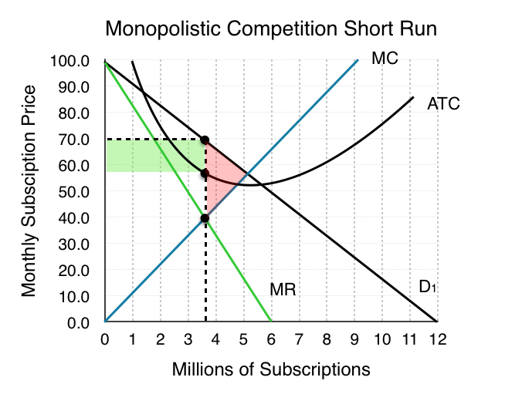
10.6 Monopolistic Competitors and Entry
Consider the profits of Rogers
at the quantity of 3.6
million subscribers,
shown by the green rectangle
in the graph. This is the profit earned
in the short run.
Notes:
At a price of $70/month, ATC is only $60 and Rogers’ profit is $36 million. ($10 profit/subscriber) Notice that this market creates a deadweight loss equal to the red area since the equilibrium quantity is less than what would occur in competitive equilibrium (5 million subscriptions).
Remember that in monopolistic competition, there are few barriers to entry. Since Rogers is earning positive economic profits, other firms will be tempted to enter the market.

Slide 10
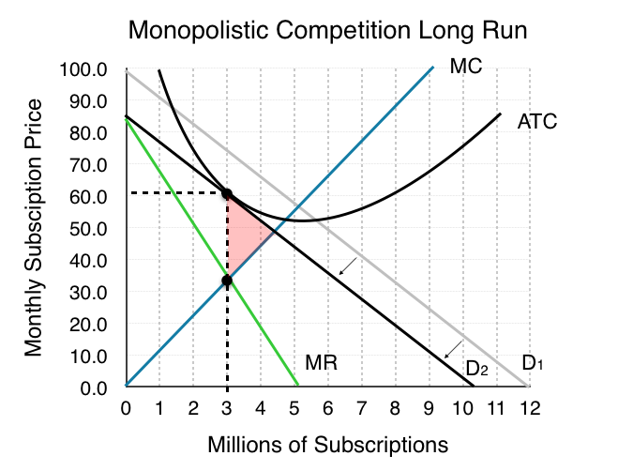
10.5 Monopolistic Competitors and Entry
When will this shifting stop? When profits are 0. As long as P > ATC firms will continue to enter the market, and demand will continue to shift inward.
As shown in this figure , this occurs when P = ATC and MR = MC. Therefore, positive profit in the short run falls to zero economic profit in the long run, due to entry by competitors.
Notes:
This specific point happens when Demand is tangent to ATC, because only when this is true can P = ATC, given that ATC is downward sloping (recall that the MC curve passes through ATC at the minimum point of ATC, and note that the minimum point of ATC is at a quantity higher than that produced by the monopolistically competitive firm).

Slide 11
10.6 The Benefits of Variety (Product Differentiation)
Even though monopolistic competition does not provide efficiency, it does have benefits of its own.
Product differentiation is based on variety and innovation. Many people would prefer to live in an economy with many kinds of clothes, foods, and car styles; not in a world of perfect competition where everyone will always wear blue jeans and white shirts, eat only spaghetti with plain red sauce, and drive an identical model of car.
Notes:
Economists have struggled, with only partial success, to address the question of whether a market-oriented economy produces the optimal amount of variety.
Critics of market-oriented economies argue that society does not really need dozens of different athletic shoes or breakfast cereals or automobiles. They argue that much of the cost of creating such a high degree of product differentiation, and then of advertising and marketing this differentiation, is socially wasteful—that is, most people would be just as happy with a smaller range of differentiated products produced and sold at a lower price.

Slide 12
10.7 Types of Market Structure Summary
Market Type | Description | MR vs P | P vs MC | LR Profit | LR ATC | DWL
Perfect Competition | Many sellers, identical goods, free entry in LR | MR=P | P=MC | Profits are zero | ATCLR=ATCMIN | No
Monopoly | Single seller, barriers to entry | MR<P | P>MC | Positive profits | ATCLR>ATCMIN | Yes
Monopolistic Competition | Many sellers, differentiated products, free entry in LR | MR<P | P>MC | Profits are zero | ATCLR>ATCMIN | Yes

Slide 13
10.8 KEY TERMS
Demand Curve
Differentiated Products
Market Price
Monopolistic Competition
Perfectly elastic
Product differentiation

