Slide 1
Active Listening
Unless otherwise noted, this work is licensed under a Creative Commons Attribution-NonCommercial-ShareAlike 4.0 International (CC BY-NC-SA 4.0) license.
All images used in this slide deck are retrieved from Microsoft PowerPoint 365 Stock Image tool unless otherwise noted. Templates and clipart are by Microsoft: all rights reserved copyright.

Slide 2
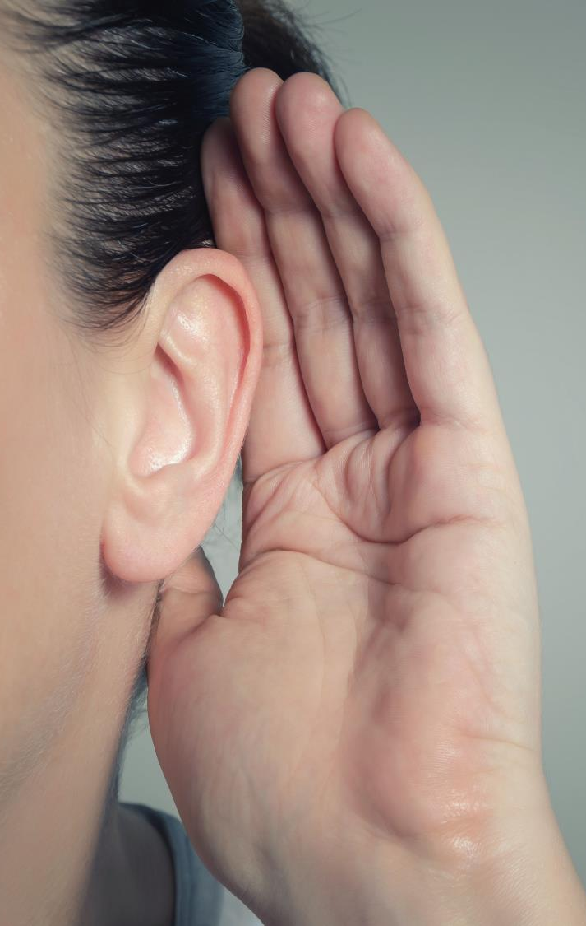
What’s The Difference Between Listening And Hearing?
Hearing
The act of perceiving sound by the ear. If you are not hearing impaired, hearing simply happens
Listening
Something you consciously choose to do. It requires concentration so that your brain processes meaning from words and sentences.

Slide 3
We Are Going To Talk About Listening…
Activity that is going to get you to think about the importance of listening and two-way communication
Instructors: Snowflake Activity
Notes:
Professor reads the exercise on pg. 30 of Skills to Pay the Bills about making a snowflake. Each person needs a sheet of paper and has to close their eyes.

Slide 4
After Activity…
Part of being a good communicator is recognizing that people may need to receive information in different ways in order to succeed.
If the goal of this activity was to have everyone’s snowflakes look the same, what are the changes to the directions that you would make?

Slide 5
“We have two ears and one mouth so that we can listen twice as much as we speak.” — Epictetus

Slide 6
Video on How to Improve Your Active Listening Skills
WATCH
Direct link: How To Improve Your Listening Skills (4.54s)
CC available on YouTube

Slide 7
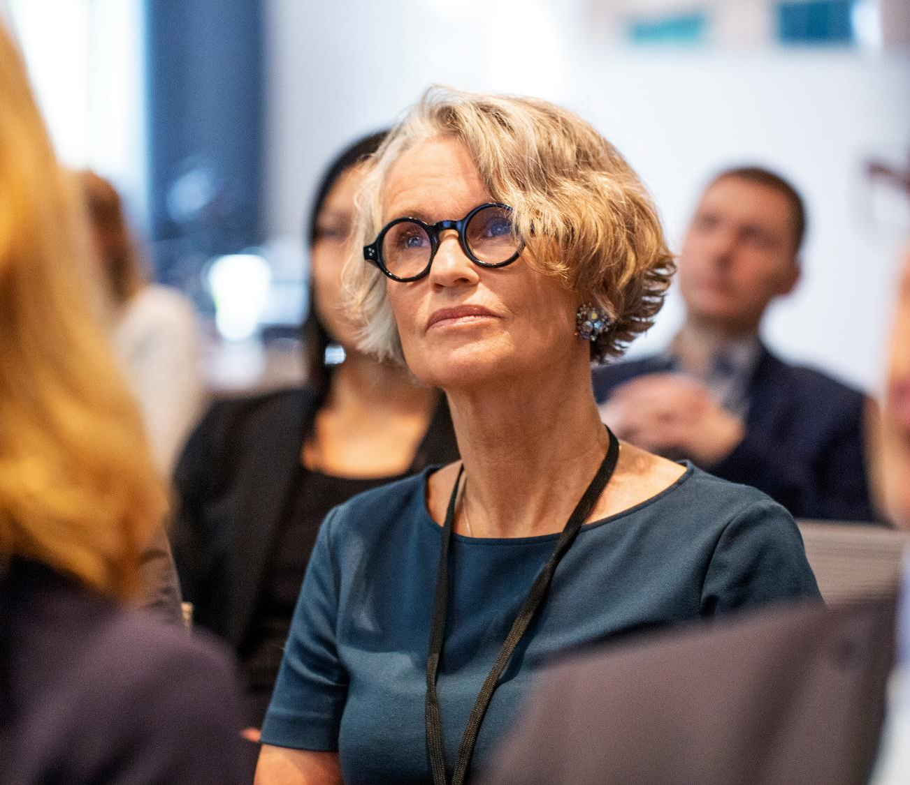
Summary: Focus Fully on The Speaker
Eye contact (if uncomfortable, look at the person’s forehead)
Body turned towards the person speaking
Now let’s try an experiment:
We are going to get into groups of 3 and do a listening exercise.
(Instructors see “Listening with and without Distraction Exercise”
Then debrief with the questions following the exercise.)

Slide 8
Avoid Interrupting
Don’t interrupt the person while they are talking.
Close your mouth while listening
Make a note during the conversation.
Listen more than you speak.
“When you talk, you are only repeating what you know; but when you listen, you learn something new.” — the Dalai Lama

Slide 9
Don’t Seem Judgmental
You don’t have to like someone or agree with them to listen to them.
Set aside your criticism and blame so that you can fully understand someone.
You can learn a lot about people and their situations if you listen when they are talking.

Slide 10
Show Your Interest
Nod while they are talking if you are understanding what they are trying to communicate with you
When they are done, comment on what they were talking about.
Ask questions after they are done if you need to understand something better.
When they are done speaking, use your own words to repeat back to the person what you think that they were communicating to you.

Slide 11
Examples Of Showing Interest
Question if not understanding:
“ I am a bit confused. Can you explain to me what you are trying to say?
“I don’t think I am quite understanding what you are saying. Could you please give me more details on what you are asking me to do?”
Comment on what they were talking about:
“That sounds interesting. Tell me more about…”
“Sounds like this is really important to you.”
Repeat what they said in your own words:
”So you want me to finish setting up for the game and then go and get the kids to come into the gym.”
”So, I won’t leave today until I have finished prepping 20 side salads.”

Slide 12
So Now We Know How To Actively Listen To Others But Sometimes We Feel That Others Don’t Listen To Us ?
What could be the reasons that sometimes people don’t seem to listen to us?
WATCH
A short video on the 7 things that we might do that makes other not want to listen to us or talk with us very much.
Instructors: I only show the video up until 3:36. After that it gets into more complex concepts.)

Slide 13
7 Mistakes In Communication
Gossiping
Judging
Being overly negative
Complaining
Blaming Other People All the Time for Everything
Exaggerating or Lying a Lot
Giving Your Opinion All The Time and Acting Like Your Opinion is 100% Fact

Slide 14
How Can You Avoid These Mistakes? H.A.I.L.
Honesty – be clear about what you are wanting to say and straight to the point
Authenticity – be yourself!
Integrity – your actions should be the same as your word
Love – wish the other person well

Slide 15
Do You Think That Sometimes People Avoid You And Don’t Want To Listen To You?
How does this make you feel?
Now you will look at a list of the 7 Mistakes of Communication that were mentioned in the video.
Think about how you may have done these mistakes at some point in your life or maybe seen someone else do them.
You are also going to look at how you feel after you do one of these mistakes.
(The instructor writes theirs on the board as examples for students to synthesize the information and the expectations of the assignment.)
Fill out the 7 Mistakes of Communication Worksheet and submit into the instructor when complete.

Slide 16
References
Office of Disability Employment Policy (ODEP), Office of Disability Employment Policy (2014). U.S. DEPARTMENT OF LABOR. Retrieved April 6, 2022, from Skills to Pay the Bills. (2014). Washington: Office of Disability Employment Policy.
Interpersonal Skills for Life and Work for College Students on the Autism Spectrum by Dr. Michael W. Duggan, LCPC, CRC is licensed under a Creative Commons Attribution 4.0 International License, except where otherwise noted.

