Slide 1
Group Diversity
Unless otherwise noted, this work is licensed under a Creative Commons Attribution-NonCommercial-ShareAlike 4.0 International (CC BY-NC-SA 4.0) license.
All images used in this slide deck are retrieved from Microsoft PowerPoint 365 Stock Image tool unless otherwise noted. Templates and clipart are by Microsoft: all rights reserved copyright.

Slide 2
Working in Groups
Is working in a group always easy?
What makes working in a group difficult sometimes?

Slide 3
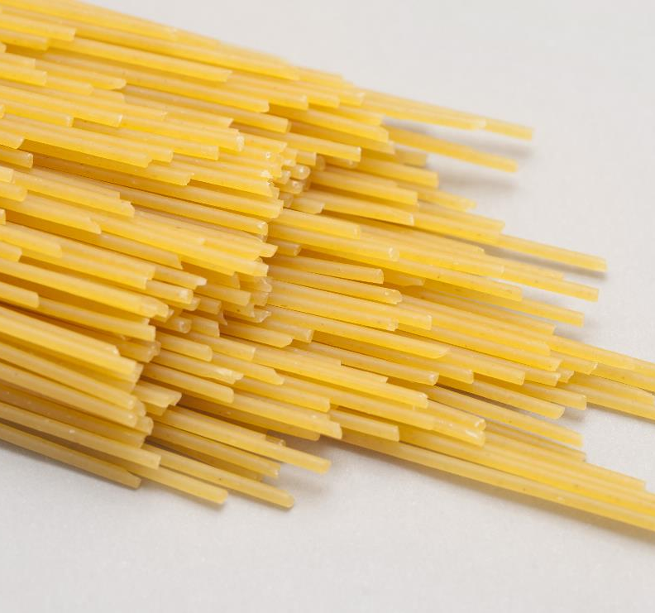
Group Activity
Groups of 4
Elect a group leader for this activity
Your group will have 15 minutes to build the tallest freestanding structure out of marshmallows and spaghetti.
The group leader may only offer instructions and supervise. They may not physically participate in this activity.
Set the timer and “Go!”
Image Source: Dried Italian spaghetti pasta by gratuity (CC BY 3.0) and Marshmallows by Heather Ann Johnson (CC BY-SA 3.0)

Slide 4
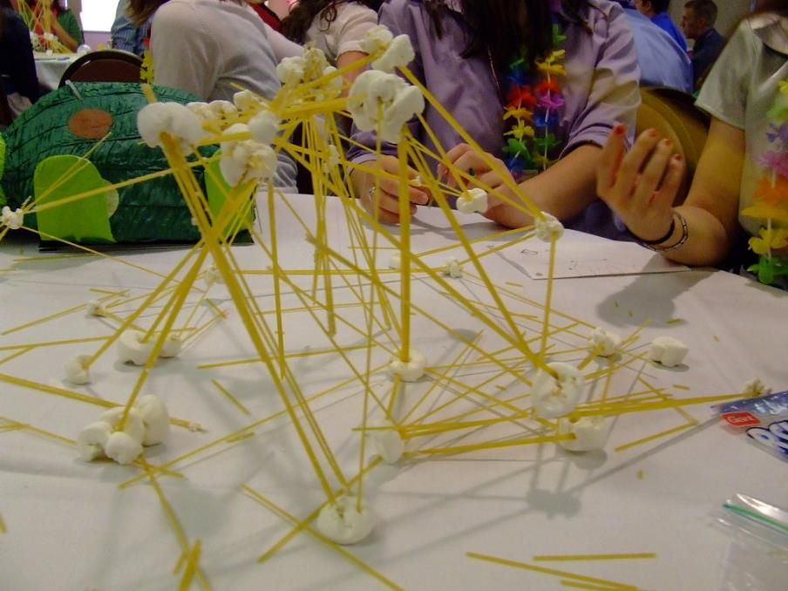
Class Discussion
What are the characteristics of the tallest freestanding structure that make it stable/successful?
Image Source: leadership and teambuilding activities by gmt903, Flickr. CC BY-NC-SA 2.0
Notes:
Highest has solid foundation
Why is a solid foundation important ? And the core of an effective team?

Slide 5
Discussion
Besides group leader, what other roles did each person play in the group?
How was each person helpful to the end goal?
Was it better or not that the group leader couldn’t physically participate in the activity?
How did the group leader feel about their level of participation?
How did your group work together?
What worked well? What difficulties did you experience?
What would you do differently if given a second chance at this activity?

Slide 6
Importance of a Good Group Member
Use your strengths Are you…
extremely organized?
good at resolving disagreements?
doing research on the internet?
good a speaking in front of a group?
good at writing down ideas, etc.?
good at motivating others to do their best?
good at coming up with new ideas?
Is there an area that you know a lot about? Take on the role in the group that best suites your strengths.

Slide 7
How Many Types Of People Does It Take?
Groups are made up of people who perform different roles.
Think about a sports team…what would happen if a quarterback never threw the ball, or a hockey player never passed the puck?
So, it takes all types of players to make an efficient and winning team, right?

Slide 8
We Are All Different Shapes
Knowing what shape someone is can help build better groups and better careers
Walk over to the shape that you like best and stand by it.
Once everyone is standing by a shape I will read out the types of traits a person that likes that shape typically has.
Notes:
Once they walk over to the shape, I will describe the personality associated with that shape.

Slide 9
Class Discussion
Now that you know the personality traits associated with the shape you picked, do you think that you fit that shape’s personality traits?
Give examples of what traits fit you and what traits didn’t.
Do you think people have the characteristics of more than one shape?
Why do you think it is important to have all different shapes working in the same group?
Notes:
Square, rectangle and triangle are all convergent---they are working TOWARDS something specific and finite and they do it in a logical and systematic way
But they might be lacking in personal creativity.
Circle and squiggle are divergent. This means that they are creative, extroverted and intuitive. But they aren’t systematic or dependable.

Slide 10
Why Do Workplaces Have Groups For Work Tasks?
To complete a task that is difficult if not impossible for people to do on their own.
Creativity increases
Productivity increases
People are inspired to collaborate to move everyone and the project forward.
Video on importance of teamwork

Slide 11
Importance Of A Good Group Member I
1. Understand the Group’s Objective
disagreements in groups may happen if there is a lack of communication and understanding about what the groups objectives are
Why are we here?
What is the deadline?
How often will we meet?
What roles and responsibilities will each of us have?
What is the perfect ending to this project?

Slide 12
Importance of a Good Group Member 2
2. Be Reliable
Do what you said you were going to do and when you said you were going to do it by.
Don’t make promises that you can’t keep.
Maintain your standard of quality work throughout the project.

Slide 13
Importance of a Good Group Member 3
3. Be. A Good Communicator
-Speak Up with Your Ideas
Offer Constructive Feedback – if you disagree be respectful and explain why you don’t agree.
Be Supportive – explain why you think an idea is a good idea
Share Information with your group
Whether you agree or disagree, it is important to always be….
POSITIVE AND RESPECTFUL

Slide 14
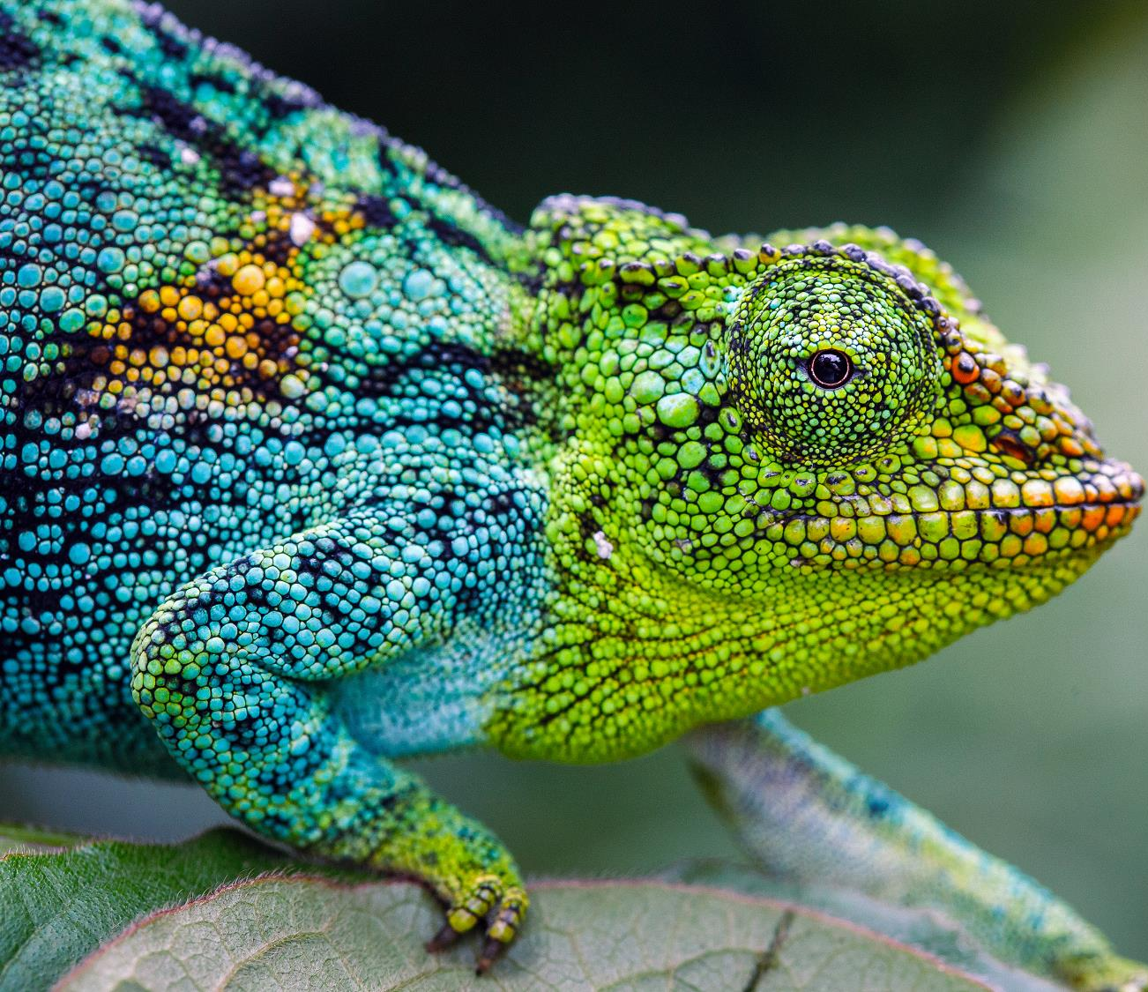
Importance of a Good Group Member 4
6. Stay Flexible
things can change quickly in a group
don’t fight change…see it as a new opportunity for growth!
Your willingness to remain comfortable and positive in a constantly changing environment is an important work skill and your boss will likely notice!

Slide 15
Create Your Own Adventure 1
Form small groups of no more than 3-4 learners.
Each group chooses one of the "Create Your Own Adventure" Games from the website below. Give groups 10 minutes to decide on a game if needed.
9 Choose-Your-Own-Adventure Games On YouTube & Netflix For Interactive Adventures From Home

Slide 16
Create Your Own Adventure 2
Begin with the introduction and then start the game.
During the game groups will need to make decisions before proceeding. Their decisions will affect their journey in the game. There are good decisions and not so good decisions.
When faced with a decision, the group will need to pause and all members will participate in making the decision. Then once they agree, they will proceed with the decision.
It is important that all group members participate in the decision making process.
Once groups have completed the adventure, each group member will fill out the 'Create Your Own Adventure" Feedback Worksheet and submit to the teacher.

Slide 17
SUMMARY
Be a Good Group Member By:
Using your strengths, clearly understanding your role and staying flexible and reliable until the project is completed.
Be positive and help others as much as you can.
Be cooperative and willing to work hard
This will make a good impression on everyone including your boss!
Video about 10 ways to become a star team player.

Slide 18
Activity
Learn more about what skills you bring to a group.
Complete the Interpersonal Skills Self-Assessment:
Screenshot your results page and save and then submit to the teacher.

Slide 19
References
Office of Disability Employment Policy (ODEP), Office of Disability Employment Policy (2014). U.S. DEPARTMENT OF LABOR. Retrieved April 6, 2022, from Skills to Pay the Bills. (2014). Washington: Office of Disability Employment Policy.
SkillsYouNeed.com. (n.d.). Interpersonal skills self-assessment. SkillsYouNeed. Retrieved April 6, 2022, from https://www.skillsyouneed.com/quiz/343479
Emerald Works Limited . (2022, April 6). Management training and leadership training – online. Mind Tools. Retrieved April 6, 2022, from https://www.mindtools.com/

