Slide 1
What is Resiliency?
Unless otherwise noted, this work is licensed under a Creative Commons Attribution-NonCommercial-ShareAlike 4.0 International (CC BY-NC-SA 4.0) license.
All images used in this slide deck are retrieved from Microsoft PowerPoint 365 Stock Image tool unless otherwise noted. Templates and clipart are by Microsoft: all rights reserved copyright.

Slide 2
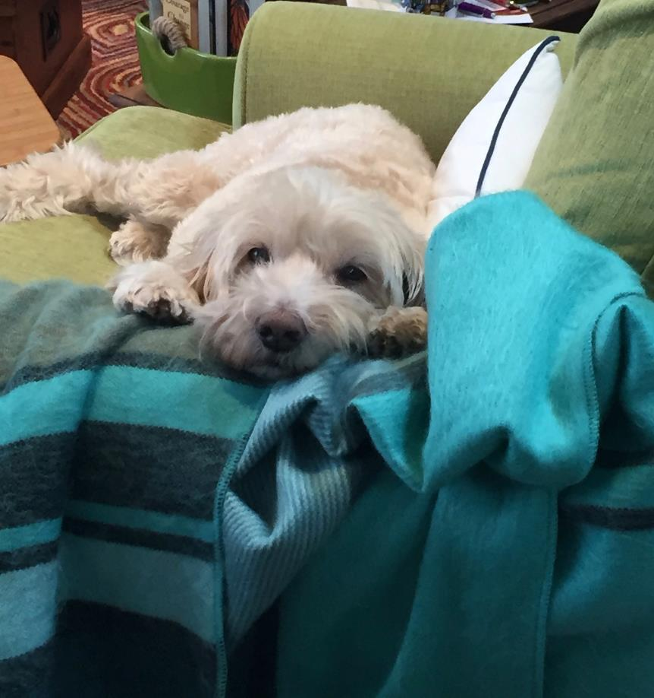
Take a moment to relax…
Image: Robin Frkovic, Photo of Dog Relaxing. London: Personal Photo. CC BY-NC-SA 4.0.
Notes:
Sit in a comfortable position.
Be present in the moment.
Close your eyes or drop your gaze downward.
Ring the chime and ask students to listen to the sound for as long as they can.
Ask students to bring their attention to their breath.
Let students know that if their mind wanders, they can notice it and then just bring their attention back to their breath.
Ring the chime again and let students know that whenever they are ready they can slowly, gently open their eyes and bring their focus back to the room.

Slide 3
So Why Did We Do That?
Everything you do in life from the time you are born to the time you die has to have the breath involved!
When things happen to us, it affects our breath….excited, scared, relaxed, anxious,…
Our brain is working hard all the time and rarely do we use it to think about the most important part of our life…our breathing!
When we think about our breathing and just keep focusing on that, our brain is present in the current moment, and it will flow: it’s in a relaxed state.
Focusing on our breath for even just a few minutes a day can increase our resilience!

Slide 4
What is Resilience?
“The ability of people or things to recover quickly after something unpleasant, such as shock, injury, etc.” (Oxford Dictionary, 2020)
In other words, your ability to BOUNCE BACK from something unpleasant.

Slide 5
COVID 19 Pandemic Resilience Examples
When people had to work from home and home school their children, they made it work. It wasn’t perfect but they did their best.
During lockdowns, people spent more time outdoors and exercised more to get out of their homes.
People helped each other out with getting groceries for those with compromised immune systems.

Slide 6
COVID 19 Resilience Examples Continued
When people lost their jobs, some decided to start their own business from home in an area that they were passionate about.
When people had a limited government income due to job loss, many realized they did not need so many things to be happy and they could live on less money.
People spent more time with their families under one roof and were less distracted with extracurricular activities because there weren’t any. (ex. Sports, going to the movies, going to restaurants, etc.)

Slide 7
Are you born with resilience, or can you develop it?
“resilience is an innate human capacity that can be learned and developed in anyone. All people have the ability to develop the skills that will put them on the path to resilience.” (Unger, 2008)
You can help protect and grow your resilience by looking after your health and wellbeing, building your support networks and changing your thinking from negative to positive.

Slide 8
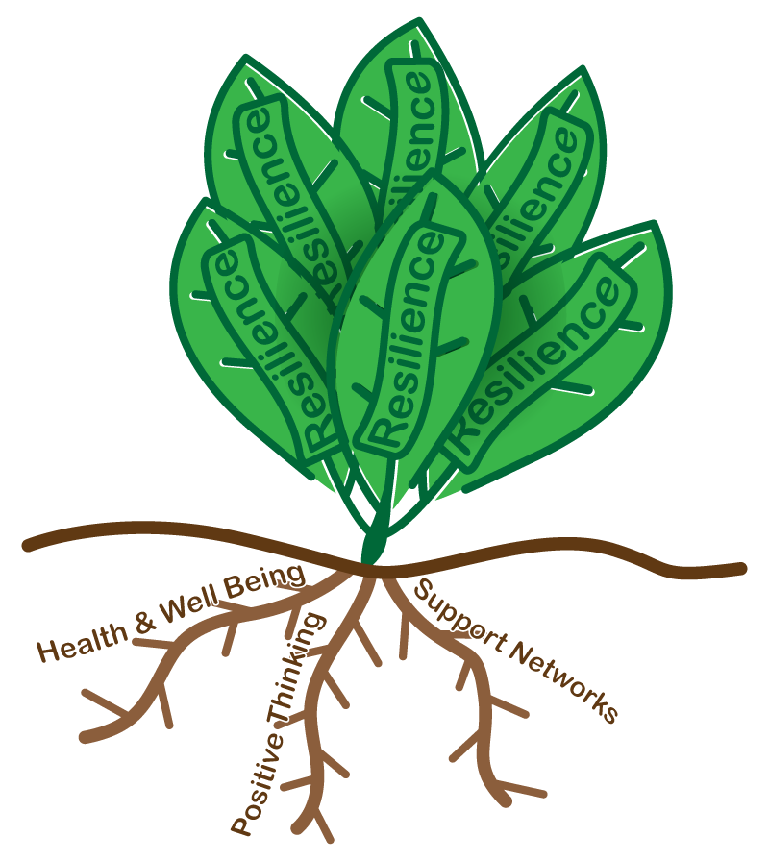
How to Grow Resilience
Image: Resilient Plant Labeling Diagram by Robin Frkovic. CC BY-NC-SA 4.0

Slide 9
Resilience Quiz
Let’s take a short quiz to see how resilient you are.
Quiz: “Brief Resistance Scale”
Take a screenshot of your results, and we will discuss them as a class.

Slide 10
Are You Surprised With The Results?
Use a poll on Nearpod

Slide 11
Why Are We Talking About Resilience?
STRESSORS
College, assignments, relationships, work, health, and money
We can’t do anything about stress; it will always be in our life, but we can control how we react to it!
We can learn from the First Nations culture on why it is important to handle stress in a positive way: empoweringthespirit.ca

Slide 12
Talking Resilience Continued
TOOLS
Exercise, Counselling, Meditation / Breathwork. Nutrition, Sleep, Friends, Family. Social Activities, Hobbies, and Music
Focusing on our breath is a resilience tool that we can use to increase mindfulness and decrease anxiety that we might have as a reaction to stress.

Slide 13
Why Is It Important to Relax?
When we are relaxed, we are better able to “BOUNCE BACK” from challenges that occur in our lives.
When our bodies and minds are relaxed, we are better equipped with clearer thinking to help us solve problems in our lives.

Slide 14
Categories of Resilience Tools
Research has shown that highly resilient people incorporate the following into their life:
Category
Examples of Tools
Quality Sleep
Healthy Nutrition
Physical Exercise
Mindfulness
Social Supports
Service/Helping Others
Growth Mindset
Sleep app, breath work
Healthy recipes app, cooking at home
Exercise app, join a gym
Meditation, journaling
Games night, Zoom Buddy
Volunteering, gratitude cards
Learn new skill, positive statements

Slide 15
Resilience Tool Presentation Assignment
Starting in Week 6, at the beginning and end of each class, students will each take a turn presenting a resilience tool to the class.
The presentations will be done live at the beginning of the class and at the end of the class each week until the end of the term. They should be no longer than 10 minutes in length.
Pick a tool that you find helpful in times of stress to make you feel more relaxed.
It can be an affirmation, song, poem, story, movie, podcast, exercise, meditation, breathing technique, social group, positive thinking practice, ritual to help you sleep, way to stay connected during COVID-19., etc.
You will create a PowerPoint presentation answering the questions on the Resilience Presentation Template on FOL. Students will also have the option of having the class participate in using the tool.

Slide 16
Resources
Break Bad Ones. Random House Business, 2019.
Clear, James. Atomic Habits: an Easy and Proven Way to Build Good Habits.
Clear, James. James Clear. jamesclear.com/. Accessed 20 Nov. 2019.
Dweck, C. (n.d.). The power of believing that you can improve. Retrieved September 4, 2020.
Jenkins, Becky. Recognizing Culture & Diversity in Occupational Therapy Practice, 2011. 23 Mar. 2014. Accessed 11 Feb. 2020.
Liebenberg, L and Unger, M. (2008). Resilience in action. University of Toronto Press.
Oxford Learner's Dictionaries. (n.d.). Resilience noun. Oxford Advanced Learner's Dictionary. Retrieved March 3, 2022, from https://www.oxfordlearnersdictionaries.com/definition/american_english/resilience
Resilience: An innate human capacity. VAWnet.org. (n.d.). Retrieved March 3, 2022, from https://vawnet.org/sc/resilience-innate-human-capacity

