Slide 1
Reflective Learning
Kolb’s Reflective Model
Unless otherwise noted, this work is licensed under a Creative Commons Attribution-NonCommercial-ShareAlike 4.0 International (CC BY-NC-SA 4.0) license.
All images used in this slide deck are retrieved from Microsoft PowerPoint 365 Stock Image tool unless otherwise noted. Templates and clipart are by Microsoft: all rights reserved copyright.

Slide 2
What is reflective learning?
Have you heard the saying ” We learn from our mistakes.” ?
Reflective Learning is a tool you can use to learn from your mistakes.
Simply stated: reflective learning is continuing to learn from your experiences throughout your life.
Thomas Edison, inventor of the light bulb stated:
“I have not failed. I’ve just found 10,000 ways that won’t work”
We can only learn from our mistakes if we think about what went wrong and why and think about what to do differently next time.

Slide 3
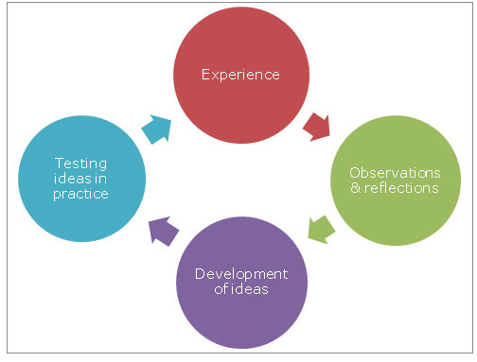
Kolb’s Reflective Model
Source 7. feedback and reflection

Slide 4
Example Using Kolb’s Model of Reflection
Experience: You gave a presentation to your class and you did not get a good grade on the presentation.
Observations and reflections: You were nervous speaking in front of the class and you talked too fast and forgot what you were saying a few times. It was probably confusing for the audience.
Development of ideas: You did some online research about how to cope with nerves when speaking in front of an audience. You watched some videos and learned a few ways to keep yourself calm and stay organized when public speaking.
Testing ideas in practice: Before your next presentation, you practised the strategies for calming that you had learned and had your notes organized so you would not lose your place. You also practised your presentation many times in advance so that you would be less nervous.

Slide 5
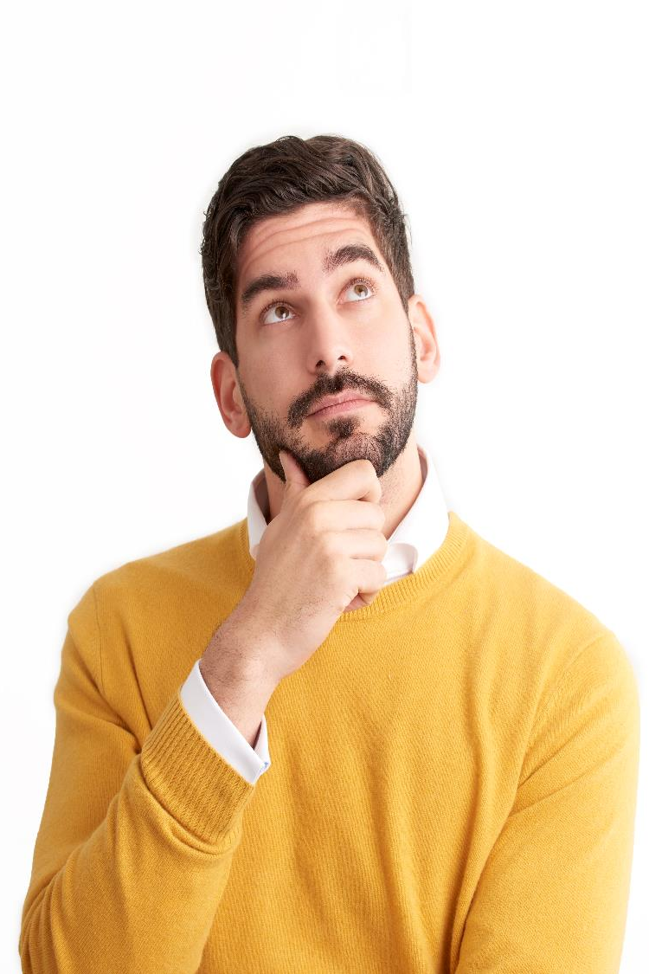
Why is it important to be a reflective learner?
When we reflect, we ask ourselves new questions, try to make sense out of the experience and what happened. This leads to putting what we learn into deeper memory!
We will all make mistakes in life. It is part of life.
It’s what we learn from those mistakes that make us change our actions in the future that matters.

Slide 6
References
Solent University. (n.d.). 7. feedback and reflection. Course: 7. Feedback and Reflection. Retrieved February 13, 2022, from https://learn.solent.ac.uk/course/view.php?id=31636%C2%A7ion#tabs-tree-start

