Slide 1
Psychology, Communication, and The Canadian Workplace
CHAPTER 9: GROUP DYNAMICS
Unless otherwise noted, this work is licensed under a Creative Commons Attribution-NonCommercial-ShareAlike 4.0 International (CC BY-NC-SA 4.0) license. Feel free to use, modify, reuse or redistribute any portion of this presentation.

Slide 2
Learning Outcomes
Upon successful completion of this chapter, you should be able to:
Differentiate between groups and teams.
Identify reasons that people join groups and when they might be preferred to working alone.
Explore the benefits and challenges associated with virtual teams.
Describe the phenomenon of social loafing and identify strategies for minimizing it.
Describe factors that influence group effectiveness including collaboration, team norms, roles, group cohesion, collective efficacy, and emotional intelligence.
Outline the life cycle of groups and their members.
Identify the symptoms of groupthink and strategies to avoid it.
Describe communication strategies for group meetings.

Slide 3
9.1 Groups and Teams I
Groups
A group is a collection of individuals who interact with each other such that one person’s actions have an impact on the others.
Photo by Austin Distel on Unsplash
Notes:
In organizations, most work is done within groups. How groups function has important implications for organizational productivity. Groups where people get along, feel the desire to contribute to the team, and are capable of coordinating their efforts may have high performance levels, whereas teams characterized by extreme levels of conflict or hostility may demoralize members of the workforce.

Slide 4
9.1 Groups and Teams II
Types of Groups
Formal
Informal
Notes:
Formal groups are work units that are prescribed by the organization. Examples of formal groups include sections of departments (such as the accounts receivable section of the accounting department), committees, or special project task forces. These groups are set up by management on either a temporary or permanent basis to accomplish prescribed tasks.
In addition to formal groups, all organizations have a myriad of informal groups. These groups evolve naturally out of individual and collective self-interest among the members of an organization and are not the result of deliberate organizational design. People join informal groups because of common interests, social needs, or simply friendship. Informal groups typically develop their own norms and roles and establish unwritten rules for their members.

Slide 5
9.1 Groups and Teams III
Teams
You probably described a team as a group of some kind. However, a team is more than just a group.
Photo by Jason Goodman on Unsplash
Notes:
When you think of all the groups that you belong to, you will probably find that very few of them are really teams. Some of them will be family or friendship groups that are formed to meet a wide range of needs such as affection, security, support, esteem, belonging, or identity.
Some may be committees whose members represent different interest groups and who meet to discuss their differing perspectives on issues of interest.
In this reading the term ‘work group’ (or ‘group’) is often used interchangeably with the word ‘team,’ although a team may be thought of as a particularly cohesive and purposeful type of work group. We can distinguish work groups or teams from more casual groupings of people by using the following set of criteria (Adair, 1983).
Increasingly, virtual team are common. A virtual team is one whose primary means of communicating is electronic, with only occasional phone and face-to-face communication, if at all.

Slide 6
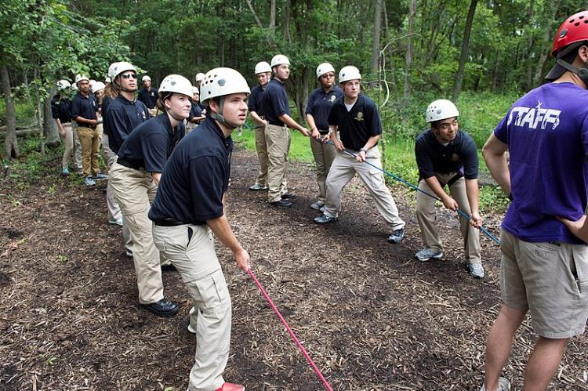
9.2 Characteristics of Effective Groups I
Social Loafing
Social loafing refers to the tendency of individuals to put in less effort when working in a group context.
Notes:
This phenomenon, also known as the Ringelmann effect, was first noted by French agricultural engineer Max Ringelmann in 1913. In one study, he had people pull on a rope individually and in groups. He found that as the number of people pulling increased, the group’s total pulling force was less than the individual efforts had been when measured alone (Karau & Williams, 1993).

Slide 7
9.2 Characteristics of Effective Groups II
Team Norms
Group Roles
Cohesion
Collective Efficacy
Emotional Intelligence

Slide 8
9.2 Characteristics of Effective Groups III
Team Norms
Norms are shared expectations about how things operate within a group or team. Just as new employees learn to understand and share the assumptions, norms, and values that are part of an organization’s culture, they also must learn the norms of their immediate team.
Notes:
This understanding helps teams be more cohesive and perform better. Norms are a powerful way of ensuring coordination within a team. For example, is it acceptable to be late to meetings? How prepared are you supposed to be at the meetings? Is it acceptable to criticize someone else’s work? These norms are shaped early during the life of a team and affect whether the team is productive, cohesive, and successful.

Slide 9
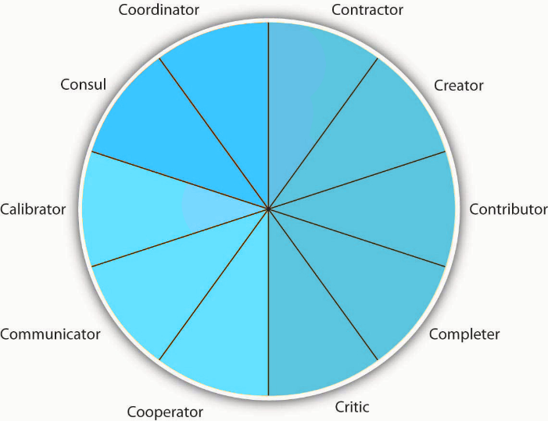
9.2 Characteristics of Effective Groups IV
Group Roles
Notes:
In order to accomplish its goals and maintain its norms, a group must differentiate the work activities of its members.
One or more members assume leadership positions, others carry out the major work of the group, and still others serve in support roles. This specialization of activities is commonly referred to as role differentiation.
More specifically, a work role is an expected behavior pattern assigned or attributed to a particular position in the organization. It defines individual responsibilities on behalf of the group.

Slide 10
9.2 Characteristics of Effective Groups V
Cohesion
Cohesion can be thought of as a kind of social glue. It refers to the degree of camaraderie within the group. Cohesive groups are those in which members are attached to each other and act as one unit.
Notes:
Generally speaking, the more cohesive a group is, the more productive it will be and the more rewarding the experience will be for the group’s members (Beal et al., 2003; Evans & Dion, 1991).
Members of cohesive groups tend to have the following characteristics: They have a collective identity; they experience a moral bond and a desire to remain part of the group; they share a sense of purpose, working together on a meaningful task or cause; and they establish a structured pattern of communication.

Slide 11
9.2 Characteristics of Effective Groups VI
Collective Efficacy
Collective efficacy refers to a group’s perception of its ability to successfully perform well (Bandura, 1997). It is influenced by a number of factors, including watching others (“that group did it and we’re better than them”), verbal persuasion (“we can do this”), and how a person feels (“this is a good group”).
Notes:
Research shows that a group’s collective efficacy is related to its performance (Gully et al., 2002; Porter, 2005; Tasa, Taggar, & Seijts, 2007).
In addition, this relationship is higher when task interdependence (the degree an individual’s task is linked to someone else’s work) is high rather than low.

Slide 12
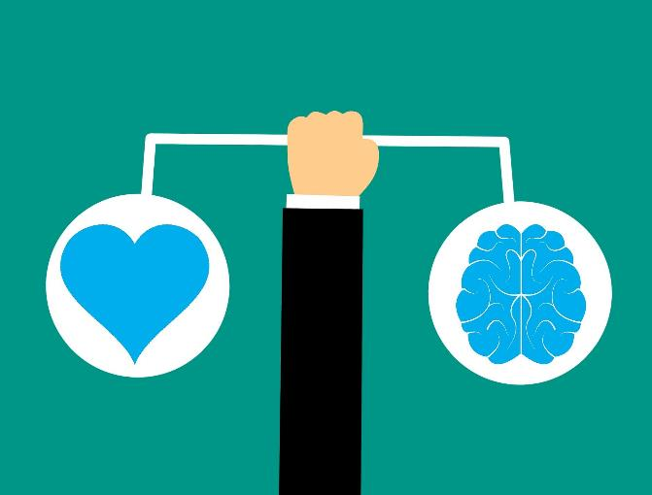
9.2 Characteristics of Effective Groups VII
Emotional Intelligence
Developing skills that can help us work better in these groups relates to the social awareness and relationship management aspects of emotional intelligence.
Picture Source: Pixabay
Notes:
These two skills—the ability to understand social cues that can be affecting others and
our ability to communicate and maintain good relationships—are the cornerstones in any group situation.

Slide 13
9.3 Group Life Cycle I
Groups are dynamic systems in constant change. Groups grow together and eventually come apart. People join groups and others leave. This dynamic changes and transforms the very nature of the group.

Slide 14
9.3 Group Life Cycle II
Group Life Cycle Patterns
Notes:
Forming- This stage is also called the orientation stage because individual group members come to know each other.
Storming- a time of struggles as the members themselves sort out their differences. There may be more than one way to solve the problem or task at hand, and some group members may prefer one strategy over another.
Norming- where the group establishes norms, or informal rules, for behavior and interaction. Who speaks first? Who takes notes? Who is creative, who is visual, and who is detail-oriented?
Performing- the group accomplishes its mandate, fulfills its purpose, and reaches its goals. To facilitate performance, group members can’t skip the initiation of getting to know each other or the sorting out of roles and norms, but they can try to focus on performance with clear expectations from the moment the group is formed.
Adjourning- members leave the group. The group may cease to exist or it may be transformed with new members and a new set of goals.

Slide 15
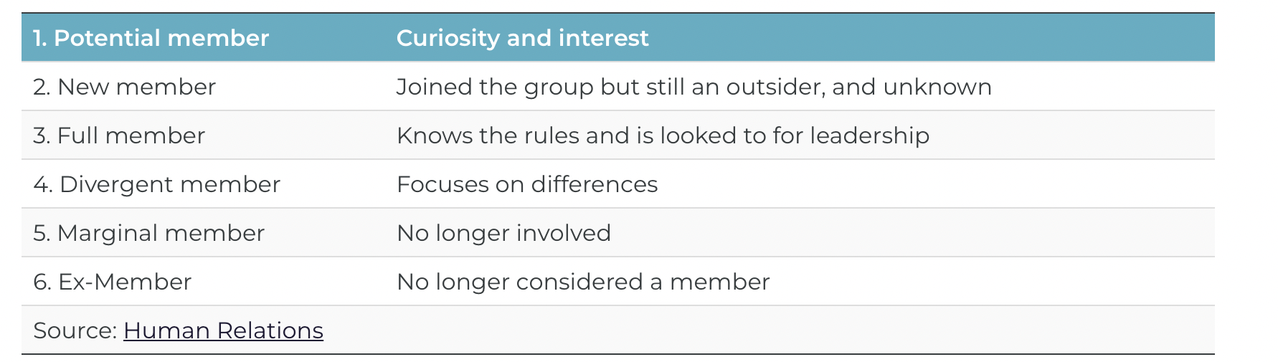
9.3 Group Life Cycle III
Life Cycle of Member Roles

Slide 16
9.4 Group Decision-making I
Group decision making has the advantage of drawing from the experiences and perspectives of a larger number of individuals.
Photo by Annie Spratt on Unsplash
Notes:
When It Comes to Decision Making, Are Two Heads Better Than One?
A group may have the potential to be more creative and lead to more effective decisions. In fact, groups may sometimes achieve results beyond what they could have done as individuals.
Groups may also make the task more enjoyable for the members. Finally, when the decision is made by a group rather than a single individual, implementation of the decision will be easier, because group members will be more invested in the decision
If the group is diverse, better decisions may be made, because different group members may have different ideas based on their backgrounds and experiences.
Research shows that for top management teams, diverse groups that debate issues make decisions that are more comprehensive and better for the bottom line (Simons et al., 1999).

Slide 17
9.4 Group Decision-making II
Groupthink
Illusion of invulnerability
Collective rationalizations
An unquestioned belief in the group’s inherent morality
Stereotyped views of outgroups
Direct pressure
Self-censorship
Illusions of unanimity
The emergence of self-appointed mindguards
Notes:
Illusion of invulnerability is shared by most or all of the group members, which creates excessive optimism and encourages them to take extreme risks.
Collective rationalizations occur, in which members downplay negative information or warnings that might cause them to reconsider their assumptions.
An unquestioned belief in the group’s inherent morality occurs, which may incline members to ignore ethical or moral consequences of their actions.
Stereotyped views of outgroups are seen when groups discount rivals’ abilities to make effective responses.
Direct pressure is exerted on any members who express strong arguments against any of the group’s stereotypes, illusions, or commitments.
Self-censorship occurs when members of the group minimize their own doubts and counterarguments.
Illusions of unanimity occur, based on self-censorship and direct pressure on the group. The lack of dissent is viewed as unanimity.
The emergence of self-appointed mindguards happens when one or more members protect the group from information that runs counter to the group’s assumptions and course of action.

Slide 18
9.5 Group Communication I
Group communication may be defined as the exchange of information with those who are alike culturally, linguistically, and/or geographically.
Picture source: Pixabay
Notes:
Group members may be known by their symbols, such as company logos or work uniforms. They may be known by their use of specialized language or jargon; for example, someone in information technology may use the term “server” in reference to the Internet, whereas someone in the food service industry may use “server” to refer to the worker who takes customer orders in a restaurant.

Slide 19
3.5 Key Takeaways
A group is a collection of individuals who interact with each other such that one person’s actions have an impact on the others. Groups can be informal or formal in nature. Both informal and formal groups serve important functions in the workplace.
When a group is cohesive and has a shared purpose it can be considered a team.
Social loafing is the finding that individuals do not always contribute as much effort to work when in a group compared to when they are working alone. There are a number of factors that can help us to understand group effectiveness and decrease the probability of social loafing.
Groups and their individual members come together and grow apart in predictable patterns. This is called the group development stages, which include forming, storming, norming, performing, and adjourning. Each group member has a life cycle that defines their role as they enter and exit the group.
Groups decision-making can lead to more diverse thinking and problem solving. However, when groups are too cohesive or controlled, they can fall prey to insulated thinking and groupthink.
Group communications, including meetings, are an important part of workplace communications.

