Slide 1
Psychology, Communication, and The Canadian Workplace
CHAPTER 8: CHAPTER 8: PERSONALITY
Unless otherwise noted, this work is licensed under a Creative Commons Attribution-NonCommercial-ShareAlike 4.0 International (CC BY-NC-SA 4.0) license. Feel free to use, modify, reuse or redistribute any portion of this presentation.

Slide 2
Learning Outcomes
Upon successful completion of this chapter, you should be able to:
Define personality, values, and attitudes.
Explain the link between personality, values, attitudes, and work behaviour.
Appreciate the diversity of methods that are used to measure personality characteristics.
Describe different theories of personality.
Understand how personality interacts with job, organizational, and situational factors to produce behaviours in the workplace.

Slide 3
8.1 Personality I
Personality encompasses our relatively stable feelings, thoughts, and behavioural patterns.
Photo by Brett Jordan on Unsplash
Notes:
Our personality differentiates us from other people and understanding someone’s personality gives us clues about how that person is likely to act and feel in a variety of situations. In order to effectively manage organizational behaviour, an understanding of different employees’ personalities is helpful. Having this knowledge is also useful for placing people in jobs and organizations.
Our personality has a lot to do with how we relate to one another at work. How we think, what we feel, and our normal behavior characterize what our colleagues come to expect of us both in behavior and the expectation of their interactions with us.

Slide 4
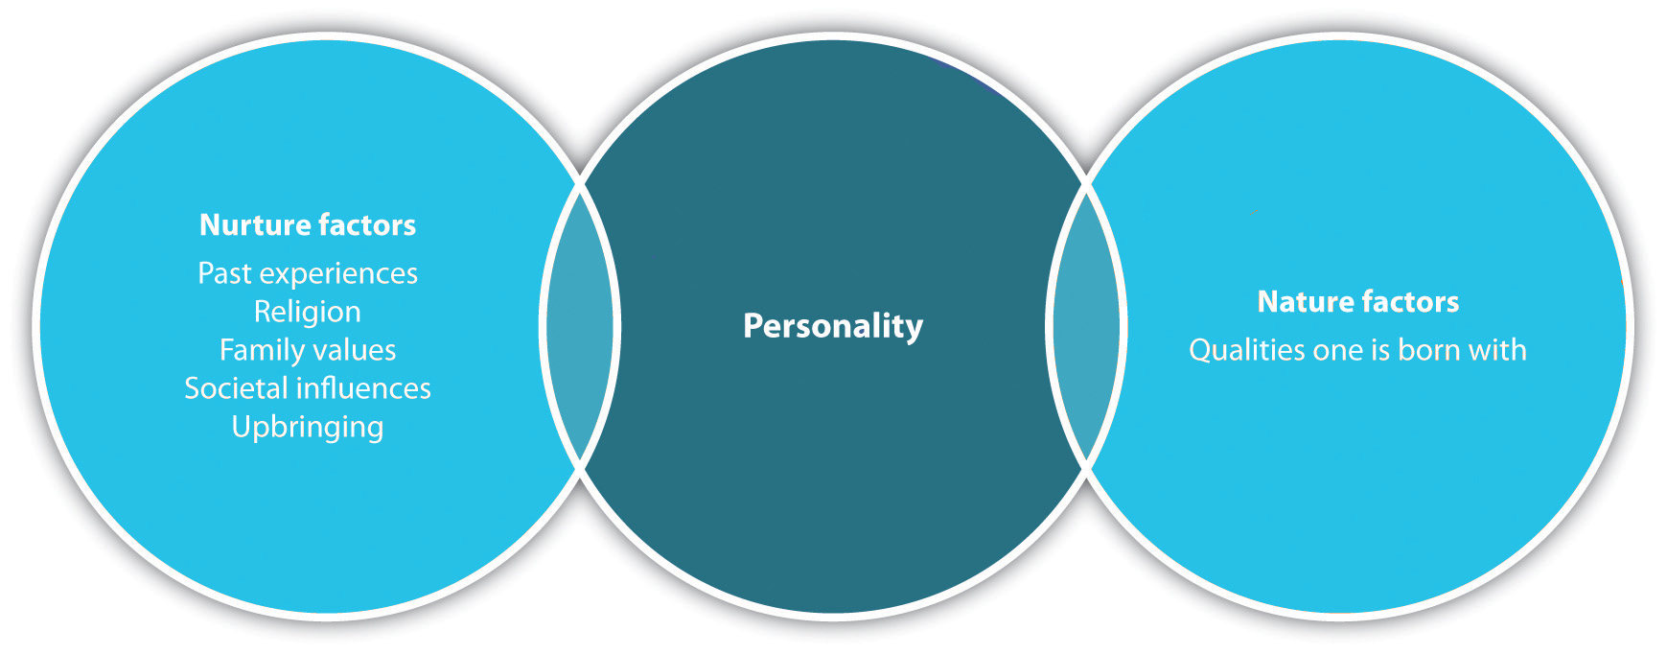
8.1 Personality II
Nature vs Nurture
Notes:
A combination of nature and nurture determines our personality.
How much of our personality is in-born and biological, and how much is influenced by the environment and culture we are raised in? Psychologists who favor the biological approach believe that inherited predispositions as well as physiological processes can be used to explain differences in our personalities (Burger, 2008).
Although there is debate between whether or not our personalities are inherent when we are born (nature) versus the way we grew up (nurture), most researchers agree that personality is usually a result of both nature and our environmental/education experiences.
For example, you have probably heard someone say, “She acts just like her mother.” She likely behaves that way because she was born with some of her mother’s traits, as well as because she learned some of the behaviors her mother passed to her while growing up.

Slide 5
8.1 Personality III
Values
Values refer to stable life goals that people have, reflecting what is most important to them. Values are established throughout one’s life as a result of the accumulating life experiences and tend to be relatively stable.
(Lusk & Oliver, 1974; Rokeach, 1973).
Notes:
The values that are important to people tend to affect the types of decisions they make, how they perceive their environment, and their actual behaviours (Judge & Bretz, 1992; Ravlin & Meglino, 1987).
People are more likely to accept job offers when the company possesses the values people care about. Value attainment is one reason why people stay in a company, and when an organization does not help them attain their values, they are more likely to decide to leave if they are dissatisfied with the job itself (George & Jones, 1996).
Research indicates that values are shaped early in life and show stability over the course of a lifetime. Early family experiences are important influences over the dominant values. People who were raised in families with low socioeconomic status and those who experienced restrictive parenting often display conformity values when they are adults, while those who were raised by parents who were cold toward their children would likely value and desire security (Kasser et al., 2002)
Our values also help determine our personality. Our values are those things we find most important to us.

Slide 6
8.1 Personality IV
Attitudes
Our attitudes are favorable or unfavorable opinions toward people, things, or situations. Many things affect our attitudes, including the environment we were brought up in and our individual experiences.
Notes:
Our personalities and values play a large role in our attitudes as well. For example, many people may have attitudes toward politics that are similar to their parents, but their attitudes may change as they gain more experiences. If someone has a bad experience around the ocean, they may develop a negative attitude around beach activities.
The important thing to remember about attitudes is that they can change over time, but usually some sort of positive experience needs to occur for our attitudes to change dramatically for the better. We also have control of our attitude in our thoughts. If we constantly stream negative thoughts, it is likely we may become a negative person.
In a workplace environment, you can see where attitude is important. Someone’s personality may be cheerful and upbeat. These are the prized employees because they help bring positive perspective to the workplace. Likewise, someone with a negative attitude is usually someone that most people prefer not to work with.

Slide 7
8.2 Measuring Personality I
Strategies used to measure personality characteristics:
Objective Tests
Projective and Implicit Tests
Behavioural Tests
Personality Testing in Employee Selection
Notes:
Strategies to assess personality include objective, projective, implicit, and behavioural tests. Personality tests can provide employers with helpful insights.

Slide 8
8.2 Measuring Personality II
Objective tests represent the most familiar and widely used approach to assessing personality. Objective tests involve administering a standard set of items, each of which is answered using a limited set of response options (e.g., true or false; strongly disagree, slightly disagree, slightly agree, strongly agree).
(Loevinger, 1957; Meyer & Kurtz, 2006)
Notes:
It must be emphasized that the term “objective” refers to the method that is used to score a person’s responses, rather than to the responses themselves.
As noted by Meyer and Kurtz (2006, p. 233), “What is objective about such a procedure is that the psychologist administering the test does not need to rely on judgment to classify or interpret the test-taker’s response; the intended response is clearly indicated and scored according to a pre-existing key.”
Information from objective tests can be gathered in two ways: through self-report in which participants reflect on their own personality or by using ratings from informants.

Slide 9
8.2 Measuring Personality III
Projective and Implicit Tests
Projective tests represent influential early examples of this approach. Projective tests originally were based on the projective hypothesis’
In recent years, researchers have begun to use implicit measures of personality (Back et al., 2009; Vazire & Carlson, 2011). These tests are based on the assumption that people form automatic or implicit associations between certain concepts based on their previous experience and behavior.
Notes:
Some approaches to personality assessment are based on the belief that important thoughts, feelings, and motives operate outside of conscious awareness. Two ways to assess these nonconscious influences on personality are through projective and implicit tests.

Slide 10
8.2 Measuring Personality IV
Behavioral Tests
Behavioral measures offer several advantages over other approaches to assessing personality. First, because behavior is sampled directly, this approach is not subject to the types of response biases (e.g., self-enhancement bias, reference group effect) that can distort scores on objective tests.
Notes:
Observing real world behavior is one way to assess personality. Tendencies such as messiness and neatness are clues to personality.

Slide 11
8.2 Measuring Personality V
Personality Testing in Employee Selection
Personality is a potentially important predictor of work behaviour. Matching people to jobs matters, because when people do not fit with their jobs or the company, they are more likely to leave, costing companies as much as a person’s annual salary to replace them.
Notes:
In job interviews, companies try to assess a candidate’s personality and the potential for a good match, but interviews are only as good as the people conducting them. In fact, interviewers are not particularly good at detecting the best trait that predicts performance: conscientiousness (Barrick et al., 2000)

Slide 12
8.3 Theories of Personality I
8 Theories of Personality
Early Trait Theories
Trait Theory: Big Five Personality
Myers-Briggs Type Inventory
Positive and Negative Affect
Self-efficacy
Self-monitoring
Proactive Personality
Type A/B Personality

Slide 13
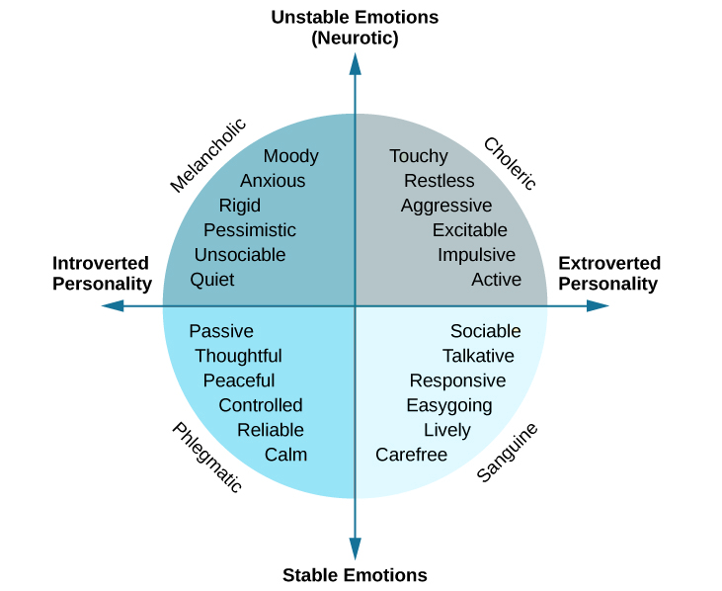
8.3 Theories of Personality II
Early Trait Theories
Notes:
Trait theorists believe personality can be understood via the approach that all people have certain traits, or characteristic ways of behaving. Do you tend to be sociable or shy? Passive or aggressive? Optimistic or pessimistic? Moody or even-tempered? Early trait theorists tried to describe all human personality traits.
For example, one trait theorist, Gordon Allport (Allport & Odbert, 1936), found 4,500 words in the English language that could describe people. He organized these personality traits into three categories: cardinal traits, central traits, and secondary traits.
A cardinal trait is one that dominates your entire personality, and hence your life—such as Ebenezer Scrooge’s greed and Mother Theresa’s altruism. Cardinal traits are not very common: Few people have personalities dominated by a single trait. Instead, our personalities typically are composed of multiple traits.
Central traits are those that make up our personalities (such as loyal, kind, agreeable, friendly, sneaky, wild, and grouchy).
Secondary traits are those that are not quite as obvious or as consistent as central traits.
The Eysencks described two factors to account for variations in our personalities: extroversion/introversion and emotional stability/instability.

Slide 14
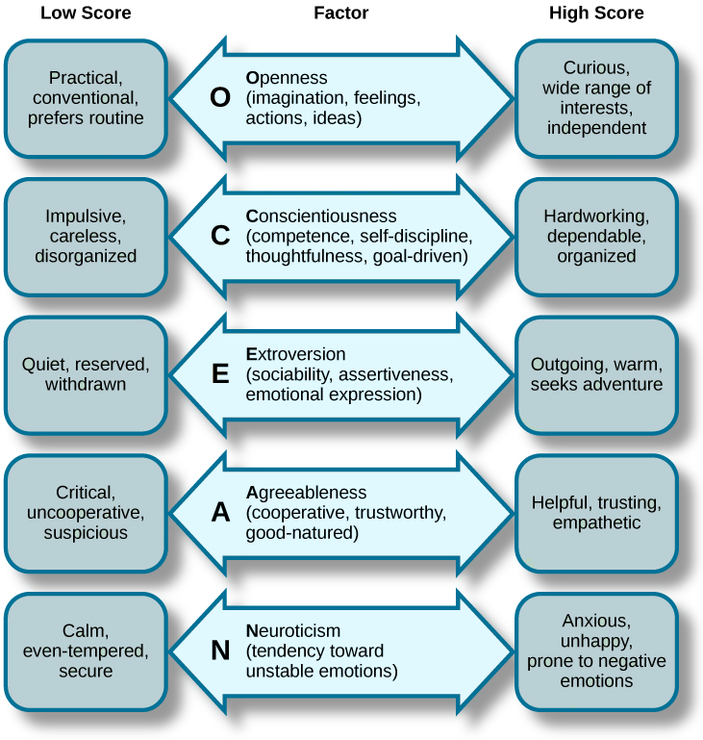
8.3 Theories of Personality III
Trait Theory:
Big Five Personality
Notes:
The Big Five personality theory is the most popular theory in personality psychology today and the most accurate approximation of the basic personality dimensions (Funder, 2001).
The five factors are openness to experience, conscientiousness, extroversion, agreeableness, and neuroticism
A helpful way to remember the factors is by using the mnemonic OCEAN.
The Big Five personality factors each represent a range between two extremes. In reality, most of us tend to lie somewhere midway along the continuum of each factor, rather than at polar ends. It’s important to note that the Big Five factors are relatively stable over our lifespan, with some tendency for the factors to increase or decrease slightly.
Openness is the degree to which a person is curious, original, intellectual, creative, and open to new ideas. People high in openness seem to thrive in situations that require being flexible and learning new things
Conscientiousness refers to the degree to which a person is organized, systematic, punctual, achievement oriented, and dependable. Conscientiousness is the one personality trait that uniformly predicts how high a person’s performance will be, across a variety of occupations and jobs
Extraversion is the degree to which a person is outgoing, talkative, and sociable, and enjoys being in social situations.
Agreeableness is the degree to which a person is nice, tolerant, sensitive, trusting, kind, and warm. In other words, people who are high in agreeableness are likeable people who get along with others.
Neuroticism refers to the degree to which a person is anxious, irritable, aggressive, temperamental, and moody.

Slide 15
8.3 Theories of Personality IV
Myers-Briggs Type Indicator
In MBTI, people are grouped using four dimensions. Based on how a person is classified on these four dimensions, it is possible to talk about 16 unique personality types, such as ESTJ and ISTP.
Notes:
MBTI was developed in 1943 by a mother–daughter team, Isabel Myers and Katherine Cook Briggs. Its objective at the time was to aid World War II veterans in identifying the occupation that would suit their personalities. Since that time, MBTI has become immensely popular, and according to one estimate, around 2.5 million people take the test annually.
MBTI was developed in 1943 by a mother–daughter team, Isabel Myers and Katherine Cook Briggs.
Its objective at the time was to aid World War II veterans in identifying the occupation that would suit their personalities. Since that time, MBTI has become immensely popular, and according to one estimate, around 2.5 million people take the test annually.

Slide 16
8.3 Theories of Personality V
Positive and Negative Affectivity
Positive affective people experience positive moods more frequently, whereas negative affective people experience negative moods with greater frequency. Negative affective people focus on the “glass half empty” and experience more anxiety and nervousness (Watson & Clark, 1984).
Notes:
You may have noticed that behaviour is also a function of moods. When people are in a good mood, they may be more cooperative, smile more, and act friendly. When these same people are in a bad mood, they may have a tendency to be picky, irritable, and less tolerant of different opinions. Yet, some people seem to be in a good mood most of the time, and others seem to be in a bad mood most of the time regardless of what is actually going on in their lives. This distinction is manifested by positive and negative affectivity traits.
Positive affective people tend to be happier at work (Ilies & Judge, 2003), and their happiness spreads to the rest of the work environment.

Slide 17
8.3 Theories of Personality VI
Self-Monitoring
Self-monitoring refers to the extent to which a person is capable of monitoring his or her actions and appearance in social situations. In other words, people who are social monitors are social chameleons who understand what the situation demands and act accordingly, while low social monitors tend to act the way they feel (Snyder, 1974; Snyder, 1987).
Notes:
High social monitors are sensitive to the types of behaviours the social environment expects from them. Their greater ability to modify their behaviour according to the demands of the situation and to manage their impressions effectively is a great advantage for them (Turnley & Bolino, 2001). In general, they tend to be more successful in their careers. They are more likely to get cross-company promotions, and even when they stay with one company, they are more likely to advance (Day & Schleicher; Kilduff & Day, 1994).

Slide 18
8.3 Theories of Personality VII
Proactive Personality
Proactive personality refers to a person’s inclination to fix what is perceived as wrong, change the status quo, and use initiative to solve problems. Instead of waiting to be told what to do, proactive people take action to initiate meaningful change and remove the obstacles they face along the way.
Notes:
In general, having a proactive personality has a number of advantages for these people. For example, they tend to be more successful in their job searches (Brown et al., 2006).
They are also more successful over the course of their careers, because they use initiative and acquire greater understanding of the politics within the organization (Seibert, 1999; Seibert, Kraimer, & Crant, 2001)

Slide 19
8.3 Theories of Personality VIII
Self-Efficacy
Self-efficacy is a belief that one can perform a specific task successfully. Research shows that the belief that we can do something is a good predictor of whether we can actually do it. Self-efficacy is different from other personality traits in that it is job specific.
Notes:
You may have high self-efficacy in being successful academically, but low self-efficacy in relation to your ability to fix your car. At the same time, people have a certain level of generalized self-efficacy and they have the belief that whatever task or hobby they tackle, they are likely to be successful in it.

Slide 20
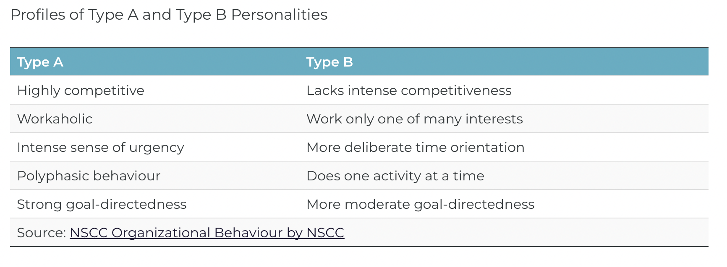
8.3 Theories of Personality IX
Notes:
Type A personality is characterized by impatience, restlessness, aggressiveness, competitiveness, polyphasic activities (having many “irons in the fire” at one time), and being under considerable time pressure
Type B people, on the other hand, experience fewer pressing deadlines or conflicts, are relatively free of any sense of time urgency or hostility, and are generally less competitive on the job.
Type A personality is frequently found in managers. Indeed, one study found that 60 percent of managers were clearly identified as Type A, whereas only 12 percent were clearly identified as Type B (Howard et al., 1976).

Slide 21
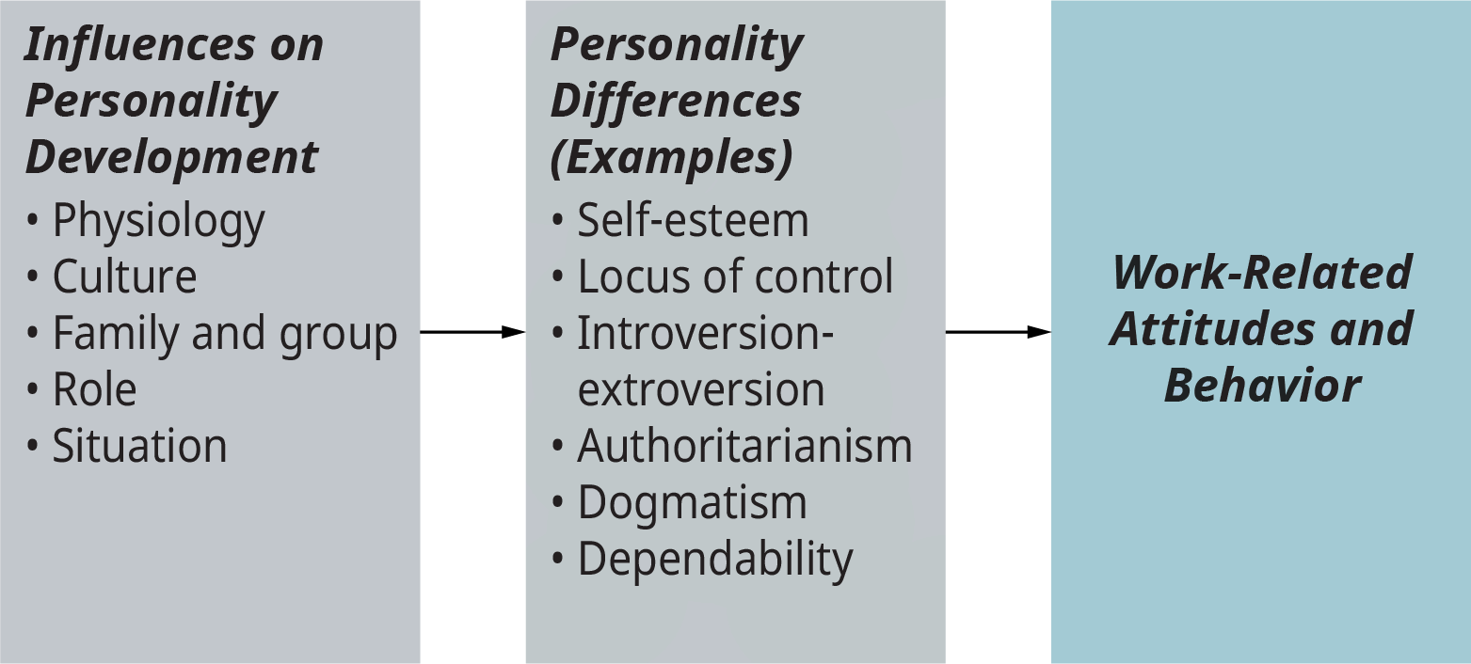
8.4 Personality at Work
Notes:
The number of traits people are believed to exhibit varies according to which theory we employ. In an exhaustive search, over 17,000 can be identified.
We can identify six traits that seem to be relatively important for our purposes here, some of which relate to the constructs discussed in the previous section.
It will be noted that some of these traits (for example, self-esteem or locus of control) have to do with how we see ourselves, whereas other traits (for example, introversion-extroversion or dependability) have to do with how we interact with others. Moreover, these traits are largely influenced by one’s personality development and, in turn, influence actual attitudes and behaviors at work
Self-esteem can be defined as one’s opinion or belief about one’s self and self-worth. It is how we see ourselves as individuals.
Locus of control refers to the tendency among individuals to attribute the events affecting their lives either to their own actions or to external forces; it is a measure of how much you think you control your own destiny
Introverts (introversion) tend to focus their energies inwardly and have a greater sensitivity to abstract feelings, whereas extroverts (extroversion) direct more of their attention to other people, objects, and events.

Slide 22
8.5 Key Takeaways
Personality is our stable traits that help us to interact with the world.
Our values and attitudes have an influence on our personality.
There are many methods used by researchers to measure personality including objective tests, projective tests, implicit tests, and by directly observing behaviour.
There are many theories to describe personality.
Studying specific traits can be useful to predict behaviour in the workplace. However, we also need to consider situational factors including a person’s fit with their job and the organization when trying to understand behaviour in the workplace.

