Slide 1
Psychology, Communication, and The Canadian Workplace
CHAPTER 7: DECISION-MAKING
Unless otherwise noted, this work is licensed under a Creative Commons Attribution-NonCommercial-ShareAlike 4.0 International (CC BY-NC-SA 4.0) license. Feel free to use, modify, reuse or redistribute any portion of this presentation.

Slide 2
Learning Outcomes
Upon successful completion of this chapter, you should be able to:
Define decision making.
Describe influences on decision-making.
Identify common biases that impact the decision-making process
Understand the different types of decisions you may make in your career and personal life.

Slide 3
7.1 Understanding Decision-making I
Decision-making is the action or process of thinking through possible options and selecting one.
Picture source: Pixabay
Notes:
Individuals throughout organizations use the information they gather to make a wide range of decisions. These decisions may affect the lives of others and change the course of an organization.
It is important to recognize that employees and managers alike are continually making decisions, and that the quality of their decision-making has an impact—sometimes quite significant—on the effectiveness of the organization and its stakeholders.

Slide 4
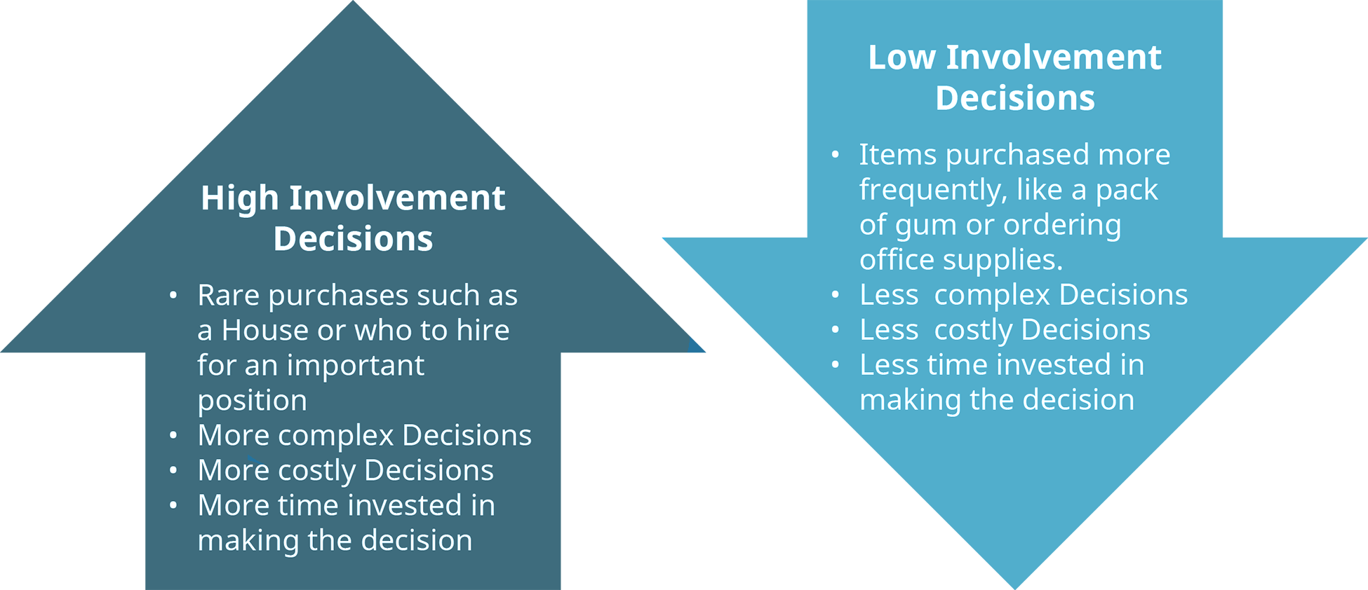
7.1 Understanding Decision-making II
Types of Decisions
Notes:
Because managers have limited time and must use that time wisely to be effective, it is important for them to distinguish between decisions that can have structure and routine applied to them (called programmed decisions) and decisions that are novel and require thought and attention (nonprogrammed decisions).
Programmed decisions are those that are repeated over time and for which an existing set of rules can be developed to guide the process. These decisions might be simple, or they could be fairly complex, but the criteria that go into making the decision are all known or can at least be estimated with a reasonable degree of accuracy.
In contrast, nonprogrammed decisions are novel, unstructured decisions that are generally based on criteria that are not well-defined. With nonprogrammed decisions, information is more likely to be ambiguous or incomplete, and the decision maker may need to exercise some thoughtful judgment and creative thinking to reach a good solution.

Slide 5
7.1 Understanding Decision-making III
Levels of Decision-making
Strategic Decisions
Tactical Decisions
Operational Decisions
Picture source: Pixabay
Notes:
Decisions can be classified into three categories based on the level at which they occur.
Strategic decisions set the course of an organization.
Tactical decisions are decisions about how things will get done.
Operational decisions refer to decisions that employees make each day to make the organization run.

Slide 6
7.2 Decision-making Models IV
4 Types of Decision-making models
Rational Decision-making
Bounded Rationality
Intuitive Decision-making
Creative Decision-making
Notes:
The importance of making good decisions relates to our ability to manage our emotional intelligence to make sure we make the right decisions. These models will help us make better decisions, which results in better human relations.

Slide 7
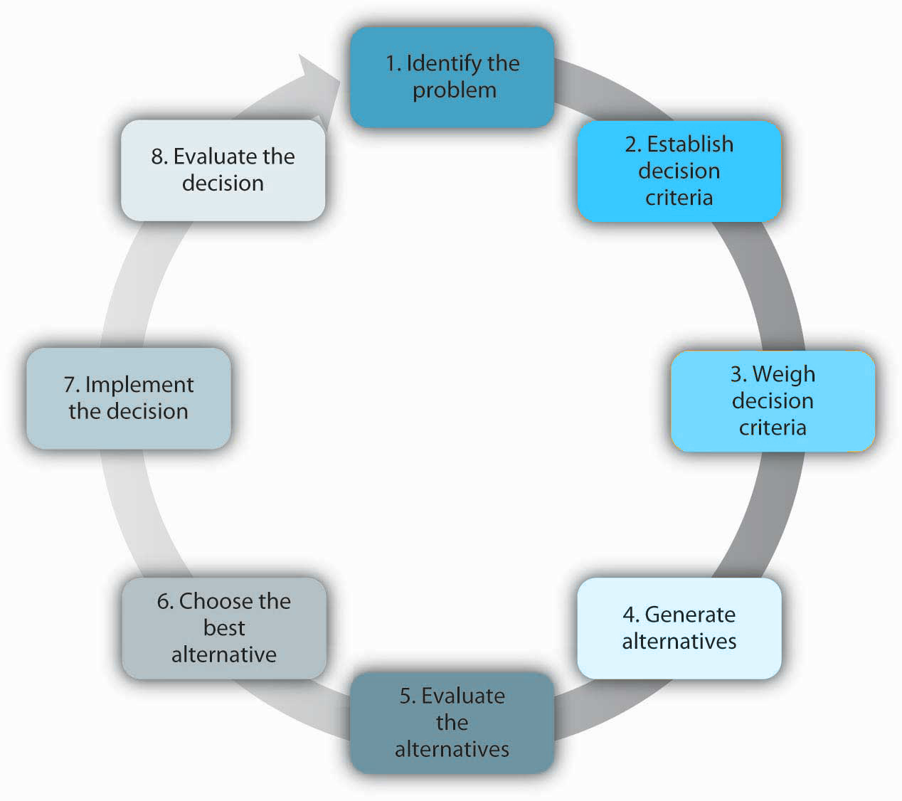
7.2 Decision-making Models V
Rational Decision Making
Notes:
The rational decision-making model describes a series of steps that decision makers should consider if their goal is to maximize the quality of their outcomes. In other words, if you want to make sure that you make the best choice, going through the formal steps of the rational decision-making model may make sense.
While decision makers can get off track during any of these steps, research shows that searching for alternatives in the fourth step can be the most challenging and often leads to failure.

Slide 8
7.2 Decision-making Models VI
Bounded Rationality: Making “Good Enough” Decisions
The bounded rationality model of decision making recognizes the limitations of our decision-making processes. According to this model, individuals knowingly limit their options to a manageable set and choose the first acceptable alternative without conducting an exhaustive search for alternatives.
Notes:
An important part of the bounded rationality approach is the tendency to satisfice (a term coined by Herbert Simon from satisfy and suffice), which refers to accepting the first alternative that meets your minimum criteria.
For example, many college graduates do not conduct a national or international search for potential job openings. Instead, they focus their search on a limited geographic area, and they tend to accept the first offer in their chosen area, even if it may not be the ideal job situation.

Slide 9
7.2 Decision-making Models VII
Intuitive Decision-making
The intuitive decision-making model has emerged as an alternative to other decision-making processes. This model refers to arriving at decisions without conscious reasoning. A total of 89 percent of managers surveyed admitted to using intuition to make decisions at least sometimes and 59 percent said they used intuition often (Burke & Miller, 1999).
Notes:
Managers make decisions under challenging circumstances, including time pressures, constraints, a great deal of uncertainty, changing conditions, and highly visible and high-stakes outcomes. Thus, it makes sense that they would not have the time to use the rational decision-making model.

Slide 10
7.2 Decision-making Models VIII
Creative Decision-making
Notes:
In addition to the rational decision making, bounded rationality, and intuitive decision-making models, creative decision making is a vital part of being an effective decision maker. Creativity is the generation of new, imaginative ideas.
With the flattening of organizations and intense competition among companies, individuals and organizations are driven to be creative in decisions ranging from cutting costs to generating new ways of doing business.
Please note that, while creativity is the first step in the innovation process, creativity and innovation are not the same thing. Innovation begins with creative ideas, but it also involves realistic planning and follow-through.

Slide 11
7.3 Bias in Decision-making I
5 biases in Decision-making
Overconfidence bias
Hindsight bias
Anchoring bias
Framing bias
Escalation of commitment
Notes:
No matter which model you use, it is important to know and avoid the decision-making traps that exist. Daniel Kahnemann (another Nobel Prize winner) and Amos Tversky spent decades studying how people make decisions. They found that individuals are influenced by overconfidence bias, hindsight bias, anchoring bias, framing bias, and escalation of commitment.
An awareness of some of the pitfalls of decision making enhances our ability to make good decisions. When we make good decisions, we are happier, which makes for more positive human relations skills.

Slide 12
7.3 Bias in Decision-making II
Overconfidence bias
Overconfidence bias occurs when individuals overestimate their ability to predict future events. Many people exhibit signs of overconfidence.
Notes:
For example, 82 percent of the drivers surveyed feel they are in the top 30 percent of safe drivers, 86 percent of students at the Harvard Business School say they are better looking than their peers, and doctors consistently overestimate their ability to detect problems (Tilson, 1999).

Slide 13
7.3 Bias in Decision-making III
Hindsight bias
Hindsight bias is the opposite of overconfidence bias, as it occurs when looking backward in time and mistakes seem obvious after they have already occurred. In other words, after a surprising event occurred, many individuals are likely to think that they already knew the event was going to happen.
Notes:
This bias may occur because they are selectively reconstructing the events. Hindsight bias tends to become a problem when judging someone else’s decisions. For example, let’s say a company driver hears the engine making unusual sounds before starting the morning routine

Slide 14
7.3 Bias in Decision-making IV
Anchoring bias
Anchoring refers to the tendency for individuals to rely too heavily on a single piece of information. Job seekers often fall into this trap by focusing on a desired salary while ignoring other aspects of the job offer such as additional benefits, fit with the job, and working environment.

Slide 15
7.3 Bias in Decision-making V
Framing Bias
Framing bias is another concern for decision makers. Framing bias refers to the tendency of decision makers to be influenced by the way that a situation or problem is presented. For example, when making a purchase, customers find it easier to let go of a discount as opposed to accepting a surcharge, even though they both might cost the person the same amount of money.

Slide 16
7.3 Bias in Decision-making VI
Escalation of commitment occurs when individuals continue on a failing course of action after information reveals it may be a poor path to follow. It is sometimes called the “sunken costs fallacy,” because continuation is often based on the idea that one has already invested in the course of action.
Notes:
For example, imagine a person who purchases a used car, which turns out to need something repaired every few weeks. An effective way of dealing with this situation might be to sell the car without incurring further losses, donate the car, or use it until it falls apart.
However, many people would spend hours of their time and hundreds, even thousands of dollars repairing the car in the hopes that they might recover their initial investment.

Slide 17
7.4 Key Takeaways
Decision making is a critical component of our success in the workplace.
Some decisions are obvious and can be made quickly, without investing much time and effort in the decision-making process. Others, however, require substantial consideration of the circumstances surrounding the decision, available alternatives, and potential outcomes.
Fortunately, there are several methods that can be used when making non-programmed decisions.
Even when specific models are followed, groups and individuals can often fall into potential decision-making pitfalls. If too little information is available, decisions might be made based on a feeling. On the other hand, if too much information is presented, people can suffer from analysis paralysis, in which no decision is reached because of the overwhelming number of alternatives.

